Slide 1

Java™ Software Solutions: Foundations of Program Design
Ninth Edition
Chapter 7
Object-Oriented Design
Copyright © 2018 Pearson Education, Inc. All Rights Reserved
Notes:
If this PowerPoint presentation contains mathematical equations, you may need to check that your computer has the following installed:
1) MathType Plugin
2) Math Player (free versions available)
3) NVDA Reader (free versions available)

Slide 2
Object-Oriented Design
Now we can extend our discussion of the design of classes and objects
Chapter 7 focuses on:
software development activities
the relationships that can exist among classes
the static modifier
writing interfaces
the design of enumerated type classes
method design and method overloading
G U I design
mouse and keyboard events

Slide 3
Outline (1 of 9)
Software Development Activities
Static Variables and Methods
Class Relationships
Interfaces
Enumerated Types Revisited
Method Design and Overloading
Testing
G U I Design
Mouse and Keyboard Events

Slide 4
Program Development
The creation of software involves four basic activities:
establishing the requirements
creating a design
implementing the code
testing the implementation
These activities are not strictly linear - they overlap and interact

Slide 5
Requirements
Software requirements specify the tasks that a program must accomplish
what to do, not how to do it
Often an initial set of requirements is provided, but they should be critiqued and expanded
It is difficult to establish detailed, unambiguous, and complete requirements
Careful attention to the requirements can save significant time and expense in the overall project

Slide 6
Design
A software design specifies how a program will accomplish its requirements
A software design specifies how the solution can be broken down into manageable pieces and what each piece will do
An object-oriented design determines which classes and objects are needed, and specifies how they will interact
Low level design details include how individual methods will accomplish their tasks

Slide 7
Implementation
Implementation is the process of translating a design into source code
Novice programmers often think that writing code is the heart of software development, but actually it should be the least creative step
Almost all important decisions are made during requirements and design stages
Implementation should focus on coding details, including style guidelines and documentation

Slide 8
Testing (1 of 3)
Testing attempts to ensure that the program will solve the intended problem under all the constraints specified in the requirements
A program should be thoroughly tested with the goal of finding errors
Debugging is the process of determining the cause of a problem and fixing it
We revisit the details of the testing process later in this chapter

Slide 9
Identifying Classes and Objects (1 of 6)
The core activity of object-oriented design is determining the classes and objects that will make up the solution
The classes may be part of a class library, reused from a previous project, or newly written
One way to identify potential classes is to identify the objects discussed in the requirements
Objects are generally nouns, and the services that an object provides are generally verbs

Slide 10
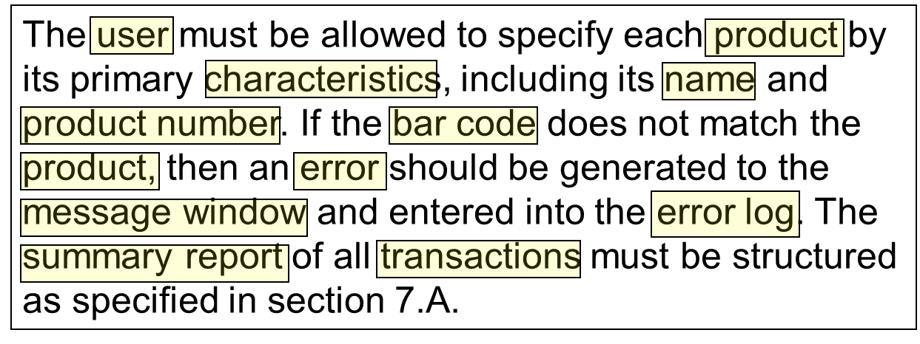
Identifying Classes and Objects (2 of 6)
A partial requirements document:
Of course, not all nouns will correspond to a class or object in the final solution

Slide 11
Identifying Classes and Objects (3 of 6)
Remember that a class represents a group (classification) of objects with the same behaviors
Generally, classes that represent objects should be given names that are singular nouns
Examples: Coin, Student, Message
A class represents the concept of one such object
We are free to instantiate as many of each object as needed

Slide 12
Identifying Classes and Objects (4 of 6)
Sometimes it is challenging to decide whether something should be represented as a class
For example, should an employee’s address be represented as a set of instance variables or as an Address object
The more you examine the problem and its details the more clear these issues become
When a class becomes too complex, it often should be decomposed into multiple smaller classes to distribute the responsibilities

Slide 13
Identifying Classes and Objects (5 of 6)
We want to define classes with the proper amount of detail
For example, it may be unnecessary to create separate classes for each type of appliance in a house
It may be sufficient to define a more general Appliance class with appropriate instance data
It all depends on the details of the problem being solved

Slide 14
Identifying Classes and Objects (6 of 6)
Part of identifying the classes we need is the process of assigning responsibilities to each class
Every activity that a program must accomplish must be represented by one or more methods in one or more classes
We generally use verbs for the names of methods
In early stages it is not necessary to determine every method of every class - begin with primary responsibilities and evolve the design

Slide 15
Outline (2 of 9)
Software Development Activities
Static Variables and Methods
Class Relationships
Interfaces
Enumerated Types Revisited
Method Design and Overloading
Testing
G U I Design
Mouse and Keyboard Events

Slide 16

Static Class Members (1 of 3)
Recall that a static method is one that can be invoked through its class name
For example, the methods of the Math class are static:
Variables can be static as well
Determining if a method or variable should be static is an important design decision

Slide 17
The Static Modifier
We declare static methods and variables using the static modifier
It associates the method or variable with the class rather than with an object of that class
Static methods are sometimes called class methods and static variables are sometimes called class variables
Let’s carefully consider the implications of each

Slide 18

Static Variables
Normally, each object has its own data space, but if a variable is declared as static, only one copy of the variable exists
Memory space for a static variable is created when the class is first referenced
All objects instantiated from the class share its static variables
Changing the value of a static variable in one object changes it for all others

Slide 19
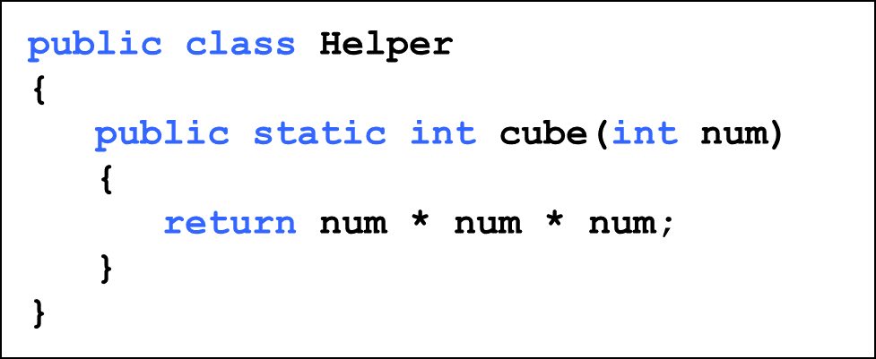
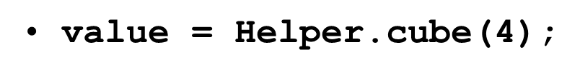
Static Methods
Because it is declared as static, the cube method can be invoked through the class name:

Slide 20
Static Class Members (2 of 3)
The order of the modifiers can be interchanged, but by convention visibility modifiers come first
Recall that the main method is static - it is invoked by the Java interpreter without creating an object
Static methods cannot reference instance variables because instance variables don’t exist until an object exists
However, a static method can reference static variables or local variables

Slide 21
Static Class Members (3 of 3)
Static methods and static variables often work together
The following example keeps track of how many Slogan objects have been created using a static variable, and makes that information available using a static method
See SloganCounter.java
See Slogan.java

Slide 22
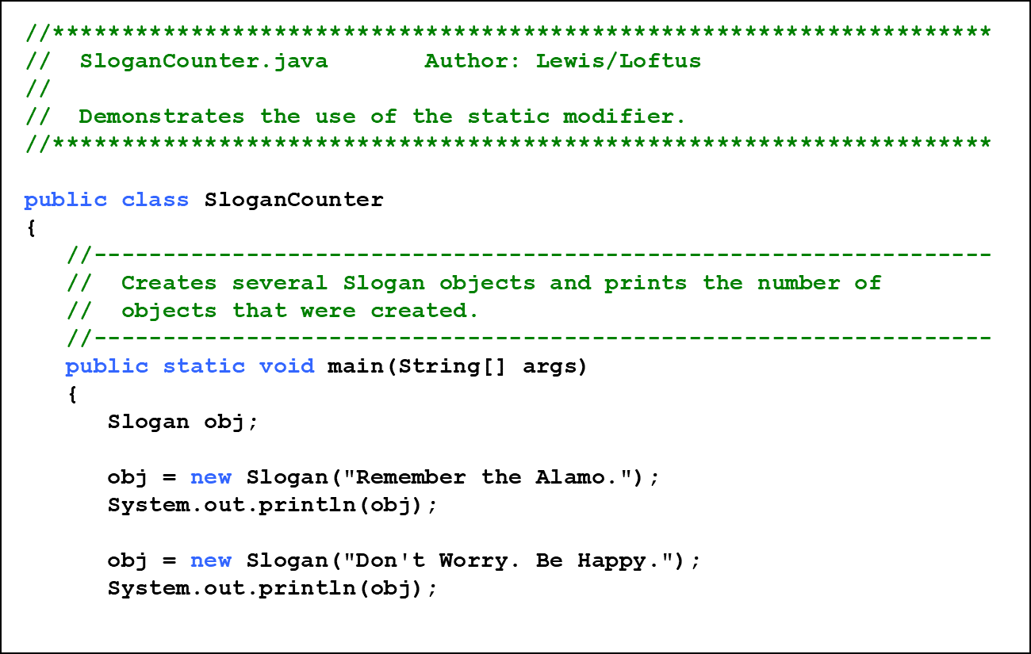
Listing 7.1 (1 of 3)

Slide 23
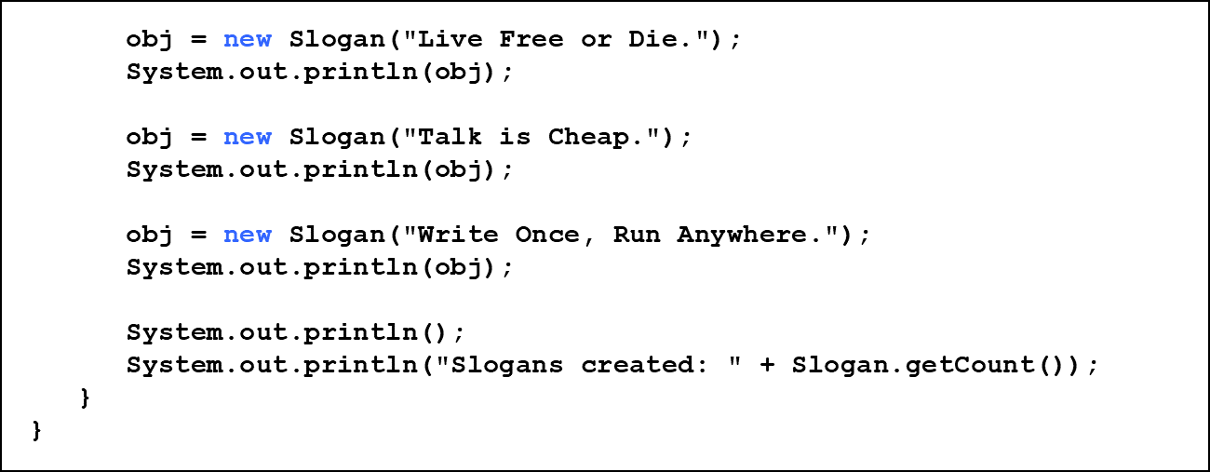
Listing 7.1 (2 of 3)

Slide 24
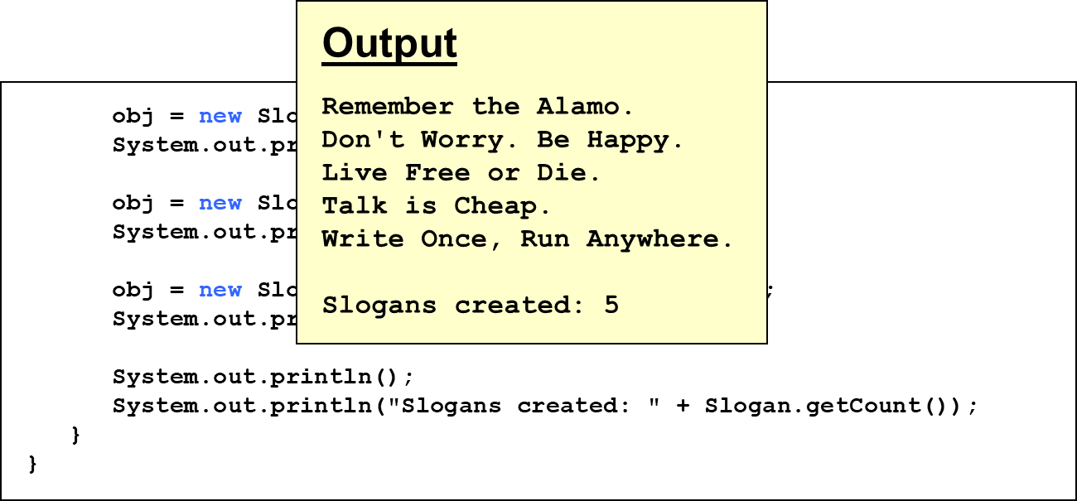
Listing 7.1 (3 of 3)

Slide 25
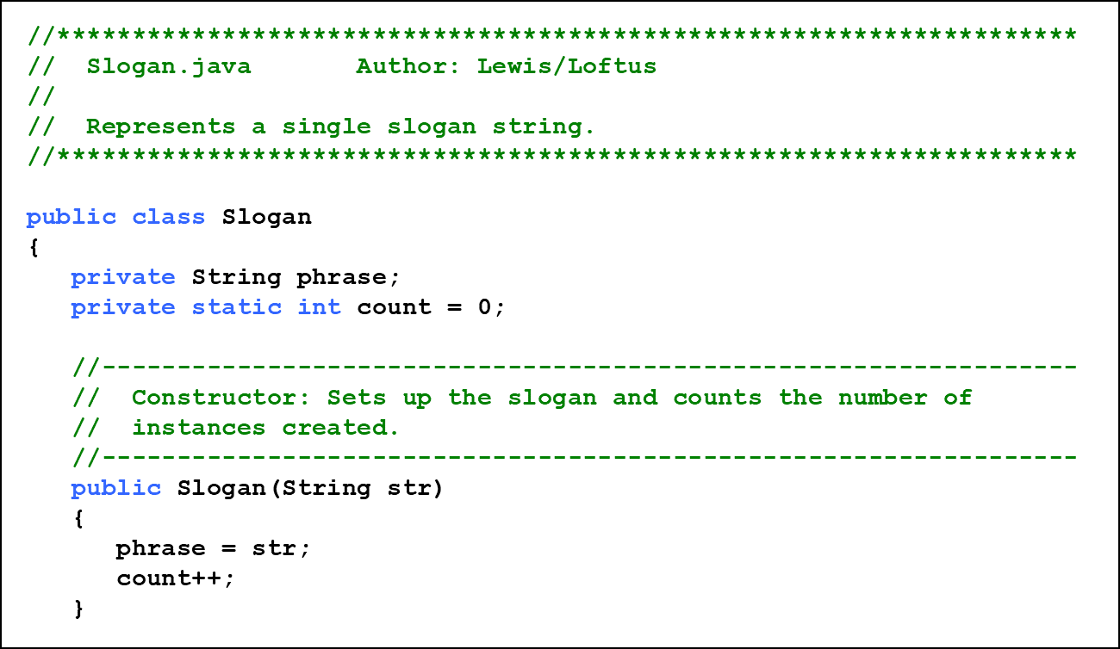
Listing 7.2 (1 of 2)

Slide 26
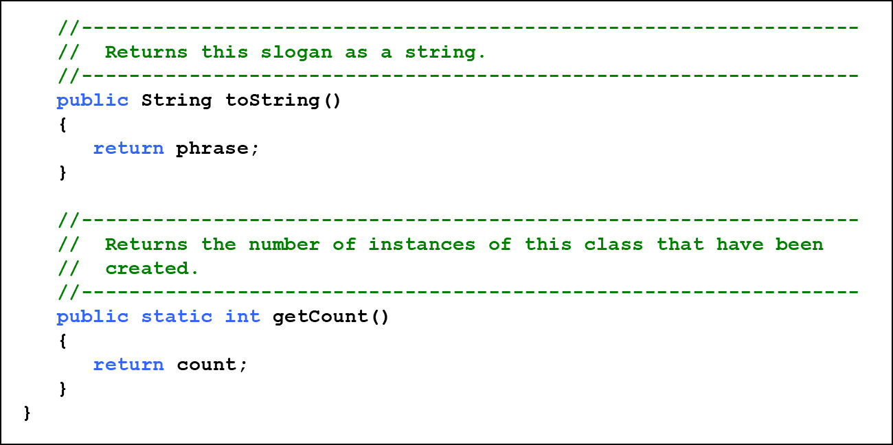
Listing 7.2 (2 of 2)

Slide 27
Quick Check 1 (1 of 2)
Why can’t a static method refer to an instance variable?

Slide 28
Quick Check 1 (2 of 2)
Why can’t a static method refer to an instance variable?
Because instance data is created only when an object is created.
You don’t need an object to execute a static method.
And even if you had an object, which object’s instance data would be referenced? (remember, the method is invoked through the class name)

Slide 29
Outline (3 of 9)
Software Development Activities
Static Variables and Methods
Class Relationships
Interfaces
Enumerated Types Revisited
Method Design and Overloading
Testing
G U I Design
Mouse and Keyboard Events

Slide 30
Class Relationships
Classes in a software system can have various types of relationships to each other
Three of the most common relationships:
Dependency: A uses B
Aggregation: A has-a B
Inheritance: A is-a B
Let’s discuss dependency and aggregation further
Inheritance is discussed in detail in Chapter 9

Slide 31
Dependency (1 of 3)
A dependency exists when one class relies on another in some way, usually by invoking the methods of the other
We’ve seen dependencies in many previous examples
We don’t want numerous or complex dependencies among classes
Nor do we want complex classes that don’t depend on others
A good design strikes the right balance

Slide 32
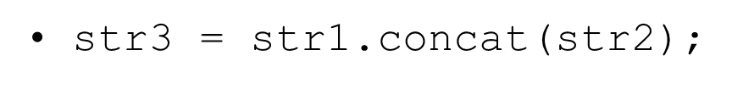
Dependency (2 of 3)
Some dependencies occur between objects of the same class
A method of the class may accept an object of the same class as a parameter
For example, the concat method of the String class takes as a parameter another String object

Slide 33
Dependency (3 of 3)
The following example defines a class called RationalNumber
A rational number is a value that can be represented as the ratio of two integers
Several methods of the RationalNumber class accept another RationalNumber object as a parameter
See RationalTester.java
See RationalNumber.java

Slide 34
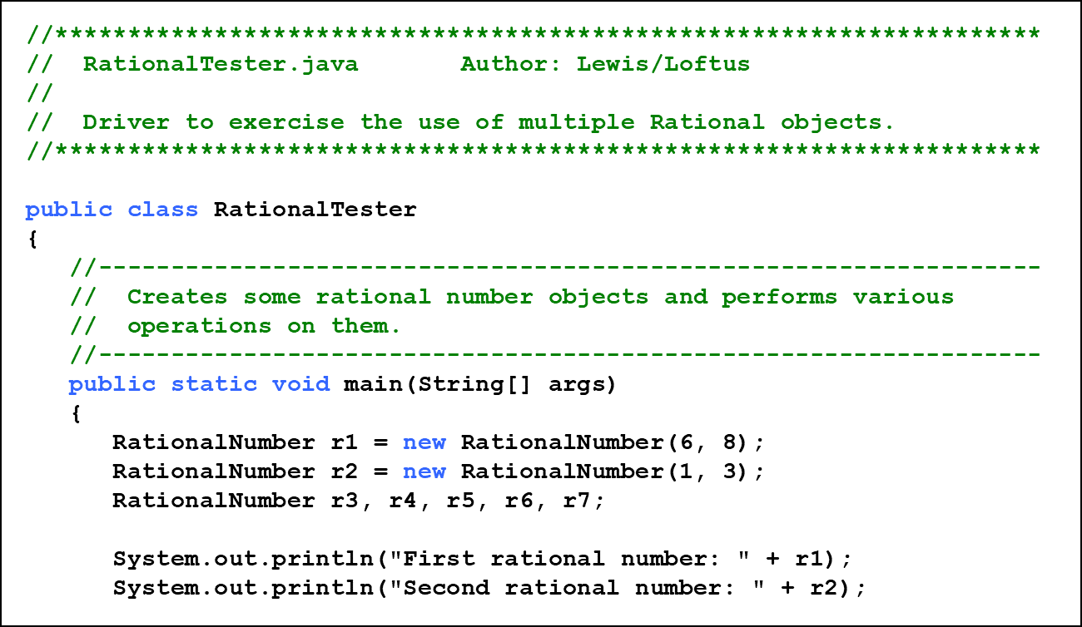
Listing 7.3 (1 of 3)

Slide 35
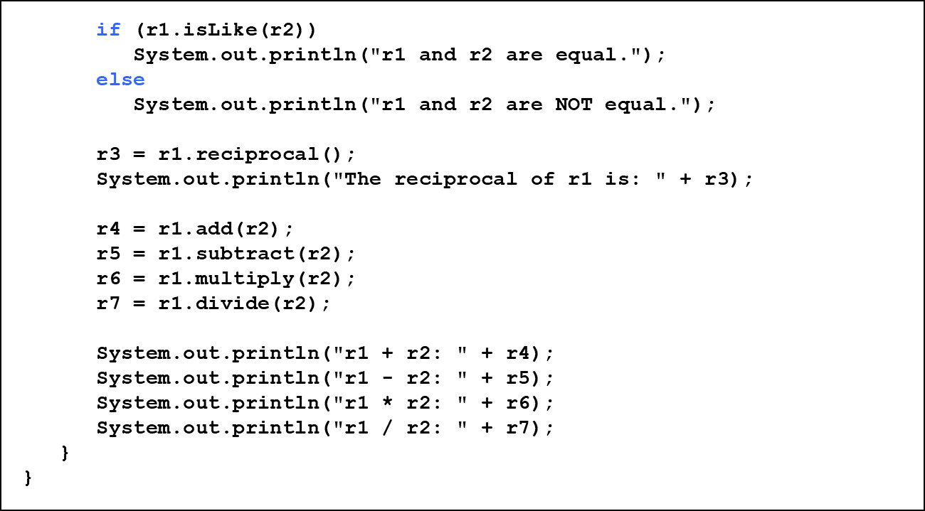
Listing 7.3 (2 of 3)

Slide 36
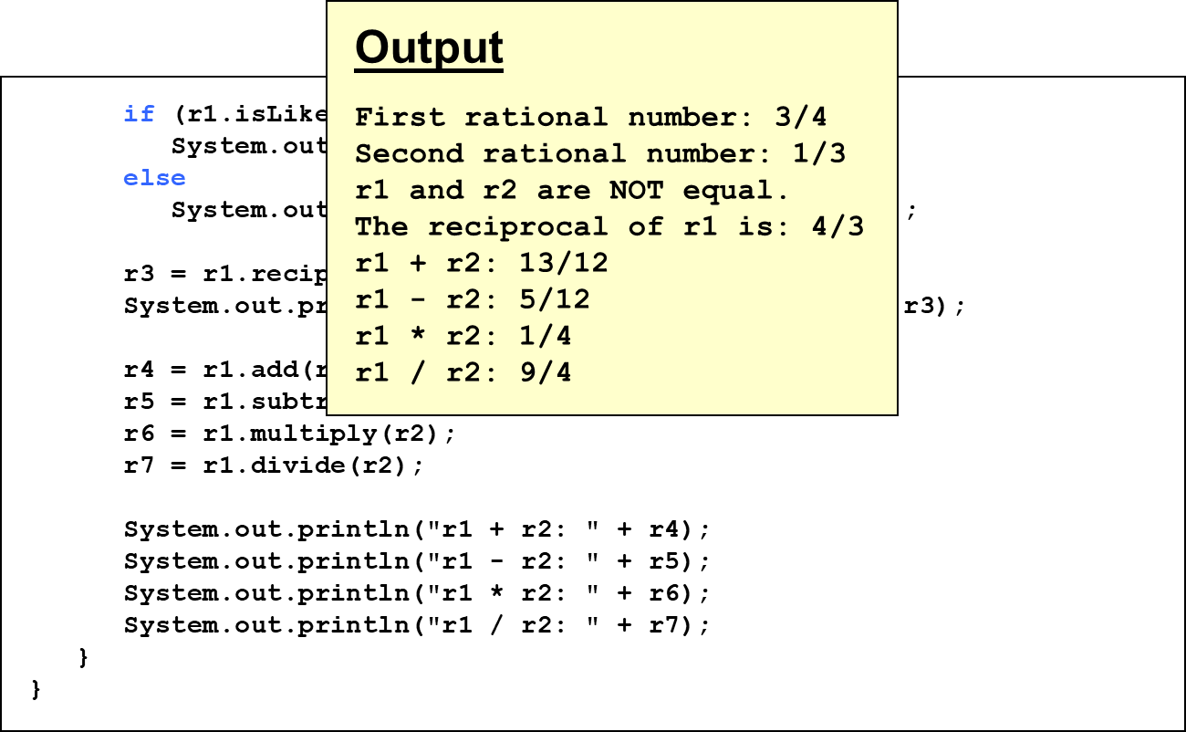
Listing 7.3 (3 of 3)

Slide 37
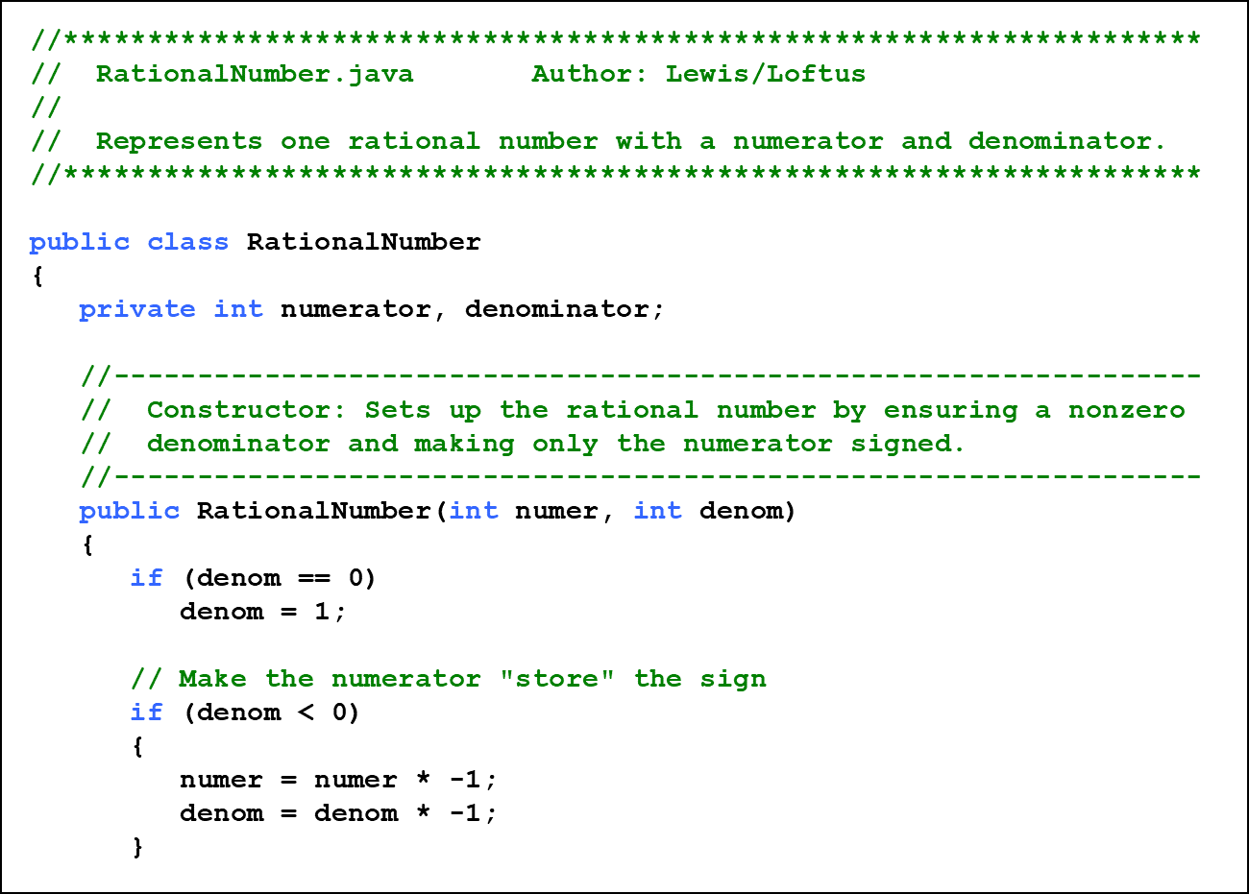
Listing 7.4 (1 of 8)

Slide 38
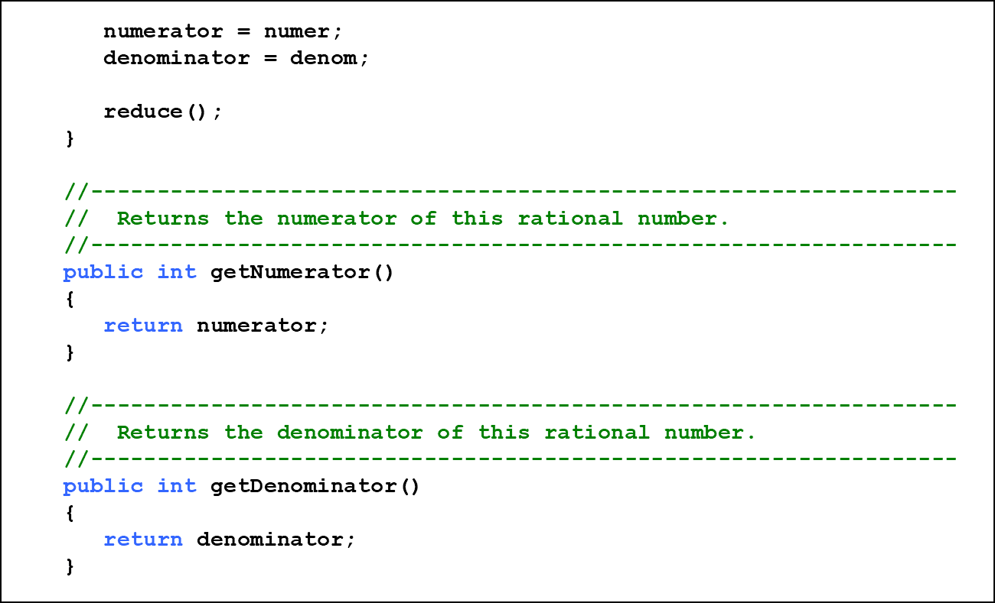
Listing 7.4 (2 of 8)

Slide 39
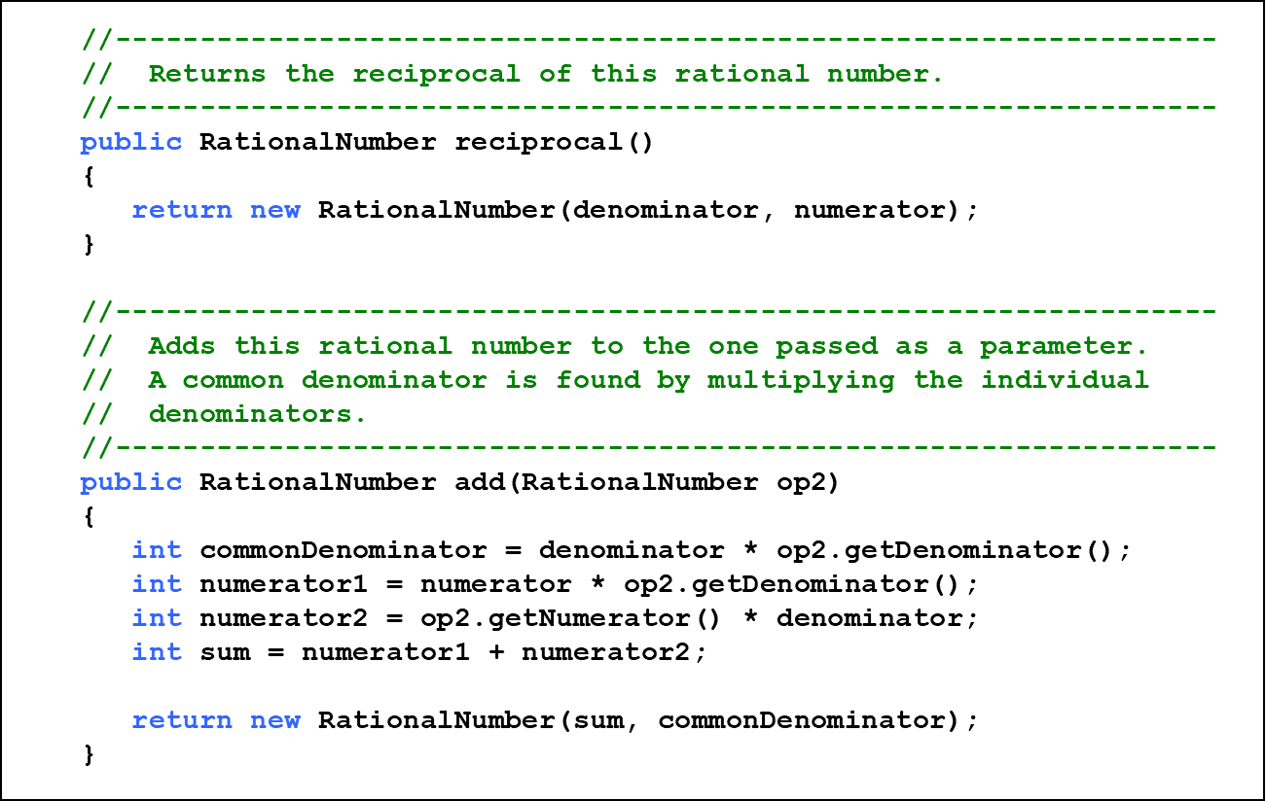
Listing 7.4 (3 of 8)

Slide 40
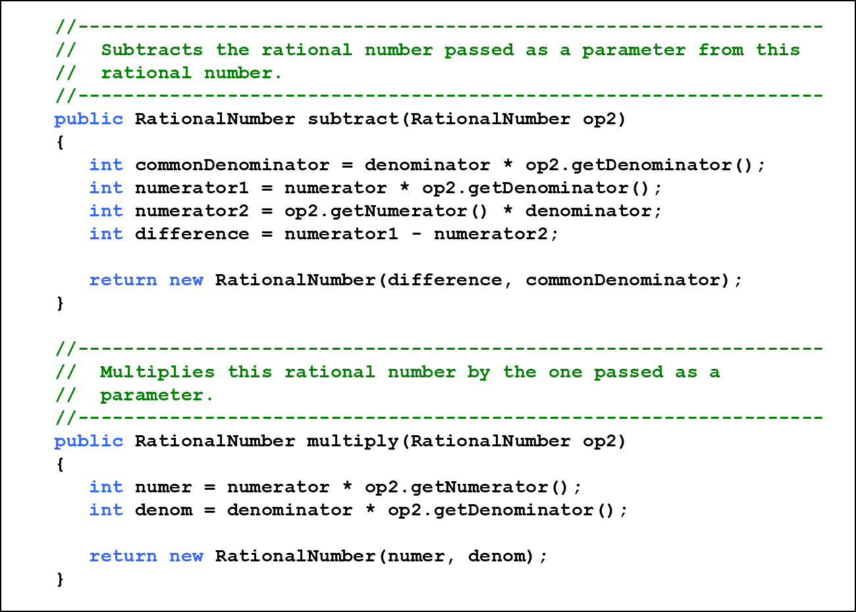
Listing 7.4 (4 of 8)

Slide 41
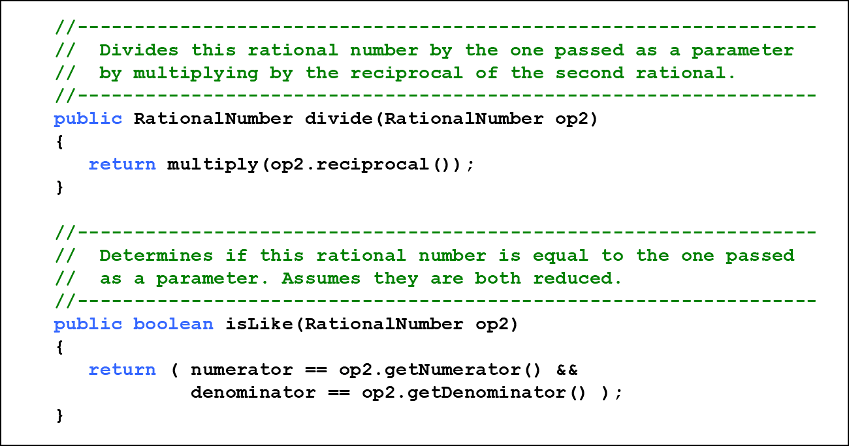
Listing 7.4 (5 of 8)

Slide 42
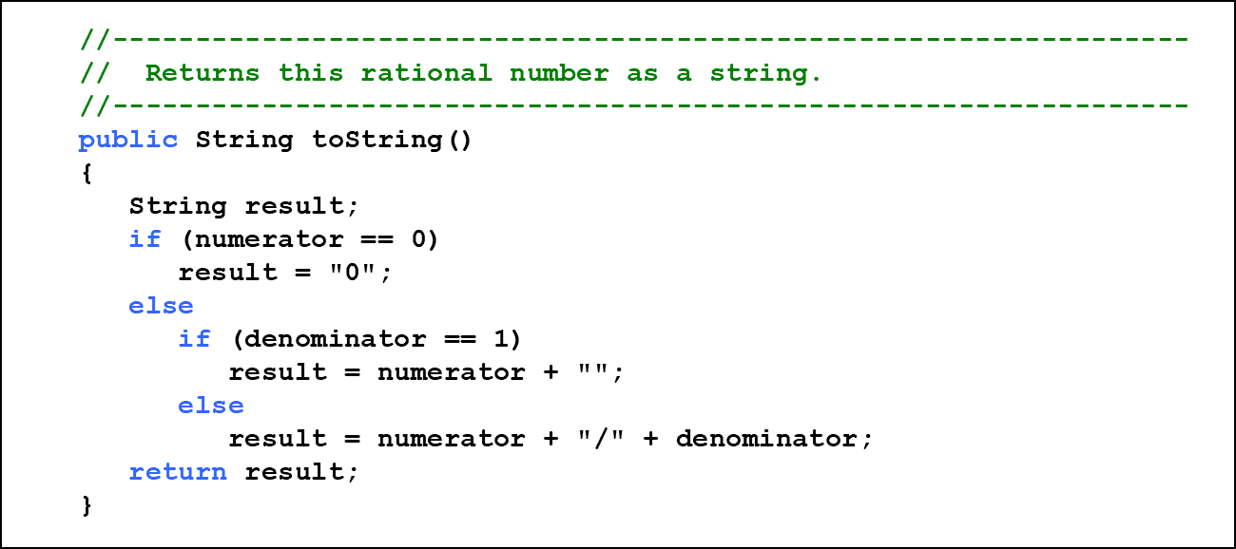
Listing 7.4 (6 of 8)

Slide 43
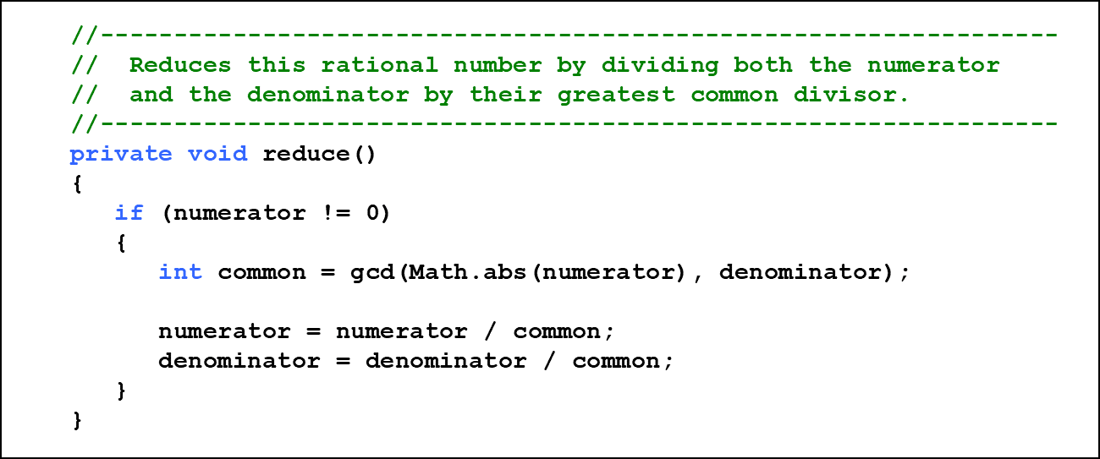
Listing 7.4 (7 of 8)

Slide 44
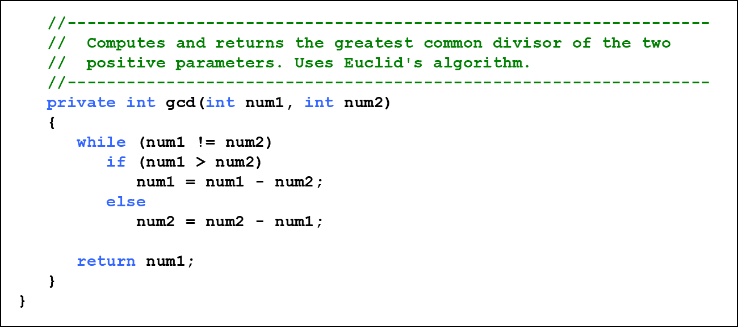
Listing 7.4 (8 of 8)

Slide 45
Aggregation (1 of 2)
An aggregate is an object that is made up of other objects
Therefore aggregation is a has-a relationship
A car has a chassis
An aggregate object contains references to other objects as instance data
This is a special kind of dependency; the aggregate relies on the objects that compose it

Slide 46
Aggregation (2 of 2)
In the following example, a Student object is composed, in part, of Address objects
A student has an address (in fact each student has two addresses)
See StudentBody.java
See Student.java
See Address.java

Slide 47
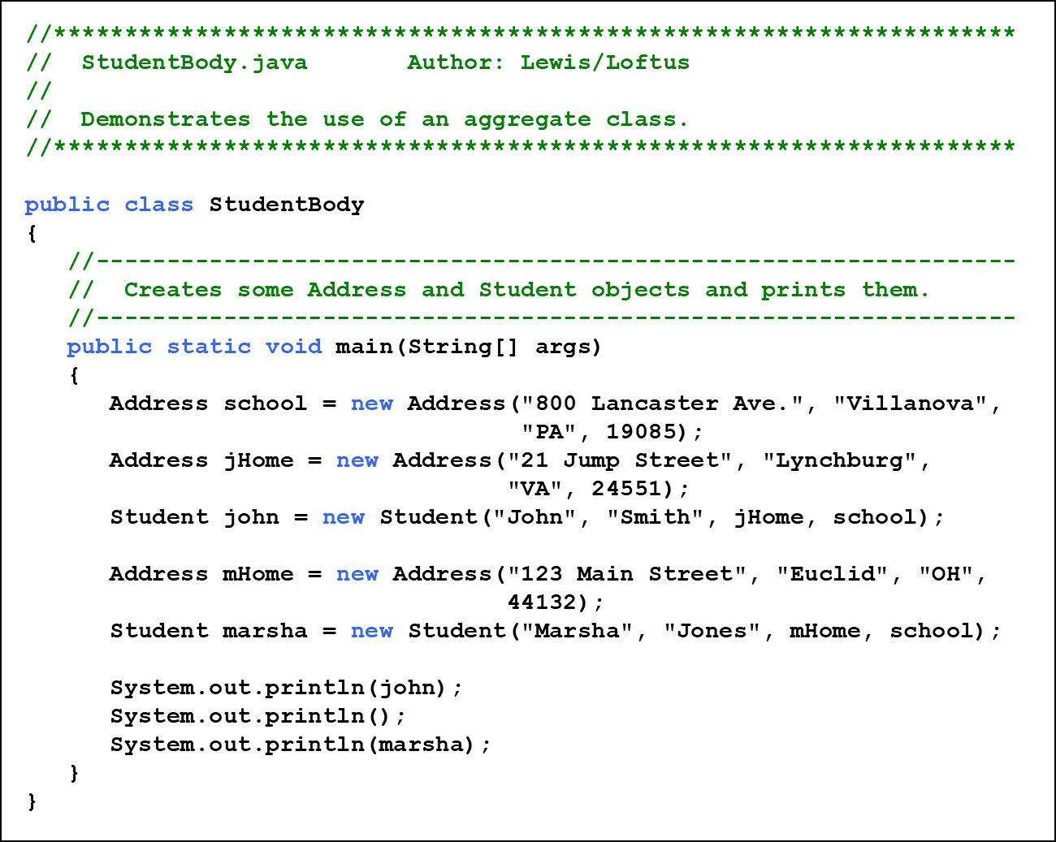
Listing 7.5 (1 of 2)

Slide 48
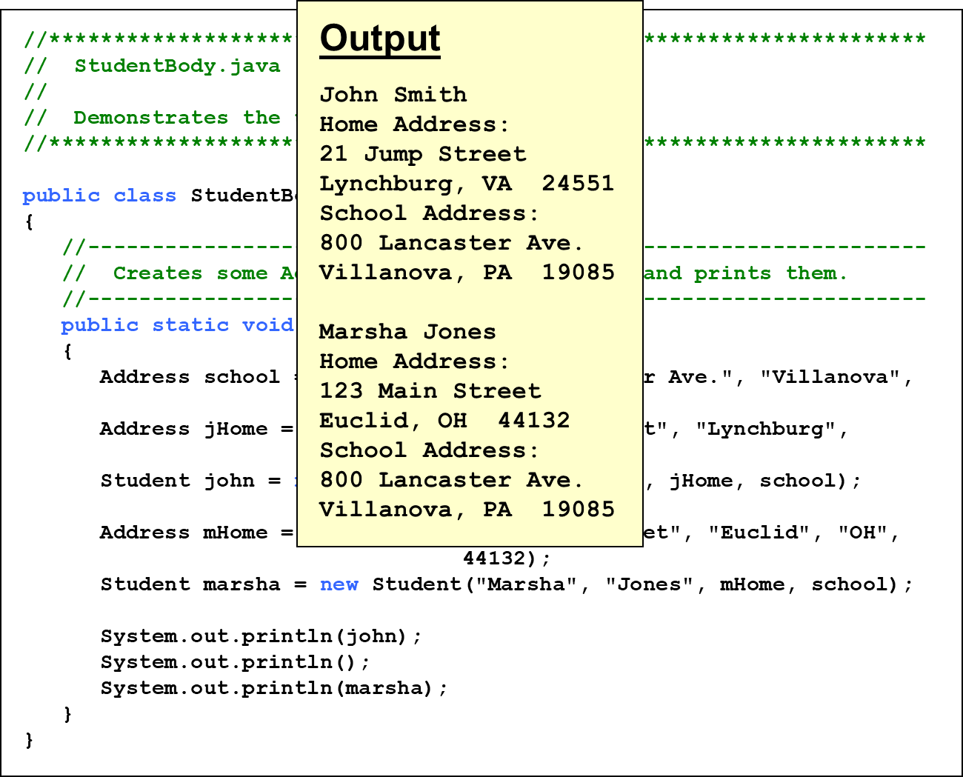
Listing 7.5 (2 of 2)

Slide 49
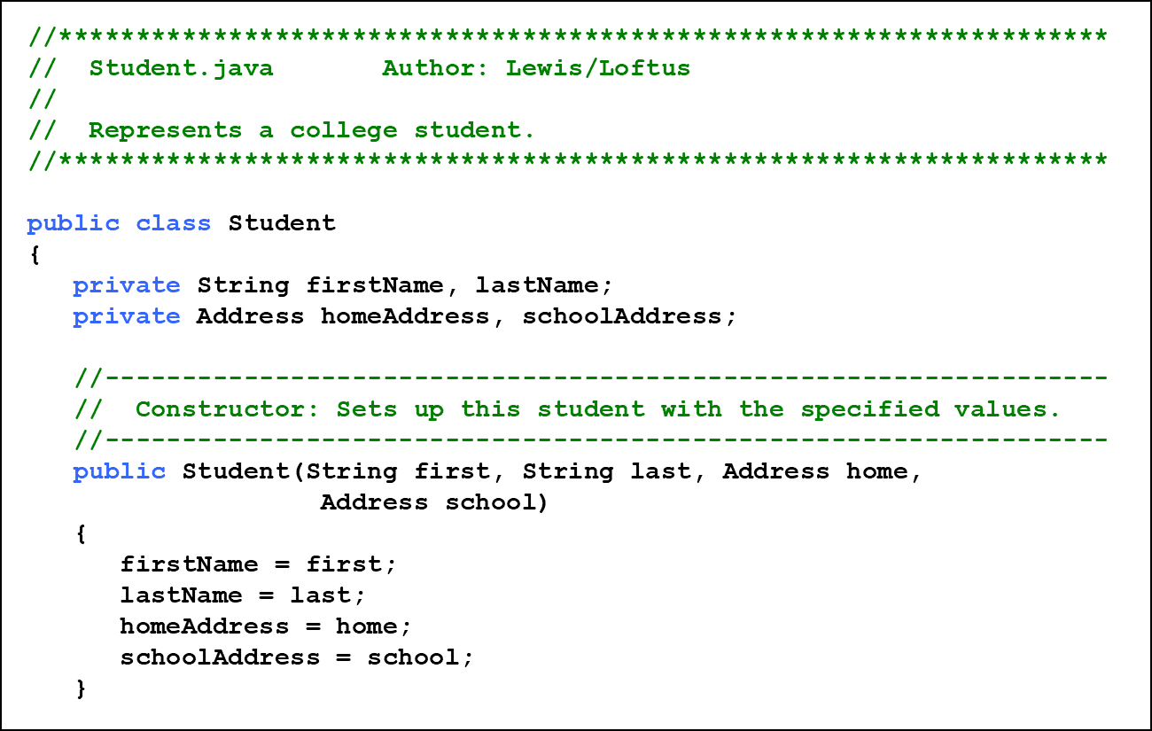
Listing 7.6 (1 of 2)

Slide 50
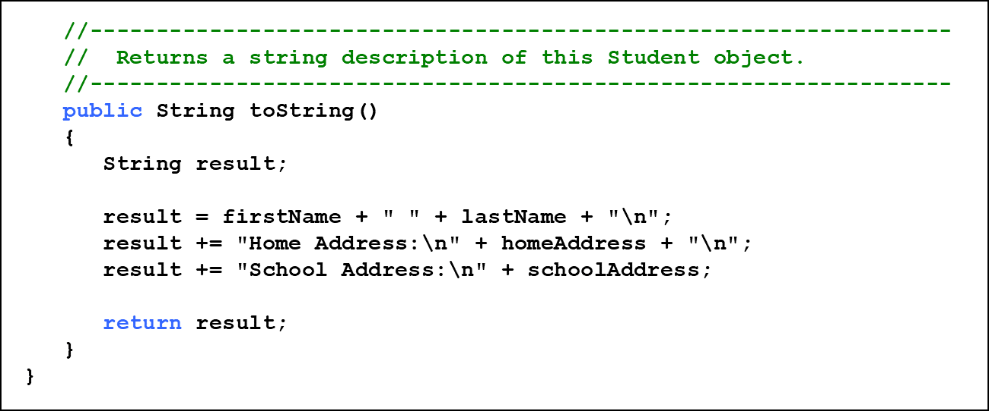
Listing 7.6 (2 of 2)

Slide 51
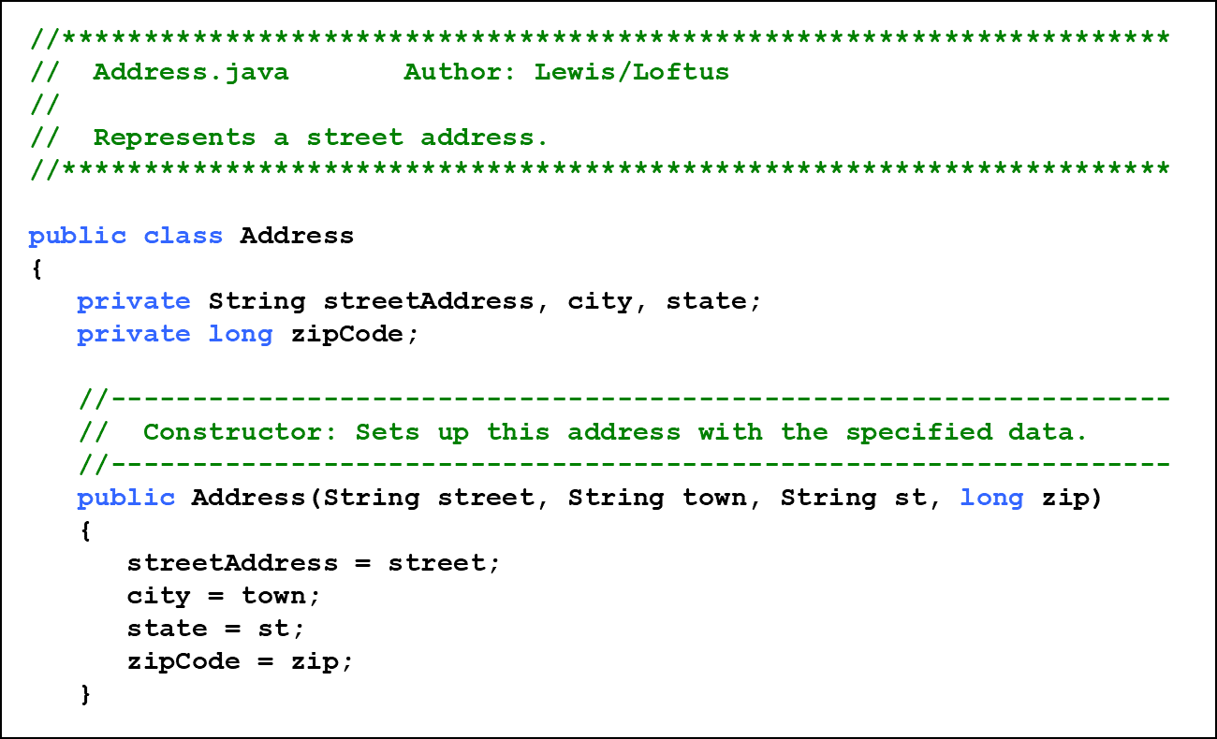
Listing 7.7 (1 of 2)

Slide 52
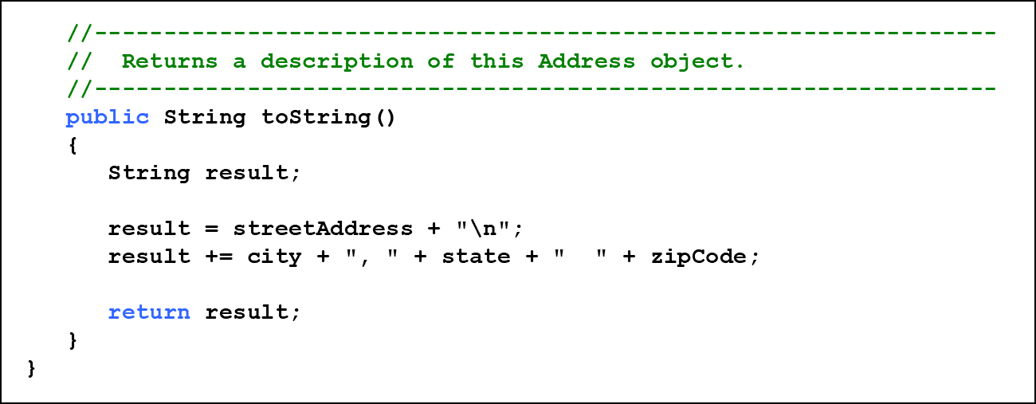
Listing 7.7 (2 of 2)

Slide 53
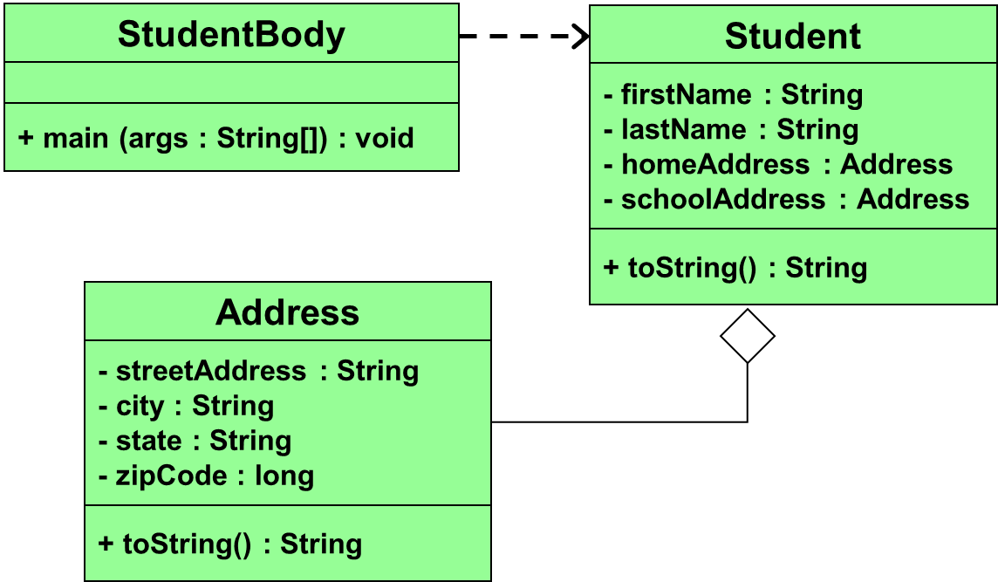
Aggregation in U M L

Slide 54
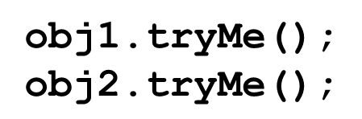
The This Reference (1 of 2)
The this reference allows an object to refer to itself
That is, the this reference, used inside a method, refers to the object through which the method is being executed
Suppose the this reference is used inside a method called tryMe, which is invoked as follows:
In the first invocation, the this reference refers to obj1; in the second it refers to obj2

Slide 55
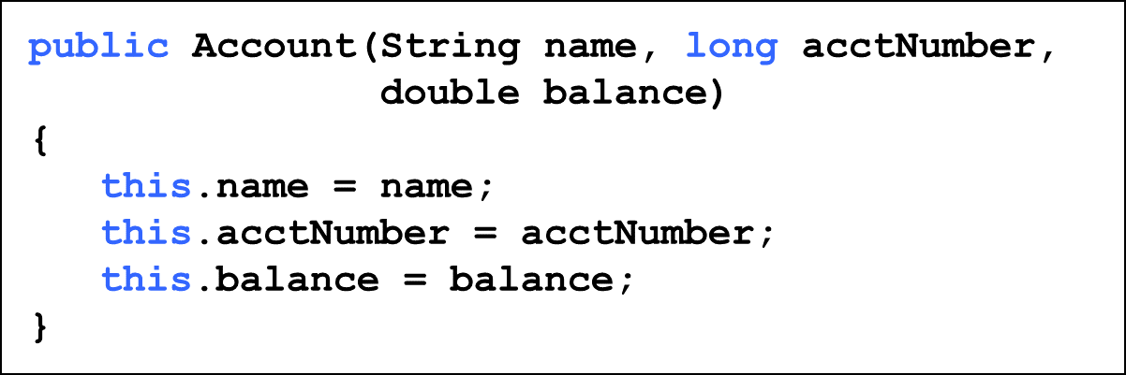
The This Reference (2 of 2)
The this reference can be used to distinguish the instance variables of a class from corresponding method parameters with the same names
The constructor of the Account class from Chapter 4 could have been written as follows:

Slide 56
Outline (4 of 9)
Software Development Activities
Static Variables and Methods
Class Relationships
Interfaces
Enumerated Types Revisited
Method Design and Overloading
Testing
G U I Design
Mouse and Keyboard Events

Slide 57
Interfaces (1 of 8)
A Java interface is a collection of abstract methods and constants
An abstract method is a method header without a method body
An abstract method can be declared using the modifier abstract, but because all methods in an interface are abstract, usually it is left off
An interface is used to establish a set of methods that a class will implement

Slide 58
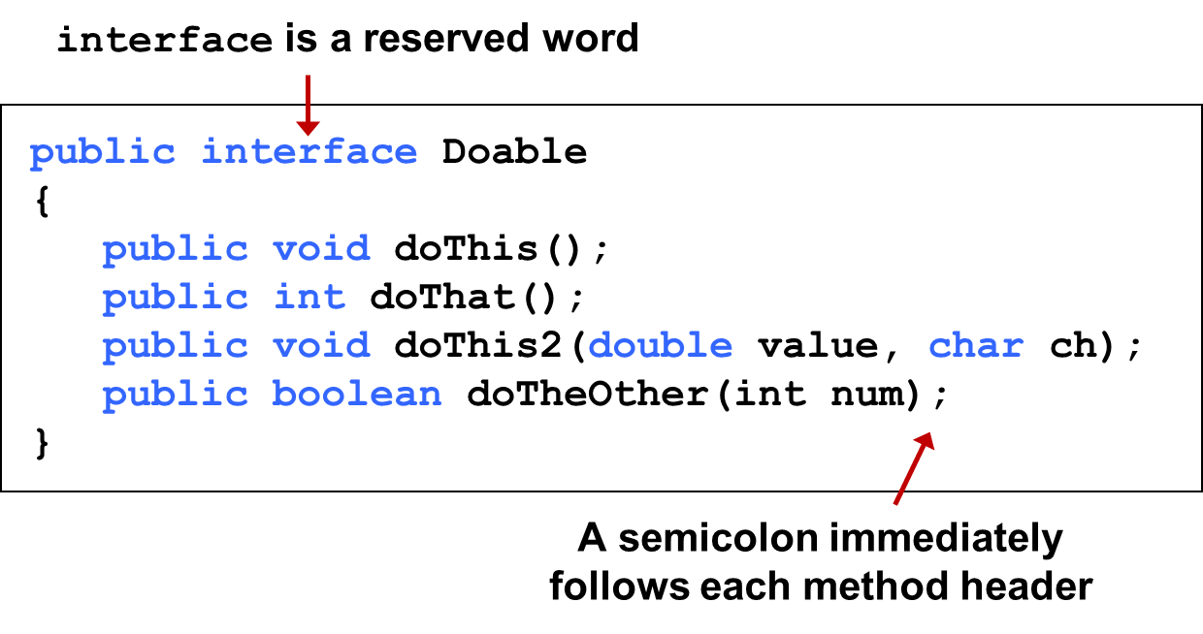
Interfaces (2 of 8)
None of the methods in an interface are given a definition (body)

Slide 59
Interfaces (3 of 8)
An interface cannot be instantiated
Methods in an interface have public visibility by default
A class formally implements an interface by:
stating so in the class header
providing implementations for every abstract method in the interface
If a class declares that it implements an interface, it must define all methods in the interface

Slide 60
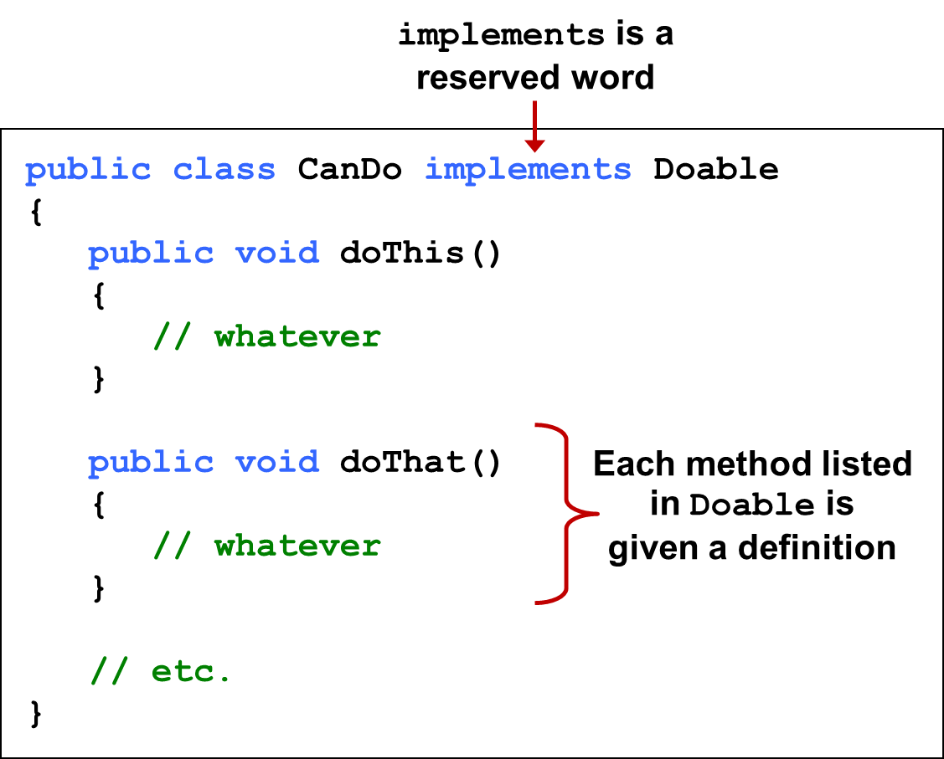
Interfaces (4 of 8)

Slide 61
Interfaces (5 of 8)
In addition to (or instead of) abstract methods, an interface can contain constants
When a class implements an interface, it gains access to all its constants
A class that implements an interface can implement other methods as well
See Complexity.java
See Question.java
See MiniQuiz.java

Slide 62
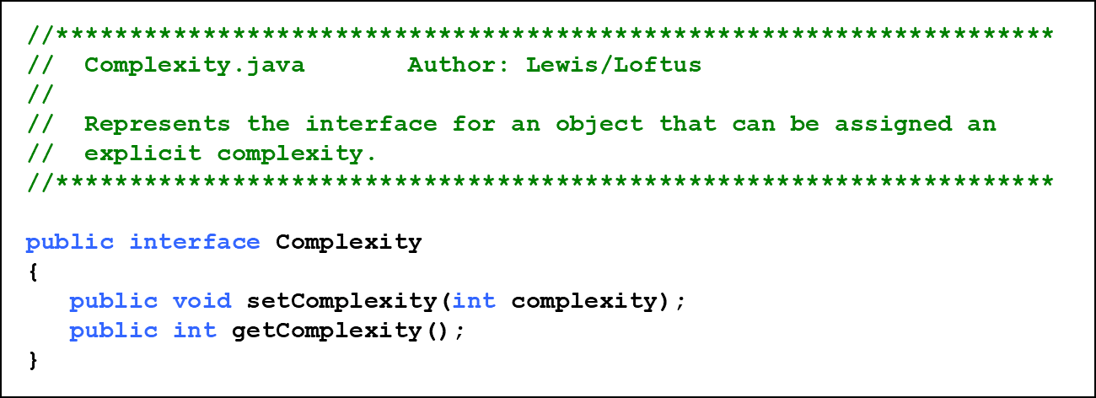
Listing 7.8

Slide 63
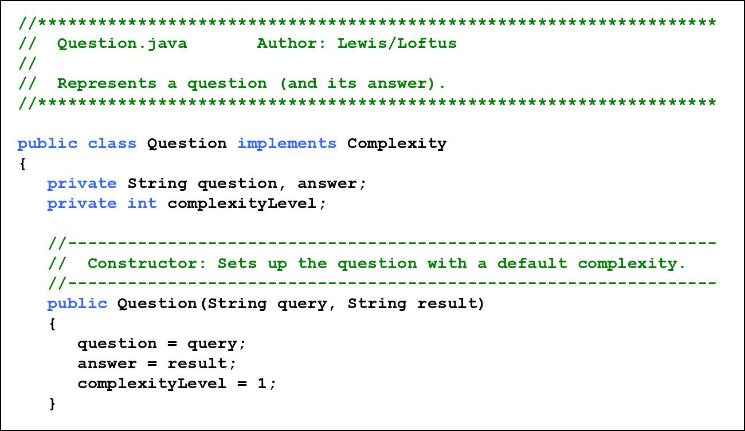
Listing 7.9 (1 of 3)

Slide 64
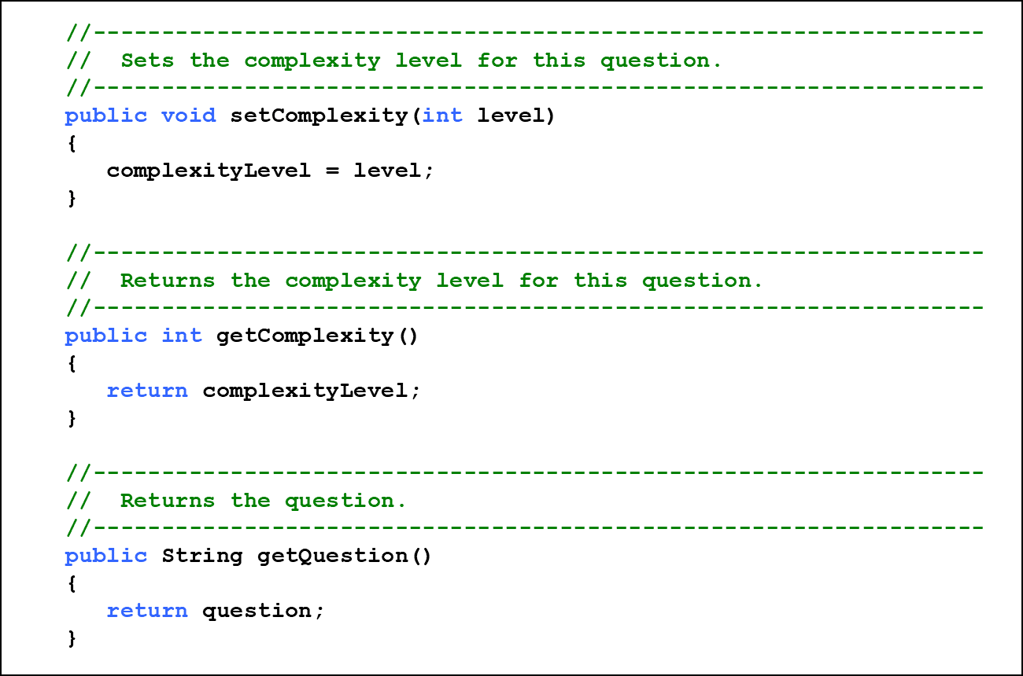
Listing 7.9 (2 of 3)

Slide 65
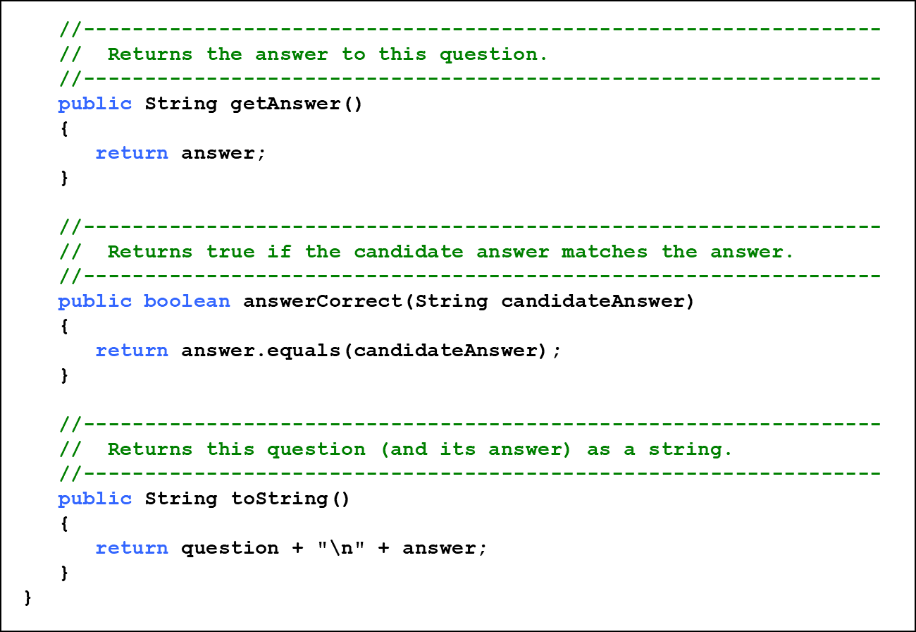
Listing 7.9 (3 of 3)

Slide 66
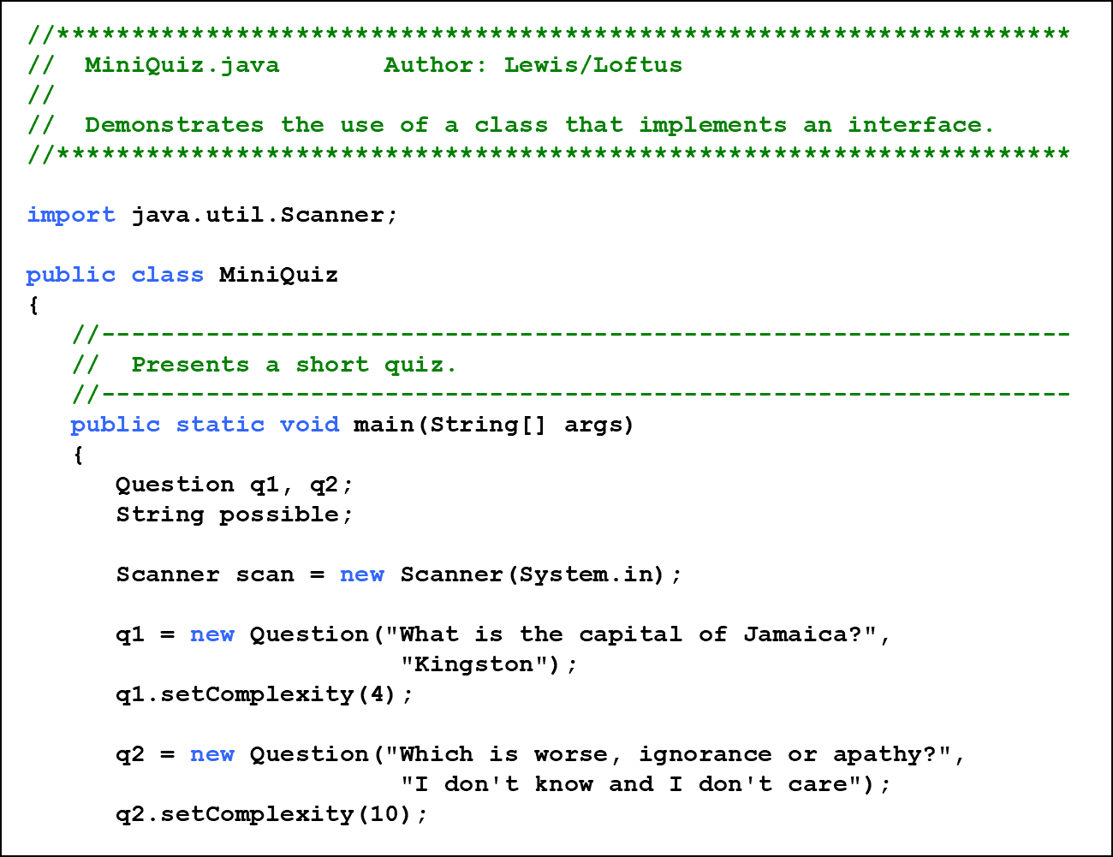
Listing 7.10 (1 of 3)

Slide 67
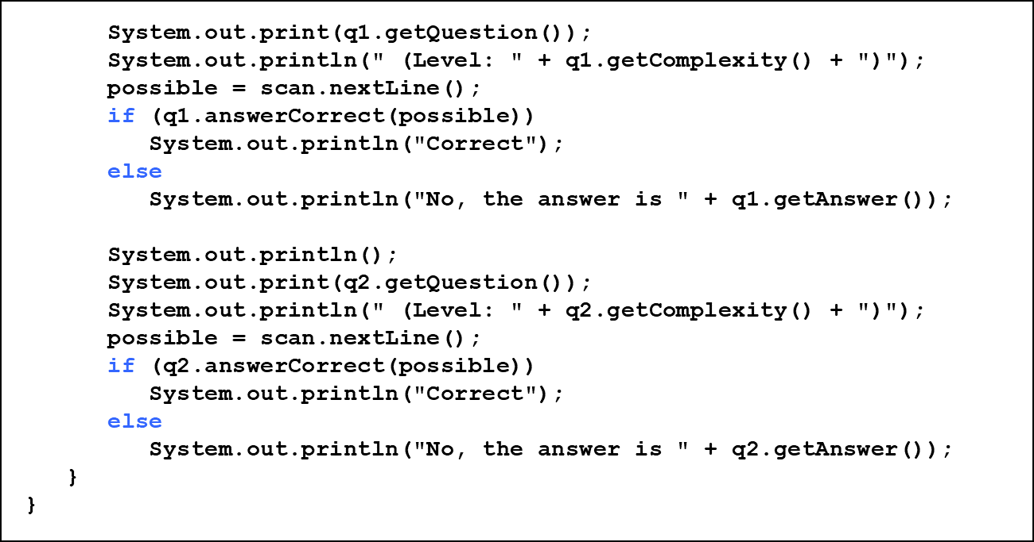
Listing 7.10 (2 of 3)

Slide 68
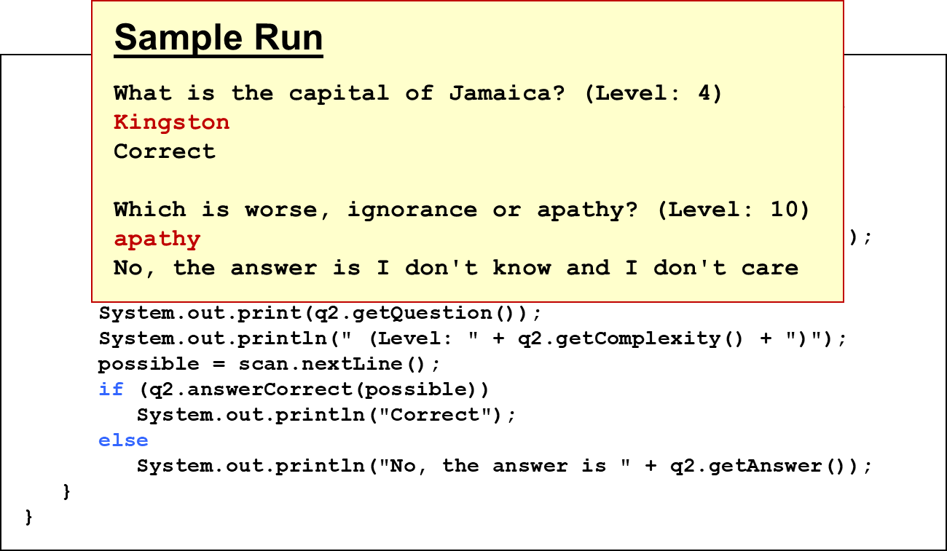
Listing 7.10 (3 of 3)

Slide 69
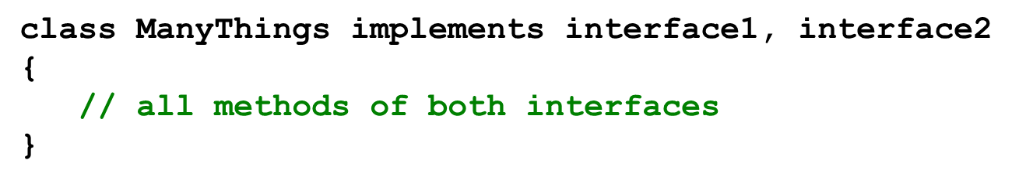
Interfaces (6 of 8)
A class can implement multiple interfaces
The interfaces are listed in the implements clause
The class must implement all methods in all interfaces listed in the header

Slide 70
Interfaces (7 of 8)
The Java A P I contains many helpful interfaces
The Comparable interface contains one abstract method called compareTo, which is used to compare two objects
We discussed the compareTo method of the String class in Chapter 5
The String class implements Comparable, giving us the ability to put strings in lexicographic order

Slide 71
The Comparable Interface
Any class can implement Comparable to provide a mechanism for comparing objects of that type
The value returned from compareTo should be negative is obj1 is less that obj2, 0 if they are equal, and positive if obj1 is greater than obj2
It’s up to the programmer to determine what makes one object less than another

Slide 72
The Iterator Interface
As we discussed in Chapter 5, an iterator is an object that provides a means of processing a collection of objects one at a time
An iterator is created formally by implementing the Iterator interface, which contains three methods
The hasNext method returns a boolean result - true if there are items left to process
The next method returns the next object in the iteration
The remove method removes the object most recently returned by the next method

Slide 73
The Iterable Interface
Another interface, Iterable, establishes that an object provides an iterator
The Iterable interface has one method, iterator, that returns an Iterator object
Any Iterable object can be processed using the for-each version of the for loop
Note the difference: an Iterator has methods that perform an iteration; an Iterable object provides an iterator on request

Slide 74
Interfaces (8 of 8)
You could write a class that implements certain methods (such as compareTo) without formally implementing the interface (Comparable)
However, formally establishing the relationship between a class and an interface allows Java to deal with an object in certain ways
Interfaces are a key aspect of object-oriented design in Java
We discuss this idea further in Chapter 10

Slide 75
Outline (5 of 9)
Software Development Activities
Static Variables and Methods
Class Relationships
Interfaces
Enumerated Types Revisited
Method Design and Overloading
Testing
G U I Design
Mouse and Keyboard Events

Slide 76
Enumerated Types (1 of 4)
In Chapter 3 we introduced enumerated types, which define a new data type and list all possible values of that type:
Once established, the new type can be used to declare variables
Season time;
The only values this variable can be assigned are the ones established in the enum definition

Slide 77

Enumerated Types (2 of 4)
An enumerated type definition is a special kind of class
The values of the enumerated type are objects of that type
For example, fall is an object of type Season
That’s why the following assignment is valid:

Slide 78
Enumerated Types (3 of 4)
An enumerated type definition can be more interesting than a simple list of values
Because they are like classes, we can add additional instance data and methods
We can define an enum constructor as well
Each value listed for the enumerated type calls the constructor
See Season.java
See SeasonTester.java

Slide 79
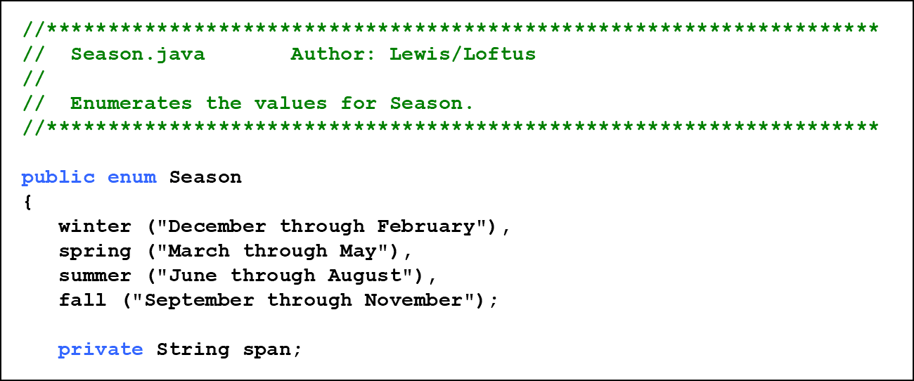
Listing 7.11 (1 of 2)

Slide 80
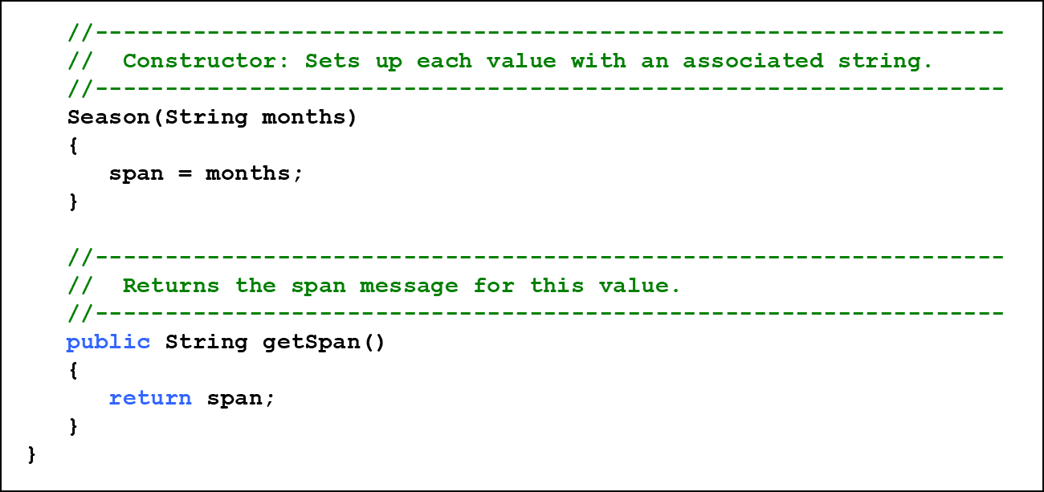
Listing 7.11 (2 of 2)

Slide 81
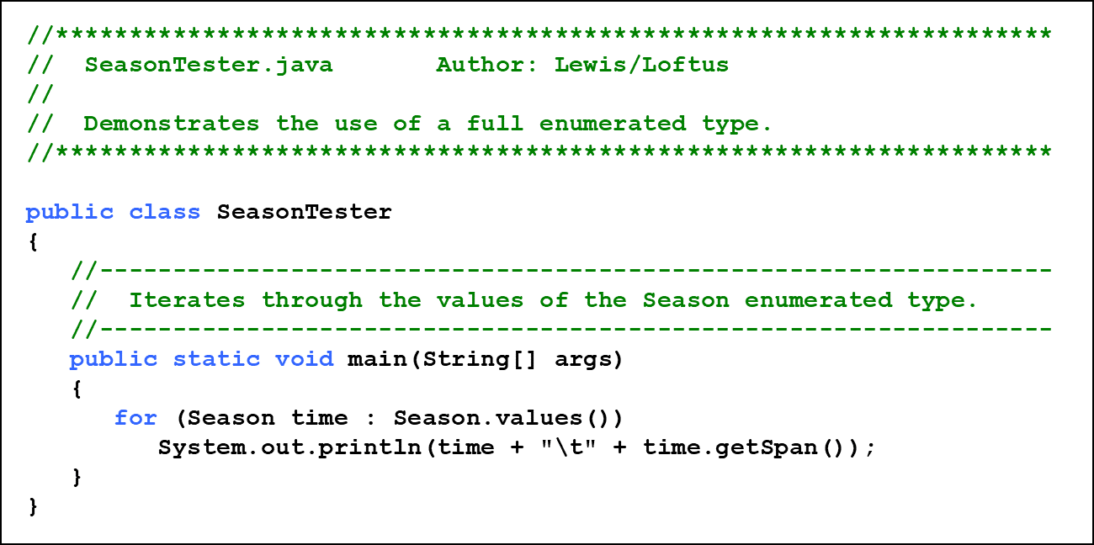
Listing 7.12 (1 of 2)

Slide 82
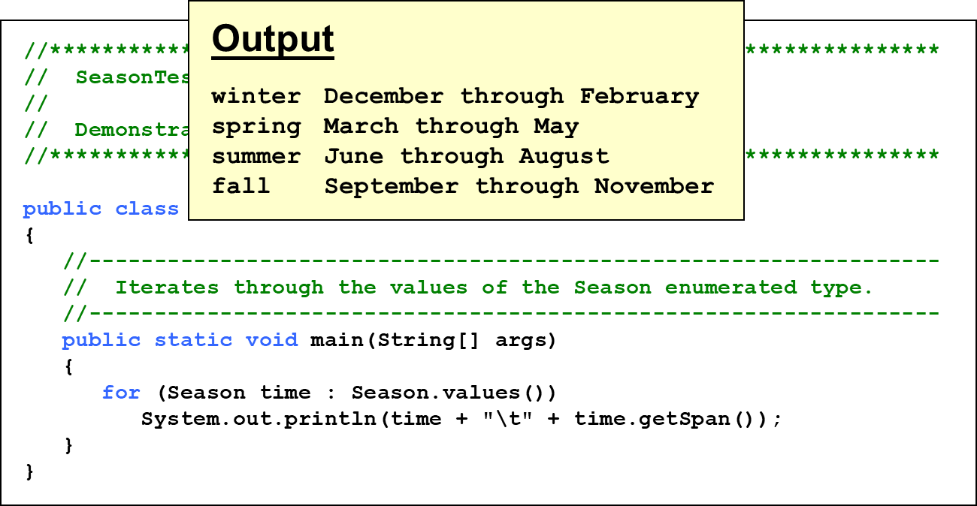
Listing 7.12 (2 of 2)

Slide 83
Enumerated Types (4 of 4)
Every enumerated type contains a static method called values that returns a list of all possible values for that type
The list returned from values can be processed using a for-each loop
An enumerated type cannot be instantiated outside of its own definition
A carefully designed enumerated type provides a versatile and type-safe mechanism for managing data

Slide 84
Outline (6 of 9)
Software Development Activities
Static Variables and Methods
Class Relationships
Interfaces
Enumerated Types Revisited
Method Design and Overloading
Testing
G U I Design
Mouse and Keyboard Events

Slide 85
Method Design
As we’ve discussed, high-level design issues include:
identifying primary classes and objects
assigning primary responsibilities
After establishing high-level design issues, its important to address low-level issues such as the design of key methods
For some methods, careful planning is needed to make sure they contribute to an efficient and elegant system design

Slide 86
Method Decomposition (1 of 4)
A method should be relatively small, so that it can be understood as a single entity
A potentially large method should be decomposed into several smaller methods as needed for clarity
A public service method of an object may call one or more private support methods to help it accomplish its goal
Support methods might call other support methods if appropriate

Slide 87
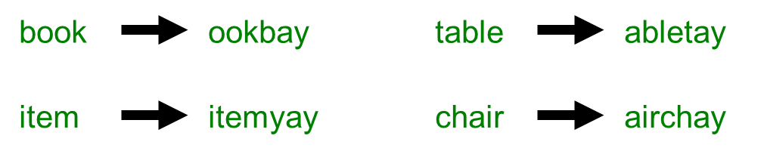
Method Decomposition (2 of 4)
Let’s look at an example that requires method decomposition - translating English into Pig Latin
Pig Latin is a language in which each word is modified by moving the initial sound of the word to the end and adding “ay”
Words that begin with vowels have the “yay” sound added on the end

Slide 88
Method Decomposition (3 of 4)
The primary objective (translating a sentence) is too complicated for one method to accomplish
Therefore we look for natural ways to decompose the solution into pieces
Translating a sentence can be decomposed into the process of translating each word
The process of translating a word can be separated into translating words that:
begin with vowels
begin with consonant blends (sh, cr, th, etc.)
begin with single consonants

Slide 89
Method Decomposition (4 of 4)
In a U M L class diagram, the visibility of a variable or method can be shown using special characters
Public members are preceded by a plus sign
Private members are preceded by a minus sign
See PigLatin.java
See PigLatinTranslator.java

Slide 90
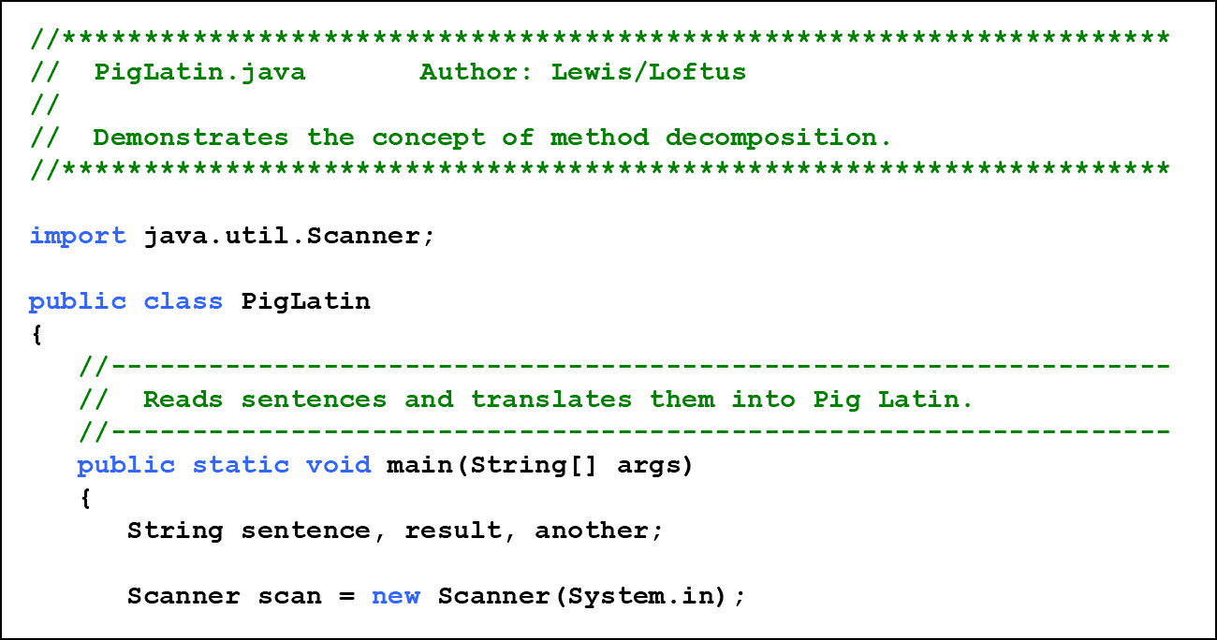
Listing 7.13 (1 of 3)

Slide 91
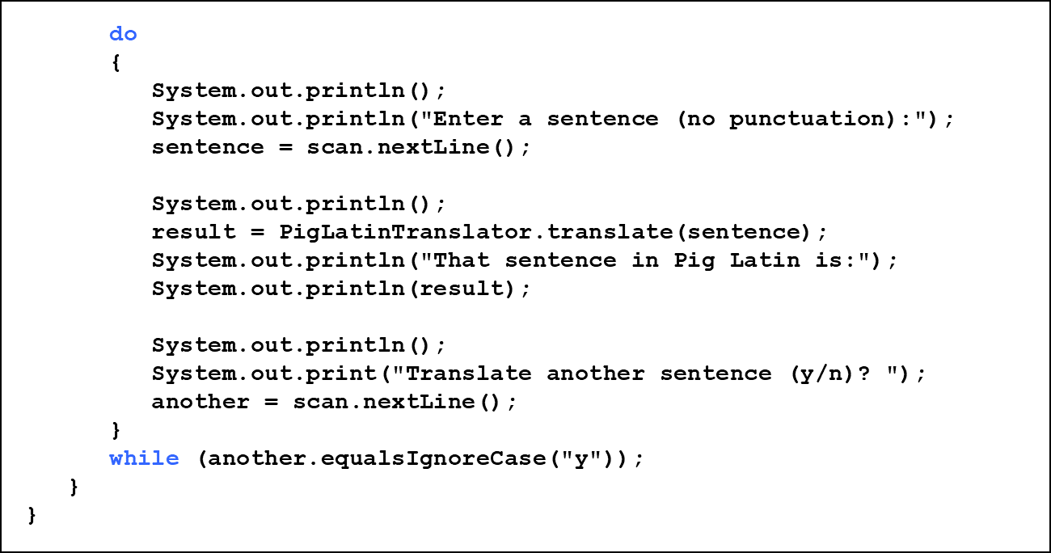
Listing 7.13 (2 of 3)

Slide 92
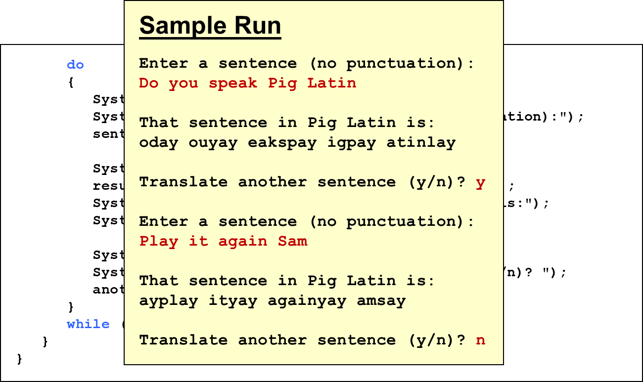
Listing 7.13 (3 of 3)

Slide 93
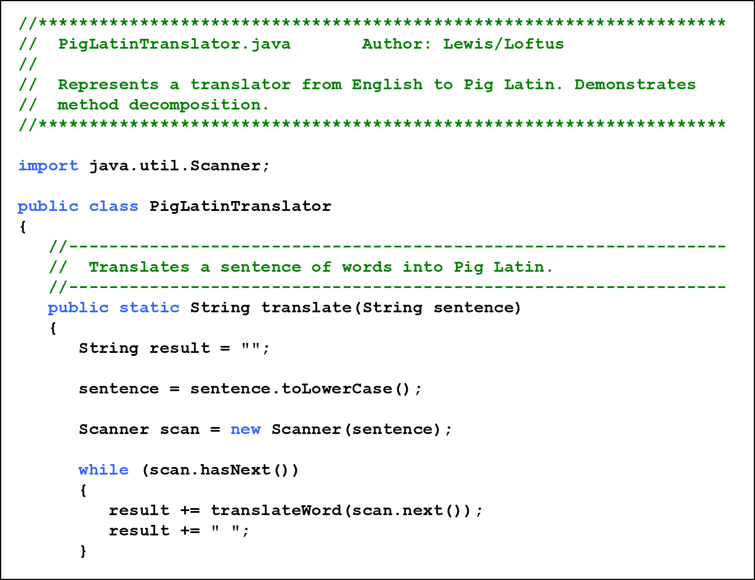
Listing 7.14 (1 of 4)

Slide 94
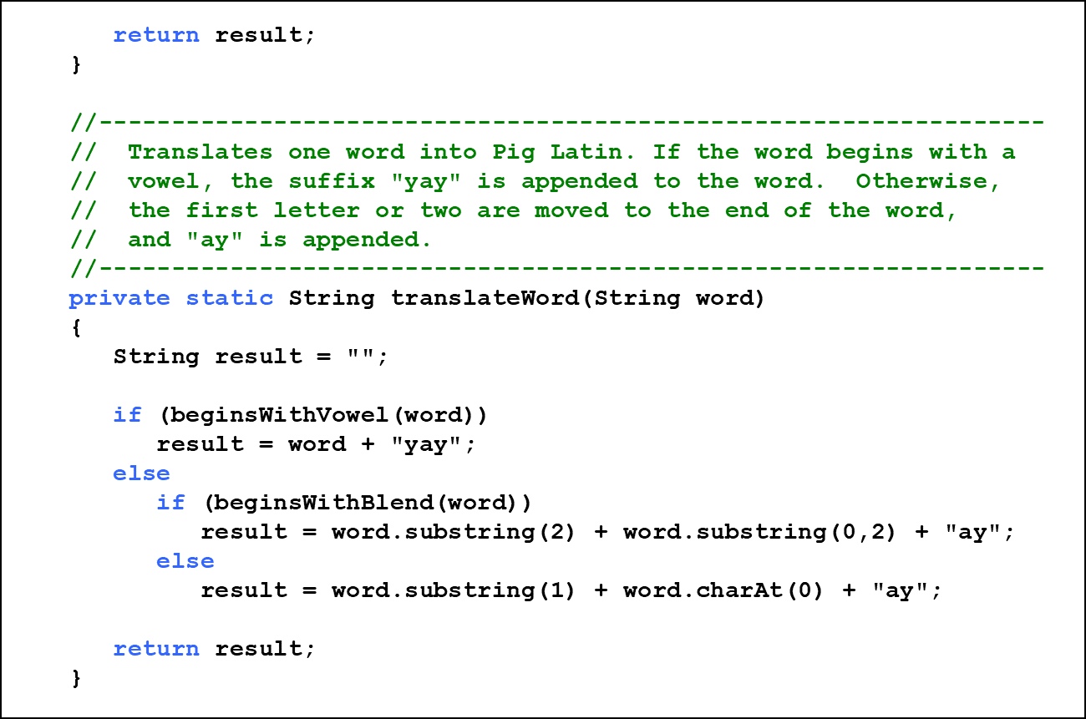
Listing 7.14 (2 of 4)

Slide 95
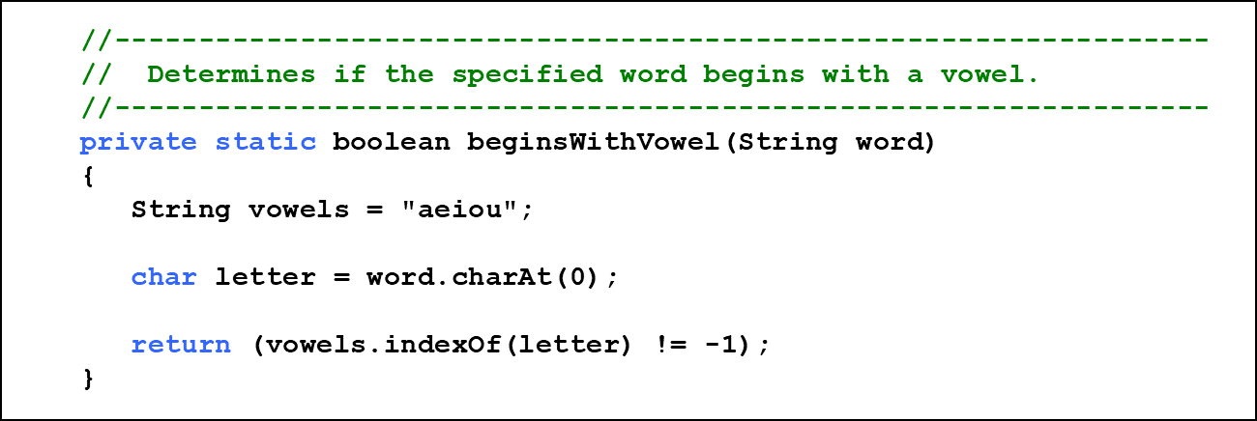
Listing 7.14 (3 of 4)

Slide 96

Listing 7.14 (4 of 4)

Slide 97

Class Diagram for Pig Latin

Slide 98
Objects as Parameters
Another important issue related to method design involves parameter passing
Parameters in a Java method are passed by value
A copy of the actual parameter (the value passed in) is stored into the formal parameter (in the method header)
When an object is passed to a method, the actual parameter and the formal parameter become aliases of each other

Slide 99
Passing Objects to Methods
What a method does with a parameter may or may not have a permanent effect (outside the method)
Note the difference between changing the internal state of an object versus changing which object a reference points to
See ParameterTester.java
See ParameterModifier.java
See Num.java

Slide 100

Listing 7.15 (1 of 3)

Slide 101

Listing 7.15 (2 of 3)

Slide 102

Listing 7.15 (3 of 3)

Slide 103

Listing 7.16

Slide 104

Listing 7.17 (1 of 2)

Slide 105

Listing 7.17 (2 of 2)

Slide 106

Tracing the Parameters in the Parameter Testing Program

Slide 107
Method Overloading (1 of 3)
Let’s look at one more important method design issue: method overloading
Method overloading is the process of giving a single method name multiple definitions in a class
If a method is overloaded, the method name is not sufficient to determine which method is being called
The signature of each overloaded method must be unique
The signature includes the number, type, and order of the parameters

Slide 108

Method Overloading (2 of 3)
The compiler determines which method is being invoked by analyzing the parameters

Slide 109


Method Overloading (3 of 3)
The println method is overloaded:
The following lines invoke different versions of the println method:

Slide 110
Overloading Methods
The return type of the method is not part of the signature
That is, overloaded methods cannot differ only by their return type
Constructors can be overloaded
Overloaded constructors provide multiple ways to initialize a new object

Slide 111
Outline (7 of 9)
Software Development Activities
Static Variables and Methods
Class Relationships
Interfaces
Enumerated Types Revisited
Method Design and Overloading
Testing
G U I Design
Mouse and Keyboard Events

Slide 112
Testing (2 of 3)
Testing can mean many different things
It certainly includes running a completed program with various inputs
It also includes any evaluation performed by human or computer to assess quality
Some evaluations should occur before coding even begins
The earlier we find an problem, the easier and cheaper it is to fix

Slide 113
Testing (3 of 3)
The goal of testing is to find errors
As we find and fix errors, we raise our confidence that a program will perform as intended
We can never really be sure that all errors have been eliminated
So when do we stop testing?
Conceptual answer: Never
Cynical answer: When we run out of time
Better answer: When we are willing to risk that an undiscovered error still exists

Slide 114
Reviews
A review is a meeting in which several people examine a design document or section of code
It is a common and effective form of human-based testing
Presenting a design or code to others:
makes us think more carefully about it
provides an outside perspective
Reviews are sometimes called inspections or walkthroughs

Slide 115
Test Cases
A test case is a set of input and user actions, coupled with the expected results
Often test cases are organized formally into test suites which are stored and reused as needed
For medium and large systems, testing must be a carefully managed process
Many organizations have a separate Quality Assurance (Q A) department to lead testing efforts

Slide 116
Defect and Regression Testing
Defect testing is the execution of test cases to uncover errors
The act of fixing an error may introduce new errors
After fixing a set of errors we should perform regression testing - running previous test suites to ensure new errors haven’t been introduced
It is not possible to create test cases for all possible input and user actions
Therefore we should design tests to maximize their ability to find problems

Slide 117
Black-Box Testing
In black-box testing, test cases are developed without considering the internal logic
They are based on the input and expected output
Input can be organized into equivalence categories
Two input values in the same equivalence category would produce similar results
Therefore a good test suite will cover all equivalence categories and focus on the boundaries between categories

Slide 118
White-Box Testing
White-box testing focuses on the internal structure of the code
The goal is to ensure that every path through the code is tested
Paths through the code are governed by any conditional or looping statements in a program
A good testing effort will include both black-box and white-box tests

Slide 119
Outline (8 of 9)
Software Development Activities
Static Variables and Methods
Class Relationships
Interfaces
Enumerated Types Revisited
Method Design and Overloading
Testing
G U I Design
Mouse and Keyboard Events

Slide 120
G U I Design
We must remember that the goal of software is to help the user solve the problem
To that end, the G U I designer should:
Know the user
Prevent user errors
Optimize user abilities
Be consistent
Let’s discuss each of these in more detail

Slide 121
Know the User
Knowing the user implies an understanding of:
the user’s true needs
the user’s common activities
the user’s level of expertise in the problem domain and in computer processing
We should also realize these issues may differ for different users
Remember, to the user, the interface is the program

Slide 122
Prevent User Errors
Whenever possible, we should design user interfaces that minimize possible user mistakes
We should choose the best G U I components for each task
For example, in a situation where there are only a few valid options, using a menu or radio buttons would be better than an open text field
Error messages should guide the user appropriately

Slide 123
Optimize User Abilities
Not all users are alike - some may be more familiar with the system than others
Knowledgeable users are sometimes called power users
We should provide multiple ways to accomplish a task whenever reasonable
“wizards” to walk a user through a process
short cuts for power users
Help facilities should be available but not intrusive

Slide 124
Be Consistent
Consistency is important - users get used to things appearing and working in certain ways
Colors should be used consistently to indicate similar types of information or processing
Screen layout should be consistent from one part of a system to another
For example, error messages should appear in consistent locations

Slide 125
Outline (9 of 9)
Software Development Activities
Static Variables and Methods
Class Relationships
Interfaces
Enumerated Types Revisited
Method Design and Overloading
Testing
G U I Design
Mouse and Keyboard Events

Slide 126
Mouse Events (1 of 3)
JavaFX nodes can generate several types of mouse-based events:
Event | Description
mouse pressed | mouse button is pressed
mouse released | mouse button is released
mouse clicked | mouse button is pressed and released
mouse entered | mouse pointer is moved onto a node
mouse exited | mouse is moved off of a node
mouse moved | mouse is moved
mouse dragged | mouse is moved while holding the mouse button down

Slide 127
Mouse Events (2 of 3)
The MouseEvent object representing the event can be used to obtain the mouse position
There are convenience methods for setting the handler for each type of mouse event (such as setOnMousePressed)
See ClickDistance.java

Slide 128

Listing 7.18 (1 of 4)

Slide 129

Listing 7.18 (2 of 4)

Slide 130

Listing 7.18 (3 of 4)

Slide 131

Listing 7.18 (4 of 4)

Slide 132
Mouse Events (3 of 3)
A stream of mouse moved or mouse dragged events occur while the mouse is in motion
This essentially allows the program to track the movement in real time
Using the mouse to “draw” a shape into place is called rubberbanding
See RubberLines.java

Slide 133

Listing 7.19 (1 of 4)

Slide 134

Listing 7.19 (2 of 4)

Slide 135

Listing 7.19 (3 of 4)

Slide 136

Listing 7.19 (4 of 4)

Slide 137
Key Events
There are three JavaFX events related to the user typing at the keyboard:
Event | Description
key pressed | a keyboard key is pressed down
key released | a keyboard key is released
key typed | a keyboard key that generates a character is typed (pressed and released)
The getCode method of the event object returns a code that represents the key that was pressed
See AlienDirection.java

Slide 138

Listing 7.20 (1 of 4)

Slide 139

Listing 7.20 (2 of 4)

Slide 140

Listing 7.20 (3 of 4)

Slide 141

Listing 7.20 (4 of 4)

Slide 142
Summary
Chapter 7 has focused on:
software development activities
the relationships that can exist among classes
the static modifier
writing interfaces
the design of enumerated type classes
method design and method overloading
G U I design
mouse and keyboard events

Slide 143

Copyright
This work is protected by United States copyright laws and is provided solely for the use of instructors in teaching their courses and assessing student learning. Dissemination or sale of any part of this work (including on the World Wide Web) will destroy the integrity of the work and is not permitted. The work and materials from it should never be made available to students except by instructors using the accompanying text in their classes. All recipients of this work are expected to abide by these restrictions and to honor the intended pedagogical purposes and the needs of other instructors who rely on these materials.

