Slide 1
CTEC 151: Java Advanced Programming
JEFFREY WALLEY

Slide 2
CONTENTS
Ch01 - Console Application with Comments
Ch02 – Mathematical Calculations & Casting
Ch03 – Parsing, Methods, and Enums
Ch04 – Custom Classes and Encapsulation
Ch05 – Conditional Statements and Complex Booleans

Slide 3
CONTENTS
Ch05 & Ch06: Loops
Ch05: File Reading
Ch05 & Ch08: Arrays & ArrayLists
Ch06: Switch Statements
Ch07: Interfaces and Overloaded Methods

Slide 4
INTRODUCTION
Welcome to my project portfolio, a comprehensive showcase of my journey through essential Java programming concepts and techniques. As a college student deeply invested in mastering software development, I have created a series of projects that not only satisfy my portfolio requirements but also demonstrate my ability to apply theoretical knowledge to practical scenarios.
This portfolio includes five key projects: printing data to the console, performing mathematical operations, parsing strings and utilizing enums, developing a custom Movie Collection application, and creating the RoboWarriorExtreme game. Each project has been meticulously crafted to highlight specific skills such as encapsulation, conditional logic, complex boolean statements, loops, file reading, and method overloading. Through these projects, I aim to illustrate my proficiency in Java and my readiness to tackle real-world programming challenges.

Slide 5
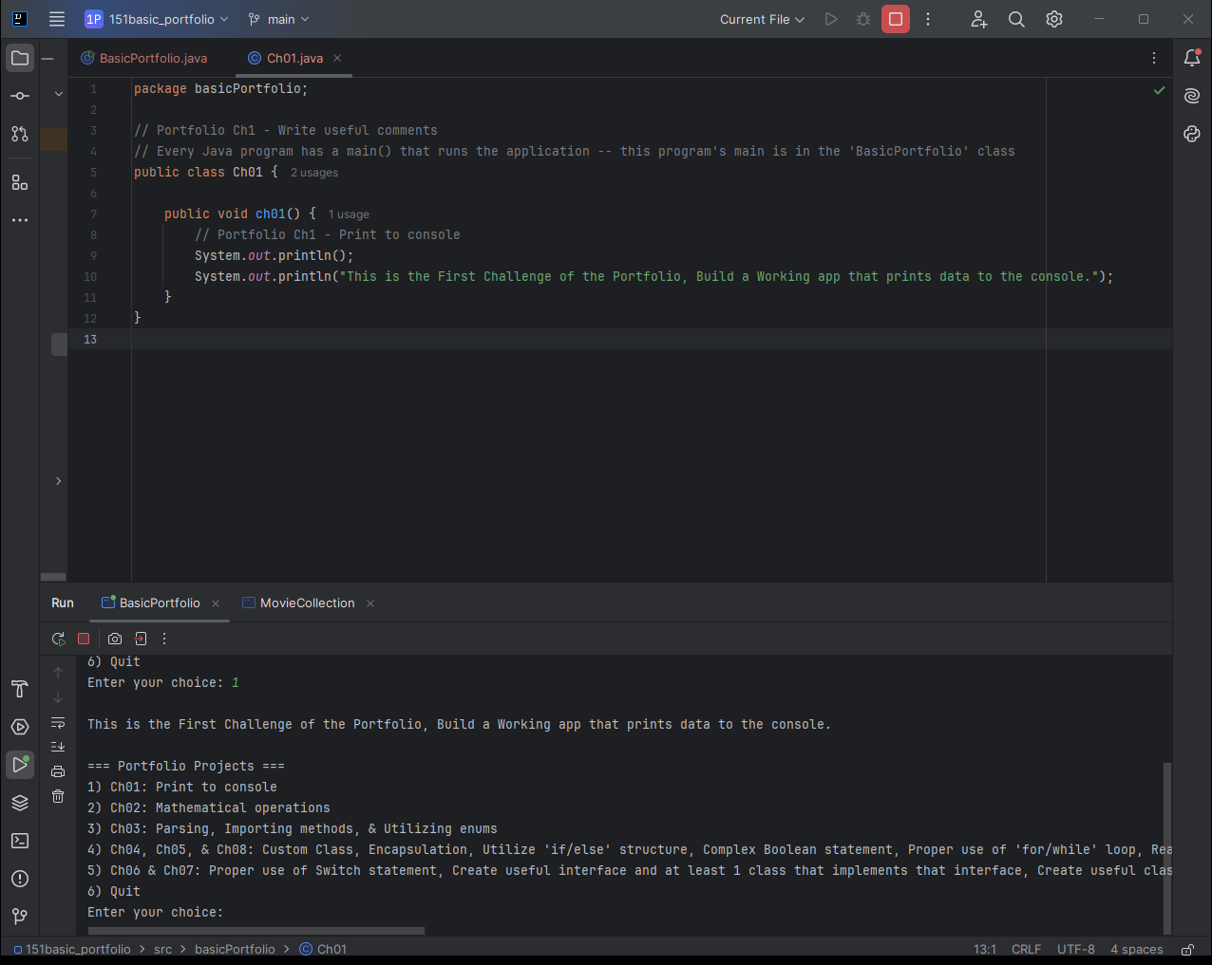
Project 01:Print to Console
Goals:
Build a working application that prints data to the console.
Use ‘System.out.println(“What You Want to Print”);’ to print text to the console in Java.
Write useful comments with your code.
I wrote a few comments, more are in the BasicPortfolio class.

Slide 6
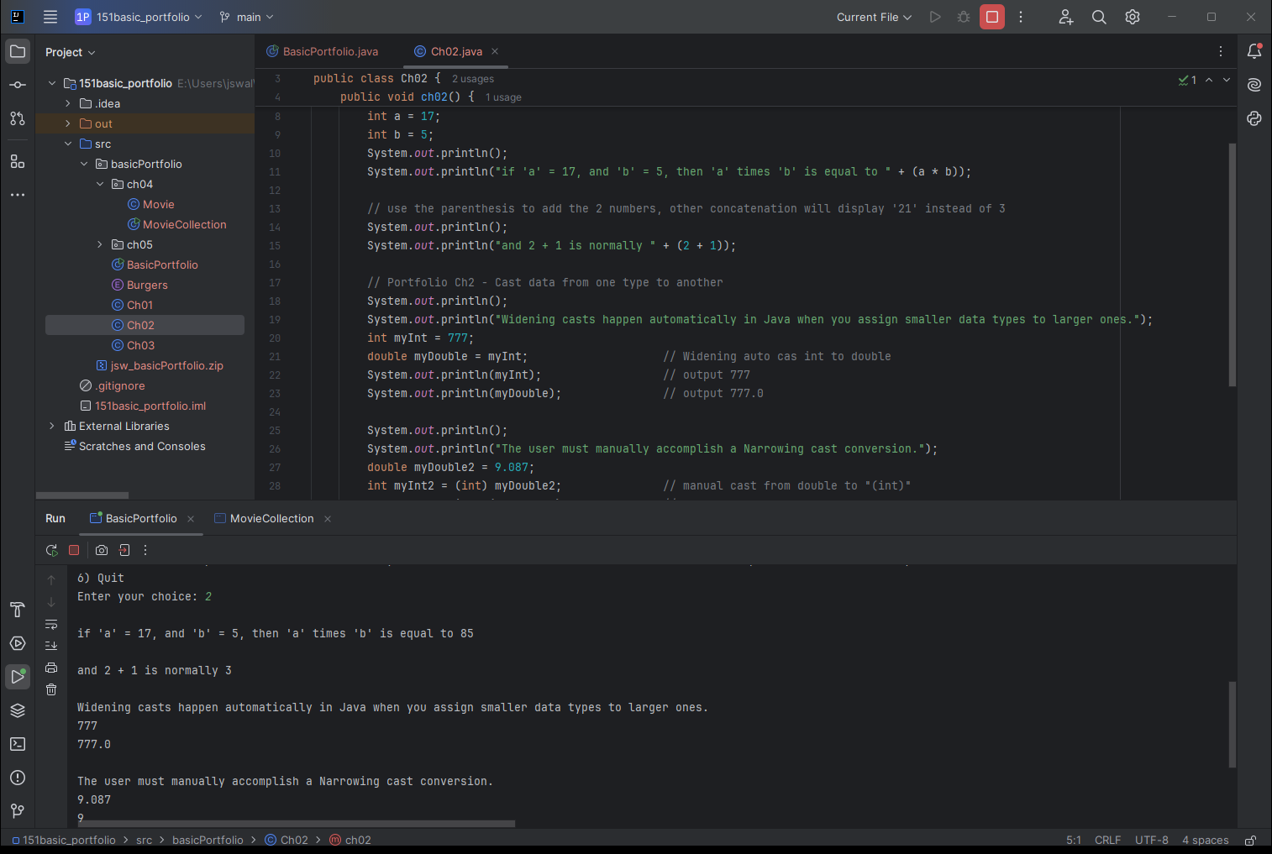
Project 02:Mathematical Operations
Goals:
Perform mathematical calculations using variables.
I declared variables as ‘int’, which means they are integers.
Use the cast operator to cast data from one type to another.
I manually cast a double, ‘myDouble2’ to an integer.

Slide 7
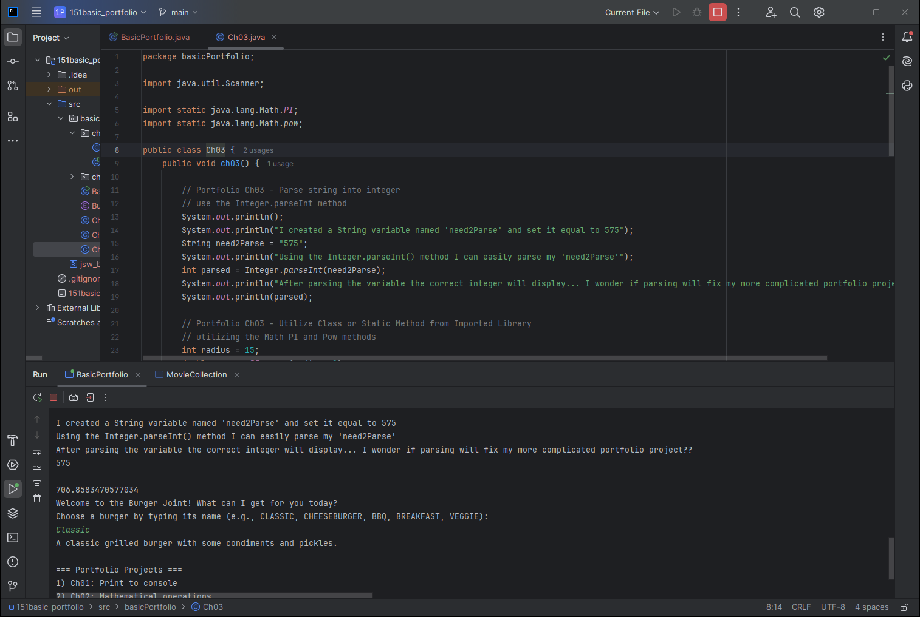
Project 03:Parsing, Importing methods
Goals:
Parse a string into an integer.
Using the .parseInt() method provided in Java.
Properly utilize a Class or Static Method from an imported library.
We use both the Math.PI and Math.pow libraries.

Slide 8
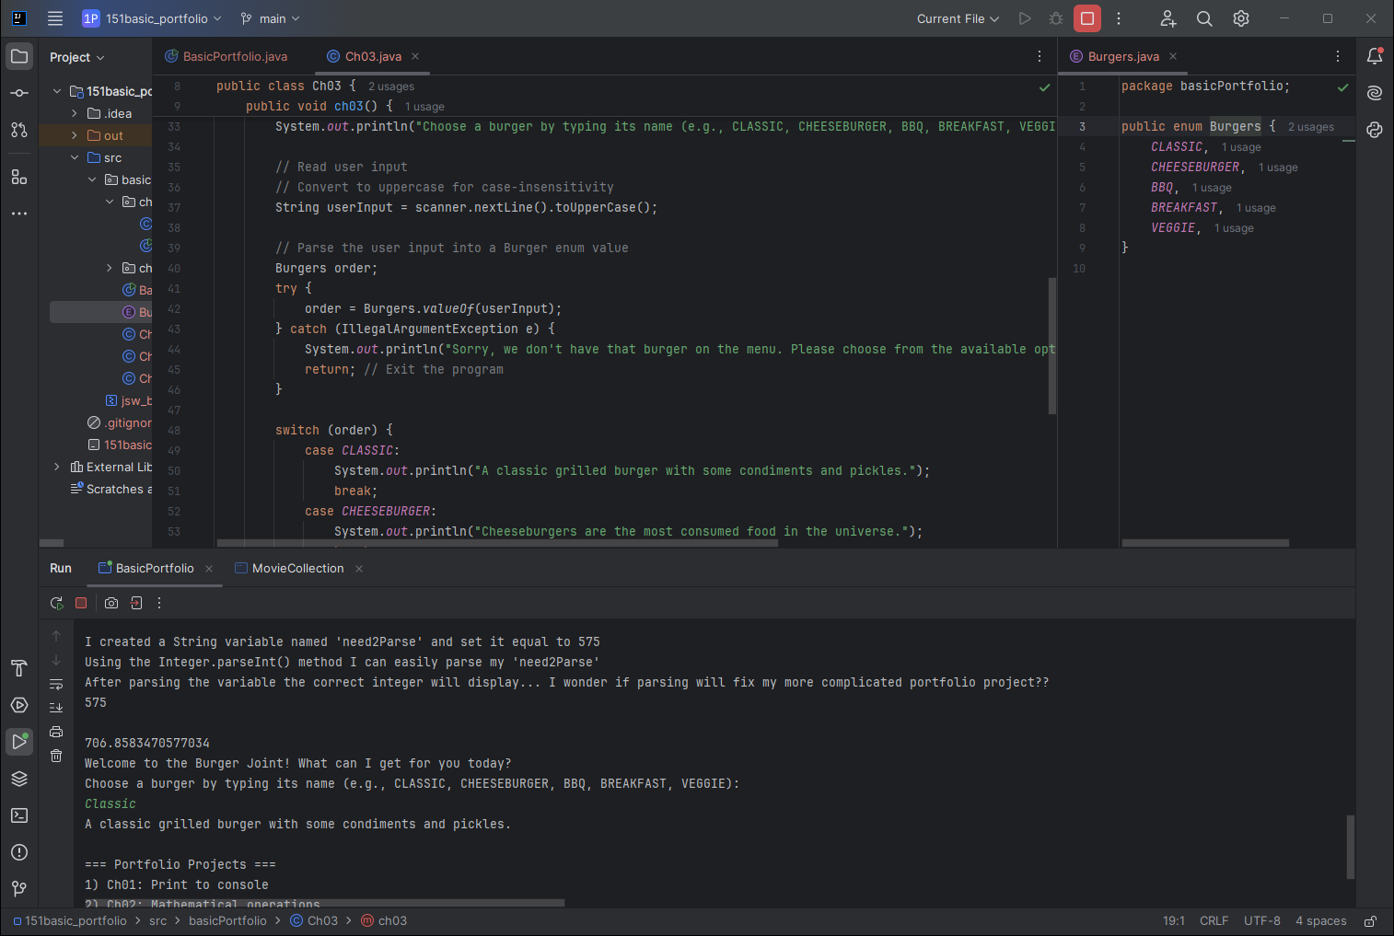
Project 03b: Utilizing enums
Goals:
Properly define and utilize an enum.
I created and use an ‘enum’ named Burgers, which contains multiple Burger types that are available.
I also use the Java ‘Scanner’
In my scanner I make certain it transforms the input into all uppercase to match my enum contents.
This project makes use of a ‘switch’ statement.

Slide 9
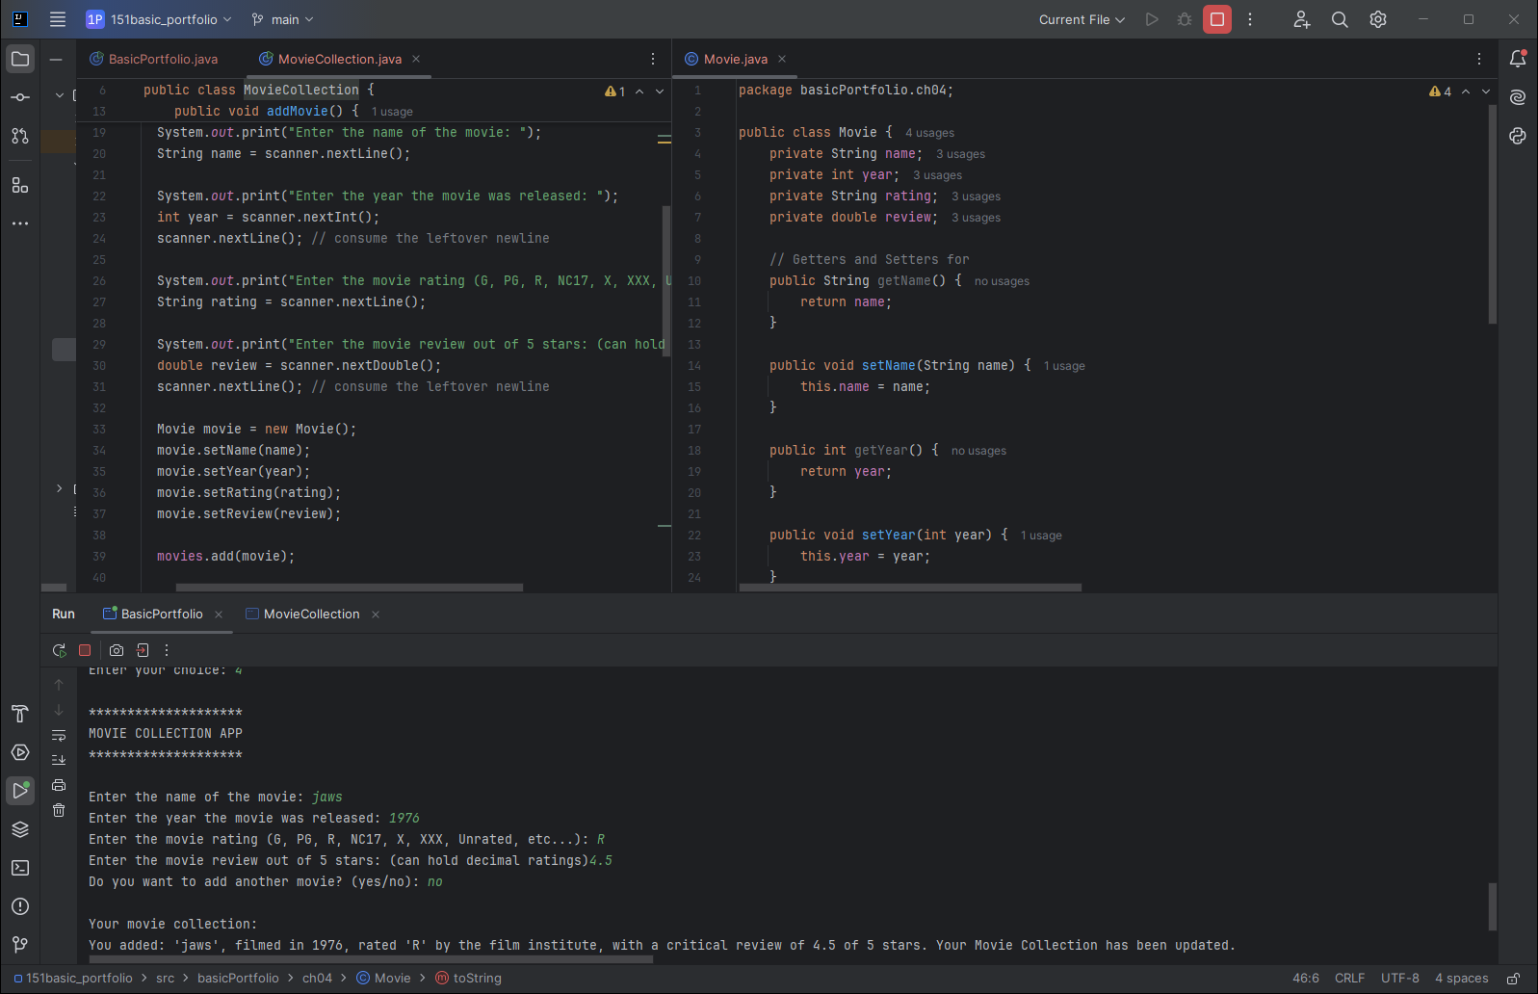
Project 04: Custom Class, Encapsulation, Read data from Scanner
Goals:
Movie is an object class that contains private fields of what we use to classify our ‘movie’.
We access the ‘private’ content of our object by creating public ‘getters and setters’ that can return information about the object, or transform that object.
Keeping the internal aspects of the object ‘private’ and using the ‘getters and setters’ is an example of encapsulation.
We again have a scanner that takes user input and stores that information for use in our ArrayList.

Slide 10
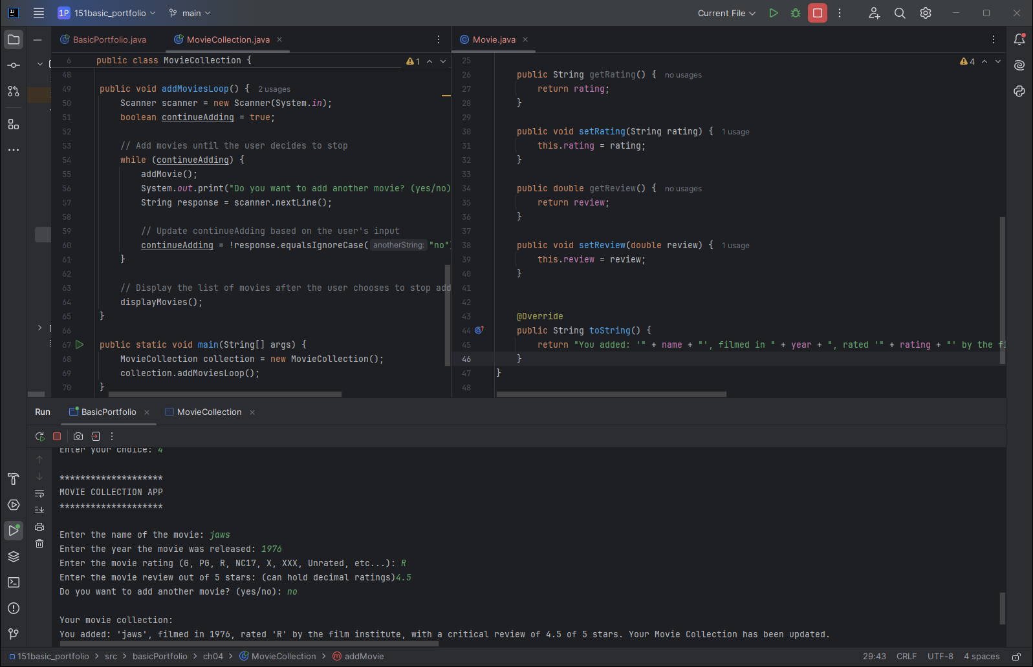
Project 04b: Complex Boolean statement, Proper use of 'for/while' loop
Goals:
I created a complex Boolean statement within my ‘while’ statement.
The statement confirms that while ‘response’ is NOT equal to ‘no’, ignoring the case that is input, the loop will continue.
The while loop here continues the process of adding movies to the ArrayList.

Slide 11
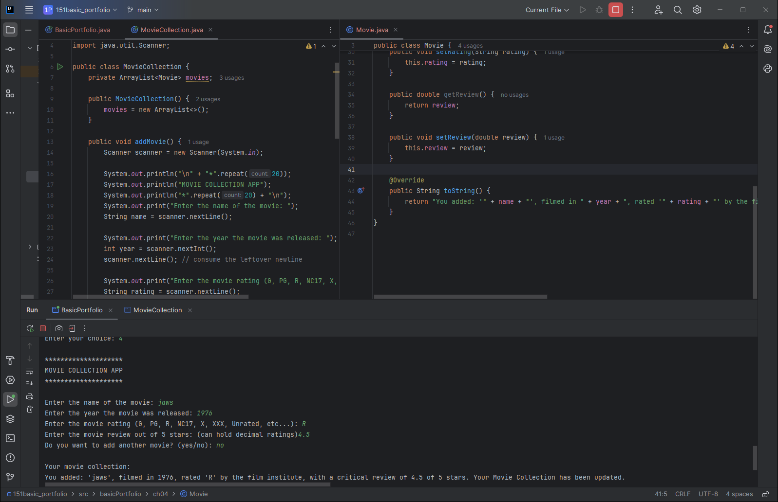
Project 04C: Utilize an ArrayList
Goals:
In this project we create an ArrayList<Movie>, named ‘movies’, we later print out the ‘movies’ ArrayList when the user exits the program.

Slide 12
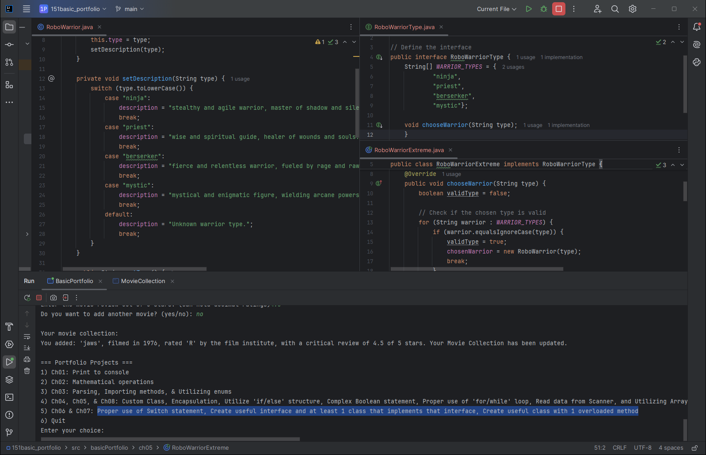
Project 05: Proper use of Switch statement, Create useful interface and at least 1 class that implements that interface
Goals:
In this project, ‘RoboWarriorExtreme’ implements an interface class named ‘RoboWarriorType’.
I do correctly make use of an ‘if’ statement in this project, also.
I have 2 different switch statements in this application, the first gives a description of the character class that the user has chosen, based on the available interface classes.

Slide 13
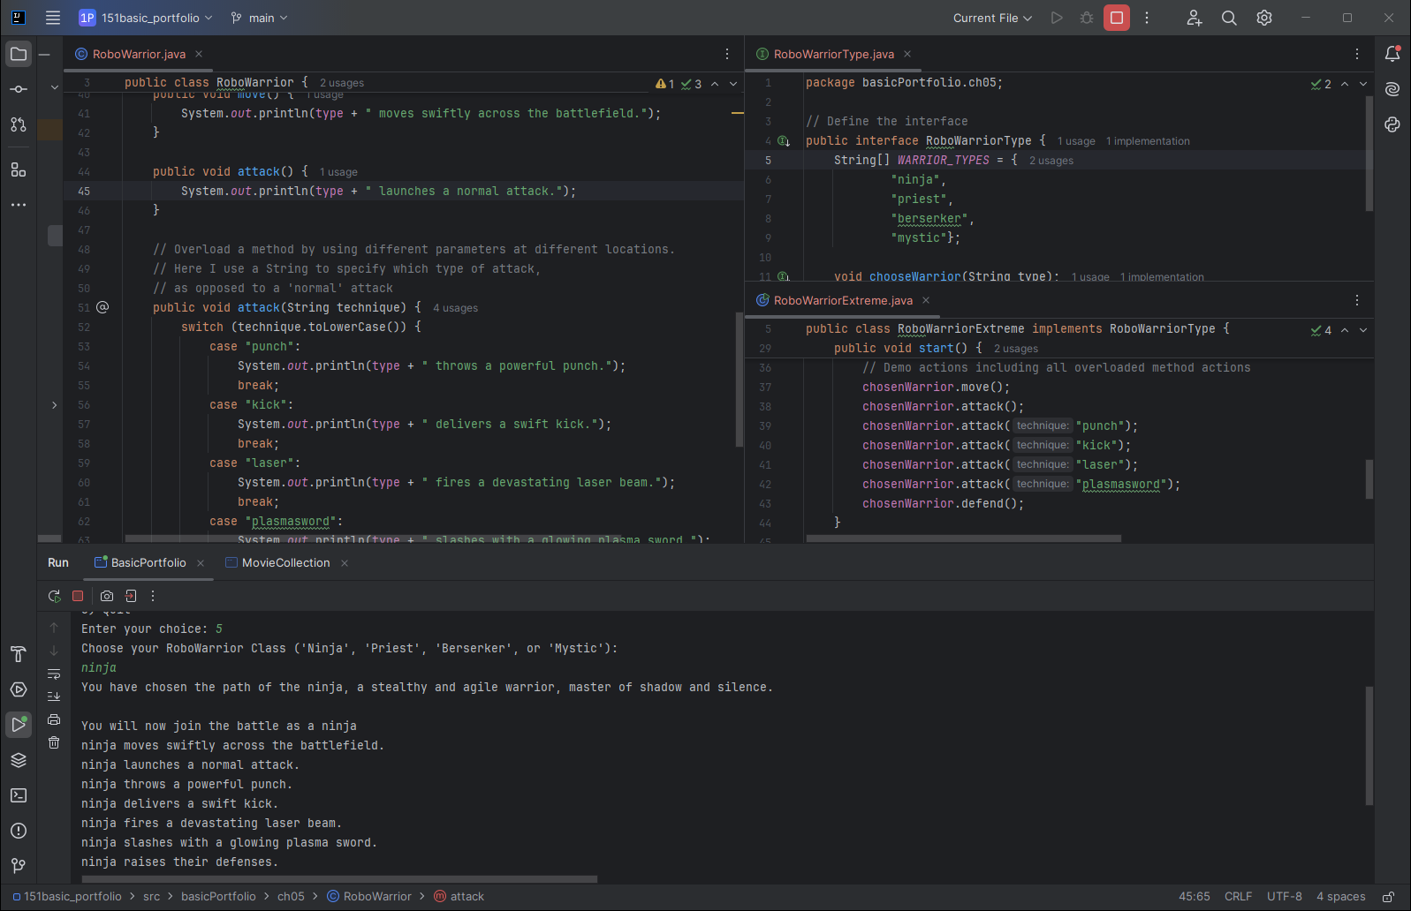
Project 05B:Create useful class with 1 overloaded method
Goals:
The ‘RoboWarrior’ class has both an ‘attack()’ method, or an overloaded: ‘attack(punch)’, ‘attack(kick)’, ‘attack(laser)’, and ‘attack(plasmasword)’ methods.

Slide 14
SUMMARY
Throughout these projects, I've demonstrated my ability to grasp and apply essential Java programming concepts, meeting all the portfolio requirements. Starting with simple tasks like printing to the console and performing mathematical operations, I progressively tackled more complex challenges such as parsing strings, using enums, and handling file inputs.
The Movie Collection app, for instance, showcases my proficiency in creating custom classes, utilizing encapsulation, and managing data using ArrayLists. In the RoboWarriorExtreme project, I highlighted my understanding of switch statements, interface implementation, and method overloading.
These projects collectively illustrate my capability to solve practical problems with Java, underscoring my readiness to take on more advanced software development tasks. This portfolio not only reflects my technical skills but also my journey as an enthusiastic student of programming.

Slide 15
THANK YOU
JEFFREY WALLEY
jeffreywalley@student.bpcc.edu
https://walleyworks.netlify.app/

