Slide 1

Java™ Software Solutions: Foundations of Program Design
Ninth Edition
Chapter 4
Writing Classes
Copyright © 2018 Pearson Education, Inc. All Rights Reserved
Notes:
If this PowerPoint presentation contains mathematical equations, you may need to check that your computer has the following installed:
1) MathType Plugin
2) Math Player (free versions available)
3) NVDA Reader (free versions available)

Slide 2
Writing Classes (1 of 2)
We’ve been using predefined classes from the Java A P I. Now we will learn to write our own classes.
Chapter 4 focuses on:
class definitions
instance data
encapsulation and Java modifiers
method declaration and parameter passing
constructors
arcs and images
events and event handlers
buttons and text fields

Slide 3
Outline (1 of 7)
Anatomy of a Class
Encapsulation
Anatomy of a Method
Arcs
Images
Graphical User Interfaces
Text Fields

Slide 4
Writing Classes (2 of 2)
The programs we’ve written in previous examples have used classes defined in the Java A P I
Now we will begin to design programs that rely on classes that we write ourselves
The class that contains the main method is just the starting point of a program
True object-oriented programming is based on defining classes that represent objects with well-defined characteristics and functionality

Slide 5
Examples of Classes (1 of 2)
Class | Attributes | Operations
Student | Name Address Major Grade point average | Set address Set major Compute grade point average
Rectangle | Length Width Color | Set length Set width Set color
Aquarium | Material Length Width Height | Set material Set length Set width Set height Compute volume Compute filled weight

Slide 6
Examples of Classes (2 of 2)
Class | Attributes | Operations
Flight | Airline Flight number Origin city Destination city Current status | Set airline Set flight number Determine status
Employee | Name Department Title Salary | Set department Set title Set salary Compute wages Compute bonus Compute taxes

Slide 7
Classes and Objects
Recall from our overview of objects in Chapter 1 that an object has state and behavior
Consider a six-sided die (singular of dice)
Its state can be defined as which face is showing
Its primary behavior is that it can be rolled
We represent a die by designing a class called Die that models this state and behavior
The class serves as the blueprint for a die object
We can then instantiate as many die objects as we need for any particular program

Slide 8
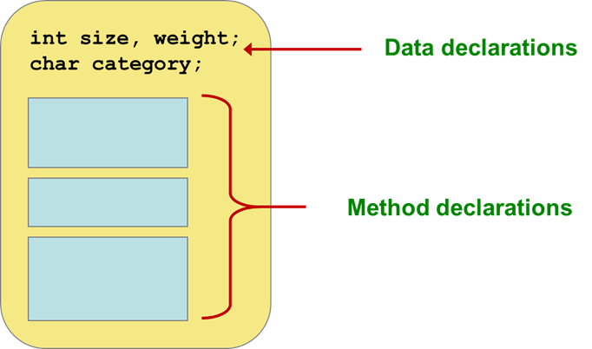
Classes (1 of 3)
A class can contain data declarations and method declarations

Slide 9
Classes (2 of 3)
The values of the data define the state of an object created from the class
The functionality of the methods define the behaviors of the object
For our Die class, we might declare an integer called faceValue that represents the current value showing on the face
One of the methods would “roll” the die by setting faceValue to a random number between one and six

Slide 10
Classes (3 of 3)
We’ll want to design the Die class so that it is a versatile and reusable resource
Any given program will probably not use all operations of a given class
See RollingDice.java
See Die.java

Slide 11
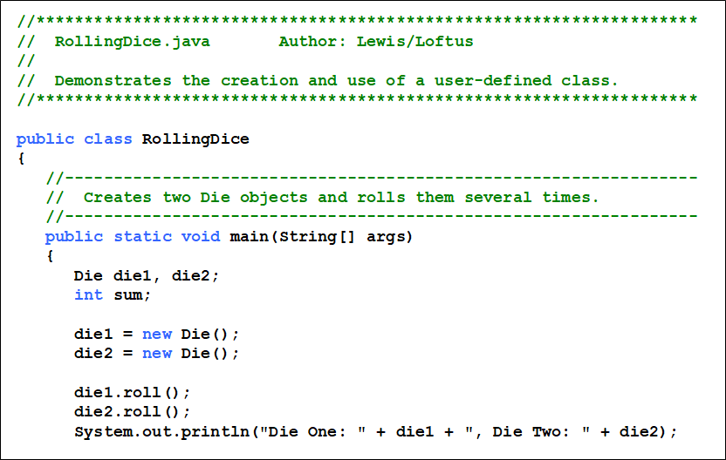
Listing 4.1 (1 of 3)

Slide 12
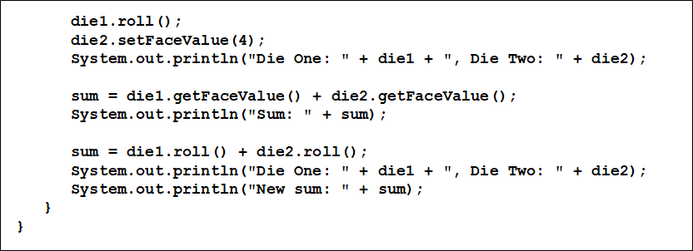
Listing 4.1 (2 of 3)

Slide 13
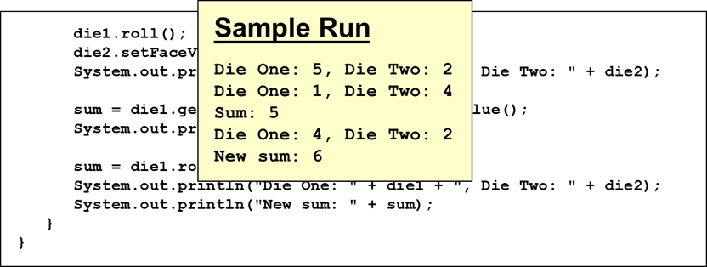
Listing 4.1 (3 of 3)

Slide 14
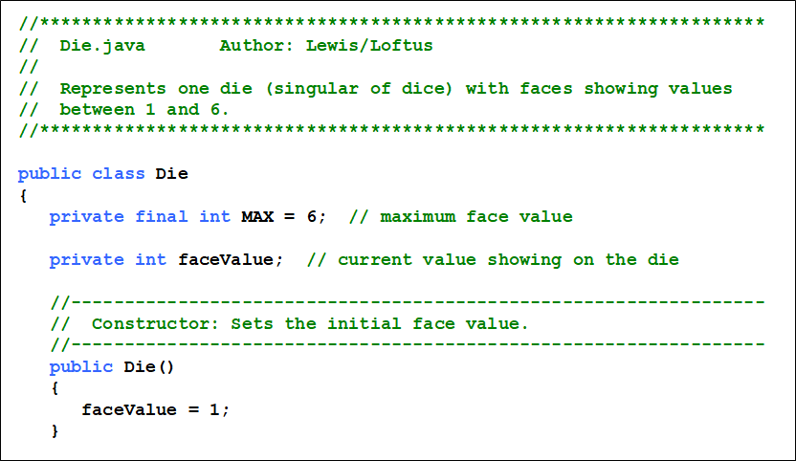
Listing 4.2 (1 of 3)

Slide 15
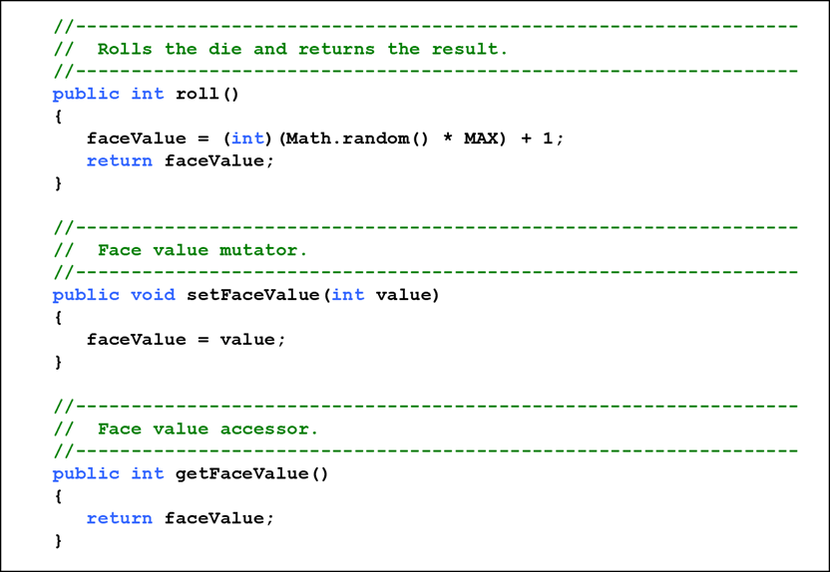
Listing 4.2 (2 of 3)

Slide 16
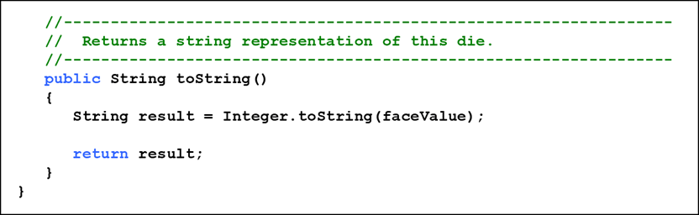
Listing 4.2 (3 of 3)

Slide 17
The Die Class
The Die class contains two data values
a constant MAX that represents the maximum face value
an integer faceValue that represents the current face value
The roll method uses the random method of the Math class to determine a new face value
There are also methods to explicitly set and retrieve the current face value at any time

Slide 18
The toString Method
It’s good practice to define a toString method for a class
The toString method returns a character string that represents the object in some way
It is called automatically when an object is concatenated to a string or when it is passed to the println method
It’s also convenient for debugging problems

Slide 19
Constructors
As mentioned previously, a constructor is used to set up an object when it is initially created
A constructor has the same name as the class
The Die constructor is used to set the initial face value of each new die object to one
We examine constructors in more detail later in this chapter

Slide 20
Data Scope
The scope of data is the area in a program in which that data can be referenced (used)
Data declared at the class level can be referenced by all methods in that class
Data declared within a method can be used only in that method
Data declared within a method is called local data
In the Die class, the variable result is declared inside the toString method -- it is local to that method and cannot be referenced anywhere else

Slide 21
Instance Data (1 of 2)
A variable declared at the class level (such as faceValue) is called instance data
Each instance (object) has its own instance variable
A class declares the type of the data, but it does not reserve memory space for it
Each time a Die object is created, a new faceValue variable is created as well
The objects of a class share the method definitions, but each object has its own data space
That’s the only way two objects can have different states

Slide 22
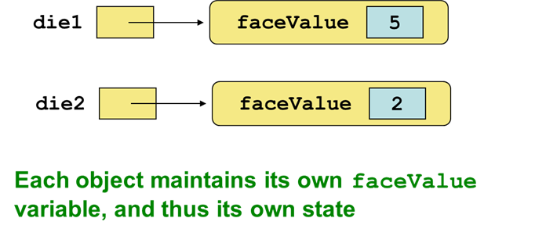
Instance Data (2 of 2)
We can depict the two Die objects from the RollingDice program as follows:

Slide 23
U M L Diagrams
U M L stands for the Unified Modeling Language
U M L diagrams show relationships among classes and objects
A U M L class diagram consists of one or more classes, each with sections for the class name, attributes (data), and operations (methods)
Lines between classes represent associations
A dotted arrow shows that one class uses the other (calls its methods)

Slide 24
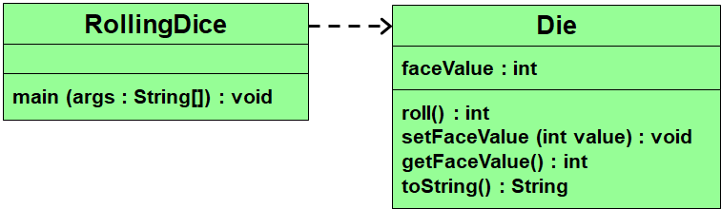
U M L Class Diagrams
A U M L class diagram for the RollingDice program:

Slide 25
Quick Check 1 (1 of 4)
What is the relationship between a class and an object?

Slide 26
Quick Check 1 (2 of 4)
What is the relationship between a class and an object?
A class is the definition/pattern/blueprint of an object. It defines the data that will be managed by an object but doesn’t reserve memory space for it. Multiple objects can be created from a class, and each object has its own copy of the instance data.

Slide 27
Quick Check 1 (3 of 4)
Where is instance data declared?
What is the scope of instance data?
What is local data?

Slide 28
Quick Check 1 (4 of 4)
Where is instance data declared?
At the class level.
What is the scope of instance data?
It can be referenced in any method of the class.
What is local data?
Local data is declared within a method, and is only accessible in that method.

Slide 29
Outline (2 of 7)
Anatomy of a Class
Encapsulation
Anatomy of a Method
Arcs
Images
Graphical User Interfaces
Text Fields

Slide 30
Encapsulation (1 of 3)
There are two views of an object:
internal - the details of the variables and methods of the class that defines it
external - the services that an object provides and how the object interacts with the rest of the system
From the external view, an object is an encapsulated entity, providing a set of specific services
These services define the interface to the object

Slide 31
Encapsulation (2 of 3)
One object (called the client) may use another object for the services it provides
The client of an object may request its services (call its methods), but it should not have to be aware of how those services are accomplished
Any changes to the object’s state (its variables) should be made by that object’s methods
We should make it difficult, if not impossible, for a client to access an object’s variables directly
That is, an object should be self-governing

Slide 32
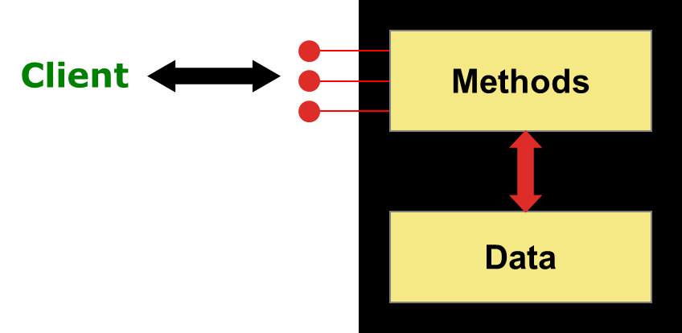
Encapsulation (3 of 3)
An encapsulated object can be thought of as a black box -- its inner workings are hidden from the client
The client invokes the interface methods and they manage the instance data

Slide 33
Visibility Modifiers (1 of 5)
In Java, we accomplish encapsulation through the appropriate use of visibility modifiers
A modifier is a Java reserved word that specifies particular characteristics of a method or data
We’ve used the final modifier to define constants
Java has three visibility modifiers: public, protected, and private
The protected modifier involves inheritance, which we will discuss later

Slide 34
Visibility Modifiers (2 of 5)
Members of a class that are declared with public visibility can be referenced anywhere
Members of a class that are declared with private visibility can be referenced only within that class
Members declared without a visibility modifier have default visibility and can be referenced by any class in the same package
An overview of all Java modifiers is presented in Appendix E

Slide 35
Visibility Modifiers (3 of 5)
Public variables violate encapsulation because they allow the client to modify the values directly
Therefore instance variables should not be declared with public visibility
It is acceptable to give a constant public visibility, which allows it to be used outside of the class
Public constants do not violate encapsulation because, although the client can access it, its value cannot be changed

Slide 36
Visibility Modifiers (4 of 5)
Methods that provide the object’s services are declared with public visibility so that they can be invoked by clients
Public methods are also called service methods
A method created simply to assist a service method is called a support method
Since a support method is not intended to be called by a client, it should not be declared with public visibility

Slide 37
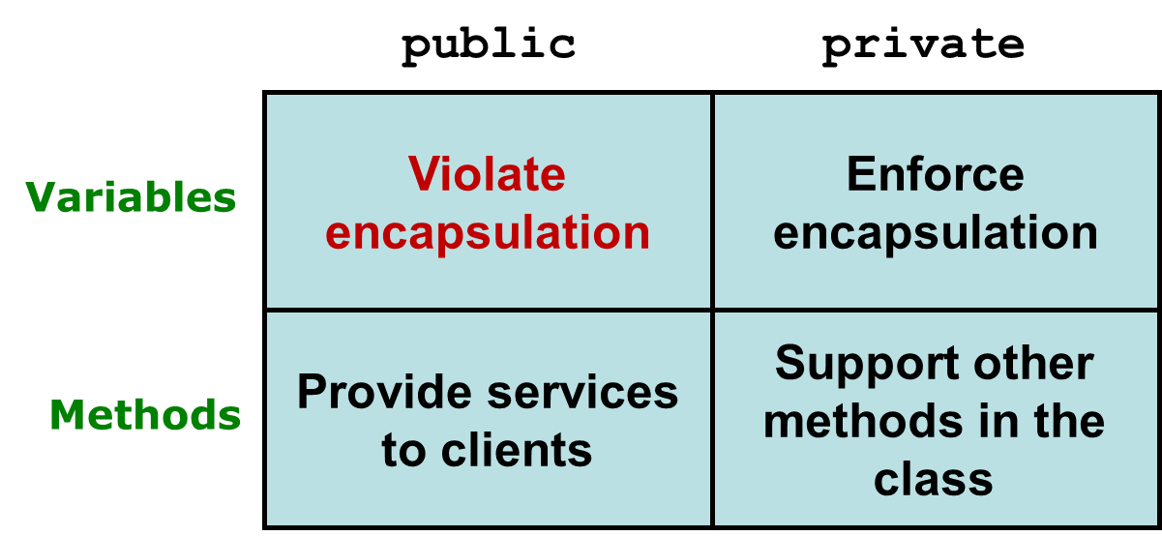
Visibility Modifiers (5 of 5)

Slide 38
Accessors and Mutators
Because instance data is private, a class usually provides services to access and modify data values
An accessor method returns the current value of a variable
A mutator method changes the value of a variable
The names of accessor and mutator methods take the form getX and setX, respectively, where X is the name of the value
They are sometimes called “getters” and “setters”

Slide 39
Mutator Restrictions
The use of mutators gives the class designer the ability to restrict a client’s options to modify an object’s state
A mutator is often designed so that the values of variables can be set only within particular limits
For example, the setFaceValue mutator of the Die class should restrict the value to the valid range (1 to MAX)
We’ll see in Chapter 5 how such restrictions can be implemented

Slide 40
Quick Check 2 (1 of 2)
Why was the faceValue variable declared as private in the Die class?
Why is it ok to declare MAX as public in the Die class?

Slide 41
Quick Check 2 (2 of 2)
Why was the faceValue variable declared as private in the Die class?
By making it private, each Die object controls its own data and allows it to be modified only by the well-defined operations it provides.
Why is it ok to declare MAX as public in the Die class?
MAX is a constant. Its value cannot be changed. Therefore, there is no violation of encapsulation.

Slide 42
Outline (3 of 7)
Anatomy of a Class
Encapsulation
Anatomy of a Method
Arcs
Images
Graphical User Interfaces
Text Fields

Slide 43
Method Declarations
Let’s now examine methods in more detail
A method declaration specifies the code that will be executed when the method is invoked (called)
When a method is invoked, the flow of control jumps to the method and executes its code
When complete, the flow returns to the place where the method was called and continues
The invocation may or may not return a value, depending on how the method is defined

Slide 44
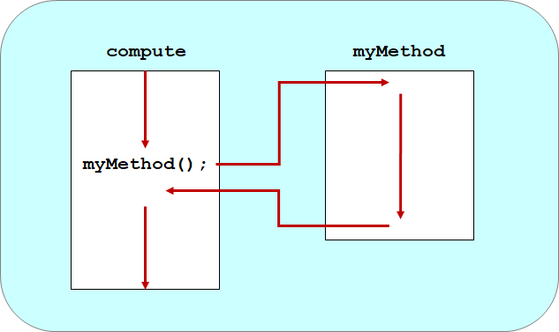
Method Control Flow (1 of 2)
If the called method is in the same class, only the method name is needed

Slide 45
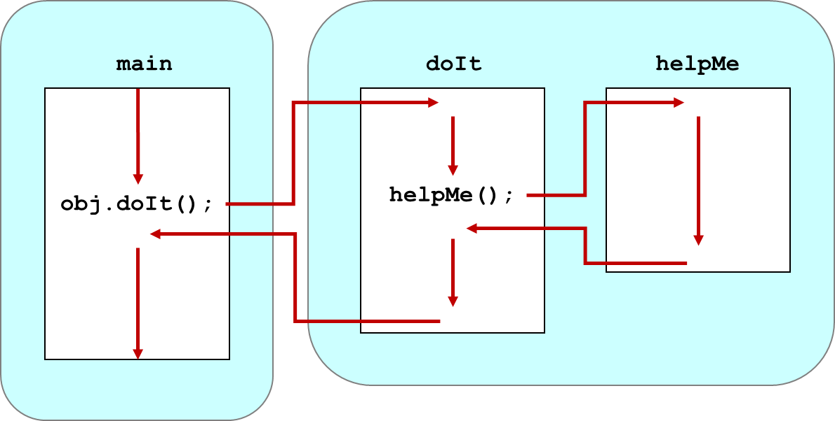
Method Control Flow (2 of 2)
The called method is often part of another class or object

Slide 46
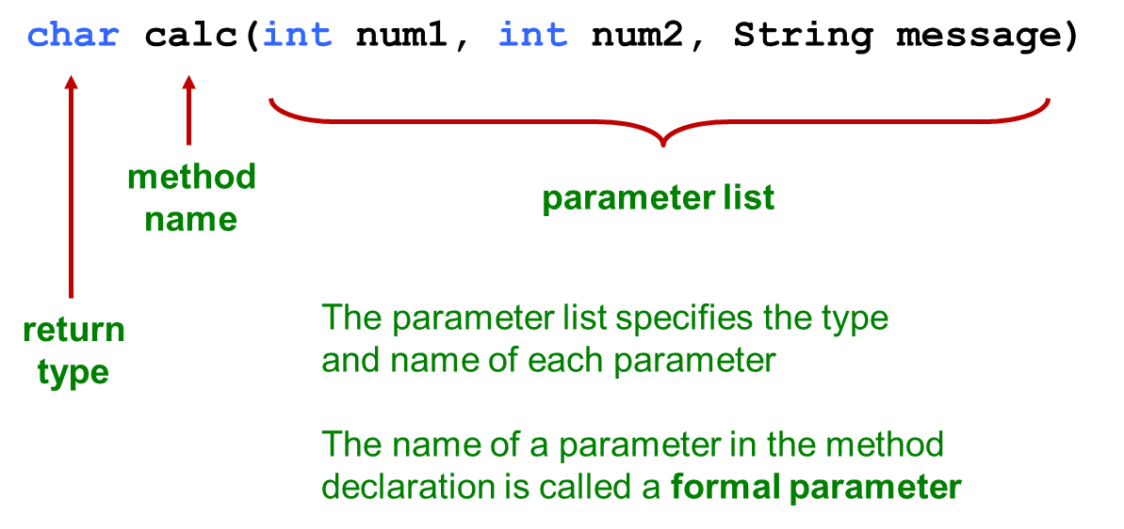
Method Header
A method declaration begins with a method header

Slide 47
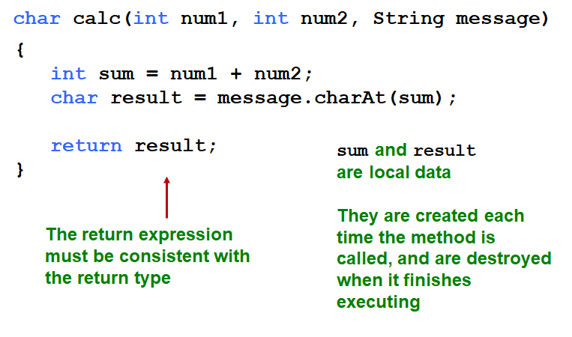
Method Body
The method header is followed by the method body

Slide 48

The return Statement
The return type of a method indicates the type of value that the method sends back to the calling location
A method that does not return a value has a void return type
A return statement specifies the value that will be returned
Its expression must conform to the return type

Slide 49
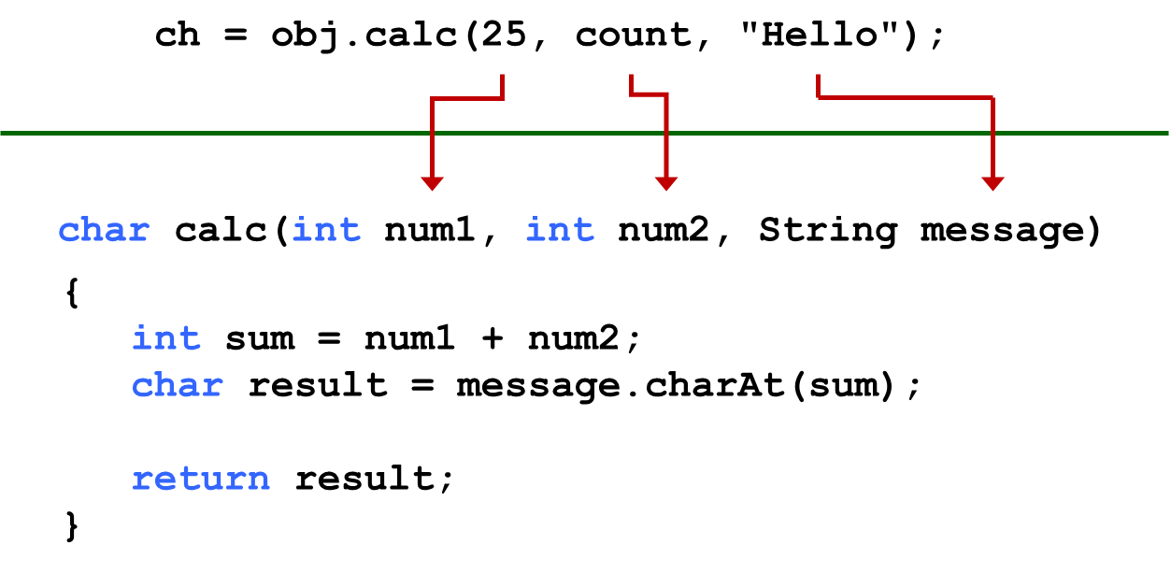
Parameters
When a method is called, the actual parameters in the invocation are copied into the formal parameters in the method header

Slide 50
Local Data
As we’ve seen, local variables can be declared inside a method
The formal parameters of a method create automatic local variables when the method is invoked
When the method finishes, all local variables are destroyed (including the formal parameters)
Keep in mind that instance variables, declared at the class level, exists as long as the object exists

Slide 51
Bank Account Example (1 of 3)
Let’s look at another example that demonstrates the implementation details of classes and methods
We’ll represent a bank account by a class named Account
It’s state can include the account number, the current balance, and the name of the owner
An account’s behaviors (or services) include deposits and withdrawals, and adding interest

Slide 52
Driver Programs
A driver program drives the use of other, more interesting parts of a program
Driver programs are often used to test other parts of the software
The Transactions class contains a main method that drives the use of the Account class, exercising its services
See Transactions.java
See Account.java

Slide 53
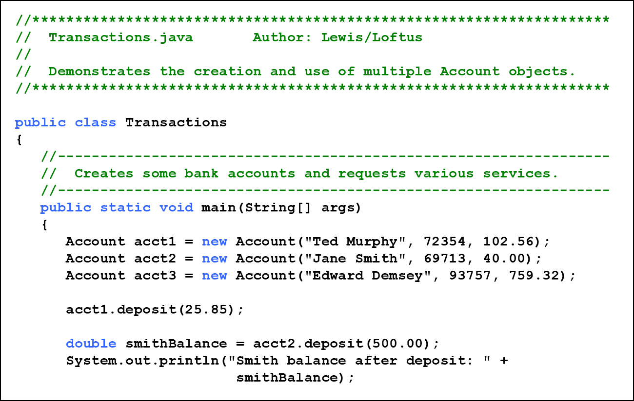
Listing 4.3 (1 of 3)

Slide 54
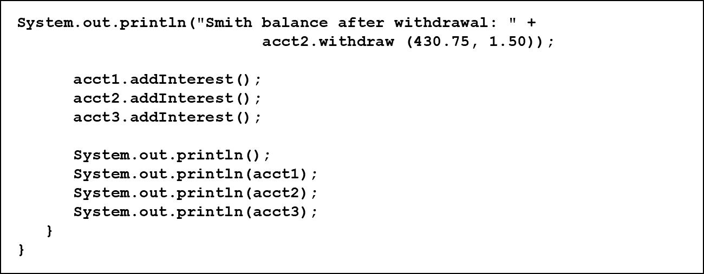
Listing 4.3 (2 of 3)

Slide 55
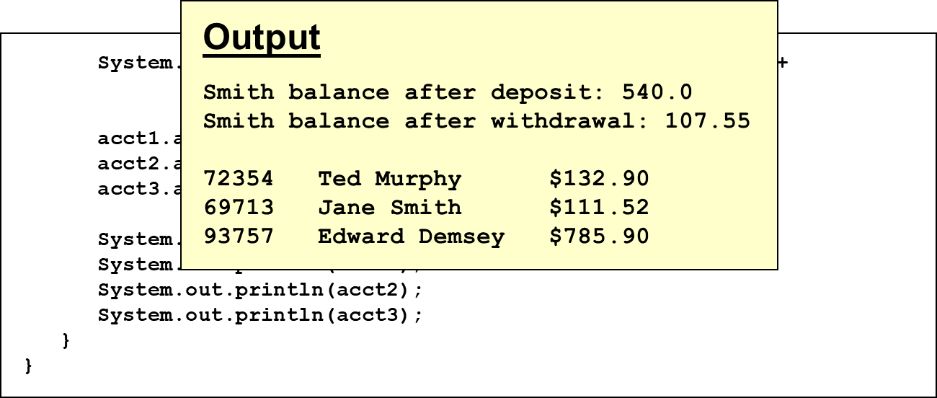
Listing 4.3 (3 of 3)

Slide 56
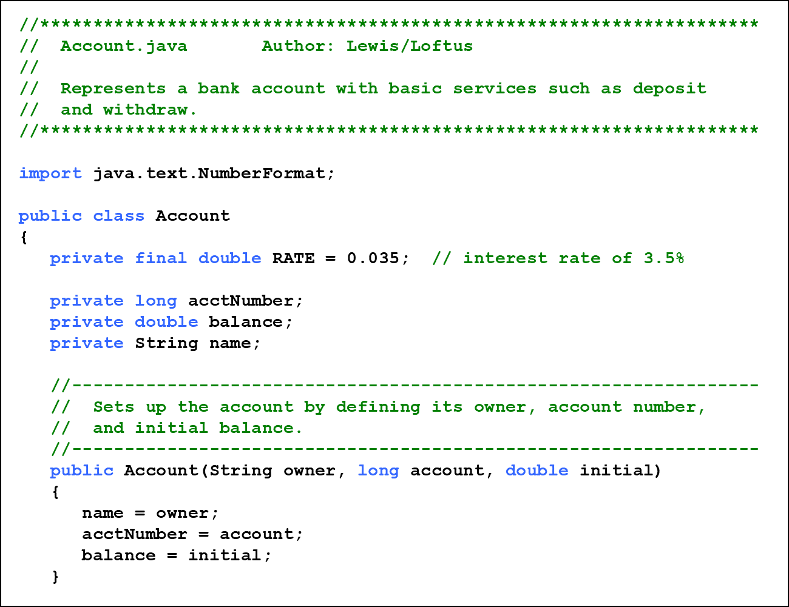
Listing 4.4 (1 of 3)

Slide 57
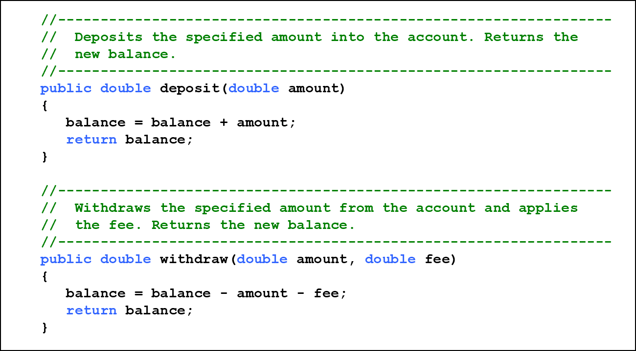
Listing 4.4 (2 of 3)

Slide 58
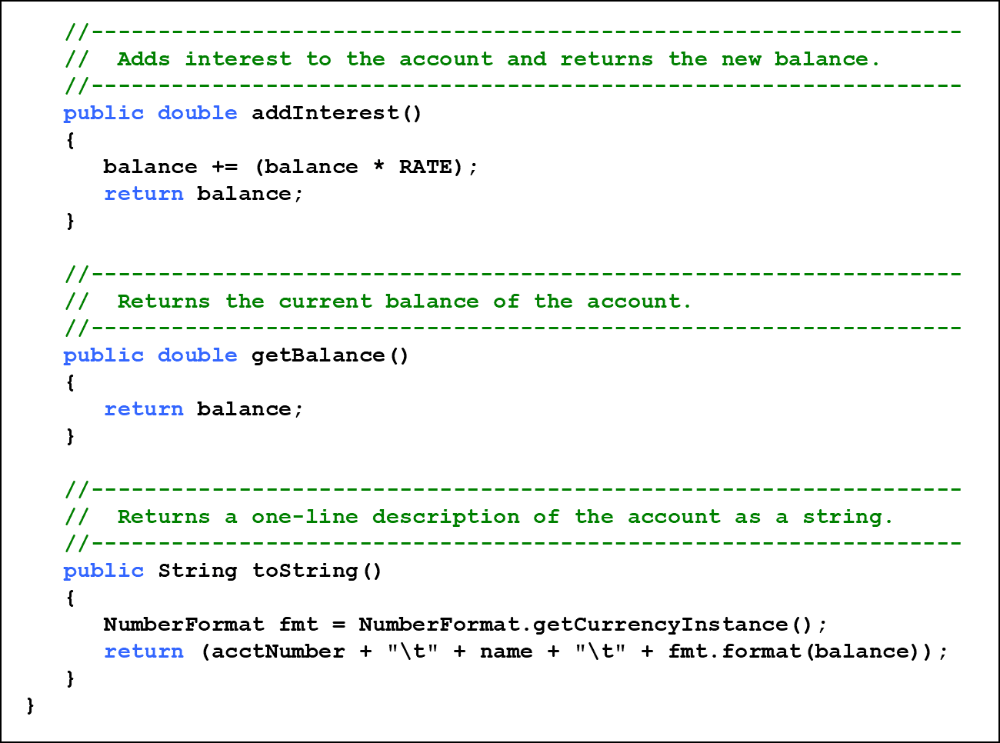
Listing 4.4 (3 of 3)

Slide 59
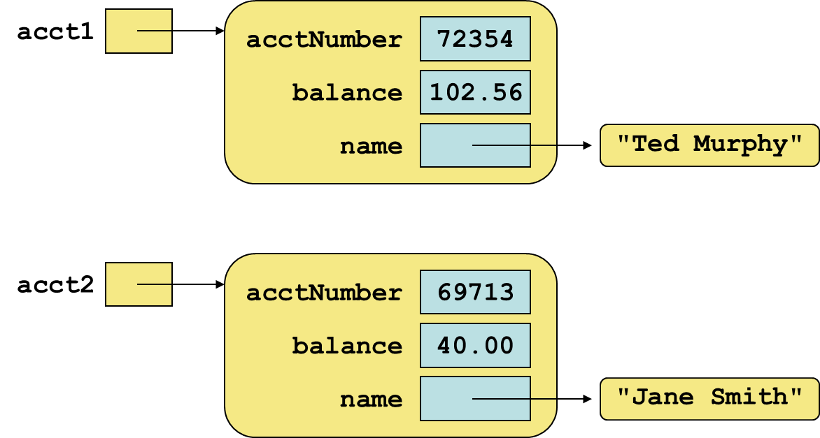
Bank Account Example (2 of 3)

Slide 60
Bank Account Example (3 of 3)
There are some improvements that can be made to the Account class
Formal getters and setters could have been defined for all data
The design of some methods could also be more robust, such as verifying that the amount parameter to the withdraw method is positive

Slide 61
Constructors Revisited
Note that a constructor has no return type specified in the method header, not even void
A common error is to put a return type on a constructor, which makes it a “regular” method that happens to have the same name as the class
The programmer does not have to define a constructor for a class
Each class has a default constructor that accepts no parameters

Slide 62
Quick Check 3 (1 of 2)
How do we express which Account object’s balance is updated when a deposit is made?

Slide 63


Quick Check 3 (2 of 2)
How do we express which Account object’s balance is updated when a deposit is made?
Each account is referenced by an object reference variable:
and when a method is called, you call it through a particular object:

Slide 64
Outline (4 of 7)
Anatomy of a Class
Encapsulation
Anatomy of a Method
Arcs
Images
Graphical User Interfaces
Text Fields

Slide 65
Arcs (1 of 4)
In Chapter 3 we explored basic shapes: lines, rectangles, circles, and ellipses
In JavaFX, an arc is defined as a portion of an ellipse
Like an ellipse, the first four parameters to the Arc constructor specify the center point (x and y) as well as the radii along the horizontal and vertical
Two additional parameters specify the portion of the ellipse that define the arc

Slide 66
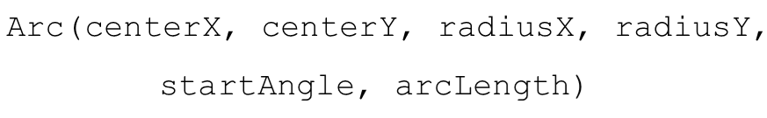
Arcs (2 of 4)
The Arc constructor:
The start angle is where the arc begins relative to the horizontal
The arc length is the angle that defines how big the arc is
Both angles are specified in degrees

Slide 67
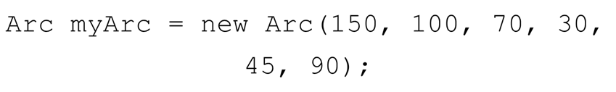
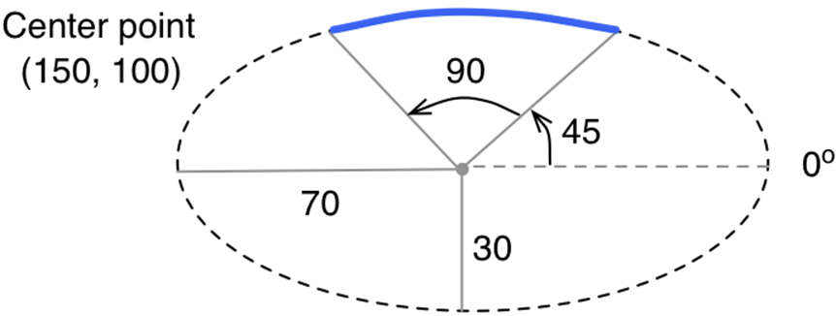
Arcs (3 of 4)
An arc whose underlying ellipse is centered at (150, 100), a horizontal radius of 70 and a vertical radius of 30, a start angle of 45 and a arc length of 90:

Slide 68
Arcs (4 of 4)
An arc also has an arc type:
ArcType.OPEN | The curve along the ellipse edge
ArcType.CHORD | End points are connected by a straight line
ArcType.ROUND | End points are connected to the center point of the ellipse, forming a rounded “pie” piece
See ArcDisplay.java

Slide 69
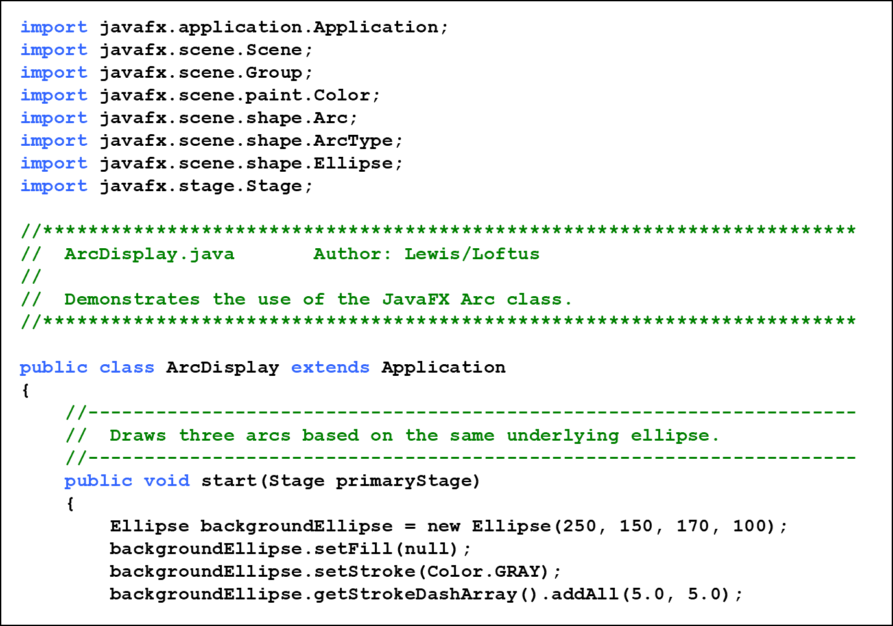
Listing 4.5 (1 of 3)

Slide 70
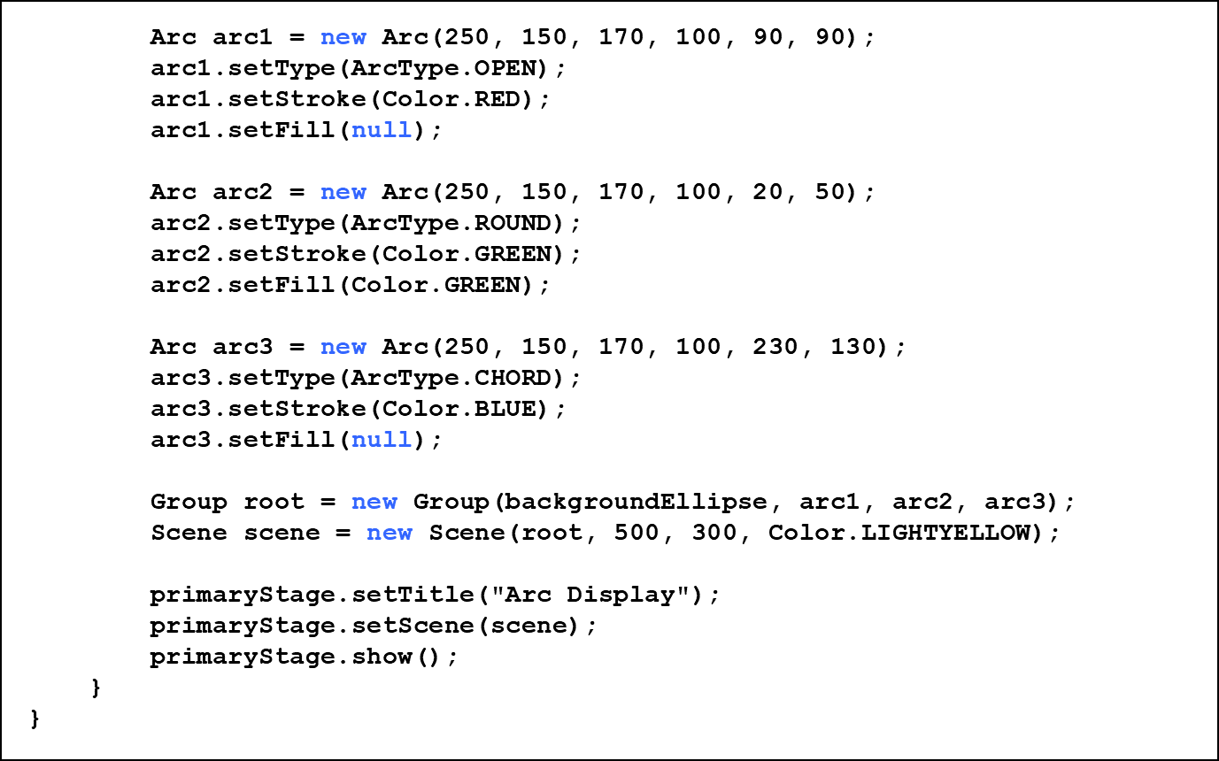
Listing 4.5 (2 of 3)

Slide 71
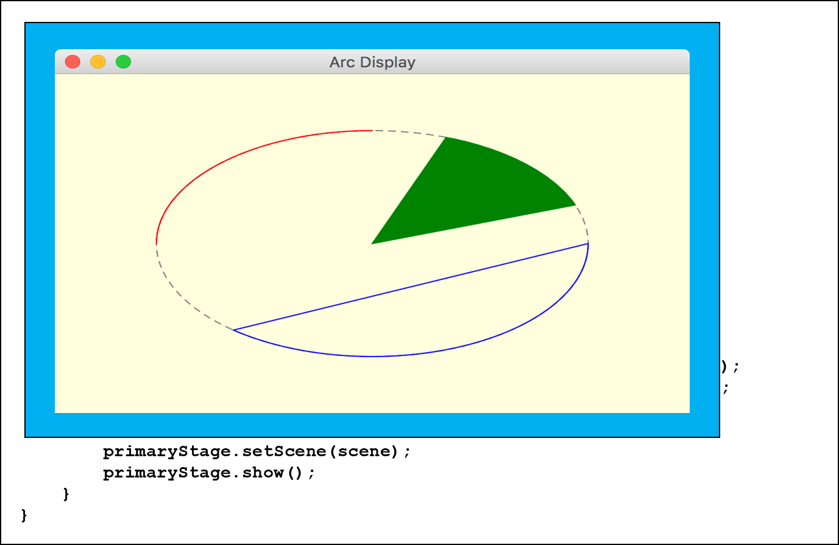
Listing 4.5 (3 of 3)

Slide 72
Outline (5 of 7)
Anatomy of a Class
Encapsulation
Anatomy of a Method
Arcs
Images
Graphical User Interfaces
Text Fields

Slide 73
Images (1 of 2)
The JavaFX Image class is used to load an image from a file or U R L
Supported formats: jpeg, gif, and png
To display an image, use an ImageView object
An Image object cannot be added to a container directly
See ImageDisplay.java

Slide 74
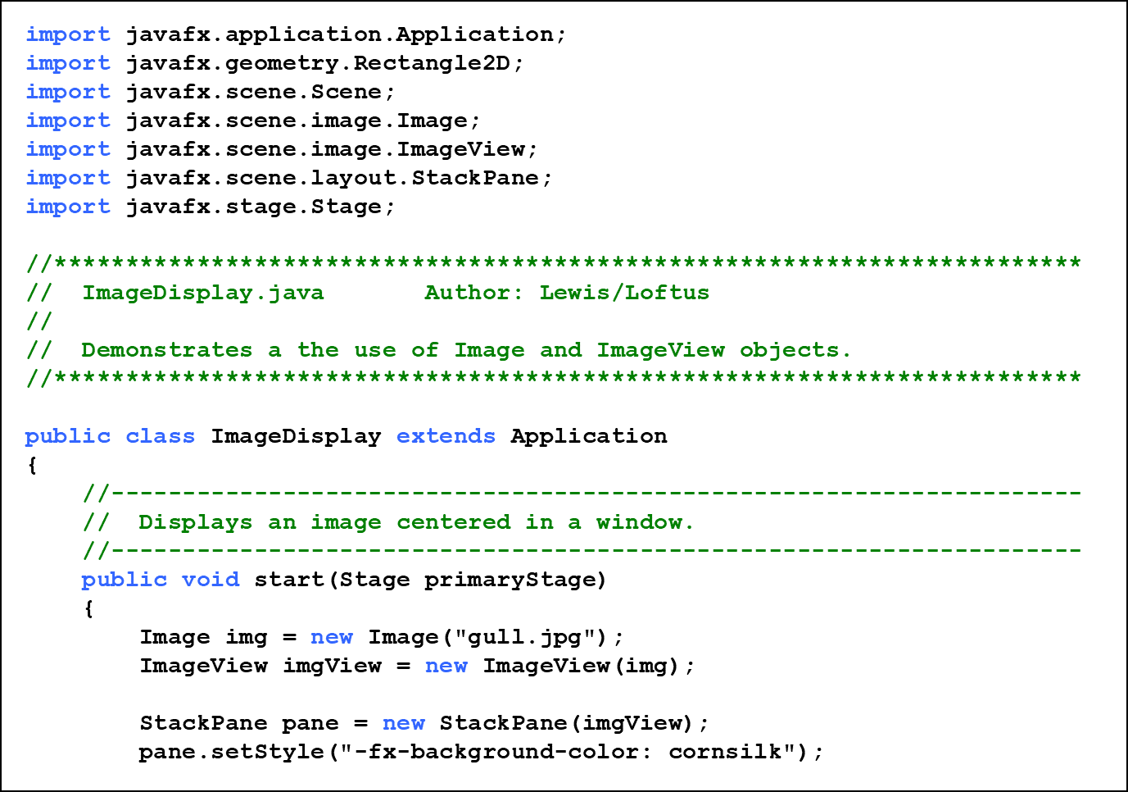
Listing 4.6 (1 of 3)

Slide 75
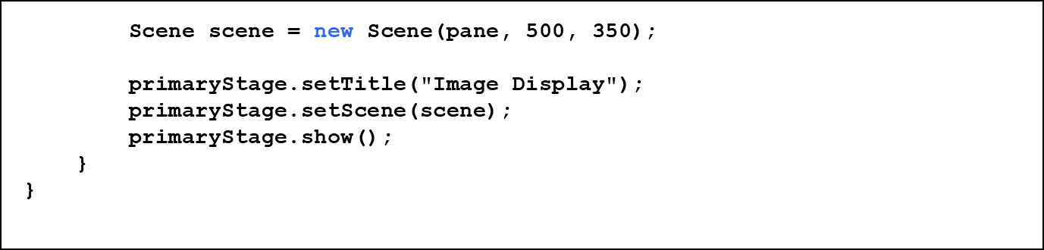
Listing 4.6 (2 of 3)

Slide 76
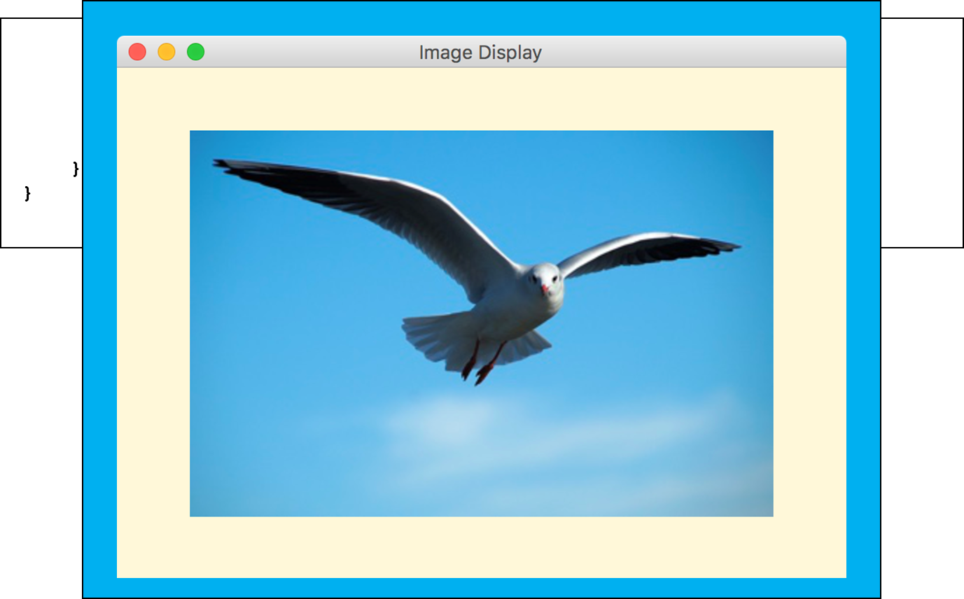
Listing 4.6 (3 of 3)

Slide 77
Layout Panes (1 of 2)
This example uses a StackPane instead of a Group as the root node of the scene
A stack pane is a JavaFX layout pane (one of several), which governs how its contents are presented
A stack pane stacks its nodes on top of each other
Since the image view is the only node in the pane, the stack pane simply serves to keep the image centered in the window

Slide 78
Layout Panes (2 of 2)
The background color of a layout pane is set using a call to the setStyle method
The setStyle method accepts a string that can specify various style properties
The notation used for JavaFX style properties are similar to cascading style sheets (C S S), used to specify the look of H T M L elements on a Web page
JavaFX style property names begin with the prefix “-fx-”

Slide 79
Images (2 of 2)
The parameter to the Image constructor can include a pathname:
It can also be a U R L:

Slide 80
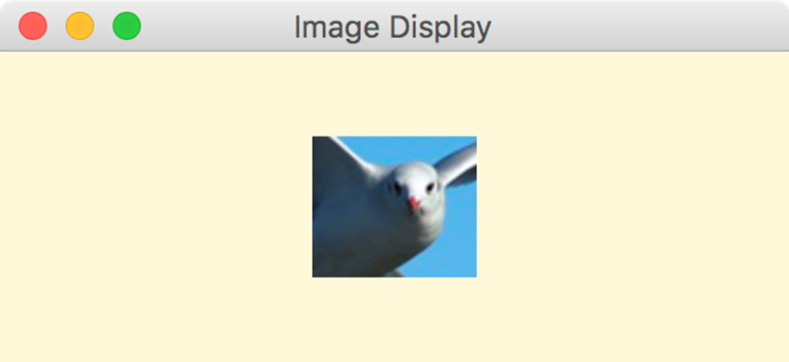
Viewports
A viewport is a rectangular area that restricts the pixels displayed in an ImageView
It is defined by a Rectangle2D object:

Slide 81
Outline (6 of 7)
Anatomy of a Class
Encapsulation
Anatomy of a Method
Arcs
Images
Graphical User Interfaces
Text Fields

Slide 82
Graphical User Interfaces (1 of 8)
A Graphical User Interface (G U I) in Java is created with at least three kinds of objects:
controls, events, and event handlers
A control is a screen element that displays information or allows the user to interact with the program:
labels, buttons, text fields, sliders, etc.

Slide 83
Graphical User Interfaces (2 of 8)
An event is an object that represents some activity to which we may want to respond
For example, we may want our program to perform some action when the following occurs:
a graphical button is pressed
a slider is dragged
the mouse is moved
the mouse is dragged
the mouse button is clicked
a keyboard key is pressed

Slide 84
Graphical User Interfaces (3 of 8)
The Java A P I contains several classes that represent typical events
Controls, such as a button, generate (or fire) an event when it occurs
We set up an event handler object to respond to an event when it occurs
We design event handlers to take whatever actions are appropriate when an event occurs

Slide 85
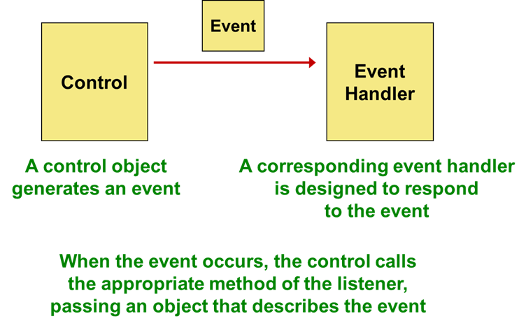
Graphical User Interfaces (4 of 8)

Slide 86
Graphical User Interfaces (5 of 8)
A JavaFX button is defined by the Button class
It generates an action event
The PushCounter example displays a button that increments a counter each time it is pushed
See PushCounter.java

Slide 87
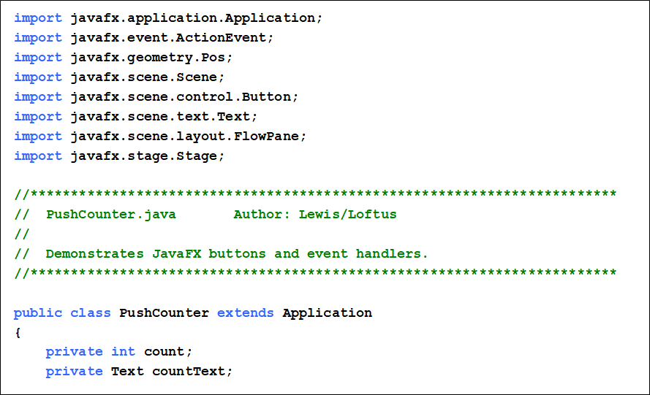
Listing 4.7 (1 of 4)

Slide 88
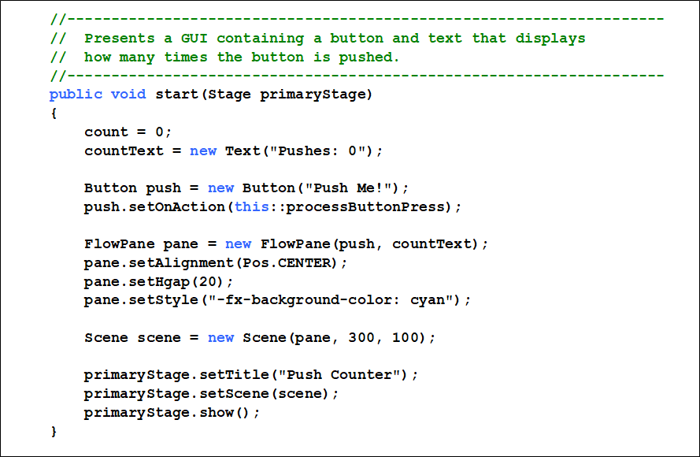
Listing 4.7 (2 of 4)

Slide 89
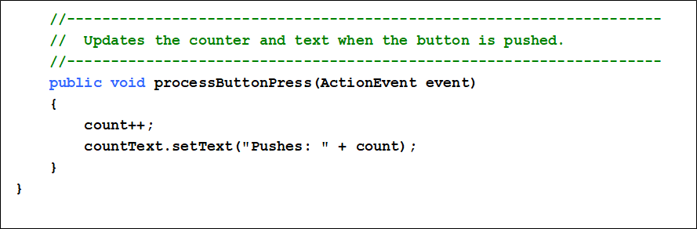
Listing 4.7 (3 of 4)

Slide 90
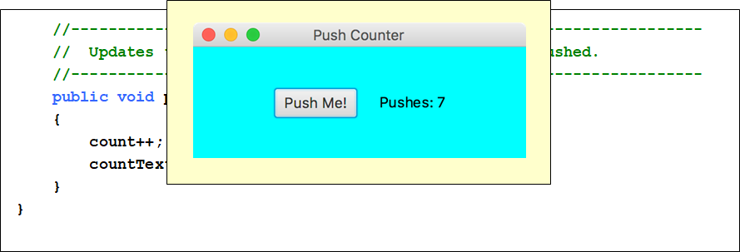
Listing 4.7 (4 of 4)

Slide 91
Graphical User Interfaces (6 of 8)
A call to the setOnAction method sets up the relationship between the button that generates the event and the event handler that responds to it
This example uses a method reference (using the
operator) to specify the event handler method
The this reference indicates that the event handler method is in the same class
So the PushCounter class also represents the event handler for this program

Slide 92
Graphical User Interfaces (7 of 8)
The event handler method can be called whatever you want, but must accept an ActionEvent object as a parmeter
In this example, the event handler method increments the counter and updates the text object
The counter and Text object are declared at the class level so that both methods can use them

Slide 93
Graphical User Interfaces (8 of 8)
In this example, a FlowPane is used as the root node of the scene
A flow pane is another layout pane, which displays its contents horizontally in rows or vertically in columns
A gap of 20 pixels is established between elements on a row using the setHGap method

Slide 94
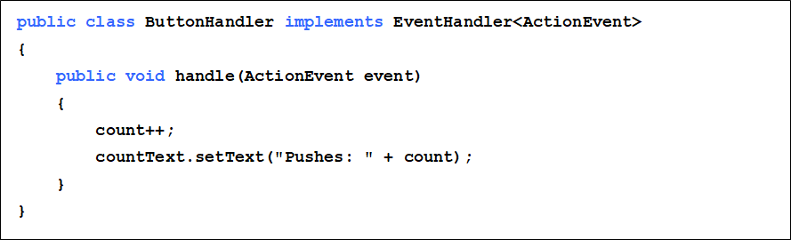
Alternate Event Handlers (1 of 4)
Instead of using a method reference, the event handler could be specified using a separate class that implements the EventHandler interface:

Slide 95
Alternate Event Handlers (2 of 4)
The event handler class could be defined as public in a separate file or as a private inner class in the same file
Either way, the call to the setOnAction method would specify a new event handler object:

Slide 96
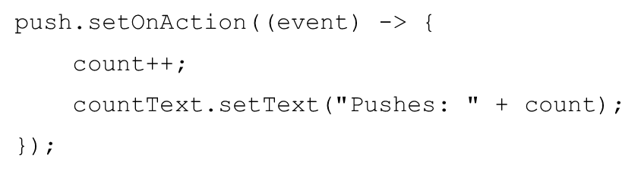

Alternate Event Handlers (3 of 4)
Another approach would be to define the event handler using a lambda expression in the call to setOnAction:
A lambda expression is defined by a set of parameters, the
operator and an expression

Slide 97
Alternate Event Handlers (4 of 4)
A lambda expression can be used whenever an object of a functional interface is required
A functional interface contains a single method
The EventHandler interface is a functional interface
The method reference approach is equivalent to a lambda expression

Slide 98
Outline (7 of 7)
Anatomy of a Class
Encapsulation
Anatomy of a Method
Arcs
Images
Graphical User Interfaces
Text Fields

Slide 99
Text Fields (1 of 3)
Let’s look at a G U I example that uses another type of control
A text field allows the user to enter one line of input
If the cursor is in the text field, the text field object generates an action event when the enter key is pressed
See FahrenheitConverter.java
See FahrenheitPane.java

Slide 100
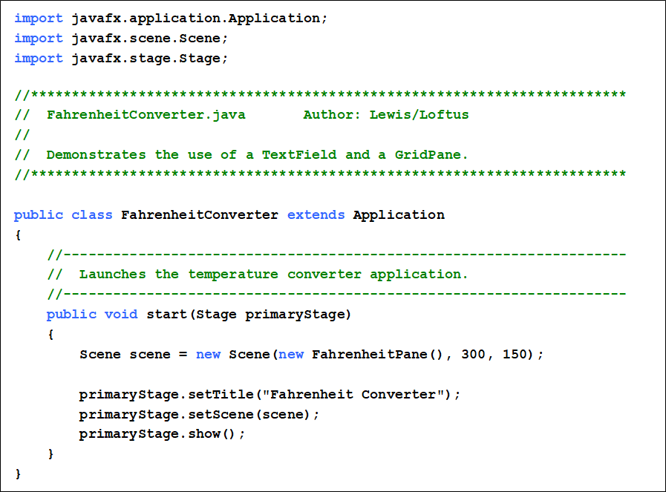
Listing 4.8 (1 of 2)

Slide 101
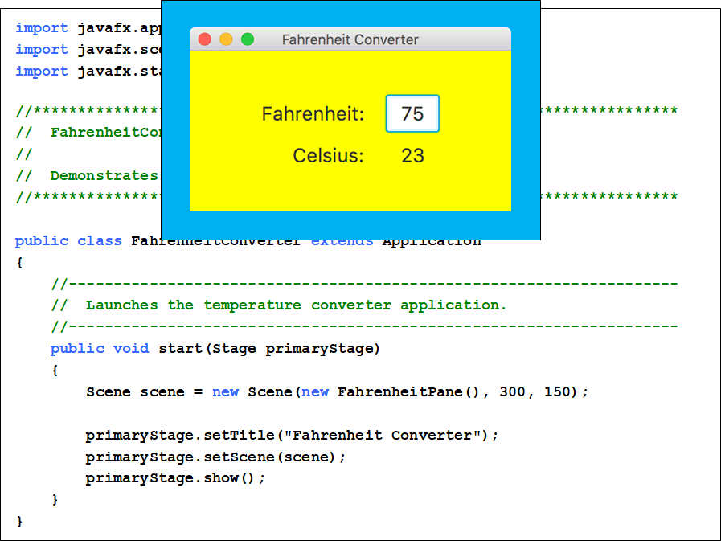
Listing 4.8 (2 of 2)

Slide 102
Text Fields (2 of 3)
The details of the user interface are set up in a separate class that extends GridPane
GridPane is a JavaFX layout pane that displays nodes in a rectangular grid
The G U I elements are set up in the constructor of FahrenheitPane
The event handler method is also defined in FahrenheitPane

Slide 103
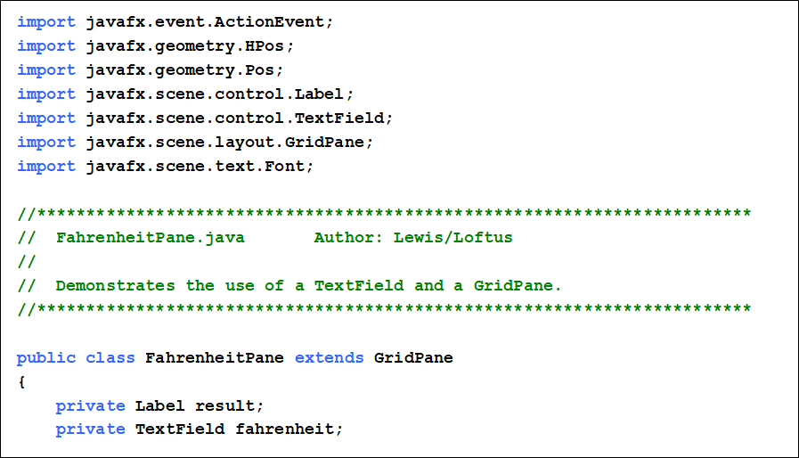
Listing 4.9 (1 of 4)

Slide 104
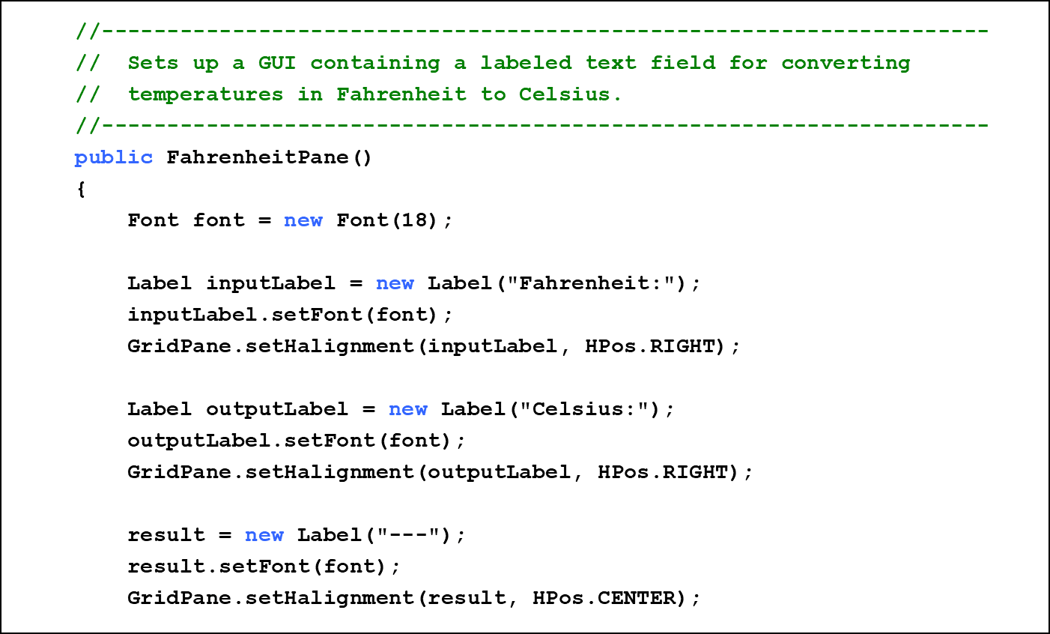
Listing 4.9 (2 of 4)

Slide 105
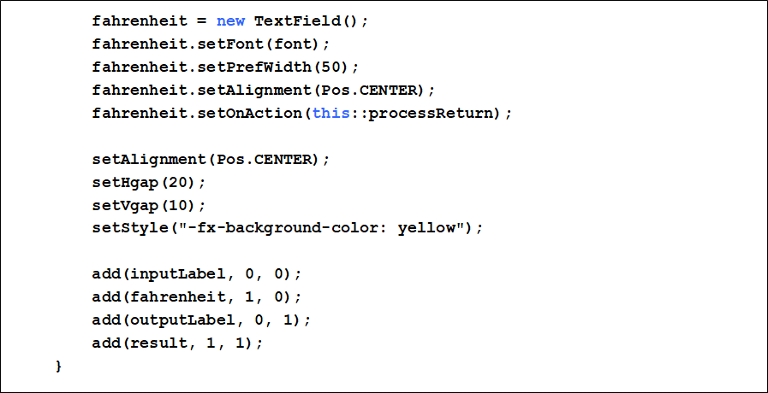
Listing 4.9 (3 of 4)

Slide 106
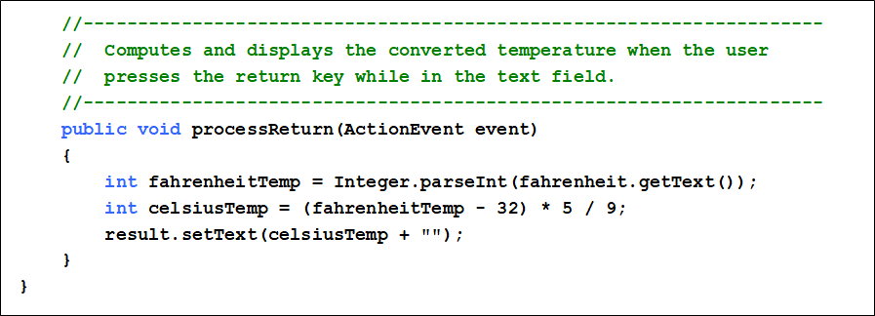
Listing 4.9 (4 of 4)

Slide 107
Text Fields (3 of 3)
Through inheritance, a FahrenheitPane is a GridPane and inherits the add method
The parameters to add specify the grid cell to which to add the node
Row and column numbering in a grid pane start at 0
When the user presses return, the event handler method is called, which converts the value and updates the text result

Slide 108
Summary
Chapter 4 focused on:
class definitions
instance data
encapsulation and Java modifiers
method declaration and parameter passing
constructors
arcs and images
events and event handlers
buttons and text fields

Slide 109

Copyright
This work is protected by United States copyright laws and is provided solely for the use of instructors in teaching their courses and assessing student learning. Dissemination or sale of any part of this work (including on the World Wide Web) will destroy the integrity of the work and is not permitted. The work and materials from it should never be made available to students except by instructors using the accompanying text in their classes. All recipients of this work are expected to abide by these restrictions and to honor the intended pedagogical purposes and the needs of other instructors who rely on these materials.

