Slide 1
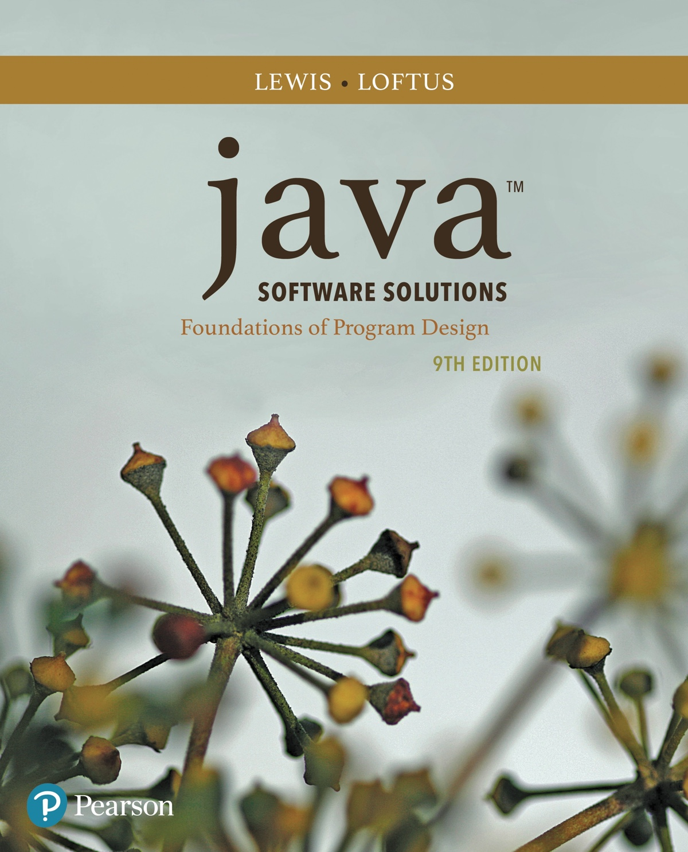
Java™ Software Solutions: Foundations of Program Design
Ninth Edition
Chapter 3
Using Classes and Objects
Copyright © 2018 Pearson Education, Inc. All Rights Reserved
Notes:
If this PowerPoint presentation contains mathematical equations, you may need to check that your computer has the following installed:
1) MathType Plugin
2) Math Player (free versions available)
3) NVDA Reader (free versions available)

Slide 2
Using Classes and Objects
We can create more interesting programs using predefined classes and related objects
Chapter 3 focuses on:
object creation and object references
the String class and its methods
the Java A P I class library
the Random and Math classes
formatting output
enumerated types
wrapper classes
JavaFX graphics A P I
shape classes

Slide 3
Outline (1 of 8)
Creating Objects
The String Class
The Random and Math Classes
Formatting Output
Enumerated Types
Wrapper Classes
Introduction to JavaFX
Shapes and Color

Slide 4
Creating Objects (1 of 2)
A variable holds either a primitive value or a reference to an object
A class name can be used as a type to declare an object reference variable
No object is created with this declaration
An object reference variable holds the address of an object
The object itself must be created separately

Slide 5
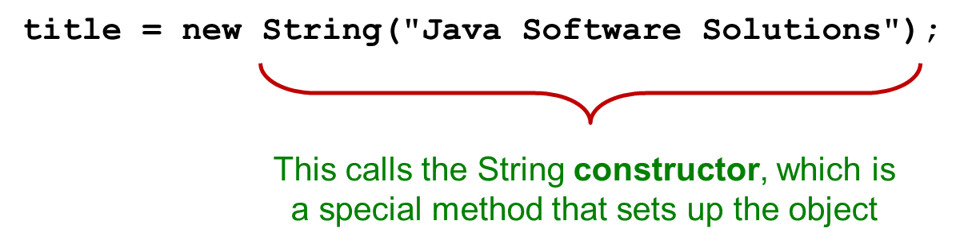
Creating Objects (2 of 2)
Generally, we use the new operator to create an object
Creating an object is called instantiation
An object is an instance of a particular class

Slide 6
Invoking Methods
We’ve seen that once an object has been instantiated, we can use the dot operator to invoke its methods
A method may return a value, which can be used in an assignment or expression
A method invocation can be thought of as asking an object to perform a service

Slide 7
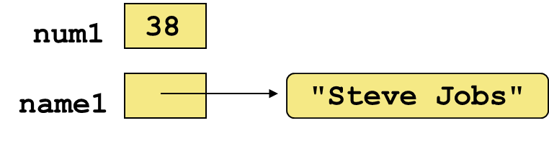
References
Note that a primitive variable contains the value itself, but an object variable contains the address of the object
An object reference can be thought of as a pointer to the location of the object
Rather than dealing with arbitrary addresses, we often depict a reference graphically

Slide 8
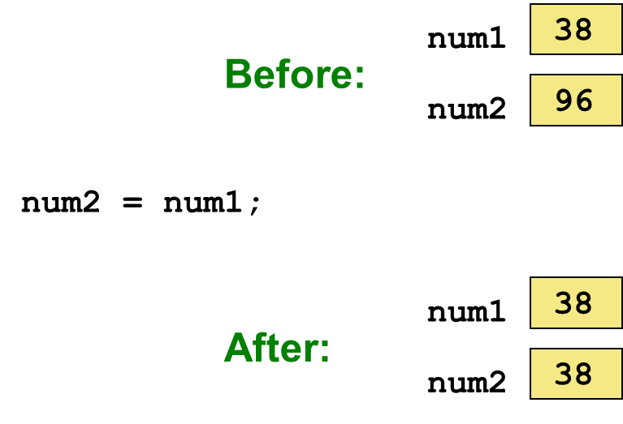
Assignment Revisited
The act of assignment takes a copy of a value and stores it in a variable
For primitive types:

Slide 9
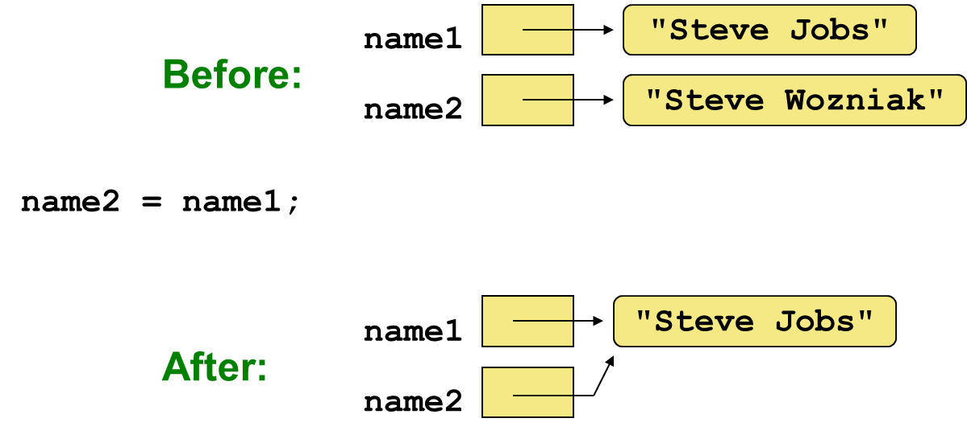
Reference Assignment
For object references, assignment copies the address:

Slide 10
Aliases
Two or more references that refer to the same object are called aliases of each other
That creates an interesting situation: one object can be accessed using multiple reference variables
Aliases can be useful, but should be managed carefully
Changing an object through one reference changes it for all of its aliases, because there is really only one object

Slide 11
Garbage Collection
When an object no longer has any valid references to it, it can no longer be accessed by the program
The object is useless, and therefore is called garbage
Java performs automatic garbage collection periodically, returning an object's memory to the system for future use
In other languages, the programmer is responsible for performing garbage collection

Slide 12
Outline (2 of 8)
Creating Objects
The String Class
The Random and Math Classes
Formatting Output
Enumerated Types
Wrapper Classes
Introduction to JavaFX
Shapes and Color

Slide 13
The String Class
Because strings are so common, we don’t have to use the new operator to create a String object
This is special syntax that works only for strings
Each string literal (enclosed in double quotes) represents a String object

Slide 14
String Methods
Once a String object has been created, neither its value nor its length can be changed
Therefore we say that an object of the String class is immutable
However, several methods of the String class return new String objects that are modified versions of the original

Slide 15
String Indexes
It is occasionally helpful to refer to a particular character within a string
This can be done by specifying the character's numeric index
The indexes begin at zero in each string
In the string "Hello", the character 'H' is at index 0 and the 'o' is at index 4
See StringMutation.java

Slide 16
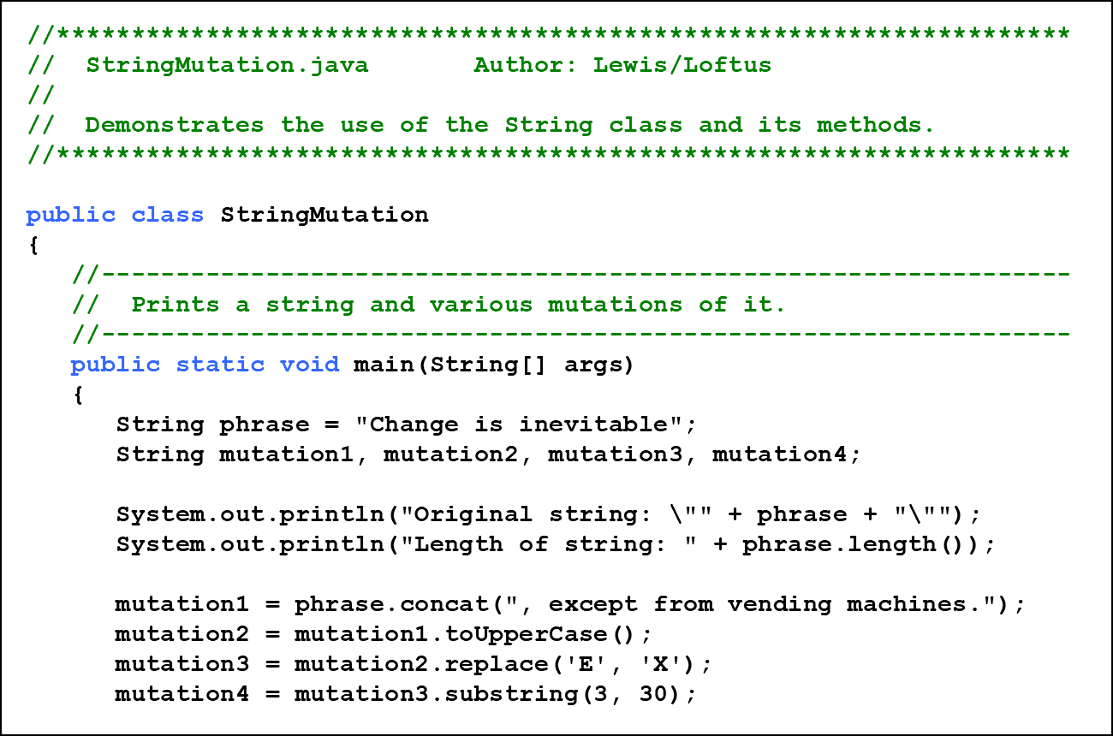
Listing 3.1 (1 of 3)

Slide 17
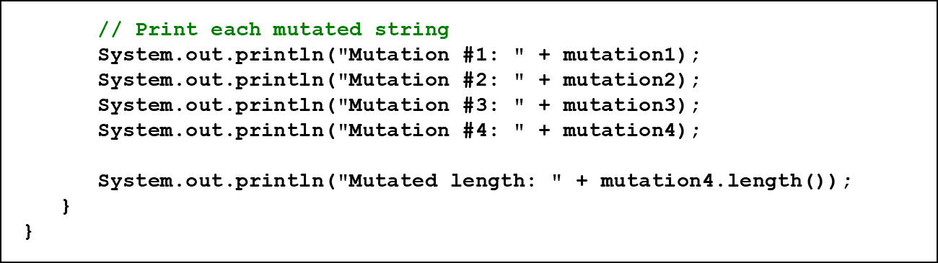
Listing 3.1 (2 of 3)

Slide 18
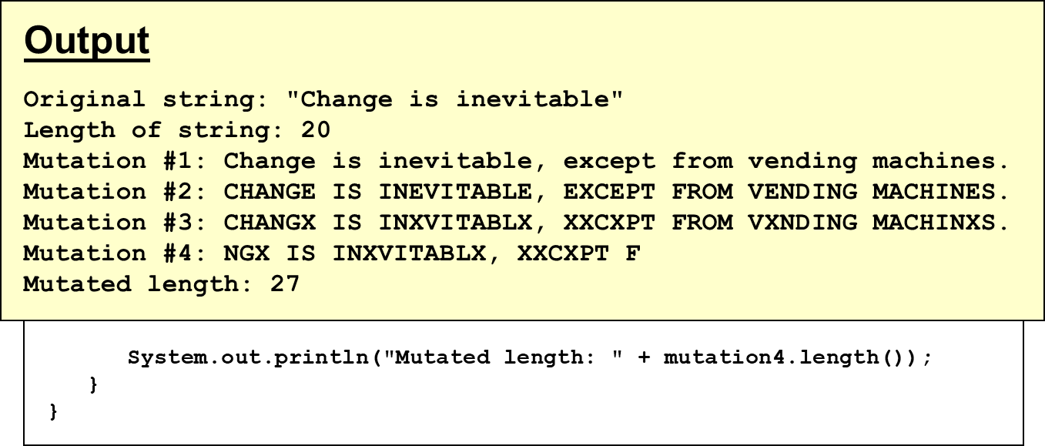
Listing 3.1 (3 of 3)

Slide 19
Quick Check 1 (1 of 2)
What output is produced by the following?

Slide 20
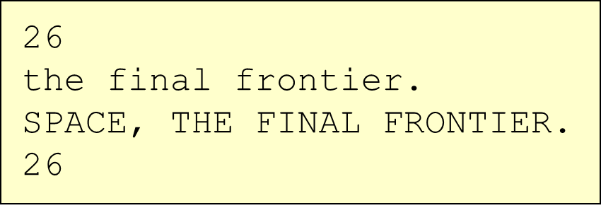
Quick Check 1 (2 of 2)
What output is produced by the following?

Slide 21
Outline (3 of 8)
Creating Objects
The String Class
The Random and Math Classes
Formatting Output
Enumerated Types
Wrapper Classes
Introduction to JavaFX
Shapes and Color

Slide 22
Class Libraries
A class library is a collection of classes that we can use when developing programs
The Java standard class library is part of any Java development environment
Its classes are not part of the Java language per se, but we rely on them heavily
Various classes we’ve already used (System, Scanner, String) are part of the Java standard class library

Slide 23
The Java A P I (1 of 2)
The Java class library is sometimes referred to as the Java A P I
A P I stands for Application Programming Interface
Clusters of related classes are sometimes referred to as specific A P Is:
The JavaFX A P I
The Database A P I

Slide 24
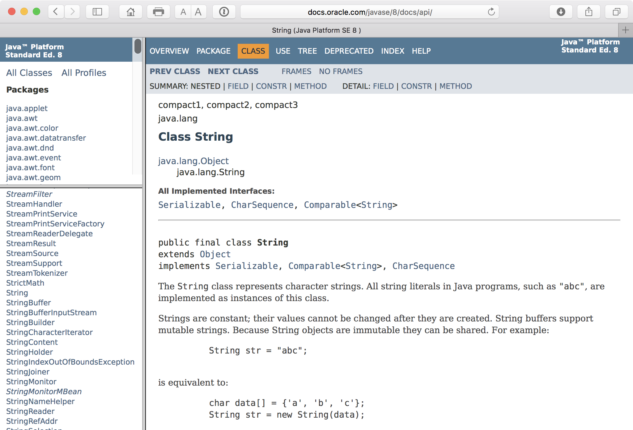
The Java A P I (2 of 2)
Get comfortable using the online Java A P I documentation

Slide 25
Packages
For purposes of accessing them, classes in the Java A P I are organized into packages
These often overlap with specific A P Is
Examples:
Package | Purpose
java.lang | General support
java.util | Utilities
java.net | Network communication
javafx.scene.shape | Graphical shapes
javafx.scene.control | G U I controls

Slide 26
The Import Declaration (1 of 2)
When you want to use a class from a package, you could use its fully qualified name
Or you can import the class, and then use just the class name
To import all classes in a particular package, you can use the * wildcard character

Slide 27
The Import Declaration (2 of 2)
All classes of the java.lang package are imported automatically into all programs
It’s as if all programs contain the following line:
That’s why we didn’t have to import the System or String classes explicitly in earlier programs
The Scanner class, on the other hand, is part of the java.util package, and therefore must be imported

Slide 28
The Random Class
The Random class is part of the java.util package
It provides methods that generate pseudorandom numbers
A Random object performs complicated calculations based on a seed value to produce a stream of seemingly random values
See RandomNumbers.java

Slide 29
Listing 3.2 (1 of 3)

Slide 30
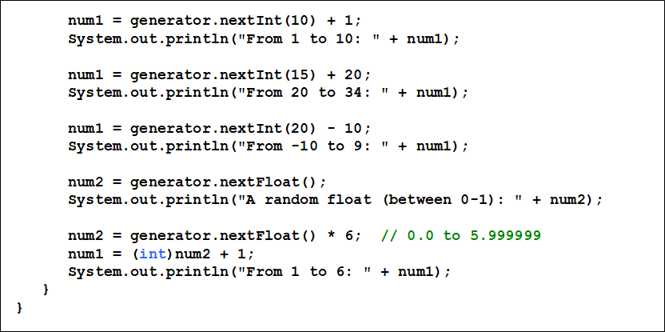
Listing 3.2 (2 of 3)

Slide 31
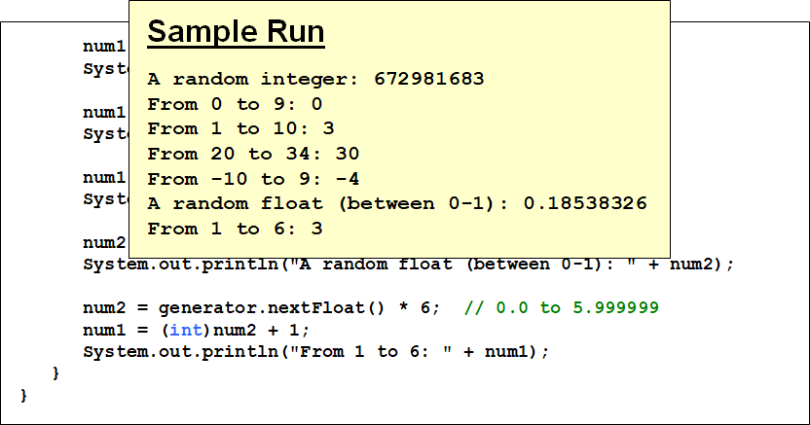
Listing 3.2 (3 of 3)

Slide 32
Quick Check 2 (1 of 4)
Given a Random object named gen, what range of values are produced by the following expressions?

Slide 33
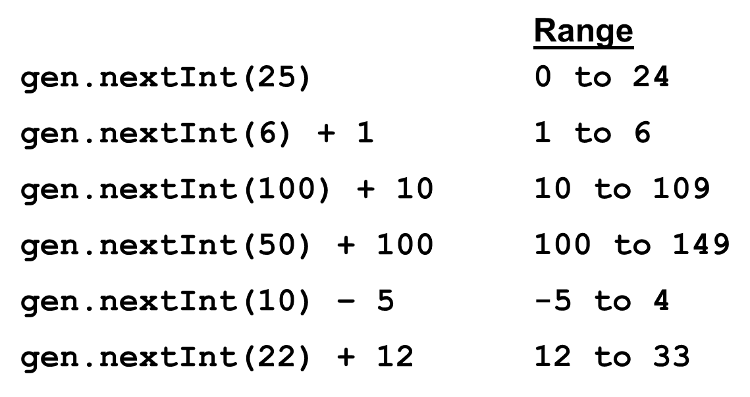
Quick Check 2 (2 of 4)
Given a Random object named gen, what range of values are produced by the following expressions?

Slide 34
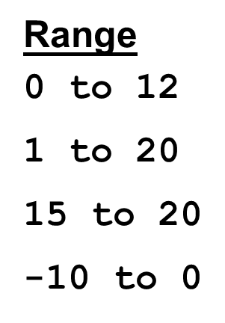
Quick Check 2 (3 of 4)
Write an expression that produces a random integer in the following ranges:

Slide 35
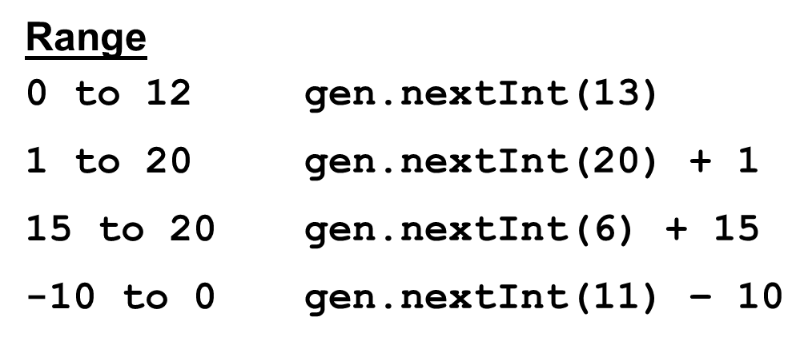
Quick Check 2 (4 of 4)
Write an expression that produces a random integer in the following ranges:

Slide 36
The Math Class (1 of 2)
The Math class is part of the java.lang package
The Math class contains methods that perform various mathematical functions
These include:
absolute value
square root
exponentiation
trigonometric functions

Slide 37
The Math Class (2 of 2)
The methods of the Math class are static methods (also called class methods)
Static methods are invoked through the class name - no object of the Math class is needed
We discuss static methods further in Chapter 7
See Quadratic.java

Slide 38
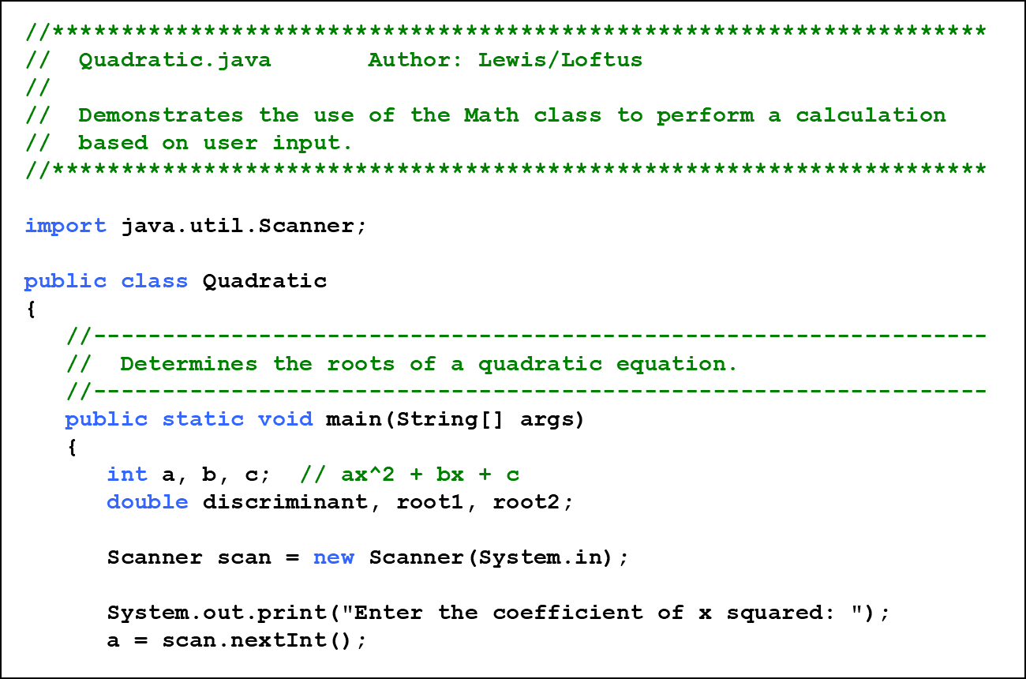
Listing 3.3 (1 of 3)

Slide 39
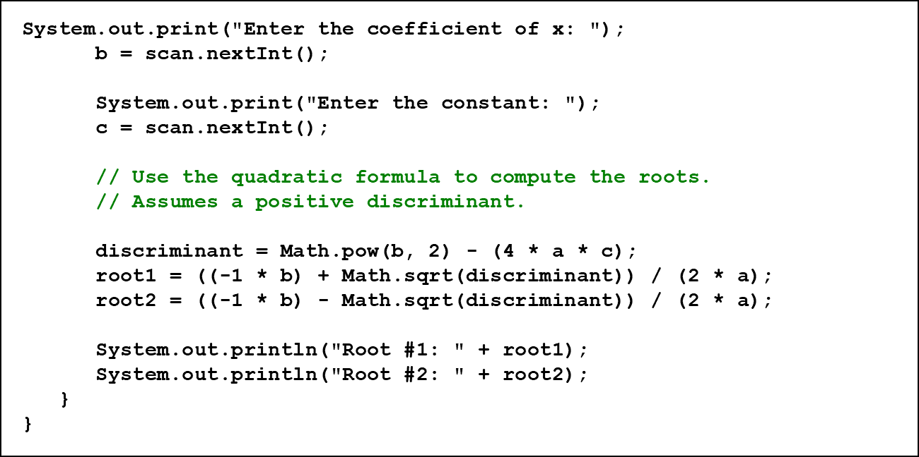
Listing 3.3 (2 of 3)

Slide 40
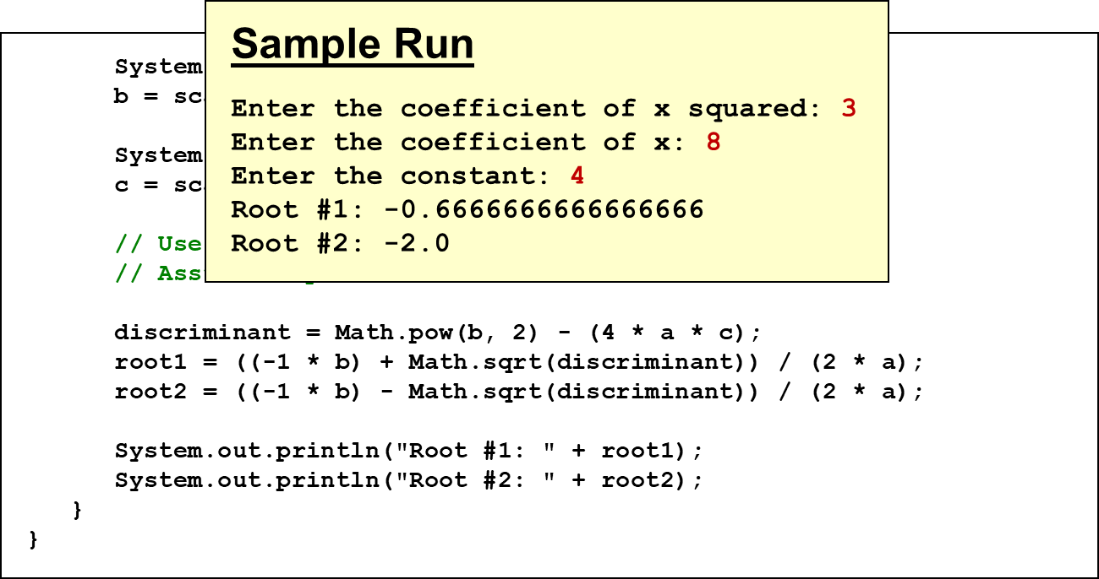
Listing 3.3 (3 of 3)

Slide 41
Outline (4 of 8)
Creating Objects
The String Class
The Random and Math Classes
Formatting Output
Enumerated Types
Wrapper Classes
Introduction to JavaFX
Shapes and Color

Slide 42
Formatting Output (1 of 3)
It is often necessary to format output values in certain ways so that they can be presented properly
The Java standard class library contains classes that provide formatting capabilities
The NumberFormat class allows you to format values as currency or percentages
The DecimalFormat class allows you to format values based on a pattern
Both are part of the java.text package

Slide 43
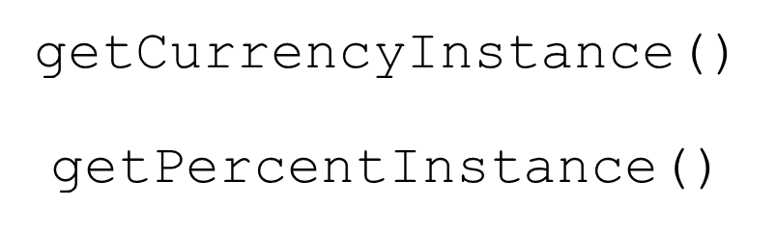
Formatting Output (2 of 3)
The NumberFormat class has static methods that return a formatter object
Each formatter object has a method called format that returns a string with the specified information in the appropriate format
See Purchase.java

Slide 44
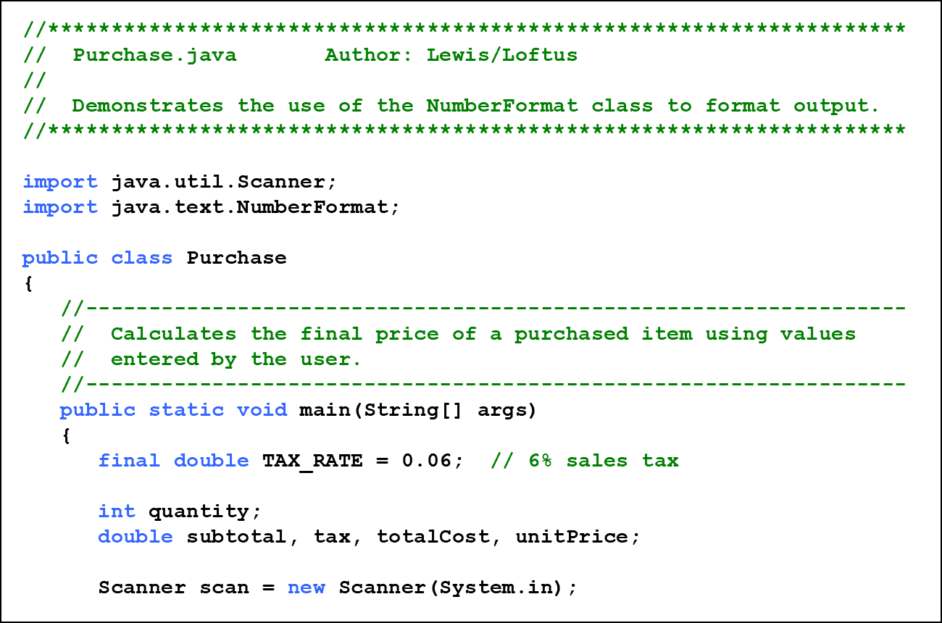
Listing 3.4 (1 of 3)

Slide 45
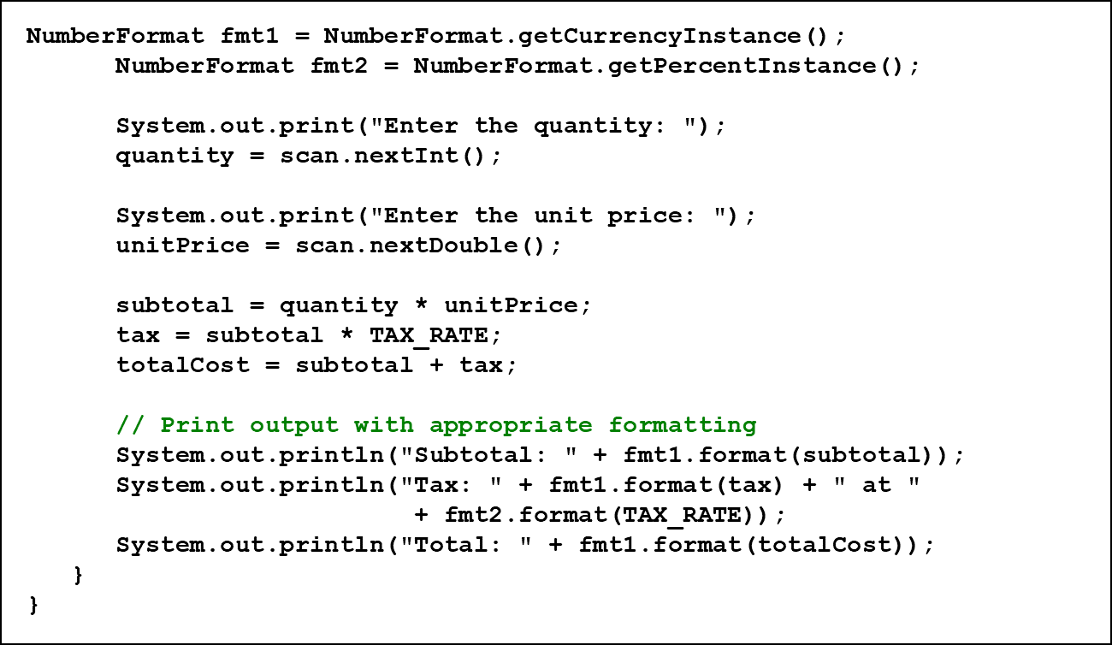
Listing 3.4 (2 of 3)

Slide 46
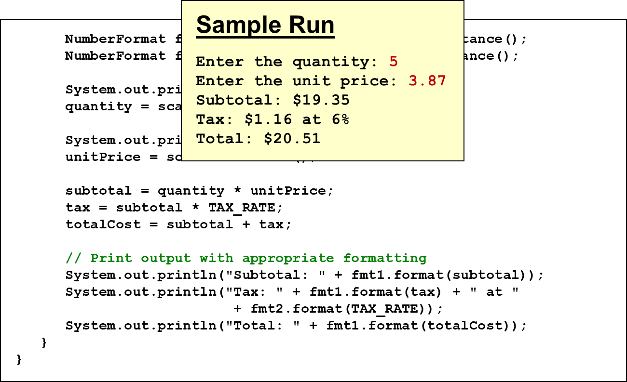
Listing 3.4 (3 of 3)

Slide 47
Formatting Output (3 of 3)
The DecimalFormat class can be used to format a floating point value in various ways
For example, you can specify that the number should be truncated to three decimal places
The constructor of the DecimalFormat class takes a string that represents a pattern for the formatted number
See CircleStats.java

Slide 48
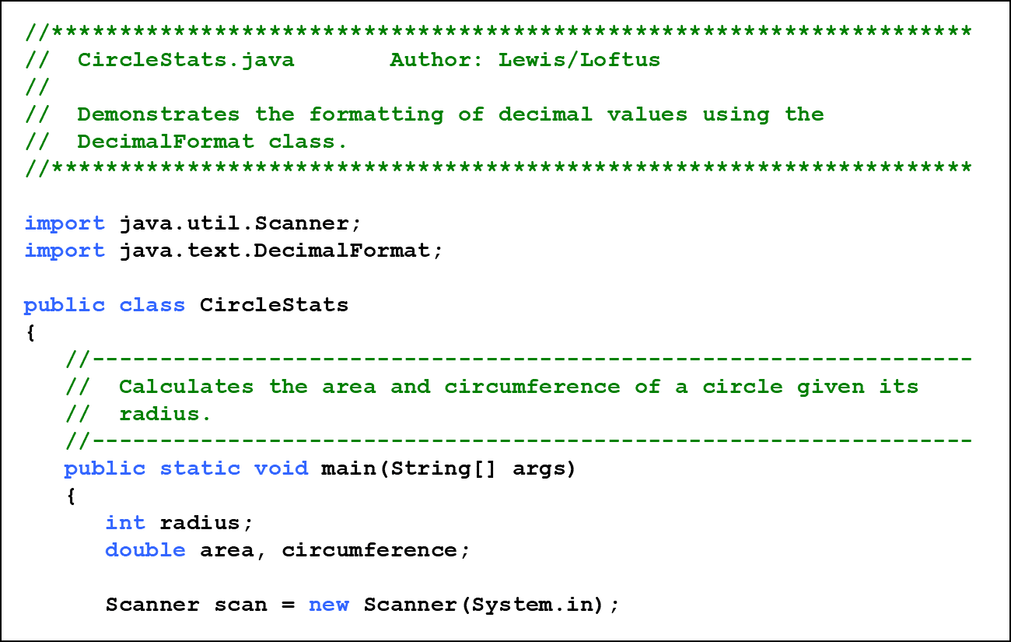
Listing 3.5 (1 of 3)

Slide 49
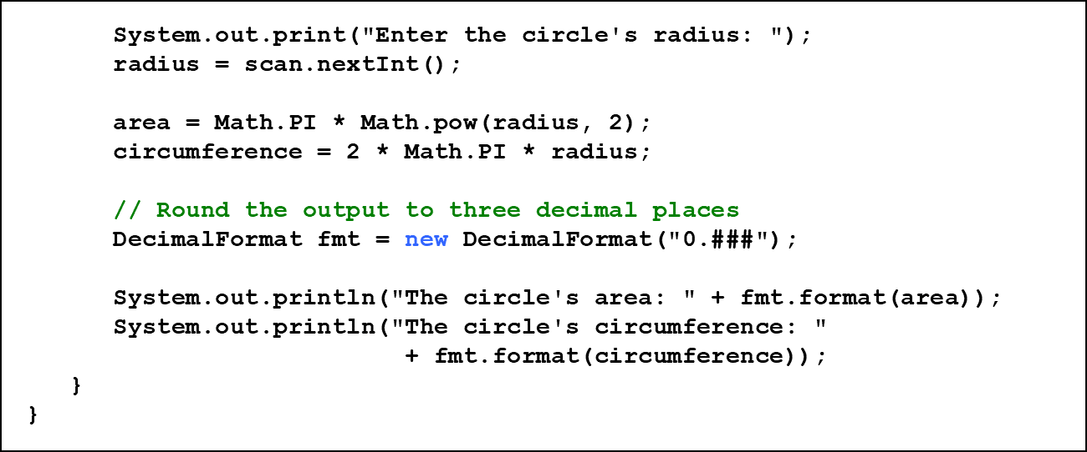
Listing 3.5 (2 of 3)

Slide 50
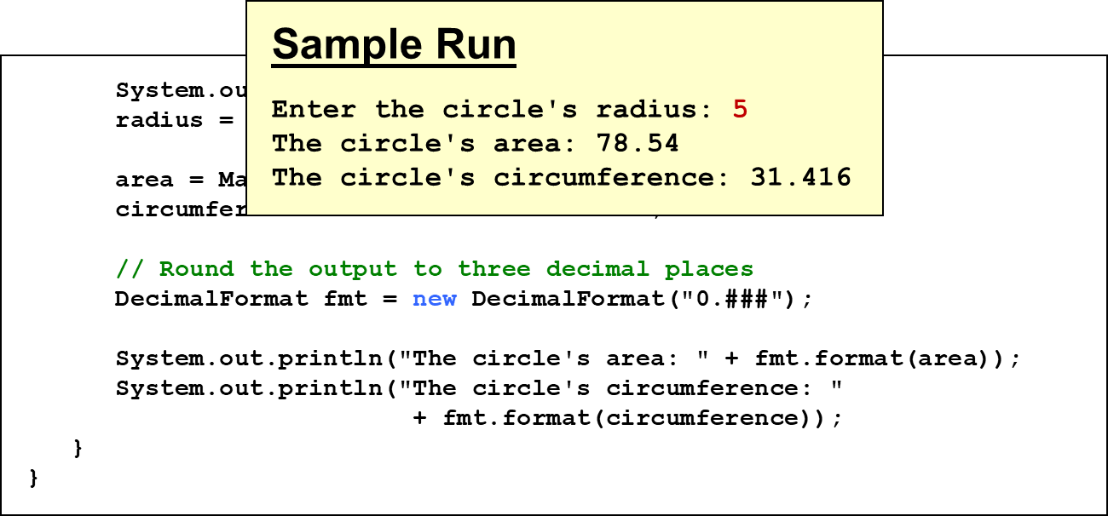
Listing 3.5 (3 of 3)

Slide 51
Outline (5 of 8)
Creating Objects
The String Class
The Random and Math Classes
Formatting Output
Enumerated Types
Wrapper Classes
Introduction to JavaFX
Shapes and Color

Slide 52
Enumerated Types (1 of 3)
Java allows you to define an enumerated type, which can then be used to declare variables
An enumerated type declaration lists all possible values for a variable of that type
The values are identifiers of your own choosing
The following declaration creates an enumerated type called Season
Any number of values can be listed

Slide 53
Enumerated Types (2 of 3)
Once a type is defined, a variable of that type can be declared:
And it can be assigned a value:
The values are referenced through the name of the type
Enumerated types are type-safe - you cannot assign any value other than those listed

Slide 54
Ordinal Values
Internally, each value of an enumerated type is stored as an integer, called its ordinal value
The first value in an enumerated type has an ordinal value of zero, the second one, and so on
However, you cannot assign a numeric value to an enumerated type, even if it corresponds to a valid ordinal value

Slide 55
Enumerated Types (3 of 3)
The declaration of an enumerated type is a special type of class, and each variable of that type is an object
The ordinal method returns the ordinal value of the object
The name method returns the name of the identifier corresponding to the object's value
See IceCream.java

Slide 56
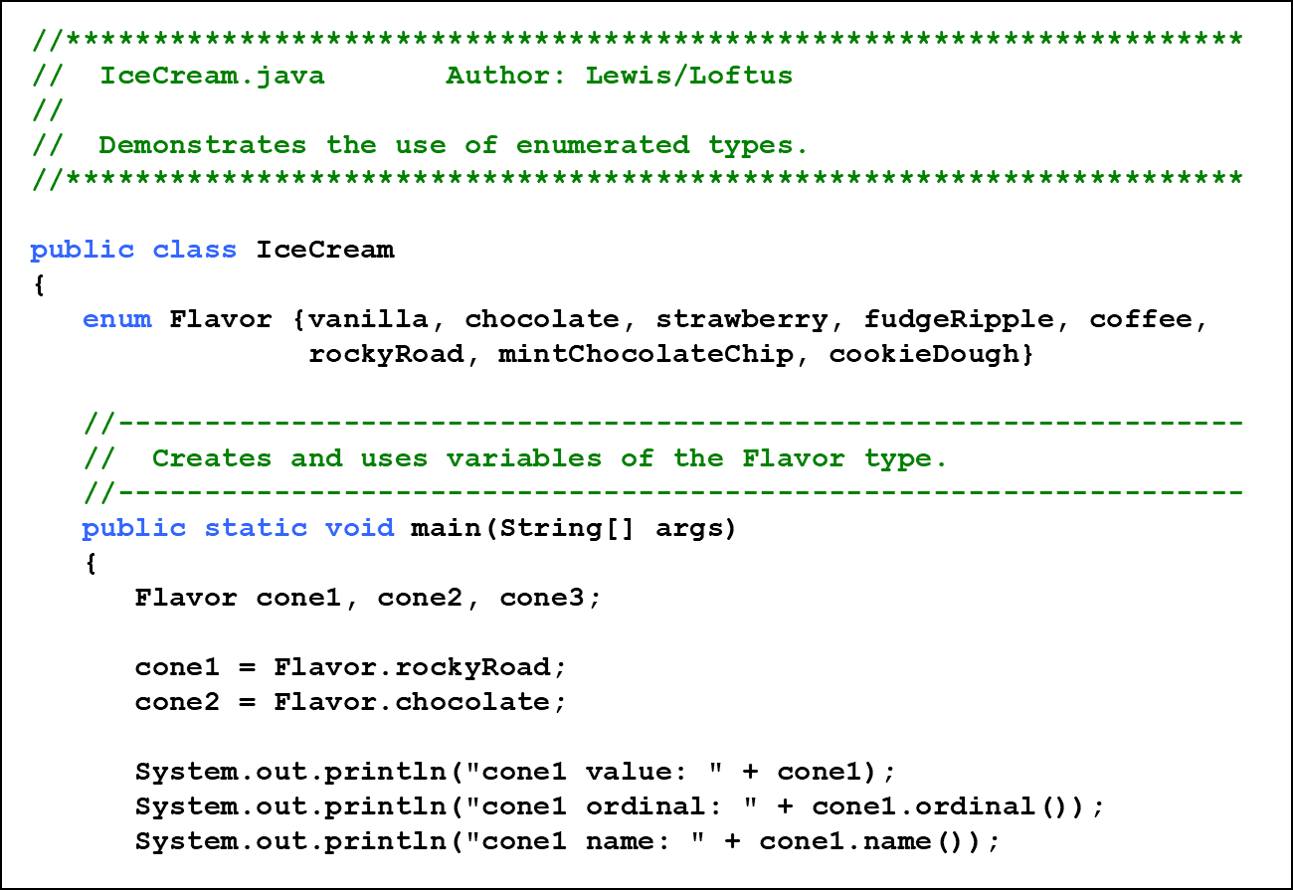
Listing 3.6 (1 of 3)

Slide 57
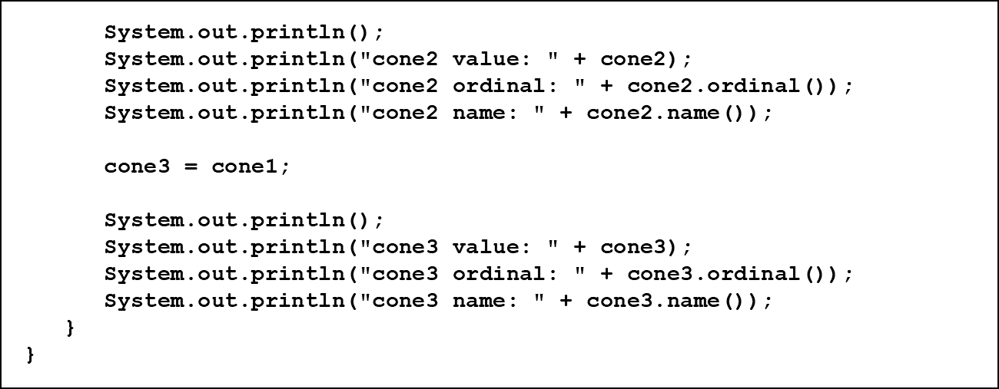
Listing 3.6 (2 of 3)

Slide 58
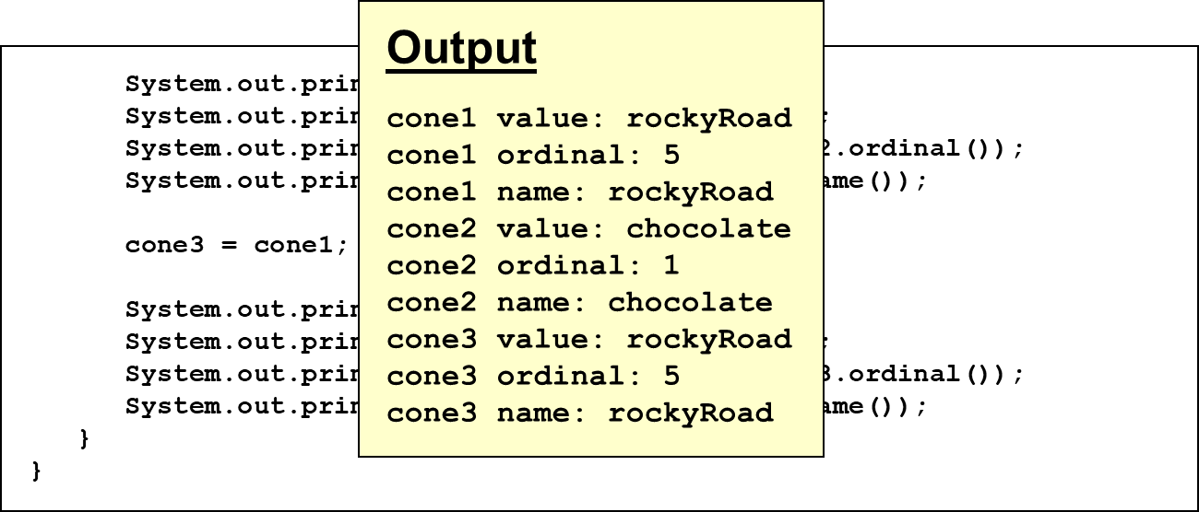
Listing 3.6 (3 of 3)

Slide 59
Outline (6 of 8)
Creating Objects
The String Class
The Random and Math Classes
Formatting Output
Enumerated Types
Wrapper Classes
Introduction to JavaFX
Shapes and Color

Slide 60
Wrapper Classes (1 of 3)
The java.lang package contains wrapper classes that correspond to each primitive type:
Primitive Type | Wrapper Class
byte | Byte
short | Short
int | Integer
long | Long
float | Float
double | Double
char | Character
boolean | Boolean

Slide 61
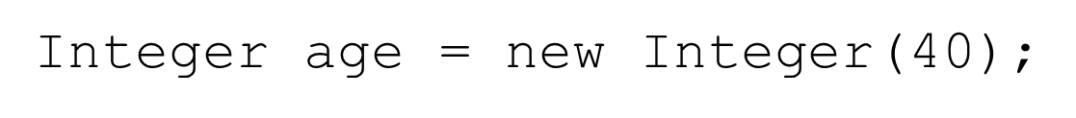
Wrapper Classes (2 of 3)
The following declaration creates an Integer object which represents the integer 40 as an object
An object of a wrapper class can be used in any situation where a primitive value will not suffice
For example, some objects serve as containers of other objects
Primitive values could not be stored in such containers, but wrapper objects could be

Slide 62
Wrapper Classes (3 of 3)
Wrapper classes also contain static methods that help manage the associated type
For example, the Integer class contains a method to convert an integer stored in a String to an int value:
They often contain useful constants as well
For example, the Integer class contains MIN_VALUE and MAX_VALUE which hold the smallest and largest int values

Slide 63
Autoboxing
Autoboxing is the automatic conversion of a primitive value to a corresponding wrapper object:
The assignment creates the appropriate Integer object
The reverse conversion (called unboxing) also occurs automatically as needed

Slide 64
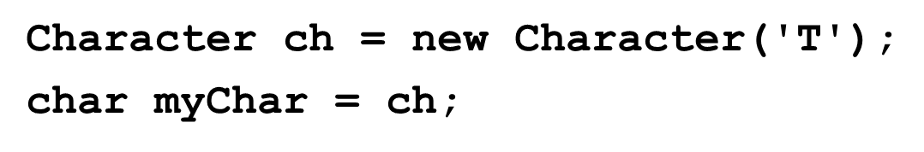
Quick Check 3 (1 of 2)
Are the following assignments valid? Explain.

Slide 65
Quick Check 3 (2 of 2)
Are the following assignments valid? Explain.
Yes. The double literal is autoboxed into a Double object.
Yes, the char in the object is unboxed before the assignment.

Slide 66
Outline (7 of 8)
Creating Objects
The String Class
The Random and Math Classes
Formatting Output
Enumerated Types
Wrapper Classes
Introduction to JavaFX
Shapes and Color

Slide 67
Intro to JavaFX (1 of 4)
The programs we’ve explored thus far have been text-based
They are called command-line applications, which interact with the user using simple text prompts
We’ll now begin to explore programs that use graphics and graphical user interfaces (G U Is)
Support for these programs will come from the JavaFX A P I
JavaFX has replaced older approaches (A W T and Swing)

Slide 68
Intro to JavaFX (2 of 4)
JavaFX programs extend the Application class, inheriting core graphical functionality
A JavaFX program has a start method
The main method is only needed to launch the JavaFX application
The start method accepts the primary stage (window) used by the program as a parameter
JavaFX embraces a theatre analogy
See HelloJavaFX.java

Slide 69
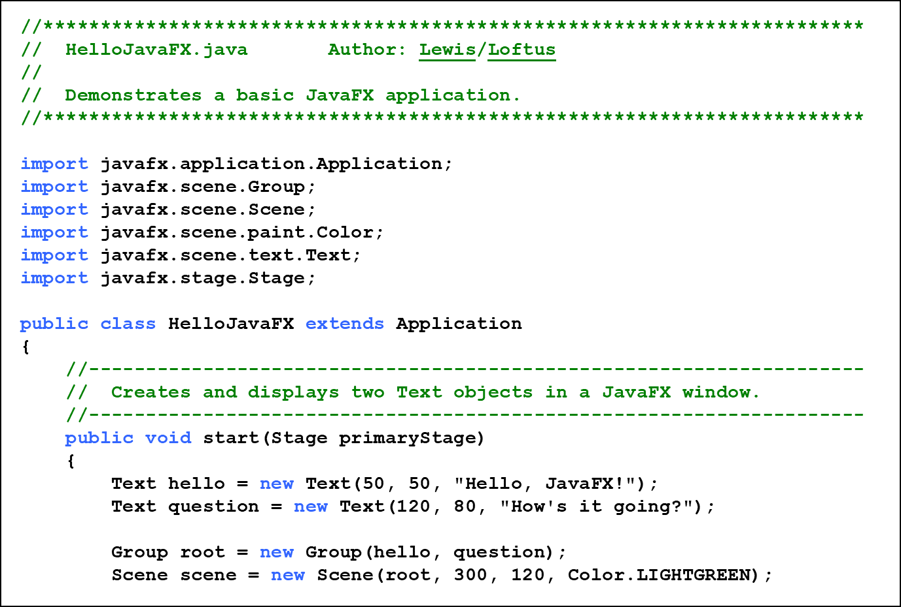
Listing 3.7 (1 of 3)

Slide 70
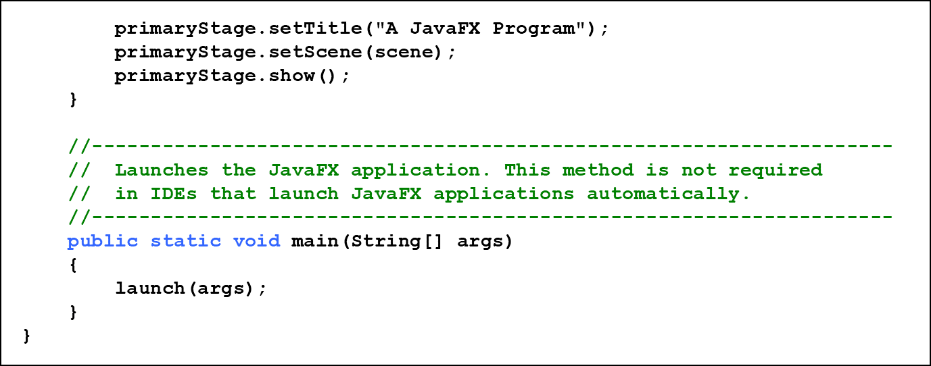
Listing 3.7 (2 of 3)

Slide 71
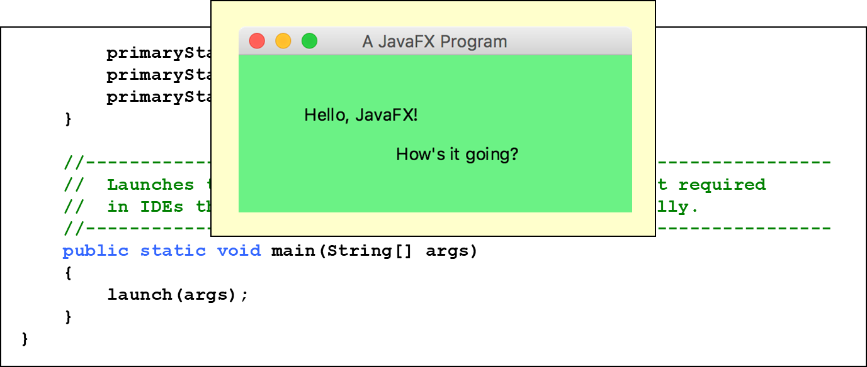
Listing 3.7 (3 of 3)

Slide 72
Intro to JavaFX (3 of 4)
In this example, two Text objects are added to a Group
The group serves as the root node of a Scene
The scene is displayed on the primary Stage (window)
The size and background color of the scene can be set when the Scene object is created
The position of each Text object is specified explicitly (in this case)

Slide 73
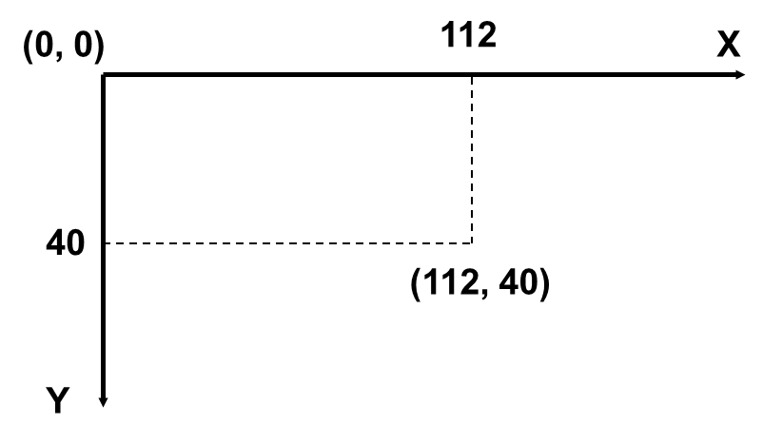
Intro to JavaFX (4 of 4)
The origin of the Java coordinate system is in the upper left corner
All visible points have positive coordinates

Slide 74
Outline (8 of 8)
Creating Objects
The String Class
The Random and Math Classes
Formatting Output
Enumerated Types
Wrapper Classes
Introduction to JavaFX
Shapes and Color

Slide 75
Basic Shapes (1 of 5)
JavaFX shapes are represented by classes in the javafx.scene.shape package
A line segment is defined by the Line class, whose constructor accepts the coordinates of the two endpoints:
For example:

Slide 76
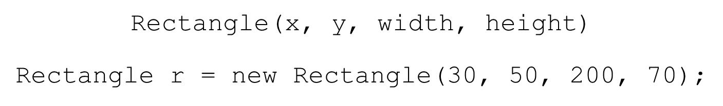
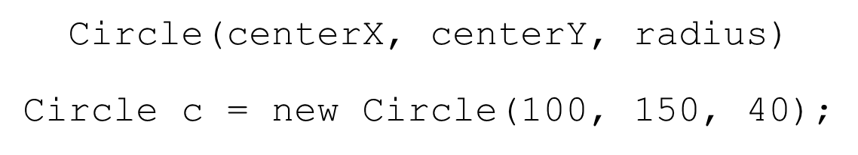
Basic Shapes (2 of 5)
A rectangle is specified by its upper left corner and its width and height:
A circle is specified by its center point and radius:

Slide 77
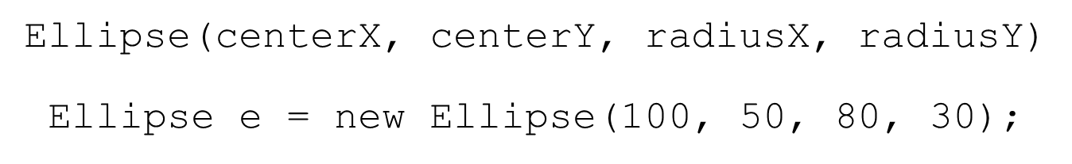
Basic Shapes (3 of 5)
An ellipse is specified by its center point and its radius along the x and y axis:
Shapes are drawn in the order in which they are added to the group
The stroke and fill of each shape can be set
See Einstein.java

Slide 78
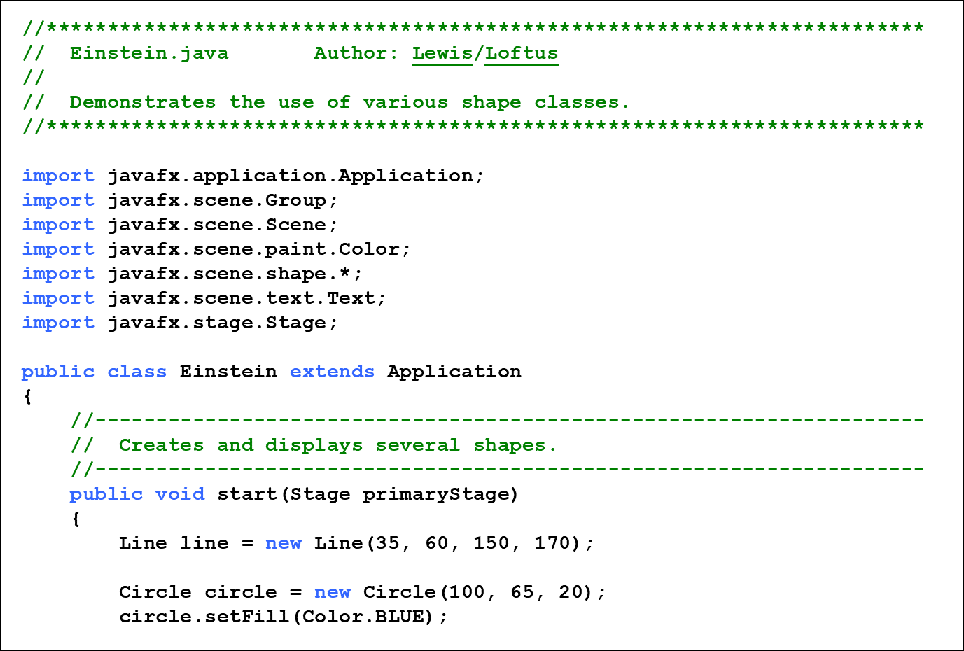
Listing 3.8 (1 of 3)

Slide 79
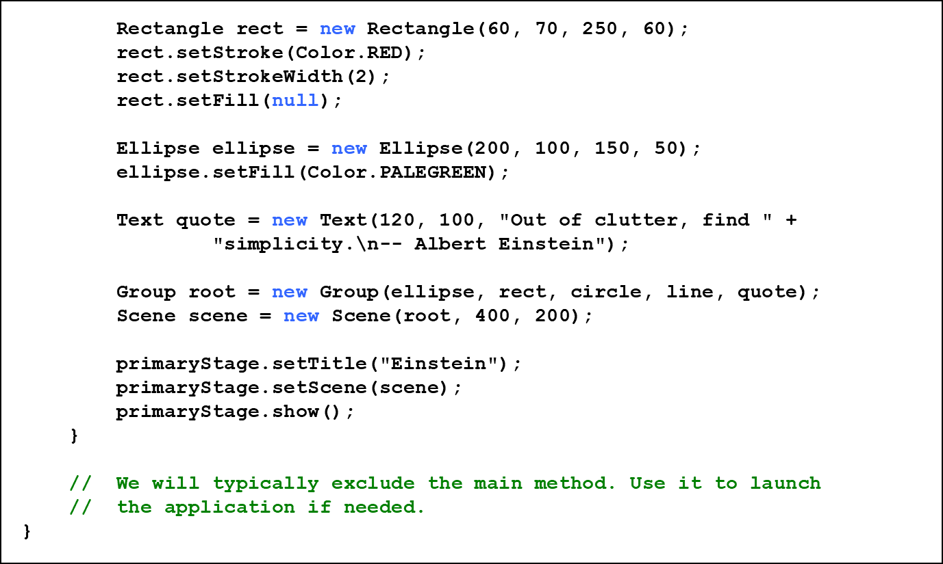
Listing 3.8 (2 of 3)

Slide 80
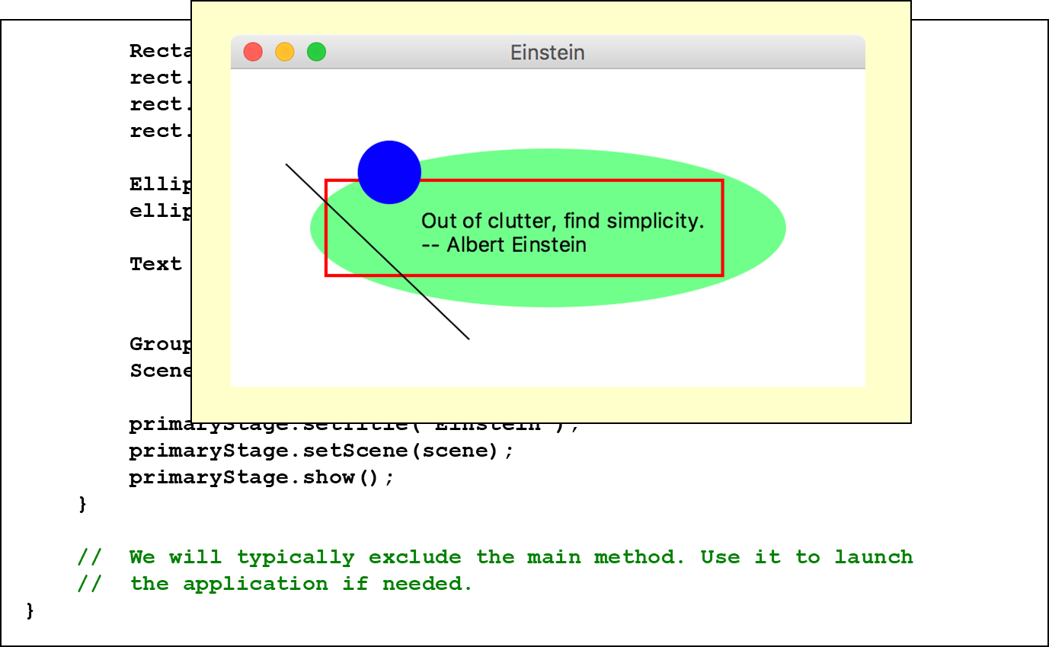
Listing 3.8 (3 of 3)

Slide 81
Basic Shapes (4 of 5)
Groups can be nested within groups
Translating a shape or group shifts its position along the x or y axis
A shape or group can be rotated using the setRotate method
See Snowman.java

Slide 82
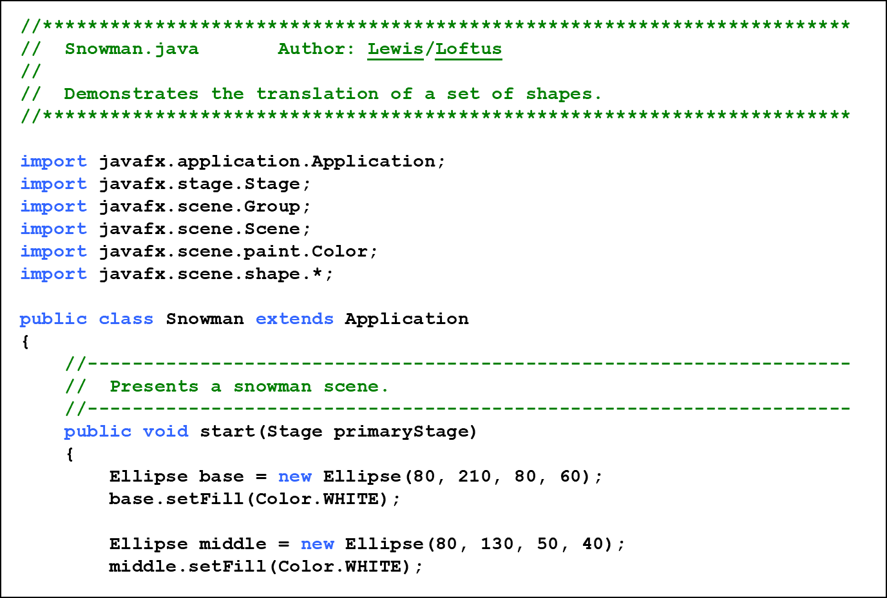
Listing 3.9 (1 of 4)

Slide 83
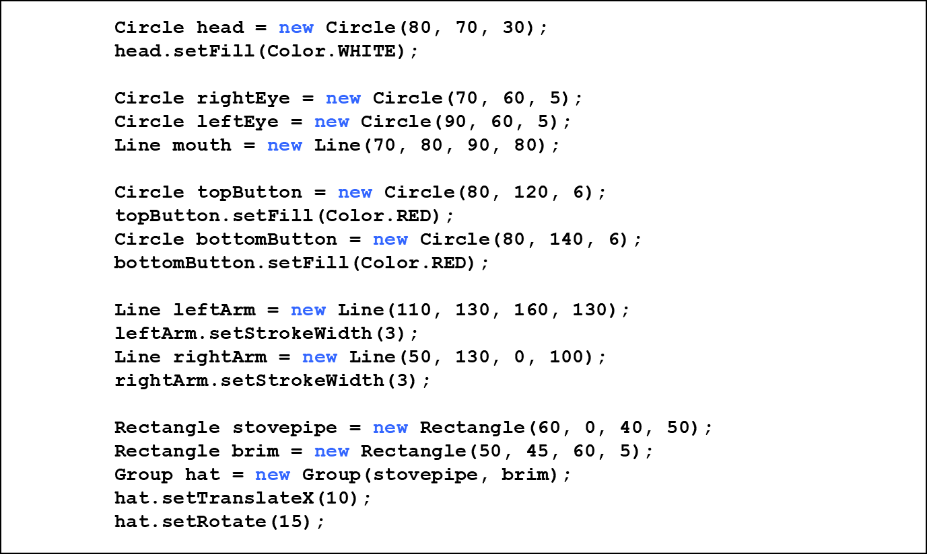
Listing 3.9 (2 of 4)

Slide 84
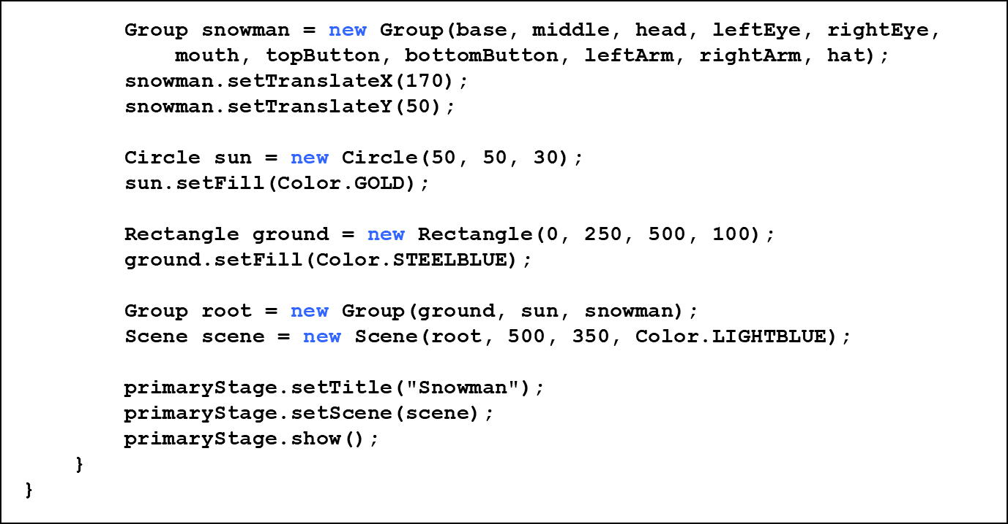
Listing 3.9 (3 of 4)

Slide 85
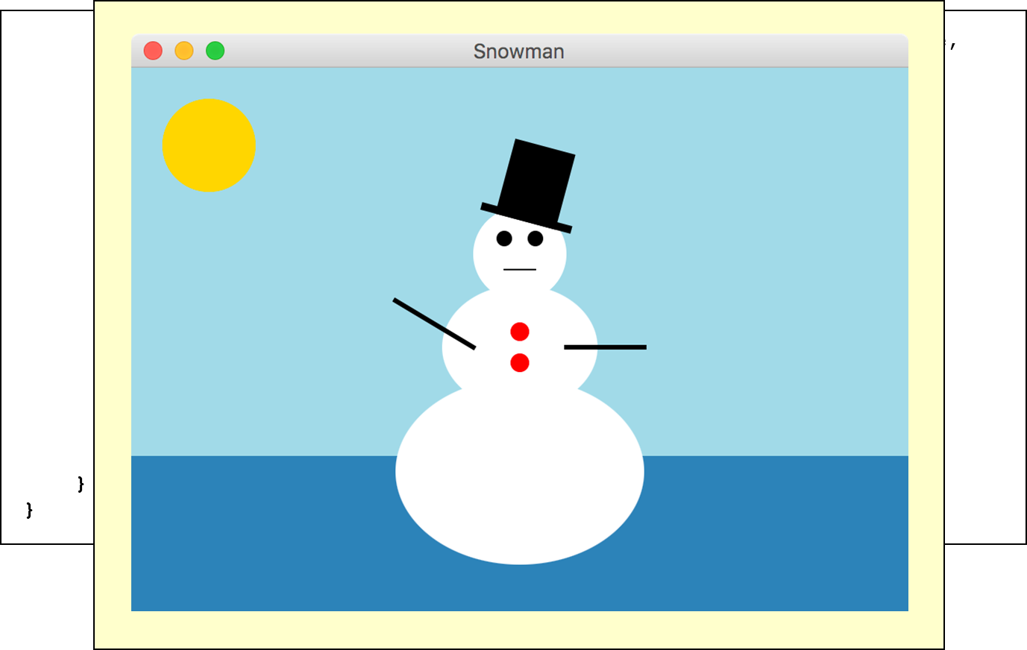
Listing 3.9 (4 of 4)

Slide 86
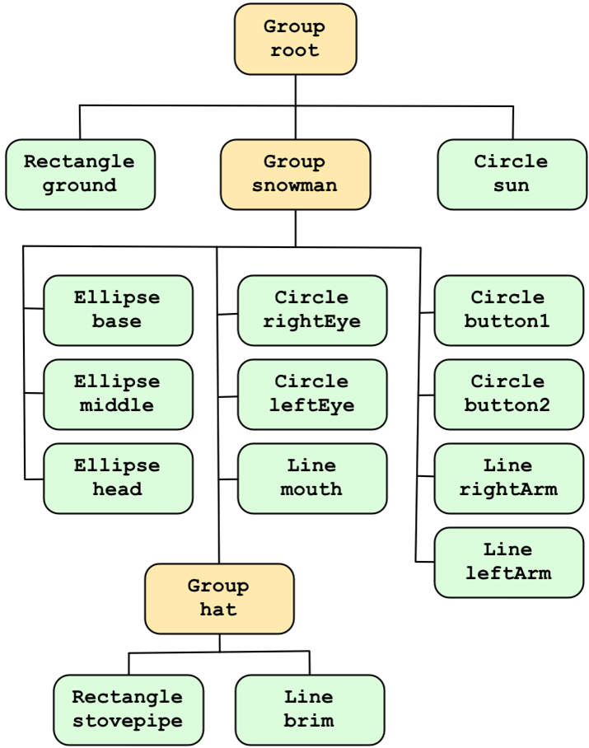
Hierarchy of Snowman Scene Elements

Slide 87
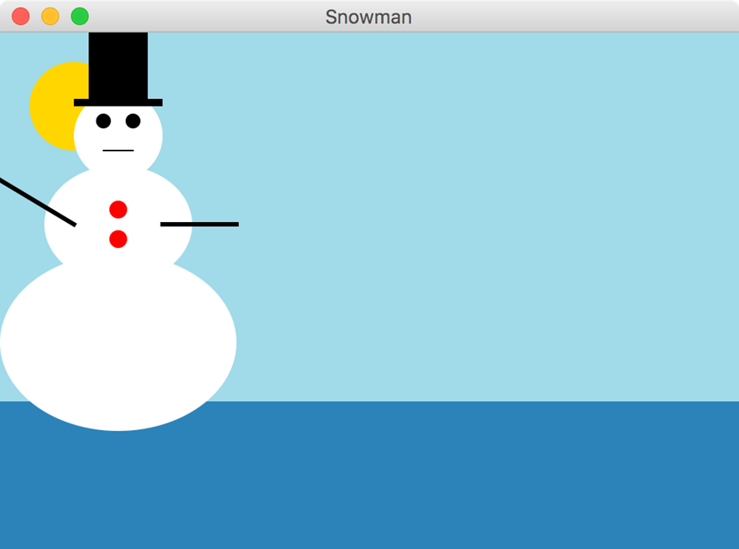
Basic Shapes (5 of 5)
Without translating (shifting) the snowman’s position:

Slide 88
Representing Color (1 of 3)
A color in Java is represented by a Color object
A color object holds three numbers called an R G B value, which stands for Red-Green-Blue
Each number represents the contribution of that color
This is how the human eye works
Each number in an R G B value is in the range 0 to 255

Slide 89
Representing Color (2 of 3)
A color with an R G B value of 255, 255, 0 has a full contribution of red and green, but no blue, which is a shade of yellow
The static r g b method in the Color class returns a Color object with a specific R G B value:
The color method uses percentages:

Slide 90
Representing Color (3 of 3)
For convenience, several Color objects have been predefined, such as:
Color.BLACK | 0, 0, 0
Color.WHITE | 255, 255, 255
Color.CYAN | 0, 255, 255
Color.PINK | 255, 192, 203
Color.GRAY | 128, 128, 128
See the online documentation of the Color class for a full list of predefined colors

Slide 91
Summary
Chapter 3 focused on:
object creation and object references
the String class and its methods
the Java standard class library
the Random and Math classes
formatting output
enumerated types
wrapper classes
JavaFX graphics A P I
shape classes

Slide 92

Copyright
This work is protected by United States copyright laws and is provided solely for the use of instructors in teaching their courses and assessing student learning. Dissemination or sale of any part of this work (including on the World Wide Web) will destroy the integrity of the work and is not permitted. The work and materials from it should never be made available to students except by instructors using the accompanying text in their classes. All recipients of this work are expected to abide by these restrictions and to honor the intended pedagogical purposes and the needs of other instructors who rely on these materials.

