Slide 1
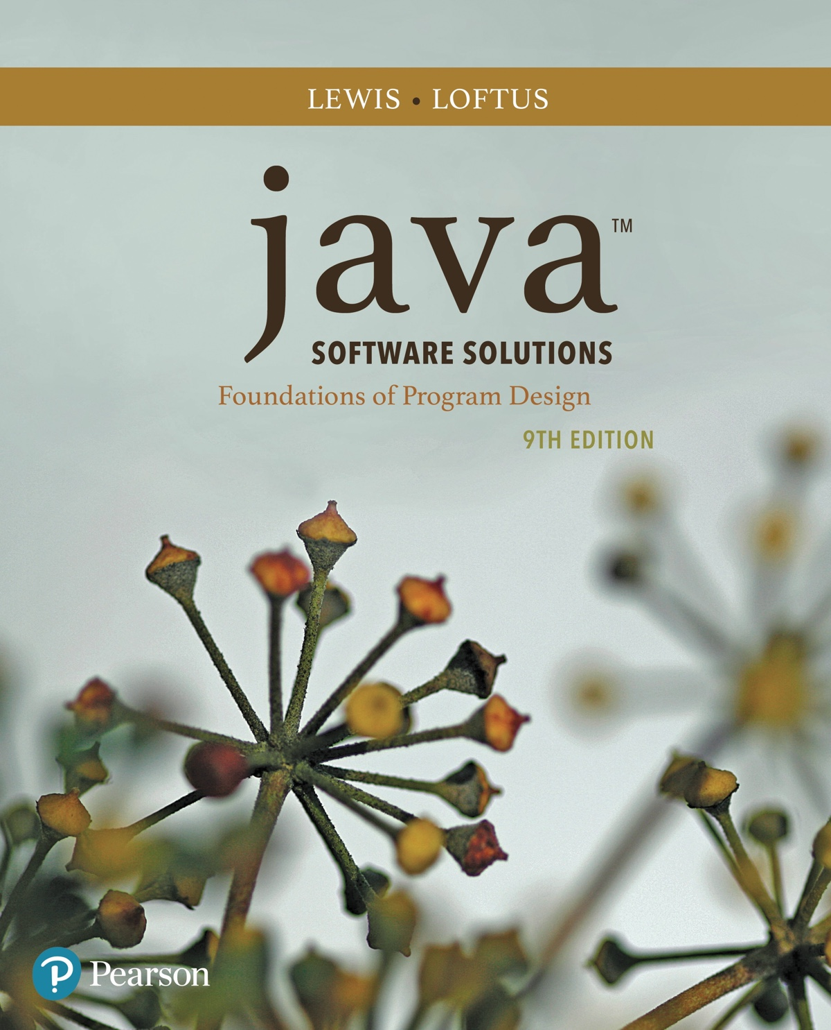
Java™ Software Solutions: Foundations of Program Design
Ninth Edition
Chapter 2
Data and Expressions
Copyright © 2018 Pearson Education, Inc. All Rights Reserved
Notes:
If this PowerPoint presentation contains mathematical equations, you may need to check that your computer has the following installed:
1) MathType Plugin
2) Math Player (free versions available)
3) NVDA Reader (free versions available)

Slide 2
Data and Expressions
Let’s explore some other fundamental programming concepts
Chapter 2 focuses on:
character strings
primitive data
the declaration and use of variables
expressions and operator precedence
data conversions
accepting input from the user

Slide 3
Outline (1 of 6)
Character Strings
Variables and Assignment
Primitive Data Types
Expressions
Data Conversion
Interactive Programs

Slide 4
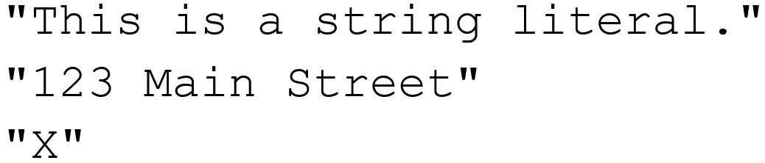
Character Strings
A string literal is represented by putting double quotes around the text
Examples:
Every character string is an object in Java, defined by the String class
Every string literal represents a String object

Slide 5
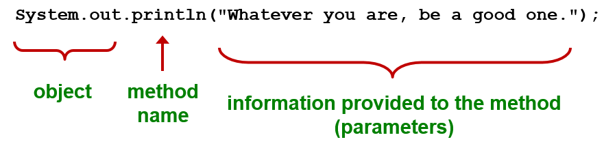
The Println Method
In the Lincoln program from Chapter 1, we invoked the println method to print a character string
The System.out object represents a destination (the monitor screen) to which we can send output

Slide 6
The Print Method
The System.out object provides another service as well
The print method is similar to the println method, except that it does not advance to the next line
Therefore anything printed after a print statement will appear on the same line
See Countdown.java

Slide 7
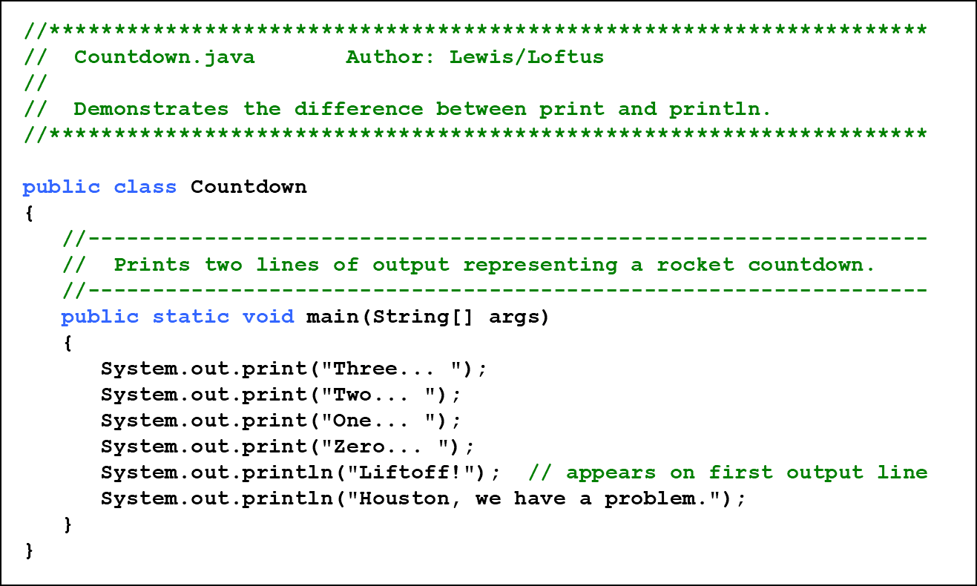
Listing 2.1 (1 of 2)

Slide 8
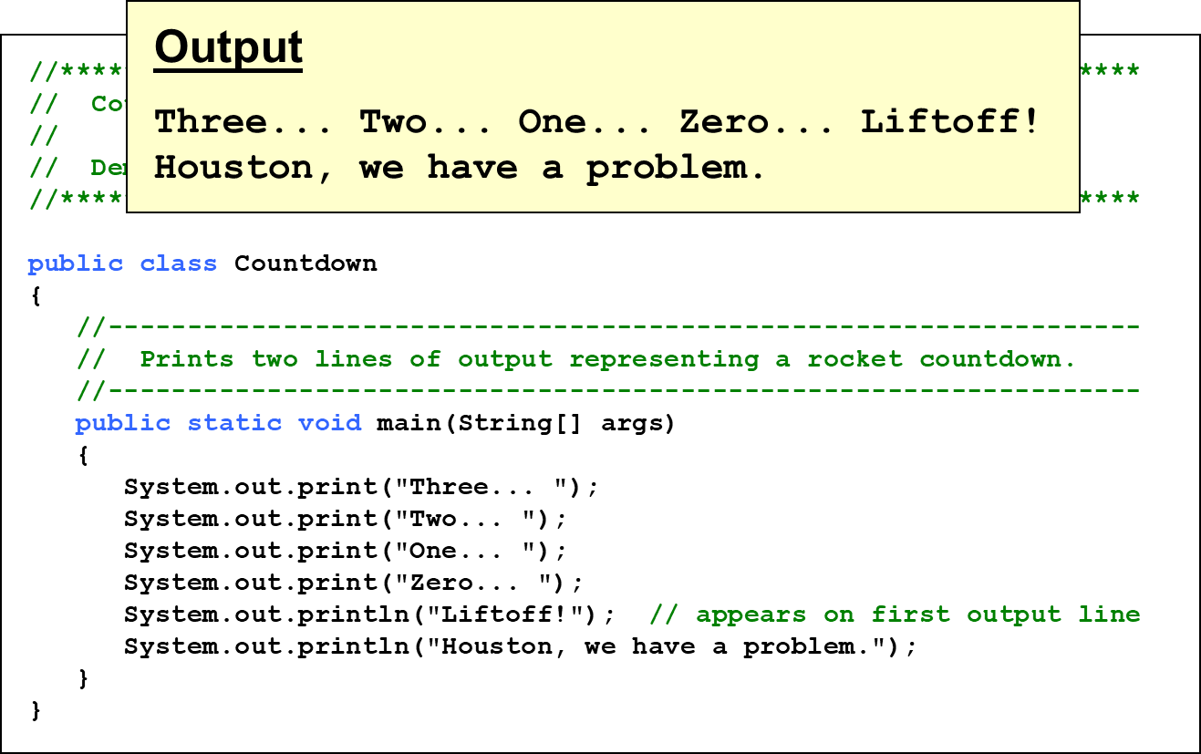
Listing 2.1 (2 of 2)

Slide 9
String Concatenation (1 of 2)
The string concatenation operator
is used to append
one string to the end of another
It can also be used to append a number to a string
A string literal cannot be broken across two lines in a program
See Facts.java

Slide 10
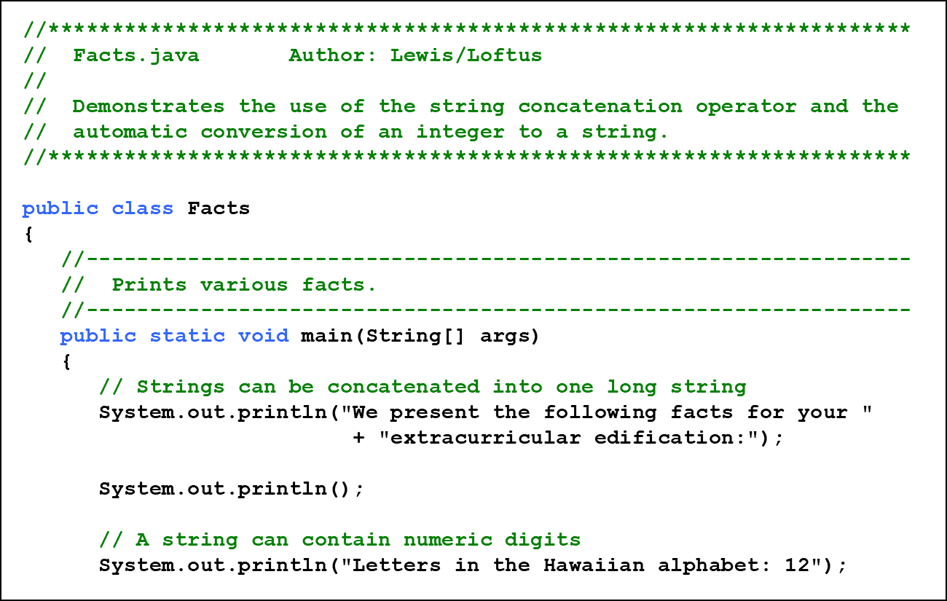
Listing 2.2 (1 of 3)

Slide 11
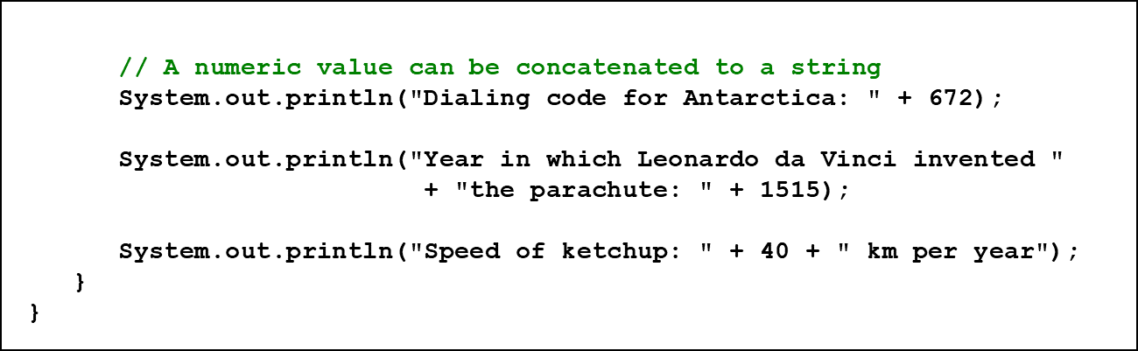
Listing 2.2 (2 of 3)

Slide 12
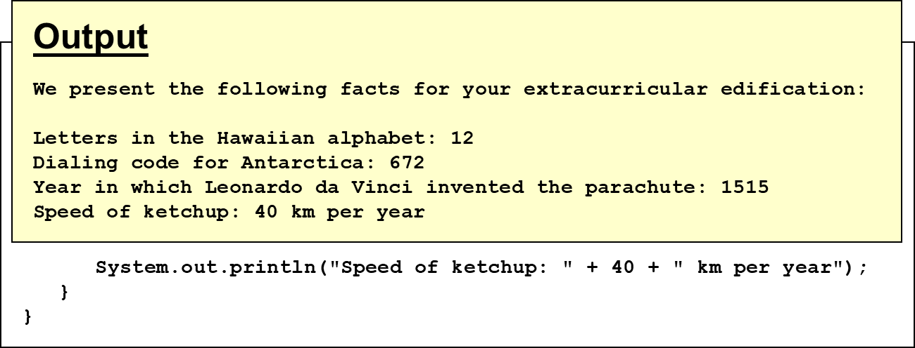
Listing 2.2 (3 of 3)

Slide 13
String Concatenation (2 of 2)
The
operator is also used for arithmetic addition
The function that it performs depends on the type of the information on which it operates
If both operands are strings, or if one is a string and one is a number, it performs string concatenation
If both operands are numeric, it adds them
The
operator is evaluated left to right, but parentheses
can be used to force the order
See Addition.java

Slide 14
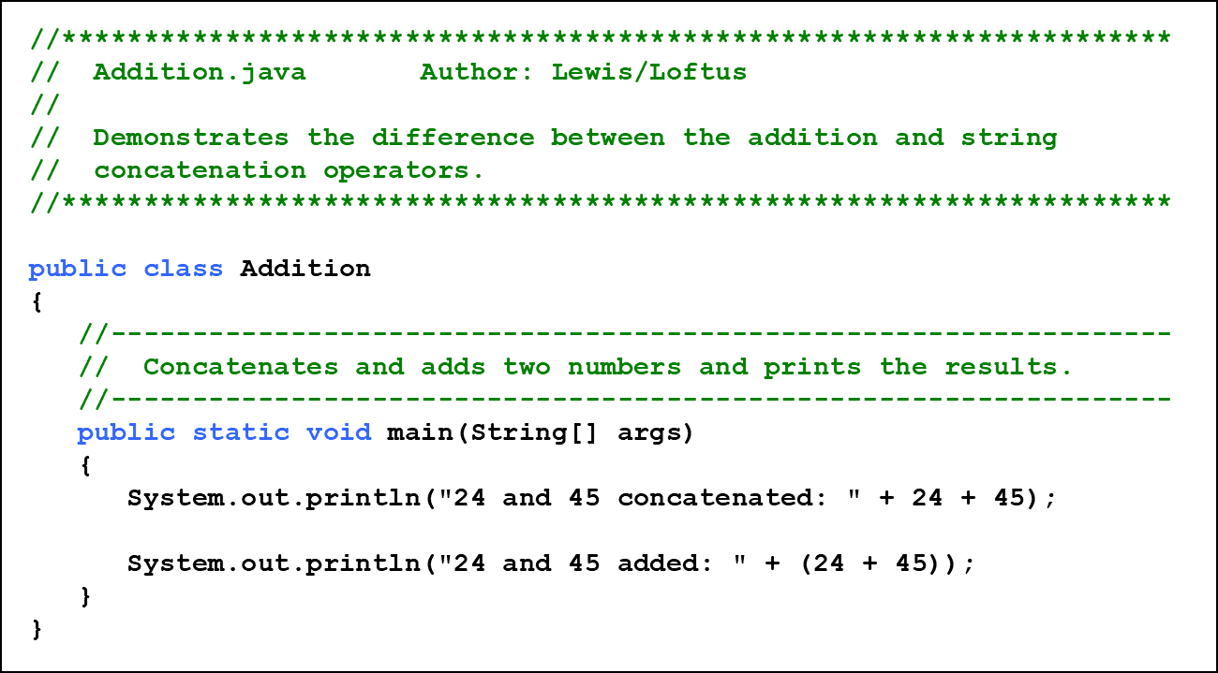
Listing 2 .3 (1 of 2)

Slide 15
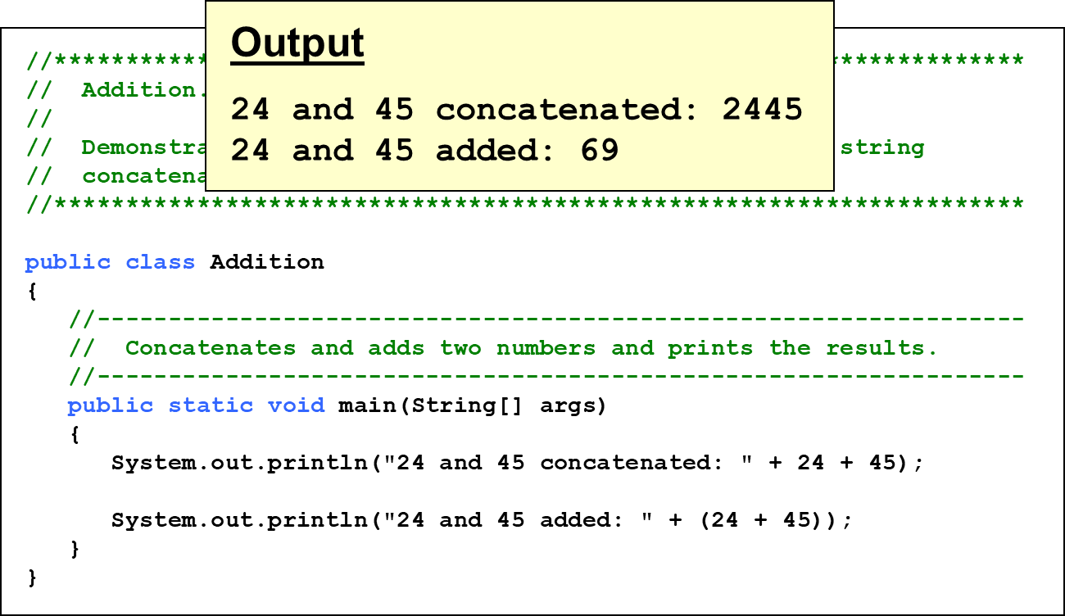
Listing 2 .3 (2 of 2)

Slide 16
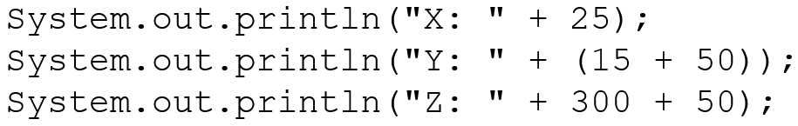
Quick Check 1 (1 of 2)
What output is produced by the following?

Slide 17
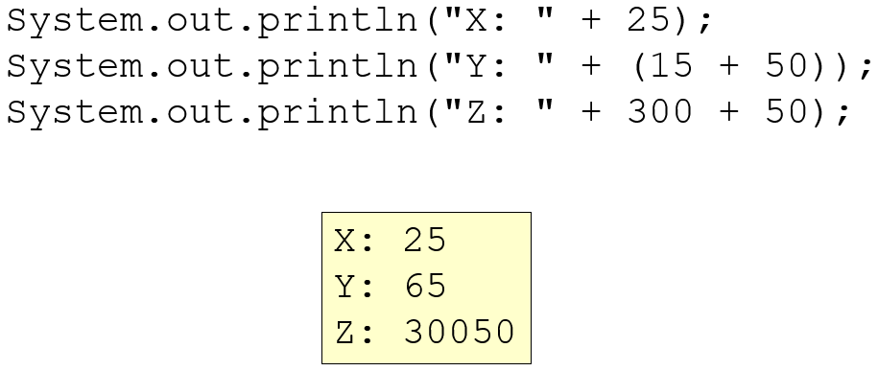
Quick Check 1 (2 of 2)
What output is produced by the following?

Slide 18
Escape Sequences (1 of 2)
What if we wanted to print the quote character?
The following line would confuse the compiler because it would interpret the second quote as the end of the string
An escape sequence is a series of characters that represents a special character
An escape sequence begins with a backslash character (\)

Slide 19
Escape Sequences (2 of 2)
Some Java escape sequences:
Escape Sequence | Meaning
back slash b | backspace
back slash t | tab
back slash n | newline
back slash r | carriage return
back slash double quote | double quote
back slash single quote | single quote
back slash back slash | backslash
See Roses.java

Slide 20
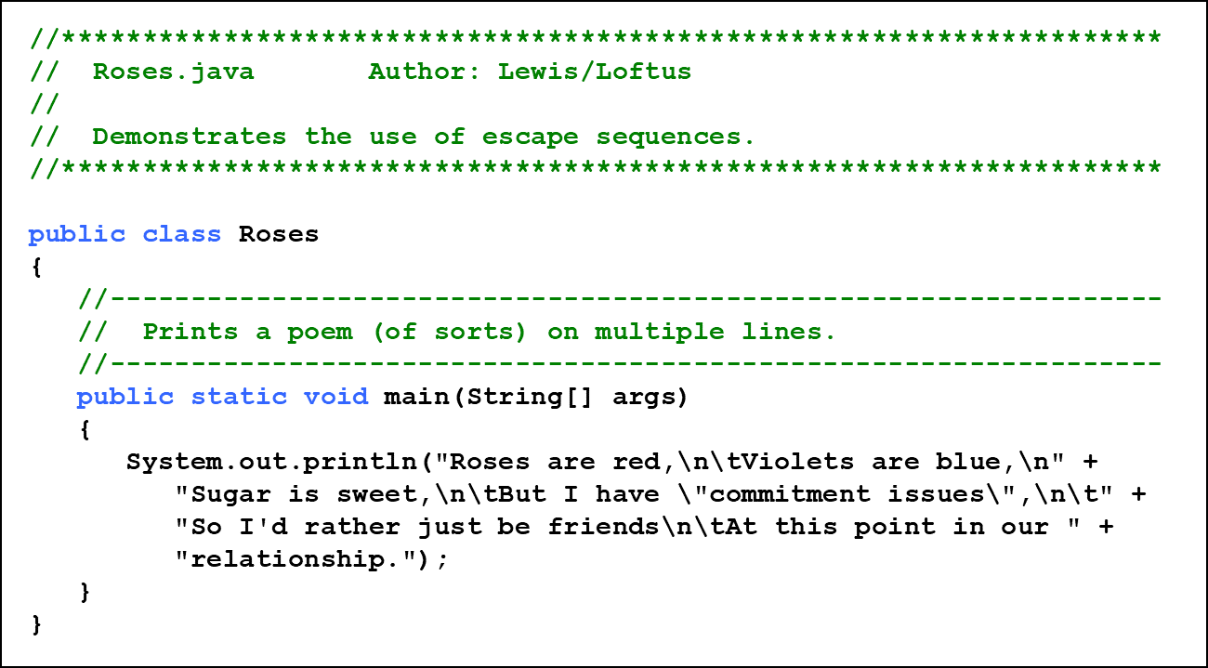
Listing 2 .4 (1 of 2)

Slide 21
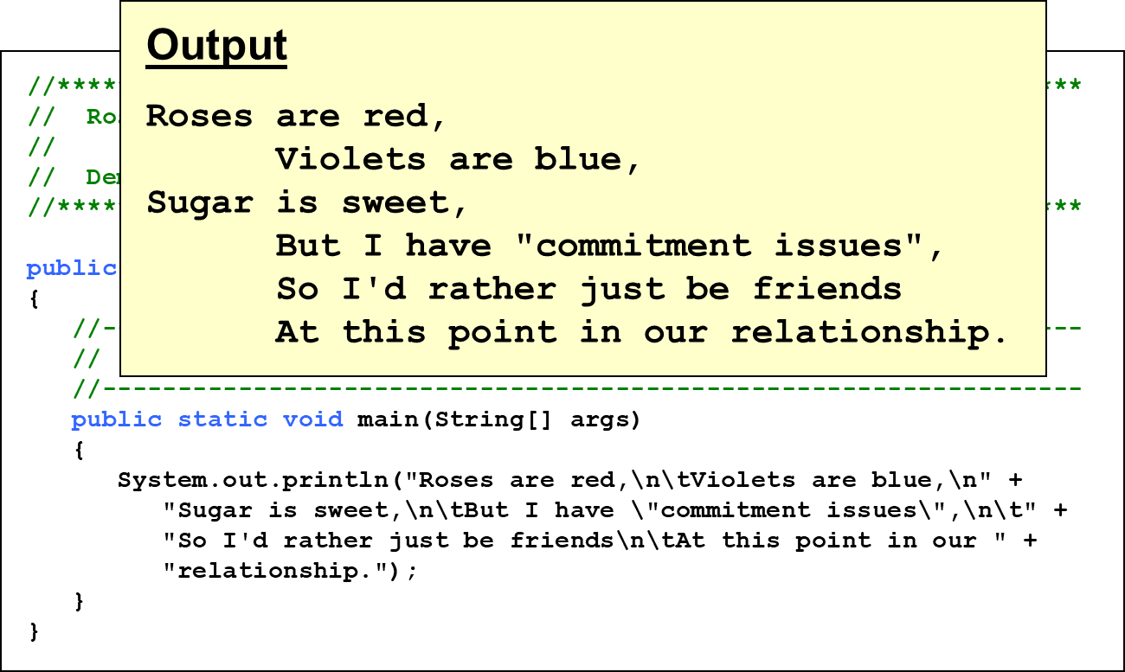
Listing 2 .4 (2 of 2)

Slide 22
Quick Check 2 (1 of 2)
Write a single println statement that produces the following output:
"Thank you all for coming to my home tonight," he said mysteriously.

Slide 23
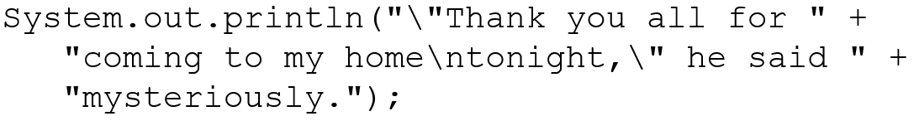
Quick Check 2 (2 of 2)
Write a single println statement that produces the following output:
"Thank you all for coming to my home tonight," he said mysteriously.

Slide 24
Outline (2 of 6)
Character Strings
Variables and Assignment
Primitive Data Types
Expressions
Data Conversion
Interactive Programs

Slide 25
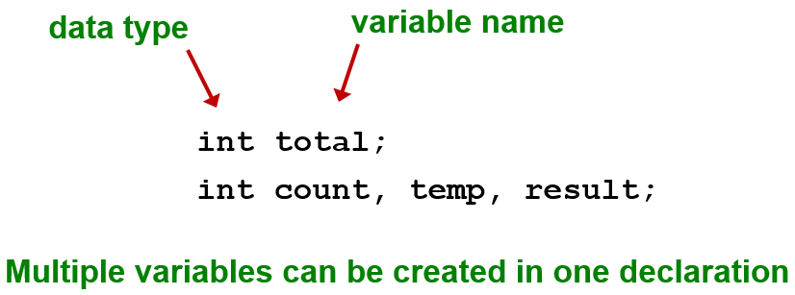
Variables
A variable is a name for a location in memory that holds a value
A variable declaration specifies the variable’s name and the type of information that it will hold

Slide 26
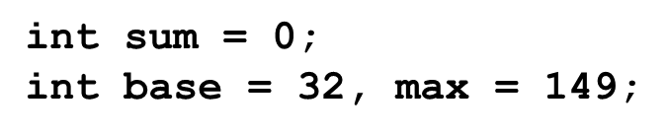
Variable Initialization
A variable can be given an initial value in the declaration
When a variable is referenced in a program, its current value is used
See PianoKeys.java

Slide 27
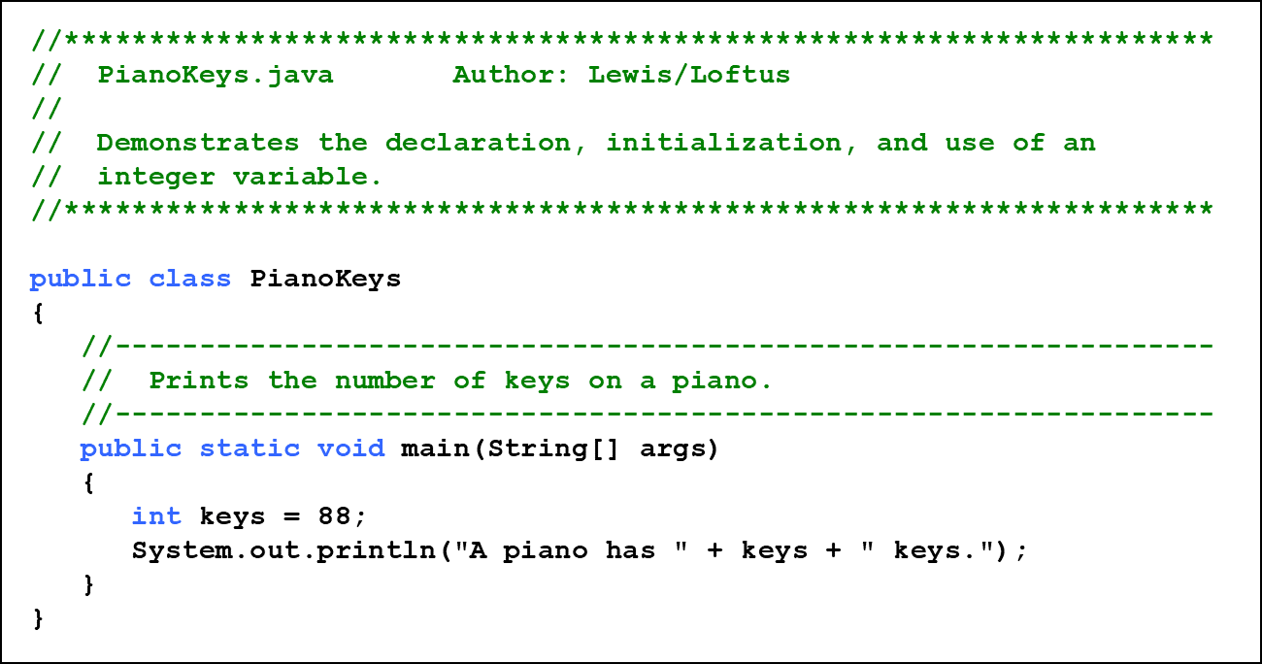
Listing 2 .5 (1 of 2)

Slide 28
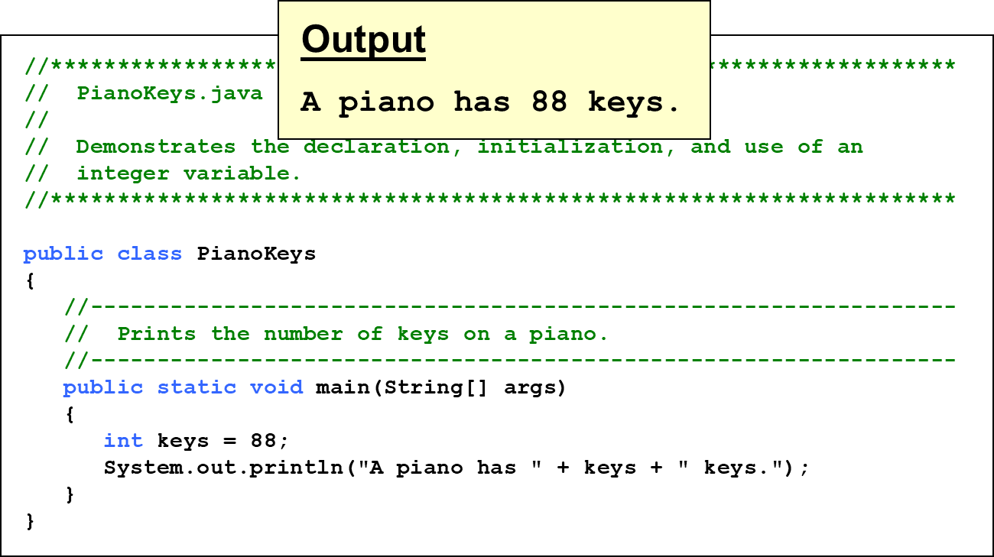
Listing 2 .5 (2 of 2)

Slide 29
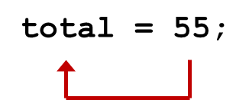
Assignment
An assignment statement changes the value of a variable
The assignment operator is the = sign
The value that was in total is overwritten
You can only assign a value to a variable that is consistent with the variable’s declared type
See Geometry.java

Slide 30
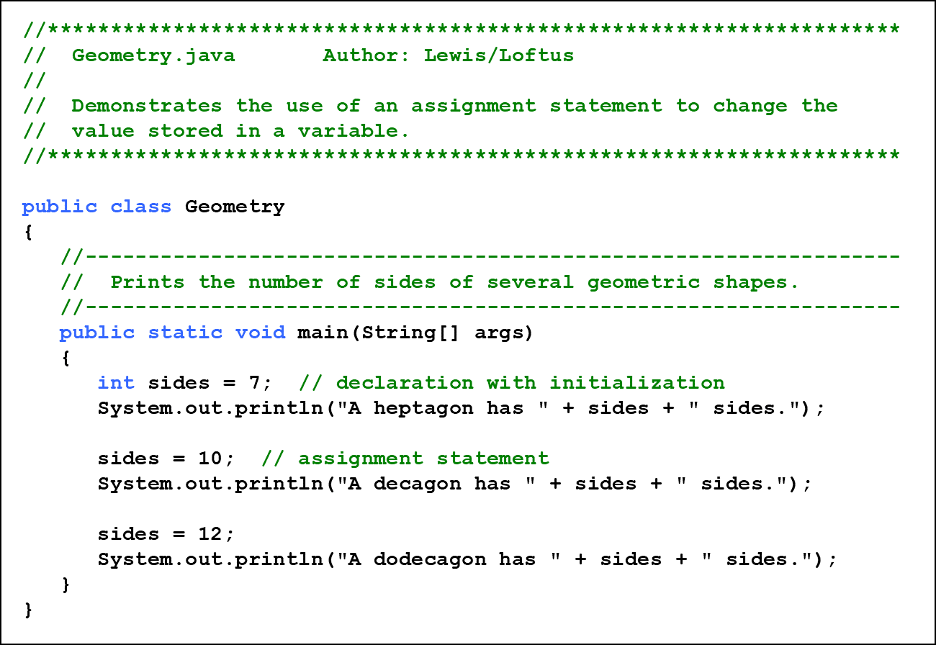
Listing 2 .6 (1 of 2)

Slide 31
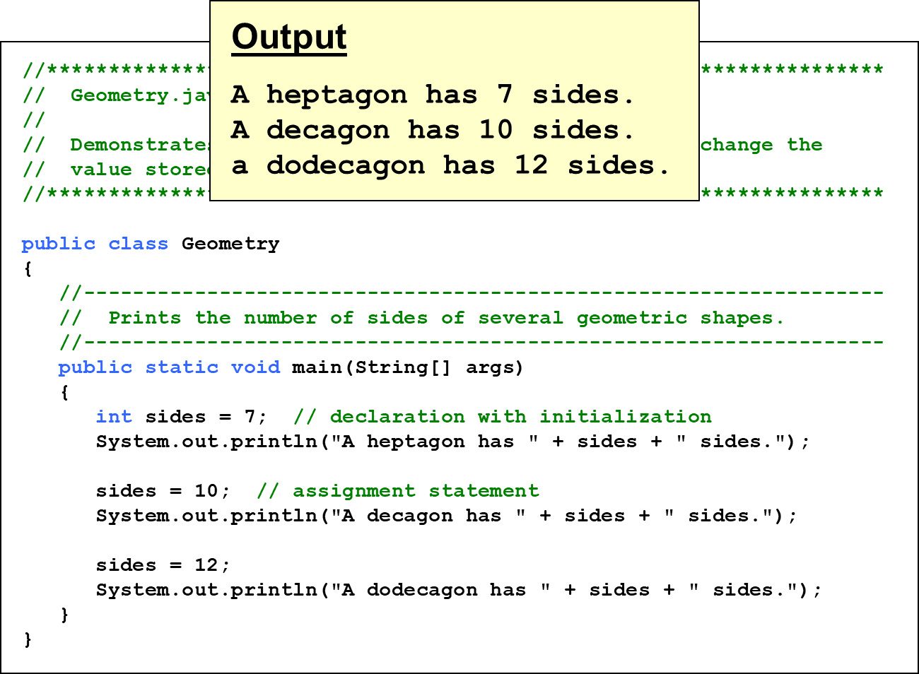
Listing 2 .6 (2 of 2)

Slide 32
Constants (1 of 2)
A constant is an identifier that is similar to a variable except that it holds the same value during its entire existence
As the name implies, it is constant, not variable
The compiler will issue an error if you try to change the value of a constant
In Java, we use the final modifier to declare a constant

Slide 33
Constants (2 of 2)
Constants are useful for three important reasons
First, they give meaning to otherwise unclear literal values
Example: MAX_LOAD means more than the literal 250
Second, they facilitate program maintenance
If a constant is used in multiple places, its value need only be set in one place
Third, they formally establish that a value should not change, avoiding inadvertent errors by other programmers

Slide 34
Outline (3 of 6)
Character Strings
Variables and Assignment
Primitive Data Types
Expressions
Data Conversion
Interactive Programs

Slide 35
Primitive Data
There are eight primitive data types in Java
Four of them represent integers:
byte, short, int, long
Two of them represent floating point numbers:
float, double
One of them represents characters:
char
And one of them represents boolean values:
boolean

Slide 36
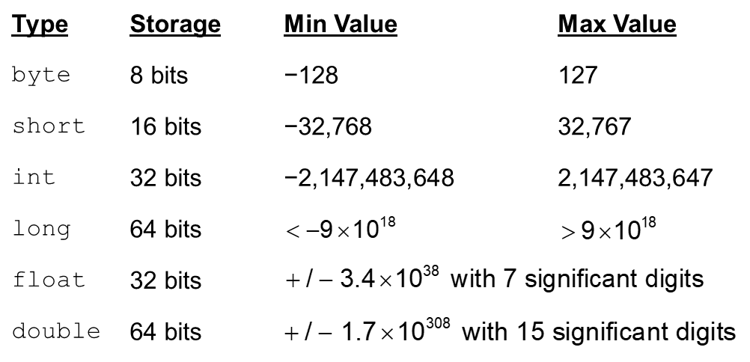
Numeric Primitive Data
The difference between the numeric primitive types is their size and the values they can store:

Slide 37
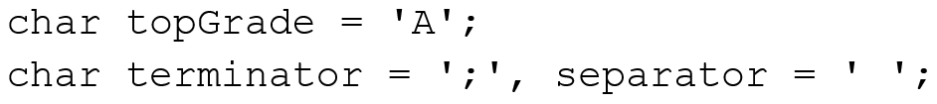
Characters (1 of 2)
A char variable stores a single character
Character literals are delimited by single quotes:
Example declarations:
Note the difference between a primitive character variable, which holds only one character, and a String object, which can hold multiple characters

Slide 38
Character Sets
A character set is an ordered list of characters, with each character corresponding to a unique number
A char variable in Java can store any character from the Unicode character set
The Unicode character set uses sixteen bits per character, allowing for 65,536 unique characters
It is an international character set, containing symbols and characters from many world languages

Slide 39
Characters (2 of 2)
The ASCII character set is older and smaller than Unicode, but is still quite popular
The ASCII characters are a subset of the Unicode character set, including:
uppercase letters | A, B, C, …
lowercase letters | a, b, c, …
punctuation | period, semi-colon, …
digits | 0, 1, 2, …
special symbols | ampersand, pipe, back slash, and so on
control characters | carriage return, tab, ...

Slide 40

Boolean
A boolean value represents a true or false condition
The reserved words true and false are the only valid values for a boolean type
A boolean variable can also be used to represent any two states, such as a light bulb being on or off

Slide 41
Outline (4 of 6)
Character Strings
Variables and Assignment
Primitive Data Types
Expressions
Data Conversion
Interactive Programs

Slide 42
Expressions
An expression is a combination of one or more operators and operands
Arithmetic expressions compute numeric results and make use of the arithmetic operators:
Addition | +
Subtraction | −
Multiplication | *
Division | /
Remainder | %
If either or both operands are floating point values, then the result is a floating point value

Slide 43
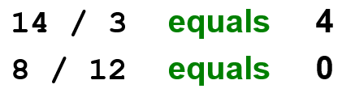
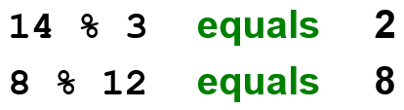
Division and Remainder
If both operands to the division operator (/) are integers, the result is an integer (the fractional part is discarded)
The remainder operator (%) returns the remainder after dividing the first operand by the second

Slide 44
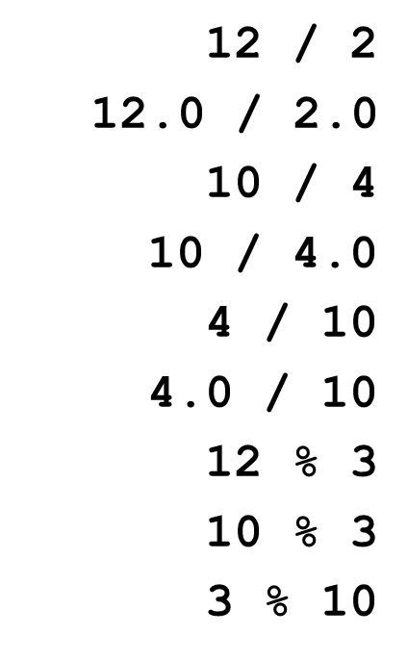
Quick Check 3 (1 of 2)
What are the results of the following expressions?

Slide 45
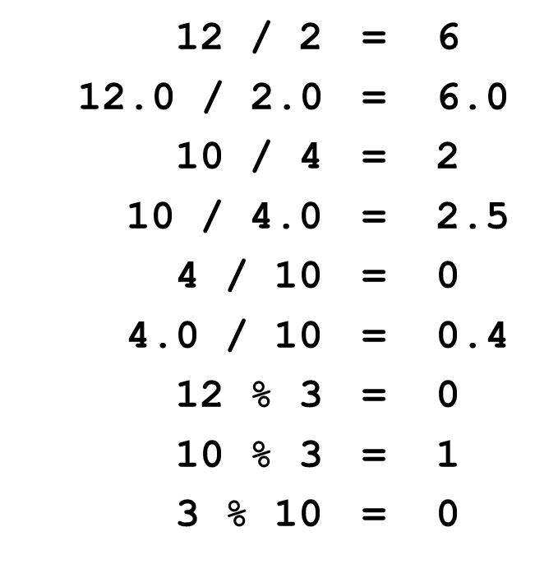
Quick Check 3 (2 of 2)
What are the results of the following expressions?

Slide 46
Operator Precedence
Operators can be combined into larger expressions
Operators have a well-defined precedence which determines the order in which they are evaluated
Multiplication, division, and remainder are evaluated before addition, subtraction, and string concatenation
Arithmetic operators with the same precedence are evaluated from left to right, but parentheses can be used to force the evaluation order

Slide 47
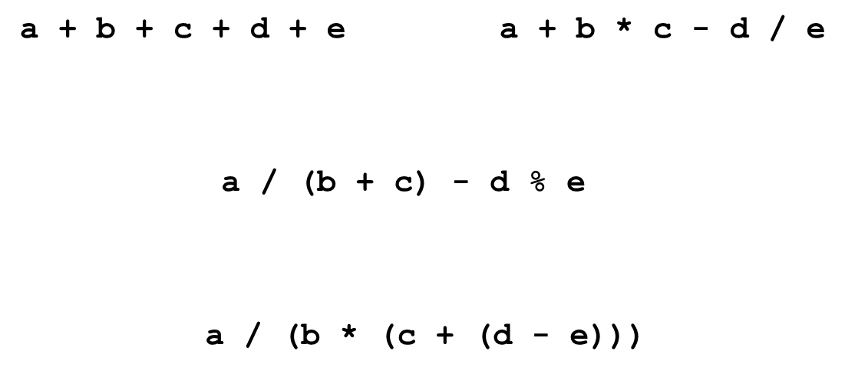
Quick Check 4 (1 of 2)
In what order are the operators evaluated in the following expressions?

Slide 48
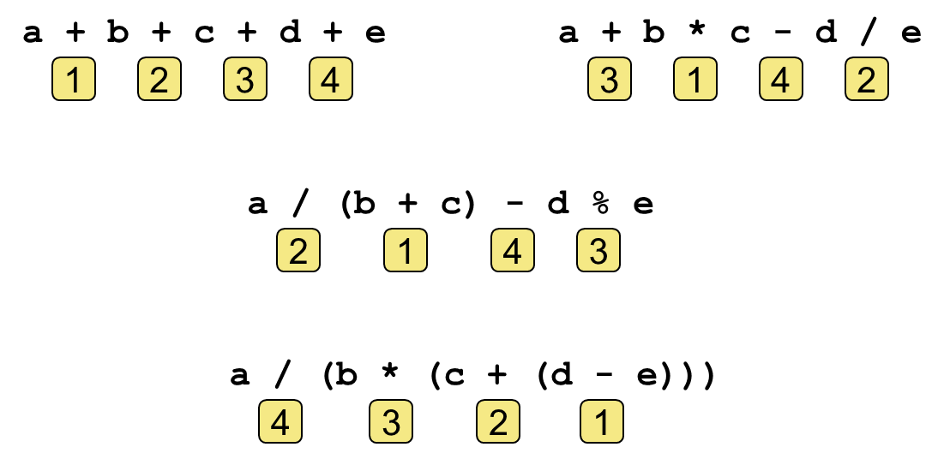
Quick Check 4 (2 of 2)
In what order are the operators evaluated in the following expressions?

Slide 49
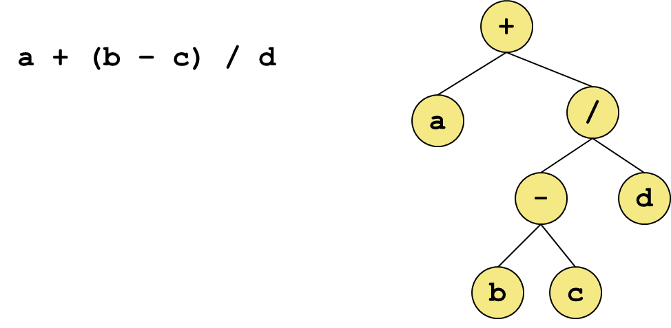
Expression Trees
The evaluation of a particular expression can be shown using an expression tree
The operators lower in the tree have higher precedence for that expression

Slide 50
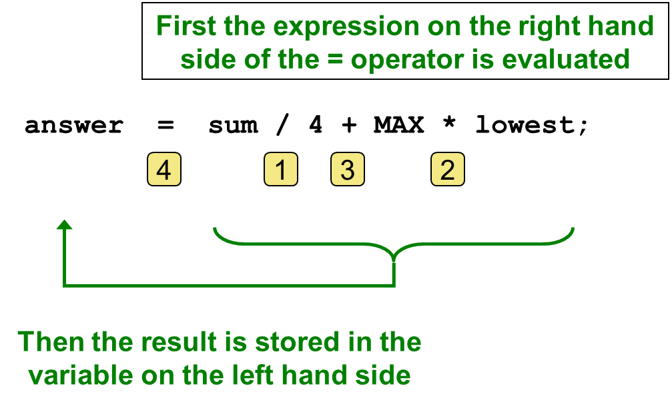
Assignment Revisited (1 of 2)
The assignment operator has a lower precedence than the arithmetic operators

Slide 51
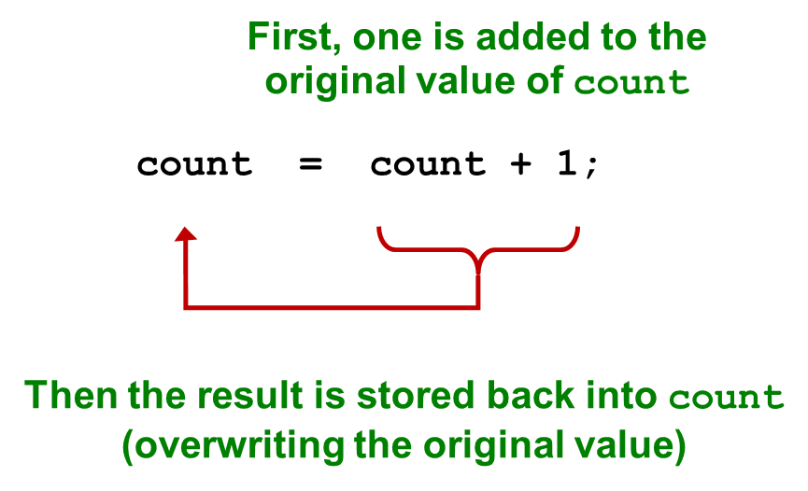
Assignment Revisited (2 of 2)
The right and left hand sides of an assignment statement can contain the same variable

Slide 52


Increment and Decrement (1 of 2)
The increment
and decrement
operators use
only one operand
The statement
is functionally equivalent to

Slide 53


Increment and Decrement (2 of 2)
The increment and decrement operators can be applied in postfix form:
or prefix form:
When used as part of a larger expression, the two forms can have different effects
Because of their subtleties, the increment and decrement operators should be used with care

Slide 54

Assignment Operators (1 of 4)
Often we perform an operation on a variable, and then store the result back into that variable
Java provides assignment operators to simplify that process
For example, the statement
is equivalent to

Slide 55
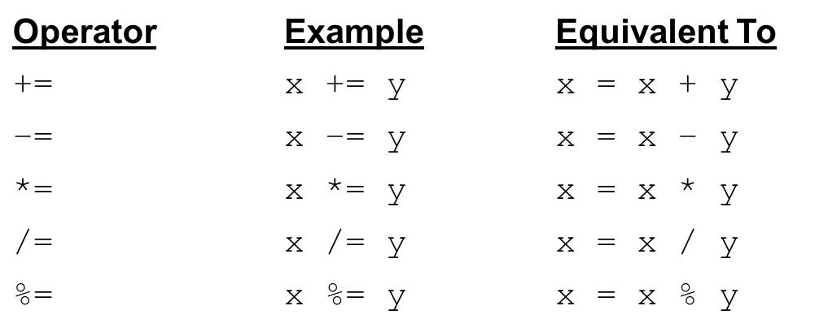
Assignment Operators (2 of 4)
There are many assignment operators in Java, including the following:

Slide 56
Assignment Operators (3 of 4)
The right hand side of an assignment operator can be a complex expression
The entire right-hand expression is evaluated first, then the result is combined with the original variable
Therefore
is equivalent to

Slide 57
Assignment Operators (4 of 4)
The behavior of some assignment operators depends on the types of the operands
If the operands to the
operator are strings, the
assignment operator performs string concatenation
The behavior of an assignment operator
is always
consistent with the behavior of the corresponding operator

Slide 58
Outline (5 of 6)
Character Strings
Variables and Assignment
Primitive Data Types
Expressions
Data Conversion
Interactive Programs

Slide 59
Data Conversion (1 of 3)
Sometimes it is convenient to convert data from one type to another
For example, in a particular situation we may want to treat an integer as a floating point value
These conversions do not change the type of a variable or the value that's stored in it - they only convert a value as part of a computation

Slide 60
Data Conversion (2 of 3)
Widening conversions are safest because they tend to go from a small data type to a larger one (such as a short to an int)
Narrowing conversions can lose information because they tend to go from a large data type to a smaller one (such as an int to a short)
In Java, data conversions can occur in three ways:
assignment conversion
promotion
casting

Slide 61
Data Conversion (3 of 3)
Widening Conversions
Narrowing Conversions
From | To
Byte | short, int, long, float, or double
short | int, long, float, or double
char | int, long, float, or double
int | long, float, or double
long | float or double
float | double
From | To
byte | char
short | byte or char
char | byte or short
int | byte, short, or char
long | byte, short, char, or int
float | byte, short, char, int, or long
double | byte, short, char, int, long, or float

Slide 62

Assignment Conversion
Assignment conversion occurs when a value of one type is assigned to a variable of another
Example:
Only widening conversions can happen via assignment
Note that the value or type of dollars did not change

Slide 63
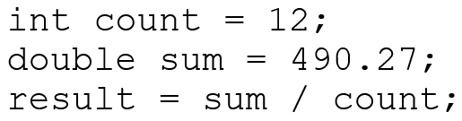
Promotion
Promotion happens automatically when operators in expressions convert their operands
Example:
The value of count is converted to a floating point value to perform the division calculation

Slide 64

Casting
Casting is the most powerful, and dangerous, technique for conversion
Both widening and narrowing conversions can be accomplished by explicitly casting a value
To cast, the type is put in parentheses in front of the value being converted
Without the cast, the fractional part of the answer would be lost

Slide 65
Outline (6 of 6)
Character Strings
Variables and Assignment
Primitive Data Types
Expressions
Data Conversion
Interactive Programs

Slide 66
Interactive Programs
Programs generally need input on which to operate
The Scanner class provides convenient methods for reading input values of various types
A Scanner object can be set up to read input from various sources, including the user typing values on the keyboard
Keyboard input is represented by the System.in object

Slide 67
Reading Input (1 of 2)
The following line creates a Scanner object that reads from the keyboard:
The new operator creates the Scanner object
Once created, the Scanner object can be used to invoke various input methods, such as:

Slide 68
Reading Input (2 of 2)
The Scanner class is part of the java.util class library, and must be imported into a program to be used
The nextLine method reads all of the input until the end of the line is found
See Echo.java
The details of object creation and class libraries are discussed further in Chapter 3

Slide 69
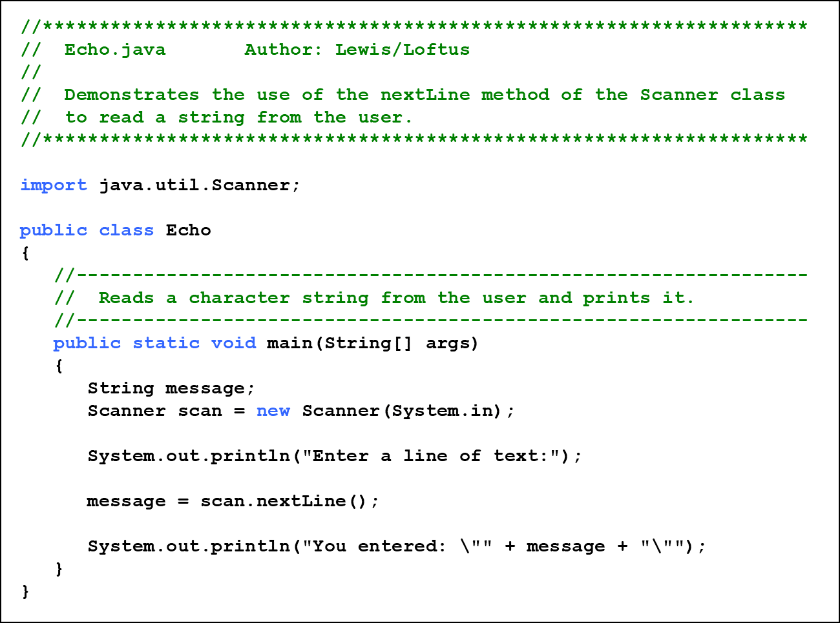
Listing 2.8 (1 of 2)

Slide 70
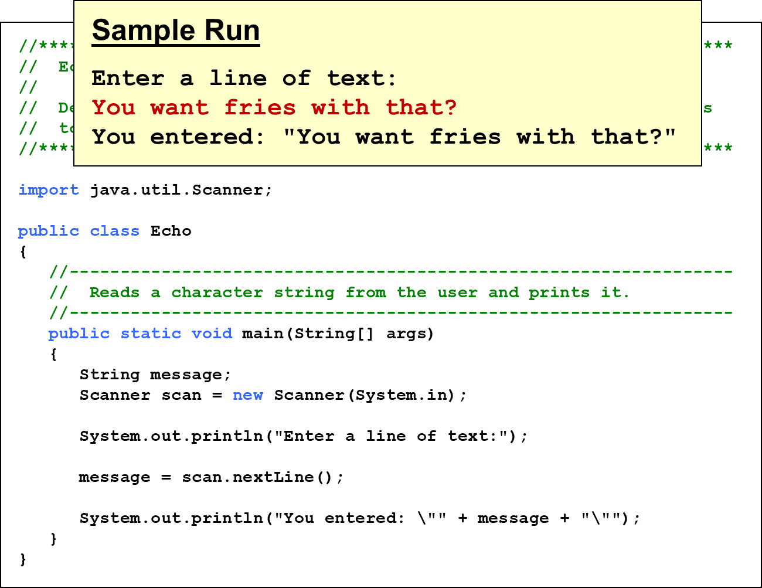
Listing 2.8 (2 of 2)

Slide 71
Input Tokens
Unless specified otherwise, white space is used to separate the elements (called tokens) of the input
White space includes space characters, tabs, new line characters
The next method of the Scanner class reads the next input token and returns it as a string
Methods such as nextInt and nextDouble read data of particular types
See GasMileage.java

Slide 72
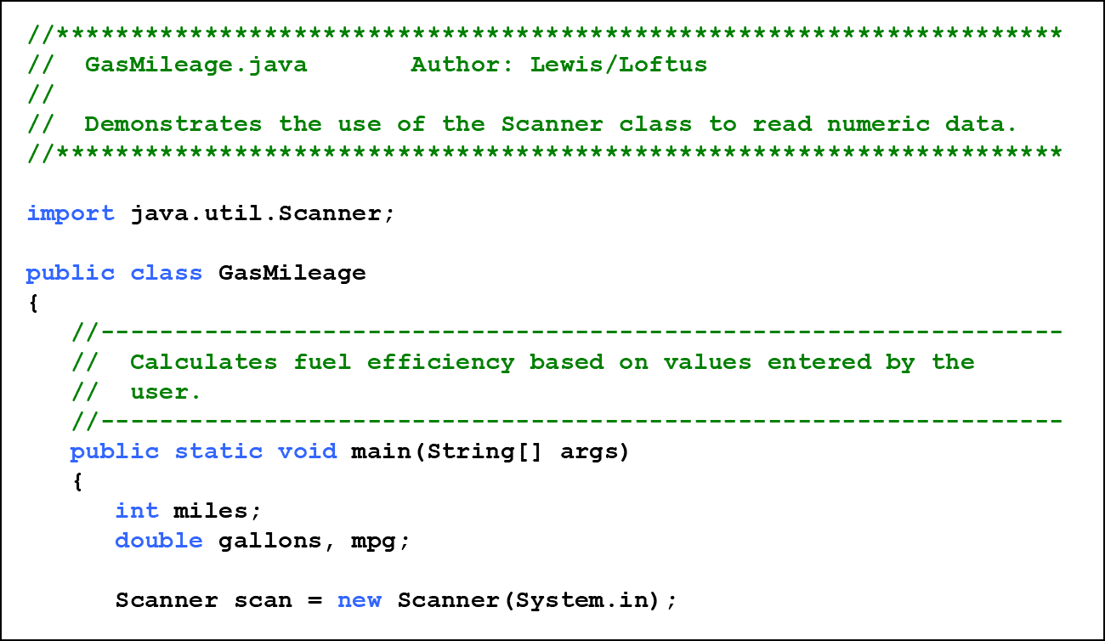
Listing 2.9 (1 of 3)

Slide 73
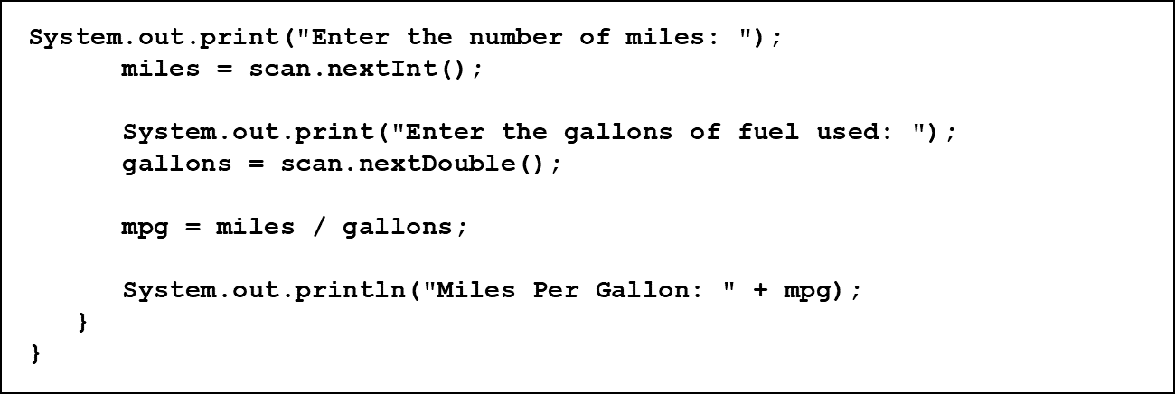
Listing 2.9 (2 of 3)

Slide 74
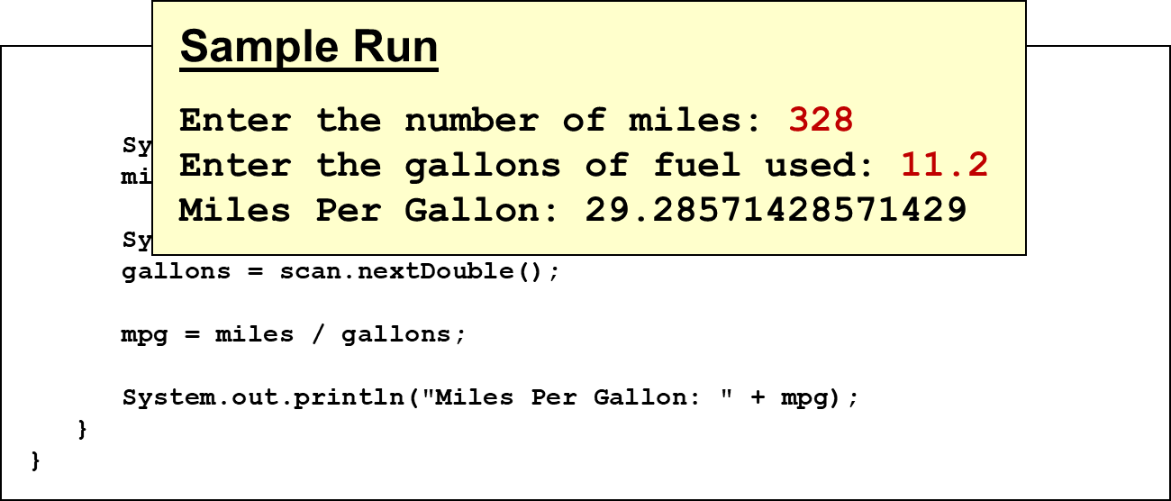
Listing 2.9 (3 of 3)

Slide 75
Summary
Chapter 2 focused on:
character strings
primitive data
the declaration and use of variables
expressions and operator precedence
data conversions
accepting input from the user

Slide 76

Copyright
This work is protected by United States copyright laws and is provided solely for the use of instructors in teaching their courses and assessing student learning. Dissemination or sale of any part of this work (including on the World Wide Web) will destroy the integrity of the work and is not permitted. The work and materials from it should never be made available to students except by instructors using the accompanying text in their classes. All recipients of this work are expected to abide by these restrictions and to honor the intended pedagogical purposes and the needs of other instructors who rely on these materials.

