Slide 1
CTEC 151: Java Advanced Programming
JEFFREY WALLEY

Slide 2
CONTENTS
Ch01 - Console Application with Comments
Ch02 – Mathematical Calculations & Casting
Ch03 – Parsing, Methods, and Enums
Ch04 – Custom Classes and Encapsulation
Ch05 – Conditional Statements and Complex Booleans

Slide 3
CONTENTS
Ch05 & Ch06: Loops
Ch05: File Reading
Ch05 & Ch08: Arrays & ArrayLists
Ch06: Switch Statements
Ch07: Interfaces and Overloaded Methods

Slide 4
CONTENTS
Ch08: Properly Utilize a 2-D Array
Ch09: Properly Override a Method
Ch09: Properly Utilize ‘super()’ in a subclass
Ch10: Properly Implement the Comparable Interface

Slide 5
CONTENTS
Ch11: Create a Custom Exception
Ch11: Properly Implement a ‘try / catch’ statement
Ch11: Properly Write Data to File
Ch12: Display Understanding of Recursion

Slide 6
INTRODUCTION
Welcome to my project portfolio, a comprehensive showcase of my journey through essential Java programming concepts and techniques. As a college student deeply invested in mastering software development, I have created a series of projects that not only satisfy my portfolio requirements but also demonstrate my ability to apply theoretical knowledge to practical scenarios.
This portfolio includes five key projects: printing data to the console, performing mathematical operations, parsing strings and utilizing enums, developing a custom Movie Collection application, and creating the RoboWarriorExtreme game. Each project has been meticulously crafted to highlight specific skills such as encapsulation, conditional logic, complex boolean statements, loops, file reading, and method overloading. Through these projects, I aim to illustrate my proficiency in Java and my readiness to tackle real-world programming challenges.

Slide 7
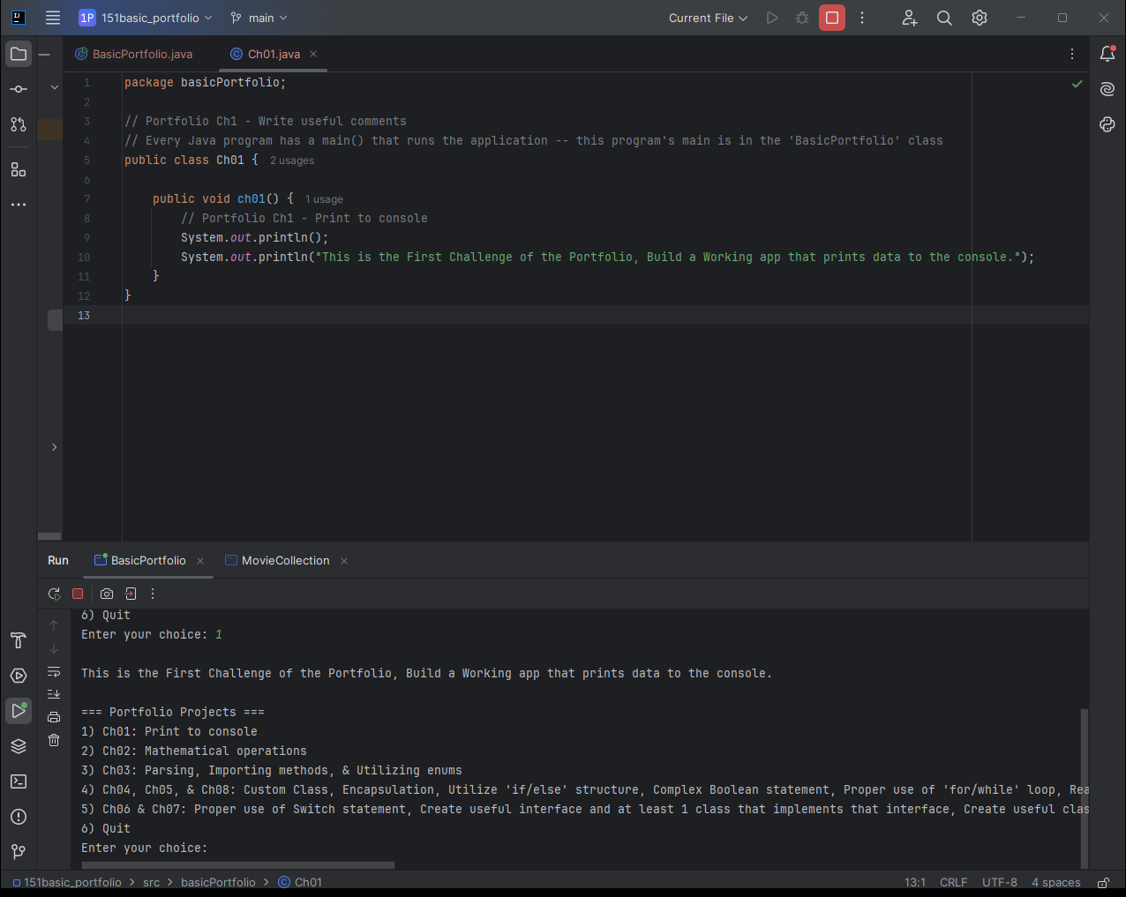
Project 01:Print to Console
Goals:
Build a working application that prints data to the console.
Use ‘System.out.println(“What You Want to Print”);’ to print text to the console in Java.
Write useful comments with your code.
I wrote a few comments, more are in the BasicPortfolio class.

Slide 8
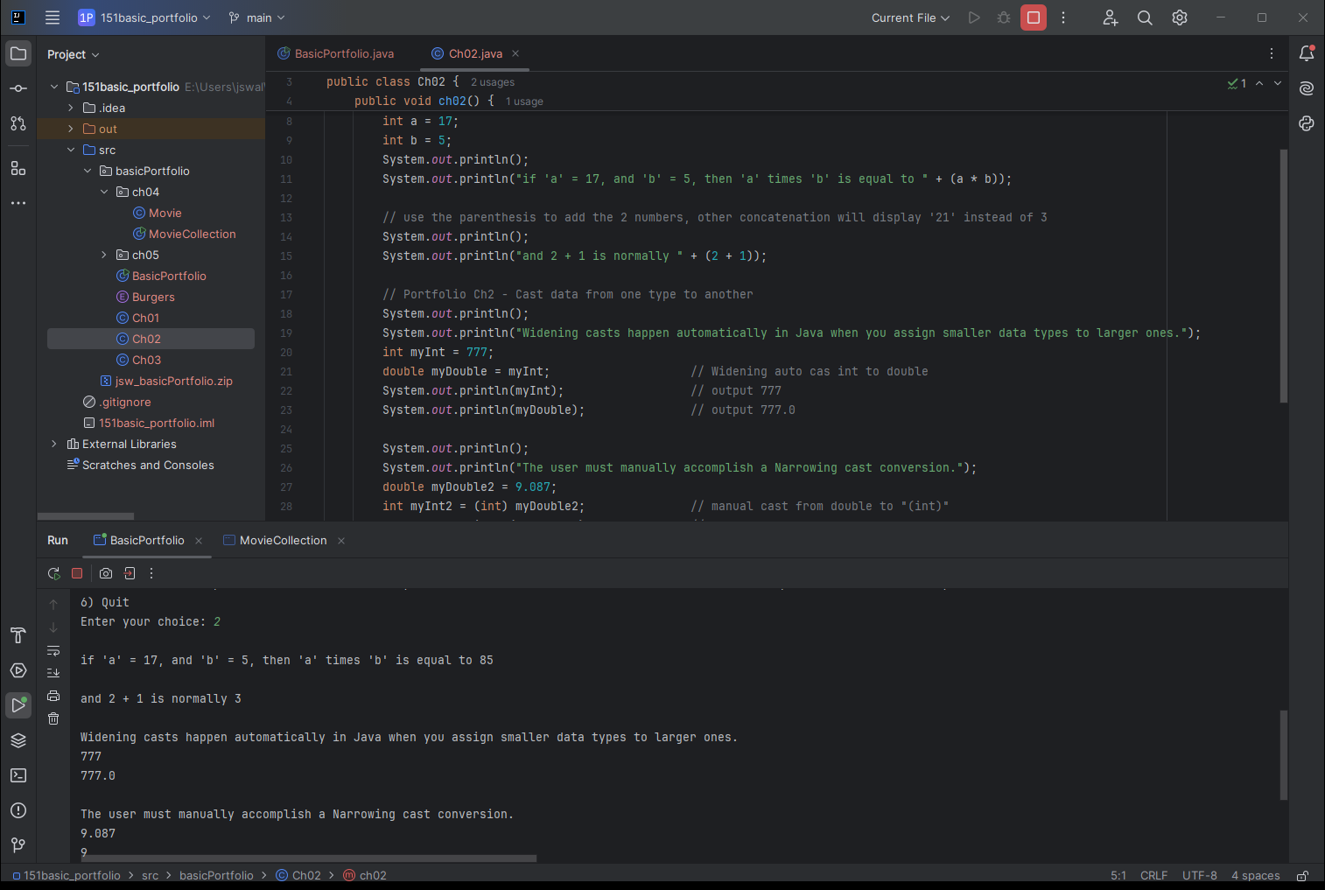
Project 02:Mathematical Operations
Goals:
Perform mathematical calculations using variables.
I declared variables as ‘int’, which means they are integers.
Use the cast operator to cast data from one type to another.
I manually cast a double, ‘myDouble2’ to an integer.

Slide 9
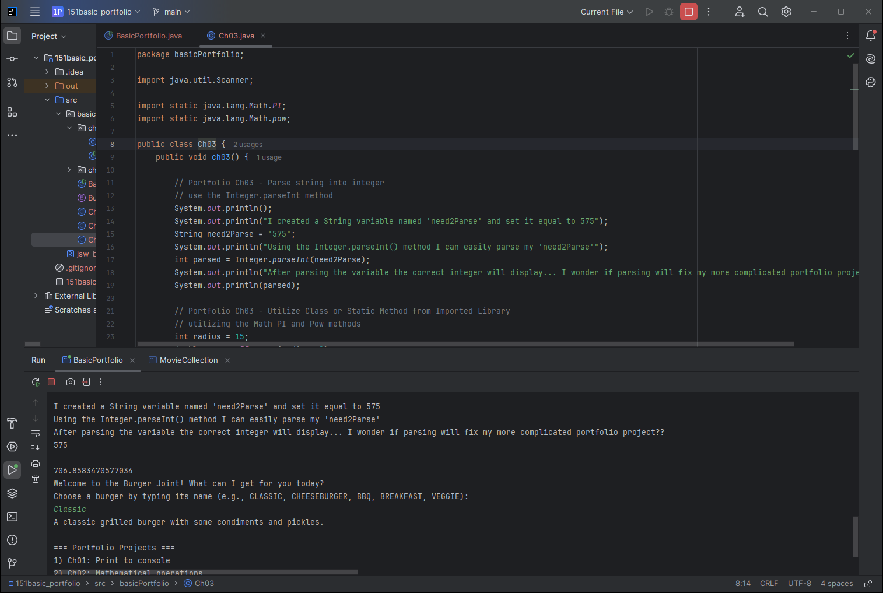
Project 03:Parsing, Importing methods
Goals:
Parse a string into an integer.
Using the .parseInt() method provided in Java.
Properly utilize a Class or Static Method from an imported library.
We use both the Math.PI and Math.pow libraries.

Slide 10
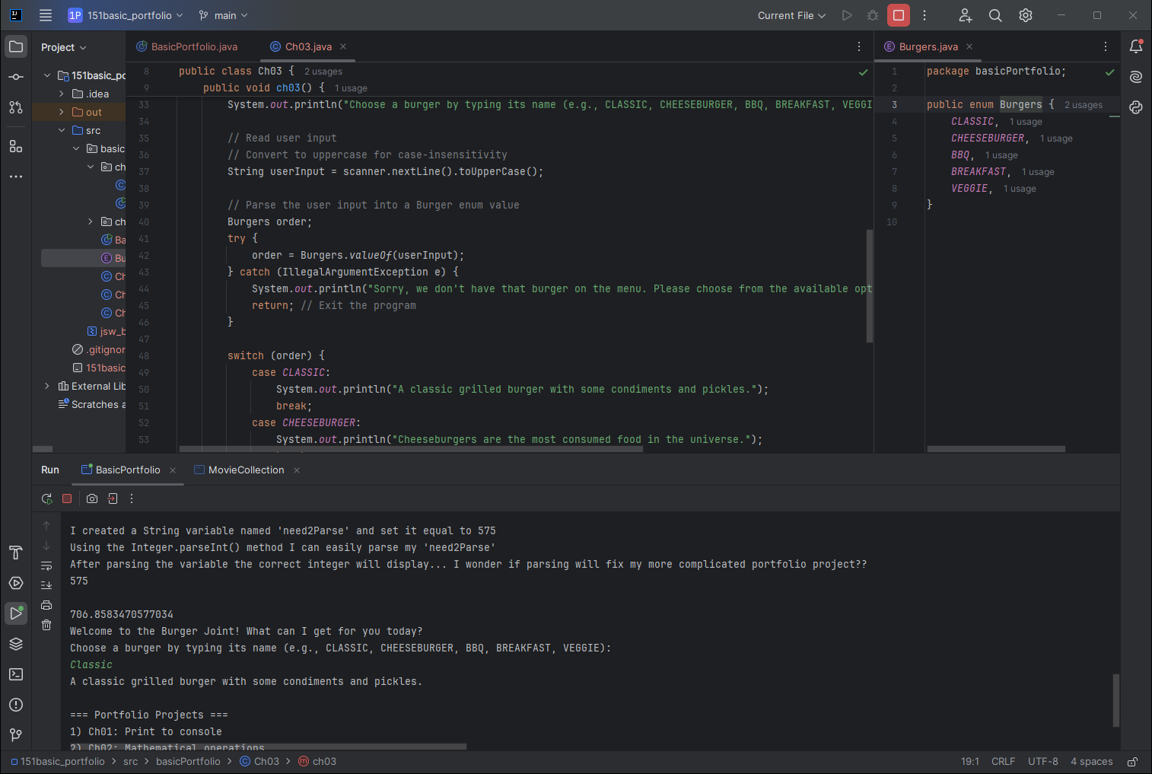
Project 03b: Utilizing enums
Goals:
Properly define and utilize an enum.
I created and use an ‘enum’ named Burgers, which contains multiple Burger types that are available.
I also use the Java ‘Scanner’
In my scanner I make certain it transforms the input into all uppercase to match my enum contents.
This project makes use of a ‘switch’ statement.

Slide 11
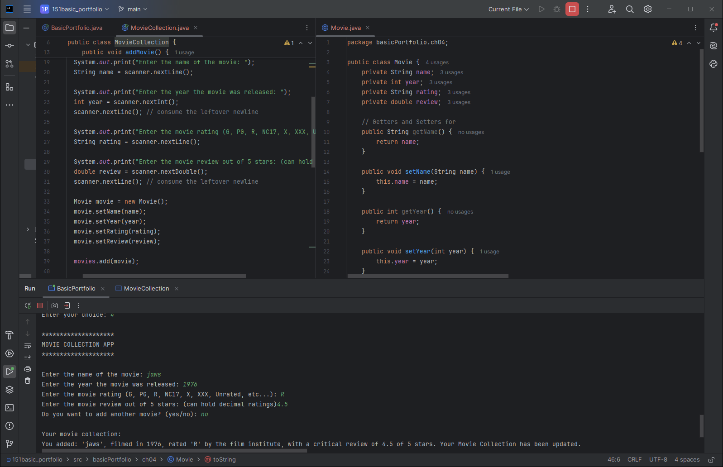
Project 04: Custom Class, Encapsulation, Read data from Scanner
Goals:
Movie is an object class that contains private fields of what we use to classify our ‘movie’.
We access the ‘private’ content of our object by creating public ‘getters and setters’ that can return information about the object, or transform that object.
Keeping the internal aspects of the object ‘private’ and using the ‘getters and setters’ is an example of encapsulation.
We again have a scanner that takes user input and stores that information for use in our ArrayList.

Slide 12
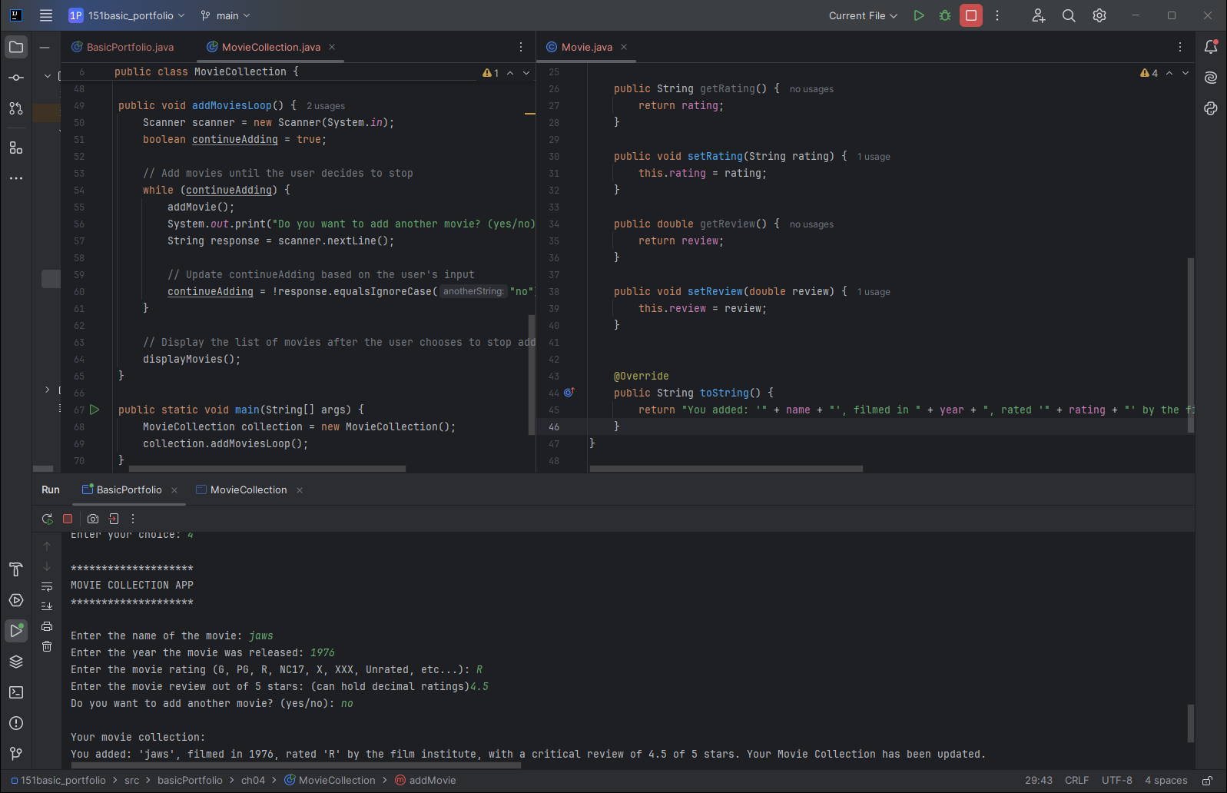
Project 04b: Complex Boolean statement, Proper use of 'for/while' loop
Goals:
I created a complex Boolean statement within my ‘while’ statement.
The statement confirms that while ‘response’ is NOT equal to ‘no’, ignoring the case that is input, the loop will continue.
The while loop here continues the process of adding movies to the ArrayList.

Slide 13
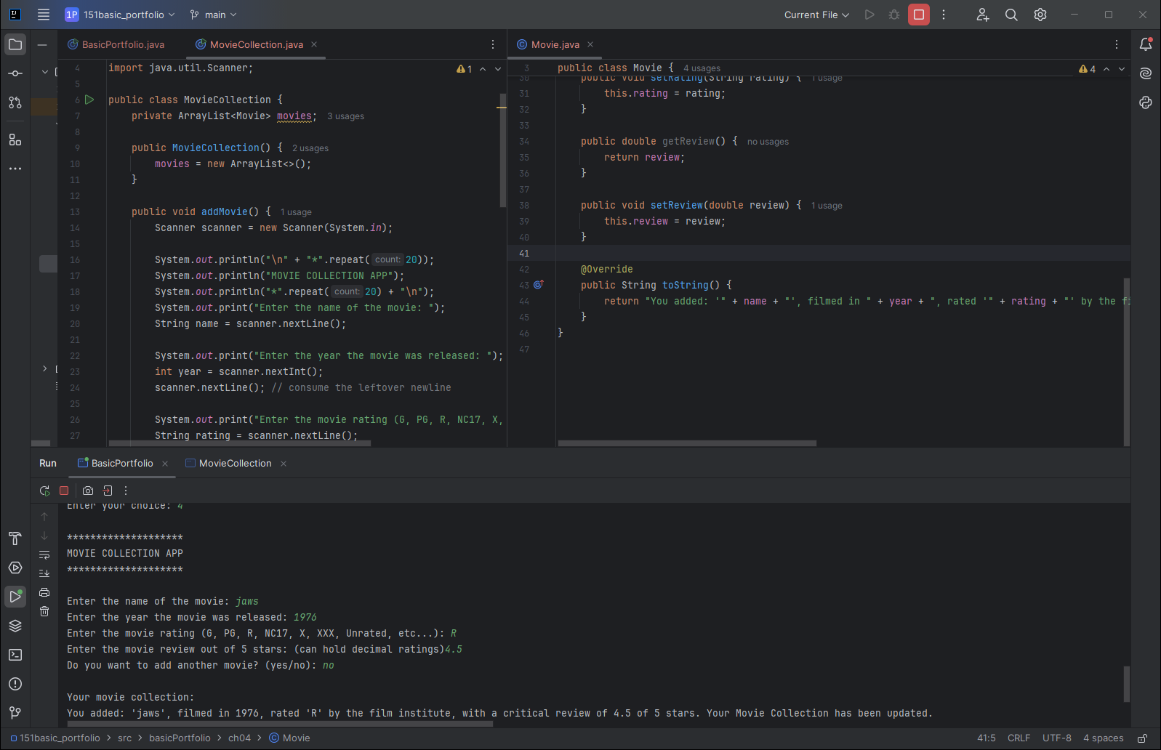
Project 04C: Utilize an ArrayList
Goals:
In this project we create an ArrayList<Movie>, named ‘movies’, we later print out the ‘movies’ ArrayList when the user exits the program.

Slide 14
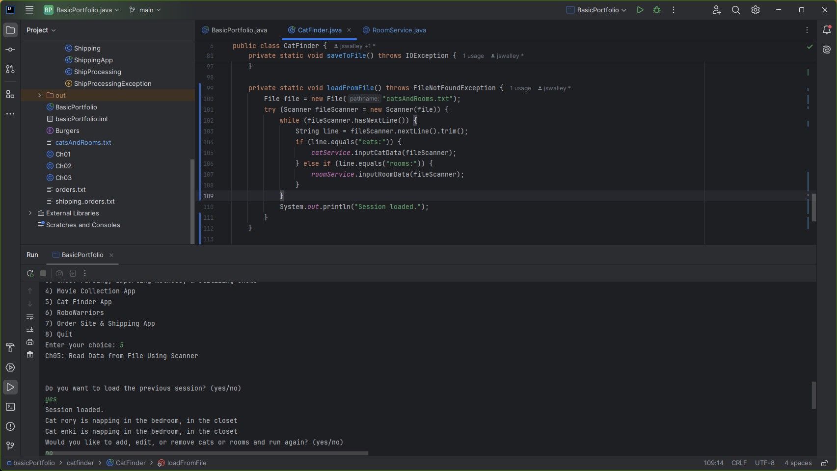
Project 05:Read Data from file using scanner
Goals:
Loads a file (catsAndRooms.txt) and then reads information from the text file.
It then reads the Cat Data and Room Data from the file.
The program searches for keywords ‘cats:’ and ‘rooms:’.

Slide 15
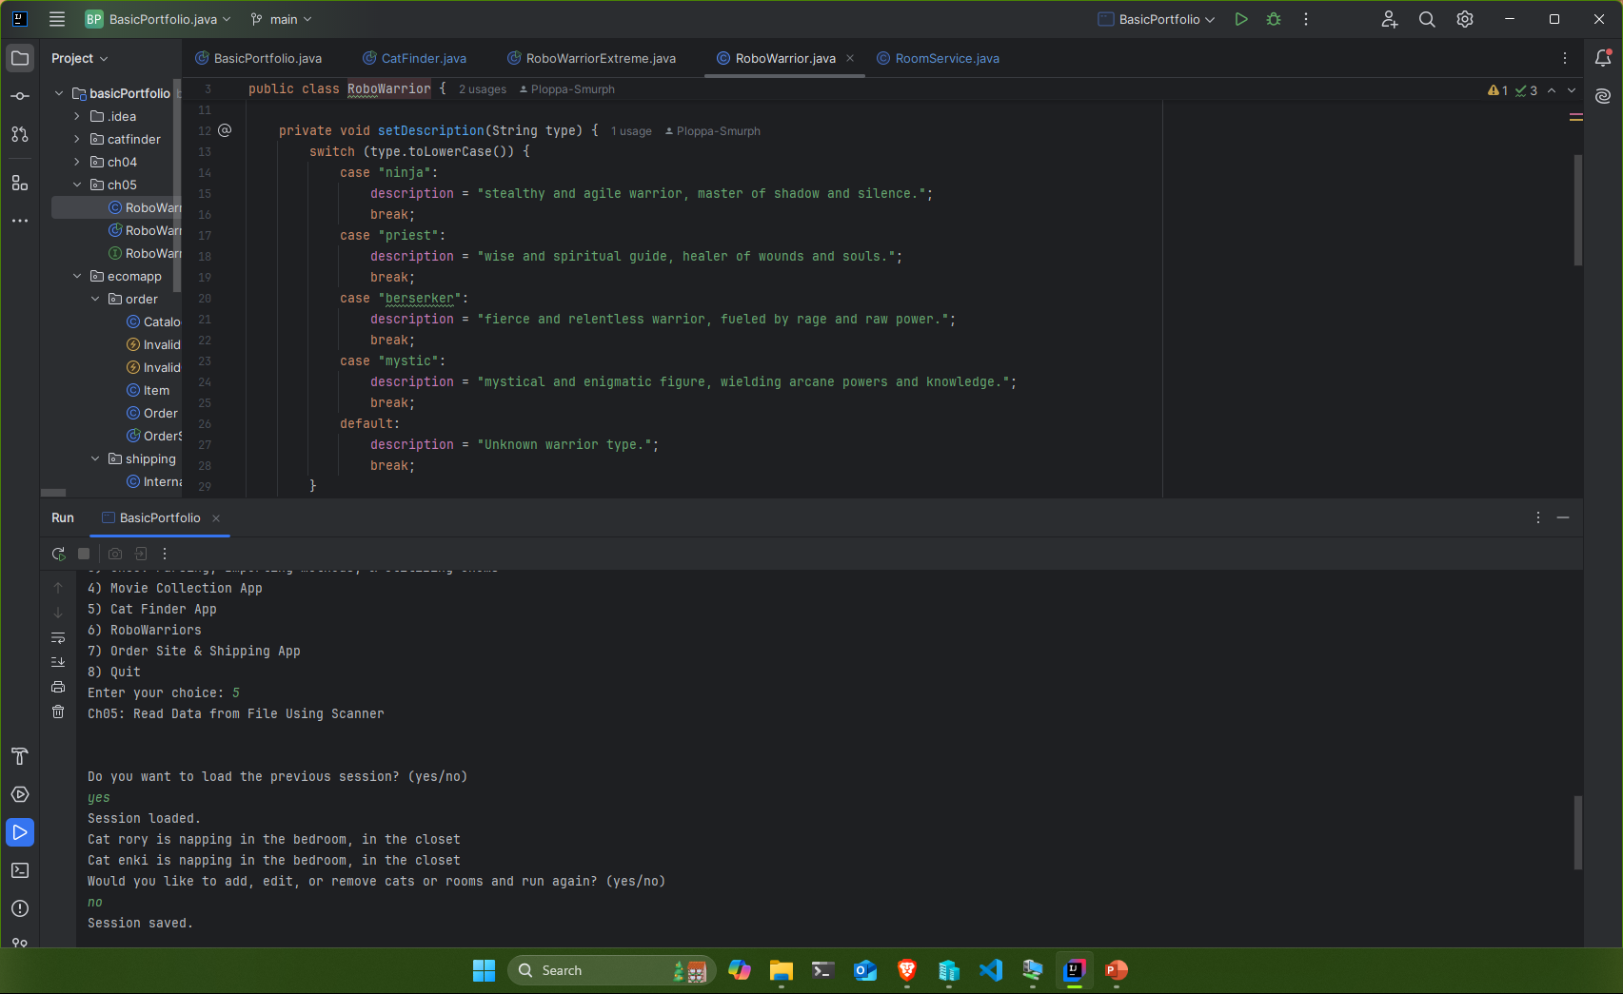
Project 06: Proper use of Switch statement, Create useful interface and at least 1 class that implements that interface
Goals:
In this project, ‘RoboWarriorExtreme’ implements an interface class named ‘RoboWarriorType’.
I do correctly make use of an ‘if’ statement in this project, also.
I have 2 different switch statements in this application, the first gives a description of the character class that the user has chosen, based on the available interface classes.
Switch statements evaluate an expression against values contained in a ‘case’ clause.
If the expression information matches a case value the case statement is executed until a break statement occurs.

Slide 16
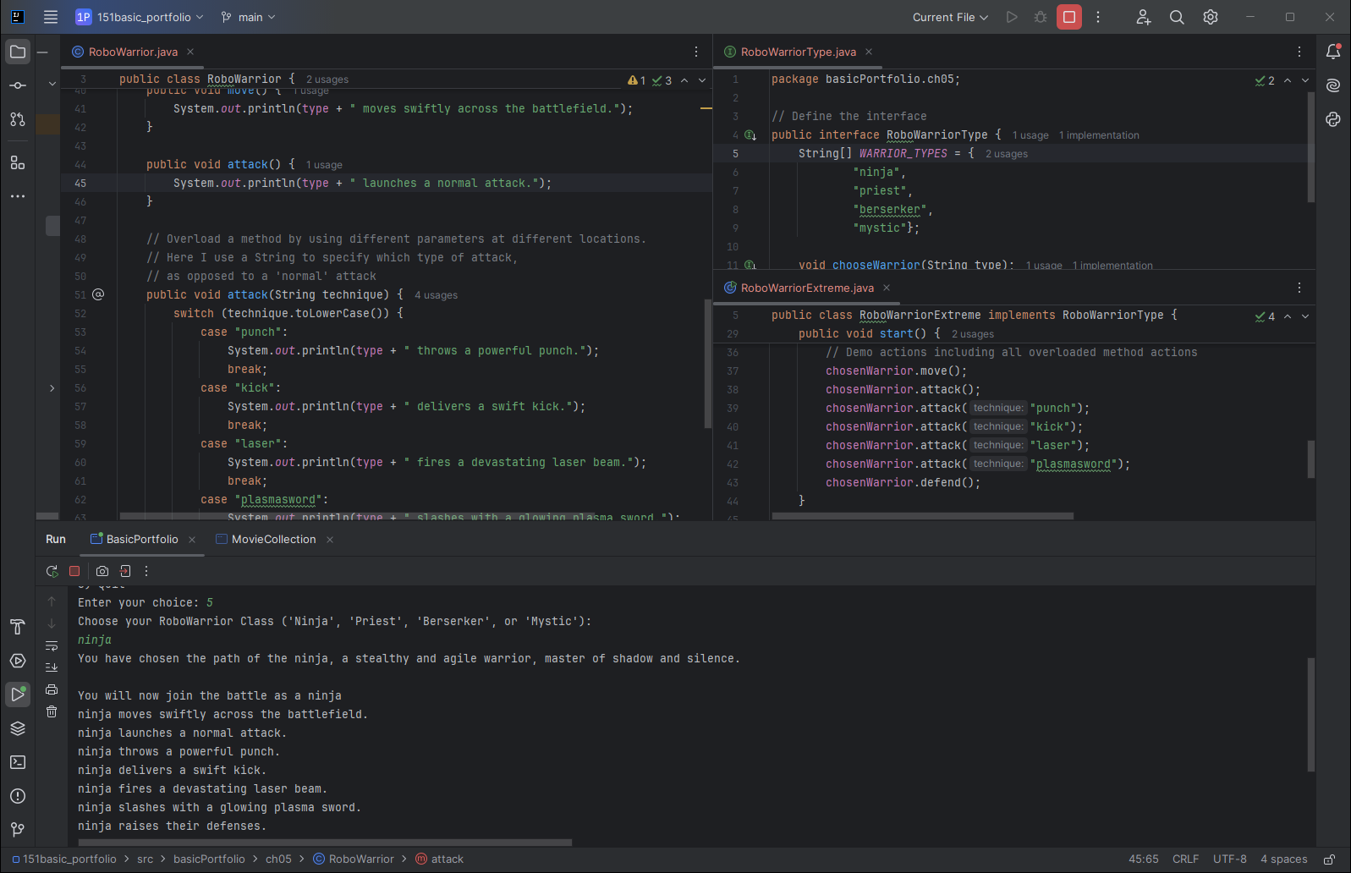
Project 06B:Create useful class with 1 overloaded method
Goals:
The ‘RoboWarrior’ class has both an ‘attack()’ method, or an overloaded: ‘attack(punch)’, ‘attack(kick)’, ‘attack(laser)’, and ‘attack(plasmasword)’ methods.

Slide 17
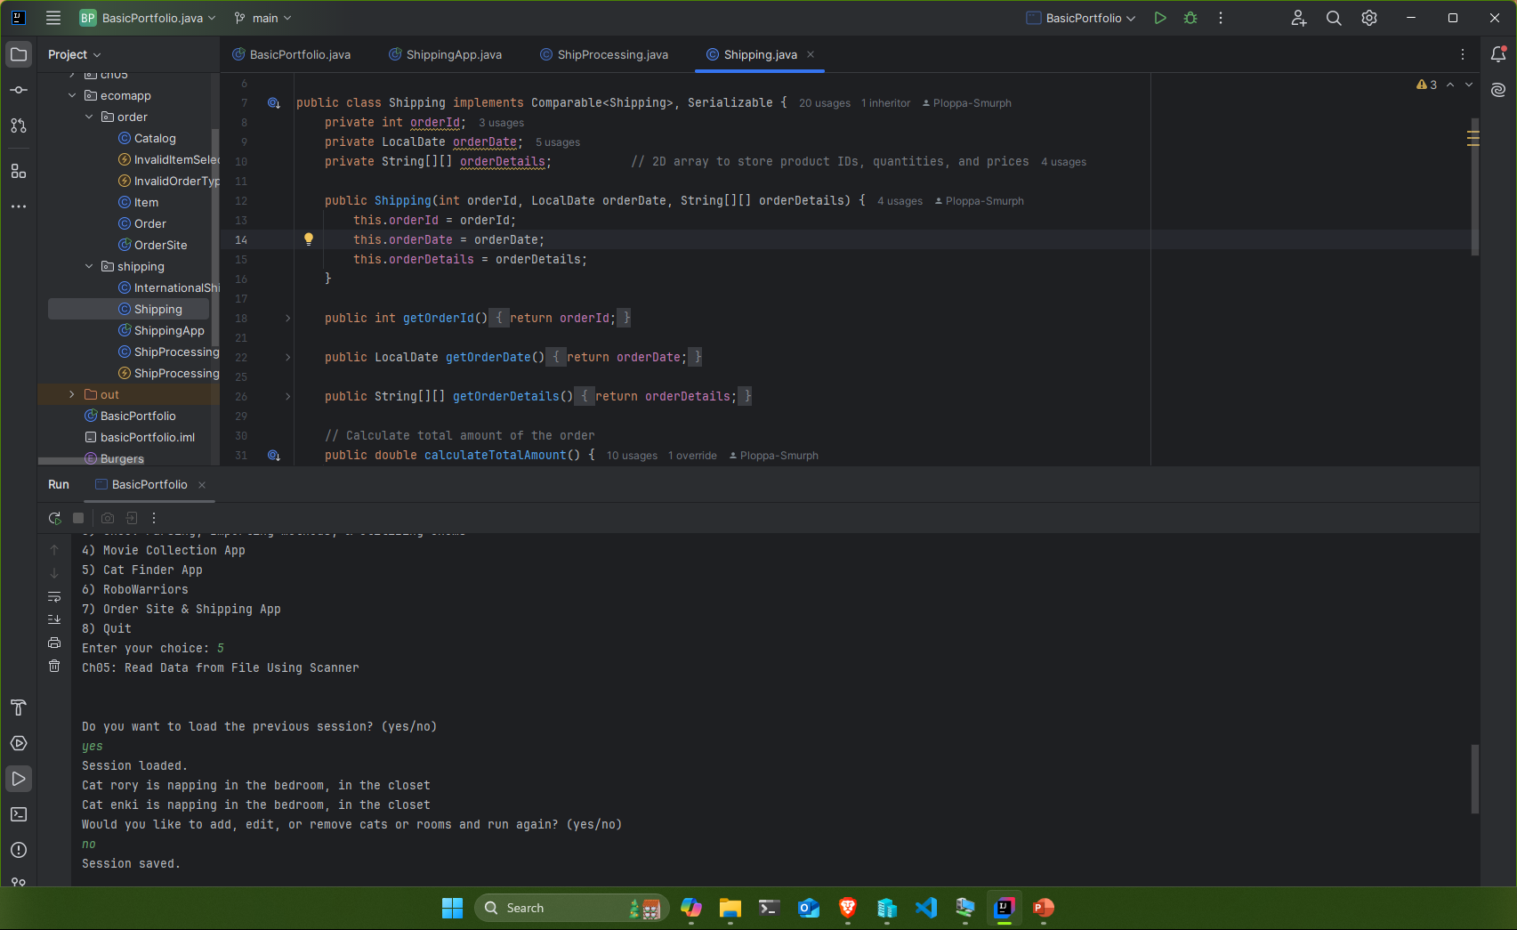
Project 07:Properly Utilize a 2-dimensional array
Goals:
The Shipping class contains the ‘orderDetails’ 2-Dimensional String array.
The Shipping constructor then utilizes the orderDetails 2-Dimensional array.

Slide 18
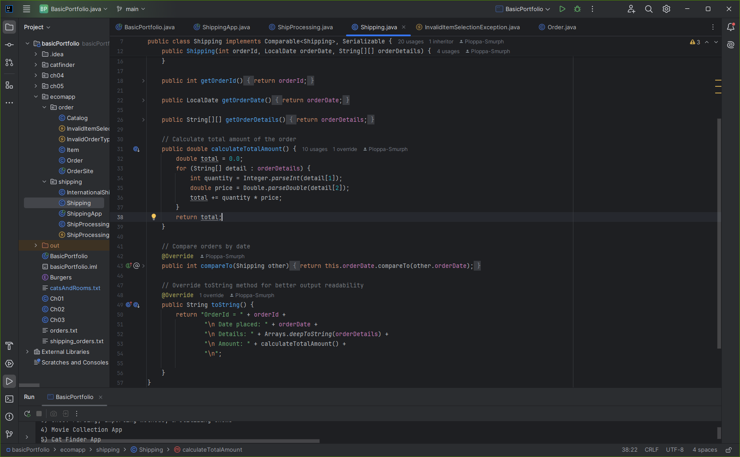
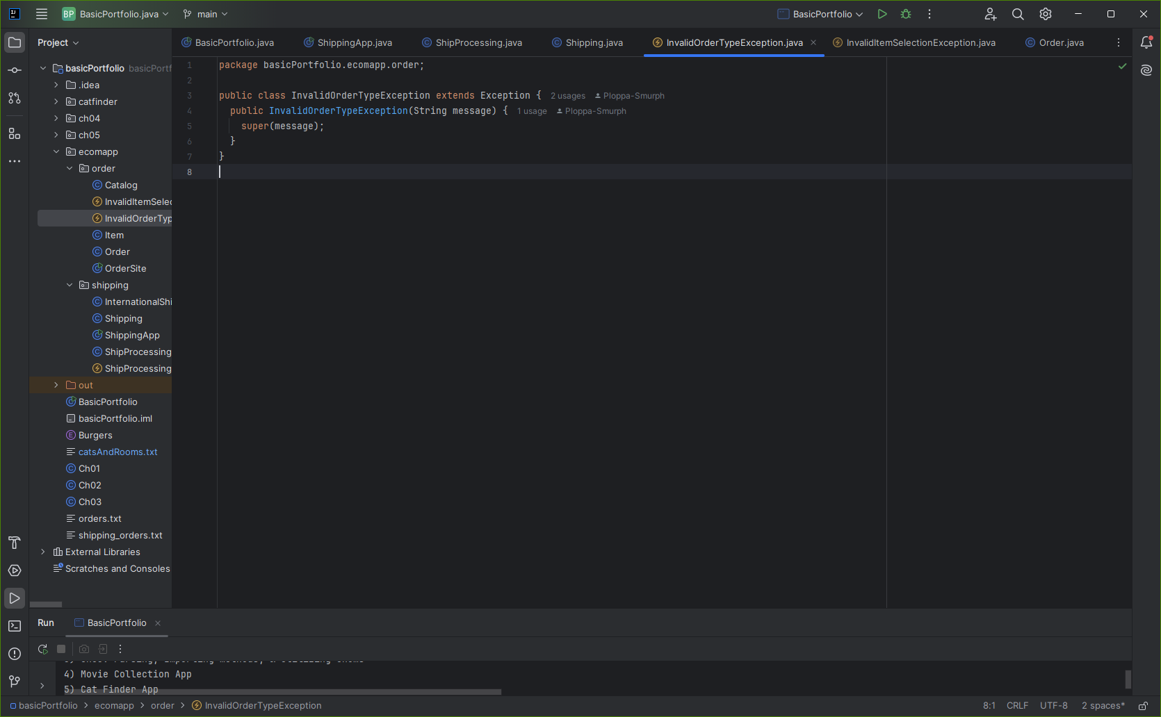
Project 07b:Properly override a method in a subclass & utilize super() in a subclass constructor
Goals:
@Override of the compareTo and toString.
super(message) calls the constructor of the superclass(Exception).

Slide 19
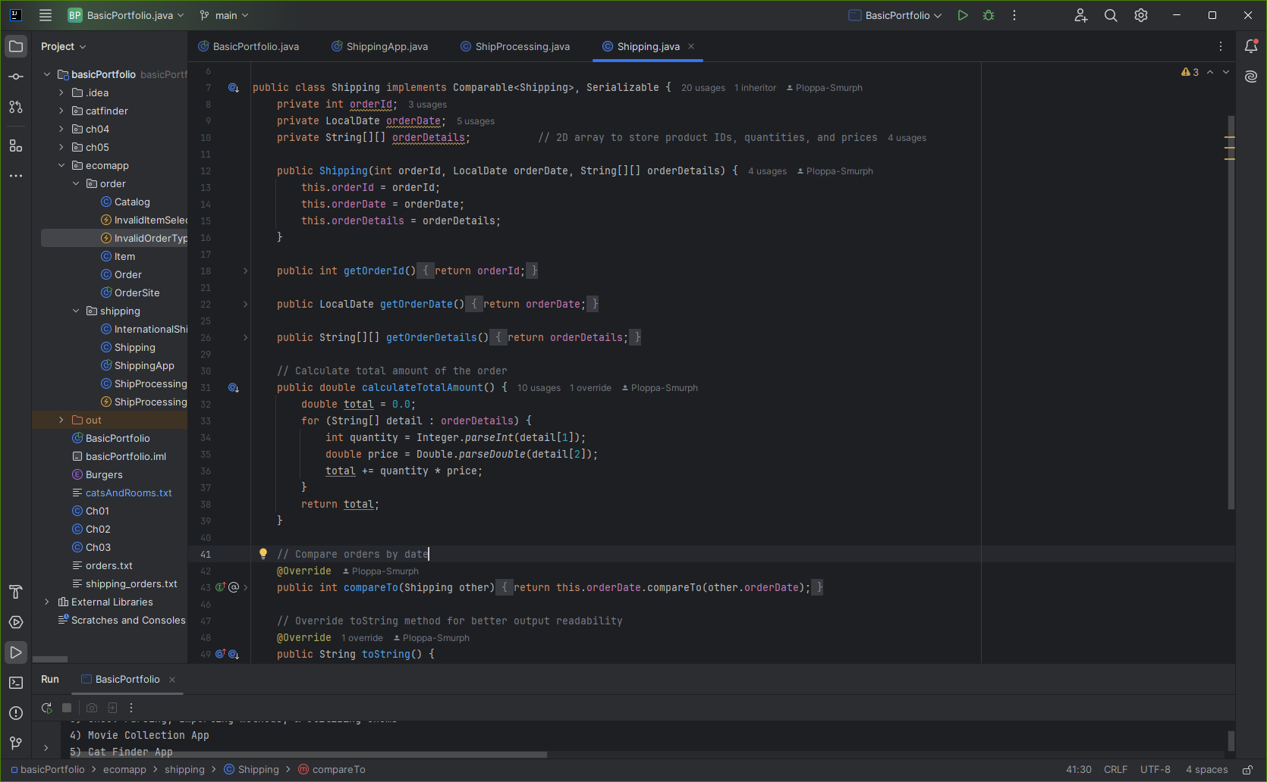
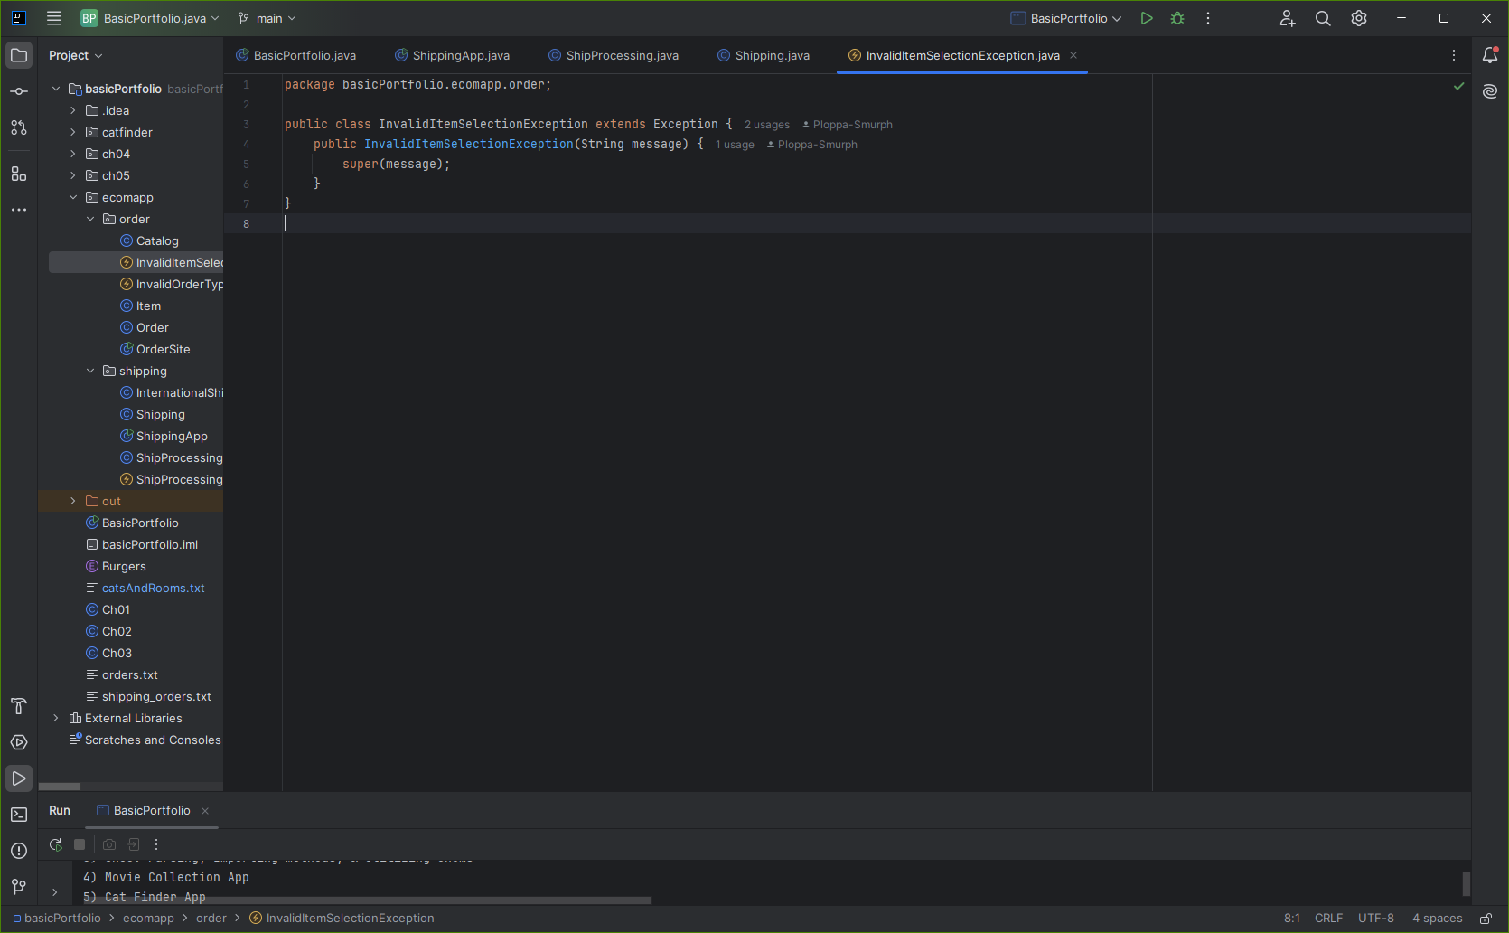
Project 07c:Properly implement the Comparable interface; Create a custom Exception
Goals:
The Shipping class implements the Comparable<Shipping> interface.
InvalidItemSelectionException is a custom exception class.

Slide 20
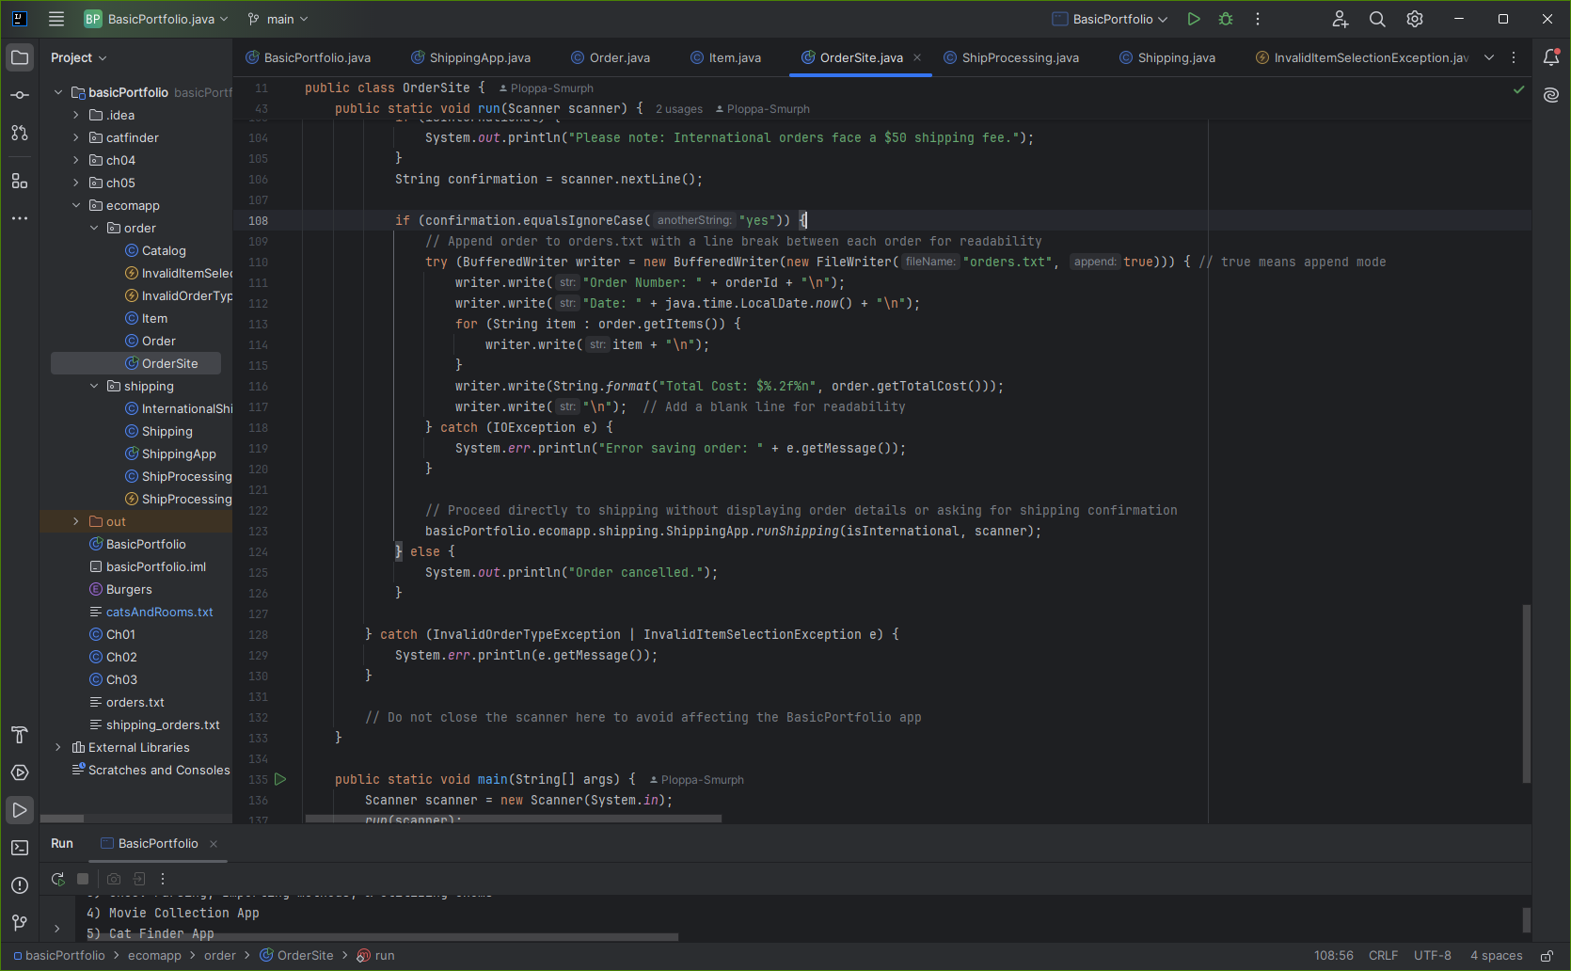
Project 07d:Properly implement a try / catch statement; Properly write data to a file
Goals:
Try / Catch blocks are used to correctly manage and control errors in code.
In this code I used BufferedWriter to create and append the ‘orders.txt’ file.

Slide 21
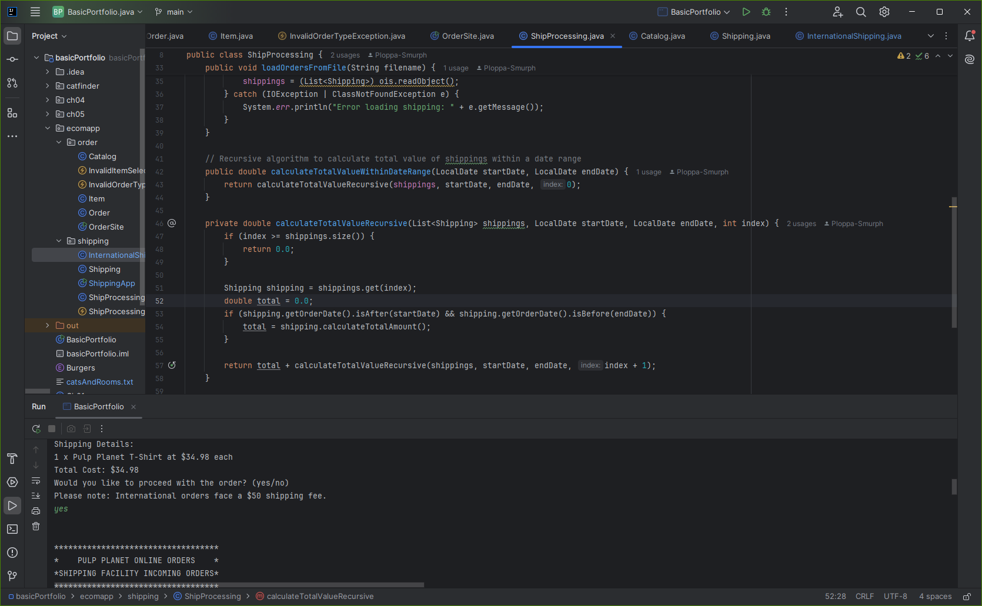
Project 07e:Display an understanding of how a recursive algorithm is implemented
Goals:
This recursive algorithm goes through shipping information and returns the total value of orders within a certain date range.
Recursive methods call upon themselves to complete complex tasks by breaking them down into simpler sub-tasks.

Slide 22
SUMMARY
Throughout these projects, I've demonstrated my ability to grasp and apply essential Java programming concepts, meeting all the portfolio requirements. Starting with simple tasks like printing to the console and performing mathematical operations, I progressively tackled more complex challenges such as parsing strings, using enums, and handling file inputs.
The Movie Collection app, for instance, showcases my proficiency in creating custom classes, utilizing encapsulation, and managing data using ArrayLists. In the RoboWarriorExtreme project, I highlighted my understanding of switch statements, interface implementation, and method overloading.
These projects collectively illustrate my capability to solve practical problems with Java, underscoring my readiness to take on more advanced software development tasks. This portfolio not only reflects my technical skills but also my journey as an enthusiastic student of programming.

Slide 23
THANK YOU
JEFFREY WALLEY
jeffreywalley@student.bpcc.edu
https://walleyworks.netlify.app/

