Slide 1
SERVER-SIDE WEB PORTFOLIO
Jeffrey Walley
CTEC-259 Spring 2025

Slide 2
Server-Side Web Development with Python, Flask, and Jinja
Task 01 - Create and use a virtual environment
Task 02 - Create a requirements file that can be used to fetch dependencies for a project
Task 03 - Build a working Flask route that utilizes URL variables
Task 04 - Build a Jinja template that properly utilizes a template conditional statement and/or a template loop
Task 05 - Build a Jinja template that inherits from another base template
Task 06 - Read and utilize data from a form submission
Task 07 - Properly implement CSRF (Cross-site Request Forgery) Protection

Slide 3
Server-Side Web Development with Python, Flask, and Jinja
Task 08 - Properly utilize the url_for() function
Task 09 - Properly implement form validation error display within a Jinja template

Slide 4
Task 01 - Create and use a virtual environment
Install Python 3 or higher
From the CLI create and navigate to a project folder
From the Command Line run:
# python –m venv venv
Install Python3
Move to Project Folder
From CLI: create a virtual environment

Slide 5
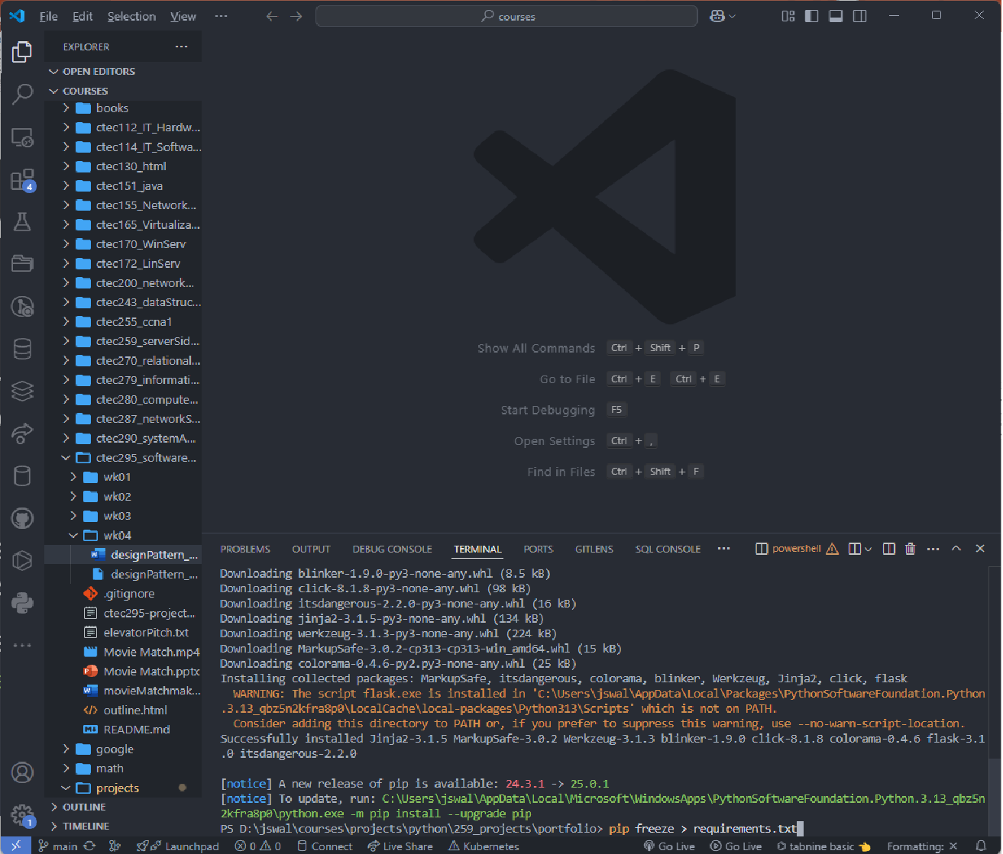
Task 02 - Create a requirements file that can be used to fetch dependencies for a project
After creating a python virtual environment, the user can install dependencies without the clutter of global installation
Use Pip, the python package installer and install flask
To create a ‘requirements.txt’ file: # pip freeze > requirements.txt

Slide 6
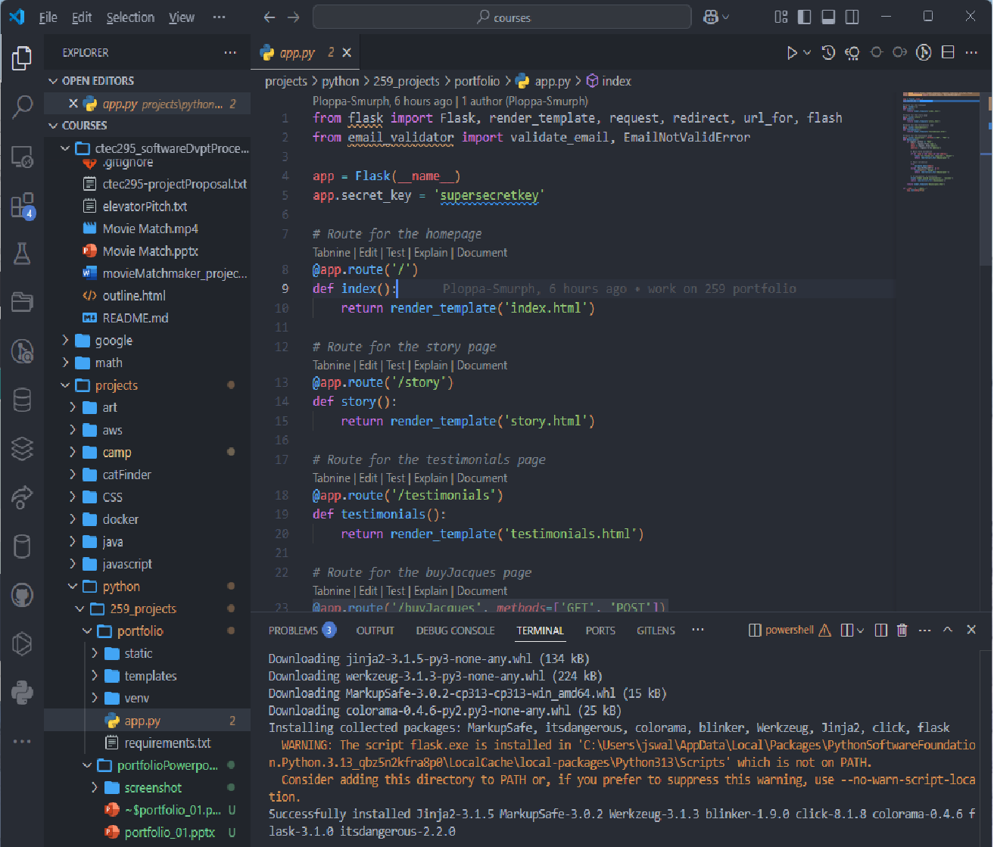
Task 03 - Build a working Flask route that utilizes URL variables
@app.route()
Define a function
Render the .html file

Slide 7
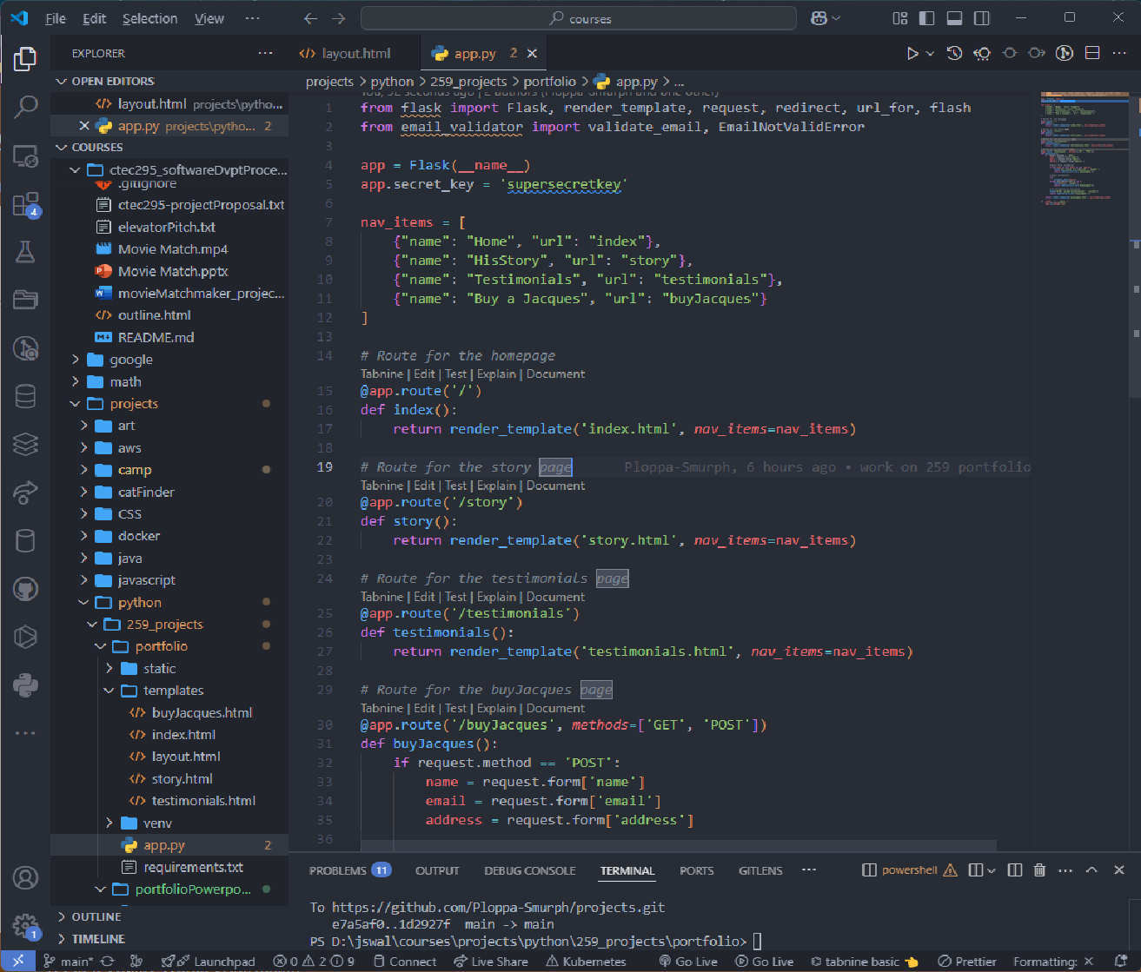
Task 04 - Build a Jinja template that properly utilizes a template conditional statement and/or a template loop
Define the items to loop through
Render through the items

Slide 8
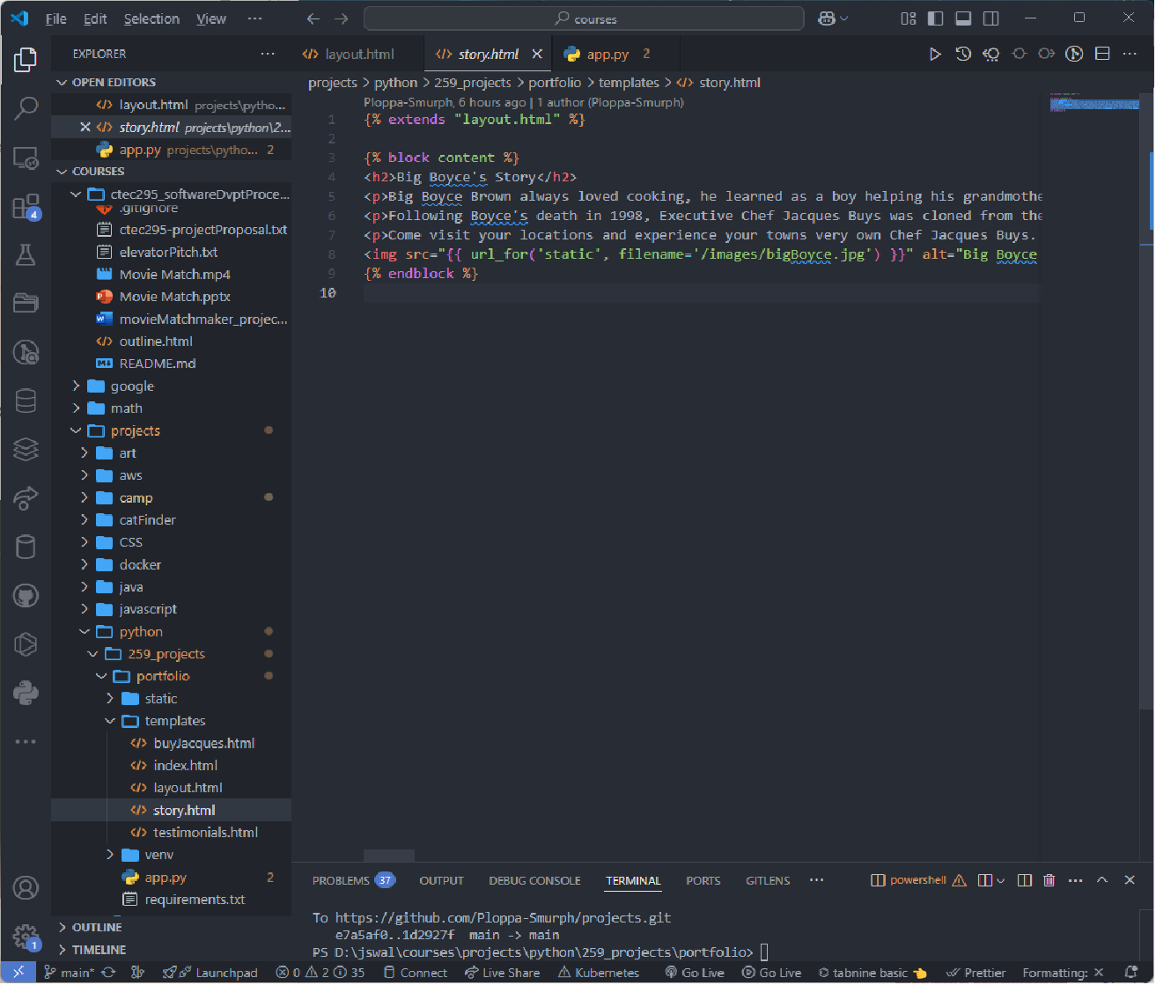
Task 05 - Build a Jinja template that inherits from another base template
The ‘story.html’ page extends, thereby it inherits from the base template ‘layout.html’

Slide 9
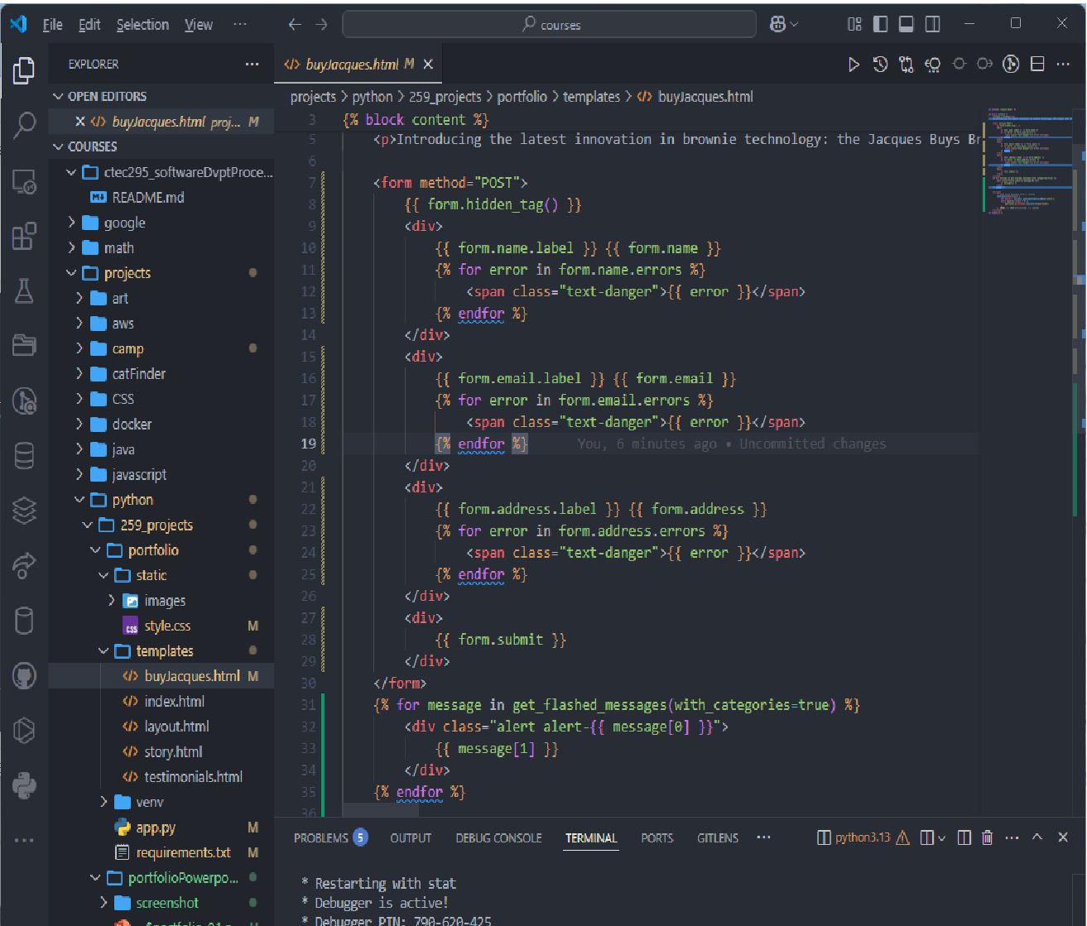
Task 06 - Read and utilize data from a form submission
The form tag collects and sends data through POST

Slide 10
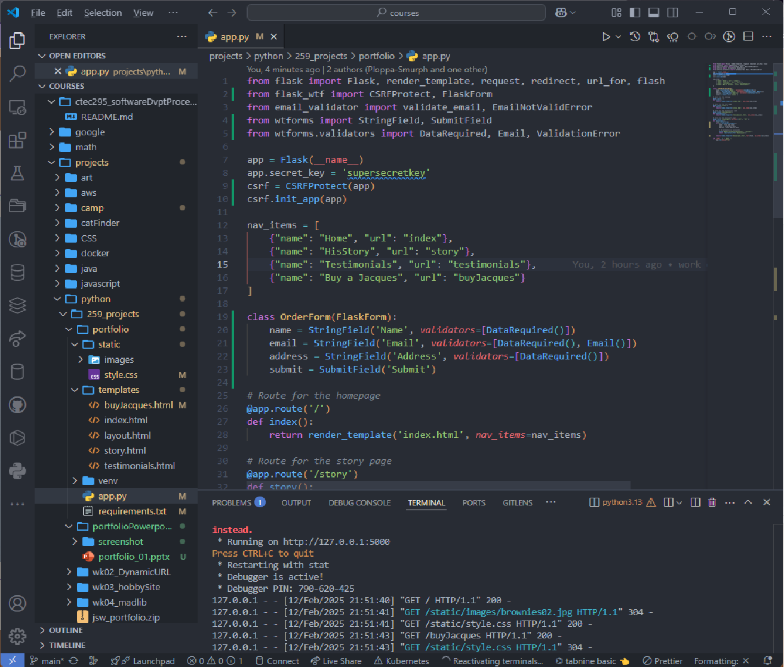
Task 07 - Properly implement CSRF (Cross-site Request Forgery) Protection

Slide 11
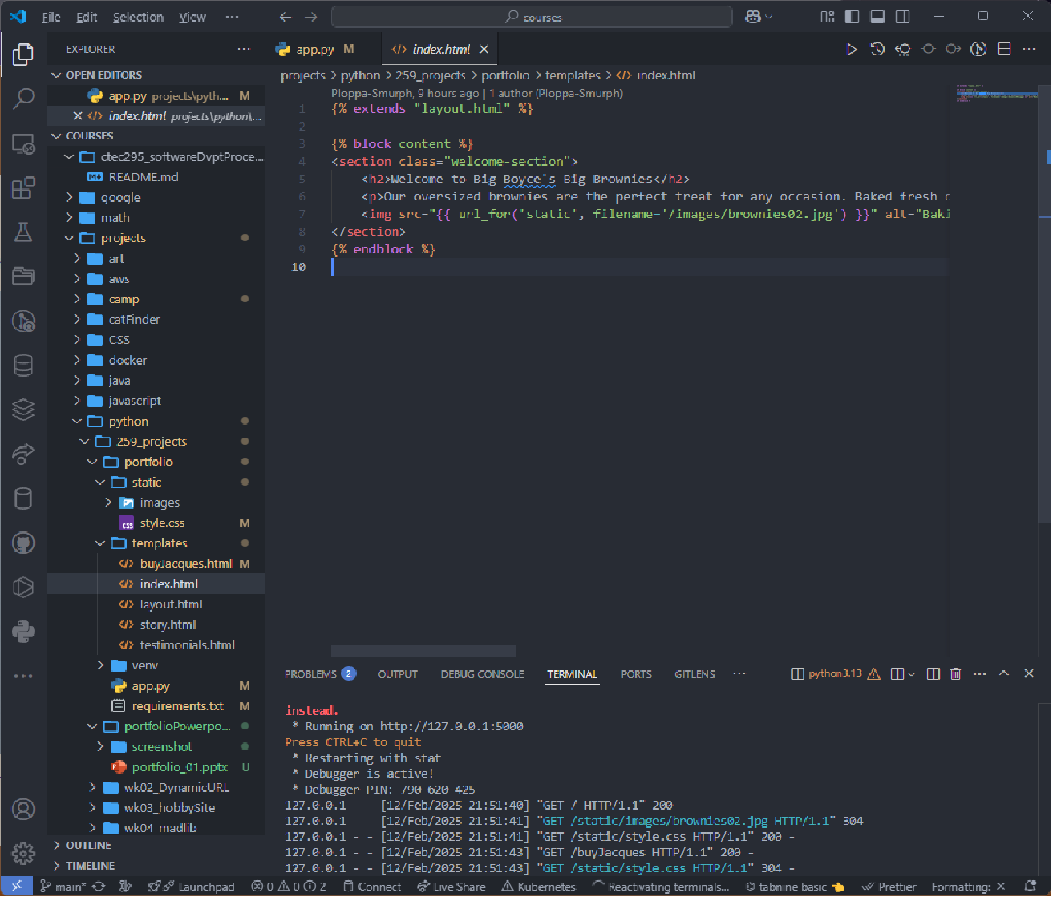
Task 08 - Properly utilize the url_for() function

Slide 12
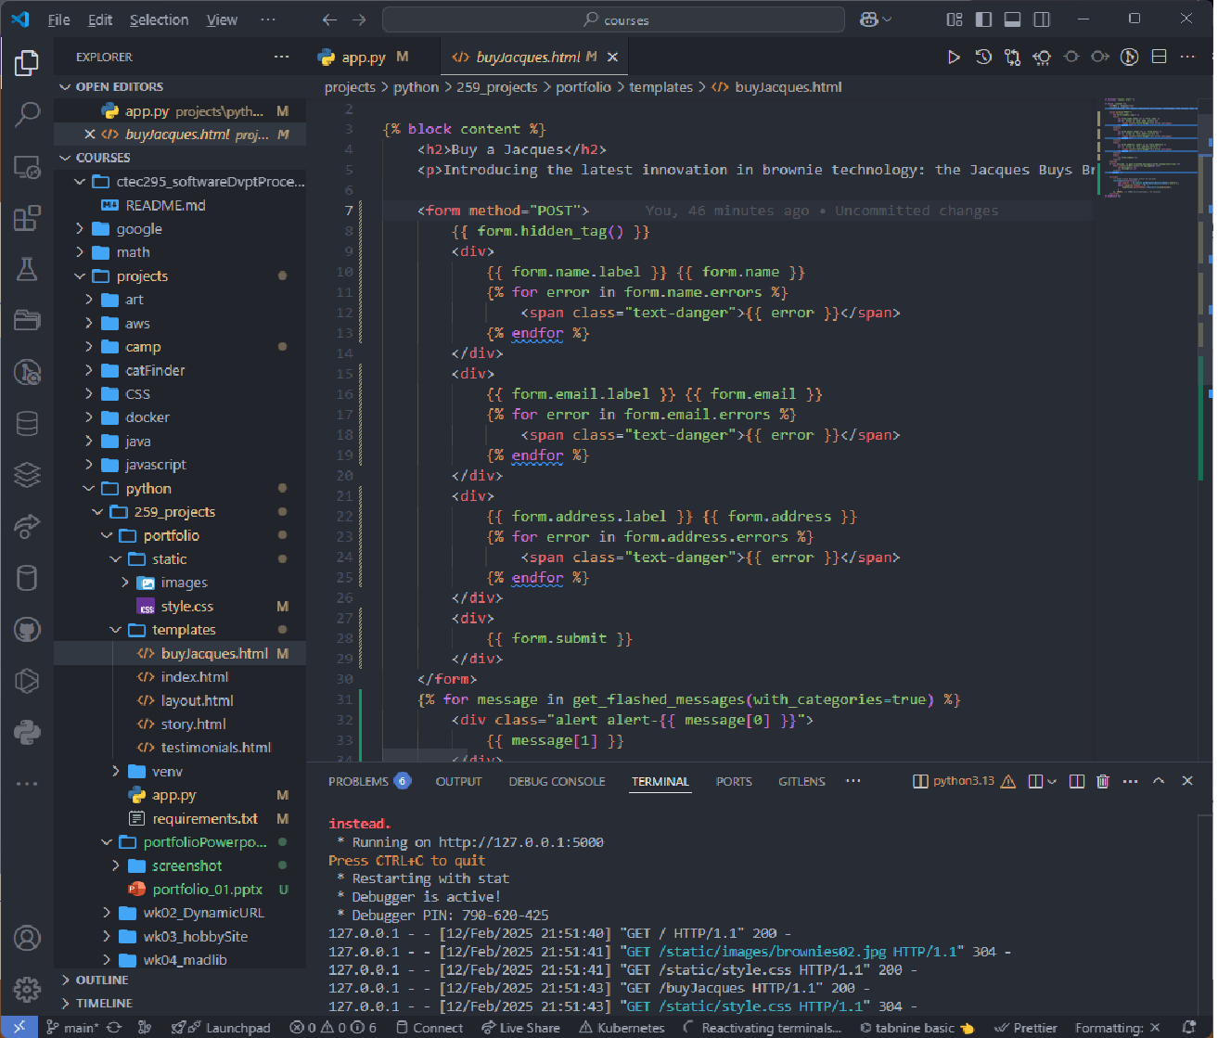
Task 09 - Properly implement form validation error display within a Jinja template

