Slide 1
Tests on SBD-STM algorithm

Slide 2
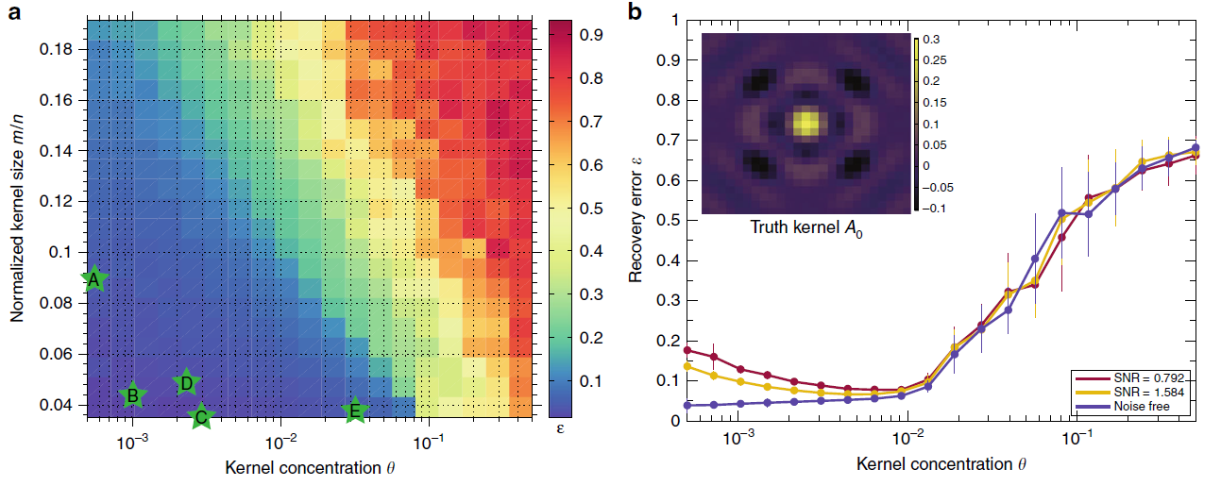
Effectiveness of the algorithm in the parameter space
Concentration of the scatters: theta θ (density of 1’s in the activation map)
Size of kernel: n= N*N
Size of observations: m = M*M
Area ratio: n/m
Sky C. Cheung etal (2020)

Slide 3
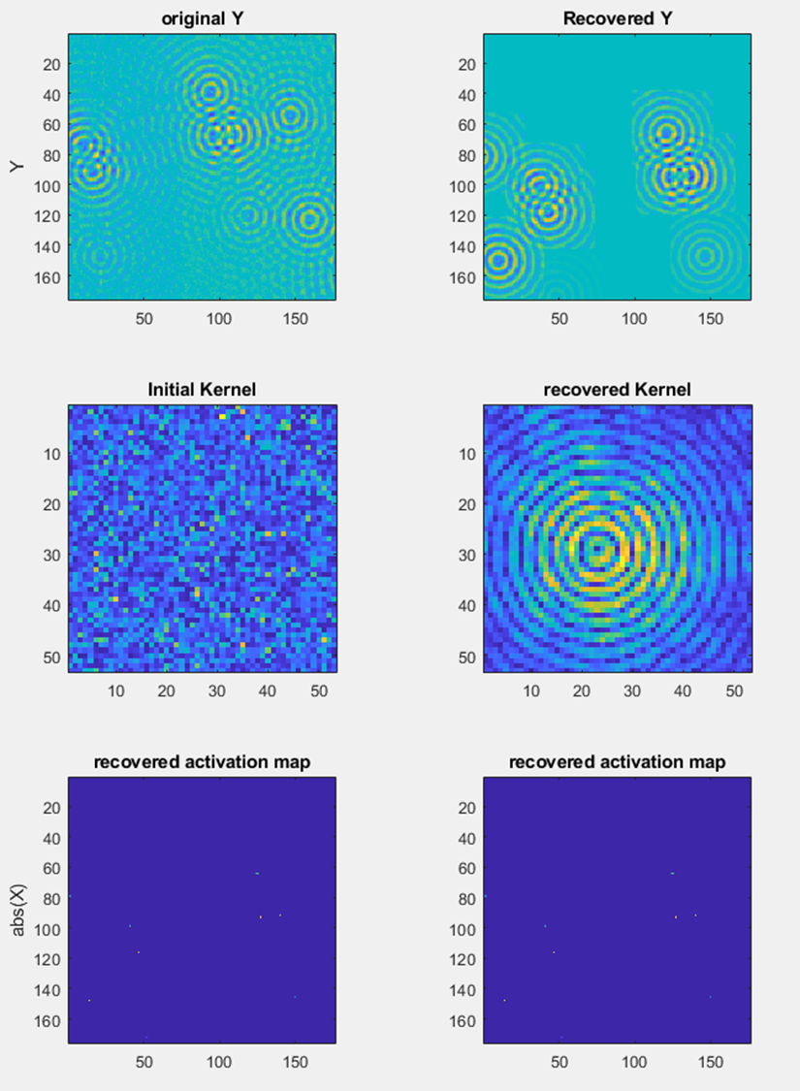
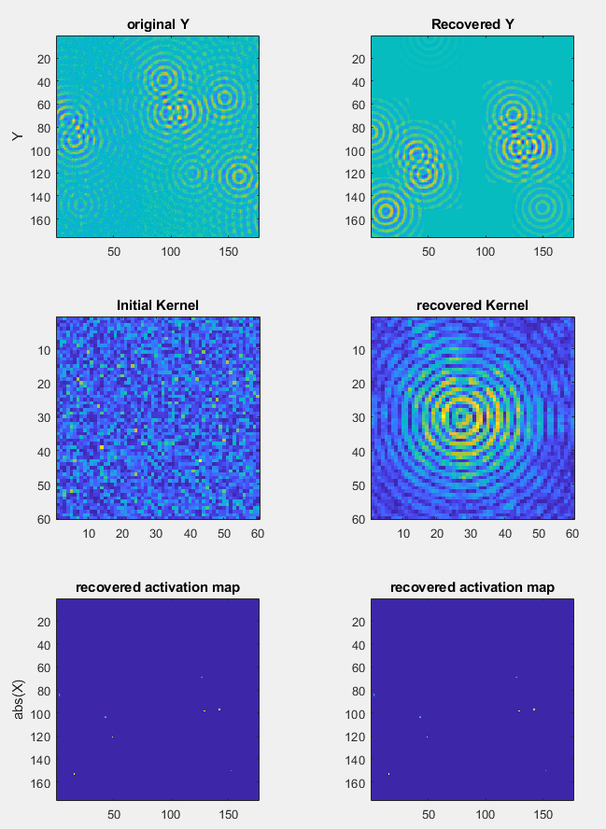
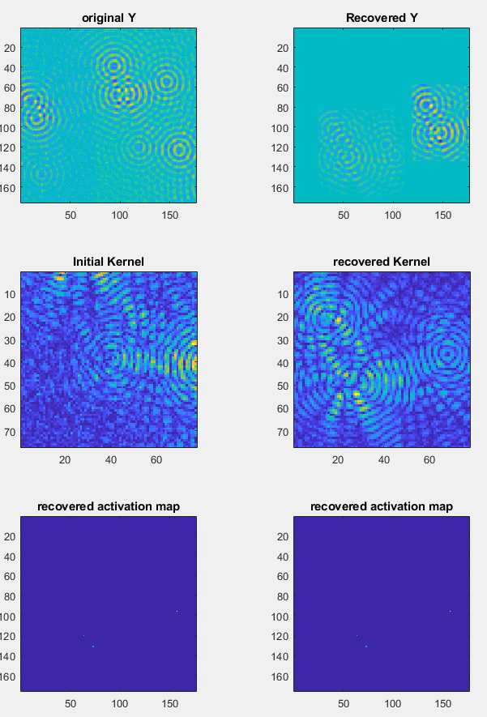
Test on the area ratio vs effectiveness
Observation size = [176 176]
Observation size = [176 176]
Observation size = [176 176]
Kernel size = [53 53]
Kernel size = [60 60]
Kernel size = [77 77]

Slide 4
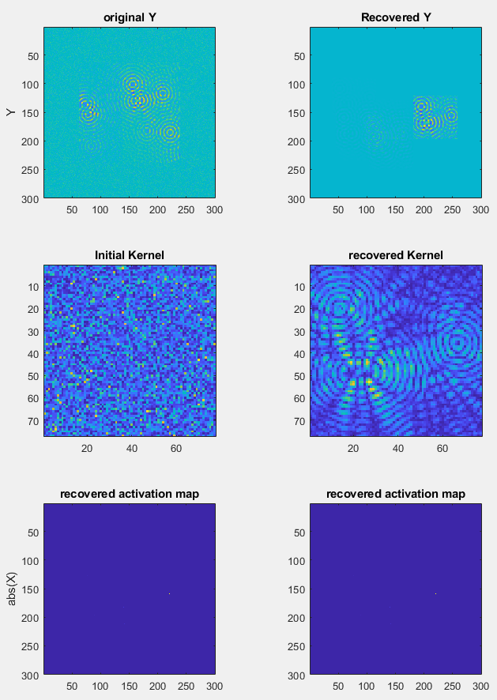
Test on the area ratio vs effectiveness
Padding with background mean and variance
Observation size = [176 176]
Observation size = [176 176]
Observation size = [300 300]
Kernel size = [60 60]
Kernel size = [77 77]
Kernel size = [77 77]

Slide 5
Test unpadded data with bigger lambda
Observation size = [176 176]
Observation size = [176 176]
Observation size = [300 300]
Kernel size = [60 60]
Kernel size = [77 77]
Kernel size = [77 77]

