Slide 1
FRA142 Computer Programming II
LAB 0 : Introduction to C++

Slide 2
What is C++ ?
It’s good to learn a second language
C++ is widely used
Can be more efficient
More control
C++ will let us “get under the hood” more
Data and program representation in memory
Memory allocation

Slide 3
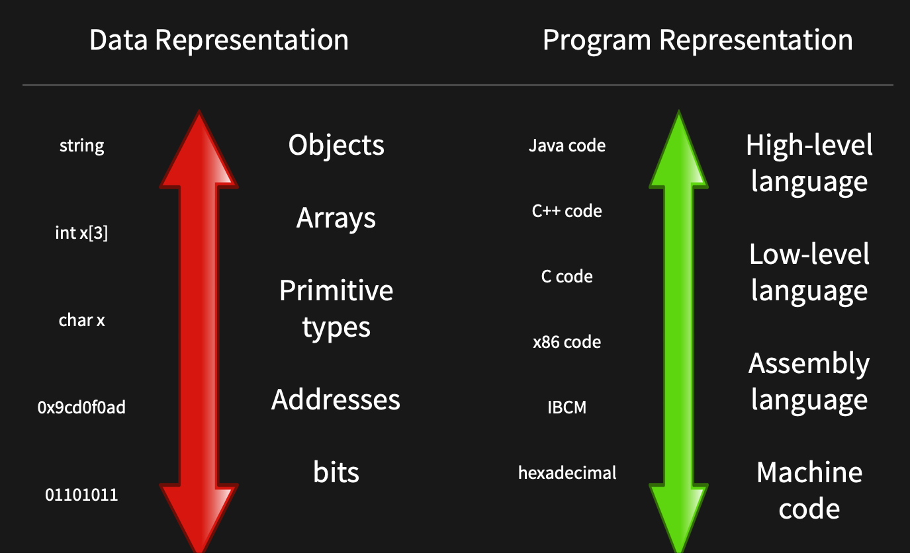
How programming languages work

Slide 4
Setting up C++ environment
IDE for C++
C++ Compiler

Slide 5
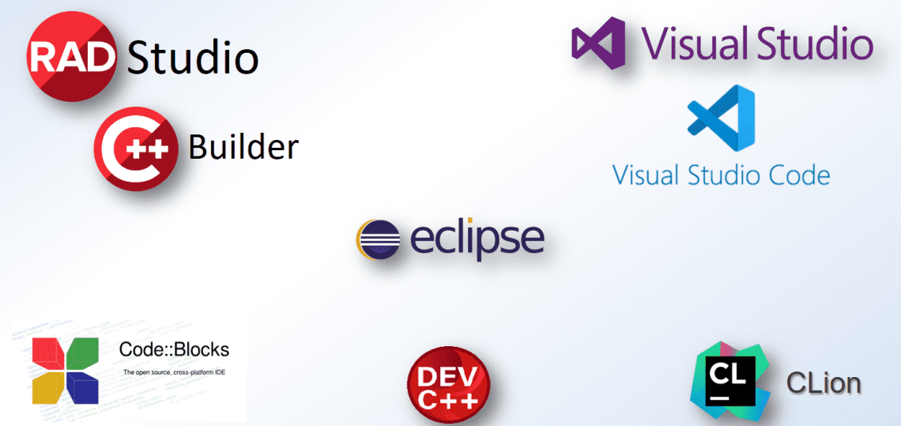
IDE for C++

Slide 6
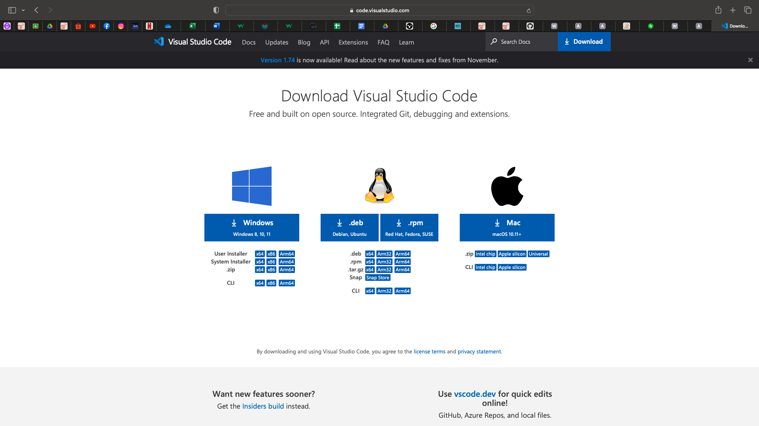
Visual Studio Code
VS Code Download Link

Slide 7
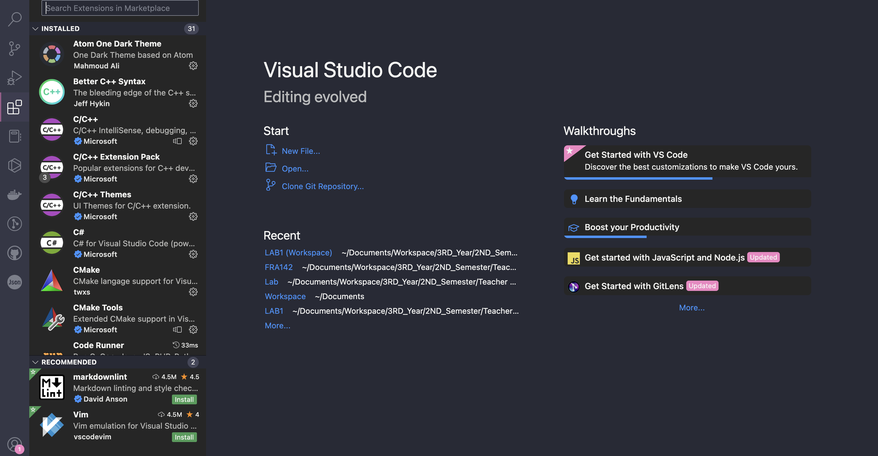
C++ Extension
Extension in VS Code

Slide 8
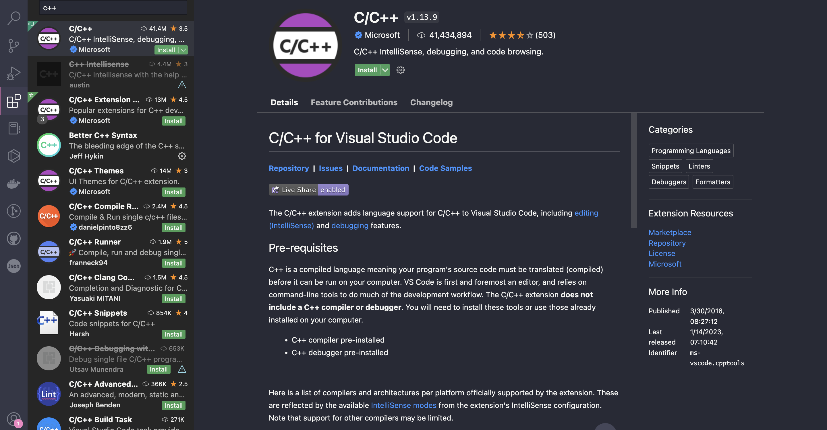
C++ Extension
Extension in VS Code

Slide 9
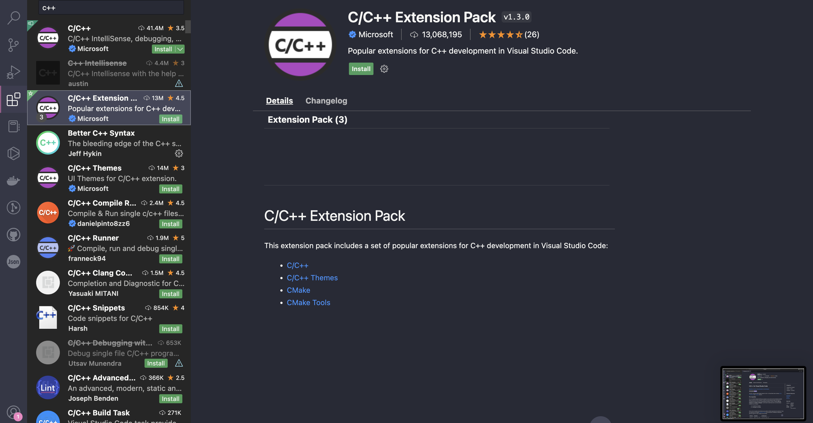
C++ Extension
Extension in VS Code

Slide 10
C++ Compiler
GNU Framework
G++
GCC
LLVM Framework
Clang++
clang

Slide 11

C++ Compiler
MinGW Download Link

Slide 12
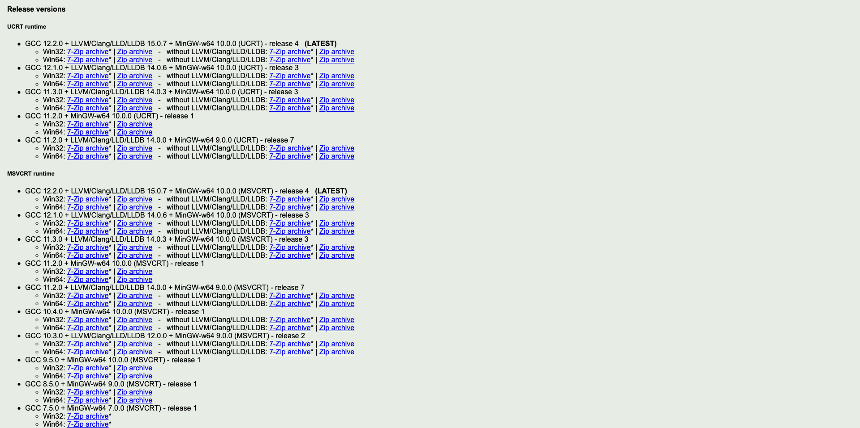
C++ Compiler
Release Version

