Slide 1
Anomaly Prediction using Deep Learning
My task was to familiarize with the research & understanding the applications of neural network on time-series data. Then building a Conv1D model for prediction of anomalies in breathing pattern.
Presented By: Rohit Singh

Slide 2
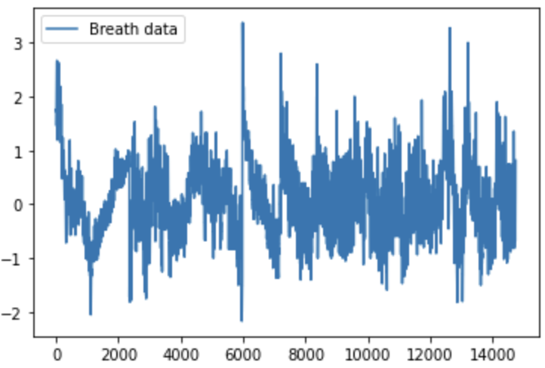
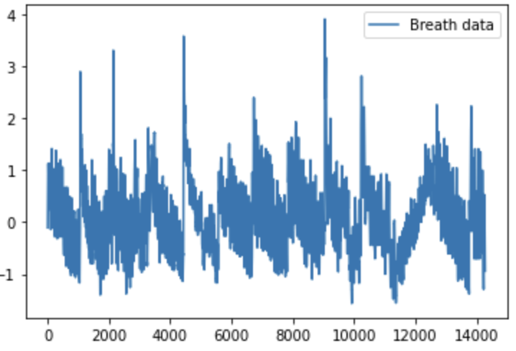
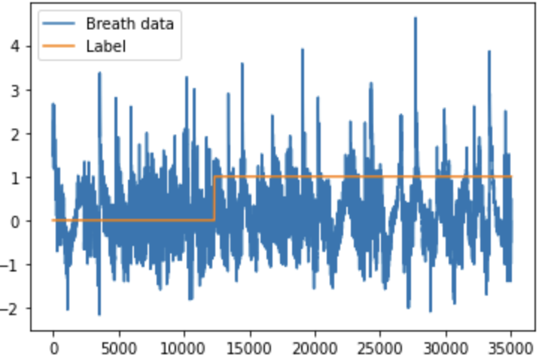
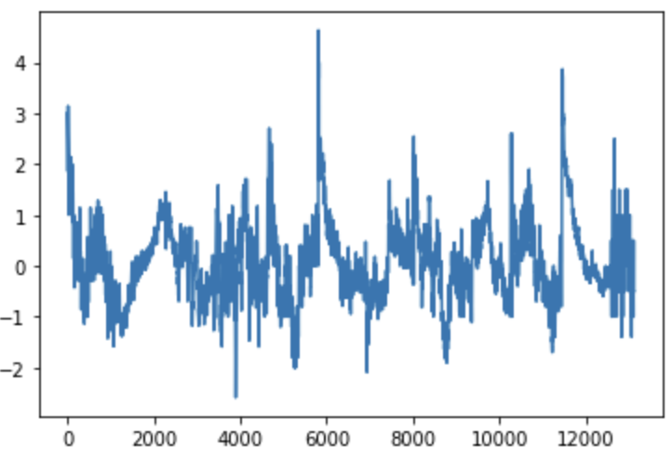
Data Preparation
+
=
+
Normal, Deep & Quick breath datasets were imported and Binary Labels were added temporarily ( Normal/Not Normal). After cleaning the data (removing few error input), the datasets were scaled individually and then combined to form a normalised ‘total’ dataset.
Normal
Deep
(Not Normal)
Total = Normal + Not Normal
Quick
(Not Normal)
Total Binary Dataset after normalisation

Slide 3
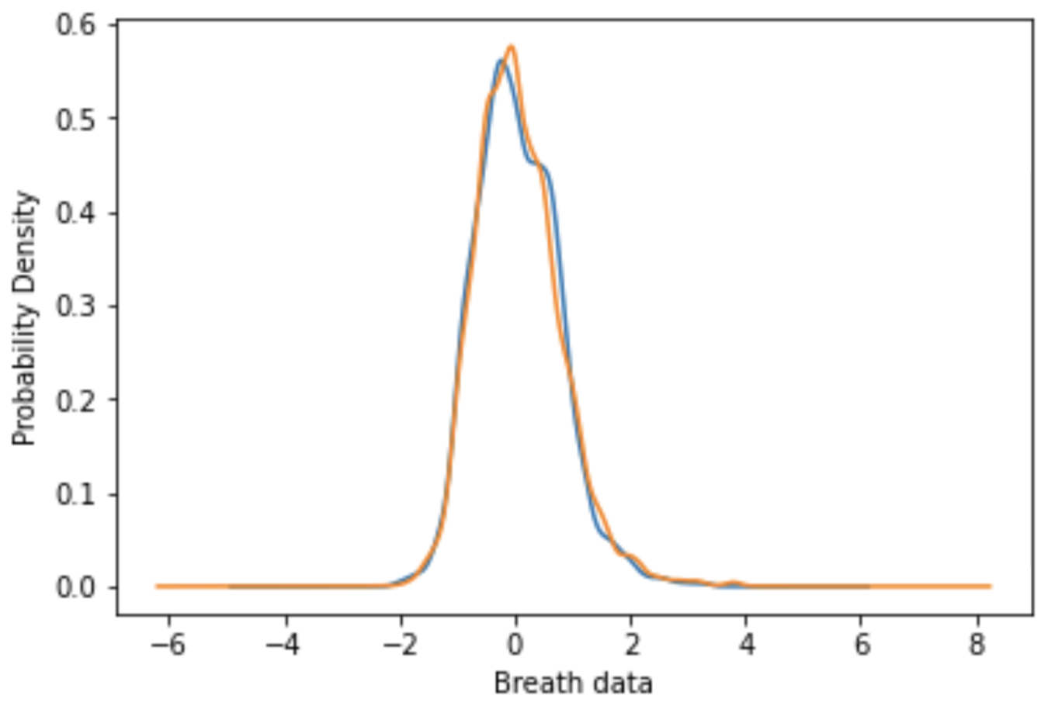
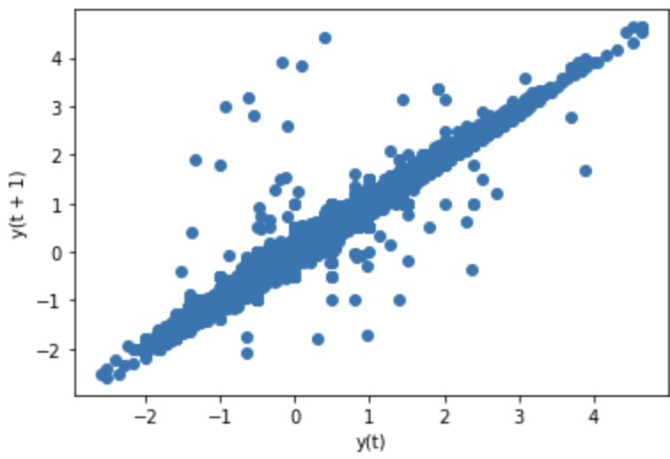
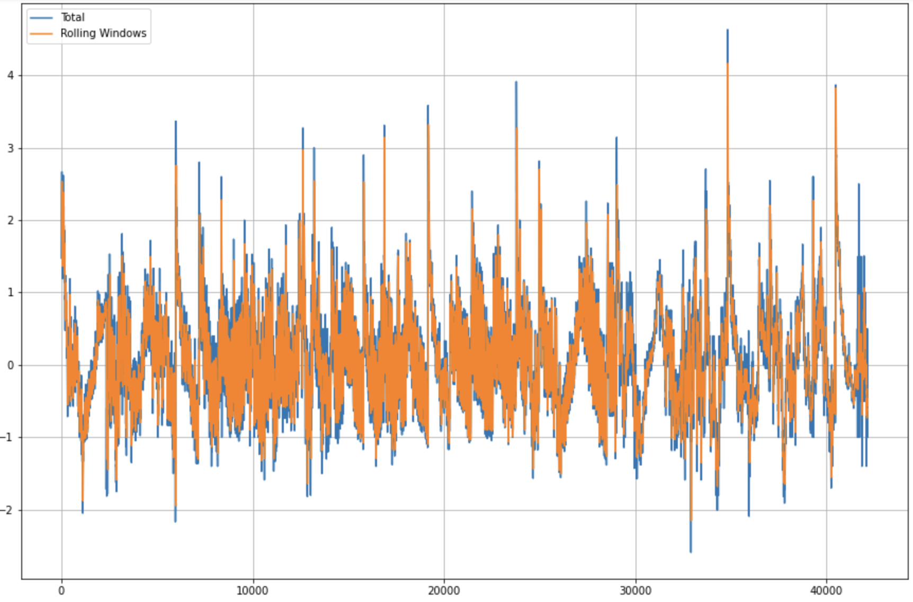
Data Exploration
Normal
Total Data
Not-Normal
Rolling Windows
Strong data correlation
(Between previous and future values)
Rolling Windows
(Previous mean values predict future values)
Probability Distribution: Most values in Normal & Not-Normal datasets have similar range of values since we have single labels over both the datasets which overlap each other as shown in graph. There should be some threshold with which the data/values are differentiated to Normal and Not-Normal. There is a difference in their Pattern & Peaks which the model will learn during training but it needs more information to accurately classify data. Finding those thresholds is one such method.
Data Correlation: The correlation of previous and future values in dataset is good (Rolling Windows). This means there should be a way to calculate anomalies when there is bad correlation in the data. There is a possibility to set some threshold in the data so that our model would be able to predict anomaly in correlation.
Probability distribution (KDA)

Slide 4
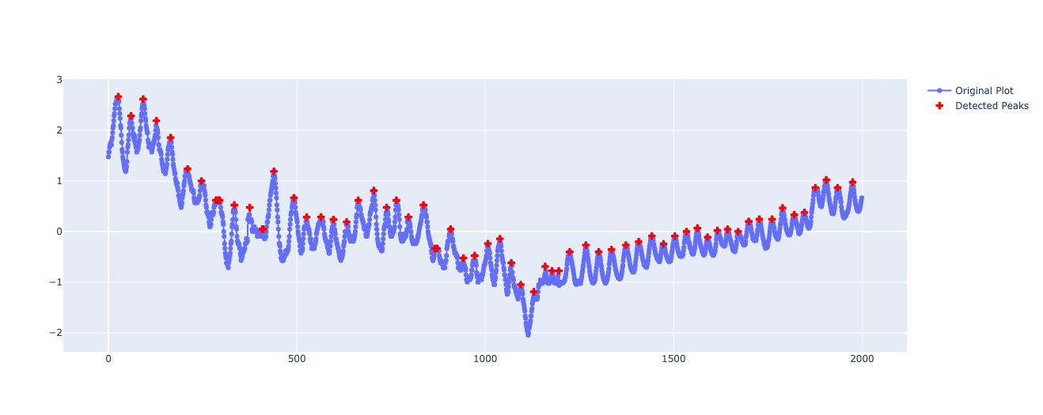
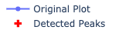
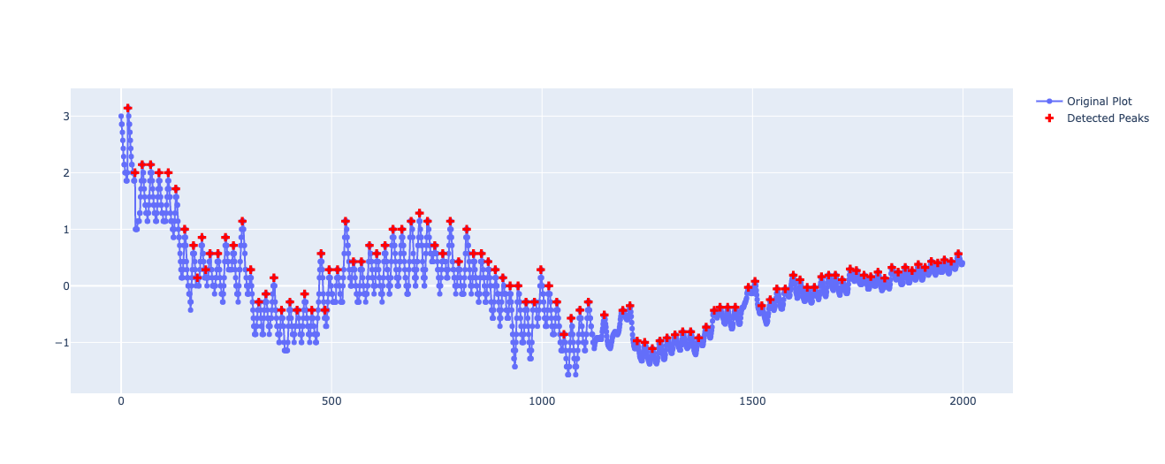
Normal
Deep
Quick
Not-Normal
Analysing the Peak Data
Intensity(no.) of Peaks in Quick data > Normal data + Deep data peaks intensity.
Overall, Peak Intensity of Normal Data > Not Normal Data (4.2%>3.5%)
Deep data Peaks have more height of Crest & Troughs than that of normal & quick.
So, Peak Height Comparison: Deep breath data > Normal breath data > Quick breath data.
Overall, Mean value and Height of Peaks of Not Normal Data are Lower than that of Normal data.

Slide 5
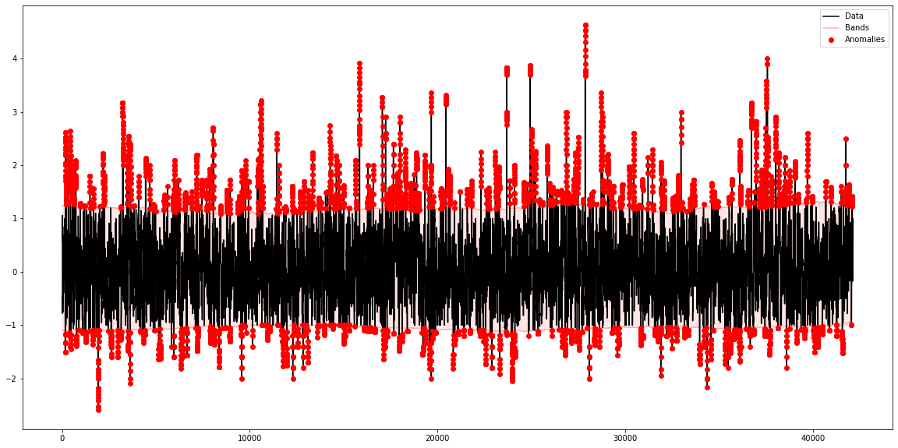
Sliding Windows technique (SWT) to detect anomalies.
Breath data has good correlation between previous and future values so i built a sliding window where, for each window i computed mean and standard deviation. This creates a local threshold (value). Next, i compared its value with all the values in the window. If it’s greater than mean +/- 1.5 times the standard deviation ( Upper/Lower Bands), I considered such points as anomaly. Therefore it detects abnormal spikes in the dataset.
Sliding Windows on shuffled data

Slide 6
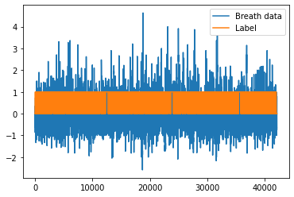
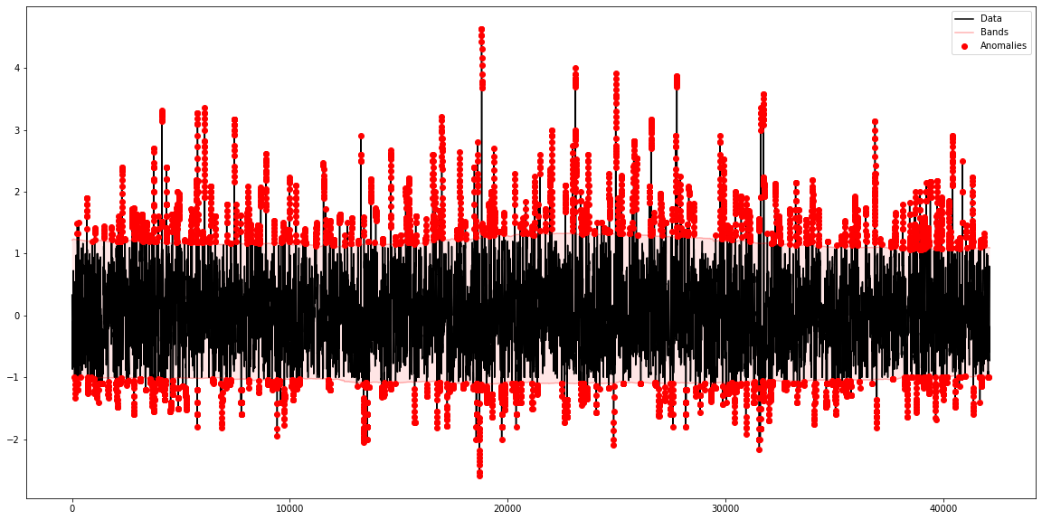
Overview
Pre-Processing Pipeline
1.
2.
3.
Anomaly
Normal
Total Dataset
(Normal + Not Normal)
Shuffled Total Dataset
Sliding Window
(On Shuffled Dataset)
After preparing the total dataset, I shuffled it in such a way that 20 simultaneous data points are grouped together. Randomisation gives a better result for SWT & model accuracy. After applying SWT, I got the anomaly values in dataset which I converted to Not-Normal and remaining values were labelled Normal. These labels replaced the previous set of labels which showed a single label over the whole data.
Now the dataset consists of Breath data and corresponding labels.The new ‘total1’ dataset is fit into Conv1D model for classification.

Slide 7
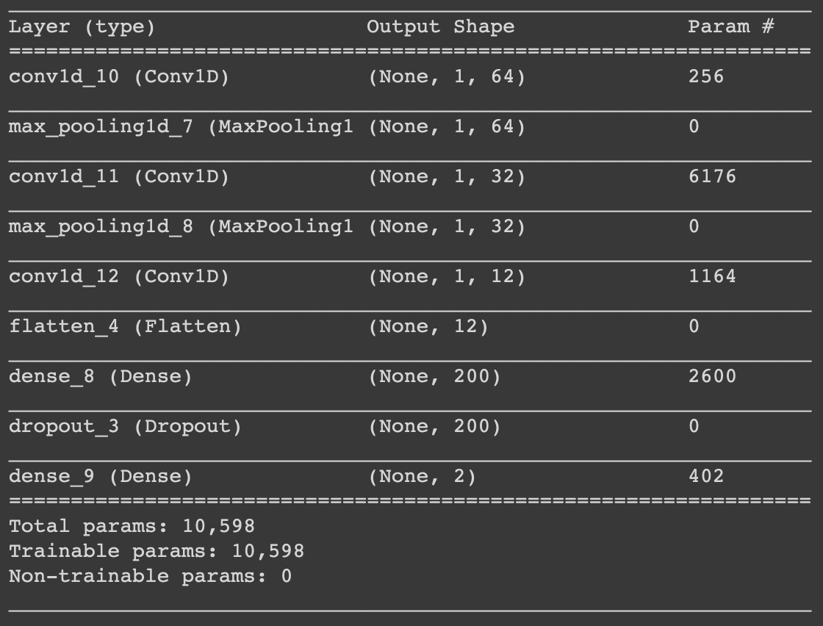
Conv1D Model
3 Convolution layers & 2 Dense layers are used for univariate analysis. Optimal hyperparameters were chosen to give the best output. ‘total1’ dataset is divided into train & test datasets in 80:20 ratio. I also used Validation dataset (10% of train data ) to tune parameters performance during training.
Model learned from pattern & detected anomaly in the peaks with high accuracy.

Slide 8
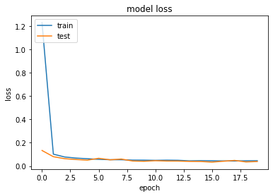
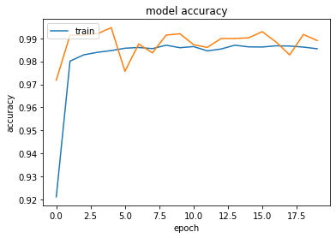
Result
During the internship term, I learned the application of deep learning for anomaly prediction and applied those techniques on the research project with the following results. Right now i am fine-tuning the model as we collect more samples to minimise error.
Model Loss: 0.057 (Low)
Model Accuracy: 97% (High)

Slide 9
Appendix
1- Code: Link to Colab Notebook.

