Slide 2
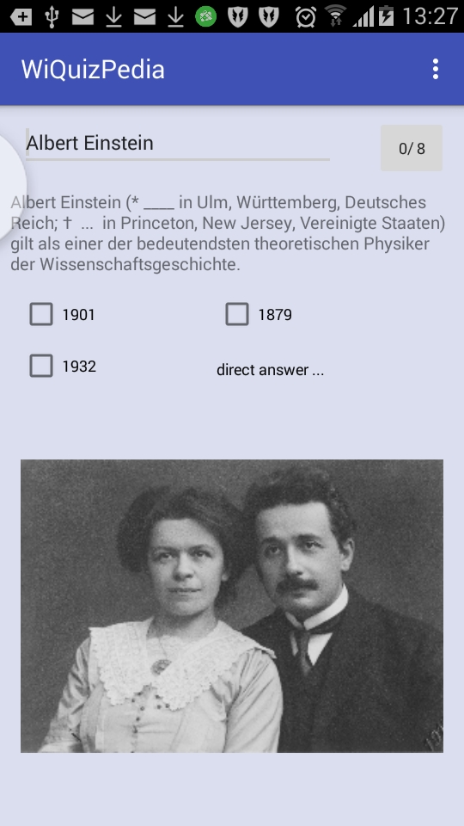

a random title
title to search
previous
query
next
query
add
next sentence
comment
(single tap)
random titles in checkbox
(double tap)
open in wikipeda
(long press)

