Slide 1
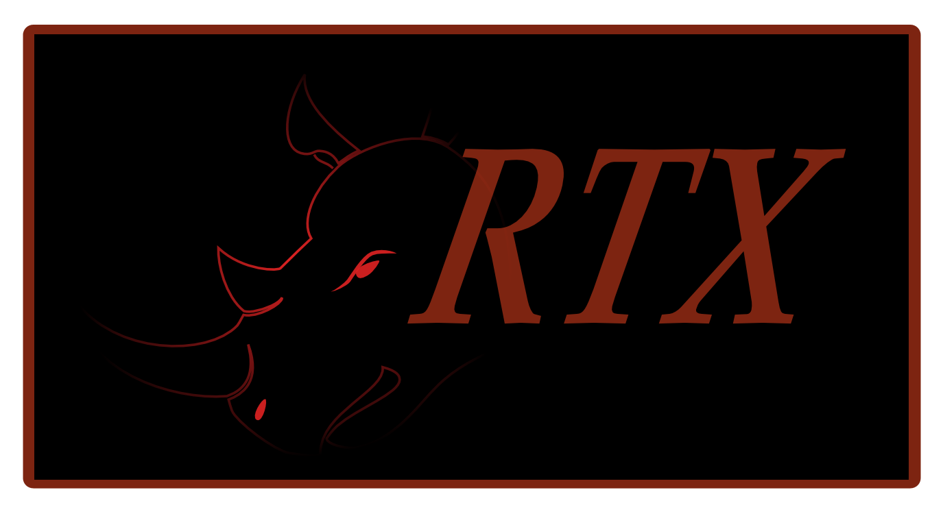
Rathaxes
Notes:
Hi everybody, I’m XXXX from the Rathaxes project.
Today, we are going to talk about something common in the Computer Field.
“Devices Drivers”
There are litteraly millions of computer devices in the world.
Each of these devices requires a driver to work, and each of these drivers has to be written by hand.
Moreover, each of these drivers must be completely rewritten for every OS in the world.
Until Rathaxes.
Rathaxes is an Epitech Innovative project that will revollutionize the way device drivers are developped.
We bring a whole new approache to the problem : The generation of device drivers !

Slide 2


Today’s specials
Why ?
How is it possible ?
Does it work ?
How does it work ?
How did we get there ?
Hello world !!!
Conclusion
Notes:
Today, we will explain how this new solution will truly bring a paradigm shift in this domain.
But let’s start with the appetizers : how much is Rathaxes needed ?
Why should we work on this issue ? Could you tell us Xxxxx ?

Slide 3
Why Rathaxes?
Driver development :
Requires a double knowledge
Lengthy training on each OS
Cross platform issue
Time consuming
Notes:
As Xxxxx(intro) said earlier, device drivers are common in the computer field as every operating systems needs them.
But that’s not it.
Drivers tend to be seven times more prone to crashs than regular software.
To be a device driver developer one needs to have at least a double knowledge :
- knowing the hardware
- knowledge of system programmation
And that’s for a developer who won’t have to port his work on several operating systems.
Let’s conclude by that, the device driver development is time consuming.

Slide 4
Why Rathaxes?
Critical part of a system: 70%
Needed by the operating system
7 time more crash prone
Notes:
Whether you are a device driver developer or a simple computer user, device drivers are a day to day issue for most people.
It’s even an issue for OS developers. Statistically, 70% of an operating system is composed of device drivers.
Fun facts, Microsoft published a bug report analysis some time ago :
- 24% of their BSOD on Vista are caused by nVidia drivers.
- Followed closely by ATI with 18%.
It’s time consuming , it’s a critical part of a system leading to crashes, it must be ported on several operating system and to develop an OS means having drivers written over and over again.
I hope I’ve managed to make you realize that there is a real need for improvement in this field.
And this is were Rathaxes comes into play by generating device drivers.
Is this even possible ? This surely seems like an utopia to me, could you help me on this Xxxxx ?

Slide 5

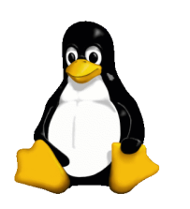

How is it possible?
Generating Drivers : utopia?
Focus on shared concepts
Abstract Operating System differences
?
Notes:
Generating device drivers is certainly not an utopia.
Code generation is a well known solution in the computer field, it means reusability of code and reduction of the development time.
As for driver generation, it’s an approach already thought by previous projects focusing on generating the lowest layers device driver with no consideration for multiplatform.
Even though we are starting from scratch a new solution, Rathaxes plan on generating the whole driver, with cross platform in mind.
In order to attain these objectives, we studied several different OS and focused on the shared concepts instead of the code in itself.
It was important to use that approach because OS are fundamentally different and it was necessary to abstract all the underlying principles
That is why we choose to study three OS, OpenBSD, Windows and Linux for their differences
Hence, Rathaxes will be able to generate drivers for most operating systems.

Slide 6
How is it possible?
Driver Anatomy
DEVICE DEPENDANT
OS DEPENDANT
ALGORITHMS
KERNEL INTERFACES
LIBRARY/BUS
CONFIGURATION
REGISTERS
LKM
Notes:
Our first task in Rathaxes was to understand what was a device driver in order .
If you would follow me, Let’s dive into the anatomy of a driver.
Device drivers purpose is to ensure the communication between a piece of hardware and your system.
Whether you install it on a computer with linux or Windows, this piece of hardware will stay unchanged.
A mouse will always be a mouse and react the same way.
Hence, There are innevitably pieces of code common on all systems.
We concluded that there are two distinct portions inside a device driver : a Device dependent part, and a OS dependant part.
Those two portions offer ways of communicating and handling information.
For the device, its main way of communicating is by registers.
The same way registers won’t change, the logic used with the information obtained will remain the same.
Those two concepts are Device dependant and are inherent to all device drivers.
To be able to interact with the system, the driver offers to the system several means of interaction.
First of all, the driver must declare himself to the system. The concept the most relevant for this is the loadable kernel module.
By doing that, the driver declares a set of « callbacks » and functionnalities that we called kernel interfaces.
Those kernel interfaces are the set of operations the device suports such as read, write or ioctl.
On the other side, the system gives to the driver its configuration , such as it’s type or magic number.
The system also provides acces to bus, or libraries of interaction that the algorithms will use to get information.
Those concepts are specific to the operating system, but are shared by most OS.

Slide 7
How is it possible?
OS Dependant concepts
KERNEL INTERFACES
COMMON INTERFACES
Read
Open
PCI INTERFACES
IoCtl
Write
BUS_SPACES
Close
AsyncRead
…
AsyncWrite
Notes:
One of those concepts we focused on the most is the kernel interfaces abstraction.
Those interfaces are the abstraction layers provided by OSes in order to relay information from userland to the system, and from the system to devices.
As said before, those interfaces are a common mechanism in most OSes, even if they all have a different API.
Whether you use a library to access the device or directly ioports, Rathaxes uses any layer of abstraction provided by the operating system. We won’t reinvent the wheel.
Hey, Xxxxx, Let us see how our subtle add on is rolling (they hating)

Slide 8
Does it work ?

Slide 9
Notes:
Demonstration : la meme que durant Tdose je pense que cela ira.
Transition :
I am certain that you wish to know more about this, well hopefully, Xxxx was planning to explain you the inner works of Rathaxes.

Slide 10
How does it work ?
Domain Specific Language
Compiler
Black Library
Notes:
Before explaining how Rathaxes is implemented, we can go further on what it is.
First of all, Rathaxes is a Domain specific Language. As SQL, it is a language used for a specific task.
Rathaxes will be dedicated to the field of Device drivers.
The domain’s underlying concepts we extracted from our studies will be implemented in this language as strong semantics.
This will allow developers to focus on the functionnalities of their device instead of focusing on the syntaxe to write for each OS.
As a complete solution, Rathaxes will also be composed of a Compiler. A Compiler is a program that converts a language into another, like a translator.
This compiler will have a library at is disposition. This Library, that Rathaxes called Black Library, will be composed of many pieces of code usable for the translation.
The Rathaxes compiler will translate our Rathaxes language in C language as it is the language used on most platforms for device drivers development.
Our compiler is made in Codeworker, a descriptive parsing scripting language. This extremely powerful tool saved us months of work.

Slide 11

How does it work ?
Parsing
RDSL
Parsing
BDSL
BackEnd
Files.rtx
.C Files
Windows
OpenBSD
Others
Linux
Black Library
Notes:
Language Parsing : Functionalities
BDSL Parsing : Extensibility, updatability
C Generation : Weaving the parsed code and the templates into a c file. This code will be human readable so it will possible to edit it for optimization, reread it for security certification purposes.
Oh it’s you gentlemens ! AHAHAHAh

Slide 12
How does it work ?
Writing Black Library templates
Rathaxes Project
Finalization
.C
Rathaxes Driver Base
C code drivers for your Operating System
Your OS
Windows
OpenBSD
Linux
Existing OS BLTs
.C
OS specific templates written in an easy to learn aspectual DSL
.blt
Every driver ever written in Rathaxes now become available for your Operating System
OS Developer
Notes:
You know what you doing ! Make your time, move zig !
Let’s end here with the technical fluff, and let’s tal ka little about the human side of the project.
Please welcome Xxxxx(certainly Davestar :p) . (round of aplause)

Slide 13
How did we get there ?
CROSS TEAM
David Verrière
Christophe Fajardo
Marc Thompson
RESEARCH
LANGUAGE
Sylvestre Gallon
David Amsallemm
Mickael Dumont
Tomas Suarez
David Giron
Adrien Silvestre
Vivien Jacquemmoze
INFRA/COM
Sebastien Cassier
Notes:
The reason why Xxxx makes fun of me is because he knows exactly what we have been trough during those month we worked together on Rathaxes.
Rathaxes is an Epitech innovative project with 11 students involved, and it could certainly look as a management issue.
So…. How did we get there ?
Well quite easily in fact.
We took early on a resolute approach to our organization, trying to focalize our energy more on our project than it’s management.
For this, we chose to think of how we could compartment our resources.
We had several different tasks to achieve : Field Studies, Language Creation, Project Management and Communication organisation.
Hence, The Rathaxes team is divided in four teams dedicated to special tasks.
Those teams are the research, language, Cross-team and Infra/com team.
The research team produced scientific papers covering all the specificities of the different OS. They had the task to abstract the different concepts from the device driver development.
These papers were then transmitted to the Language team that will extract those concepts and extend then to semantics used in the language.
They will also develop the compiler and the infrastructure of the Black Library.
The Research team will then validate the usability of the language and complete the black library.
The Infra/com team is in charge of the external communication and the visibility of the project. This team also maintain the website and all the logistic infrastructure needed by a project of this envergure.
In order to organize the communication between the teams and to backup them in case of problems, the Crossteam team implemented quality management process and methods.
We felt it was necessary in our situation to have such a team.

Slide 14




How did we get there ?
Methods :
MILSTD 498
V-model
Tools :
Notes:
This team was in charge to implement and maintain somewhat of an order during the development process.
We applied several well known methods to Rathaxes, with the addition of our own techniques.
These methods are industry standards : MilSTD498 and the V_Model
The MILSTD is a standard used by the military to control software quality and the V-Model is a standard method that the use is not limited to the IT field.
Rathaxes also uses several organization software : Trac, Subversion and a complete website / email domain on www.rathaxes.org.
Trac is a bug reporting solution while Subversion is a source code versionning and backup infrastructure.
Rathaxes has had since the beginning a well planned internal communication infrastructure with the help of its Infra / com team.
But how is going our external communication ?
Would the Infra-com team explain us ?

Slide 15
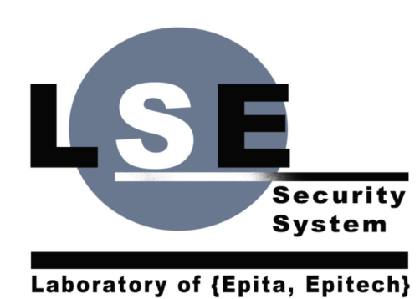


Hello world !!!
Other OS : Haiku
Partnership
RMLL 2008 Mont de Marsan
T-Dose
Association
Notes:
Indeed, Rathaxes is not only about technical issues and internal organisation. It is also a community project turned towards the open source world.
We already have exotic OS working on the implemetation of their OS into Rathaxes, such as Examour.
The project was initially initiated by the LES, and Rathaxes is still in close Partnership with the laboratory. The Laboratory offers all of its technical knowledge and manpower, and in exchange Rathaxes shares it’s discoveries.
We’ve been to the RMLL in Mont de Marsan were we’ve had our first chance to present our project to the world, and we had some pretty good criticisms and people were really interested.
We even had the opportunity to present our projects to the T-Dose in Eidhoven, an open source reunion in Netherlands where we held a conference and a stand during 2 days.
The public approval was the same than during the RMLL, most people were really interesting and some even fascinated by our project. Some other people also had more experience than us and gave us good advices on loopholes we should avoid.
We also are well advanced in the process of creating an association in charge of the future maintenance of Rathaxes.
We did not want Rathaxes to live only during our school years, and this is the best way for it to evolve and open up to the community to become an important open Source project.
I’m going to let Xxxx conclude now,

Slide 16
Conclusion
Rathaxes generates drivers for Open BSD,Linux and Windows
Driver development is easier
Companies are interested :ON-X
Association a well done communication
Notes:
(le meme que l’intro surement)
Rathaxes is functional, we are currently able to generate drivers for Open BSD, Linux and Windows.
And our tool is designed to evolve and we will be able to handle even more Oses in the future.
More than its cross platform aspect, Rathaxes does indeed improve the accessibility of Device driver development.
Our language is more human readable and intuitive, while still being fully functional.
Our project also interest companies, such as ON-X, that want to use it themselves as tools. (ME CORIGER LA DESSUS SI C’EST PAS CA)
As you can see, Rathaxes is a project that works both Technicaly and externally. We’ve done many conference inside the school, and a couple very important ones outside.
Confronting our ideas and results with the real world, and being well received at that.
We are planning its life for the future with the association.
In conclusion, Rathaxes is a living project, and will be for quite some time.
In our opinion, Rathaxes as met all its objectives and can be considered successful.
Thank you for your attention, do you have any questions ?

Slide 17


Questions
contact@rathaxes.org
rathaxespublic@googlegroups.com
www.rathaxes.org
Notes:
Rajouter Codeworker
All your EIP are belong to Rathaxes

