Slide 1
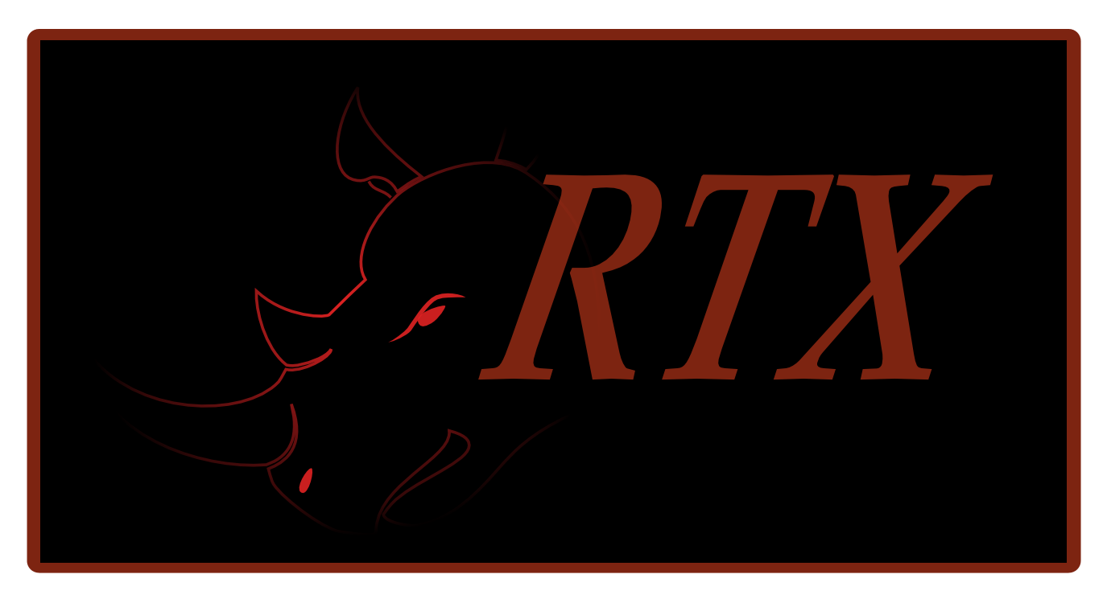
Rathaxes
Notes:
There are litteraly millions of computer devices in the world. Each of these devices requires a driver to work, and each of these drivers had to be written by hand, each of these device has a potential to crash your computer, each of these drivers has to be completely rewriten for every OS in the world.
Until Rathaxes.
Rathaxes is an Epitech Innovative project that will revollutionize the way device drivers are developped.
We bring a whole new approache to the problem : The generation of device drivers !

Slide 2


Today’s specials
Why ?
How is it possible ?
Is it working ?
How is it working ?
How did we get there ?
Hello world !!!
What’s next ?
Notes:
But how much is Rathaxes needed ? Could you tell us David ?

Slide 3
Why Rathaxes?
2 month for one driver
One driver per device
Millions devices
One driver per device per Operating System
2 X 1 000 000 X 3 = 6 000 000 Months
Notes:
To demonstrate rathaxes a simple equation

Slide 4
Why Rathaxes?
7 more time crash
Requires a double knowledge
Multiply that by the number of OS
Time consuming
Notes:
To demonstrate rathaxes a simple equation

Slide 5
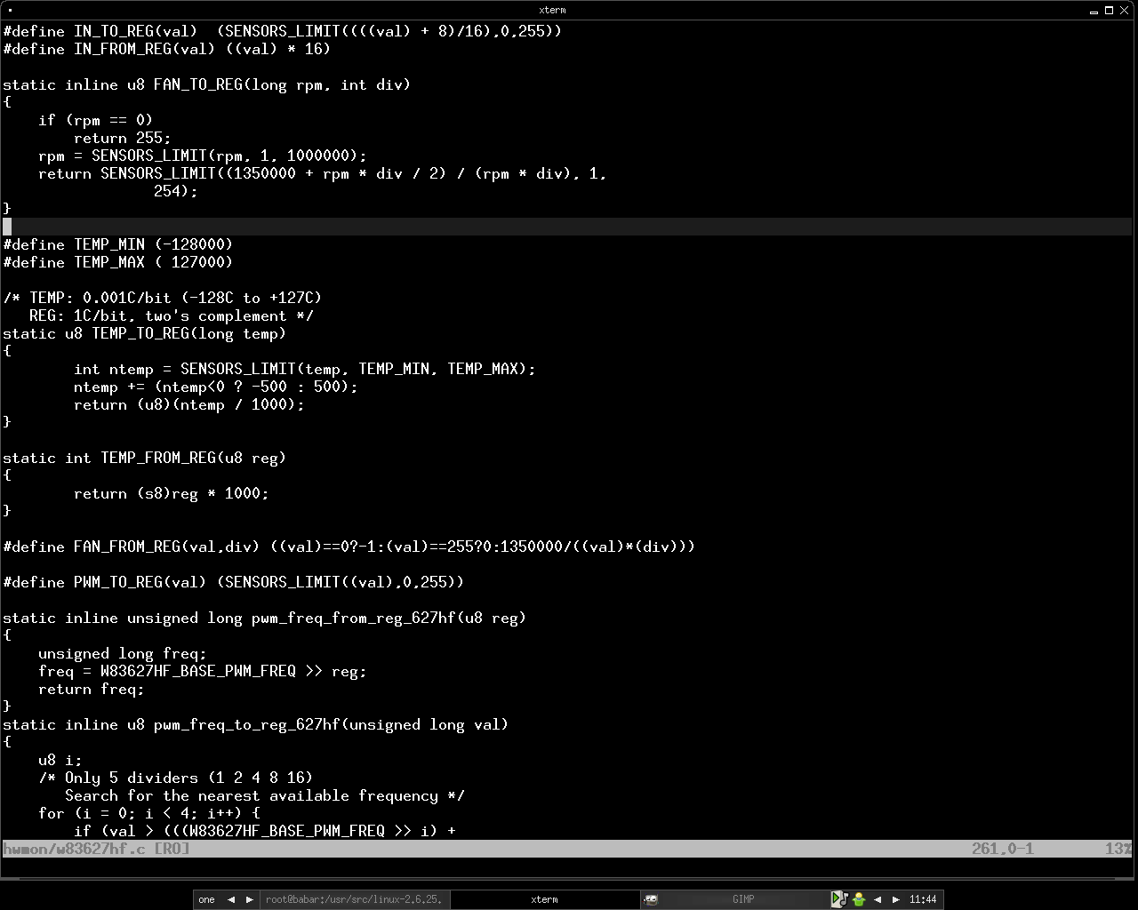
Why Rathaxes?
Notes:
Code de driver screen : diifcile code moche, redondance = bacle

Slide 6
Why Rathaxes?
70 %
FAIL
Of code in Operating System
Notes:
So if crash system fail :
Bug report vista : 24 nvidia, 18 ati

Slide 7




How is it possible?
Generating Drivers : utopia?
Focus on shared concepts
Abstract Operating System differences
?
Notes:
Is generating drivers an Utopia ? Well NO !
A Doctor, Laurent Reveillere, was able to generate parts of a device driver code.
For Rathaxes, we plan on generating the whole driver.
In order to attain these objectives, we studied several different OS and focused on the shared concepts instead of the code in itself.
It was important to use that approach because OS are fundamentally different.
That is why we choose to study four OS, OpenBSD, Windows, Linux and MacOSx for their differences
Hence, Rathaxes will be able to generate drivers for most of the OS. +? box+

Slide 8
How is it possible?
7 abstracted layers
Kernel registration
User interface
OS dependant
Library
Callbacks
Bus
Device dependant
Registers
Algorithms
Notes:
7 couches,
Utilisés par le langage

Slide 9
Demonstration
Notes:
Code de driver screen : diifcile code moche, redondance = bacle

Slide 10
How is it working ?
Domain Specific Language
7 layers => 7 semantics
Compiler
Black Library
Notes:
Before explaining how Rathaxes Works, we can go further on what it is.
First of all, Rathaxes is a Domain specific Language. AsSQL, it is a language used for one and only task.
Rathaxes will be dedicated to the field of Device drivers. The 7 layers we extracted of our studies will be implemented in this language as strong semantics.
This will allow developers to focus on the functionnalities of their device instead of focusing on the syntaxe to write for each OS.
As a complete solution, Rathaxes will also be composed of a Compiler. A Compiler is a program that converts a language into another, like a translator.
This compiler will have a library at is disposition. This Library, that Rathaxes called Black Library, will be composed of many pieces of code usable for the translation.
The Rathaxes compiler will translate our Rathaxes language in C language as it is the language used on most platforms for device drivers development.
Our compiler is made in Codeworker, a descriptive parsing scripting language. This extremely powerful tool saved us months of work.

Slide 11

How is it working ?
Parsing
Frontal
RDSL
Parsing
Frontal
BDSL
BackEnd
Files.rtx
.C Files
Windows
OpenBSD
Others
Linux
Black Library
Notes:
Language Parsing : Functionalities
BDSL Parsing : Extensibility, updatability
C Generation : Weaving the parsed code and the templates into a c file. This code will be human readable so it will possible to edit it for optimization, reread it for security certification purposes.

Slide 12
Project management
CROSS TEAM
David Verrière
Christophe Fajardo
Marc Thompson
RESEARCH
LANGUAGE
Sylvestre Gallon
David Amsallemm
Mickael Dumont
Tomas Suarez
David Giron
Adrien Silvestre
Vivien Jacquemmoze
INFRA/COM
Sebastien Cassier
Notes:
How did we get there ? Well quite easilly in fact. We has several diferent tasks to achieve : Field Studies, Language Creation, Project Management and Communication organisation.
Hence, The Rathaxes team is devided in four teams dedicated to special tasks.
Those teams are the research, language, Cross-team and Infra/com team.
The research team produces scientific papers covering all the specificities of the different OS. They have the task to abstract the different concepts from the device driver development.
These papers are then transmited to the Language team that will extract those concepts and extend then to semantics used in the language. They will also develop the the compiler and the infrastructure of the Black Library.
The Research team will then validate the usability of the language and complete the black library.
The Infra/com team is in charge of the external communication and the visibility of the project. This team also maintain the website and all the logistic infrastructure needed by a project of this envergure.
In order to organize the communication between the teams and to backup them in case of problems, the Crossteam team implemented quality management process and methods.

Slide 13



Project management
Methods :
MILSTD 498
V-model
Tools :
Notes:
These methods are industry standards : MilSTD498 and the V_Model
The MILSTD is a standard used by the military to control software quality and the V-Model is a standard method that the use is not limited to the IT field.
Rathaxes also uses several organisation software : Trac, Subversion and a complete website / email domain on www.rathaxes.org.
Trac is a bug reporting solution while Subversion is a source code versionning and backup infrastructure.
Rathaxes has had since the beggining a well planned internal communication infrastructure. But how is going our external cummunication ?
Would the Infra-com team explain us ?

Slide 14
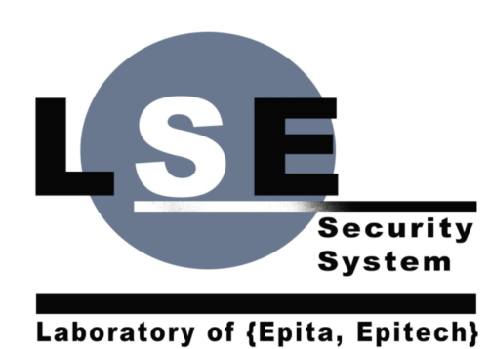

Hello world !!!
Other OS : Examour
Partnership
RMLL 2008 Mont de Marsan
Association
Notes:
Indeed, Rathaxes is not only about technical issues and internal organisation. It is also a community project turned towards the open source world.
We already have exotic OS working on the implemetation of their OS into rathaxes, such as Examour.
The project was initially initiated by the LES, and Rathaxes is still in close Partnership with the laboratory. The Laboratory offers all of its technical knowledge and manpower, and in exchange Rathaxes shares it’s discoveries.
We’ve been to the RMLL in Mont de Marsan were we’ve had our first oportunity to present our project to the world, and we had some prety good criticisism and people were really interested.
We also are well advanced in the process of creating an association in charge of the futur maintenance of Rathaxes.
But how much is Rathaxes turned to the futur ? What’s next ?

Slide 15
What’s next ?
First Release in December 2008
Next Papers in September 2008
T-Dose 2008 in Netherlands
Notes:
Dev
Next Papers : library, bus and callback
T-dose : conference open source
As you can see, Rathaxes is a project that works both Technicaly and externally. We are planning its life for the future with the association.
In conclusion, Rathaxes is a living project, and will be for quite some time.
Thank you for your attention, do you have any questions.

Slide 16


Questions
Thanks to :
Notes:
Methode de travaille
Outils
Trac, svn, site web pour communiquer

