Slide 1

#Lets GIT it peeps!!!

Slide 2
What is Git?
Git is a version control software which allows a developer to preserve all changes to source code files in a project .
Rather than relying on a central server , you have your own cloned copy
In projects that involve multiple developers, you always have a record of who changed what

Slide 3
What is a repository ?
A “repo” is nothing but a digital directory or a storage space ,where you can access your project , its files and all its versions .

Slide 4
Configure yourself on git !
To configure your name :
$ git config --global user.name “your name”
Configure your email :
$ git config --global user.email “your email”
Check your settings :
$git config --list

Slide 5
Lets now create our very git project!
Create a folder on desktop
To navigate to the folder :
Step 1 : $pwd
Step 2 : $ cd Desktop
Step 3 : $ cd foldername
Step 4 : $ ls

Slide 6
Time to link git to repo :
$ git init

Slide 7
The Git Workflow
Working copy
Staging area
Repository

Slide 8
Commit your changes!
>> To add your changes :
$ git add .
>> To check your status :
$ git status
>> Now commit your changes :
$ git commit –m “This is our very first commit”

Slide 9
How to view your changes :
$ git diff
Git diff is used to view the changes to your file. Now it’s time to commit your changes .
Also git diff only compares your working copy and the repository. If you have already added your file to the staging area , git diff is not valid . For that use : $git diff -- staged

Slide 10
Removing files
Step 1 :$ git rm filename.txt
Step 2 : Check the status
$ git status
Step 3 : commit the changes
$ git commit –m “Deleted one file “

Slide 11
How to rename files :
$ git mv oldname.txt newname.txt
Eg $ git mv Home.txt first.txt
To move it in a folder use :
$ git mv Home.txt gunjan/index.txt

Slide 12
How to undo changes:
Step 1 : First check the status
$ git status
Step 2 : $ git checkout – filename.txt
Checkout is nothing but take something from the repository and make it your working copy
Step 3 : Check status

Slide 13
Getting older versions :
Commits are nothing but points in time.
To get back a commit :
Step1 : $ git checkout 0078dg – filename.txt
Step 2 : Check status
Step 3: Commit your changes

Slide 14
What is GITHUB ?
A website where you can publish your project for the world to see .
Anyone can view your files , make changes and submit their changes to your file
People collaborate and work on projects together by pushing , cloning and branching .

Slide 15
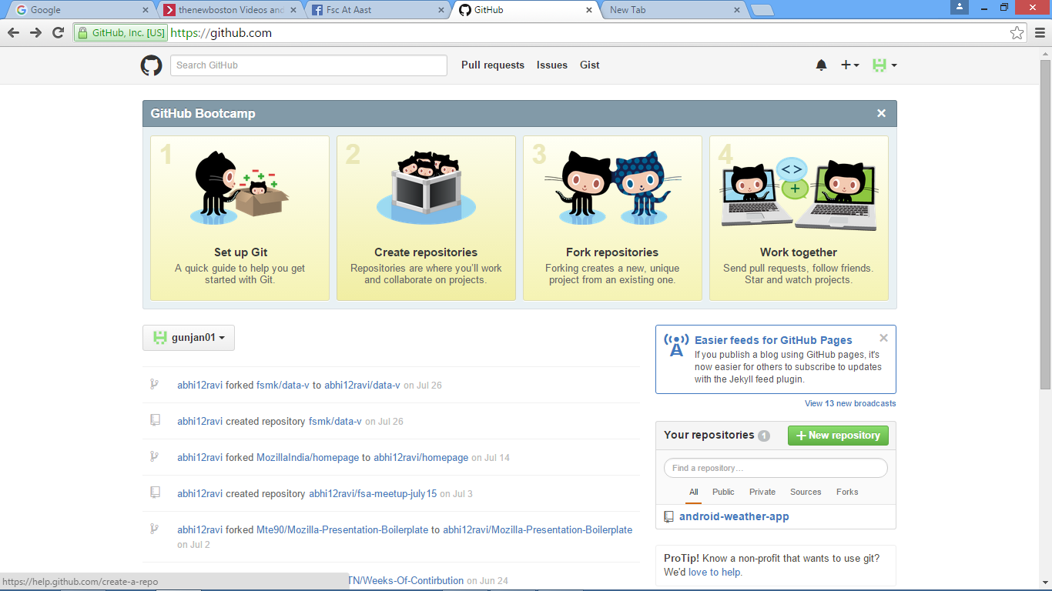
Make your own repository

Slide 16
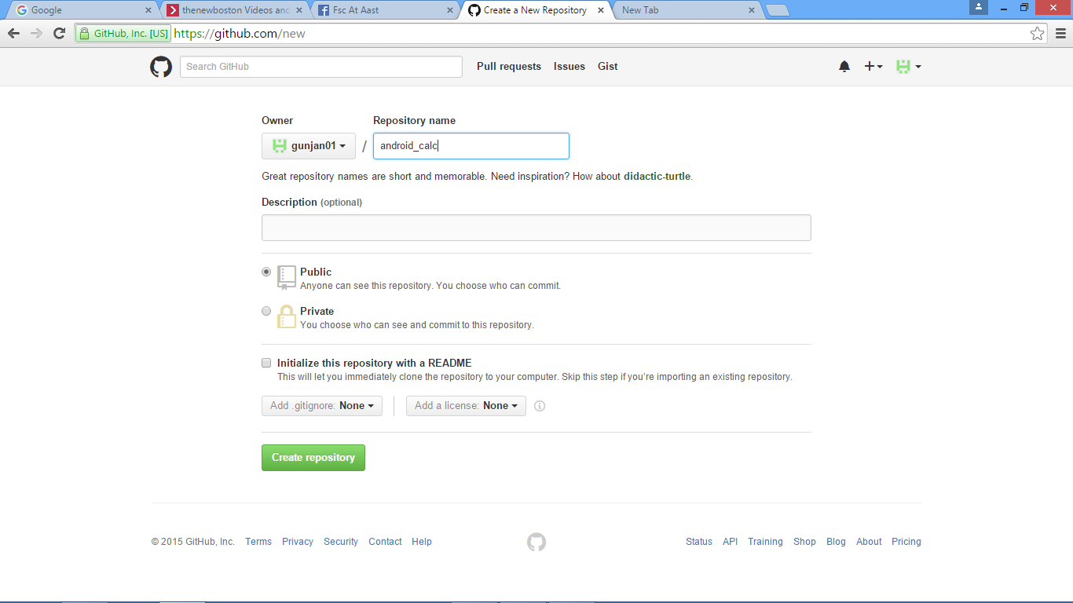

Slide 17
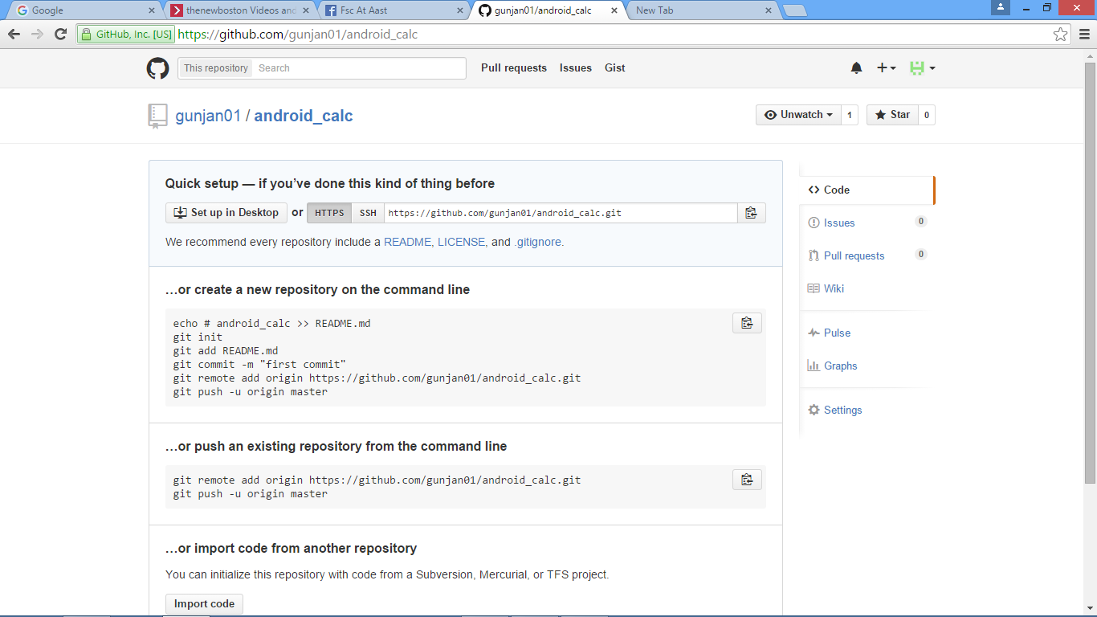

Slide 18
Lets link it to Git Bash now :P
Step 1 :Create a Remote :
$ git remote add githubrepo https://github.com/gunjan01/android_calc.git
Step 2 : check the nick name (you don’t wanna type the URL again and again)
$ git remote
It will display the nickname
Step 3 : Now push (add) your files:
$ git push –u githubrepo master

Slide 19
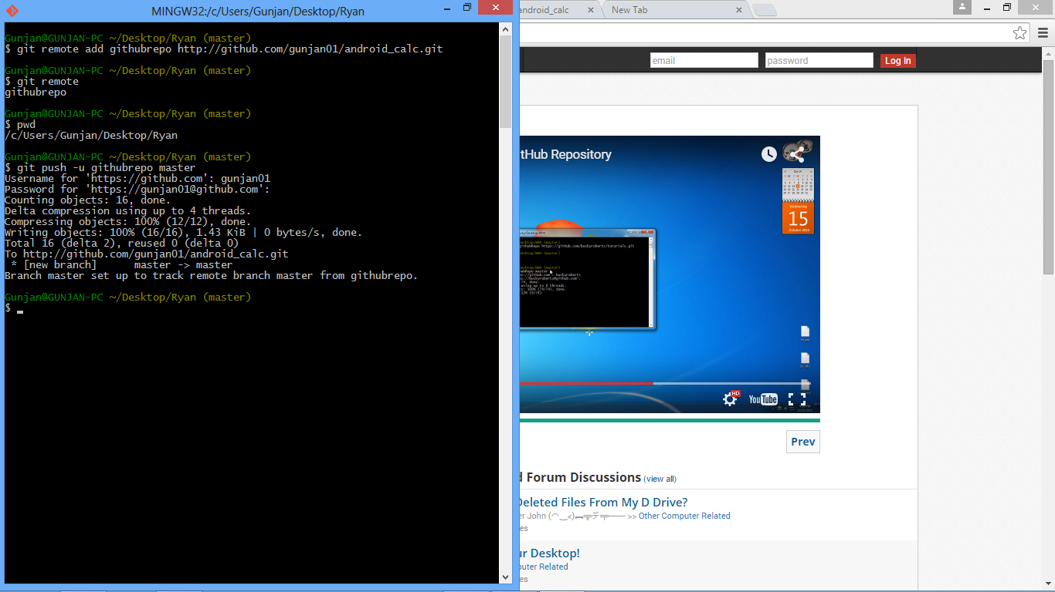

Slide 20
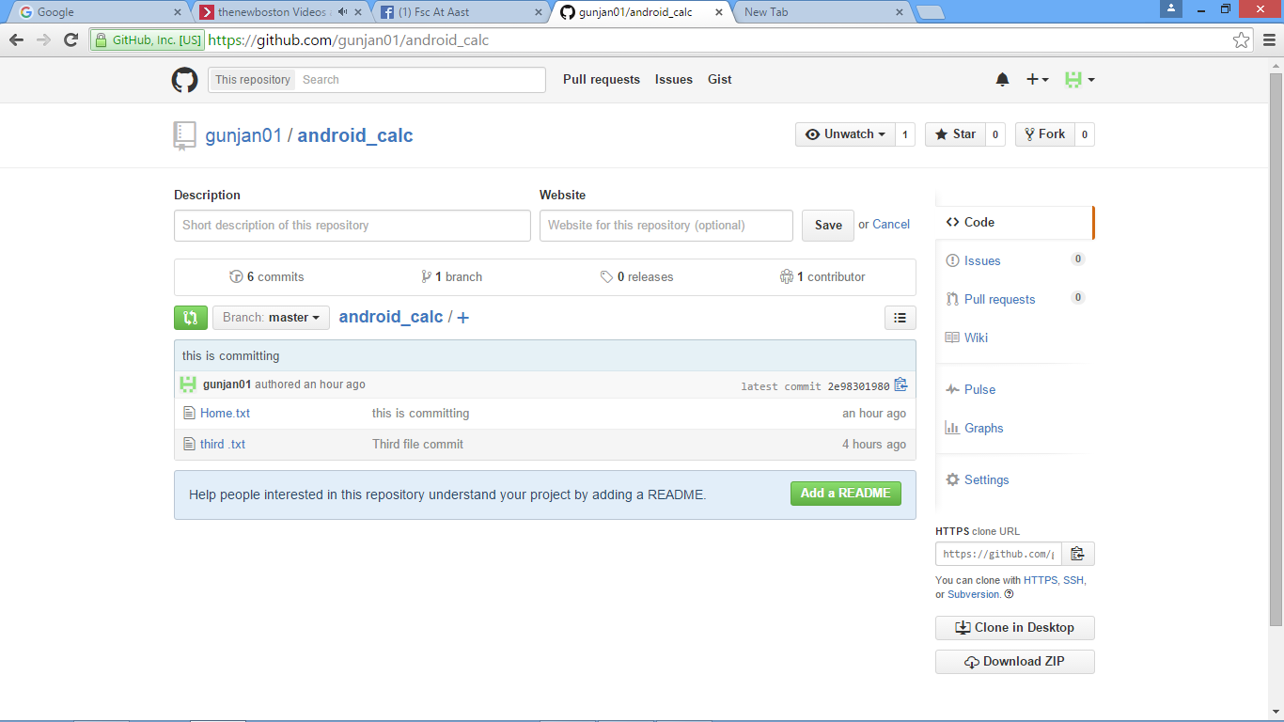

Slide 21
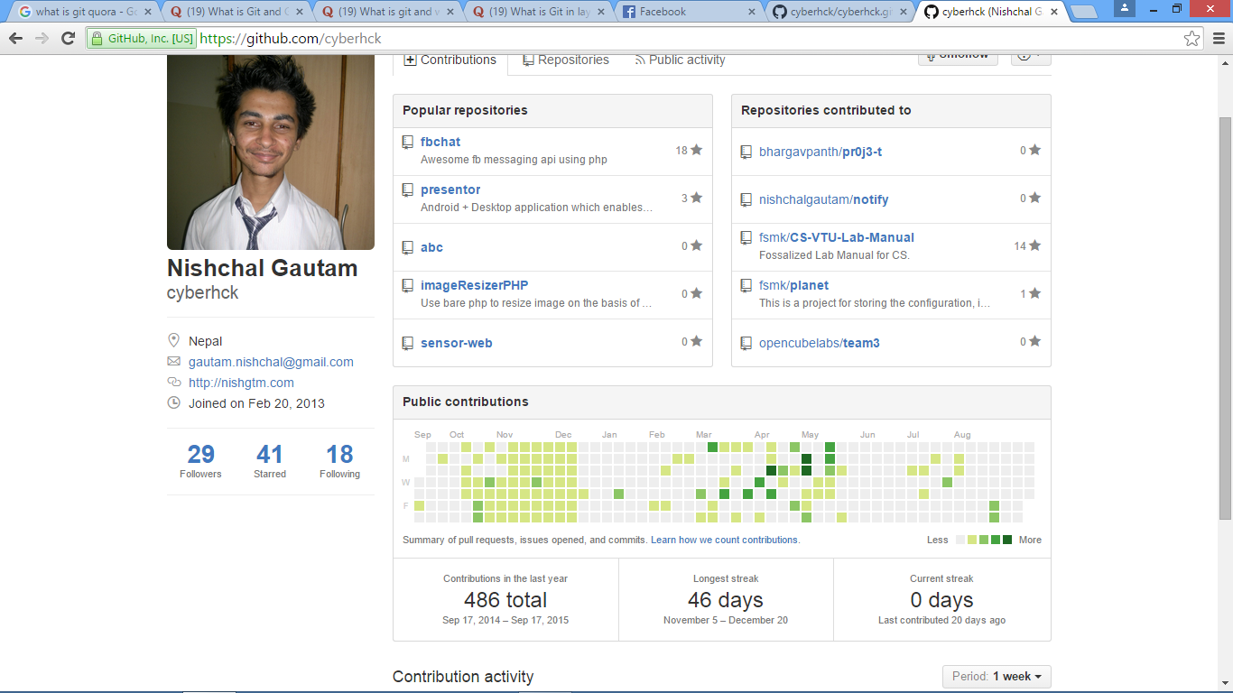

Slide 22
Git hub flow
Fork
Clone
Pull request
Merge

