Slide 1

BUDGET WISE
Securely Manage Your Finances
CryptoKnights
Moegamat Rashaad•Entisaar Elfadl•Misha Jacobs

Slide 2

BUDGET WISE
The Problem
Cape Town has one of the highest costs of living in South Africa
Housing, utilities, and food prices rose 4.5% to 4.8% nationally, even higher in Western Cape.
Average rent in Cape Town: increased by 68% since 2014 (vs 45% nationally).
Average rent in Cape Town: increased by 68% since 2014 (vs 45% nationally).
Notes:
Cape Town has one of the highest cost of living in South Africa, especially when it comes to housing, utilities, and food.
Tourism keeps growing here and while it’s good for the city’s economy, it’s also driving up the cost of living for locals.
Prices of housing, food, transport, and even basic necessities keep climbing.
Just taking a look at the numbers:
Food prices in South Africa rose by almost 4.5 to 4.8% in the past year
Housing and accommodation are up by around 6 to 7%
But the average salary increase is barely 3%
That means that every month, the value of people’s pay checks is shrinking
Imagine working harder each year, but finding your groceries cost 9% more while your salary only rose 3%.
Rent climbs, food prices climb, and people are left stretched thin.
This is the sad reality of the cost of living in Cape Town today, which is why we built our budgeting tool, to give people a tool to the situation that they are forced to adapt to.

Slide 3

The Solution
BUDGET WISE
A budgeting website that:
Tracks income vs expenses
Compares store prices with AI
Give rewards through coupons & discounts
Provides recommended budget allocations
Offers investment recommendations
Notes:
A budgeting website that helps users to track their expenses, compare store prices with AI, earn coupons as rewards, and receive personalized recommendations for budgeting, saving, and investing.
The goal of this program is to empower users to make smarter financial decisions, reduce overspending, and to grow their wealth through simple, AI-assisted tools.

Slide 4
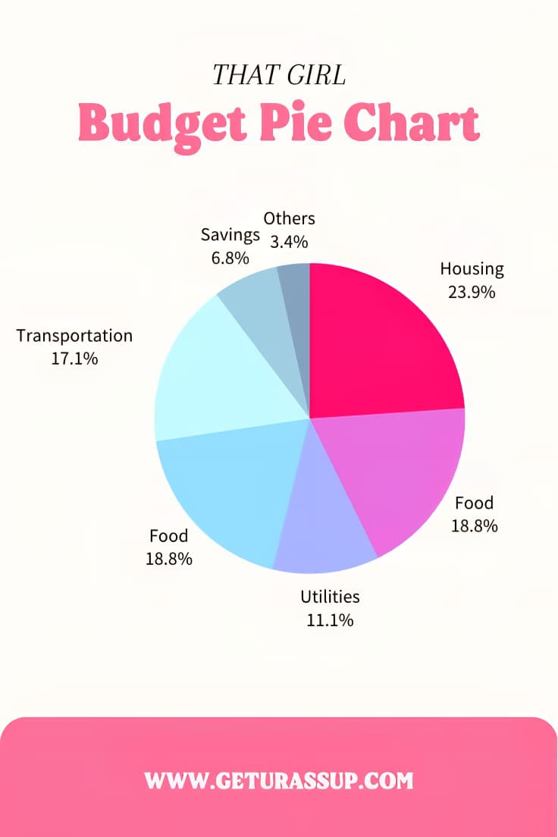
Core Features
BUDGET WISE
Budgeting & Tracking: Income vs Expenses, Fixed vs Flexible spending, Recommended budget allocation.
Smart Shopping: Coupons, AI price comparison
Maps & Store Locator: Nearby stores
Saving Tips: General Saving tips and personalized advice
Investments: Beginner tips for user to learn investing

Slide 5
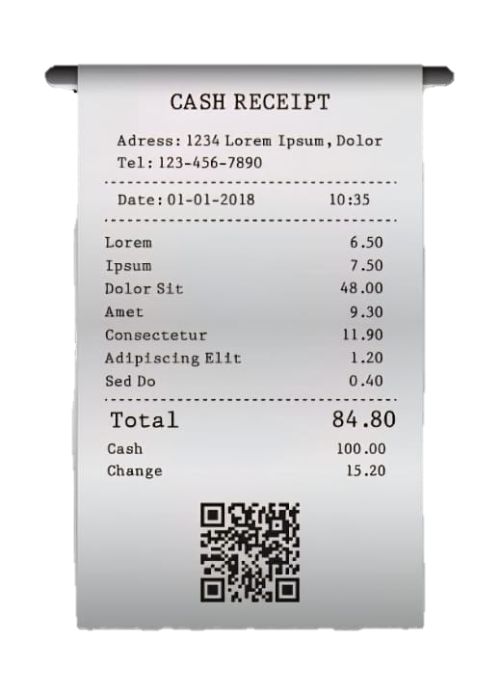
Budgeting Features
Savings
6.8%
Recommended Budget
Needs (60%) | Savings & Investments (20%) | Wants (20%)
Rent (25%) | Emergency fund (10%) | Entertainment (10%)
Food (10%) | Investment 10% | Shopping (5%)
Transport (10%) |  | Lifestyle (5%)
Utilities (5%)
Necessities (10%)
Charts: Income vs Expenses, Fixed vs Flexible
Recommended Budget Example
Needs (60%): Rent 25%, Food 10%, Transport 10%, Utilities 5%, Necessities 10%
Wants (20%): Entertainment 10%, Shopping 5%, Lifestyle 5%
Savings & Investments (20%): Emergency fund 10%, Investment 10%
Can be changed based on User needs
Transportation
17.1%
Actual Budget
Needs (50%) | Savings & Investments (30%) | Wants (20%)
Rent (20%) | Emergency fund (20%) | Entertainment (5%)
Food (10%) | Investment (10%) | Shopping (15%)
Transport (5%) |  | Lifestyle (0%)
Utilities (5%)
Necessities (10%)
Food
18.8%
Notes:
The AI reader that scans the electronic slips will be added on in the future.
The recommended budgets are generated using AI as well which will also be added on in the future

Slide 6
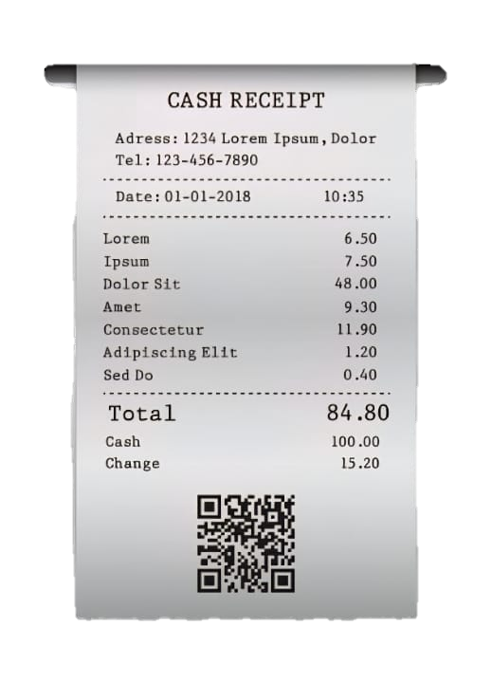

Smart Shopping Features
AI compares prices across stores
Coupons and bundle deals auto-applied
Map shows nearby stores with discounts
AI uses electronic receipts to scan items and find discounts

Slide 7
System Architecture
Frontend: Dashboard, charts, map, investment tools.
Backend: Budget module, AI engine, coupon engine, investment module
Database: Users, expenses, coupons, stores.
APIs: Google Maps, product stores

Slide 8



Gamification
Users earn points by:
Staying within budget
Following saving tips
Completing challenges (e.g., “Save 3% on groceries this week”)
Points can be redeemed for:
Custom themes / UI personalization
Coupons / discounts for shopping
Encourages healthy financial habits while keeping the platform fun and interactive.

Slide 9
Conclusion
Gamification
Demo
Empowers Cape Town residents to take control of their finances
Combines budgeting, smart shopping, and gamification for lasting habits
Provides personalized investment guidance for future security
Encourages saving, spending wisely, and financial independence

