Slide 1
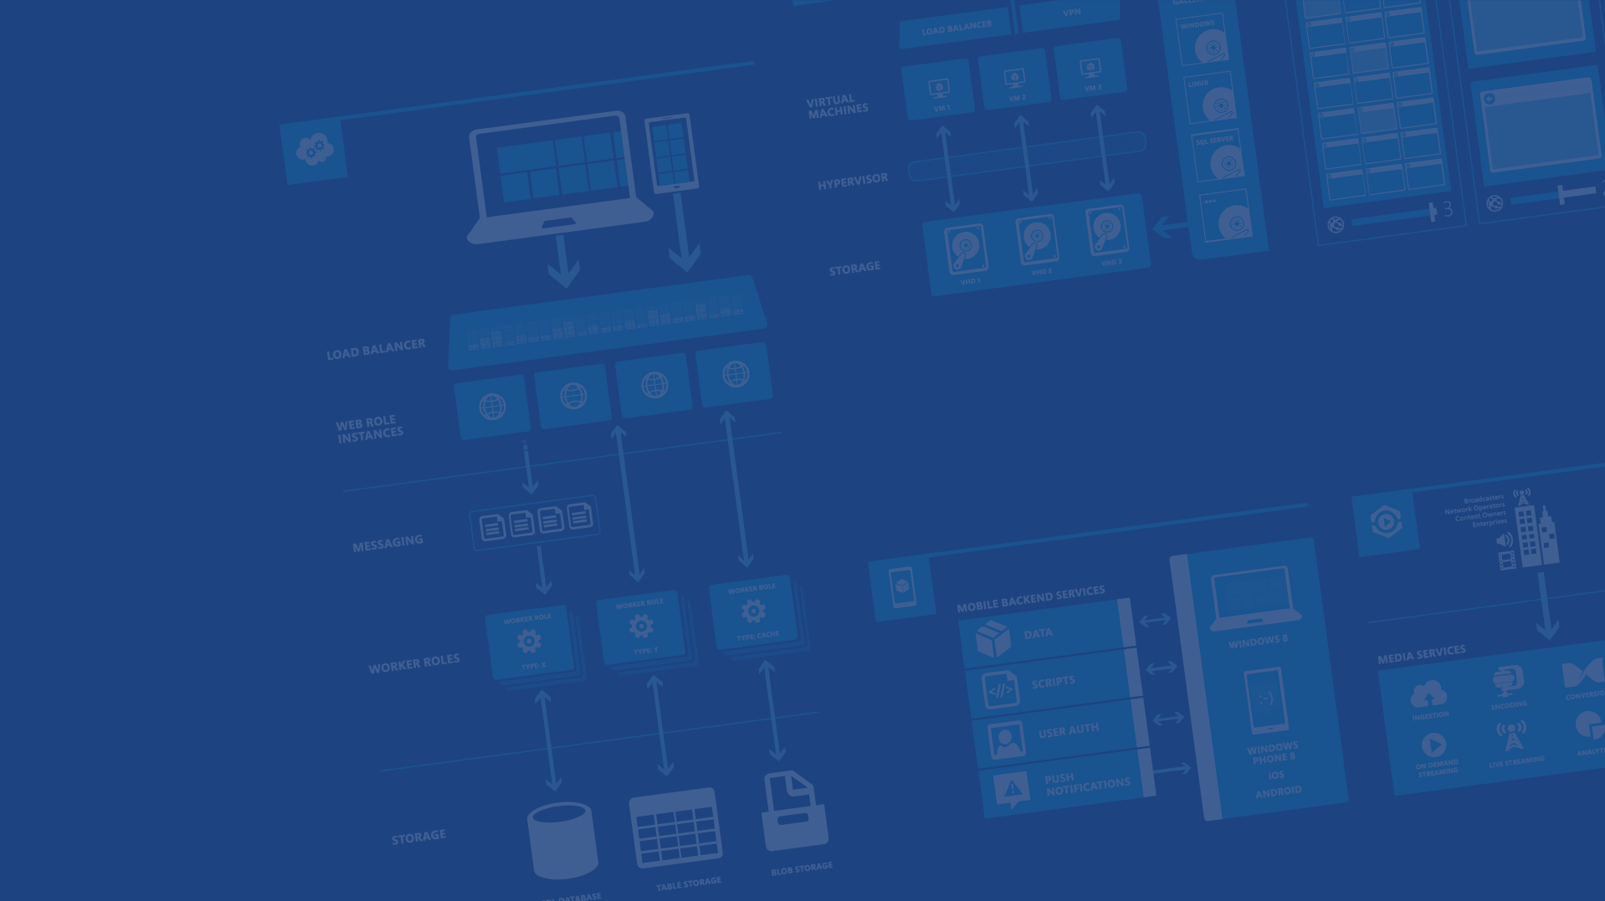
Azure, Notifications, and Android
<Speaker Name>
<Role>
<Contact Info>
Microsoft Azure

Slide 2
Agenda
Push Notifications
Microsoft Azure
Azure Notification Hubs
Tags
Templates
Questions
Notes:
Slide Objectives:
Go over agenda for the session
Speaking Points:
we’re going to start by talking about why push notifications are important and how prevalent they are
We’ll talk about Azure at a high-level and explain where Notification Hubs sits
We’ll go over two of the amazing features of Notification Hubs: Tags and Templates
We’ll have time for questions

Slide 3
Push Notifications are BIG
Provide proactive updates to users
Alert users when app isn’t running
Trigger background sync
Pull users back into your apps!
Notes:
Slide Objectives:
Explain how important push notifications are
Speaking points:
Push notifications are great for
Providing updates to users
Alerting users when the app isn’t running / they aren’t checking it
Trigger background sync
Pulls users back into your apps (critical for consumer apps)

Slide 4
Common Push Notifications
Emails
Game updates
Flight reminder
Rental car reminder
Appointments
Video chat requests
Data usage alerts
Bills due
Notes:
Slide Objectives:
Review common push notifications
Speaking Points:
* Most mobile devices are inundated with Push Notifications

Slide 5
Challenges of push notifications
Platform dependency
Different communication protocols to PNS’ (e.g. HTTP vs TCP, xml payload vs json payload)
Different presentation formats and capabilities (tiles vs toasts vs badges)
Routing
PNS’ provide a way to send a message to a device/channel
Usually notifications are targeted at users or interest groups (e.g. employees assigned to a customer account)
App back-end has to maintain a registry associating device handles to interest groups/users
Scale
App back-end has to store current handles for each device → high storage and VM costs
Broadcast to millions of devices with low latency requires parallelization (DB ad VM)
Notes:
Slide objectives:
Explain the complexity of handling push notifications
Speaking points
Challenges include:
Platform dependency (different protocols for PNS (http vs tcp, payload format)
Presentation format (tiles vs toast vs badge)
Routing
PNS send message to device / channel
Notifications usually target specific user or group
App has to maintain registry associating device handles to groups
Scale
Storing device handles / groups involves storage (could be big)
Low latency push requires parallelization

Slide 6
Push Notification Lifecycle
App registers with provider
App gets token
App sends token to backend
Push requested
Backend delivers push to provider
Provider pushes to device
Platform
Notification
Service
App back-end
Notes:
Slide Objectives:
Go over push life cycle
Speaking Points:
This explains how push notifications work
Your Android app talks to a Push Notification Service (Google Cloud Messaging, Amazon Device Messaging, etc)
That provider gives your app an ID (registration ID for GCM) which identified the device and app
That ID can then be used from a server backend to ask the PNS to push down to the app.

Slide 7

Notification Hubs
Cross-platform Push Notifications
Highly scalable
Managed
Notes:
Slide Objectives:
Highlevel overview of Notification Hubs
Speaking Points:
Notification Hubs solves the server side aspect for you
It provides for cross-platform push
It’s highly scalable (millions of push notifications)
It’s a managed solution

Slide 8
Cross-Platform Push
Client SDKs for
Android – GCM, ADM, Baidu
iOS – APNS
Windows Phone – MPNS
Windows Store – WNS
Capable of pushing to specific platform or to all at once
Server SDKs for
REST API
.NET
Node.JS
Java
Notes:
Slide Objectives:
Detail how hubs are cross platform
Speaking Points:
There are client SDKs for Android (Google Cloud Messaging, Amazon Device Messaging, Baidu)
iOS – APNS
WinPhone – MPNS
WinStore – WNS
Hubs can push to a specific platform or all at once
Server side SDKs (for trigger your pushes) in .NET, Node.JS, and Java along with a standard REST API

Slide 9
Highly Scalable
Part of Azure Service Bus
Three tiers
Free (1 million)
Basic (10 million)
Standard (10 million w/ added features)
Millions of push notifications in minutes
Notes:
Slide Objectives:
Detail how hubs are scalable
Speaking Points:
Hubs are part of Azure Service Bus which is an underlying feature used across all of Azure
Three levels of scale
Free provides for 1 million push notifications
Basic allows for 10 million
Standard is also 10 million with additional features enabled
After you reach your “limit” cost is based off # of pushes
Basic and standard auto-scale to support delivery of millions of push notifications in minutes

Slide 10
Managed
Notification Hubs deals with
Storing device registration information
Signing push requests and sending to PNS
Dealing with invalid push ID registrations
Handling templates and tags
You just need to
Configure your hub and app
Register with the PNS
Pass along the push ID
Notes:
Slide Objectives:
Detail how hubs are a managed solution
Speaking Points:
Notification Hubs deals with device registration storage
Signing push requests with API key / certificate before going to PNS
Dealing with invalid push IDs
Templates and tags
Client app just need to register with PNS and pass info over to hub

Slide 11
Using Notification Hubs
App registers with provider
App gets token
App sends token to Hub
Push requested
Hub delivers push to provider
Provider pushes to device
Hub handles expired tokens
iOS app
Windows app
MPNS
GCM
WNS
APNs
App backend
ADM
Notification Hub
Notes:
Slide Objectives:
Explain how Notification Hubs work
Speaking Points:
* The difference from the earlier diagram is here we have out Notification Hub which our clients talk to and our app backend talks to the Hub when we want to do a push

Slide 12
Demo: Hubs
Creating a Hub
Configuring a Hub
Register and Push
Notes:
Demo Objectives:
Show basic usage of Hubs
Demo Points:
Create a new Hub in the portal
Create an App in google API Console
Turn on GCM
Create a server Key, copy it over
Configure hub it to push to GCM
Open Android application and show where the reference to Notification Hubs jars are
Put Notification Hub name and listen connection string into app
Walk through Android code necessary to register with GCM and talk to the hub
Run app
Go to Mobile Service script for NoTokenTest and put the name and full connection string into the app
Run service
Return to app, show off receiving the push notification

Slide 13
Tags
Notes:
Slide Objectives:
Talk about targeted pushes
Speaking Points:
So far the push notification we saw was only targeted at GCM devices. That means that any GCM device that has registered with my Hub, will receive the push.
That’s great for sending messages to all (or all GCM users) but usually we want to target our pushes
These could be targeted at a specific user, a group, or even a specific device
Tags will allow us to do that.

Slide 14
Tags
Clients register with set of tags
Tags are strings tied to the Push ID
Requests to push to a Tag will push to connected Push IDs
“Interest based push”
Notes:
Slide Objectives:
Explain Tags
Speaking Points:
When a client registers with the Hub, it can also pass over Tags
Tags are strings which are tied to your registration with the hub.
To filter out push down to specific recipients, we tell the hub to push to a tag
This allows us to do interest based push based off whatever we want

Slide 15
Tags: Example
App back-end
Tag:”Tablet”
Notification Hub
Tag:”Phone”
Tag:”Tablet”
Notes:
Slide Objectives:
Example of Tags
Speaking Points:
Here is an example of using tags where we have a phone and a tablet
The phone uses the “phone” tag
The Tablet uses the “tablet” tag
When our backend tells the hub to only push to the “tablet” tag, only the tablet will be sent the push

Slide 16
Other Tag Usages
Conference name
Username
Zip code
Sports team
Band name
Stock ticker
Notes:
Slide Objectives:
Provide other examples of tag usage
Speaking Points:
Just some simple tags you might use are
Conference names
Username
Zip code
Sports team
Band name
Stock ticker
etc

Slide 17
Demo: Tags
Registering with Tags
Pushing with Tags
Notes:
Demo Objectives:
Show tags at work
Demo Points:
In client app, show code which registers with tags
Run app and perform tag registration
Go to server and update TestTag with hub name and full connection string
Demonstrate push working with tag
Return to the portal and go to the Push Debug area
Use the push debugger to perform a push to a tag NOT registered for
Demo debug not working
Return to the debugger, push to a tag that has been registered, demo push working from debug

Slide 18
Tag Expressions
Logic based tag pushed
Social: “All of this group but me”
Group:id && !user:id
Version and platform
Version:1.0 && platform:iOS
Events: “Anyone interested in the game”
FollowTeam:SeaHawks || FollowTeam:Broncos || EventInterest:SuperBowl
Notes:
Slide Objectives:
Explain tag expressions
Speaking Points:
In addition to just doing simple “push to this tag” you can also use expressions
You could use this to push to all members of a group except for one
To push to all users on an old version of your app
Etc (probably want to change the last one to something locally relevant)

Slide 19
Geo Push
Notes:
Slide Objectives:
Explain how Geo Push is very popular
Speaking Points:
* One thing that has become very popular is geography based push and geofencing

Slide 20
Making GeoPush Work
Client requests location
Client uses reverse geocoding service to get city(etc)
Client registers with Hubs using city as a tag
Server pushes to city
All clients in that city receive notification
Notes:
Slide Objectives:
Explain GeoPush
Speaking Points:
With hubs, geo push is simple, once you get the devices location, you can use it as a tag.

Slide 21
Demo: Geo Push
Notes:
Demo Objectives:
Show geo push in action
Demo Points:
Open Geo android app
Put connection string and hub name in app
Run app
Show that the app registered the device’s city
Go to Debug page / script in portal
Update to push to the city
Perform push

Slide 22
Templates
Notes:
Slide Objectives:
Transition to Templates
Speaking Points:
So far all of our push requests have been specifically to GCM
That’s fine if I’m only building an app using GCM, but what if we want to go xPlat
Ideally, we could just tell our Hub to push to a tag with some information, and the hub would make sure it was in the right format for each PNS

Slide 23
Templates
Clients can specify templates when registering
Templates specify format of payload when specific push is sent
If “Message” push is sent, send it in this format { alert : “$info” }
Enables app backend to send platform independent messages
i.e. push to all the devices with this tag
Multiple templates per device
Different tags per template
Notes:
Slide Objectives:
Explain templates
Speaking Points:
Templates allow us to do that
When the client registers, it also passes along the format that it expects to receive a push in.
This template can also include wildcards that the Hub will be able to replace with variables you’ve passed in from the backend
You can have multiple templates per device
You can have different tags per template

Slide 24
Demo: Templates
Registering with Templates
Push to all the devices!
Notes:
Demo Objectives:
Demo template based push working
Demo Points:
Run the android app and do the template based registration
Go to the TemplateTest script and update the hub name and connection string
Highlight the code to push does not include GCM
Test the push
Run the test app on iOS or Windows or Windows phone
Register from the other platform’s app
Trigger a push, show push going to both platforms

Slide 25
Client vs Server Registration
Notes:
Slide Objectives:
Explain client vs server registration
Speaking Points:
* When it comes to actual registration we can do it from the client, like we’ve been doing, or from the server

Slide 26
Registering from the Client
Client app talks directly with Notification Hub
Sends over the wire
Push ID (Channel URI, Registration ID, Token)
Tags
Templates
Notification Hub Listen Connection String
Not completely secure
Notes:
Slide Objectives:
Explain client side registration
Speaking Points:
From the client side, we pass along our Push ID, tags, and templates
This isn’t entirely secure because if someone disassembled our app, they could add or remove whatever tags they want.
The dangerous scenario here is let’s say I want to push to all of my devices so I use username as a tag.
What if you rework my application to register with that username as well, even though it isn’t your real username. Then you get those pushes as well.

Slide 27
Registering from the Server
Authenticate the request before registering
Is the user who they say they are?
Can still specify tags and templates
Great for setting up registrations from a web app
Good for when an app update requires a user’s registrations being updated
i.e. manager adding an employee to a group
Notes:
Slide Objectives:
Explain server side registration
Speaking Points:
The solution is to do the registration from the server
Your client sends that same info (push ID, tags and templates) to your app’s backend
Your app backend should know who the user is and can guarantee they’re only registering for tags they should
This also enables you to edit a user / devices registrations remotely (from a website’s Notification Center for example)

Slide 28
Registering from the Server
createId()
upsert({id}, channel, tags)
App backend
Notification Hub
{id}
Notes:
Slide Objectives:
Explain how server registration works
Speaking Points:
Here our client is never talking directly to our Hub, but instead to our app backend
The app backend then registers with the hub.

Slide 29
Demo: Server Registration
Notes:
Demo Objectives:
Show server registration
Demo Points:
Show off script for server registration

Slide 30
Push-to-Sync
Notes:
Slide Objectives:
Detail push to sync
Speaking Points:
So far all of our pushes have just shown some information on the screen
That might not always be what you want to do though
You can also do a push which will just trigger your app to go fetch information.

Slide 31
Push-to-Sync
Different support on different platforms
Windows / Windows Phone – Only Lock Screen Apps
iOS – only iOS 7 and up
Android / Kindle
Useful in scenarios where push isn’t satisfactory
Too much data to fit in payload
Don’t want to send secure information through PNS
Notes:
Slide Objectives:
Detail push-to-sync
Speaking Points:
Push to Sync or Background push is only supports on some platforms
For Android, this has been around since day one because you code exactly what you want to happen when you receive any type of push
This is also useful when you want to get info to the device that is too sensitive to send through the PNS (or even Azure itself)

Slide 32
Notification Hubs
Cross-platform Push Notifications
Highly scalable
Managed
Notes:
Slide Objectives:
Highlevel overview of Notification Hubs
Speaking Points:
Notification Hubs solves the server side aspect for you
It provides for cross-platform push
It’s highly scalable (millions of push notifications)
It’s a managed solution

Slide 33
Resources
Get a FREE Microsoft Azure Trial Account:
http://azure.microsoft.com
Check out Notification Hubs
http://aka.ms/NH
SDK Source Code on GitHub
https://github.com/Azure/azure-notificationhubs
Contact Details
<Contact Info>
Microsoft Azure
Notes:
Slide Objectives:
Provide additional resources
Speaking Points:
Here we have a link to the free azure trial
To The Notification Hubs landing page
The open source client SDK for Notification Hubs

Slide 34

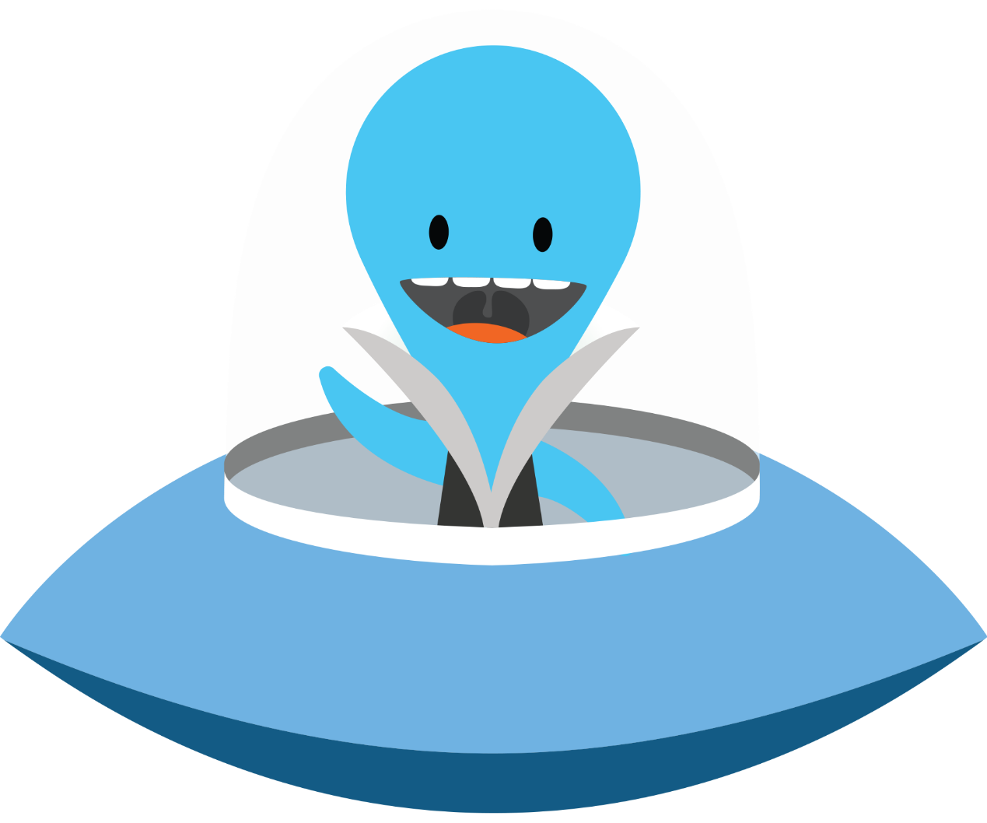
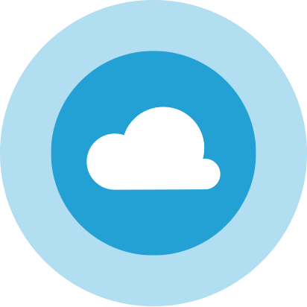

Thanks!
Questions?

