Slide 1
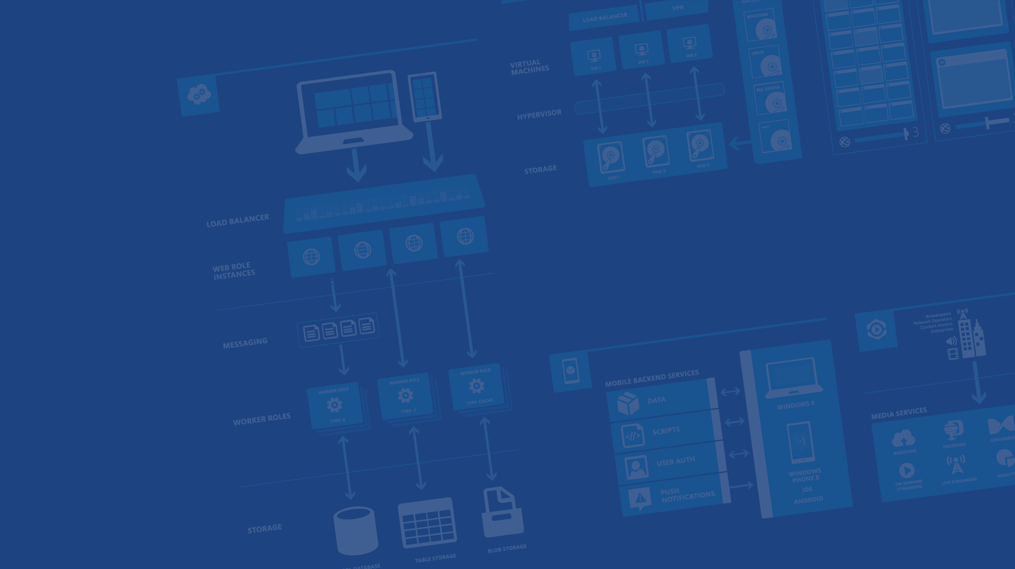
Android and Microsoft
<Speaker Name>
<Role>
<Contact Info>
Microsoft Azure

Slide 2
Microsoft
Accessible
Open
Easy
Works on all popular devices
Open source
Easy and pleasant dev experience
Notes:
Slide Objectives:
Start the conversation by talking about the new Microsoft and highlight the three principles we’re going to talk about for Microsoft
Speaking Points:
We’ll first start by talking about the new Microsoft
When we talk about the new Microsoft, we talk often about three core principles
Accessible, Open, and Easy
We think these things are just as important to you as developers

Slide 3

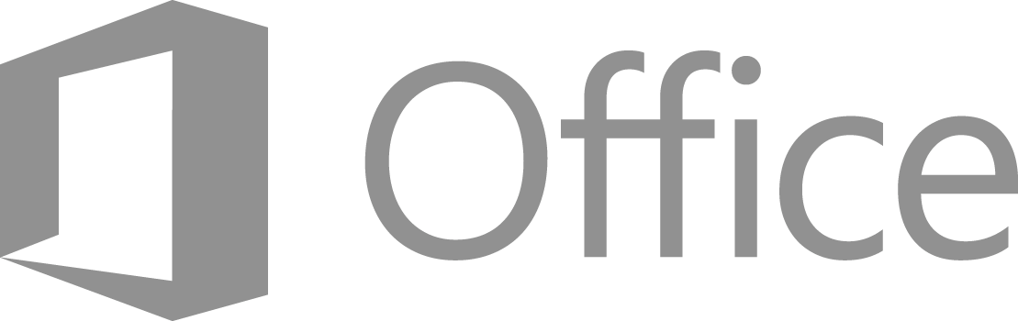

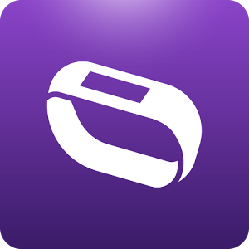

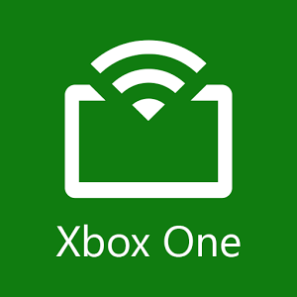
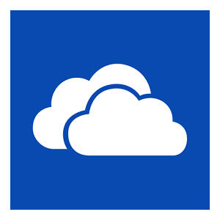
First-party apps
Accessible
Microsoft Azure
Works on all popular devices
Notes:
Slide Objectives:
Cover how we’re accessible
Speaking Points:
The first point to talk about is accessibility
We’ve made an earnest commitment to delivering our applications and experiences on the mobile platforms that people use
This means first-party Microsoft apps on Android including Skype and Office as well as OneDrive, Xbox Smart Glass and others
We’ve also made sure to deliver SDKs for many areas of Microsoft Azure on these platforms

Slide 4



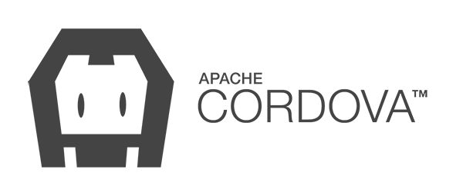

Developed and
Distributed with
OSS contributions:
Open source
many others…
Notes:
Slide Objectives:
Talk about our open source initiatives
Speaking Points:
When it comes to Open Source, the one thing that most people will have most recently heard about was us open sourcing .NET itself
This is part of being more open
We’ve also contributed to many different open source frameworks like Cordova, jQuery, Couch, Docker, etc
Many of our SDKs (like .NET) are now developed on GitHub in public

Slide 5

Contributions
Accepted
Feature Requests
Wanted
Open source
Notes:
Slide Objectives:
More open source
Speaking Points:
We’re also very open source about how we develop some of our products
For example, most of the SDKs you’ll see in use today are on GitHub
And they accept community contributions
We also have just about all of our Azure systems on UserVoice where we accept feature requests and votes on features

Slide 6
Build anywhere: Windows, Linux, OS X
Open source SDKs
Industry standard REST APIs
Choose your source control
Free to get started
Free tiers of many services
Easy and pleasant dev experience
Notes:
Slide Objectives:
Talk about how it’s easy to use Microsoft and Azure
Speaking Points:
The last point before we start focusing entirely on Azure is ease
Being accessible and open are great, but if it isn’t easy to develop on our platforms, we know it won’t matter.
You can build for azure on any OS
We have SDKs FOR the languages you want to build with
Everything we expose uses industry standard REST
Our systems connect to popular source control systems like GitHub
Azure is free to get started with the trial
Plus there are many free tiers to many services

Slide 7
Accessible
Open
Easy
Works on all popular devices
Open source
Easy and pleasant dev experience
Notes:
Slide Objectives:
Reiterate the three principles
Speaking Points:
Again, Microsoft is
Accessible, Open, and Easy

Slide 8


Microsoft and Android
Notes:
Slide Objectives:
Talk about Microsoft and Android
Speaking Points:
Now we’ll talk more about what Microsoft is doing with Azure

Slide 9
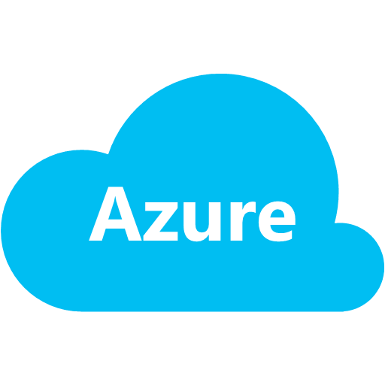

Azure and Android
Notes:
Slide Objectives:
Talk about Azure and Android
Speaking Points:
More specifically, we’ll talk about Microsoft Azure and Android
Azure is Microsoft’s cloud platform
The idea of the cloud is that it is something that is globally available, efficient, and saves you time and money

Slide 10


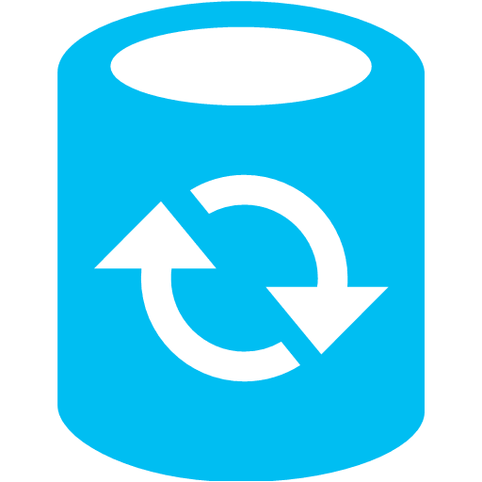









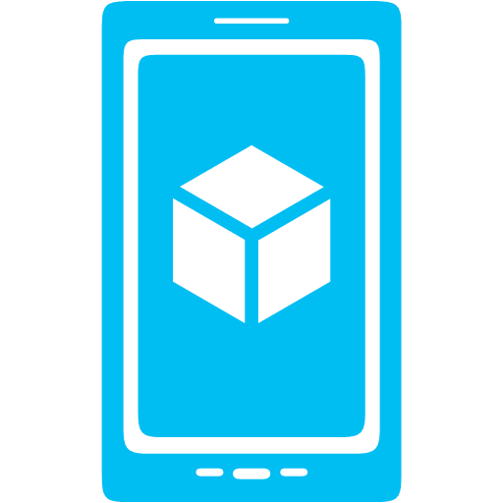




Azure and Android
Notes:
Slide Objectives:
Talk about Azure and Android
Speaking Points:
When it comes to Android, Azure overs many different services
From Mobile Services, our backend-as-a-service
To Notification Hubs for delivering push notifications
To many different storage options, job processing, version control, continuous integration
And more

Slide 11
Why the cloud?
Hosting models
Business model
On Premises
Infrastructure
(as a Service)
Platform
(as a Service)
Software
(as a Service)
Applications
Applications
You manage
Applications
Applications
You scale, make resilient and manage
You scale, make
resilient & manage
Data
Data
Data
Data
Runtime
Runtime
Runtime
Runtime
Scale, resilience and management by vendor
Middleware
Middleware
Middleware
Scale, resilience and management by vendor
Middleware
O/S
O/S
O/S
O/S
Virtualization
Virtualization
Managed by vendor
Virtualization
Virtualization
Servers
Servers
Servers
Servers
Storage
Storage
Storage
Storage
Networking
Networking
Networking
Networking
Notes:
Slide Objectives:
Talk about hosting models from on-premises to SaaS
Speaking Points:
First we’ll go over a bit of terminology and architecture
To the far left we have the traditional on-premises approach.
This is when you have your own DataCenter and you run everything from the floor up.
Next is Infrastructure-as-a-Service, where the hardware infrastructure and virtualization is taken care of.
This is what you think of as Virtual Machines. This is the most popular form of cloud usage right now.
Next is Platform-as-a-Service. This is an abstraction on top of IaaS where the OS, middleware, and runtime are handled for you so you’re only responsible for the app code and data.
As you’ll see, there are a number of different pieces that fall under PaaS
The last column here is for Software-as-a-Service.
SaaS refers to a whole stack that you just use or pay to use.
This is stuff like Office 365, OneDrive, SalesForce, Google Apps, etc

Slide 12
Mobile Services
Notes:
Slide Objectives:
Mobile Services
Speaking Points:
Mobile Services is a feature designed specifically for making it easy to build Android apps and we’ll start by talking about that

Slide 13

Develop backends with…
.NET
Node.js
Notes:
Slide Objectives:
Mobile Services backend
Speaking Points:
When you create a Mobile Service, you have a enhanced runtime that provides a lot of functionality out of the box for you
You can build some of the backend yourself though and you can choose between .NET and Node.js

Slide 14
Flexible Data
Notes:
Slide Objectives:
Mobile Services Data Storage
Speaking Points:
The default storage for Mobile Services is Azure SQL Database
However, you can also connect to other storage systems in azure
Built into the Mobile Services SDK is an offline sync capability (this may still only be in the BETA sdk)
We’ll talk more about storage later on

Slide 15
Active Directory
Notes:
Slide Objectives:
Authentication
Speaking Points:
Another benefit of Mobile Services is easy authentication with many different providers
There is built in auth with Facebook, Twitter, Google, and Microsoft accounts
As well as the ability to authenticate with Active Directory

Slide 16
Office 365 APIs
Notes:
Slide Objectives:
APIs
Speaking Points:
Finally there are lots of APIs and access into other services that Microsoft provides that you can plug into
This includes Office 365, OneDrive, Sharepoint, and more

Slide 17
Demo: Mobile Services
Notes:
Demo Objectives:
Show off Mobile Services
Demo Points:
Go to portal
Create a new mobile service and explain it
Move over to an existing mobile service
Open app in Android Studio
App should already be configured to connect to pre-existing mobile service
Run the app and demonstrate authentication working then data storage
Walk through client side code
Explain how data isn’t being tied to users yet
Alter the server side script for inserting to tie data to user
Save data in app and show the app saved in the backend
Alter the Where clause, so items retrieved are restricted to the user

Slide 18
Notification Hubs
Notes:
Slide Objectives:
Mobile Services
Speaking Points:
Notification hubs is a feature of Azure that helps deliver push notifications to several platforms
Hubs does this by making use of the built in Push Notification technology provided for iOS, Android, Windows, and Windows Phone
This works with your apps regardless of if you’re using Azure for anything else or not.

Slide 19
Broadcast Notifications
APP BACKEND
Notes:
Slide Objectives:
Notification Hubs
Speaking Points:
Notification Hubs are able to send push notifications through APNS, GCM, ADM, Baidu, WNS, and MPNS
The first and easiest capability is broadcasting pushes to everyone or all the users that are using your app

Slide 20
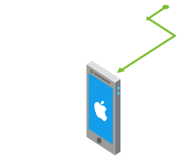
Targeted Notifications
APP BACKEND
Notes:
Slide Objectives:
Notification Hubs
Speaking Points:
You can also do targeted push
This enables you to push to a specific platform, or a user, or a device

Slide 21
Demo: Notification Hubs
Notes:
Demo Objectives:
Show off Notification Hubs at work
Demo Points:
Return to app in Android Studio
Walk through code that connects to GCM and shows notifications (manifest, build file, activity code, handler)
Add code to register device with Notification Hub after user authenticates
Go to Hubs debug page and test out a push to the app
Go to the insert script and add a push to all the devices when an item is inserted
Test out and show the push arriving
Edit the script to push to the specific device
Test and show the push working

Slide 22
Data
Notes:
Slide Objectives:
Data
Speaking Points:
Let’s take a minute to talk about the different data storage options offered in Azure

Slide 23
Data Storage
SQL Database
SQL on IaaS
Table Storage
Blob Storage
Files
Queues
MongoDB
DocumentDB
Notes:
Slide Objectives:
Data options
Speaking Points:
Azure Has many data storage options
SQL Database which is a full SQL DB running as a service in Azure, we’ve already seen this in use in Mobile Services
Alternatively, you can deploy your own SQL Database Server on VMs using IaaS
NoSQL options include Azure Table Storage, MongoDB (running in IaaS) and Document DB (a JSON Document based store)
Blob storage can be used for file storage from any other area in Azure and also is used for disks in VMs
Azure Files provides for shared file directories for VMs
Queues provide a way to do messaging between pieces of applications in Azure

Slide 24
Services
Notes:
Slide Objectives:
Services
Speaking Points:
Next we’ll talk about a few additional services that as an Android developer, Azure provides for you

Slide 25









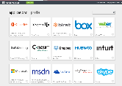

Azure Active Directory
Active Directory
Microsoft apps
Other Directories
Active Directory
Custom LOB apps
ISV/CSV apps
Non-MS cloud-based apps
PCs and devices
Notes:
Slide Objectives:
Identify different pieces of Identity and AAD
Speaking Points:
Identity is big and very important
Bridging identity on-premises and the cloud is something most haven’t figured out
Here we have Microsoft apps, non-ms cloud based apps and SaaS
On-Prem Active Directory running in Windows Server, Other Directories
Azure Active Direcotry is able to bridge all of these together in one place
Sync on prem to cloud
Secure azure resources and mobile apps with AAD

Slide 26
Azure AD Auth Library (ADAL)
Authenticate users against Azure AD
Uses industry standard OAauth2
Refresh tokens allows for access to APIs w/o prompting the user
Dialog and Fragment support for Android
AD Sync connects on-premises AD to Azure
Notes:
Slide Objectives:
Talk about ADAL
Speaking Points:
Azure AD Auth Library (ADAL) provides for easy connectivity / authentication from Android (and iOS) apps
Support easy sync with on-premises AD
Uses industry standard OAuth2
Refresh tokens ensure users don’t have to continually sign in
Dialog and Fragment support for easier usage from Android apps

Slide 27
Office 365 SDK
Provides access to
SharePoint Online Files and Lists
Exchange Online Mail, Calendars, and Contacts
Azure Active Directory Graph
Works in conjunction with ADAL
Notes:
Slide Objectives:
Talk about office 365 capabilities
Speaking Points:
Office 365 is pre-integrated with Azure AD (if you login to Office 365, you’re logging in to Azure AD)
The O365 SDK provides access to features including:
SharePoint Online files and lists
Exchange mail, calendars, contact
Azure AD graph
Works with ADAL (i.e. get a token from logging in and then use that token with the O365 SDK)

Slide 28


BizTalk Services Hybrid Connections
Microsoft Azure
Your Enterprise
Hybrid Connection Manager
1433
Connection string points to My-Database:1433
My-Database
Notes:
Slide Objectives:
Talk about BizTalk Services Hybrid Connections
Speaking Points:
BizTalk Services Hybrid Connections
Creates a way of connecting from azure to on-premises
Run a connection manager in data center
That connects an endpoint in azure to whatever resource you want in your DC
DB
Web Service
ETC

Slide 29
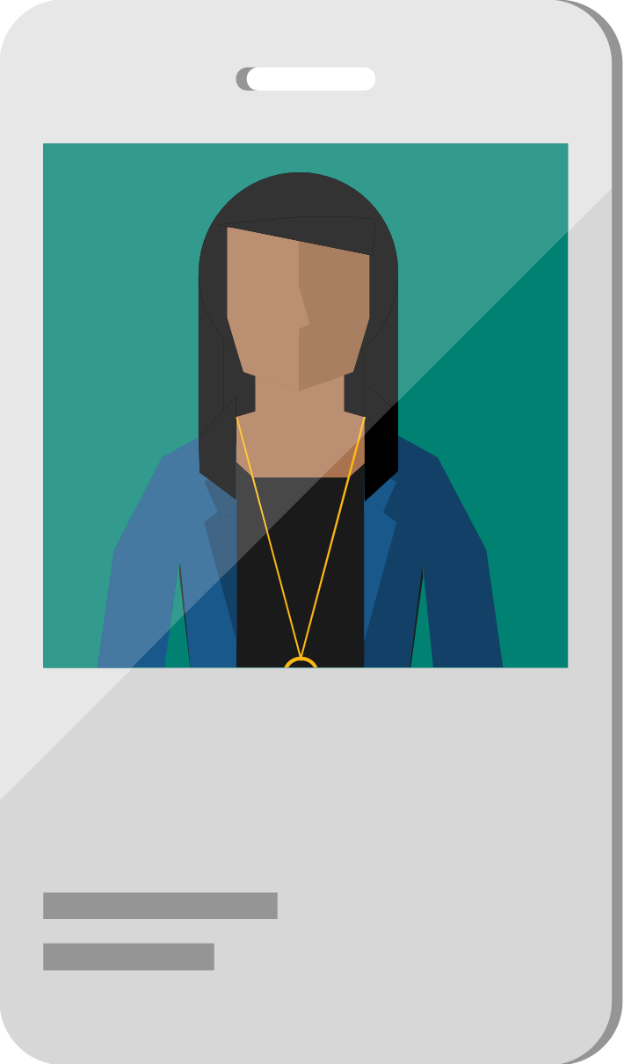
Azure RemoteApp
Remote applications delivered from the reliable Azure platform
Access from Windows, iOS, Mac OS X, and Android devices
Delivered via Microsoft Remote Desktop Protocol and RemoteFX
Scale without large capital expense
Flexible hybrid or cloud deployment options
User
Notes:
Slide Objectives:
Explain how Azure Remote App allows running Windows applications on Android
Speaking Points:
Remote apps delivered from Azure
Access apps from Win, iOS, OS X, Android, all using free Remote Desktop apps
Cloud App images or custom images
Vnet / hybrid solutions enable you to host your own custom apps as well as do data connection back to your on-premises and do AD auth

Slide 30

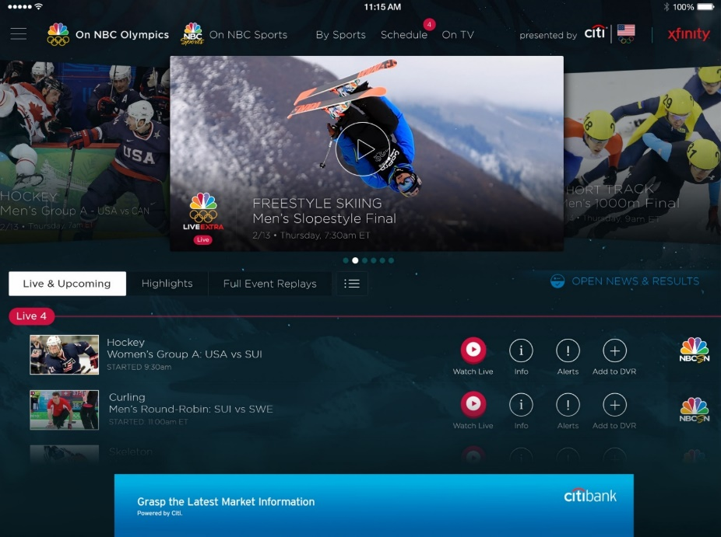
Azure Media Services
Olympics NBC Sports
On Demand Media Services
Video-on-demand
Ingest
Encode
Package
Encrypt
Delivery
Live Streaming Support
Office 365 Integration
Live video encoding and streaming
Web + Mobile
100 million viewers
2.1 million concurrent HD viewers during the USA vs. Canada hockey match
Notes:
Slide Objectives:
Talk about Azure Media Services
Speaking Points:
Provides video streaming support including
Ingesting media
Encoding it
Package and encrypt
Deliver it down to devices
Supports AES and DRM encryption
AES Clear Key
DRM
Also indexing content (closed captionaing)

Slide 31
Azure and Android
Notes:
Slide Objectives:
Talk about Azure and Android
Speaking Points:
So as we’ve seen, Azure offers a ton of different services for Android
Starting with the BaaS in Mobile Services
We then saw Notification Hubs which enables easy push notifications to devices
Finally we saw a lot of different data storage options as well as additional services offered to Android

Slide 32
Resources
Get a FREE Microsoft Azure Trial Account:
http://azure.microsoft.com
Checkout the Android Azure dev center
http://azure.microsoft.com/android
Contact Details
<Contact Info>
Microsoft Azure
Notes:
Slide Objectives:
Provide additional Resources
Speaking Points:
* Here we have links to many of the different resources we mentioned as well as to a free trial for Azure

Slide 33




Thanks!
Questions?

