Slide 1
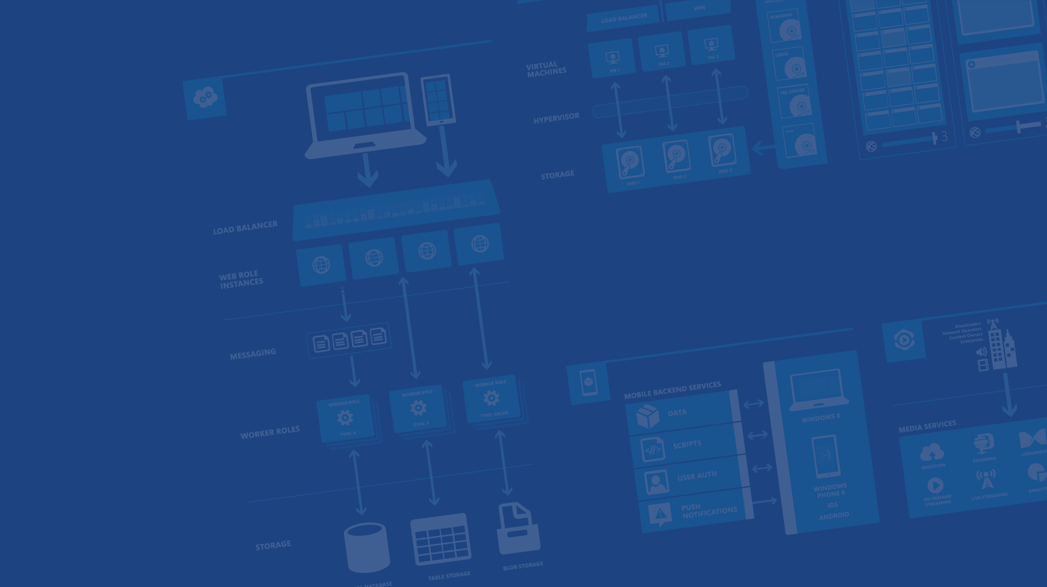
Wrap Up
<Speaker Name>
<Role>
<Contact Info>
Microsoft Azure

Slide 2
Accessible
Open
Easy
Works on all popular devices
Open source
Easy and pleasant dev experience
Notes:
Slide Objectives:
Highlight the three principles we mentioned early on
Speaking Points:
When we talk about the new Microsoft, we talk often about three core principles
Accessible, Open, and Easy
We think these things are just as important to you as developers and hope you’ve seen this in the services for Android

Slide 3

19
Azure datacenter regions open for business
Azure footprint
Notes:
Slide Objectives:
19 DCs
Speaking Points:
As of right now Azure is running in 19 datacenters around the world

Slide 4
The Cloud Makes it Easy
Hosting models
Business model
On Premises
Infrastructure
(as a Service)
Platform
(as a Service)
Software
(as a Service)
Applications
Applications
You manage
Applications
Applications
You scale, make resilient and manage
You scale, make
resilient & manage
Data
Data
Data
Data
Runtime
Runtime
Runtime
Runtime
Scale, resilience and management by vendor
Middleware
Middleware
Middleware
Scale, resilience and management by vendor
Middleware
O/S
O/S
O/S
O/S
Virtualization
Virtualization
Managed by vendor
Virtualization
Virtualization
Servers
Servers
Servers
Servers
Storage
Storage
Storage
Storage
Networking
Networking
Networking
Networking
Notes:
Slide Objectives:
Talk about hosting models from on-premises to SaaS
Speaking Points:
The Cloud makes it easy so you don’t have to deal with everything from the ground up.
To the far left we have the traditional on-premises approach.
This is when you have your own DataCenter and you run everything from the floor up.
Next is Infrastructure-as-a-Service, where the hardware infrastructure and virtualization is taken care of.
This is what you think of as Virtual Machines. This is the most popular form of cloud usage right now.
Next is Platform-as-a-Service. This is an abstraction on top of IaaS where the OS, middleware, and runtime are handled for you so you’re only responsible for the app code and data.
As you’ll see, there are a number of different pieces that fall under PaaS
The last column here is for Software-as-a-Service.
SaaS refers to a whole stack that you just use or pay to use.
This is stuff like Office 365, OneDrive, SalesForce, Google Apps, etc

Slide 5







Azure Mobile Services
Storage
Authentication
Logic
Push
Scheduler
Notes:
Slide Objectives:
Explain the purpose of Azure Mobile Services to attendees.
Speaking Points:
Mobile Services helps devs by providing common mobile app backend features in a turnkey manner
Data storage powered by SQL Database (but you don’t have to be a Database Admin to use it)
User Authentication and Data Authorization
Backend Logic
Push Notifications (using services built into Android, iOS, Windows Phone, and more)
Backend job processing using the scheduler

Slide 6
Notification Hubs
Cross-platform Push Notifications
Highly scalable
Managed
Notes:
Slide Objectives:
Highlevel overview of Notification Hubs
Speaking Points:
Notification Hubs solves the server side aspect for you
It provides for cross-platform push
It’s highly scalable (millions of push notifications)
It’s a managed solution

Slide 7
Free one month trial, free tiers beyond
Sign-up for free and get $200 to spend on all Azure services
Virtual Machines
SQL Databases
Websites
Hadoop
Mobile Push
Media Streaming
Active Directory
Everything else...
http://aka.ms/AndroidAzureCamp

Notes:
Slide Objectives:
Explain the free trial
Speaking Points:
The trial gives you $200 to spend in a month
Remind that several services including Mobile Services and Notification Hubs have free tiers

Slide 8
Web Videos on Channel 9
Cloud Cover
http://channel9.msdn.com/Shows/Cloud+Cover
Azure Friday
http://channel9.msdn.com/Shows/Azure-Friday
WebCamps TV
http://channel9.msdn.com/Shows/Web+Camps+TV
All Azure Content
http://channel9.msdn.com/Azure

Slide 9
Resources
Pricing
http://azure.microsoft.com/en-us/pricing/
Case Studies
http://azure.microsoft.com/en-us/case-studies/
Free Trial
http://azure.microsoft.com/en-us/pricing/free-trial/
Trust Center
http://azure.microsoft.com/en-us/support/trust-center/
Compliance
http://azure.microsoft.com/en-us/support/trust-center/compliance/
Security
http://azure.microsoft.com/en-us/support/trust-center/security/

Slide 10
Contact and Location Info
General Feedback on Azure on User Voice
http://feedback.azure.com/forums/34192--general-feedback
Mobile Services team
MobileServices@microsoft.com
@AzureMobile on Twitter
<SpeakerName>
<Speaker Email Address>
<Additional Contact Info>

Slide 11
Get started today at http://azure.microsoft.com

Slide 12




Thanks!
Questions?
Notes:
Slide Objectives:
Speaking Points:

