Slide 1
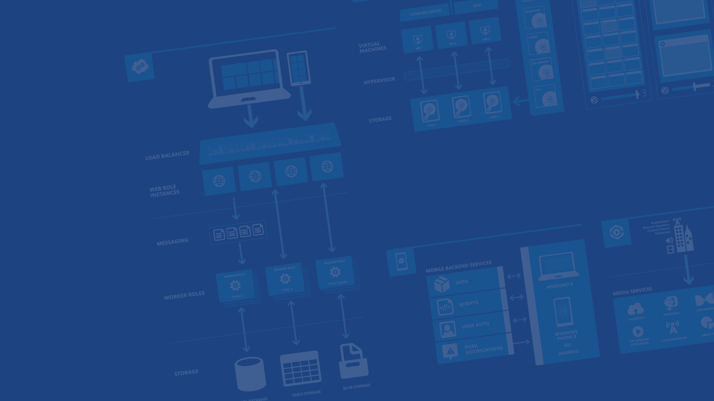
Mobile Services and Android
<Speaker Name>
<Role>
<Contact Info>
Microsoft Azure

Slide 2
Agenda
Mobile Services
Basic Features
Demos
Advanced Features
Scaling and Pricing
Questions
Notes:
Slide Objectives:
Go over the agenda for the presentation
Speaking Points:
In this session we’ll be going over the following items:
What Mobile Services is?
The Basic features of Mobile Services
Demos of those features
Some of the advanced features
How scaling and pricing works
Questions

Slide 3



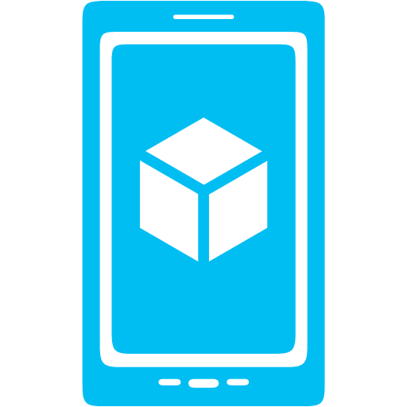



What is Azure Mobile Services?
Storage
Authentication
Logic
Push
Scheduler
Notes:
Slide Objectives:
Explain the purpose of Azure Mobile Services to attendees.
Speaking Points:
Users don’t really care (and usually don’t know) what a mobile app is using for it’s backend
Users care most about enjoying the app experience
Devs should therefore spend most of their time building the best client experience they can
Mobile Services helps devs by providing common mobile app backend features in a turnkey manner
Data storage powered by SQL Database (but you don’t have to be a Database Admin to use it)
User Authentication and Data Authorization
Backend Logic
Push Notifications (using services built into Android, iOS, Windows Phone, and more)
Backend job processing using the scheduler

Slide 4
Demo: Getting Started
Your first Mobile Service
Notes:
Demo Objectives:
Demonstrate creating a new Mobile Service, walk through some of the code, show parts of the portal experience.
Demo Points:
Open Azure portal
Go to Mobile Services
Create new Mobile Service (choose Javascript for backend)
Go into Mobile Service quick start
Pick Android platform
Follow Create New Android App steps
Import project into Android Studio
Run app
Walk through code / highlight Mobile Services SDK references

Slide 5
Structured Storage
Powered by SQL Database
Supports rich querying capabilities
Dynamic Schematization
Data management in:
Azure Portal
SQL Portal (Silverlight)
SQL Management Studio
REST API
Azure CLI Tools
SQL CLI
Microsoft Azure
Notes:
Slide Objectives:
Discuss the storage and data management options
Speaking Points:
Mobile Services is powered by Azure SQL Database out of the box
Azure SQL Database provides a full featured DB that you can connect to from anything you want (i.e. a website)
Thanks to SQL you’re given rich querying so you can query based off any column
Mobile Services uses Dynamic Schematization to create new DB columns for you
Data management is possible through:
Azure Portal (view data, delete rows, remove all data from tables, add columns)
SQL Portal (Silverlight tool for SQL Admin)
SQL Management Studio (Windows app for doing SQL admin)
REST API (more on this in a minute)
Azure CLI Tools (xPlat CLI tools that we’ll see later)
SQL CLI (a NPM module which enables you to connect and run SQL statements from the CLI)

Slide 6
The REST API
Base Endpoint: https://MobileService.azure-mobile.net/tables/*
Action | HTTP Method | URL Suffix
Create | POST | /TodoItem
Read | GET | /TodoItem?filter=id%3D42
Update | PATCH | /TodoItem/id
Delete | DELETE | /TodoItem/id
Microsoft Azure
Notes:
Slide Objectives:
Go over REST API generated for each table
Speaking Points:
When you create a table, a REST API is generated around that table
This is standard REST
If we don’t have an SDK for something that you want to connect with (i.e. OS X) you can just communicate over the standard REST

Slide 7
JSON to SQL Type Mappings
JSON Type | T-SQL Type
Numeric values (integer, decimal, floating point) | Float(53)
Boolean | bit
DateTime | DateTimeOffset(3)
String | Nvarchar(max)
Microsoft Azure
Notes:
Slide Objectives:
Review JSON to SQL mappings used by dynamic schematization
Speaking Points:
When Mobile Services reviews the data sent in, it creates new columns based off this mapping

Slide 8
Auto-generated Columns
id – unique guid
__createdAt – date
__updatedAt – date
__version – timestamp
Helps with concurrency and offline
__deleted: bool
Enables soft delete
Microsoft Azure
Notes:
Slide Objectives:
Discuss Autogenerated columns
Speaking Points:
id : unique key for every table
Created at, updated at, version all help with optimistic concurrency and offline
Deleted enables soft delete

Slide 9
Offline
Currently in beta
http://aka.ms/Iajk6q
Walkthrough
http://azure.microsoft.com/blog/2014/08/07/offline-support-in-azure-mobile-services-android-sdk/
Uses Futures and callbacks
Sync Tables
Microsoft Azure
Notes:
Slide Objectives:
Talk about Offline data storage
Speaking Points:
Offline support is currently part of a beta SDK
Enables easy offline storage using SQLITE and then syncs up to server
Uses different constructs (SyncTable instead of Table)
Developer decides / enables sync action once network is restored

Slide 10
Backend Logic: .NET & JavaScript
Notes:
Slide Objectives:
Transition to talking about backend logic
Speaking Points:
When the mobile service is created, we can choose what backend to use
Since we chose javascript, server side scripts are created along with the REST API for every table

Slide 11
Server Side Table Scripts
Node.js scripts
.NET Web API
backend in
Visual Studio
Passes through to SQL by default
MongoDB, Table Storage, SQL out of the box
Intercept CRUD requests to tables
Fully customizable
Notes:
Slide Objectives:
Discuss server side scripts
Speaking Points:
For javascript backend, server scripts are Node.js scripts
These scripts intercept any CRUD request against a table
By default these scripts just pass through the request (i.e. execute the SQL)
You can alter these scripts to perform any logic you want
Alternatively the .NET backend creates a Visual Studio project you can develop and deploy to your Mobile Service
This is where you can alter from using SQL to another storage system

Slide 12
Node Modules
request
push.*
sendgrid
console
mssql
pusher
tables
azure
twilio
Notes:
Slide Objectives:
Discuss built in Node Modules
Speaking Points:
Several Node modules are preinstalled so you can easily access them in your scripts
Request – enables HTTP web requests to be made to other endpoints
Push – enables you to trigger push notifications down to clients
Console – logs info and error messages to a logging window
Mssql – enables you to run custom SQL commands as well as stored procs
Tables – a more Object Oriented way to access the other tables in your service
Azure – plugs into other areas of Azure (table, blob storage, service bus, etc)
Several partners also have offerings that you can use from your scripts:
Sendgrid – handles sending emails
Push – real-time web socket style communication
Twilio – performs sms, voice, and fax communications

Slide 13
Demo: Customizing Logic
Adding Data Validation
Notes:
Demo Objectives:
Demonstrate customizing a script
Demo Points:
Now we’ll look at how you can customize a script to add data validation
The easiest thing to do is return a StatusCodes.BAD_REQUEST if the todo’s text field’s length is too short in the Todo item’s insert script

Slide 14
.NET Backend
Web API based w/ additional functionality, developed in and deployed from Visual Studio
TableController data context can map to SQL, Table Storage, Mongo, etc
Pull in NuGet modules and other .NET libraries
Set permissions with attributes on classes
Local Debug
Microsoft Azure
Notes:
Speaking points
.NET backend is currently in preview
Bases off of Web API
Develop and deploy in VS (also create new Mobile Services with VS project template)
Debug locally
Can pull in NuGet and other .NET libs
TableController is base for accessing data, can be overridden to talk to Table Storage, Mongo, etc
Permissions handled as attributes on classes

Slide 15
Custom API
Non-table based endpoints
Accessible from
GET
POST
PUT
PATCH
DELETE
For node.js logic in scripts like table endpoints
For .NET delivered through a WebAPI
Expose any functionality you want
Microsoft Azure
Notes:
Speaking points
All scripts so far tied to a table action
Custom APIs are non-table based endpoints
Script functionality for normal HTTP methods

Slide 16
File Storage
Don’t store files in Mobile Services DB
Use Mobile Service to provide a Valet Key Pattern to Blob Storage, aka BLOB SAS
Create table / custom API script to talk to Blob Storage
Script generates Shared Access Signature (SAS) URL
Script returns SAS URL to client app
Client app uploads data to blob storage directly
Store file URL in Mobile Service DB as needed
Blob storage costs less and is built for redundant file storage
Use the Resource Broker
https://github.com/Azure/azure-mobile-services-resourcebroker
Microsoft Azure
Notes:
Speaking Points
SQL DB for Mobile Services not ideal for file data storage
Best practice is to use Mobile Service as Proxy
Mobile Service script generates SAS URL
Client uploads file to SAS URL
Valet Key Patternhttp://msdn.microsoft.com/en-us/library/dn568102.aspx
Resource Broker (for Javascript and .NET backends) helps deal with this process of getting a SAS

Slide 17
Push Notifications
Notes:
Slide Objectives:
Transition to talking about Push Notifications
Speaking Points:
Highlight that push notifications are important for all kinds of apps

Slide 18
Push Notification Flow
Client
Mobile Services
Register for push notifications with PNS
Send your identifier to Mobile Service
Send push from server scripts
PNS delivers notification to device
App
(2)
(3)
(4)
(1)
PNS
Microsoft Azure
Notes:
Slide Objectives:
Discuss push notifications flow
Speaking Points:
Regardless of what client platform you’re building an app for, this flow is going to be the same
Client talks to a Push Notification Service (such as Google Cloud Messaging, Amazon Device Messaging, Baidu)
Client gets a registration ID that identifies Device and App (but only to PNS)
Client sends reg ID to Mobile Service
Mobile Service can then request the PNS to send a push

Slide 19
Demo: Adding Push
Notes:
Demo Objectives:
Demonstrate push notifications
Demo Points:
Walk through the different pieces of code / settings that need to be added to enable push
Update the push settings in the portal
Update insert script to trigger a push to the device when a Todo is inserted

Slide 20
Notification Hubs
Separate from Mobile Services
Can be used regardless of whether you’re storing data in Azure
Extremely scalable push notifications
Cross platform support
Push to iOS, Android, Kindle, Windows Phone, Windows Store
Tags (i.e. tie my registration to this topic or user ID)
Templates (i.e. when I get a push, send it in this format)
Microsoft Azure
Notes:
Slide Objectives:
Discuss Notification Hubs
Speaking Points:
Mobile Services is actually using Notification Hubs behind the scenes
However, Notification Hubs is a separate feature and can be used independently of Mobile Services (or any compute in Azure)
Hubs provides for extremely scalable (millions in minutes) of push notifications
Supports many platforms (iOS, Android, Kindle, Windows Phone, Windows Server)
Tags enable push filtering (who receives it)
Templates enable single request push to all platforms (hubs puts data in the right format for each PNS)

Slide 21
Authorization & Authentication
Notes:
Slide Objectives:
Transition to data and user security
Speaking Points:
So far, all data in our application is visible to all users.
We’ll next talk about how to lock that down

Slide 22
Data Authorization
Per HTTP method auth options:
App Key Required
Not ideal for production use
Everyone
Authenticated Users
Admins and other scripts
Requires Master Key as header
401 Unauthorized response if security check fails
Microsoft Azure
Notes:
Slide Objectives:
Talk about Data Authorization
Speaking Points:
Each Table / Custom API operation can have a permission level set
By default, that level is anyone with App Key
That isn’t secure as getting the App Key once your app is available publicly is trivial
Other options are
Everyone (anyone can access)
Authenticated Users (only users with a valid user ID and token can get through)
Admins and other scripts (only other server scripts or someone with the Master Key can get through)
401 is returned if your auth isn’t valid

Slide 23
User Auth Flow (server)
GOOGLE
CREDENTIALS (via oAuth/WebView)
FACEBOOK
DEVICE
AUTH TOKEN
TWITTER
GRAPH ACCESS (LIMITED)
IDENTITY
MICROSOFT
MOBILE SERVICE
Microsoft Azure
Notes:
Slide Objectives:
Discuss server side user auth flow
Speaking Points:
There are two forms of auth and the first we’ll talk about is server auth
This is a basic Oauth flow
The client device calls a method in the SDK which opens a webview which goes to a specific auth provider
The user authenticates
The provider hands back information to the Mobile Service
The Mobile Service creates an identity which it hands back to the client
Future requests from the client contain that identity (though it needs to be cached locally for app restarts)
The Mobile Service now has Graph access to the provider

Slide 24
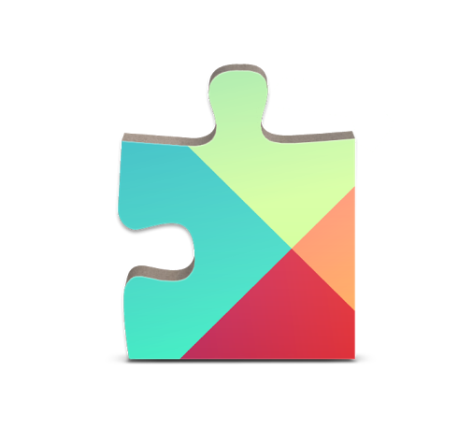
User Auth Flow (client)
CREDENTIALS (via native SDKs)
GOOGLE
AUTH CODE + TOKEN
FACEBOOK
DEVICE
GRAPH ACCESS
TWITTER
GRAPH ACCESS
AUTH CODE
MICROSOFT
IDENTITY
MOBILE SERVICE
Microsoft Azure
Notes:
Slide Objectives:
Talk about the client flow
Speaking Points:
Alternatively, you can use local SDKs to authenticate with a provider
This hands the Auth Code and Token back to the Device
Device can then send that info to the Mobile Service, who will verify it
An identity is then sent back to the client
Both Device and Service now have graph access

Slide 25
The User object
User.level
Admin
Authenticated
Anonymous
User.userId
Provider:id or undefined
User.getIdentities()
UserId
Provider Access Token / Secret
Basic user information (i.e. name, username, locale, picture, link)
Microsoft Azure
Notes:
Slide Objectives:
Discuss the user object
Speaking Points:
So far the User object which is a parameter in each of our script methods has only told us the user is anonymous
Once authenticated we get additional info
userId is a unique ID for each user
getIdentities will give us the provider token / secret (for graph access) and basic info depending on the provider

Slide 26
Demo: Adding Auth
Lock Down and Login
Notes:
Demo Objectives:
Demonstrate auth in action
Demo Points:
Lock down permissions on table to “Only authenticated users”
Run app / refresh data and show error is returned
Go to provider developer portal
Create app in provider portal, copy secret / key to Identity page in Mobile Service portal
Add code to authenticate client
Demonstrate logging in and getting access again
Go to insert script and add the UserId to the Todo Item before saving it to the DB
Demonstrate saving an item in app, show new field in data page and how User ID is now tied to items
Change Read script to add UserId query
Demonstrate that users only have access to their own data now (can’t see other user’s todo items)

Slide 27
Command Line Interface
Notes:
Slide Objectives:
Transition to talking about the Command Line Interface
Speaking Points:
* We’ll next take a look at the cross platform Command Line Interface tools for Mobile Services

Slide 28
CLI
Create / Delete Services
Inspect / Delete Table Data
Create / Update / Delete Tables and Permissions
Create / Upload / Delete Scripts
Scale Up / Down Services
Much More Across Azure
Notes:
Slide Objectives:
Talk about CLI capabilities
Speaking Points:
The CLI tools allow you to do a lot across Azure
For Mobile services you can
Create and delete services
Read and delete table data
Update permissions
Download and upload scripts
Change the scale of your service
Enable new features

Slide 29
Demo: Using the CLI
Notes:
Demo Objectives:
Showcase the CLI tools
Demo Points:
Suggestions are to list out your mobile services and then get the config info for the service you’ve been using

Slide 30
Scheduler
Notes:
Slide Objectives:
Transition to talk about the scheduler
Speaking Points:

Slide 31
Scheduled Jobs
Executes a script on defined schedule
Can be run on demand
Ideal for any backend data processing job
Microsoft Azure
Notes:
Slide Objectives:
Discuss scheduled jobs
Speaking Points:
Scheduled jobs are scripts that can be run on demand or on a schedule
Not triggered by a client action
Ideal for any backend data processing (deleting old data, sending regular push notifications, etc)

Slide 32
Script Source Control
Notes:
Slide Objectives:
Transition to talking about script source control
Speaking Points:
* So far all of the script editing we’ve done has been done IN the portal

Slide 33
Script Source Control
Creates a Git repo in Azure
Access table, scheduler, custom API, shared scripts and permissions
Pushing changes triggers a redeploy of your Mobile Service
Enables installing NPM modules
Shared Scripts
Create scripts that can be used from all other scripts in your Service
Microsoft Azure
Notes:
Slide Objectives:
Talk about Script Source Control
Speaking Points:
When you create a Mobile Service, a git repo is auto created for your service
This contains all of the scripts you have as well as JSON files that contain the permissions
Changing a script and pushing it to your repo triggers a redeploy of your service
This also enables you to add NPM modules and shared scripts which can be used from any other script

Slide 34
Diagnostics Logging Scale
Notes:
Slide Objectives:
Transition to diagnostics, logging, and scale
Speaking Points:

Slide 35
Diagnostics, Logging, Scale
API Calls, # of Devices, Data Out
Console Logging (auto error logging)
Scale Service Based off API Calls
Auto-scale to Save Money
Free Tier for Mobile
Free Tier for SQL
Notes:
Slide Objectives:
Talk about diagnostics, logging, and scale
Speaking Points:
By default you get some basic information out of your Mobile Service
Number of API Calls, Number of Devices, and amount of Data Out are important because that ties into usage and scale
Scaling of a service is based off of the number of API calls
Mobile Services supports Auto-Scale so you’re not paying for more than you use
Any errors are auto logged but you can also use the Console module to log info
Mobile Services, SQL Database, and Notification Hub all offer a free tier

Slide 36
Mobile Service Scaling
→ Free: 500k calls / month / subscription
→ Basic: 1.5M calls / unit (6) / month
→ Standard: 15M calls / unit (10) / month
Notes:
Slide Objectives:
Discuss scale levels
Speaking Points:
There are three scale levels for Mobile Services
Free is 500k calls / month across an entire subscription (this lasts BEYOND the free trial)
Basic and Standard provide for Units so if you need 2M API calls, you’d want 2 units of Basic

Slide 37
Demo: Scaling
Leaving Free Mode and Turning on AutoScale
Notes:
Demo Objectives:
Show how scaling works
Demo Points:
Start by showing the diagnostics and logging tabs
Go to Scale
Go from free to Basic or Standard
Switch Scale-By-Metric to be API Calls
Show how you can set a min/max unit number

Slide 38
Mobile Service Tiers
usage & licensing
service level agreements
$
 | Free | Basic | Standard
Usage Restrictions | Up to 10 services, Up to 500 Active Devices* | N/A | N/A
API Calls | 500K (per subscription) | 1.5M (per unit) | 15M (per unit)
Scale | N/A | Up to 6 (in portal) | Up to 10 (in portal)
Scheduled Jobs | Limited | Included | Included
SQL Database (required) | 20MB free DB | 20MB free DB | 20MB free DB
General Availability 99.9%
*Active devices refers to the number of physical devices and emulators that make at least one call to or receive a push notification from your mobile service.
Microsoft Azure
Notes:
Slide Objectives:
Go over tiers again
Speaking Points:
Highlight free tier
Once you go into Basic or Standard, a 99.9% SLA applies to your Mobile Service

Slide 39
Azure Mobile Services
Storage
Authentication
Logic
Push
Scheduler
Notes:
Slide Objectives:
Resummarize the purpose of Azure Mobile Services to attendees.
Speaking Points:
Users don’t really care (and usually don’t know) what a mobile app is using for it’s backend
Users care most about enjoying the app experience
Devs should therefore spend most of their time building the best client experience they can
Mobile Services helps devs by providing common mobile app backend features in a turnkey manner
Data storage powered by SQL Database (but you don’t have to be a Database Admin to use it)
User Authentication and Data Authorization
Backend Logic
Push Notifications (using services built into Android, iOS, Windows Phone, and more)
Backend job processing using the scheduler

Slide 40
Resources
Get a FREE Microsoft Azure Trial Account:
http://azure.microsoft.com
Videos, Tutorials, and More
http://azure.microsoft.com/android
SDK Source Code on GitHub
https://github.com/Azure/azure-mobile-services
Contact Details
<Contact Info>
Microsoft Azure
Notes:
Slide Objectives:
Provide additional resources
Speaking Points:
You can sign up for a free trial for Mobile Services which provides X of Azure usage to be used in a month (but remember Mobile Services has a free tier)
There are more videos and tutorials available at http://azure.microsoft.com/android
The client side SDK we’re using in the Android app is open source and available on GitHub
Here is my contact info

Slide 41




Thanks!
Questions?

