Slide 1
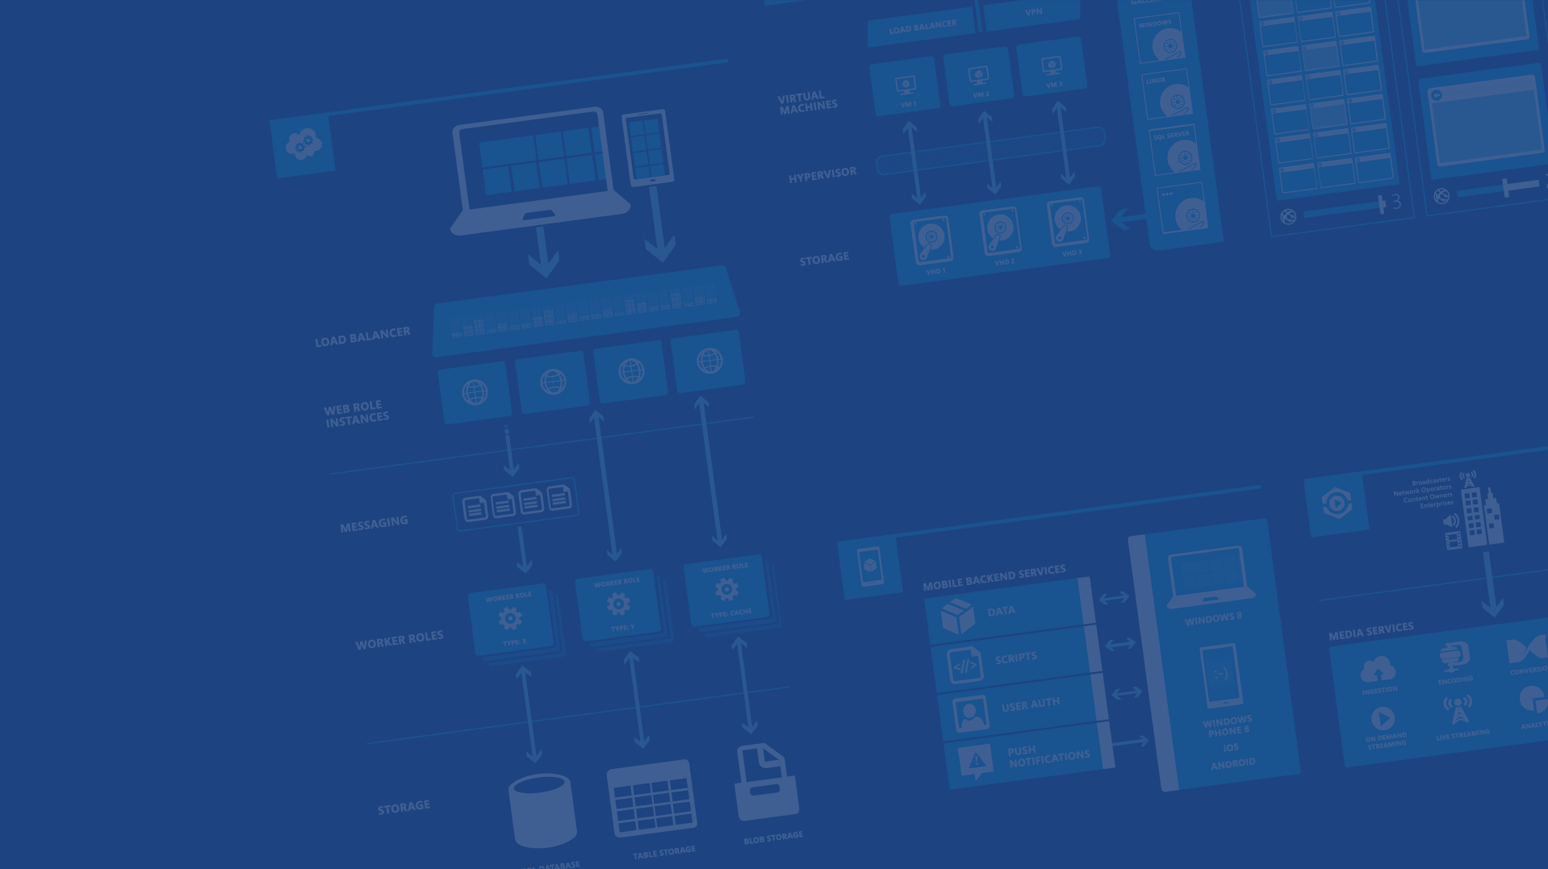
Other Microsoft Services for Android
<Speaker Name>
<Role>
<Contact Info>
Microsoft Azure

Slide 2
Agenda
Building Android Apps
Services from Microsoft and Azure
Building Java Apps
Notes:
Slide Objectives:
Review agenda for this session.
Speaking Points:
This session is going to review a few additional services Microsoft and Azure has for Android and Java devs
We’ll start by talking about actual building of Android apps
Then we’ll review some different services we offer
Finally we’ll touch on how you can use your Java skills to also build Java applications that run in the cloud

Slide 3
Building Android Apps
Notes:
Slide Objectives:
Talk about Building Android apps
Speaking Points:
The first thing we’ll discuss is building android apps
These will be tools for compiling and testing your apps and how to distribute them

Slide 4

Visual Studio
Notes:
Slide Objectives:
Transition into Visual Studio
Speaking Points:
The first thing we’ll touch on are features built into Visual Studio which is Microsoft’s IDE

Slide 5

Visual Studio Tools
Cordova
Hybrid Native / Web
HTML + JS + CSS (also TS)
Access to native capabilities
VS 2013 (extension) and 2015
Build, deploy, and debug on Android, iOS, Windows
Notes:
Slide Objectives:
Discuss some visual studio tools for cordova
Speaking Points:
First, VS 2013 and 2015 feature tooling which supports development of Cordova apps
These are HTML / JS / CSS apps which have access to native capabilities and can be published in the app store
TypeScript can also be used
Visual Studio enables building, deploying, and debugging against Android, iOS, and Windows

Slide 6
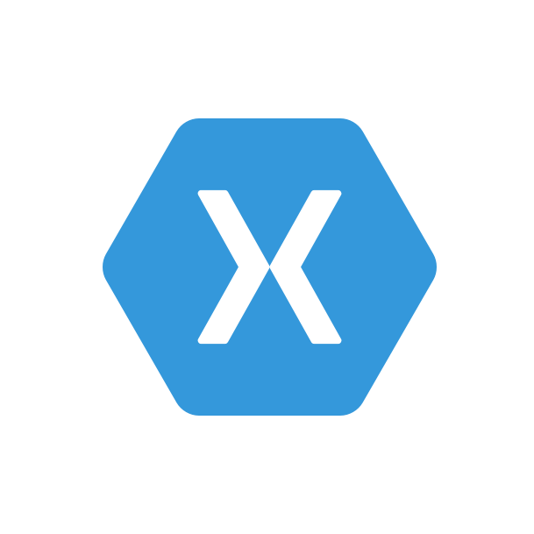
Visual Studio Tools
Xamarin
Build iOS / Android apps with .NET
Compiles to native
Build, deploy, and debug in Visual Studio
Hooks into native libraries
UI builder for iOS and Android
PCL / Shared Library support for sharing code
Notes:
Slide Objectives:
Talk about Xamarin’s usability in Visual Studio
Speaking Points:
Xamarin is a company that makes it possible to deploy .NET apps on iOS and Android
They have their own IDE (Xamarin Studio) but their plugin also installs right into VS
Compiles down to native
Able to hook into native (Obj-C / Java) libraries
Visual Studio has a UI builder for iOS and Android Uis
PCL / Shared libs provides for lots of code reuse across different platforms

Slide 7
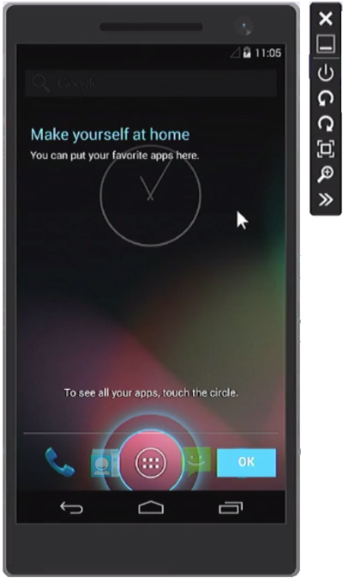
Visual Studio Tools
Emulator for Android
Visual Studio 2015
Fast, x86 image built from AOSP
Runs on Hyper-V
Phone and Tablet versions
Build, Deploy, & Debug from VS
Works with other IDEs
Built-in sensor control
Orientation
Accelerometer
Location
Battery
More coming
Notes:
Slide Objectives:
Talk about the emulator for Android
Speaking Points:
Now available in VS 2015
This is a FAST x86 image that is build from the Android Open Source Project (no google services natively)
Runs on Hyper-V
Currently supports phone and tablet versions of the emulator
Enables building, deploying, and debugging from VS (as well as other IDEs)
Built in Sensor / capabilities:
Zoom, Rotation, Network, Location, Accelerometer, Battery, SD Card, Camera, Audio Playback, Keyboard input, configurations

Slide 8
Building, Testing, Distributing
Notes:
Slide Objectives:
Transition into talking about Building, Testing, and distributing apps
Speaking Points:
Next we’ll talk about a few tools which can help you whether you’re building your Apps with Visual Studio or not

Slide 9
Visual Studio Online
Source Control: GIT and TFVC
Project Management
Tasks
Teams
Bugs
Continuous Integration
Build
Test
Notes:
Slide Objectives:
* Go over capabilities of Visual Studio Online (VSO)
Speaking Points:
Visual Studio Online (VSO) is much more than an IDE in the cloud
First it provides private version source control using either GIT or TFVC
Provides full project management and team capabilities
Provides easy to set up Continuous Integration for building apps when code is checked in and auto running unit tests
Currently requires you to run a build agent on your own Windows box but a xPlat (Linux / OS X) build agent is coming out soon

Slide 10

Hockey App
Beta distribution
Easy management of testers
Crash reporting
Feedback
Testing analytics
Also works with iOS and WinPhone
Notes:
Slide Objectives:
Talk about our new acquisition, HockeyApp
Speaking Points:
Microsoft recently acquired HockeyApp to help with app distribution and provide application insights
Easy to set up beta distribution to trusted testers
Provides crash reports, feedback from testers, and testing analytics
Also works with iOS and WinPhone apps

Slide 11
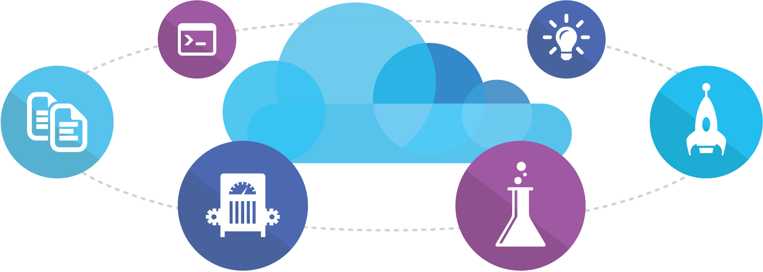
Visual Studio Online
Code
Insights
Agile
Deploy
Build
Test
Full Portal Integration
Not just for Microsoft shops
Notes:
Slide Objectives:
Speaking Points:

Slide 12



Eclipse, IntelliJ Android Studio
Notes:
Slide Objectives:
Move on to tools for traditional Android IDEs
Speaking Points:
* Next we’ll talk about some capabilities inside of the Android IDEs

Slide 13
IDE Plugins
Plugins for Ecilpse, IntelliJ, & Android Studio
Connect Android apps to
Azure Mobile Services
Office 365
Create and run Java deployments
Publish Java apps to Cloud Services
Notes:
Slide Objectives:
Talk about plug-in capabilities
Speaking Points:
We have plugins for Eclipse, IntelliJ, and Android Studio
These enable you to connect Android apps to Azure Mobile Services and Office365
Also enables creating and running Java deployments for Cloud Services in the emulator (windows only emulation today)

Slide 14
Demo: Plugins
Notes:
Demo Objectives:
Show off Mobile Services and Office 365 pieces of plugin
Demo Points:
Open up Android Studio, show Mobile Services activity add
Show Office 365 activity add

Slide 15
Services from Microsoft and Azure
Notes:
Slide Objectives:
Transition to talking about services
Speaking Points:
At this point you’ve already seen a lot of what Azure has to offer with Mobile Services and Notification Hubs
Now we’ll cover a few additional Services and Libraries

Slide 16
Services
Azure Active Directory
Office 365
Hybrid Connections
Storage
Azure RemoteApp
Media Services
Notes:
Slide Objectives:
Mention services that will be talked about
Speaking Points:
There are 6 services we’ll talk about now
Azure Active Directory
Office 365
Hybrid Connections
Azure Storage
Azure RemoteApp
Media Services

Slide 17
Azure Active Directory
Notes:
Slide Objectives:
Provide a brief overview of AAD
Speaking Points:
Azure Active Directory (AAD) provides for single sign-on to any cloud and on-premises app
Easy integration with many different software as a service providers (Salesforce, Google Apps, Box, etc)
Enables multi-factor auth with applications

Slide 18










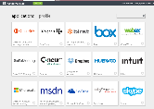

Public Identity as the control point
Active Directory
Microsoft apps
Other Directories
Active Directory
Custom LOB apps
ISV/CSV apps
Non-MS cloud-based apps
PCs and devices
Notes:
Slide Objectives:
Identify different pieces of Identity and AAD
Speaking Points:
Identity is big and very important
Bridging identity on-premises and the cloud is something most haven’t figured out
Here we have Microsoft apps, non-ms cloud based apps and SaaS
On-Prem Active Directory running in Windows Server, Other Directories
Azure Active Direcotry is able to bridge all of these together in one place
Sync on prem to cloud
Secure azure resources and mobile apps with AAD

Slide 19
Azure AD Auth Library (ADAL)
Authenticate users against Azure AD
Uses industry standard OAauth2
Refresh tokens allows for access to APIs w/o prompting the user
Dialog and Fragment support for Android
AD Sync connects on-premises AD to Azure
Notes:
Slide Objectives:
Talk about ADAL
Speaking Points:
Azure AD Auth Library (ADAL) provides for easy connectivity / authentication from Android (and iOS) apps
Support easy sync with on-premises AD
Uses industry standard OAuth2
Refresh tokens ensure users don’t have to continually sign in
Dialog and Fragment support for easier usage from Android apps

Slide 20
Demo: AAD
Notes:
Demo Objectives:
Show off AD
Demo Points:
Go into Azure portal
Go to AAD section
Move around different pages within AAD and highlight the different areas (including DirSync, adding apps, etc)

Slide 21
Office 365 SDK
Provides access to
SharePoint Online Files and Lists
Exchange Online Mail, Calendars, and Contacts
Azure Active Directory Graph
Works in conjunction with ADAL
Notes:
Slide Objectives:
Talk about office 365 capabilities
Speaking Points:
Office 365 is pre-integrated with Azure AD (if you login to Office 365, you’re logging in to Azure AD)
The O365 SDK provides access to features including:
SharePoint Online files and lists
Exchange mail, calendars, contact
Azure AD graph
Works with ADAL (i.e. get a token from logging in and then use that token with the O365 SDK)

Slide 22
Azure Storage Library
Enables access to assorted Azure Storage features
Blob storage used to store large files
Table storage used to store tabular data
Queues used for message processing
Notes:
Slide Objectives:
Discuss Azure Storage Library
Speaking Points:
Azure Storage provides for large data storage, tabular non-relational data, and queues

Slide 23
Blob Storage Concepts
http://<account>.blob.core.windows.net/<container>/<blobname>
Account
Container
Blob
Pages/ Blocks
PIC01.JPG
images
Block/Page
PIC02.JPG
contoso
Block/Page
videos
VID1.AVI
Notes:
Speaker Notes
The Blob service provides storage for entities, such as binary files and text files.
The REST API for the Blob service exposes two resources:
Containers
Blobs.
A container is a set of blobs; every blob must belong to a container.
The Blob service defines two types of blobs:
Block blobs, which are optimized for streaming.
Page blobs, which are optimized for random read/write operations and which provide the ability to write to a range of bytes in a blob.
Blobs can be read by calling the Get Blob operation. A client may read the entire blob, or an arbitrary range of bytes.
Block blobs less than or equal to 64 MB in size can be uploaded by calling the Put Blob operation.
Block blobs larger than 64 MB must be uploaded as a set of blocks, each of which must be less than or equal to 4 MB in size.
Page blobs are created and initialized with a maximum size with a call to Put Blob.
To write content to a page blob, you call the Put Page operation. The maximum size currently supported for a page blob is 1 TB.
Notes
http://msdn.microsoft.com/en-us/library/dd573356.aspx
Using the REST API for the Blob service, developers can create a hierarchical namespace similar to a file system. Blob names may encode a hierarchy by using a configurable path separator. For example, the blob names MyGroup/MyBlob1 and MyGroup/MyBlob2 imply a virtual level of organization for blobs. The enumeration operation for blobs supports traversing the virtual hierarchy in a manner similar to that of a file system, so that you can return a set of blobs that are organized beneath a group. For example, you can enumerate all blobs organized under MyGroup/.

Slide 24
Table Storage
Account
Table
Entity
Name =…
Email = …
customers
Name =…
EMailAdd=
contoso
Photo ID =…
Date =…
photos
Photo ID =…
Date =…
Notes:
Slide Objectives
Understand Tables
Speaker Notes
The Table service provides structured storage in the form of tables.
The Table service supports a REST API that is compliant with the ADO.NET Data Services REST API.
Developers may also use the .NET Client Library for ADO.NET Data Services to access the Table service.
Notes
http://msdn.microsoft.com/en-us/library/dd573356.aspx

Slide 25
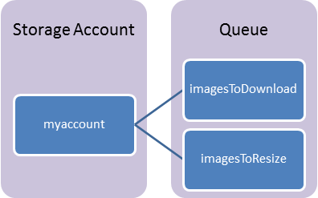
Queues
Storage Account: All access to Azure Storage is done through a storage account.
Queue: A queue contains a set of messages. All messages must be in a queue.
Message: A message, in any format, of up to 64KB.
Notes:
Storage Account: All access to Azure Storage is done through a storage account.
Queue: A queue contains a set of messages. All messages must be in a queue.
Message: A message, in any format, of up to 64KB.

Slide 26
Azure Storage Library
Provides easy access to
Blob Storage
CRUD on Containers
CRUD on Blobs
Advanced blob operations
Queues
Create / Delete
Insert / Peek Messages
Advanced queue operations
Table Storage
CRUD on tables
CRUD on entities
Batch operations
Advanced table operations
Notes:
Slide Objectives:
Discuss the storage library
Speaking Points:
The Azure Storage Library for Android provides you with access to the three different storage systems:
Blob storage
Create/Read/Update/Delete on containers and blobs
Table storage
CRUD on tables / entities
Batch operations
Queues
Create / Delete
Insert / Peek
Not secure in public apps since you need the account name and key.
Better used in an admin style application

Slide 27


BizTalk Services Hybrid Connections
Microsoft Azure
Your Enterprise
Hybrid Connection Manager
1433
Connection string points to My-Database:1433
My-Database
Notes:
Slide Objectives:
Talk about BizTalk Services Hybrid Connections
Speaking Points:
BizTalk Services Hybrid Connections
Creates a way of connecting from azure to on-premises
Run a connection manager in data center
That connects an endpoint in azure to whatever resource you want in your DC
DB
Web Service
ETC

Slide 28

Azure RemoteApp
Remote applications delivered from the reliable Azure platform
Access from Windows, iOS, Mac OS X, and Android devices
Delivered via Microsoft Remote Desktop Protocol and RemoteFX
Scale without large capital expense
Flexible hybrid or cloud deployment options
User
Notes:
Slide Objectives:
Explain how Azure Remote App allows running Windows applications on Android
Speaking Points:
Remote apps delivered from Azure
Access apps from Win, iOS, OS X, Android, all using free Remote Desktop apps
Cloud App images or custom images
Vnet / hybrid solutions enable you to host your own custom apps as well as do data connection back to your on-premises and do AD auth

Slide 29

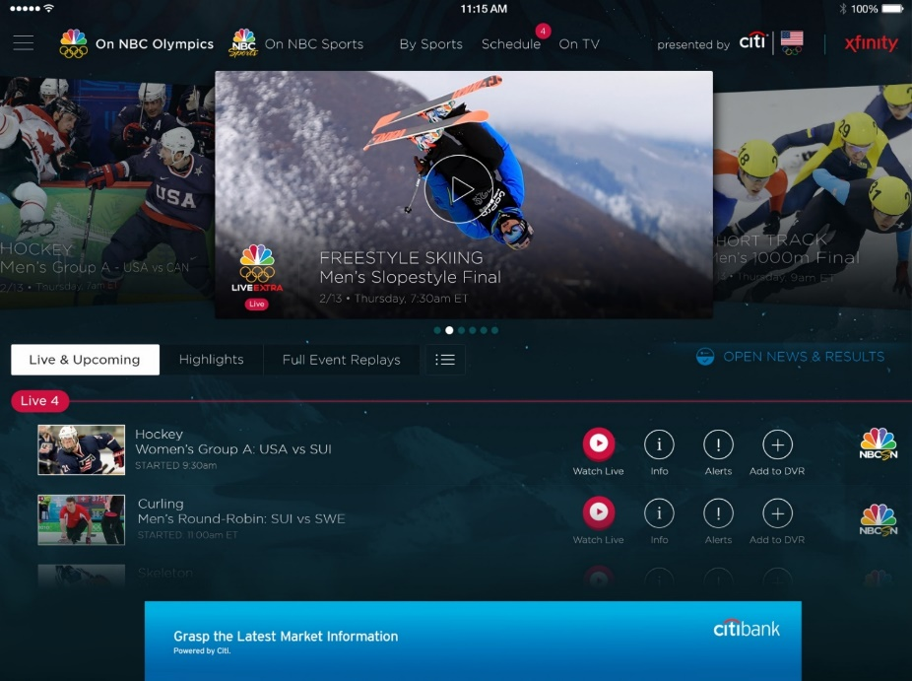
Azure Media Services
Olympics NBC Sports
On Demand Media Services
Video-on-demand
Ingest
Encode
Package
Encrypt
Delivery
Live Streaming Support
Office 365 Integration
Live video encoding and streaming
Web + Mobile
100 million viewers
2.1 million concurrent HD viewers during the USA vs. Canada hockey match
Notes:
Slide Objectives:
Talk about Azure Media Services
Speaking Points:
Provides video streaming support including
Ingesting media
Encoding it
Package and encrypt
Deliver it down to devices
Supports AES and DRM encryption
AES Clear Key
DRM
Also indexing content (closed captionaing)

Slide 30
Building Java Apps
Notes:
Slide Objectives:
Transition to talking about Java apps
Speaking Points:
Now we’ll discuss how you can use your knowledge of Java from building Android apps and use it to built server side apps running Java in Azure

Slide 31
Building Java Apps
Azure Websites
Azure Cloud Services
Oracle
SDKs
IDE Plugins
…
Notes:
Slide Objectives:
Overview of Java Apps on Azure
Speaking Points:
We have 5 different aspects of running Java on Azure that we’ll talk about
First we’ll discuss Azure websites support
Then Azure Cloud Services
Microsoft’s partnership with Oracle
Different Java SDKs (not the same as the Android ones)
The IDE Plugins for pushing to Cloud Services

Slide 32
Azure Websites
Notes:
Slide Objectives:
Discuss Azure Websites
Speaking Points:
Azure Websites supports for easy hosting of websites that are scalable, reliable, and performant

Slide 33

Develop apps with…
.NET
Python
Node.js
Java
PHP
Notes:
Slide Objectives:
Review multi-language support in websites
Speaking Points:
Websites supports development in many languages including .NET, Python, Node.js, PHP, and Java

Slide 34
Java on Azure Websites
Multiple source control options
Pre-configured TomCat and Jetty
Completely configurable options in the Gallery
Supports Java 1.7.0_51 by default
32 bit by default (can switch to 64 bit)
Supports uploading your own Java version
Remote debugging
All the great features of Websites
Notes:
Slide Objectives:
Review Java support in Websites
Speaking Points:
Deploying to websites supports many different options (GitHub, Git, FTP, TFS, Dropbox, etc)
You can turn on a pre-configured TomCat or Jetty server in a site’s configuration
You can deploy a fully configurable TomCat or Jetty from the Gallery
Supports 32bit Java 1.7.0_51 by default
You can switch to 64 bit by changing the web.config file
Supports uploading your own version of java
Allows for Remote Debugging
Provides great features from WebSites including Scaling, Slots, WebJobs, etc

Slide 35
Demo: Websites
Notes:
Demo Objectives:
Show off Websites
Demo Points:
Create a new java website
Turn on java in the portal’s configuration section
Navigate to the site
Show how easy scaling works
Show tomcat / jetty in the gallery

Slide 36
Azure Cloud Services and Java
Runs on Azure’s PaaS system
Enabled through plugins in Java IDEs
Upload any JDK
Use any Java Server
Runs in Azure Worker Roles
Notes:
Slide Objectives:
Review Azure Cloud Services
Speaking Points:
Java is capable of running on Cloud Services, Azure’s PaaS system
Enabled through plugins in Java IDEs
Upload any JDK and Java Server
Runs in a Worker Role

Slide 37
Azure and Oracle
Official partnership with Oracle
Bring your own License or use license-included VM
Several VMs ready to go:
Oracle WebLogic Server
Oracle Database
Oracle Linux
Supported by Oracle
Notes:
Slide Objectives:
Detail Azure’s Oracle partnership
Speaking Points:
Official partnership with Oracle which means images are officially supported by Oracle
Bring your own license or pre-made VMs which include the License
Pre-made VMs:
Oracle WebLogic
Oracle Database
Oracle Linux

Slide 38
Java SDKs for Azure
Azure SDK for Java
Azure AD Auth Library for Java
Azure Management Libraries for Java
DocumentDB SDK for Java
Notification Hubs SDK
Azure Storage library for Java
Notes:
Slide Objectives:
Detail Java SDKs for Azure
Speaking Points:
Like Android, there are many SDKs built for Java
Azure SDK provides for access to many resources including management of your Azure resources
ADAL for Java
DocDB (json document-based noSQL storage in Azure)
Notification Hubs (trigger push notifications from Java)
Azure Storage Library (Blobs, Tables, Queues)

Slide 39
IDE Plugins and Java
Eclipse plugin and alpha IntelliJ
Creates Cloud Services deployment package
Test locally using Azure Emulators
Select JDK and Server to run in Azure
Enable special features
Session Affinity (sticky sessions)
Caching
Remote Debugging
Notes:
Slide Objectives:
Detail IDE plugins for Java
Speaking Points:
We already saw that the IDE plugins have some capabilities to plug into Office 365 and Mobile Services
We also have the ability to create Cloud Services deployments and test locally using the Azure Emulator (Windows only)
Take your own JDK and Server
Enable special features
Session Affinity
Caching
Remote Debugging

Slide 40
Resources
Get a FREE Microsoft Azure Trial Account:
http://azure.microsoft.com
Visual Studio Tools for Cordova: http://www.visualstudio.com/en-us/explore/cordova-vs.aspx
Visual Studio Emulator for Android: http://www.visualstudio.com/en-us/explore/msft-android-emulator-vs.aspx
Java Plugins: http://msopentech.com/blog/2014/10/28/ms-open-tech-tools/
Storage library: https://github.com/Azure/azure-storage-android
Office 365 SDK: https://github.com/OfficeDev/Office-365-SDK-for-Android
Contact Details
<Contact Info>
Microsoft Azure
Notes:
Slide Objectives:
Provide additional Resources
Speaking Points:
* Here we have links to many of the different resources we mentioned as well as to a free trial for Azure

Slide 41




Thanks!
Questions?

