Slide 1
CIS 505 Software Systems
Lecture 18: GFS November 16, 2016
Some slides are courtesy of Haeberlen and Ives

Slide 2

The Road Ahead
So far, we've been looking at some basic building blocks for distributed systems
Synchronization
Group communication
Fault tolerance
...
Next, we'll look at some case studies of real systems
GFS, MapReduce, Bigtable, Spark
Chord, CFS, …
Special topic: Time-critical systems

Slide 3
Plan for today
Context: Web search
The Google File System
Architecture
Read algorithm
Write algorithm
Append algorithm
Consistency and fault tolerance
NEXT

Slide 4

Why GFS?
GFS is a rather unusual file system
Properties & design decisions very different from, say, NFS + Coda
Let's look at the original use case at Google first!
What happens when you enter a search query on Google.com?

Slide 5
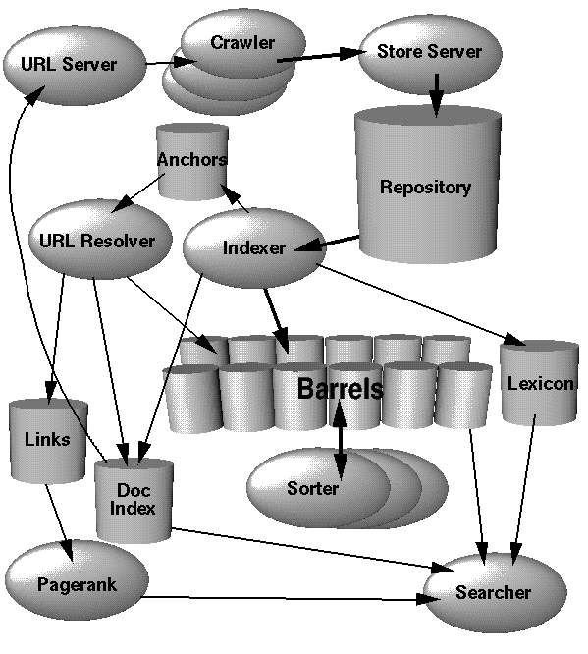
Web search: Major components
How do we know how Google works?
Brin and Page wrote a paper about the original Google in 1998!
(Today they don't publish details anymore...)
Three major components:
Crawler: Downloads all the web pages it can find
Indexer: Builds an index data structure from the crawled pages
Searcher: Accepts queries from users and looks them up in the index; returns a ranked list of matching pages

Slide 6
Crawling
Goal: Download as many web pages as possible
Basic process:
Maintain a queue Q of URLs to crawl, set P of pages already crawled
Initialize Q with a set of seed URLs
Pick the first URL from Q and download the corresponding page
Append the downloaded page to our collection of pages
Extract all URLs from the page (<base href> tag, anchor links, CSS, DTDs, scripts, optionally image links)
Append to Q any URLs that a) meet the search engine's criteria, and b) are not already in P
If Q is not empty, repeat from step 2

Slide 7
Crawling visualized
"Frontier"
Pages currently being crawled
URLs that will eventually be crawled
Seeds
Unseen web
URLs already crawled
URLs that do not fit our criteria (too deep, etc)
The Web

Slide 8
Indexing
Once we have lots of pages crawled, how do we find the ones that match a given query?
Can't afford to 'scan' the entire set of pages on every single query!
Idea: Build an inverted index!
Maps each search term to a set of pages that contain that term
Example: "Penn" → { www.upenn.edu, en.wikipedia.org/wiki/William_Penn, ... }
How would you construct such an index?
Read all the collected pages from beginning to end
Extract a tuple (T, U) for each term T that appears in URL U
Group the tuples by their first element
See next lecture (about MapReduce)!

Slide 9
Searching
Given the inverted index, how do we find the pages to return for a query "cheap flights Hawaii"?
Look up each of the three terms in the inverted index → set of URLs for each term
Output all the pages that appear in the intersection
Is that enough?
No! Ranking the results is critical, and very tricky
There might be billions of matching pages, but users rarely look beyond the first page of results!
Ranking involves many other criteria: PageRank, where exactly the terms appear, whether they appear in a phrase, ...
Google reportedly uses over 200 different criteria for ranking

Slide 10
Workload characteristics
If we wanted to build a file system for this kind of workload, what would we wish for?
Very large capacity (need to store billions of web sites!)
Efficient append (that's what the crawler does!)
Efficient sequential reading (that's what the indexer does!)
Good fault tolerance (need lots of servers → many faults each day!)
What might we not care about so much?
Perfect consistency (what if a few pages are corrupted?)
Random access (rarely needed)
Transparency or backwards compatibility
Should these properties even be supported?

Slide 11
Plan for today
Context: Web search
The Google File System
Architecture
Read algorithm
Write algorithm
Append algorithm
Consistency and fault tolerance
NEXT

Slide 12
Chunks and chunkservers
GFS breaks files into 64MB chunks
Similar to the disk blocks we discussed earlier, but MUCH larger!
Pro: Much less metadata needed, efficient sequential reads/writes
Con: Internal fragmentation (but how bad is this really?)
Chunks can be stored on different chunkservers
Result: Files can be much larger than any individual node's disk
Chunks can also be replicated individually
Typically, each chunk is stored on three different nodes
Replicas are placed on a mix of different nodes (different racks, etc.) – why?
Each chunk has a unique, immutable 64-bit chunk handle (~block no.)
What kind of metadata is needed for this?

Slide 13



GFS architecture
foo.txt: 3,9,6 bar.data: 2,4
Chunk #2 of foo.txt?
3
9
Master
4
9
2
6
9
Read chunk 9
2
3
4
9
6
2
4
3
9
Client
Chunkservers
A single master node stores the metadata
Mapping from file names to lists of chunks
Also knows which chunkservers have a copy of each chunk
Reads go directly to the chunk servers (not through the master!)
What do you think of this design?
Pros and cons? How does it relate to what we've discussed so far?
Is the master likely to become a bottleneck (at data center scales)?

Slide 14
The Master
Created abc.txt Appended chunk 21 to blah.txt
Deleted foo.txt
Appended chunk 22 to blah.txt
Appended chunk 23 to xyz.img
...
foo.txt: 3,9,6 bar.data: 2,4
blah.txt: 17,18,19,20
xyz.img: 8,5,1,11
Master
Operation log
Checkpoint
Keeps an operation log of critical metadata changes
This file is critical! If it is lost, the data becomes unreadable
Replicated on multiple machines
Changes are flushed to this log before the master responds to clients
Also periodically checkpoints its state
Result: Quick startup (e.g., after a crash)!
The master can read its latest checkpoint and then reapply only those changes in the log that happened after this checkpoint
"Shadow masters" provide read-only access when primary is down

Slide 15
The Master
Doesn't the master also need to know which nodes have copies of which chunk?
Yes – but that information is not persistent!
Chunkservers periodically send heartbeat messages to the master → Master always knows which servers are 'alive'
Master can ask the chunkservers which chunks they currently have
Why this design?
Advantage #1: Simplicity!
Advantage #2: Naturally handles common changes (disk failure on a chunkserver, chunkserver is renamed) without extra mechanism

Slide 16
Plan for today
Context: Web search
The Google File System
Architecture
Read algorithm
Write algorithm
Append algorithm
Consistency and fault tolerance
NEXT

Slide 17
Client interface
GFS does not implement a standard interface, such as POSIX
Without special drivers, you cannot 'mount' a GFS volume into your machine's file system!
However, it has many of the usual operations
open, close, read, write, create, delete
hierarchical directories and "path names"
Clients have a library for interacting with GFS

Slide 18
Read algorithm
foo.txt: 3,9,6 bar.data: 2,4
Chunk #2 of foo.txt?
3
9
Master
4
9
2
6
9
Read chunk 9
2
3
4
9
6
2
4
3
9
Client
Chunkservers
When a client wants to read from a file:
GFS client translates (filename, byte range) → (filename, chunk no.)
Example: (foo.txt, 70000000-80000000) → (foo.txt, second chunk)
Client queries the master, which responds with a chunk handle and a set of chunkservers that have a copy of that chunk
Client picks a chunkserver and sends a (chunk handle, byte range) request to that server
Chunkserver returns the requested data to the client

Slide 19

Primaries and secondaries
X←7
Ordered requests
X?
X←2,
X?,
X←7
X←2
Primary replica
Secondary replicas
Scenario: Multiple replicas, concurrent requests from different clients for a given chunk
How to ensure consistency?
Idea: Master designates one replica as the primary
Accepts all requests, orders them, and then forwards ordered requests to the backups
Reports success to the clients only after all the secondaries have responded
How do clients know which node is the primary?

Slide 20
Leases
For write operations, one of the owners of the chunk gets a lease from the master
That replica becomes the primary for the chunk; all others are secondaries
Leases come with a timeout, but can be renewed
Initial timeout: 60 seconds
Primary can request, and will typically receive, extensions from the master node
Sometimes the master will revoke a lease, e.g., when it wants to rename a file (need to temporarily disable writes)
What happens when a primary fails?
Master grants a new lease to another replica once old lease expires

Slide 21
Write algorithm
Client asks Master for chunk handle and the ID of the lease-owning (primary) chunkserver
Master returns ID of primary, secondary chunkservers
The client caches this information
Client sends its data to all replicas, in any order (in a chain! why?)
Data initially stored in internal buffers
Once client gets ACK, it asks the primary to write the data
Primary assigns a serial number to the write operation & applies it
Primary forwards the writes to the secondaries in the same order
Secondaries reply “SUCCESS”
Primary replies to client
Master
Secondary replica A
Primary replica
Secondary replica B

Slide 22
Failures during a write
What happens if a write fails at some secondaries?
Notice that GFS isn't doing 2PC or something comparable!
In this case, GFS reports a failure to the client!
The write may have succeeded at the primary and an arbitrary subset of the secondaries
Modified region is left in an inconsistent state – some replicas have the new data, others don't
Client can choose to retry the operation ("at least once")
It is up to the client to handle this situation - e.g., with checksums, record IDs, or periodic checkpointing
What do you think about this choice?
Is this a good idea in general? For Google's specific use case?

Slide 23
Append algorithm
Recall: Append is important for Google's workload!
Example: Crawler appends crawled pages to a file
We'll also see another use case in MapReduce (next lecture)
How does this work?
Application issues append request
GFS client translates request & sends it to the master
Master sends chunk handle & primaries/secondaries of last chunk
Client pushes write data to all replicas (as before), asks primary
Primary checks whether the chunk has enough room for the data
If so, the primary appends the record & tells the secondaries to do the same (at the same offset)
After receiving responses from the secondaries, the master responds to the client

Slide 24
Append algorithm
What if the data doesn't fit into the chunk?
The primary pads the chunk to the maximum size (!)
In other words, it fills the chunk up with zeroes
Maximum append size is limited to ¼ of a chunk to limit fragmentation
It then tells the secondaries to do the same
Finally, it tells the client to retry on the next chunk
As with writes, failures during append can cause duplication
What do you think about this?
Very different behavior from general-purpose file systems!
However, how much damage does this really cause?
What does this mean for applications?

Slide 25
Plan for today
Context: Web search
The Google File System
Architecture
Read algorithm
Write algorithm
Append algorithm
Consistency and fault tolerance
NEXT

Slide 26
Consistency
GFS has a very relaxed consistency model
No 'locking' or other coordination → when multiple clients write data, they can "step on each other's toes"
Failed writes or appends can cause the replicas to diverge → reads by different clients could return different data!
Remember: Clients are allowed to read from any replica!
However, metadata operations (rename, etc.) go through the master and are therefore atomic
Applications need to be aware of this!
Example: Applications can use metadata to coordinate
e.g., write to a temporary file at first, and then atomically rename it when done
Example: Application can write their own headers and checksums
This can help them to detect & skip padding and to discard corrupted records
If the at-least-once appends are a problem, the application can detect duplicates

Slide 27
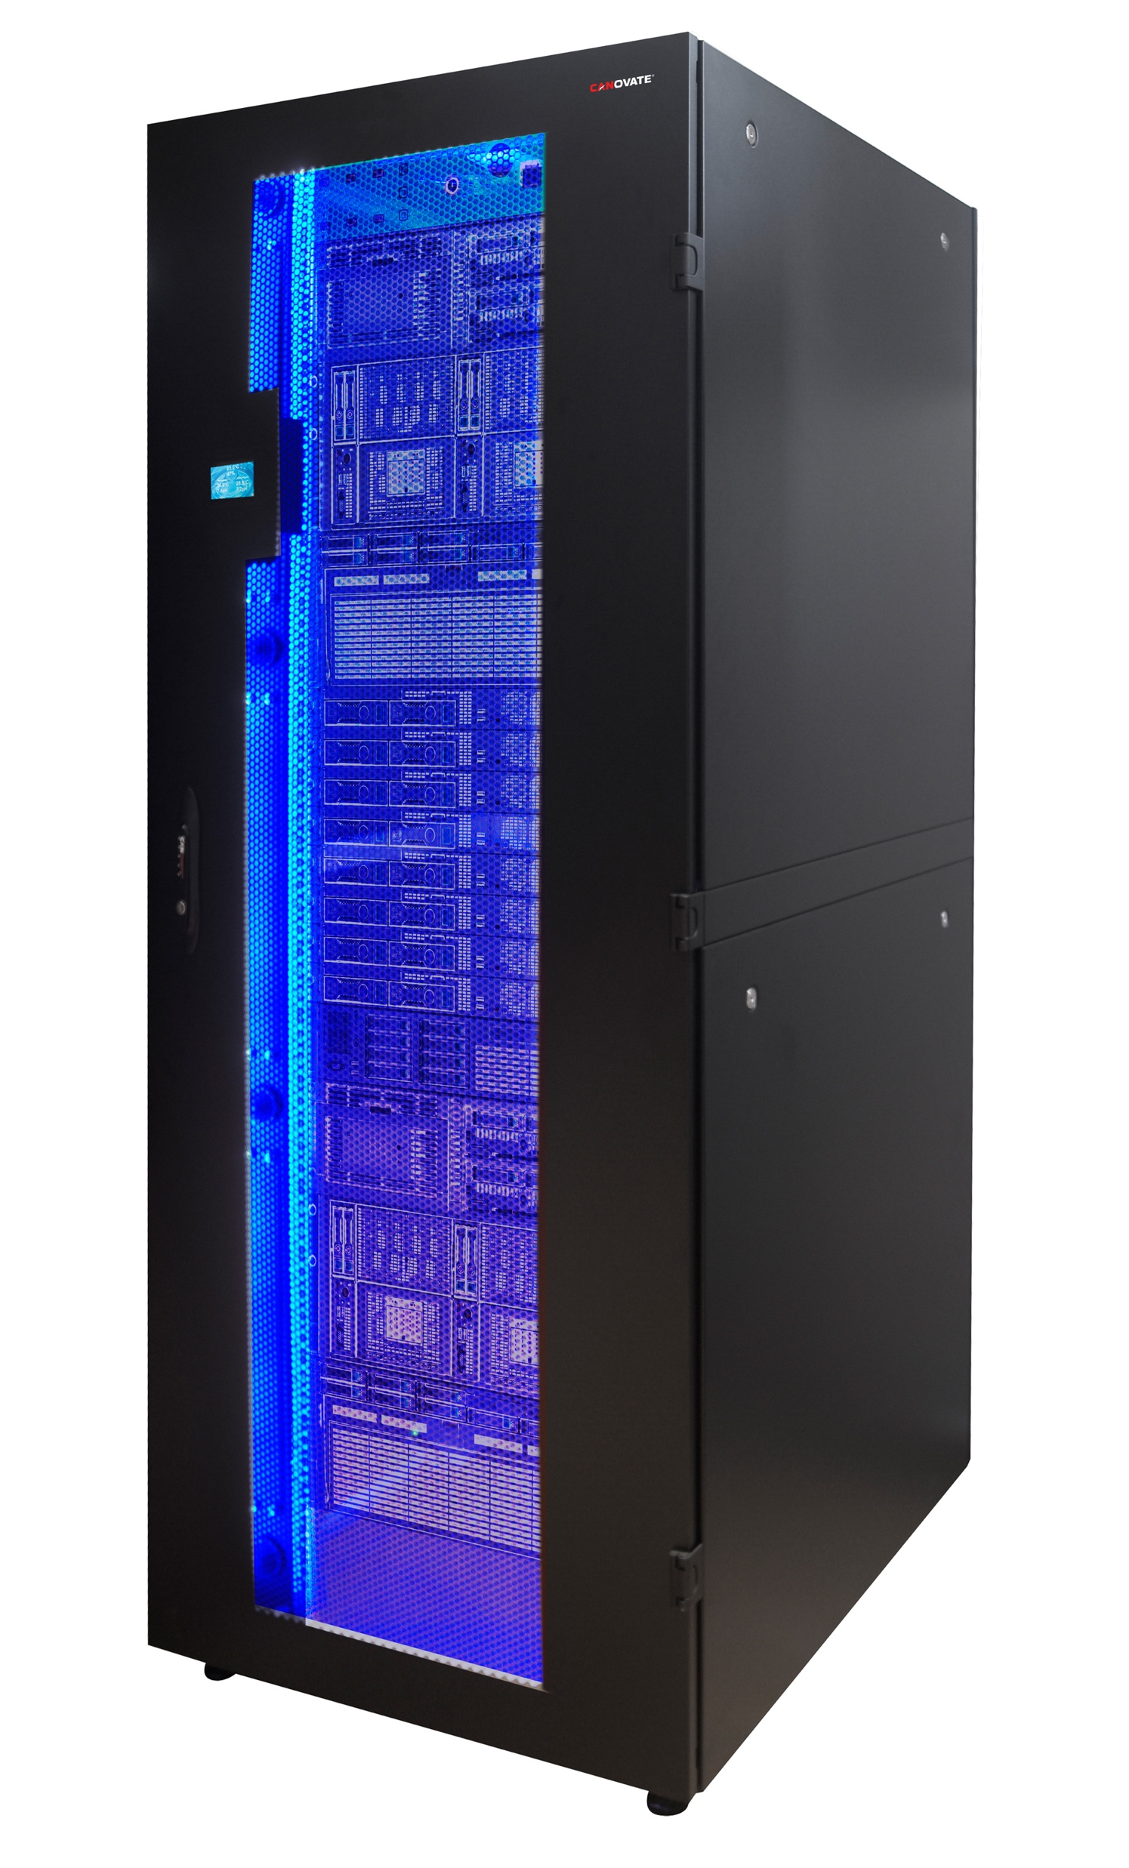
Replica placement
3
5
Many nodes
5
9
5
9
3
3
9
Where should the replicas of a chunk be stored?
Definitely not on the same node (fault tolerance!). Other constraints?
Nodes are typically organized in racks
Each rack has a few 'top-of-rack' (ToR) switches that connect it to the other racks in the data center → limited inter-rack bandwidth
It is possible for an entire rack to fail (e.g., power/network disconnect)
GFS tries to place replicas in different racks to get more aggregate bandwidth and to avoid correlated failures
Preferably uses underutilized nodes; avoids creating hot spots
Notes:
Underutilized nodes: Tries to pick nodes whose disk utilization is below average. That way, utilization is equalized over time. However, it avoids putting too many new chunks on any individual node because experience shows that newly created chunks are soon read again -> possible overload.

Slide 28
Other interesting details
What if some replicas are destroyed?
Examples: Disk failure, node failure, etc.
Master can tell when this happens (how?) & creates new replicas
Prioritizes the chunks with the fewest remaining replicas (why?)
What if storage utilization becomes unbalanced?
Master gradually moves chunks from 'full' nodes to 'emptier' nodes
What happens when a file is deleted?
Chunks are kept around for a few days (undelete!)
After that, the master lazily deletes the chunks ("garbage collection")
What happens when chunks are corrupted?
Examples: Faulty disks, faulty controller, OS errors, ...
GFS keeps a checksum of each chunk and occasionally scans the chunks to verify the checksum when it is otherwise idle

Slide 29
Side-by-side: GFS versus NFS
Network File System (NFS)
Google File System (GFS)
Single virtual file system spread over many nodes
Optimized for sequential read and local accesses
PRO: High throughput, high capacity
"CON": Specialized for particular types of applications
Single machine makes part of its file system available to other nodes
Sequential or random access
PRO: Simplicity, generality, transparency
CON: Storage capacity and throughput limited by single node

Slide 30
Recap: Google File System
A very unusual file system
Very large scale (data center!), enormous capacity
Designed for a particular workload, not for general-purpose use
Relaxed consistency model; relies more on applications
Centralized master node
Some interesting optimizations (e.g., for network capacity)

