Slide 1
Observer Pattern

Slide 2
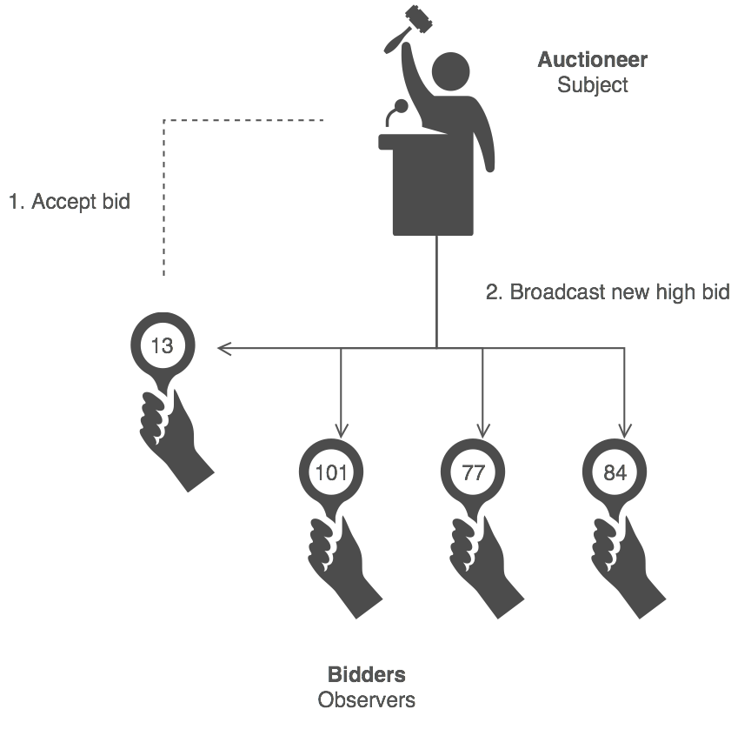
Observer Pattern
观察者模式定义了一种一对多的依赖关系，让多个观察者对象同时监听某一个主题对象。这个主题对象在状态上发生变化时，会通知所有观察者对象，使它们能够自动更新自己。

Slide 3
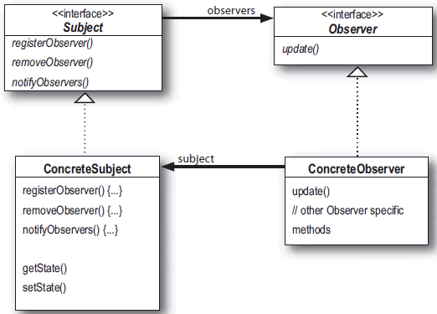

Slide 4
class Observable:
def __init__(self):
self.__observers = []
def register_observer(self, observer):
self.__observers.append(observer)
def notify_observers(self, *args):
for observer in self.__observers:
observer.notify(self, *args)
Code Example 1
class Observer:
def __init__(self, observable):
observable.register_observer(self)
def notify(self, observable, *args):
print('Got', args, 'From', observable)
subject = Observable()
observer = Observer(subject)
subject.notify_observers('test')
Run:
('Got', ('test',), 'From', <__main__.Observable instance at 0x00000000022634C8>)
Notes:
简单介绍观察者模式的框架的代码

Slide 5
class publisher():
""" Abstract publisher """
""" Could add, remove, and inform the followers. """
def __init__(self):
self.followers = []
self.state = ' '
def add(self, *args):
for concrete_follower in args:
self.followers.append(concrete_follower)
def remove(self, *args):
for concrete_follower in args:
self.followers.remove(concrete_follower)
def publisher(self, *args):
pass
def inform(self):
for person in self.followers:
person.notify()
class teacher(publisher):
""" Concrete publisher """
""" Have their own publisher style. ""“
def publisher(self, concrete_publish):
self.state = concrete_publish
print(self.state)
self.inform()
Code Example 2
Notes:
Teacher & Students 形式的观察者模式代码
Subject

Slide 6
class active_student(observer):
""" One type of student, concrete observer. ""“
def notify(self):
print("%s: I have get your message, thank you." % self.name)
class inactive_student(observer):
""" Concrete observer ""“
def notify(self):
print("%s: Oh, I see." % self.name)
class observer():
""" Abstract observer """
""" Could receive notice. ""“
def __init__(self, name):
self.name = name
def notify(self):
pass
Code Example 2
Notes:
Observer

Slide 7
if __name__ == "__main__":
""" init """
publisher1 = teacher()
observer1 = active_student('Tom')
observer2 = inactive_student('Jerry')
publisher1.add(observer1, observer2)
""" publish notices """
message1 = "We will have an exam next class."
publisher1.publisher(message1)
print("-----Remove Observer1 From the Inform List-----")
publisher1.remove(observer1)
message2 = "%s is not on the inform list." % observer1.name
publisher1.publisher(message2)
Code Example 2
Run:
We will have an exam next class.
Tom: I have get your message, thank you.
Jerry: Oh, I see.
-----Remove Observer1 From the Inform List-----
Tom is not on the inform list.
Jerry: Oh, I see.
Notes:
运行

Slide 8
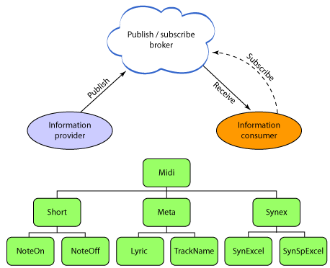
Publish/Subscribe Pattern

Slide 9
Thanks!

