Slide 1
State Pattern

Slide 2
State Pattern
当一个对象的内在状态改变时允许改变其行为，这个对象看起来像是改变了其类。
主要解决的是当控制一个对象状态转换的条件表达式过于复杂时的情况。把状态的判断逻辑转移到表示不同的一系列类当中，可以把复杂的逻辑判断简单化。

Slide 3
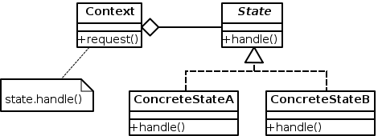

Slide 4

BuildState
DevelopState
TestState
EndState
Error
Project
set_state()
Notes:
Observer

Slide 5
class Project:
def __init__(self):
self.name = None
self.state = None
def set_name(self, name):
self.name = name
def get_name(self):
return self.name
def set_currentstate(self, state):
self.state = state
def get_currentstate(self):
return self.state
def change_currentwork(self):
if not self.state:
self.set_currentstate(BuildState())
else:
self.state.change_currentwork(self)
def do_currentwork(self):
self.state.do(self)
Notes:
简单介绍观察者模式的框架的代码

Slide 6
class BuildState:
def do(self, project):
print("%s is on the build state." % project.get_name())
def change_currentwork(self, project):
project.set_currentstate(DevelopState())
class DevelopState:
def do(self, project):
print("%s in on the develop state." % project.get_name())
def change_currentwork(self, project):
project.set_currentstate(TestState())
class TestState:
def do(self, project):
print("%s in on the test state." % project.get_name())
def change_currentwork(self, project):
project.set_currentstate(EndState())
class EndState:
def do(self, project):
print("%s in on the end state." % project.get_name())
class Work:
def __init__(self, name):
self.project = Project()
self.project.set_name(name)
def do_work(self):
for i in range(4):
self.project.change_currentwork()
self.project.do_currentwork()
print("%s is done." % self.project.get_name())
if __name__ == '__main__':
projectA = Work("Free ROI")
projectA.do_work()
Run:
Free ROI is on the build state.
Free ROI in on the develop state.
Free ROI in on the test state.
Free ROI in on the end state.
Free ROI is done.
Notes:
Teacher & Students 形式的观察者模式代码
Subject

Slide 7
Thanks!

