Slide 1
The Factory Pattern
9/23/2016

Slide 2
Brief Introduction to Design Pattern
Introduce the Factory Pattern
Factory Method Pattern
Abstract Factory Pattern
Comparison Between them

Slide 3
What is Design Pattern?
Design patterns are formalized best practices that the programmer can use to solve common problems when designing an application or system.
A framework or a solution, not concrete code.

Slide 4
Why we use it?
They are reusable across multiple projects
The architectural level of problems can be solved
They are time-tested and well-proven, which is the experience of developers and architects
They have reliability and dependence

Slide 5
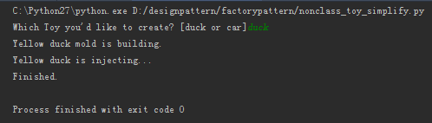
if __name__ == '__main__': toy_type = raw_input("Which Toy you'd like to create? [duck or car]") if toy_type == "duck": # duck_method, each print represent for a process color = "Yellow" print('{} {} mold is building.'.format(color, toy_type)) print('{} {} is injecting...'.format(color, toy_type)) print('Finished.') pass elif toy_type == "car": # car_method, each print represent for a process size = "Small" print('{} {} mold is building.'.format(size, toy_type)) print('{} {} is injecting...'.format(size, toy_type)) print('Finished.') pass else: print("Toy type error!")

Slide 6
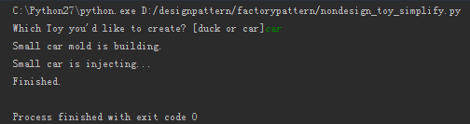
class Factory: # build duck mold def __init__(self, name): self.name = name pass def build(self): if self.name == "duck": self.color = 'Yellow' print('{} {} mold is building.'.format(self.color, self.name)) elif self.name == "car": self.size = 'Small' print('{} {} mold is building.'.format(self.size, self.name)) def injecting(self): if self.name == "duck": print('{} {} is injecting...'.format(self.color, self.name)) elif self.name == "car": print('{} {} is injecting...'.format(self.size, self.name)) return self.__inject() def __inject(self): # private # real injection process print('Finished.') if __name__ == '__main__': toy_type = raw_input("Which Toy you'd like to create? [duck or car]") toy = Factory(toy_type) toy.build() toy.injecting()

Slide 7
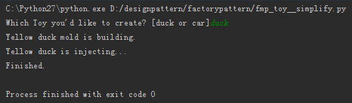
class InjectionMold: def inject(self): # real injection process print('Finished.') class duck(InjectionMold): # build duck mold def __init__(self, name): self.name = name self.color = 'Yellow' print('{} {} mold is building.'.format(self.color, self.name)) def injecting(self): print('{} {} is injecting...'.format(self.color, self.name)) return self.inject() class car(InjectionMold): # build car mold def __init__(self, name): self.name = name self.size = 'Small' print('{} {} mold is building.'.format(self.size, self.name)) def injecting(self): print('{} {} is injecting...'.format(self.size, self.name)) return self.inject()
def create(toy_type): # create request for building # factory method try: toy = eval(toy_type)(toy_type) toy.injecting() except: print("Toy type error!") if __name__ == '__main__': toy_type = raw_input("Which Toy you'd like to create? [duck or car]") create(toy_type)

Slide 8
The Factory Pattern
Factory Method Pattern
Abstract Factory Pattern

Slide 9
Advantages of Factory Patterns
The first advantage is loose coupling in which object creation can be independent of the class implementation.
Adding another class to the factory to create objects of another type can be easily done without the client changing the code. At a minimum, the client needs to pass just another parameter.
The factory can also reuse the existing objects. However, when the client does direct object creation, this always creates a new object.

Slide 10
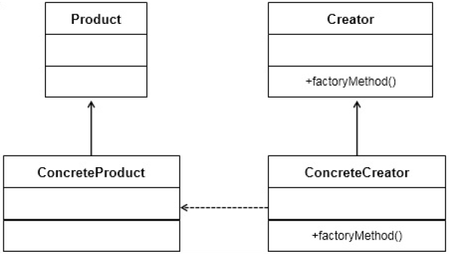
Factory Method Pattern
Theory
Practice
This exposes a method to the client to create the objects.
Using factory methods to deal with the problem of creating objects.
Moving instances creating to subclasses

Slide 11
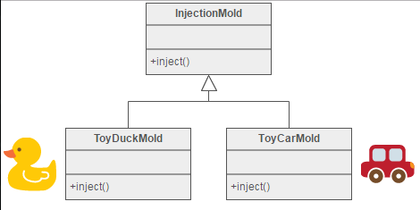
Factory Method Pattern
Notes:
Injection molding presses demonstrate this pattern. Manufacturers of plastic toys process plastic molding powder, and inject the plastic into molds of the desired shapes. The class of toy (car, action figure, etc.) is determined by the mold

Slide 12
class InjectionMold: def inject(self): # real injection process print('Finished.') class duck(InjectionMold): # build duck mold def __init__(self, name): self.name = name self.color = 'Yellow' print('{} {} mold is building.'.format(self.color, self.name)) def injecting(self): print('{} {} is injecting...'.format(self.color, self.name)) return self.inject() class car(InjectionMold): # build car mold def __init__(self, name): self.name = name self.size = 'Small' print('{} {} mold is building.'.format(self.size, self.name)) def injecting(self): print('{} {} is injecting...'.format(self.size, self.name)) return self.inject()
def create(toy_type): # create request for building # factory method try: toy = eval(toy_type)(toy_type) toy.injecting() except: print("Toy type error!") if __name__ == '__main__': toy_type = raw_input("Which Toy you'd like to create? [duck or car]") create(toy_type)

Slide 13
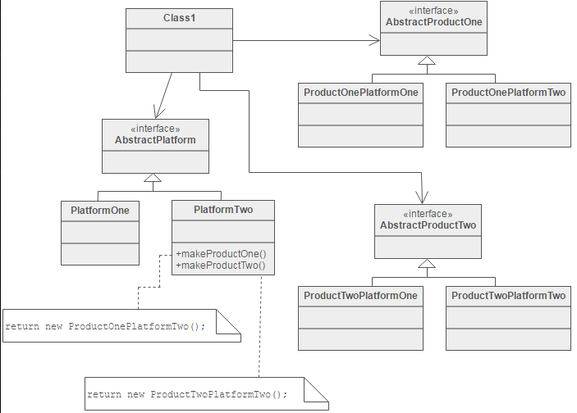
Abstract Factory Pattern
Theory
Practice
This contains one or more factory methods to create a family of related objects.
To define a factory interface that consists of a factory method per product.
To create families of related objects without depending on their specific classes

Slide 14
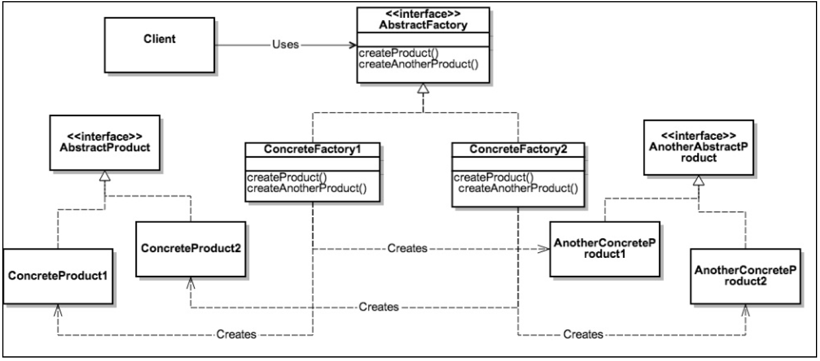
Abstract Factory Pattern
Notes:
电脑风格切换，Win & Mac
The method createButton on the GuiFactory interface returns objects of type Button. What implementation of Button is returned depends on which implementation of GuiFactory is handling the method call.

Slide 15
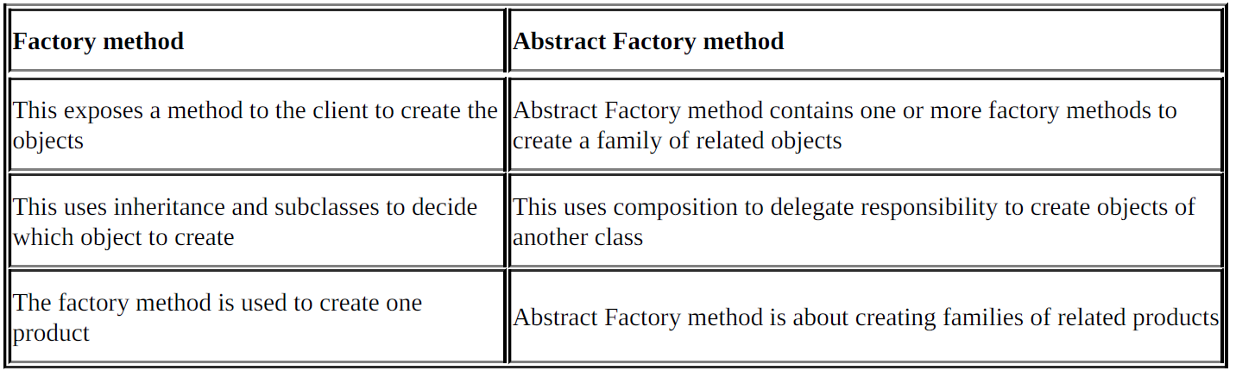
Factory method versus Abstract Factory
Notes:
Factory method Abstract Factory method
This exposes a method to the client to create the
objects
Abstract Factory method contains one or more factory methods to
create a family of related objects
This uses inheritance and subclasses to decide
which object to create
This uses composition to delegate responsibility to create objects of
another class
The factory method is used to create one
product Abstract Factory method is about creating families of related products

Slide 16
Thanks!

