Slide 1
Computational Database Framework
Advanced queries

Slide 2
To query a database
You must know the structure of the database
What the table and column names are
The relationships between tables and columns

Slide 3
Main tables in the CDF
dacapo
Contains url, calculation parameters, composition string, space group, and total energy
unit_cell
Contains the unit cell definition, volume, and stress if it is available
positions
Contains each atom in the calculation, its position, and the force on the atom
elements
Contains symbol, name, mass and covalent radius of each element
Each of these tables contains data related to another table

Slide 4
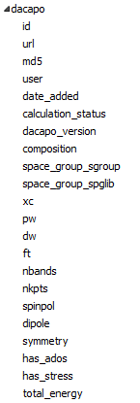


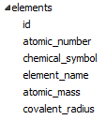
Columns in the tables
Each id is a unique integer.
The data is structured this way to minimize the amount of redundantly stored data and because integer comparisons are very fast (string comparisons are very slow)

Slide 5
Supplementary tables in the cdf
users
list of usernames and email addresses
tags
list of unique tags
user_tagged
Many to Many table of user-tagged calculations
tagged_urls
a “view” to make search tagged urls easier
user_comment
user contributed comments on a calculation

Slide 6





Supplementary table structures

Slide 7
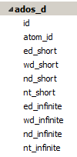
Electronic structure table atom-projected DOS
When atom-projected DOS data is available, the d-band properties for transition metals are stored in a table

Slide 8
Querying the CDF
When the data you want is spread over several tables, you must perform queries on “joined tables”
Example: Find all the atoms that have the identity “Pd”
The atoms are stored in the positions table, but there is an element_id field that refers to an entry in the elements table.
We want “Pd” not an integer element_id

Slide 9
Approach #1
Query the element table to get the id for Pd, then query the positions table for rows with that element_id
SELECT id from elements where chemical_symbol=“Pd”;
SELECT * from positions where element_id=47;
Pros:
Reasonably transparent what you are doing
Cons:
error prone
a little tedious
there is a better way

Slide 10
Approach #2
Join the positions and elements table
match rows in each table where the element_id in positions equals the id in elements
Then query the joined table
SELECT * from positions INNER JOIN elements ON positions.element_id=elements.id WHERE elements.chemical_symbol=‘Pd’
This creates a new table with the columns of both tables, but we match the new columns on the element_id

Slide 11
Example #2 – finding tagged calculations
Tagged urls are stored by a set of ids in the user_tagged table
Performing a query requires joining 3 tables
dacapo contains the url, tags contains the tag, and user_tagged contains rows with a dacapo_id and tag_id
SELECT url,tag from dacapo INNER JOIN user_tagged ON dacapo.id=user_tagged.dacapo_id INNER JOIN tags ON user_tagged.tag_id=tags.id WHERE tag='my-tag'

Slide 12
Aliases in queries
The previous example had a lot of typing
What happens if two tables have a url column?
It would be ambiguous which one to return in the query
Enter the alias
SELECT d.url,t.tag from dacapo AS d INNER JOIN user_tagged AS ut ON d.id=ut.dacapo_id INNER JOIN tags as t ON ut.tag_id=t.id WHERE tag='my-tag‘
Aliases remove ambiguity and reduce typing.

Slide 13
Views
A view is a saved query that can be searched like a table
There is a tagged_url view that simplifies the previous query
SELECT * from tagged_urls WHERE tag=“my-tag”

Slide 14
Advanced composition searching
Find calculations that could contain CO2
You could search for C_O2 or C%O%
This will give a lot of false hits (Cr, Ca,…, O1,…)
And will miss others (C1O3)
The data we need is in the positions table, but we need to group results
Rephrasing the query
Find the groups of atoms in the position tables where there is at least one C and at least 2 O

Slide 15
aggregate functions and intersections
select d.id, d.composition
from dacapo as d
inner join positions as p
on p.dacapo_id=d.id
inner join elements as e
on p.element_id=e.id
group by d.id,e.id
having e.chemical_symbol="C" and count(e.chemical_symbol)>=1
intersect
select d.id, sd.composition
from dacapo as d
inner join positions as p
on p.dacapo_id=d.id
inner join elements as e
on p.element_id=e.id
group by d.id,e.id
having e.chemical_symbol="O" and count(e.chemical_symbol)>=2

Slide 16
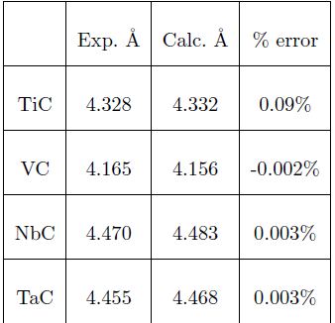
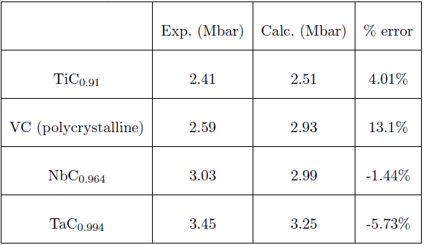
Exercise #1
Find calculations for rocksalt carbides (hint: the formula is XC where X is in (Ti, V, Nb or Ta)
Select a subset of the data and compute the lattice constant and bulk modulus
Compare your result to:
Hint: the primitive cell of the rocksalt lattice is ¼ the volume of the conventional cubic cell, and there the stoichiometry of the primitive cell is XC
1 bar = 100 kPa

Slide 17
Exercise #2 Compute for TiO₂
Compute the heat of formation of TiO2 at a planewave cutoff of 350 eV
Hints:
look for O4Ti2 as bulk composition for TiO2 with 8kpts and 35 bands
Look for Ti2 for Ti
Look for spin-polarized O2 in a 10x10x10 cell
I get -8.26 eV

Slide 18
Exercise #3 lattice constant and bulk modulus of Al as a function of nkpts
pw=350, nkpts=64 and 216 are two datasets to work with
Compare the results. What can you say about convergence of these two properties?

