Slide 1
Atomistic thermodynamics
including pressure and temperature

Slide 2
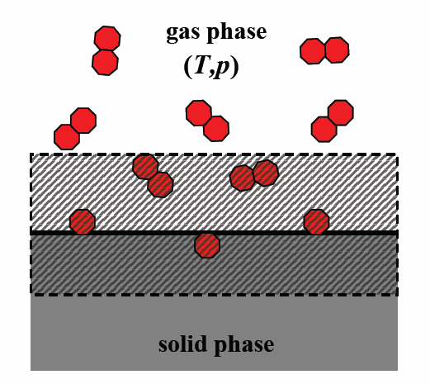
DFT – 0K, 0 Pa
DFT calculations provide the energy at 0K, in vacuum
Most properties are affected by pressure and temperature
Atomistic thermodynamics provides a mechanism to connect DFT to pressure and temperature
We need a way to connect the relevant energies to thermodynamic reservoirs.
In other words, if you put an adsorbate on a surface you gain some energy, but that energy is offset by the energy it took to take the adsorbate from the reservoir
Notes:
http://ftp.rta.nato.int/public//PubFullText/RTO/EN/RTO-EN-AVT-142///EN-AVT-142-02.pdf

Slide 3
Reformulating the energy equations
We have typically only examined differences in DFT total energies
These are like internal energies (U)
They have no pV (enthalpy) terms or TS (entropy) terms
The general approach is to formulate everything in terms of Gibbs free energies and simplify where appropriate

Slide 4

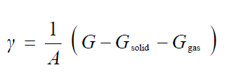
Gibbs free energy formulation
The total Gibbs free energy of this system is
Let’s consider the case where the surface is uniform. Then we can express the surface energy as:
And note that this is defined by a finite part of the system, namely the surface region. As the system grows large, the contributions from the infinite portion of the system eventually cancel.

Slide 5

Chemical potential formalism
We are interested in the cost to take a molecule from a thermodynamic reservoir
This is the chemical potential
The chemical potential defines the energy required to add or take something from a thermodynamic reservoir
It is temperature and pressure dependent

Slide 6
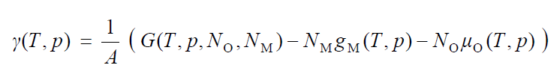
Surface energy in chemical potential terms

Slide 7
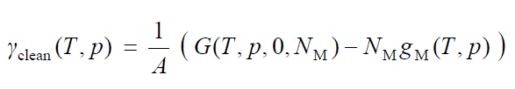
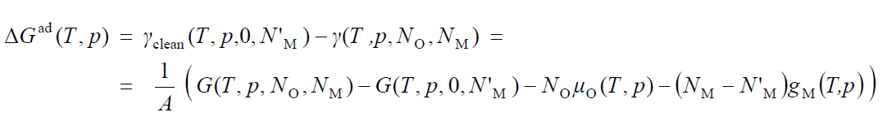
Alternative, equivalent formulation focus on adsorption energy
This shows the adsorption energy can be thought of in terms of differences in surface energy
exothermic adsorption lowers the surface energy
Adsorption energies depend on T,p

Slide 8
From Gibbs to DFT
The Gibbs free energy formulation is exact, but we do not calculate G directly
We need a set of systematic approximations to get from G to DFT for each term in the equation

Slide 9


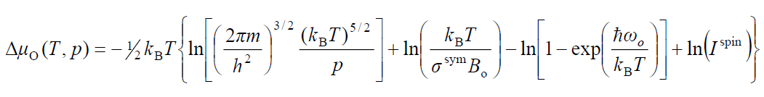
Gas phase chemical potentials
Major assumption: Ideal gas law is adequate
The partition function (Q) contains contributions from translation, rotation, vibrations, electronic and nuclear contributions
All of these can be calculated using DFT, but a simpler approach is often used

Slide 10
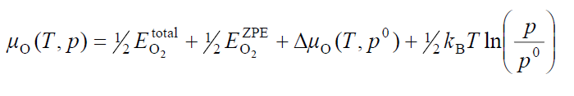
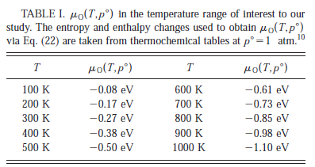

Janaf thermodynamic tables
This is the equation relating the DFT energy of O₂ to a non-zero pressure and temperature
Can be applied to other gas-phase adsorbates
Notes:
1. K. Reuter and M. Scheffler, Composition, structure, and stability of RuO2(110) as a function of oxygen pressure. Physical Review B, 2002. 65(3): p. 035406. (http://dx.doi.org/10.1103/PhysRevB.65.035406 )

Slide 11

Solid phase Gibbs energies
The key to what follows is that G is not the relevant energy, but ΔG
So we focus on what terms dominate ΔG
Dimensional analysis leads to: [pV/A] = atm Å³/Å² ~ 10-3 meV/Å²
We neglect the pV dependence on G

Slide 12
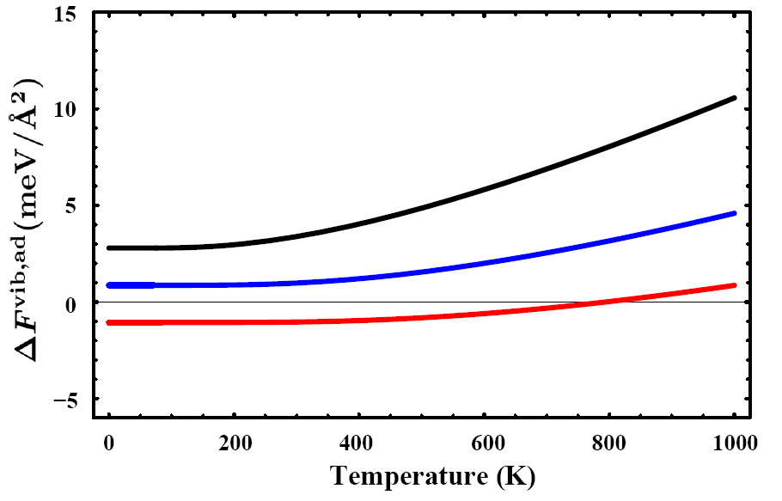
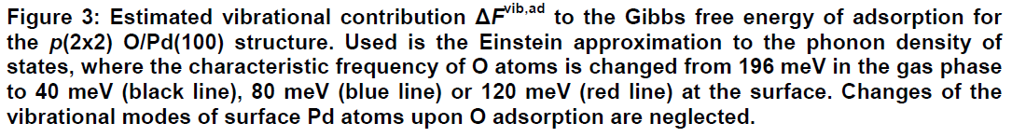
Vibrational contributions
We often will neglect F_{vib}
It tends to be small except at very high T
ΔF^{vib,ad} always stays within ≈ ±5 meV/ Å² for this system
You need to evaluate this for each system
It requires an estimation of phonon DOS of the two systems (clean and covered)

Slide 13
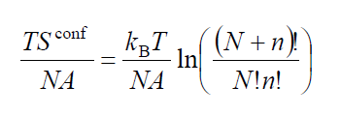
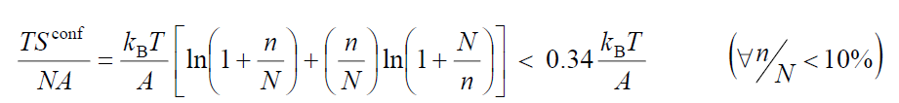
Configurational free energy
Requires a statistical mechanical treatment to be rigorous
Simple estimate:
With a typical area per surface site of A ~ 10 Å² for transition metal surfaces, we correspondingly deduce that the configurational entropy contribution to the Gibbs free energy is less than 3 meV/ Å² for any T < 1000 K [15].
And hence we neglect that too, for pure systems.

Slide 14
What is left?
ΔG ≈ΔE for bulk solids
Care must be taken for other systems where
defects or configurational disorder is high
Large changes in vibrational characteristics of the two states
Soft materials where pV is important

Slide 15
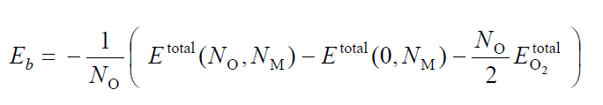
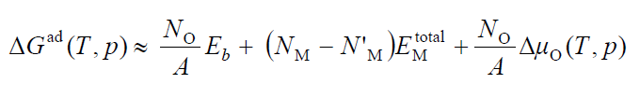
Case study in simple adsorption
This is the definition for an average binding energy
Note it has the opposite sign convention from typical thermodynamics
This leads to the following definition for the adsorption energy
Forming a surface with N_{o} oxygen atoms gains E_{b} per atom
At a cost of N_{o} atoms from the gas reservoir
The middle term accounts for cases where there are more metal atoms in the oxidized surface than in the clean surface

Slide 16
What are the questions?
Given a p_{O2} and T, which surface structure is most stable?
The one with the lowest surface energy
The surface energy depends on the number of oxygen atoms and the chemical potential

Slide 17
limiting cases
clean surfaces have a constant surface energy
neglecting temperature dependent vibrational and configurational free energy
In the limit of μ_{o} = -∞, all surfaces are clean
G becomes very positive due to entropy

Slide 18
Transition from clean to adsorbate covered
when Δμ_{O} = –E_{b} the adsorbate covered surface is as stable as the clean surface
For more positive Δμ_{O} the adsorbate covered surface is more stable than the clean surface

Slide 19


Upper bound on number of oxygens
The highest number of oxygen atoms a surface can accommodate is in the bulk oxide phase
in a thick oxide layer on top of the metal N_{o} →∞ and the slope of the μ_{o} dependence approaches ∞
This occurs at a μ_{o} where the bulk oxide is more favorable than metal and gas phase oxygen

Slide 20
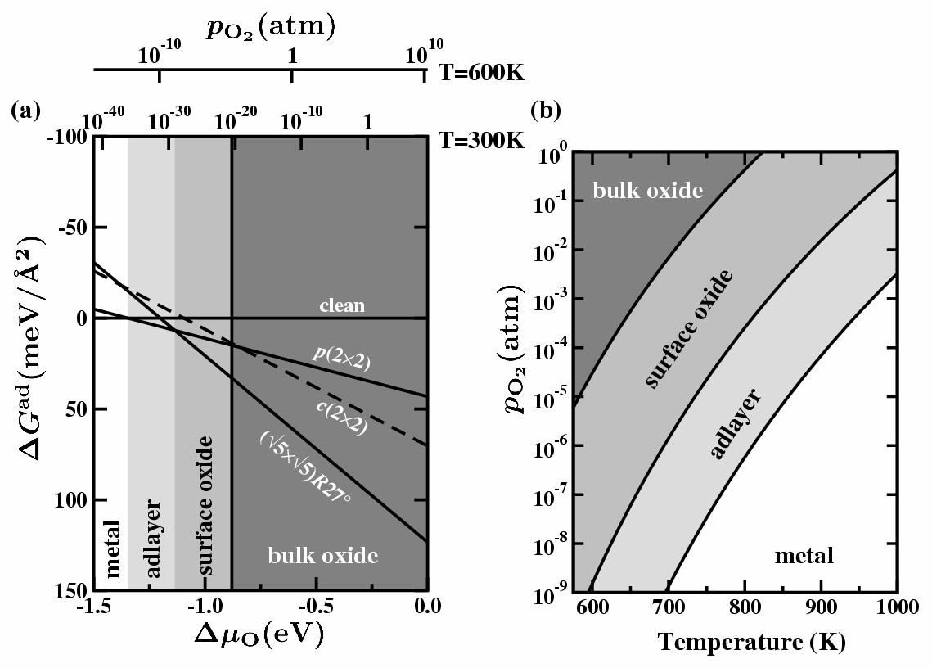
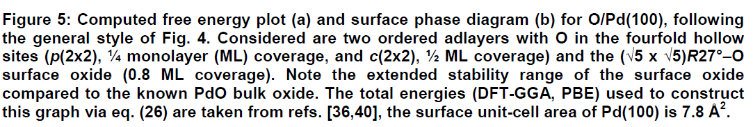
Summarizing the oxidation of Pd

Slide 21
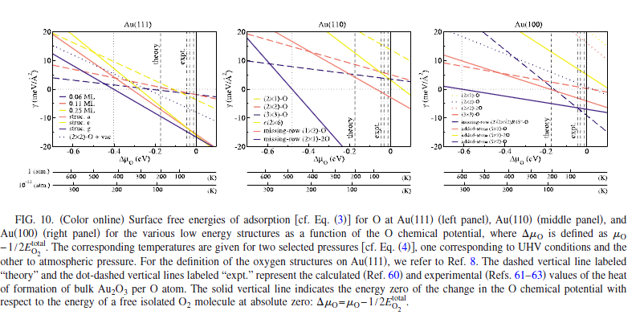
Gold oxidation example
Different facets change surface energy at different rates
Notes:
1. H.Q. Shi and C. Stampfl, Shape and surface structure of gold nanoparticles under oxidizing conditions. Physical Review B, 2008. 77(9): p. 094127. (http://dx.doi.org/10.1103/Physrevb.77.094127)

Slide 22
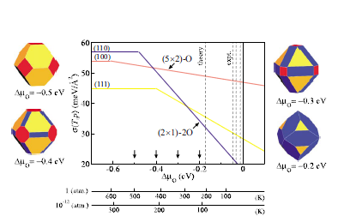
Effect on particle shape

Slide 23

More complicated example – Sulfur poisoning and multiple adsorbates
Given multiple gas species, how do we estimate surface coverages?
Consider Cu surfaces with gas phase H₂, H₂S, CO, CO₂, H₂O

Slide 24
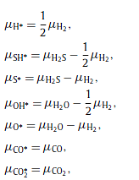
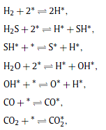
Chemical potential determined by equilibrium reactions

Slide 25

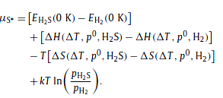
Defining chemical potentials

Slide 26

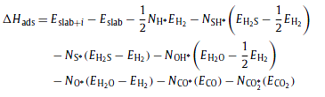
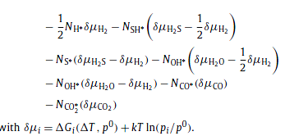

Multicomponent surface energies

Slide 27
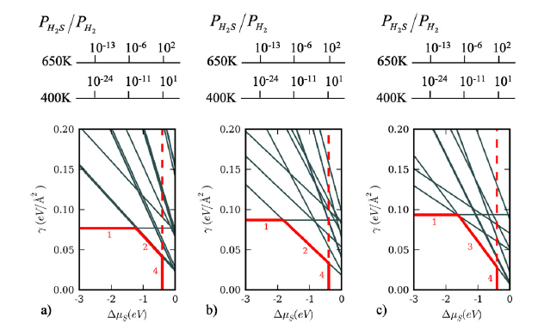
Adsorption of S on Cu surfaces
H₂S→S* + H₂
Cu(111)
Cu(110)
Cu(100)

Slide 28
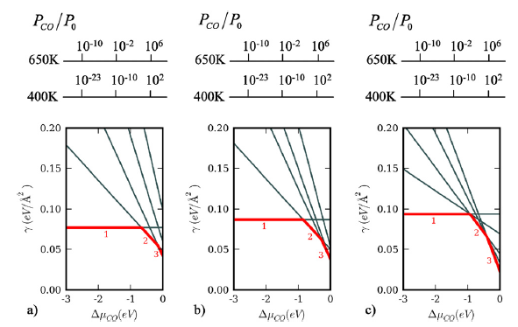
CO adsorption
CO→CO*

Slide 29
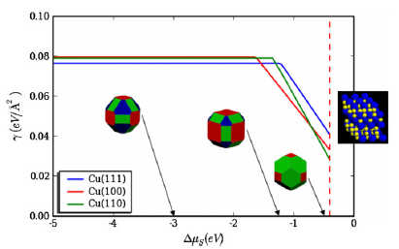
Effect of surface energy changes on particle shape
Use the Wulff construction to estimate particle shapes
Shapes change because the relative surface energies of each facet change at different rates with sulfur chemical potential
Notes:
http://cad4.cpac.washington.edu/winxmorphhome/winxmorph.htm

Slide 30
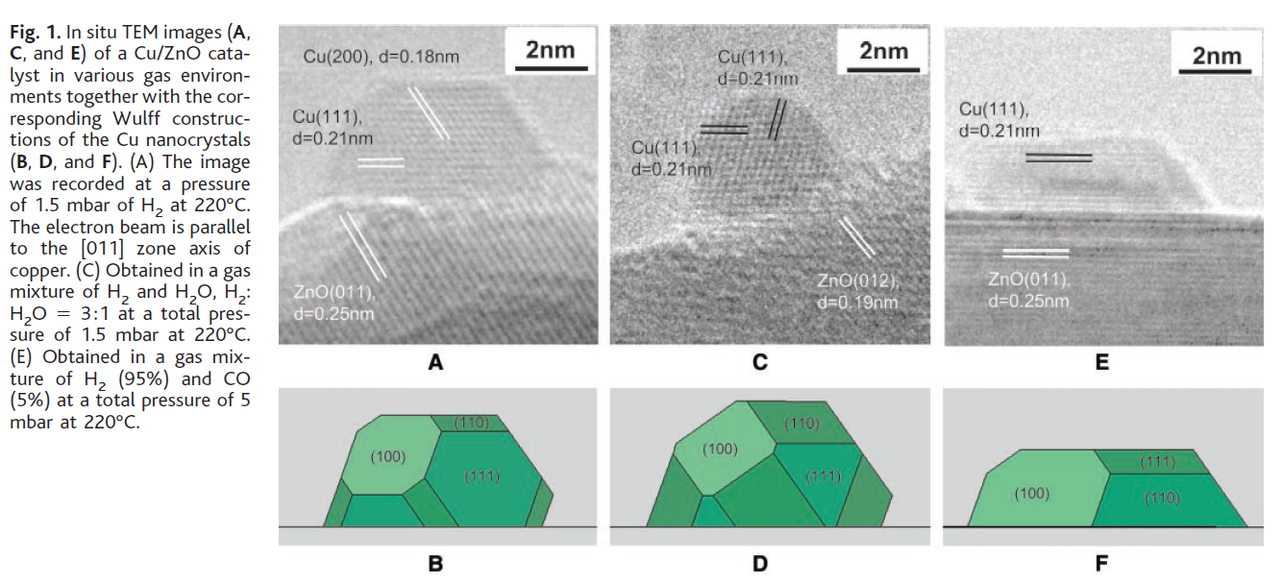
Experimental evidence of environment induced shape cahnge
http://lib.semi.ac.cn:8080/tsh/dzzy/wsqk/science/vol295/295-2053.pdf
Notes:
http://lib.semi.ac.cn:8080/tsh/dzzy/wsqk/science/vol295/295-2053.pdf

Slide 31
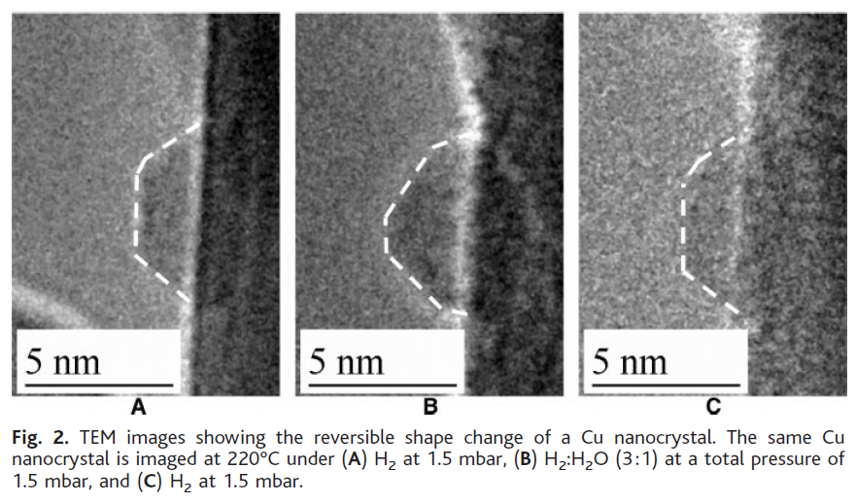
Reversible shape change in reducing/oxidizing environments

Slide 32
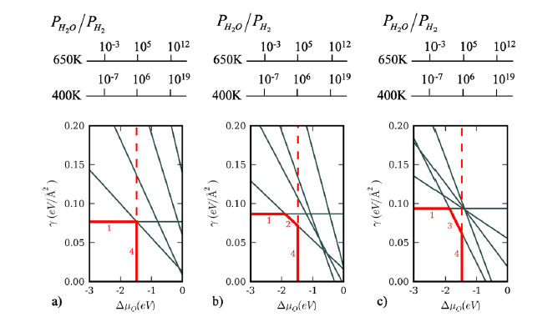
oxygen adsorption on Cu surfaces
H₂O→O* + H₂

