Slide 1
INTRO TO CLOJURE-CLR
CLOJURE FOR THE .NET DEVELOPER

Slide 2
WHAT IS CLOJURE?
Derivative of Lisp Created by Rich Hickey that targets the JVM, CLR and JavaScript
Code as data – (println “Hi, Richmond!”)
‘Variables’ are immutable by default
Dynamic

Slide 3
ENVIRONMENT SETUP
Download from https://github.com/clojure/clojure-clr
Unzip to a directory of your choice
Update PATH variable to include directory mentioned above
Set CLOJURE_LOAD_PATH to the directory where clojure.main.exe lives.

Slide 4
VARIABLES AND FUNCTIONS
Declaring Variables:
  Namespace wide:
    (def my-var “Value here”)
  Local:
    (let [my-var “Value here”] <code here>)
    Variables defined in let calls are scoped within the let parenthesis
Declaring functions:
  (defn my-func [param] <body of function>)
  (fn [p1 p2 p3] <body of function>)
  #(println “Hi from my anonymous fn”)
  Called by fully qualified name => namespace/function name

Slide 5
NAMESPACES
Defining a namespace: (ns db.queries)
Namespaces are used to set scope for functions, variables, keywords, etc.
To include a namespace you can
  Call the use function: (use <namespace>) brings all fn, defs into your namespace
  Call the require makes them available but requires you to use qualified name
Map to the file system.
  (ns db.queries) indicates that the the queries.clj file lives in the db directory

Slide 6
COLLECTIONS
Vectors – collection of values indexed by continuous integers.
  (def my-vec [ 0 “One” 2.0])
Maps – Key/Value collection
  (def my-map {:one 1 :two “Some String”})
Sequences – a logical, immutable list. Most sequences are lazy.
  (def my-seq ‘(1 2 3 “4” 5.0 my-map))

Slide 7
PROCESSING COLLECTIONS
map – like a foreach loop processes a sequence item by item
  (map #(println “processed %”) my-seq)
first and rest
  (first my-seq) returns the first item in my-seq.
  (rest my-seq) returns a new sequence with all but the first item of the sequence
filter
  (filter my-filter-fn my-seq) – filter is similar to map that it processes each item. All items that cause a true value to be returned by the testing fn are returned.

Slide 8
THE REPL
Read-Eval-Print Loop
Start the reply by running %CLOJURE_LOAD_PATH% \clojure.main.exe
REPL Demo
  Basics
    Variables
    Functions
  Sequences and maps
    Map
    filter
  .NET interaction
    Instantiating a class
    Using .Net assemlies
    Get/Set Properties
Notes:
Basics do:
(def msg “Clojure is Cool!”)
(defn echo [my-str] (println “you said:” my-str))
Sequences do:
(def numbers (range 10))
(map println numbers)
(apply + numbers)
.NET:
(assembly-load-from “deps\\ReplExample.dll”)
(def obj (ReplExample.MyClass.))
(set! (.MyVal obj) 10)
(.GetTime obj)
(.SayHi obj “Richmond”)

Slide 9
THE HOCKEY PLAYER LOOKUP APPLICATION

Slide 10
BUILDING AN APPLICATION
  Connect to and query a Postgresql database using ADO.NET
  Create a Windows.Forms based User Interface
  Display the results of user’s query
  Demo

Slide 11
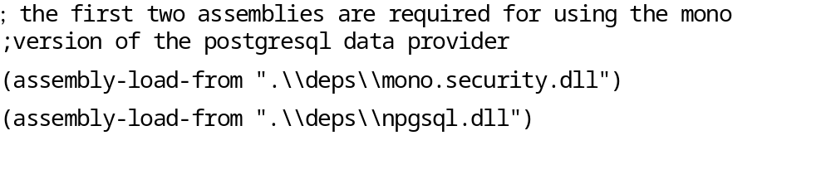
THE DB LAYER - LOADING ASSEMBLIES
Loading the PostgreSQL and ADO.NET libraries:
Loading the ADO.NET library

Slide 12
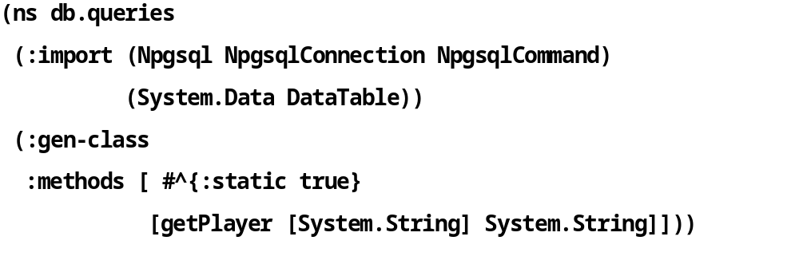
THE DB LAYER – NAMESPACES, IMPORT, AND GEN-CLASS
Define the db.queries namespace
Import the necessary classes - think using in C#
Gen-class – exposing the function for use in C#

Slide 13
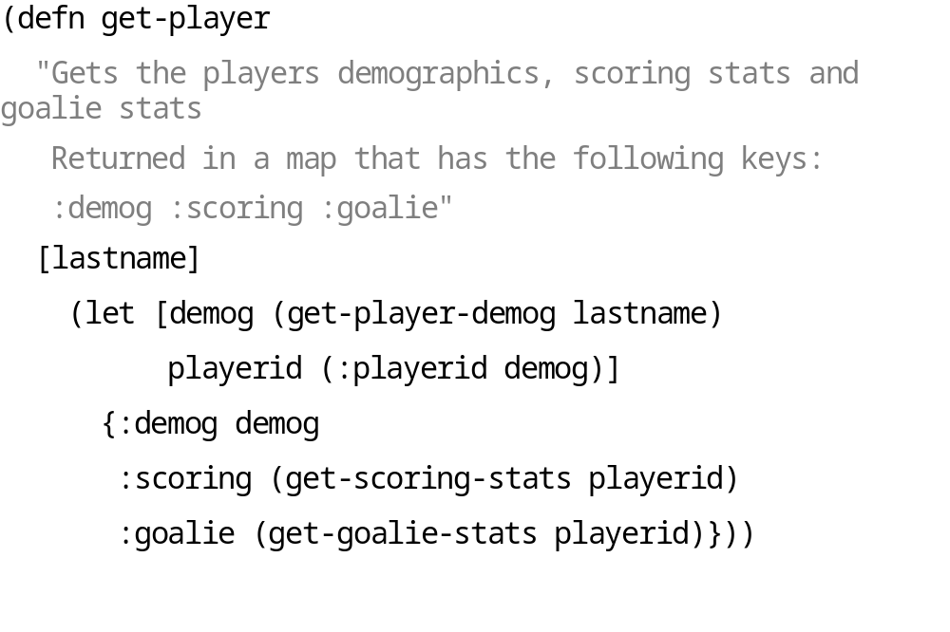
THE DB LAYER - GET-PLAYER

Slide 14
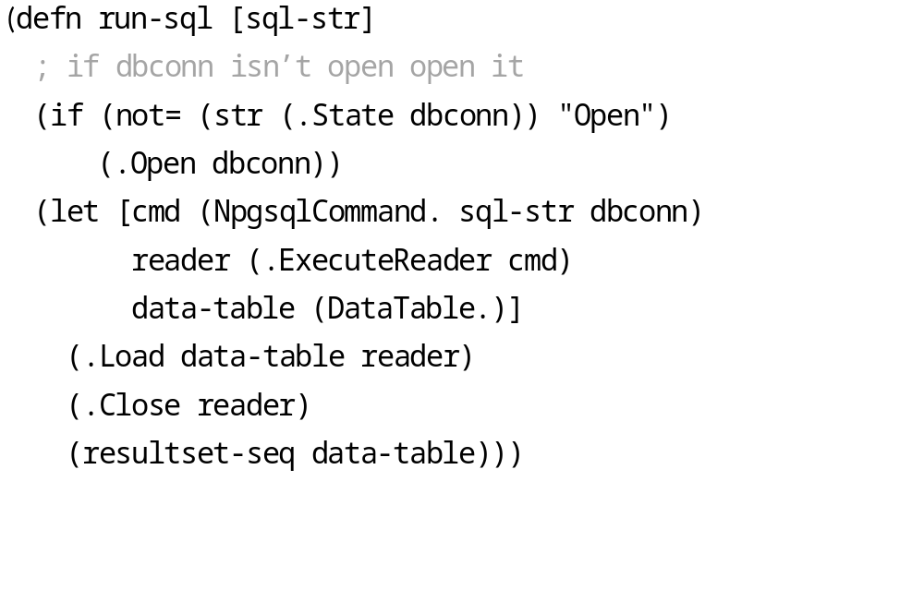
THE DB LAYER - RUN-SQL

Slide 15
THE UI LAYER - LIBRARIES
Uses System.Forms to create the UI
After Loading the Assemblies the :import statement brings in all the .NET classes we need
The :require statement is used to bring the db.queries functions into the hockey namespace
  (:require [db.queries :as query])
  All db.queries functions can be called using query instead of db.queries: queries/get-player
The –main function is what starts off the app.

Slide 16
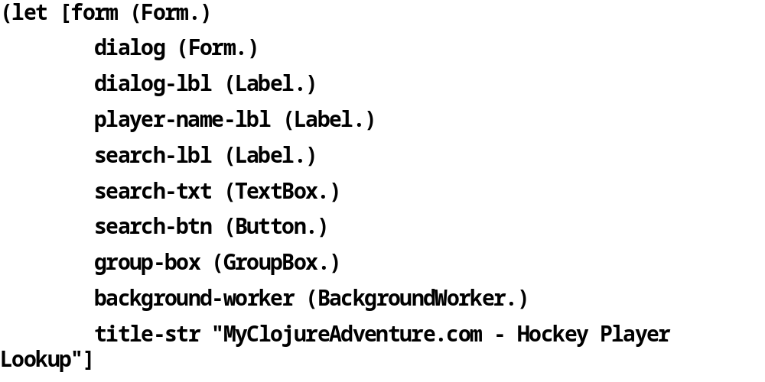
THE UI LAYER –MAIN FUNCTION
Creating the objects

Slide 17
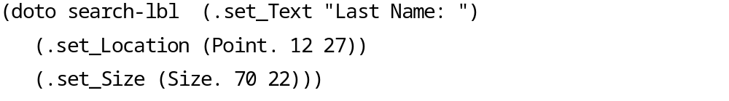
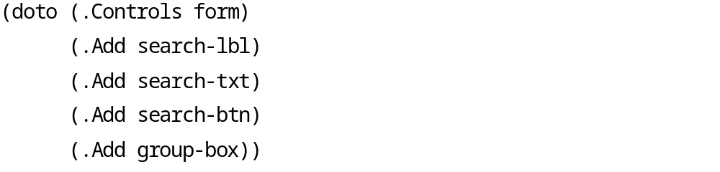
THE UI LAYER - SETTING ATTRIBUTES
Setting up the Search Button
Adding the components to the form
The doto macro takes the first parameter and applies the trailing calls to that object. Same as:
  (.Add (.Controls form) search-lbl)
  (.Add (.Controls form) search-txt)
  Etc…

Slide 18
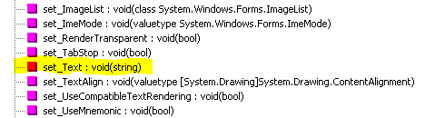
WHERE DID SET_TEXT COME FROM?
When you look at the Label class in the Object Browser you don’t see a set_Text method
Clojure-clr access .NET objects and the CLR ‘level’
The set_Text method is the CLR representation of the Label.Text property.
You can see what methods are available at the CLR level by using the ildasm tool which is part of the .NET SDK

Slide 19
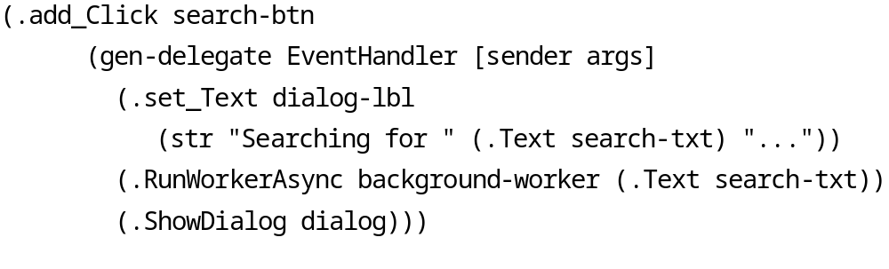
THE UI LAYER - EVENT HANDLING
The gen-delegate macro creates an EventHandler delegate
  First Parameter is type of delegate to create
  Second Parameter is the delegate’s parameter vector
  The body of the function is passed as the third parameter

Slide 20
THE UI LAYER – RETRIEVING THE DATA
When the ‘Get Stats!’ button is clicked this code retrieves the data
(reset! qry-results (query/get-player name))
Query/get-player is called to retrieve demographic and stats info
The results are stored in qry-results
What is the reset! Function all about?

Slide 21
THE UI LAYER – STORING THE RESULTS WITH AN ATOM
query-results is an atom, which means its state can change.
Defining an atom is very similar to any other def
(def qry-results (atom {}))
The reset! call changes the value of qry-results to the results of the get-player call.
(reset! qry-results (query/get-player name))
To access the data in qry-results use on of the following:
(deref qry-results) or @qry-results

Slide 22
THE UI LAYER - DISPLAY THE RESULTS
create-scoring-grid
The stats are added on a row by row basis using the doseq function.
(doseq [rec (:scoring @qry-results)]
(add-row-to-grid scoring-grid rec))
doseq allows us to process lazy sequences (think foreach)
Each entry in (:scoring @qry-results) will be assigned to the rec variable and passed to the fn that will add the data to the grid.

Slide 23
RUNNING A CLOJURE-CLR APP
Directory structure for my Clojure-clr projects:
  bin – base directory for executable. Contains all hockey related DLLs and executables.
  bin\deps and src\deps – contains the projects dependencies (Npgsql.dll and Mono.Security.dll)
Pre-reqs for running hockey.exe
  10 Clojure and 2 Microsoft DLLS need to be copied into the project’s bin directory.
  Src\hockey.clj to bin dir and src\db\queries.clj to bin\db\queries.clj
  I use a build.bat file to do this

Slide 24
CALLING CLOJURE-CLR
FROM C#

Slide 25
CLOJURE-CLR CODE
The code we will call from C# is in src/export/html.clj
To make the clj code visible in C# we use :gen-class
  (:gen-class
  :methods [#^{:static true}
  [CreateHtml [System.String] System.String]])
  :methods is a vector of vectors that describes each fn to be exposed
  [<function name> [ <vector of params>] <return type>]
  By default when the CreateHtml function is called from C# it will look for a fn named –CreateHtml in the clojure code.
  -CreateHtml is a ‘normal’ Clojure fn

Slide 26
C# PROJECT SETUP
Required References
  All Clojure-clr dlls in the project’s bin directory
  Microsoft.Scripting.dll and Microsoft.Dynamic.dll
  Bin\export.html.clj.dll and bin\export.html.exe (You MUST reference both files)
  All Dlls in the bin\deps directory

Slide 27
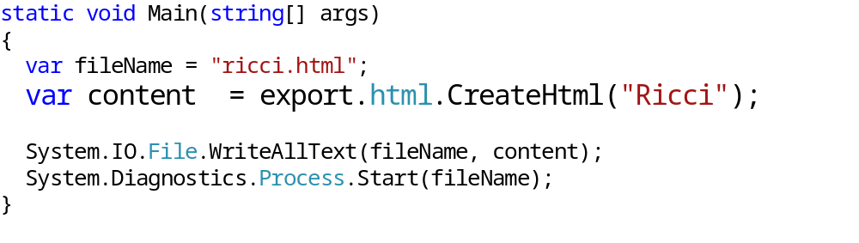
CALLING CREATEHTML
The C# Code

Slide 28
RESOURCES
Me
@rippinrobr / rippinrobr@gmail.com
My Clojure Blog: www.myclojureadventure.com
My General Dev blog: http://progadventure.blogspot.com/
Github: github.com/rippinrobr
github.com/rippinrobr/intro-to-clojureclr-talk
Clojure and Clojure-clr Resources
Clojureclr.blogspot.com
https://github.com/clojure/clojure-clr/
Planet.clojure.in <- A TON of clojure related blogs

