Slide 1
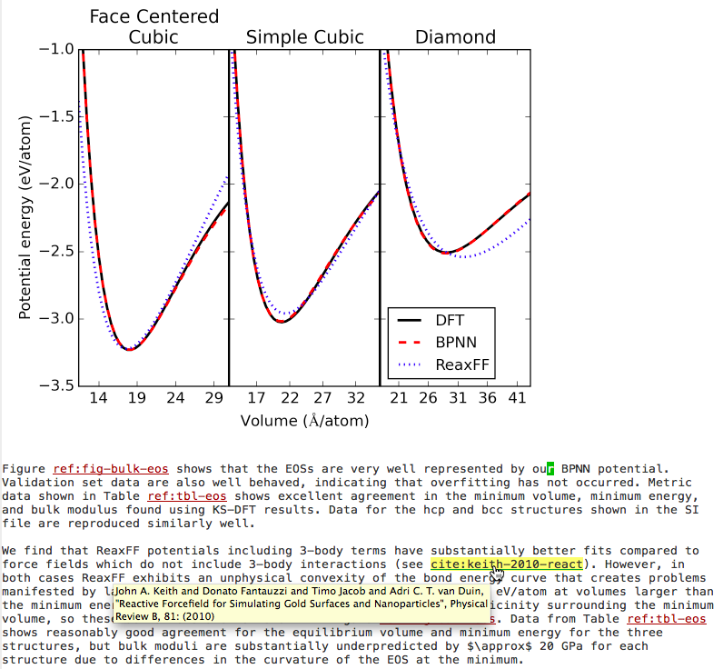
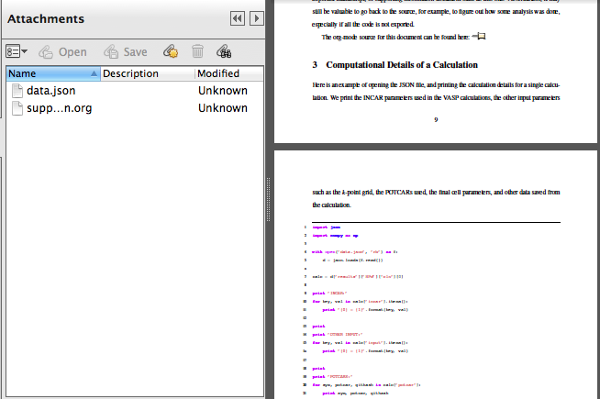
Plain text
working document
Published manuscripts in PDF and HTML
Data
Code
DOI
URL
Citations, cross-references
Embedded code and data

