Slide 1
Amino Acid Salt Precipitates

Slide 2
Method
Created 3g solutions of 30 wt% of Taurate, Lysinate, Glycinate, and Prolinate (all with Potassium cation)
Bubbled carbon dioxide through each for ~5 hours, or until saturated
Filtered and washed solids out of the solution using Ethanol
Stored solids in desiccator to remove the moisture
Performed Raman spectroscopy on the solids to determine composition

Slide 3
Method
Also found spectra for possible precipitate constituents:
Potassium bicarbonate
Potassium carbonate
Pure amino acid
Ethanol (due to washing the filtrate)
Dehydrated 30% wt solids (In the cases of glycine and taurine)

Slide 4
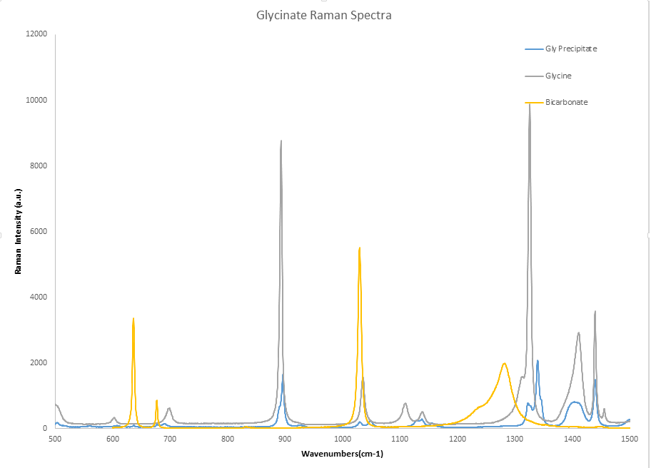
Glycine Results
Bicarbonate is not present in the precipitate
Glycine’s peaks seem to correlate with the precipitate’s peaks, but do not match
May be an indication that the precipitate is a different glycine ion

Slide 5
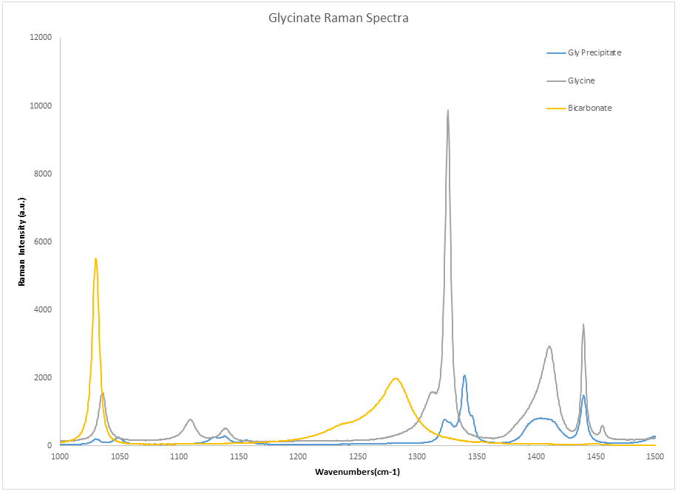
Glycine Results
The precipitate does share a peak with glycine at ~1440 cm-1
However, the rest of the precipitate peaks are similar in structure yet shifted off center from the glycine peaks

Slide 6
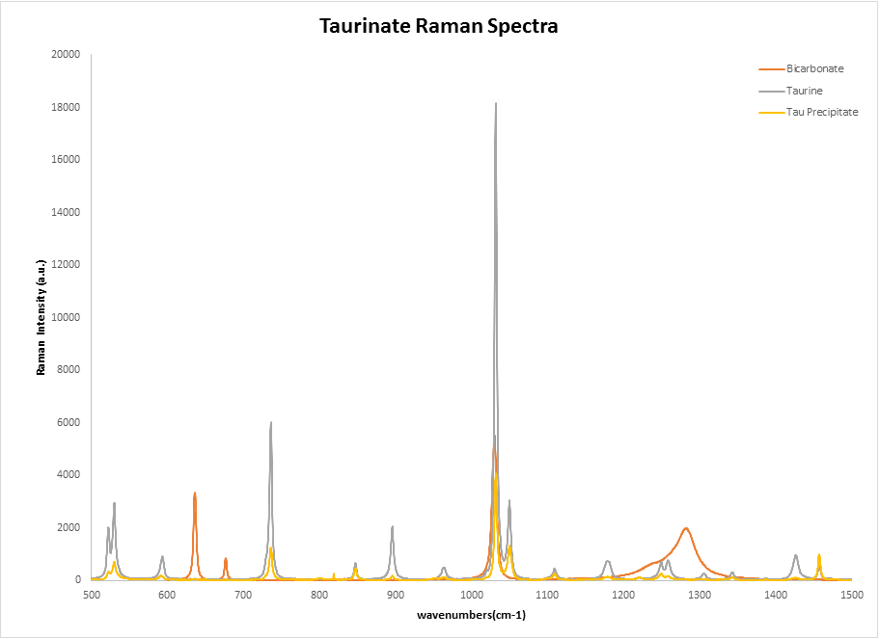
Taurine Results
The precipitate clearly shares many peaks with Taurine
Bicarbonate’s peaks are not in line with the precipitate’s peaks in any region of the spectrum

Slide 7
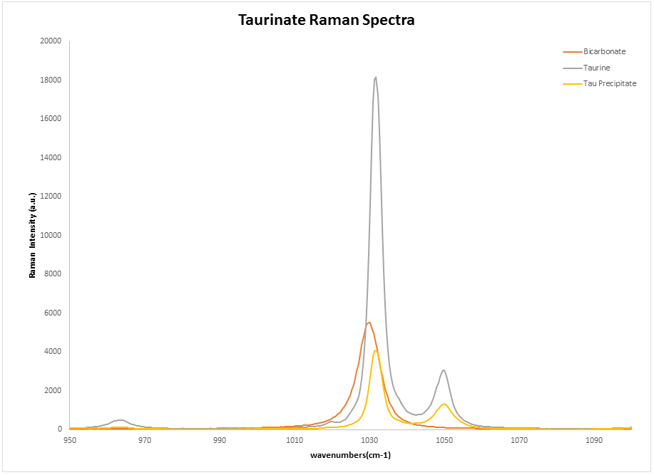
Taurine Results
A closer look at the two stronger peaks near ~1000 cm-1 reveals the congruency between the Taurine and precipitate spectra
The bicarbonate peak around ~1030 is shown to be misaligned with the precipitate

Slide 8
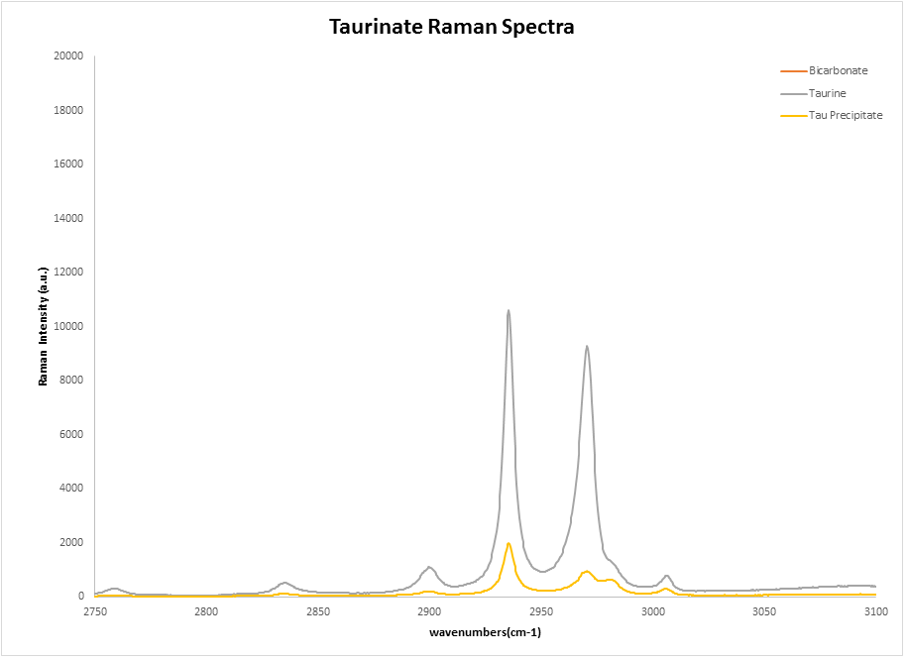
Taurine Results
More congruency is seen further down along the spectra of both Taurine and the precipitate
The precipitate has been found to be neutral Taurine

Slide 9
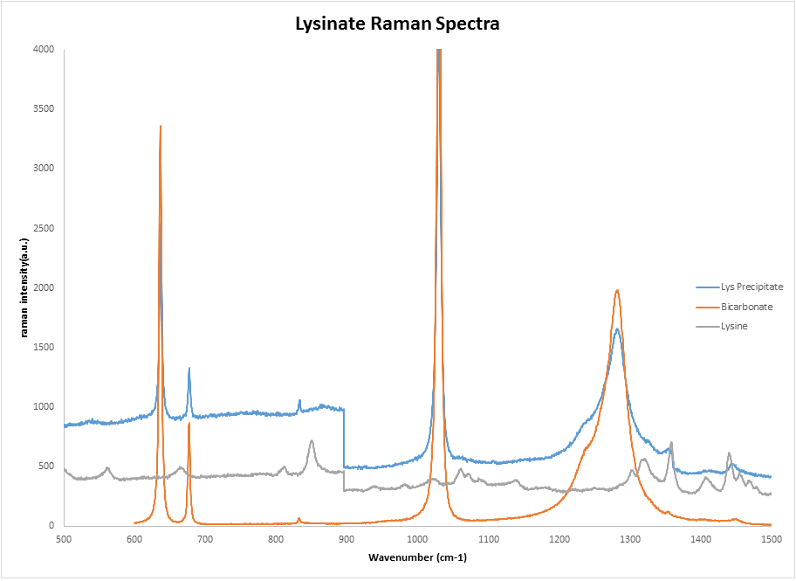
30 wt% Lysine Results
Bicarbonate has four main peaks, all shared with the precipitate
At this concentration, no evidence of Lysine was found was found in the precipitate

Slide 10
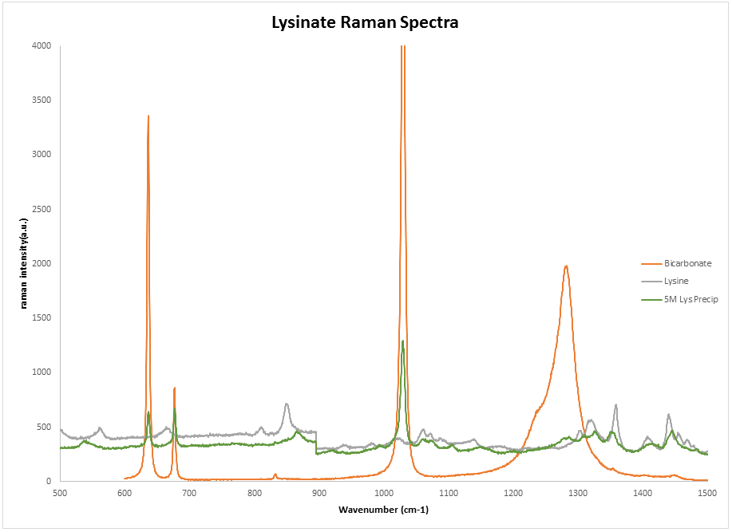
5M Lysine Results
At a higher concentration, bicarbonate peaks are still present in the Precipitate
A correlation can be seen between the peaks of the precipitate and the peaks of Lysine

Slide 11
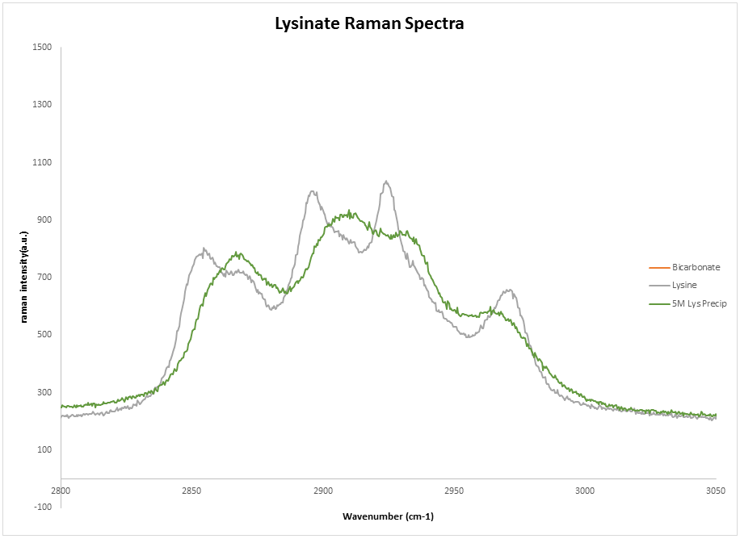
5M Lysine Results
Further down the spectra, more correlation can be seen between Lysine and the precipitate
The presence of both Lysine and bicarbonate could be due to the presence of unreacted Lysine in the precipitate at this high concentration

Slide 12
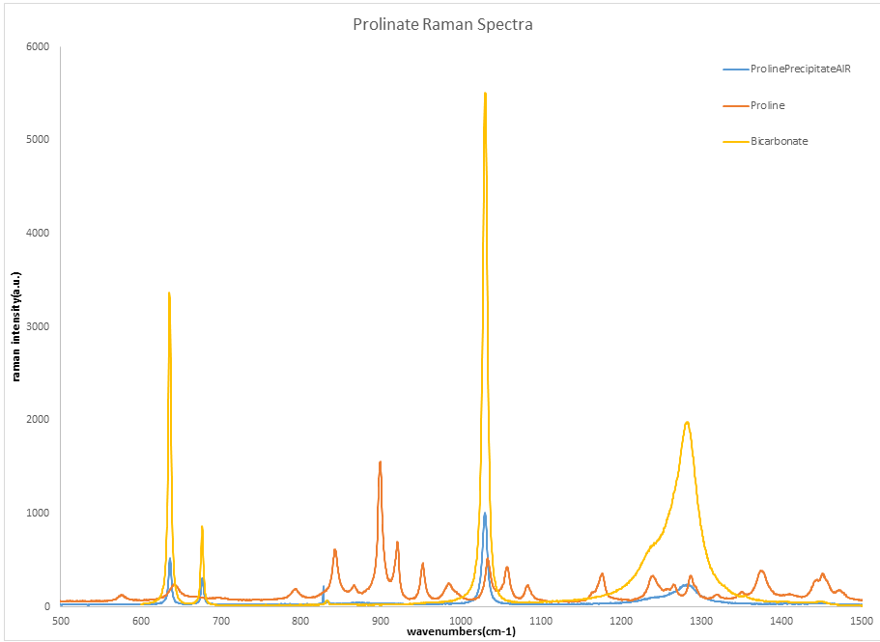
Proline Results
The precipitate was shown to be pure bicarbonate, with no traces of Proline

Slide 13
Conclusions
Glycinate’s precipitate was found to have many peaks shifted rightwards, but they still correlated with Glycine
Indication that it may be a different ion of the glycine molecule
Taurinate was found to precipitate pure Taurine
Lysinate was found to precipitate only bicarbonate at lower concentrations, and both bicarbonate and Lysine at higher concentrations
Prolinate was found to precipitate pure bicarbonate

Slide 14
What’s Next?
Clarification of conflicting Lysine spectra
Microfluidic experiments at high concentrations
Before and After Raman spectra of the amino acid salt solutions
Further testing of the absorption capacities of used amino acid salt solutions

