Slide 1
Protothreads –
Simplifying Programming of Memory-Constrained Embedded Systems
  Adam Dunkels*, Oliver Schmidt, Thiemo Voigt*, Muneeb Ali**
  * Swedish Institute of Computer Science
  ** TU Delft
  ACM SenSys 2006

Slide 2
What this talk is about
Memory-constrained networked embedded systems
  2k RAM, 60k ROM; 10k RAM, 48K ROM
    “Artificial” limitations – based on economy, not mother nature
    More memory = higher per-unit cost
Concurrent programming
  Multithreading – requires “lots” of memory for stacks
    100 bytes is ~5% of 2k!
  Event-driven – less memory

Slide 3
Why use the event-driven model?
“In TinyOS, we have chosen an event model so that high levels of concurrency can be handled in a very small amount of space. A stack-based threaded approach would require that stack space be reserved for each execution context.”
J. Hill, R. Szewczyk, A. Woo, S. Hollar, D. Culler, and K. Pister. System architecture directions for networked sensors. [ASPLOS 2000]

Slide 4
Problems with the event-driven model?
“This approach is natural for reactive processing and for interfacing with hardware, but complicates sequencing high-level operations, as a logically blocking sequence must be written in a state-machine style.”
P. Levis, S. Madden, D. Gay, J. Polastre, R. Szewczyk, A. Woo, E. Brewer, and D. Culler. The Emergence of Networking Abstractions and Techniques in TinyOS. [NSDI 2004]

Slide 5
Enter protothreads
Protothreads – a new programming abstraction
  For memory-constrained embedded systems
  A design point between events and threads
  Very simple, yet powerful idea
Programming primitive: conditional blocking wait
  PT_WAIT_UNTIL(condition)
  Sequential flow of control
    Programming language helps us: if and while
Protothreads run on a single stack, like the event-driven model
  Memory requirements (almost) same as for event-driven

Slide 6
An example protothread
int a_protothread(struct pt *pt) {
PT_BEGIN(pt);
PT_WAIT_UNTIL(pt, condition1);
if(something) {
PT_WAIT_UNTIL(pt, condition2);
}
PT_END(pt);
}
/* … */
/* … */
/* … */
/* … */

Slide 7
Implementation
Proof-of-concept implementation in pure ANSI C
  No changes to compiler
  No special preprocessor
  No assembly language
  Two deviations: automatic variables not saved across a blocked wait, restrictions on switch() statements
Six-line implementation will be shown on slide!
Very low memory overhead
  Two bytes of RAM per protothread
  No per-thread stacks

Slide 8
Evaluation, conclusions
We can replace explicit state machines with protothreads
  Protothreads let programs use if and while statements instead of state machines
  16% - 49% reduction in lines of code for rewritten programs
  Most explicit state machines completely replaced
  Code size increase/decrease depends on program
Run-time overhead small (3-15 cycles)
  Useful even in time-critical code; interrupt handlers
Protothreads have been adopted, used by others

Slide 9
The details…

Slide 10
Example:
A hypothetical sensor network MAC protocol

Slide 11
Radio sleep cycle
t_{wait_max}
t_{awake}
t_{sleep}
Radio on
Communication left…
Radio off
t₀

Slide 12
Five-step specification
t_{wait_max}
Turn radio on.
Wait until t = t_0 + t_awake.
If communication has not completed, wait until it has completed or t = t_0 + t_awake + t_wait_max.
Turn the radio off. Wait until t = t_0 + t_awake + t_sleep.
Repeat from step 1.
t_{awake}
t_{sleep}
Communication left…
Radio on
Radio off
t₀
No blocking wait!
Problem: with events, we cannot implement this as a five-step program!

Slide 13
The event-based implementation: a state machine
t_{wait_max}
t_{awake}
t_{sleep}
ON
Communication left…
Radio on
WAITING
Timer expires
Radio off
Timer expires
t₀
Timer expires
Communication completes,
timer expires
OFF

Slide 14
Event-driven state machine implementation: messy
enum {ON, WAITING, OFF} state;
void eventhandler() {
if(state == ON) {
if(expired(timer)) {
timer = t_sleep;
if(!comm_complete()) {
state = WAITING;
wait_timer = t_wait_max;
} else {
radio_off();
state = OFF;
}
}
} else if(state == WAITING) {
if(comm_complete() ||
expired(wait_timer)) {
state = OFF;
radio_off();
}
} else if(state == OFF) {
if(expired(timer)) {
radio_on();
state = ON;
timer = t_awake;
}
}
}
t_{wait_max}
t_{awake}
t_{sleep}
Communication left…
Radio on
Radio off
t₀
ON
WAITING
Timer expires
Timer expires
Timer expires
Communication completes,
timer expires
OFF

Slide 15
Protothreads makes implementation easier
t_{wait_max}
Protothreads – conditional blocking wait: PT_WAIT_UNTIL()
No need for an explicit state machine
Sequential code flow
t_{awake}
t_{sleep}
Communication left…
Radio on
Radio off
t₀

Slide 16
Protothreads-based implementation is shorter
int protothread(struct pt *pt) {
PT_BEGIN(pt);
while(1) {
radio_on();
timer = t_awake;
PT_WAIT_UNTIL(pt, expired(timer));
timer = t_sleep;
if(!comm_complete()) {
wait_timer = t_wait_max;
PT_WAIT_UNTIL(pt, comm_complete()
|| expired(wait_timer));
}
radio off();
PT_WAIT_UNTIL(pt, expired(timer));
}
PT_END(pt);
}
t_{wait_max}
t_{awake}
t_{sleep}
Communication left…
Radio on
Radio off
t₀
Code shorter than the event-driven version
Code uses structured programming (if and while statements)
Mechanism evident from the code

Slide 17
Protothread scheduling
A protothread runs in a C function
We schedule a protothread by invoking its function
We can invoke the protothread from an event handler
  Protothreads as blocking event handlers
We can let the operating system invoke our protothreads
  Contiki
Protothreads can invoke other protothreads
  Can wait until a child protothread completes
  Hierarchical protothreads

Slide 18
What’s wrong with using state machines?
There is nothing wrong with state machines!
  State machines are a powerful tool
  Amenable to formal analysis, proofs
But: state machines typically used to control the logical progam flow in many event-driven programs
  Like using gotos instead of structured programming
  The state machines not formally specified
  Must be infered from reading the code
  These state machines typically look like flow charts anyway
    We’re not the first to see this
Protothreads: use language constructs for flow control

Slide 19
Why not just use multithreading?
Multithreading the basis of (almost) all embedded OS/RTOSes!
  WSN community: Mantis, BTNut (based on multithreading); Contiki (multithreading on a per-application basis)
Nothing wrong with multithreading
  Multiple stacks require more memory
    Networked = more concurrency than traditional embedded
    Can lead to more expensive hardware
  Preemption
  Threads: explicit locking; Protothreads: implicit locking
Protothreads are a new point in the design space
  Between event-driven and multithreaded

Slide 20
How do we implement protothreads?

Slide 21
Implementing protothreads
Modify the compiler?
  There are many compilers to modify… (IAR, Keil, ICC, Microchip, GCC, …)
Special preprocessor?
  Requires us to maintain the preprocessor software on all development platforms
Within the C language?
  The best solution, if language is expressive enough
  Possible?

Slide 22
Proof-of-concept implementation of protothreads in ANSI C
Slightly limited version of protothreads in pure ANSI C
  Uses the C preprocessor
  Does not need a special preprocessor
  No assembly language
Very portable
  Nothing is changed between platforms, C compilers
Two approaches
  Using GCCs C extension computed goto
    Not ANSI C: works only with GCC
  Using the C switch statement
    ANSI C: works on every C compiler

Slide 23
Six-line implementation
Protothreads implemented using the C switch statement
struct pt { unsigned short lc; };
#define PT_INIT(pt) pt->lc = 0
#define PT_BEGIN(pt) switch(pt->lc) { case 0:
#define PT_EXIT(pt) pt->lc = 0; return 2
#define PT_WAIT_UNTIL(pt, c) pt->lc = __LINE__; case __LINE__: \
if(!(c)) return 0
#define PT_END(pt) } pt->lc = 0; return 1

Slide 24
C-switch expansion
int a_protothread(struct pt *pt) {
PT_BEGIN(pt);
PT_WAIT_UNTIL(pt, condition1);
if(something) {
PT_WAIT_UNTIL(pt, condition2);
}
PT_END(pt);
}
int a_protothread(struct pt *pt) {
switch(pt->lc) { case 0:
pt->lc = 5; case 5:
if(!condition1) return 0;
if(something) {
pt->lc = 10; case 10:
if(!condition2) return 0;
}
} return 1;
}
Line numbers

Slide 25
Limitations of the proof-of-concept implementation
Automatic variables not stored across a blocking wait
  Compiler does produce a warning
  Workaround: use static local variables instead
  Ericsson solution: enforce static locals through LINT scripts
Constraints on the use of switch() constructs in programs
  No warning produced by the compiler
  Workaround: don’t use switches
The limitations are due to the implementation, not protothreads as such

Slide 26
How well do protothreads work?
Quantitative: reduction in code complexity over state machines
  Rewritten seven state machine-based programs with protothreads
    Four by applying a rewriting method, three by rewriting from scratch
  Measure states, state transitions, lines of code
Quantitative: code size
Quantitative: execution time overhead
Qualitative: useful in practice?

Slide 27
Reduction of complexity
 | States before | States after | Transitions before | Transitions after | Reduction in lines of code
XNP | 25 | 0 | 20 | 0 | 32%
TinyDB DBBufferC | 23 | 0 | 24 | 0 | 24%
Mantis CC1000 driver | 15 | 0 | 19 | 0 | 23%
SOS CC1000 driver | 26 | 9 | 32 | 14 | 16%
Contiki TR1001 driver | 12 | 3 | 22 | 3 | 49%
uIP SMTP client | 10 | 0 | 10 | 0 | 45%
Contiki codeprop | 6 | 4 | 11 | 3 | 29%
Found state machine-related bugs in the Contiki TR1001 driver and the Contiki codeprop code when rewriting with protothreads

Slide 28
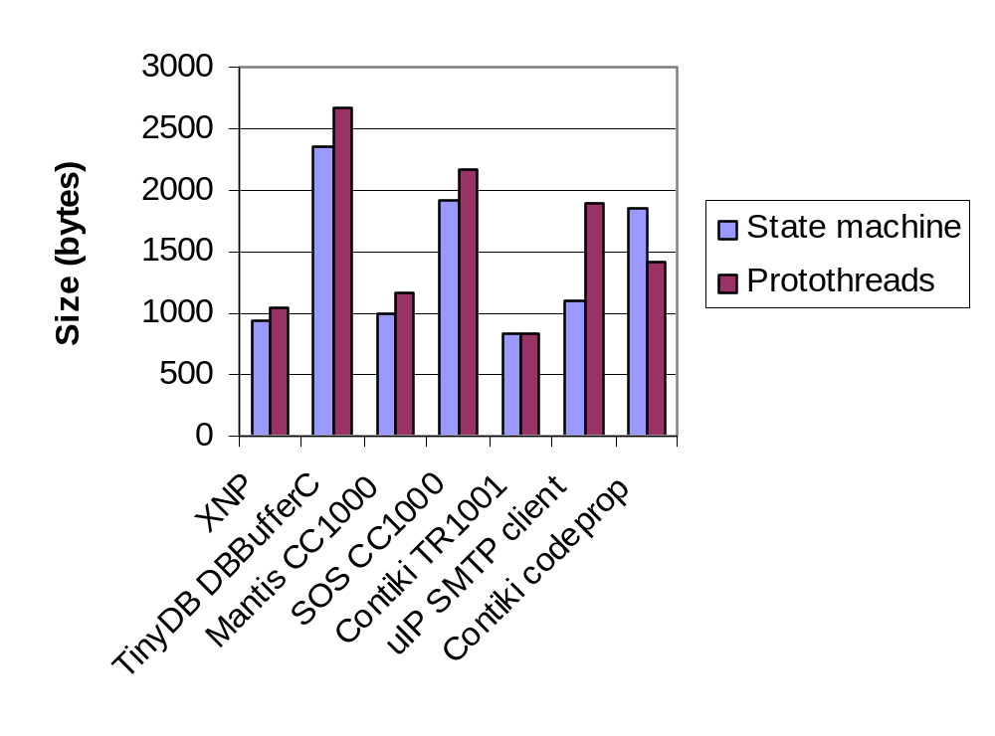
Code footprint
Average increase ~200 bytes
  Inconclusive

Slide 29
Execution time overhead is a few cycles
Switch/computed goto jump incurs small fixed size preamble
 | State machine | Protothreads, switch statement | Protothreads, computed gotos
gcc -Os | 92 | 98 | 107
gcc –O1 | 91 | 94 | 103
Contiki TR1001 radio driver average execution time (CPU cycles)

Slide 30
Are protothreads useful in practice?
We know that at least thirteen different embedded developers have adopted them
  AVR, PIC, MSP430, ARM, x86
    Portable: no changes when crossing platforms, compilers
  MPEG decoding equipment, real-time systems
  Others have ported protothreads to C++, Objective C
  Probably many more
    From mailing lists, forums, email questions
Protothreads recommended twice in embedded “guru” Jack Ganssle’s Embedded Muse newsletter

Slide 31
Conclusions
Protothreads can reduce the complexity of event-driven programs by removing flow-control state machines
  ~33% reduction in lines of code
Memory requirements very low
  Two bytes of RAM per protothread, no stacks
Seems to be a slight code footprint increase
(~ 200 bytes)
Performance hit is small (~ 10 cycles)
Protothreads have been adopted by and are recommended by others

Slide 32
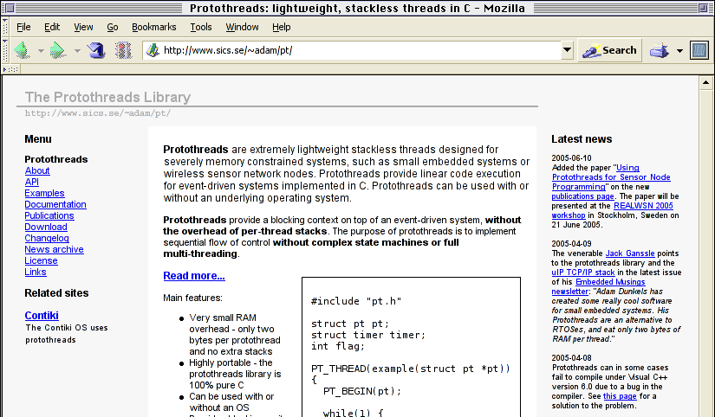
Questions?
  http://www.sics.se/~adam/pt/

Slide 33
Hierarchical protothreads
int a_protothread(struct pt *pt) {
static struct pt child_pt;
PT_BEGIN(pt);
PT_INIT(&child_pt);
PT_WAIT_UNTIL(pt2(&child_pt) != 0);
PT_END(pt);
}
int pt2(struct pt *pt) {
PT_BEGIN(pt);
PT_WAIT_UNTIL(pt, condition);
PT_END(pt);
}

Slide 34
Threads vs events…
Threads: sequential code flow
Events: unstructured code flow
No blocking wait!

Slide 35
Threads require per-thread stack memory
Four threads, each with its own stack
Thread 1
Thread 2
Thread 3
Thread 4

Slide 36
Events require one stack
Threads require per-thread stack memory
Four threads, each with its own stack
Four event handlers, one stack
Thread 1
Thread 2
Thread 3
Thread 4
Stack is reused for every event handler
Eventhandler 2
Eventhandler 3
Eventhandler 4
Eventhandler 1

Slide 37
Protothreads require one stack
Threads require per-thread stack memory
Four threads, each with its own stack
Four protothreads, one stack
Thread 1
Thread 2
Thread 3
Thread 4
Just like events
Events require one stack
Four event handlers, one stack
Protothread 2
Protothread 3
Protothread 4
Protothread 1

Slide 38
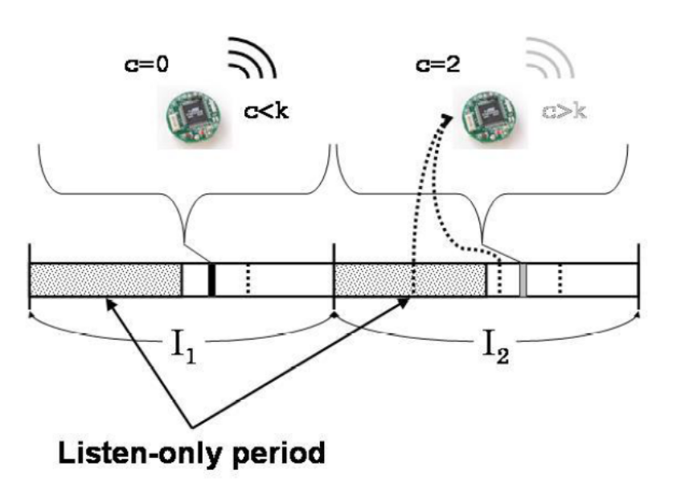
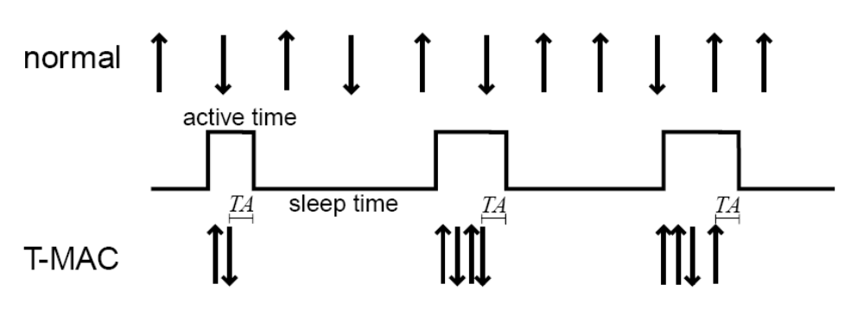
Trickle, T-MAC

