Slide 1
Modeling coverage dependent properties
John Kitchin

Slide 2
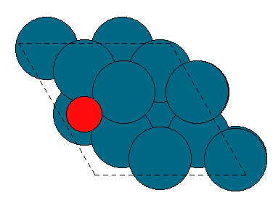
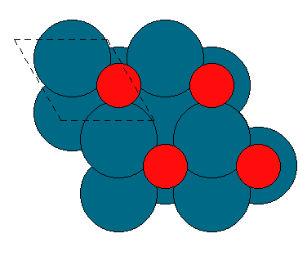
Why is coverage dependence important?
Low coverage
High adsorption energies
Low dissociation/reaction barriers
High coverage
Lower adsorption energies
High dissociation/reaction barriers
How does coverage dependence change with metal and adsorbate?
What factors determine the coverage dependence? Geometry? Electronic structure?

Slide 3
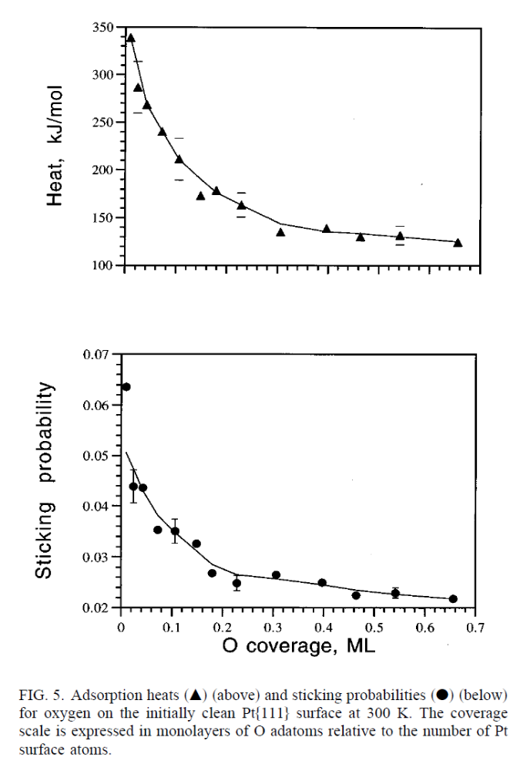
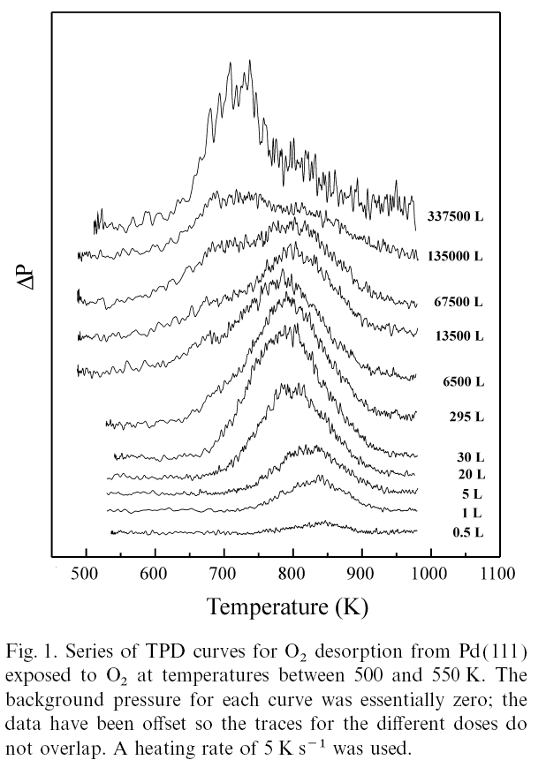
Coverage dependent data is rare
Microcalorimetry
O/Pt(111)
Temperature programmed desorption
O/Pd(111)
Oxide, new site, coverage dependence?
?
Loss of symmetry
Simple 2nd order desorption
G. Zheng, E.I. Altman / Surface Science 462 (2000) 151–168
Yeo, Vattuone, King, "Calorimetric heats for CO and oxygen adsorption and for the catalytic CO oxidation reaction on Pt{111}", J. Chem. Phys. 1996
Are there similarities here between Pd and Pt(111)? Other metals?

Slide 4




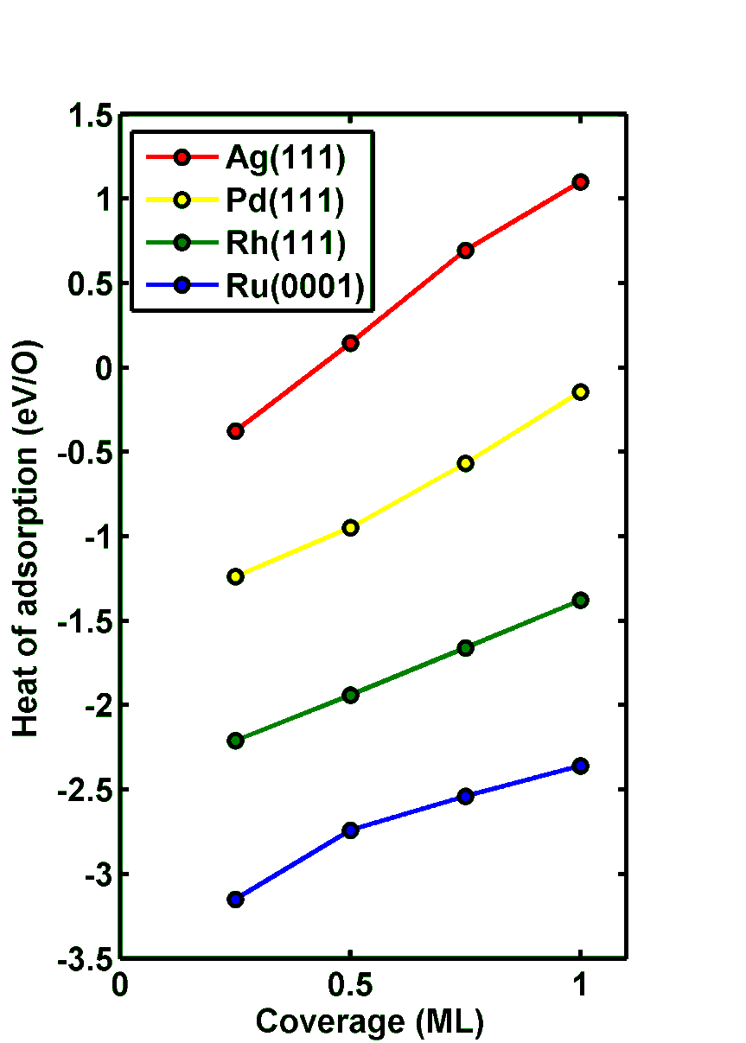
Calculating coverage dependence
Dissociative oxygen adsorption on fcc sites
Estimate coverage dependence using density functional theory
Approximately linear dependence for many metals
Intermediate coverages?
Configurations with degenerate coverages?
Other sites?
Are these relevant configurations?
Phys. Rev. Lett. 89, 096103 (2002)

Slide 5
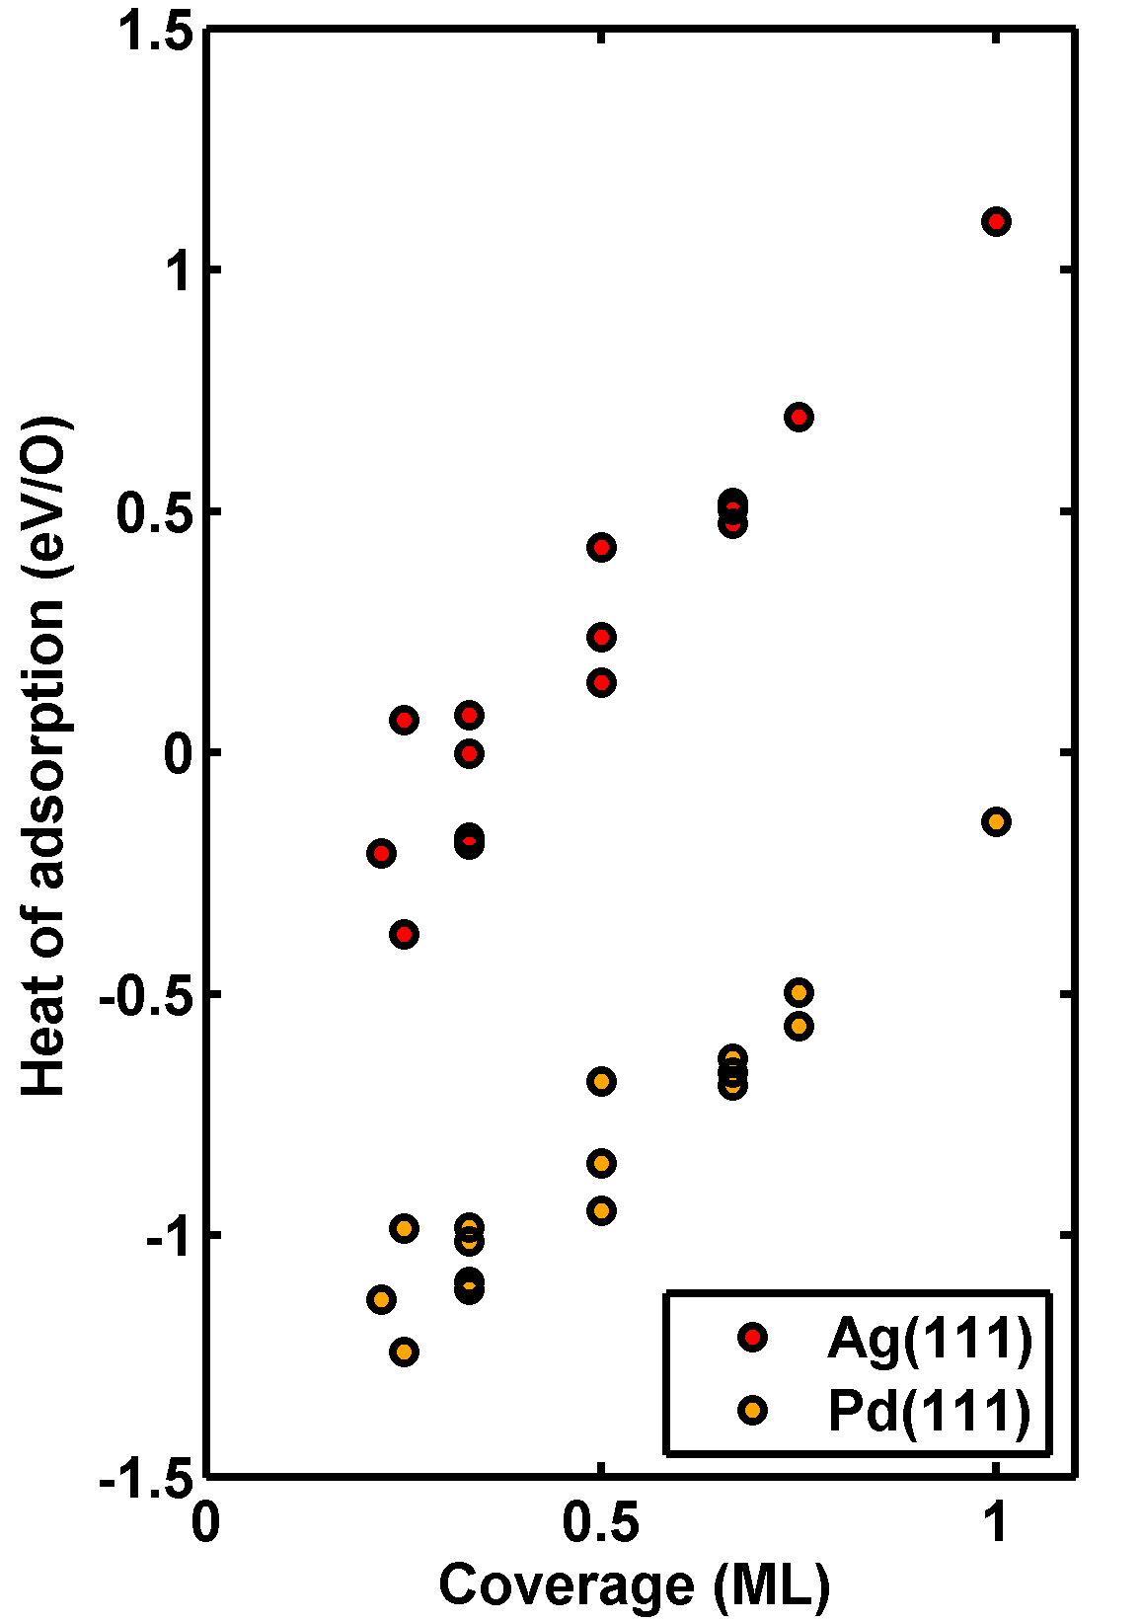

Calculate more…
Oxygen adsorption on Ag(111) and Pd(111)
We can always do more DFT calculations, but
No analytical function fits this
Still, are these relevant?
Are there any missing?
There are over 300,000 possible structures in unit cells up to 15 sites!
DFT calculations are “fast” but not that fast
DFT alone can not solve this problem
Notes:
Even at an hour a calculation we are talking 34 years

Slide 6
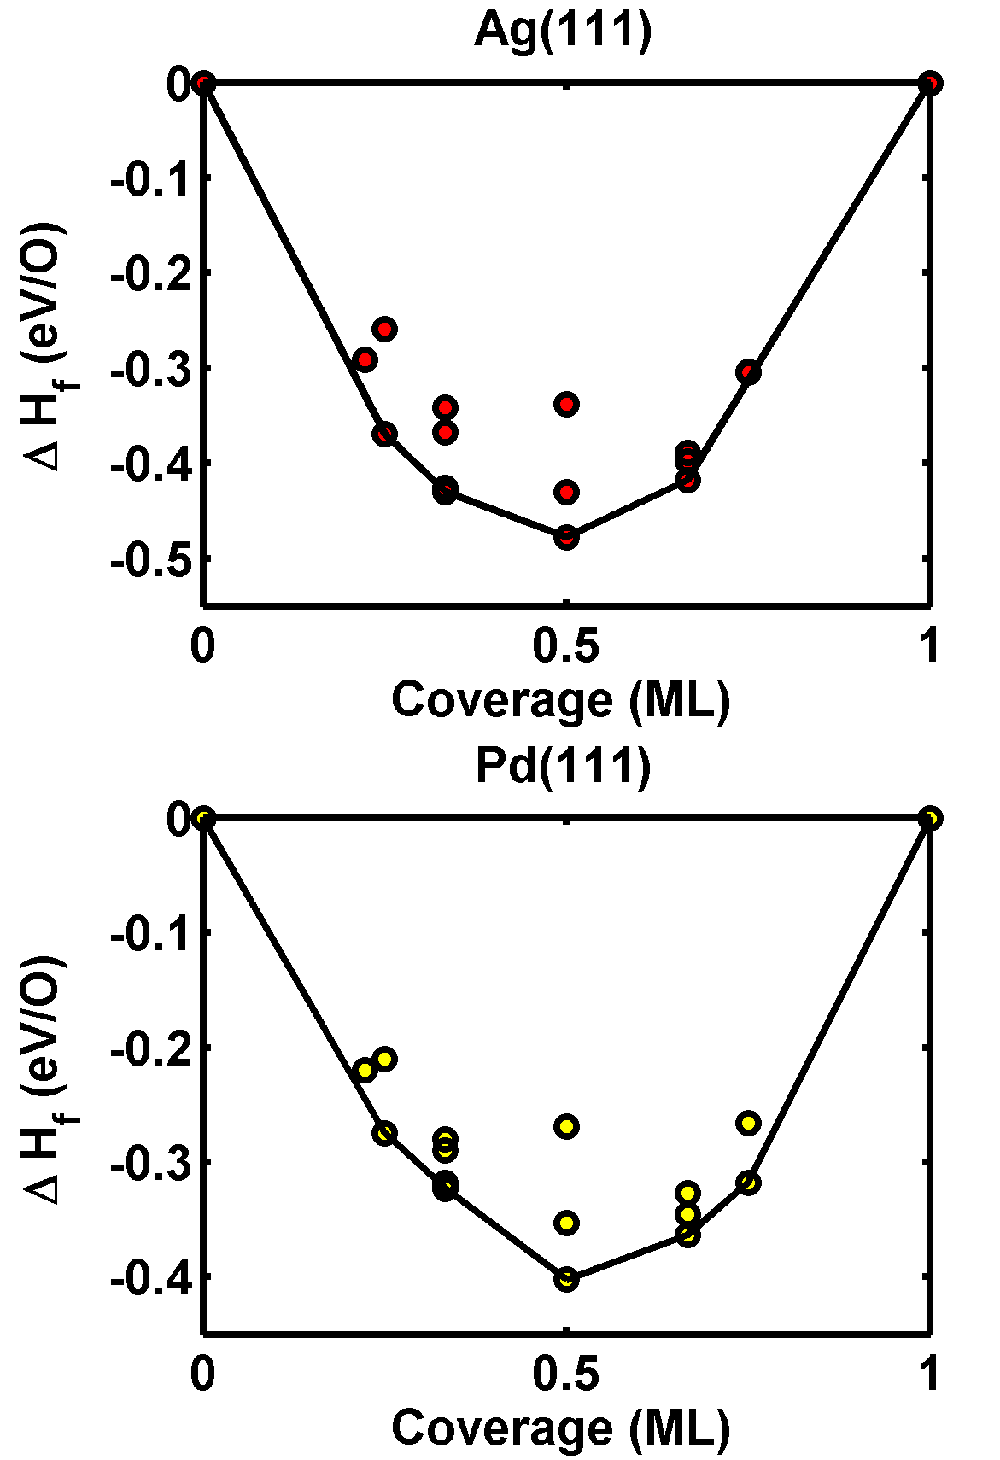
Thermodynamic approach to stability
Ground state structures on the phase diagram are the ones stable to phase separation
  Stability of a configuration with respect to separation into two others
ΔH_{formation}=θ(ΔH_{ads}(eV/O) - ΔH_{ads}(1 ML eV/O) )
How do we know we didn’t miss a more stable one?

Slide 7
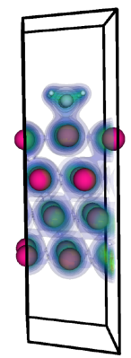
Why can’t we use DFT?
We have:
We want:
E=DFT( )
E=f( )
Variables are:
List of sites
Site occupations
Unit cell
Output = energy only
Minimal information = fast
What is f?
How to represent ?
Variables are:
Ion positions
Unit cell
Output includes:
Electron density
Total energy
Forces
…
Too much information=too long to calculate

Slide 8
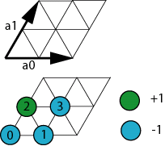
Coarse-graining the continuous surface into discrete adsorption sites
Use unit cells to describe periodic adsorbate configurations
Discretize the unit cell into adsorption sites
Describe the occupation of a site by an integer (+1=occupied, -1=vacant)
σ = {-1, -1, +1, -1}
This is a simple, mathematical representation of a configuration.

Slide 9
The new energy functional
From DFT we have:
We know E_{i} and the configuration
We can approximate f() by expanding it is a suitable basis function and estimating the expansion coefficients.
f( )=E₁
f( )=E₂
f( )=E₃
f( )=E₄
f( )=E₅
…

Slide 10
Basis set for expansion
Conceptually
Energy is determined by localized interactions at each site
The basis functions should reflect localized interactions
Discrete polynomials in the occupation variables
Complete and orthogonal
The idea now is to find the J’s
On-site cluster
Pair clusters
Trio clusters
Quarto clusters
E(σ) =
J₀
+
J₁
+
J₂
+
J₃
+
J₄
+
J₅
+
J₆
+
…

Slide 11
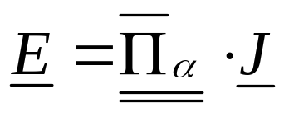
Combining DFT with cluster expansions
E(σ) =
J₀
+
J₁
+
J₂
+
J₃
+
J₄
+
J₅
+
J₆
+
…
E₀( ) = J₀ - J₁ 0.5 + …
DFT
E₁( ) = J₀ + J₁ 0.0 + …
E₂( ) = J₀ + J₁ 0.5 + …
E₃( ) = J₀ + J₁ 1.0 + …
Basis set values
?
Solve for J by any convenient method
Which figures do we choose?

Slide 12
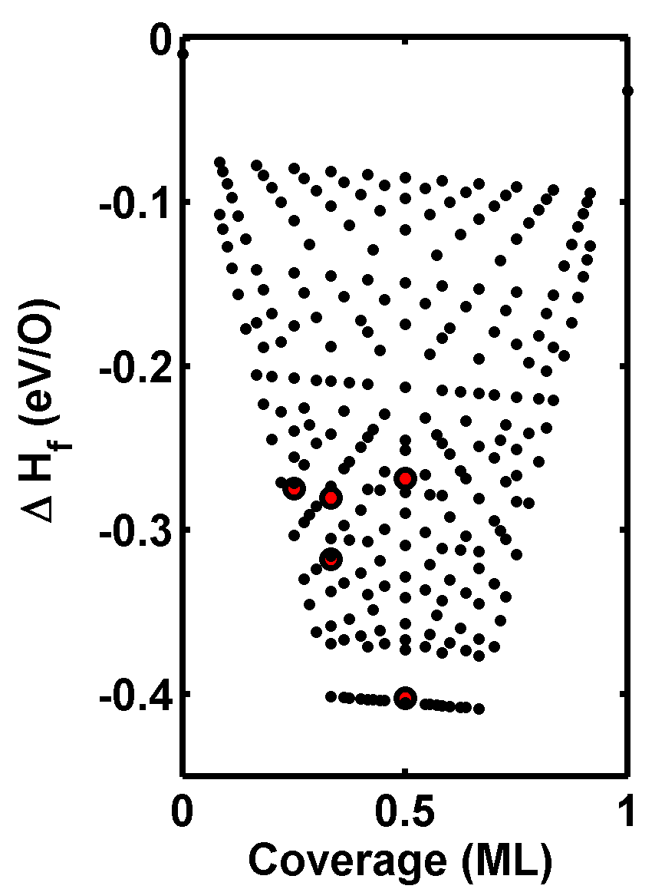
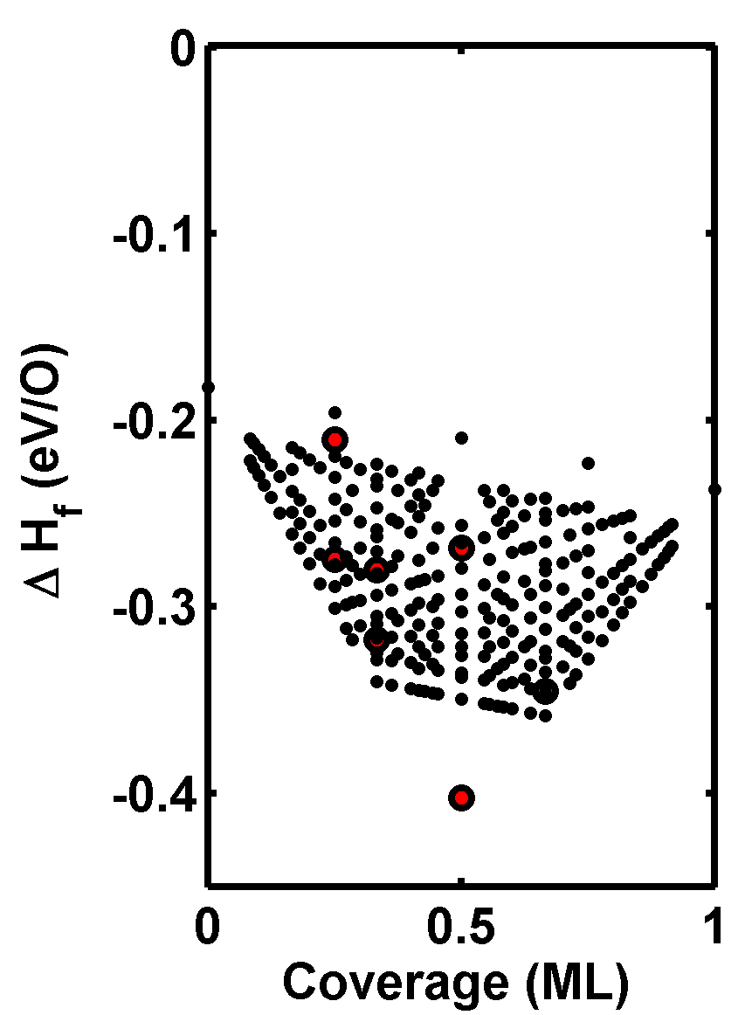
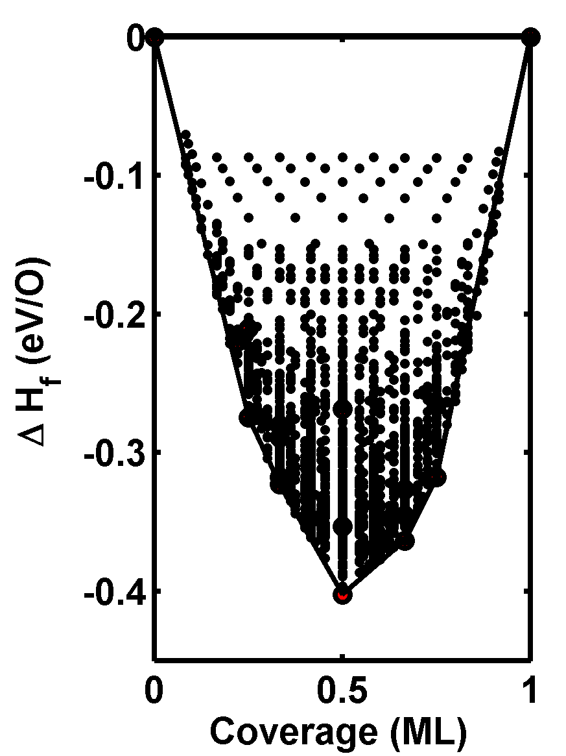
Iterate to convergence
Step 1
Step 2
…
Last step
Choose a set of figures
Parameterize a cluster expansion
Direct enumeration of configurations
Add new groundstates to DFT database
Go to 1 until self-consistency is achieved
You are done when:
All CE ground states agree with known DFT ground states
Errors in predicted energies are acceptably small – here less than 10 meV/O

Slide 13
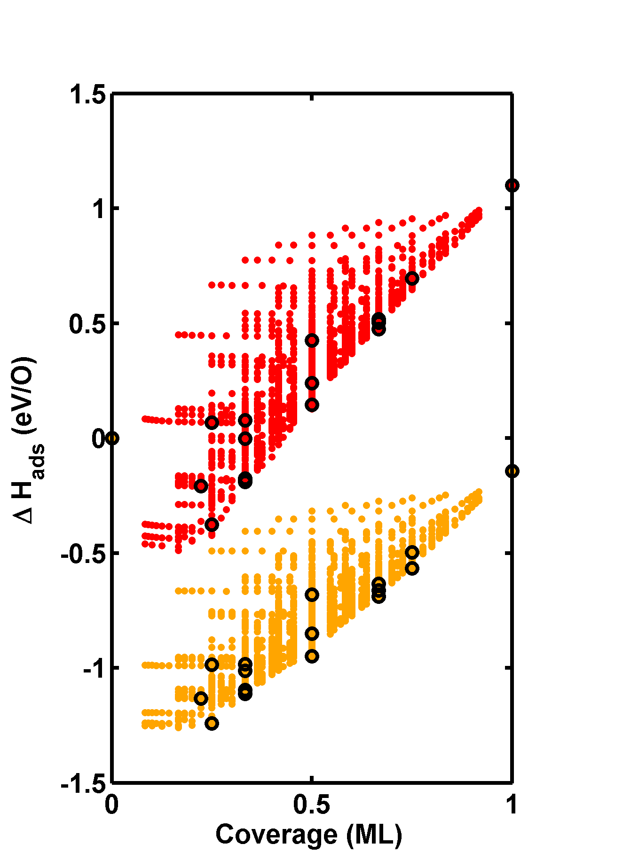
Full coverage dependence
Cluster expansion predicts the rest of the energies
Many of these configurations are not relevant
Ag(111)
Pd(111)

Slide 14
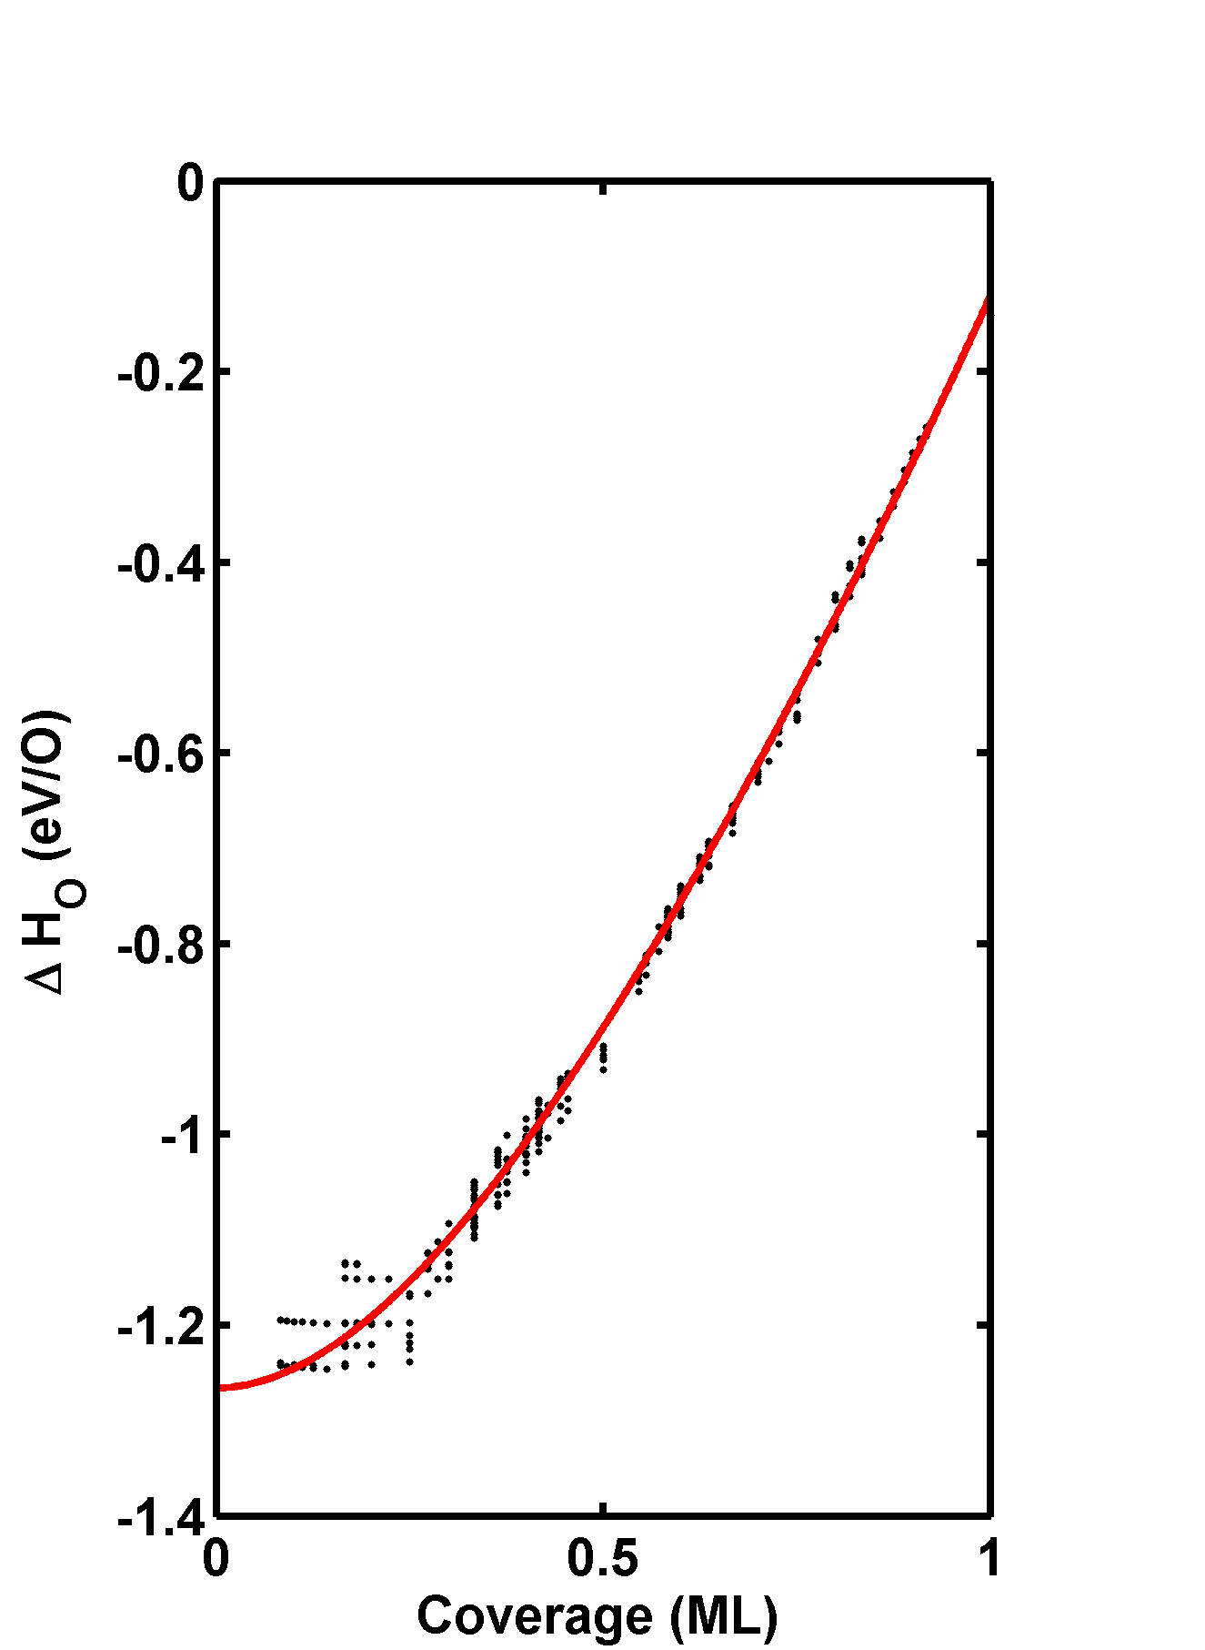
Relevant coverage dependence
4th order polynomial fit
We can extract the configurations near the ground state lines
Fit an analytical function to the data
Pd(111)

Slide 15
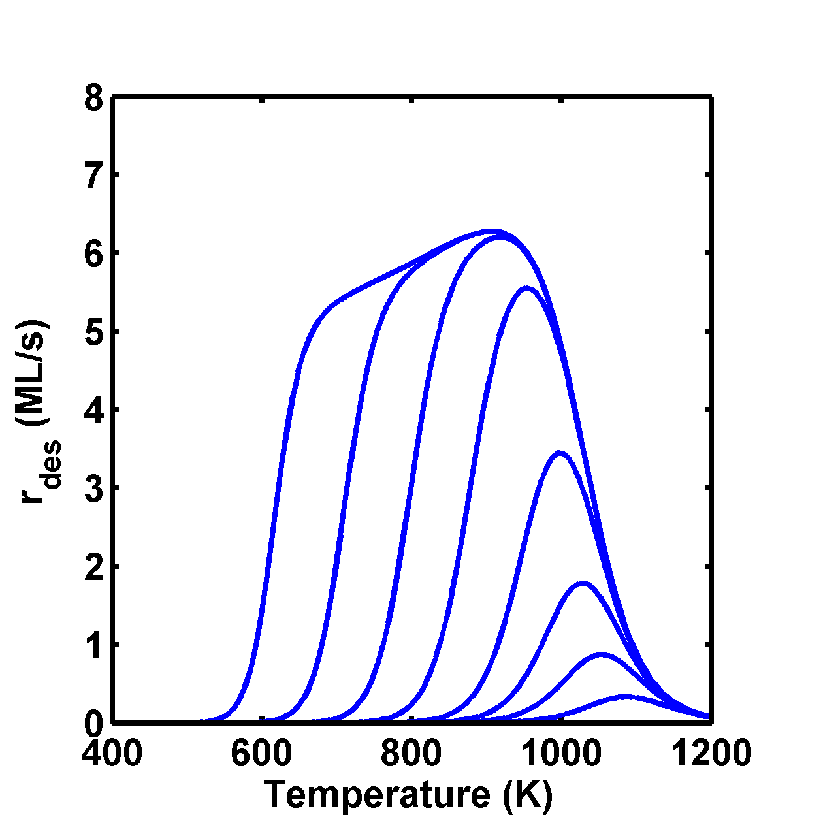
TPD simulation by Redhead equation
We assumed:
Pre-exponential factor
Site density
Same heating rate
2nd order desorption
E_{d} = -ΔH_{ads}
All the variation is due to coverage effects
  Only one type of site (fcc)
  Mean field
Qualitative agreement with the experiment
T_{p} is too high in low coverage limit
G. Zheng, E.I. Altman / Surface Science 462 (2000) 151–168

Slide 16
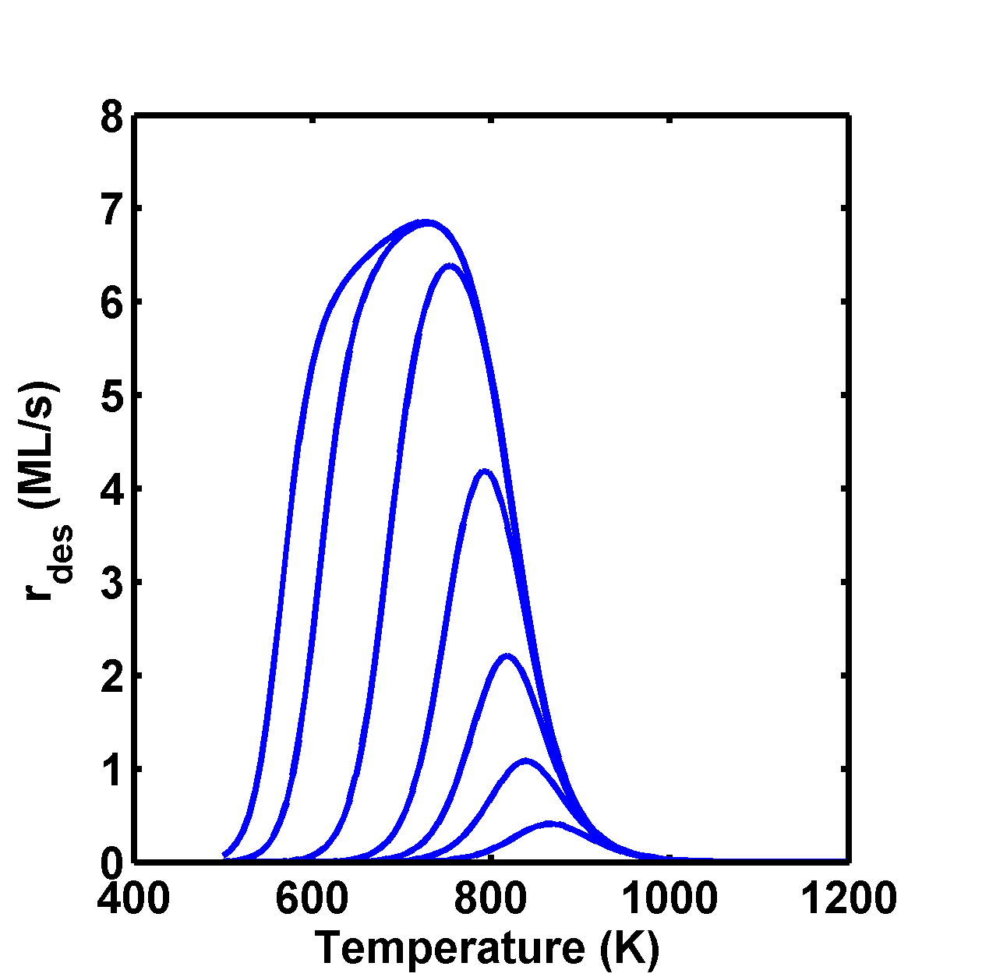
TPD simulation by Redhead equation
Add a constant offset to the adsorption energy to match low-coverage limit peak temperature
G. Zheng, E.I. Altman / Surface Science 462 (2000) 151–168
ΔH_{formation}=θ(ΔH_{ads}(eV/O) - ΔH_{ads}(1 ML eV/O) )

Slide 17
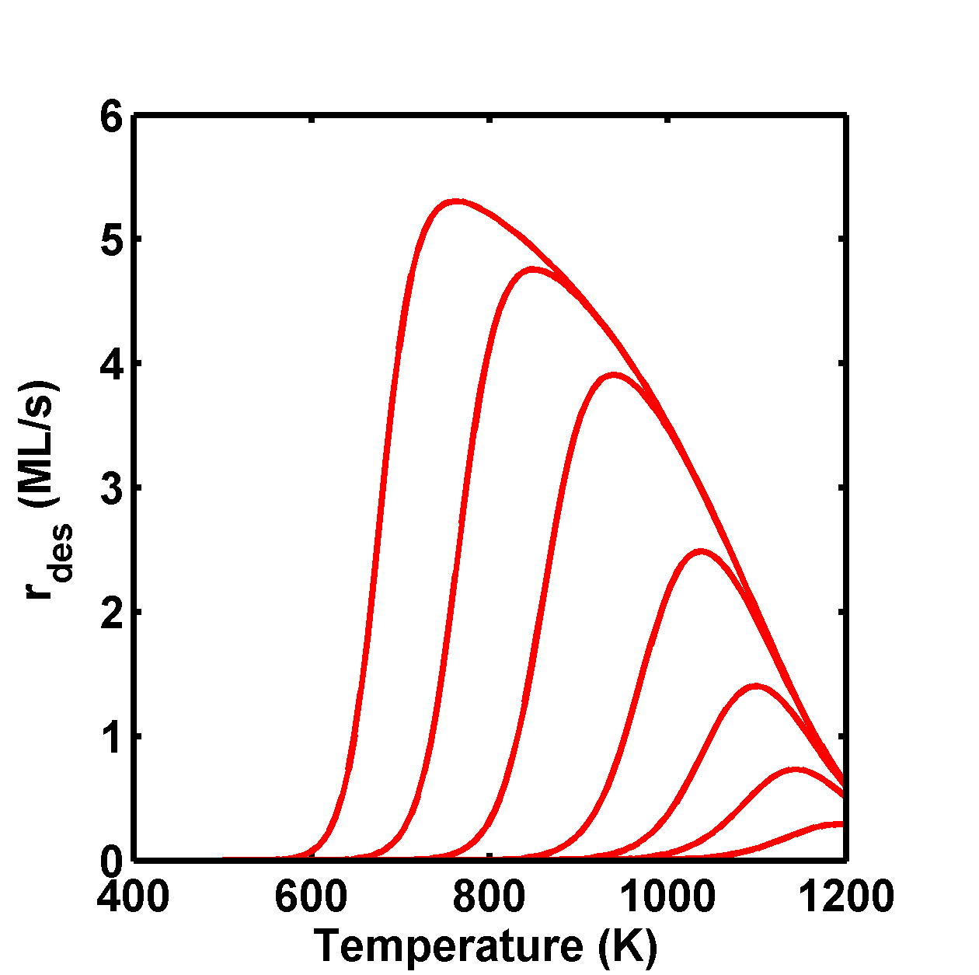
TPD simulation for linear fit
We assumed:
Pre-exponential factor
Site density

Slide 18
Improvements to TPD simulations
Limiting assumptions in Redhead analysis
  Mean-field approach
    does not allow clustering, island formation or diffusion limits
  ΔH_{ads} = -E_{d}.
    At high coverages there may be barriers to dissociation
  Did not consider other sites
    e.g. hcp, defects or steps
  Bulk oxidation is not considered
More advanced simulation methods could address the mean-field limitation (e.g. kMC)
More advanced cluster expansion could address different sites
Different DFT calculations could address desorption barriers

Slide 19
Summary so far
Modeled coverage dependence of oxygen on Pd(111) and Ag(111) using DFT and cluster expansions
Interpreted the coverage dependence in terms of the surface electronic structure
Simulated a TPD spectrum that almost looks like one we already had
Can we use the cluster expansions to identify physics that are not observable but still useful?
Can we use the calculations to understand the observations?

Slide 20
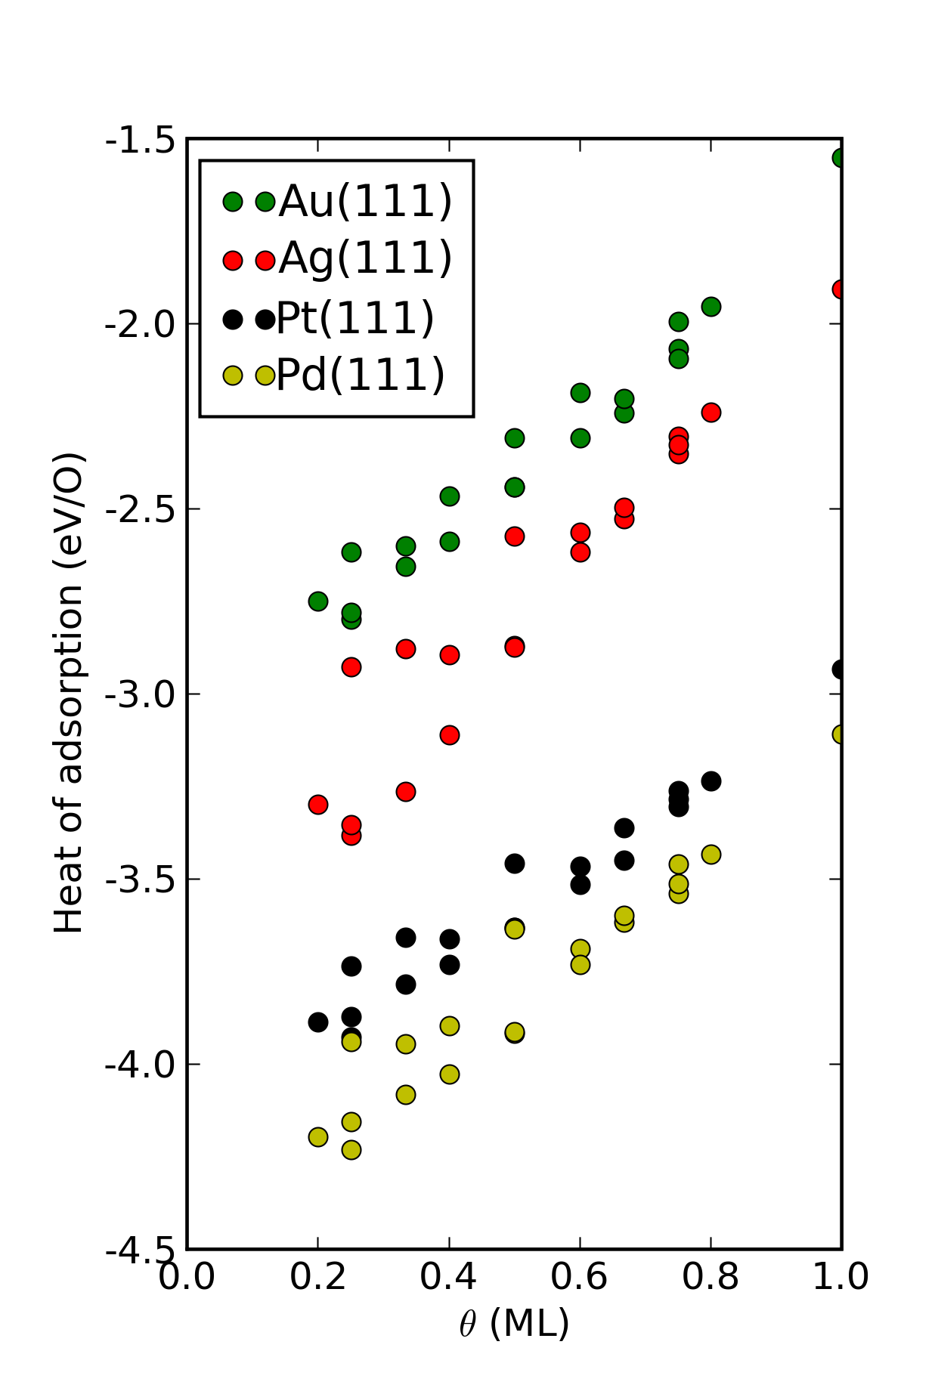
Computational coverage dependent data is easy
We use DFT to compute coverage dependence in surface unit cells
The magnitude of ΔH_{ads} and its coverage dependence varies with the metal
Similar patterns are observed on each surface
Suggests the adsorption behaviors are correlated
Miller, Kitchin Surface Science, 2009. 603(5): p. 794-801.

Slide 21
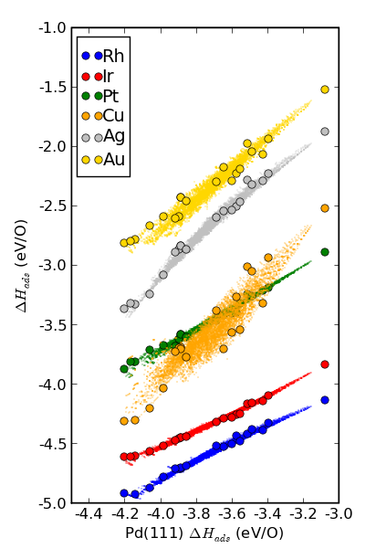
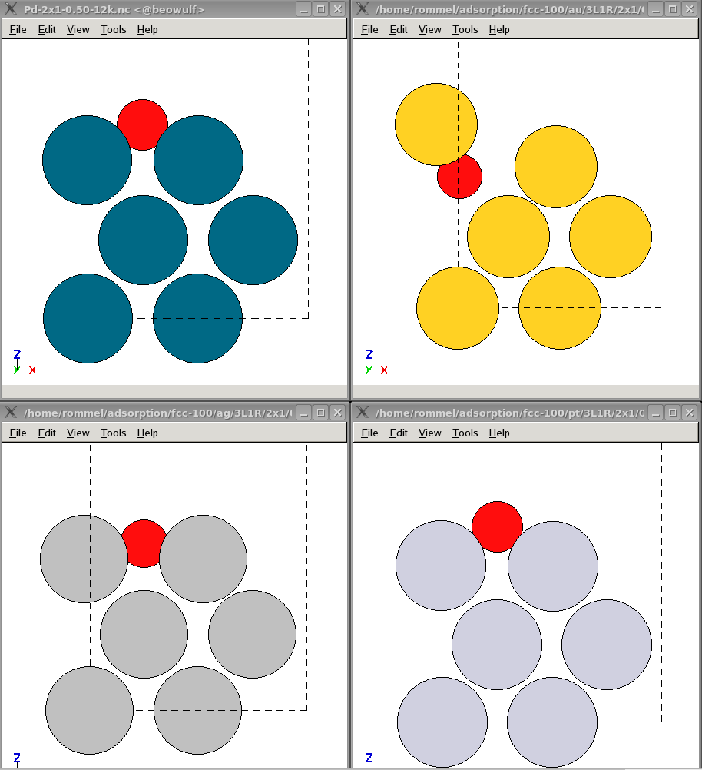
Configurational correlations of oxygen on fcc(111) late transition metal surfaces
All the configurations at all the coverages are correlated
Scatter in direct enumeration reflects scatter in DFT dataset
Scatter in DFT set related to “reconstruction” or geometric non-ideality
similar
reference
dissimilar

Slide 22
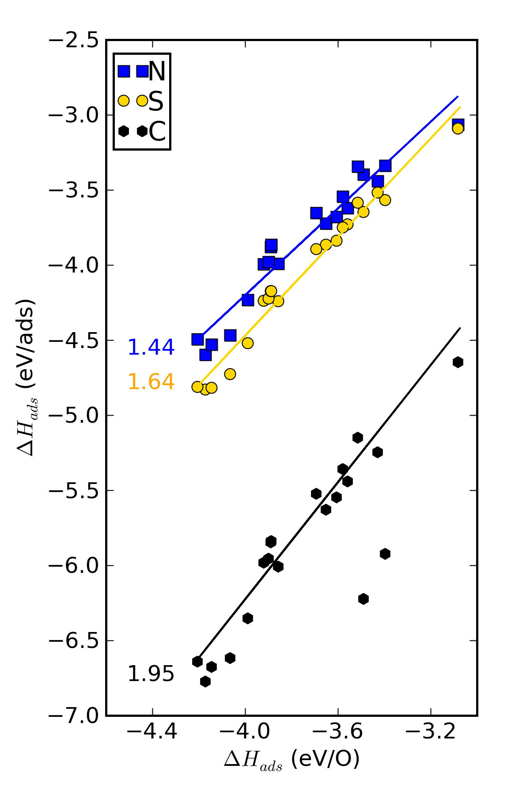
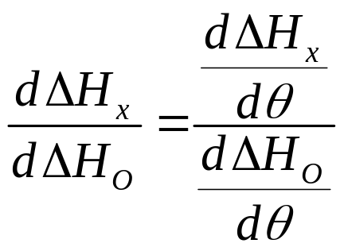
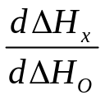
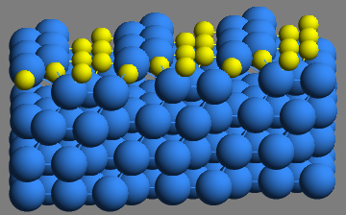
Configurational correlations are not unique to oxygen
Predicted
slopes
1.46
1.64
Massive reconstruction of surface breaks correlation for some carbon configurations
1.81
Kitchin, Physical Review B, 79, 205412 (2009).

Slide 23
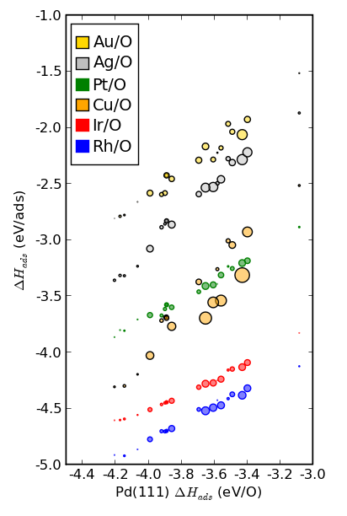
Quantifying geometric dissimilarity
Ideal position
Real position
The size of the dots are proportional geometric dissimilarity
Bigger dots means more relaxation and less geometric similarity
Less geometric similarity means lower quality correlation

Slide 24
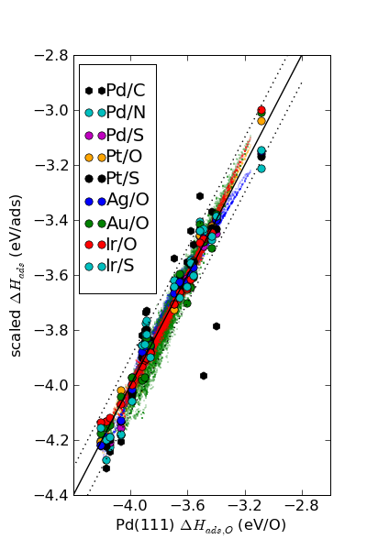
Corresponding states of adsorption
Master curve describing coverage dependence
The correlation on fcc sites falls within ~100 meV of parity
Very simple view of correlations in the adsorption energies of geometrically similar adsorbate configurations
This does not suggest all of these structures are relevant!
Kitchin, Physical Review B, 79, 205412 (2009).

Slide 25
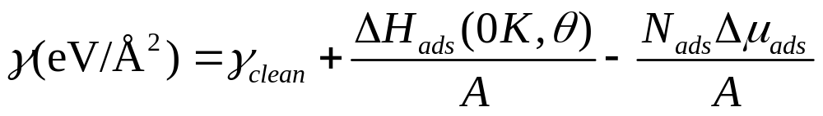
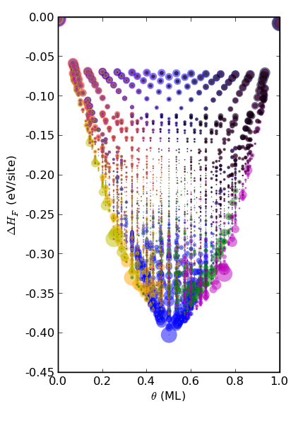
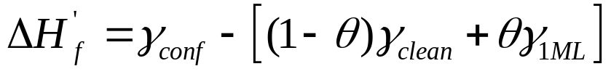


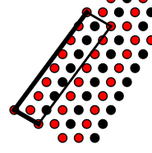

A structural phase diagram
0 ML
Size of colored dots related to similarity of configuration to a structural motif
There are only a few structural motifs that are relevant
The rest are related defective structures
2×2-O
2×1-O
2×2-3O
1 ML
Miller, S. D. and J. R. Kitchin (2009). "Uncertainty and figure selection for DFT based cluster expansions for oxygen adsorption on Au and Pt (111) surfaces." Molecular Simulation 35(10-11): 920-927.

Slide 26
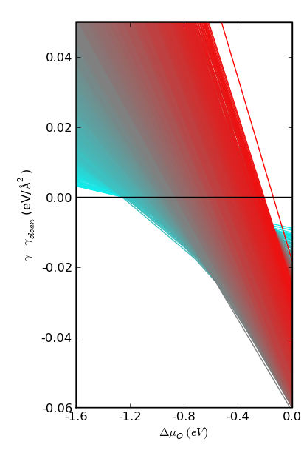
Atomistic thermodynamics
Pd(111)/O
With ~9000 unique configurations there are still 4 distinct breakpoints
Surface/bulk oxides not considered here
We are considering these in ongoing work
1
0 ML
2
0.083 ML
clean
1 ML
3
Thin/bulk oxide formation

Slide 27
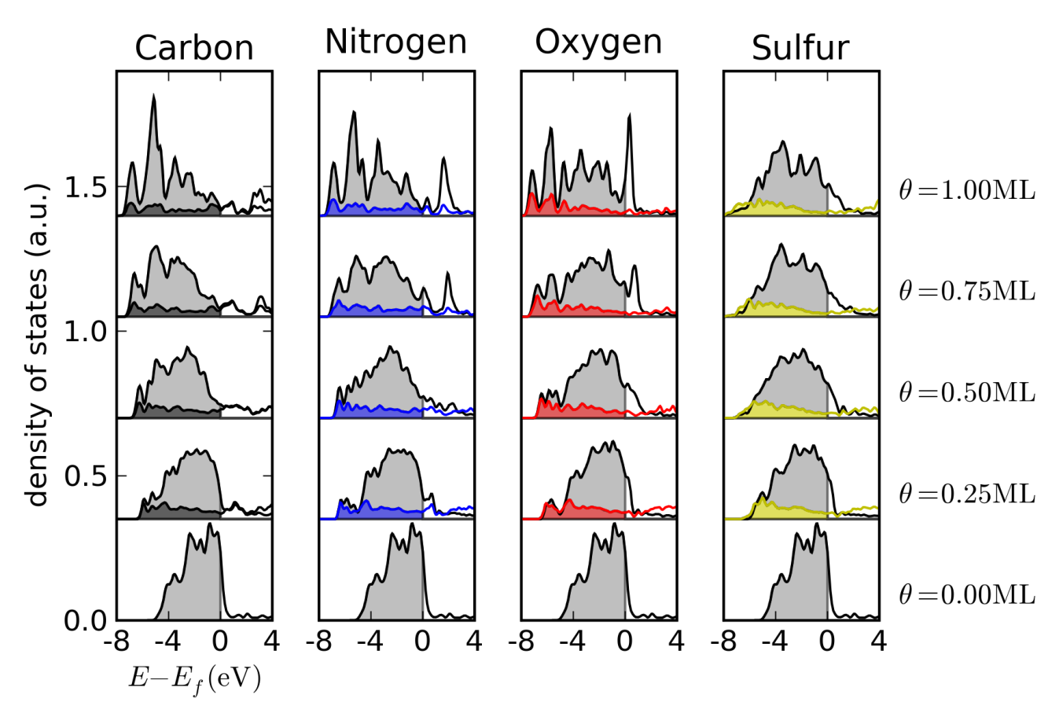
Electronic structure changes with coverage
Surface d-band gets broader with coverage
d-band filling stays constant
Adsorbate anti-bonding states are populated at higher coverages
These lead to weaker adsorption energies at higher coverages

Slide 28
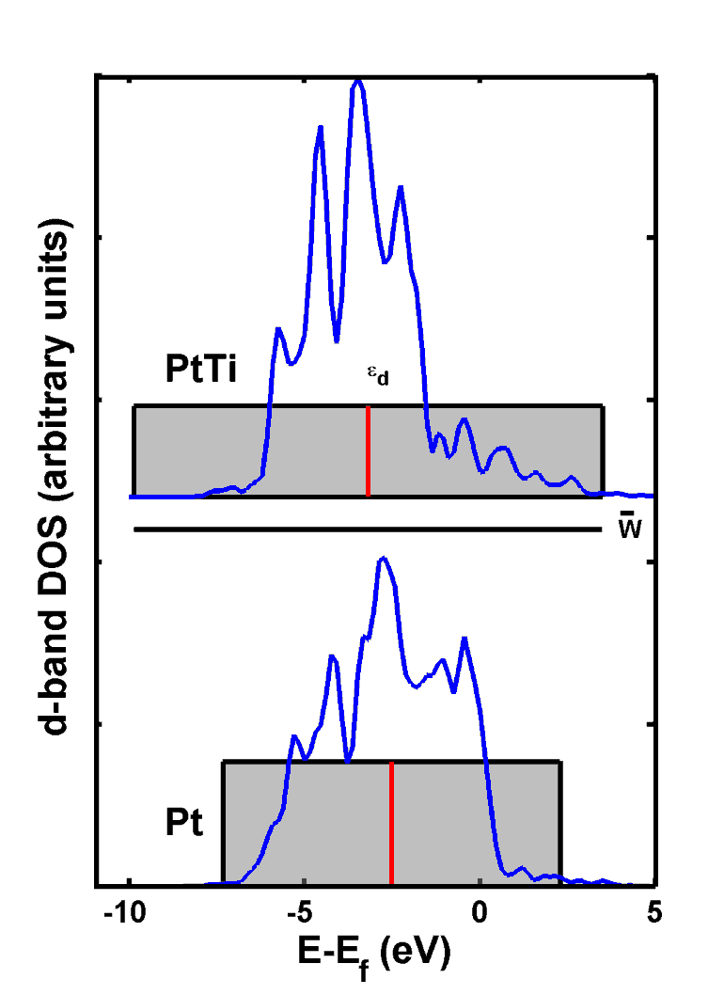
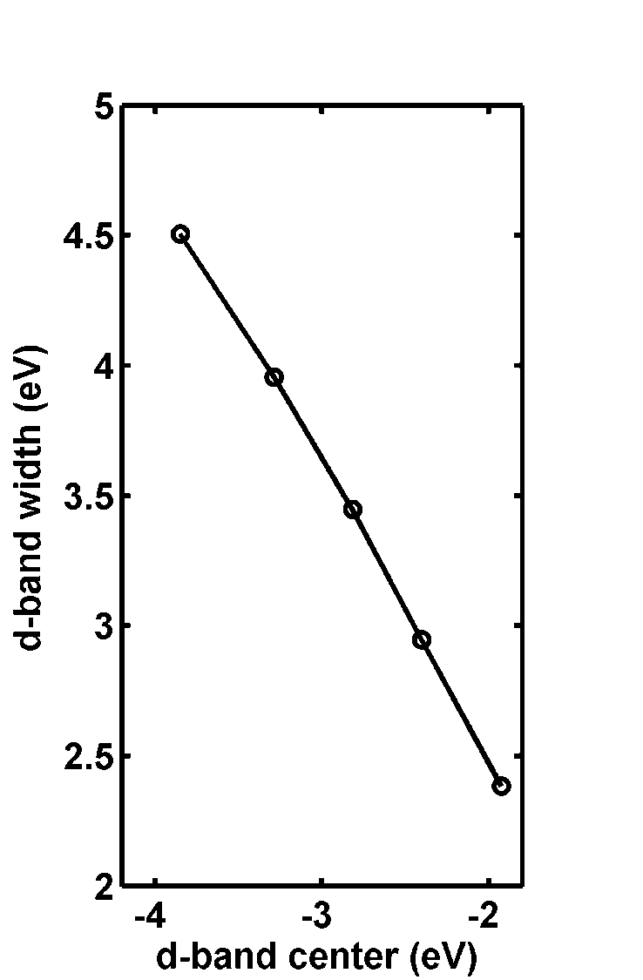
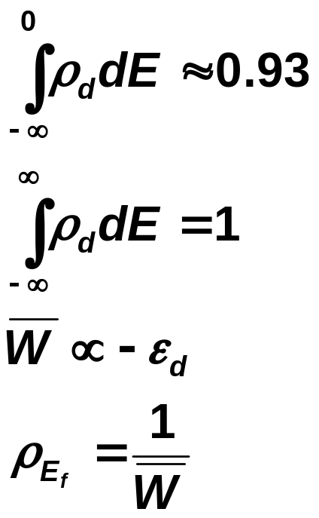
Rectangular band model
Pd(111)
Same physics observed in alloy surfaces

Slide 29
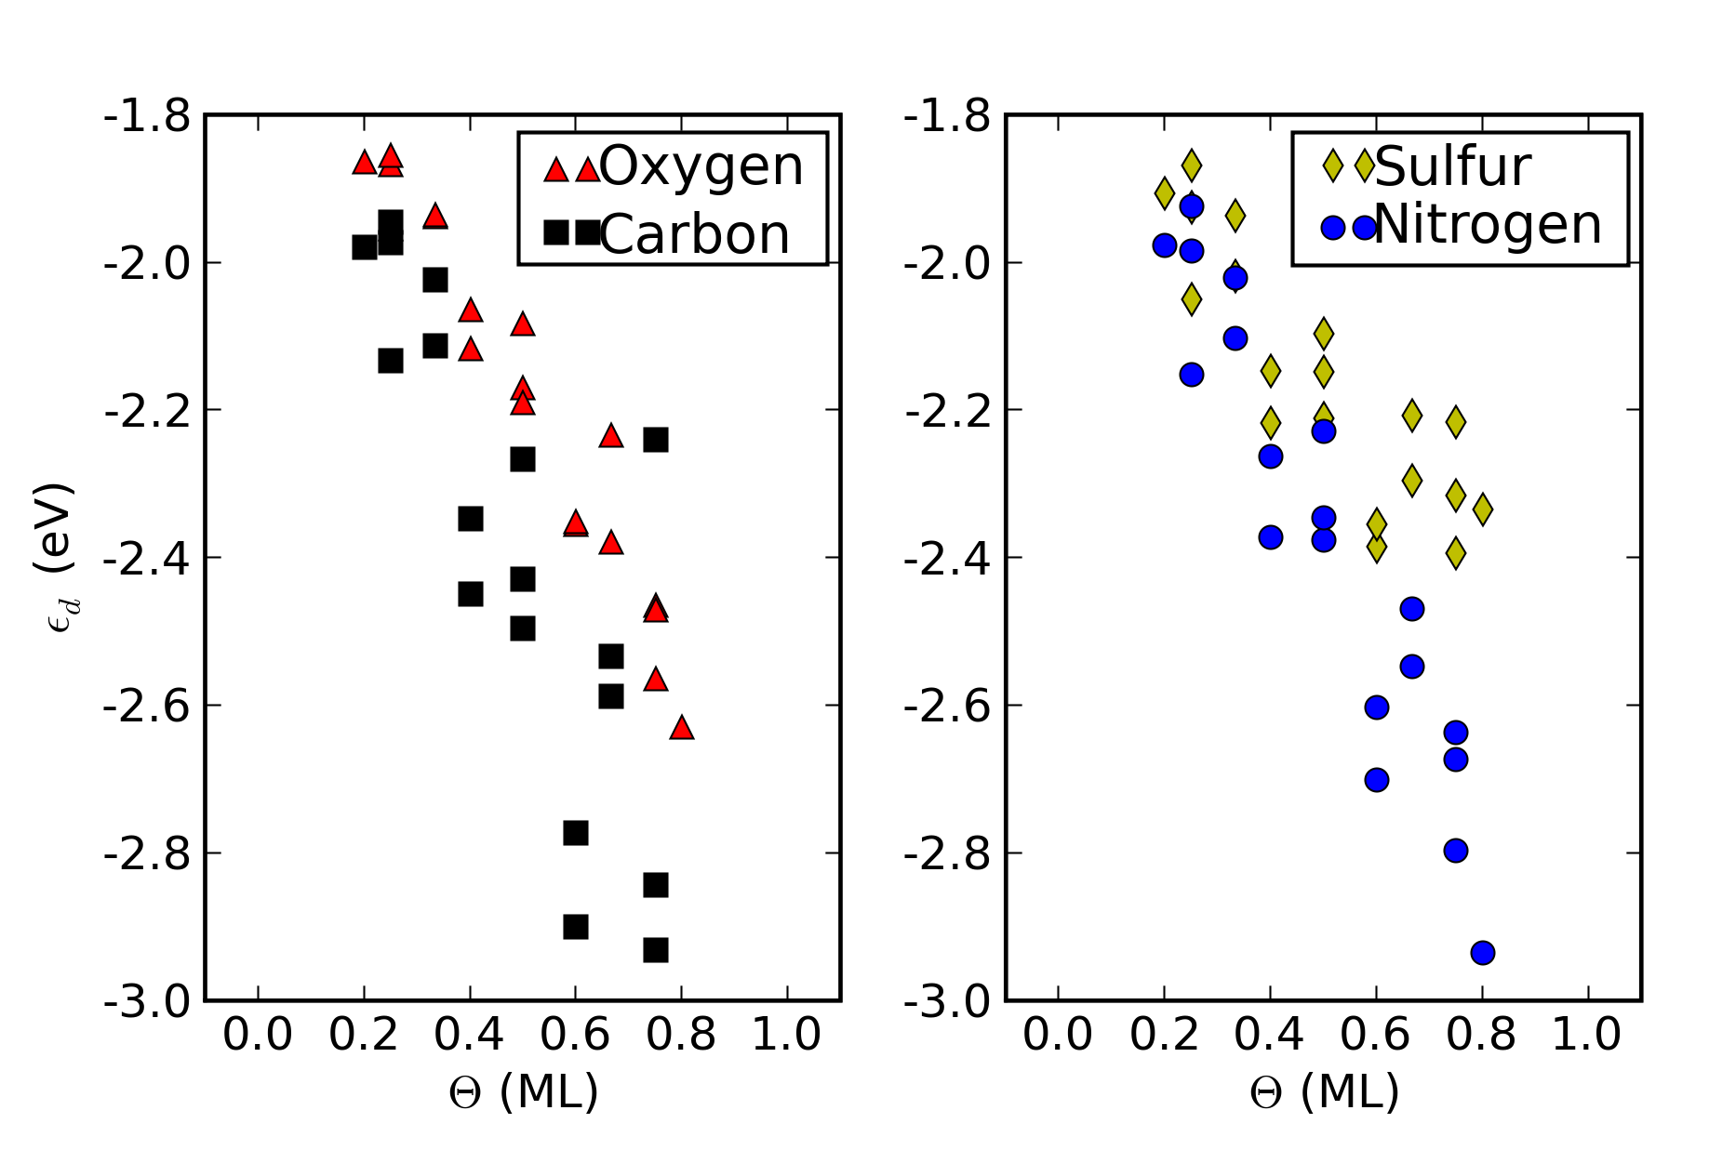
Adsorbate-induced surface electronic structure changes
Adsorbates affect the Pd(111) d-band differently
Coverage dependence is largely explained by adsorbate-induced modification of the surface electronic structure
Bonding competition or repulsive interactions between adsorbates?
- both result in weaker bonds at higher coverages

Slide 30
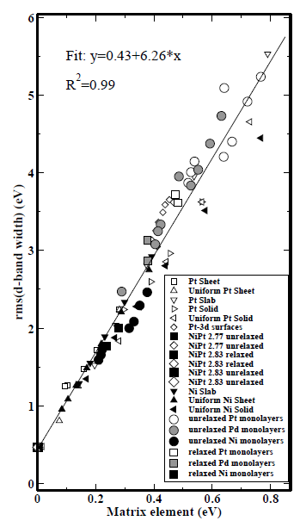

Orbital overlaps determine d-band width
In alloy systems, the width is determined by ligand effects and strain effects through the d-d matrix elements.
ligand
strain
Physical Review Letters, 2004. 93(15): p. 156801.

Slide 31
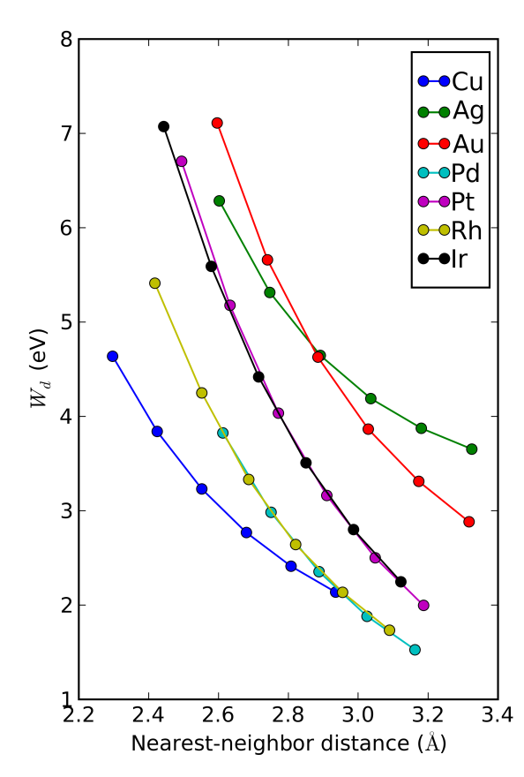
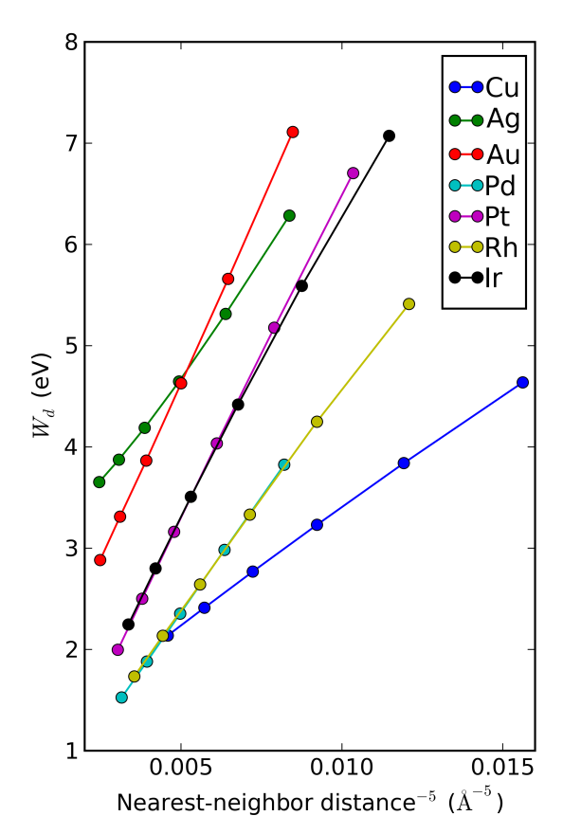
DFT-based solid state table
We can derive the parameters from DFT calculations of W_{d} vs volume.
Each metal has a characteristic r_{d}
Metals:
 |  | Cu 2.53
Rh 3.13 | Pd 3.16 | Ag 3.17
Ir 3.42 | Pt 3.53 | Au 3.66

Slide 32
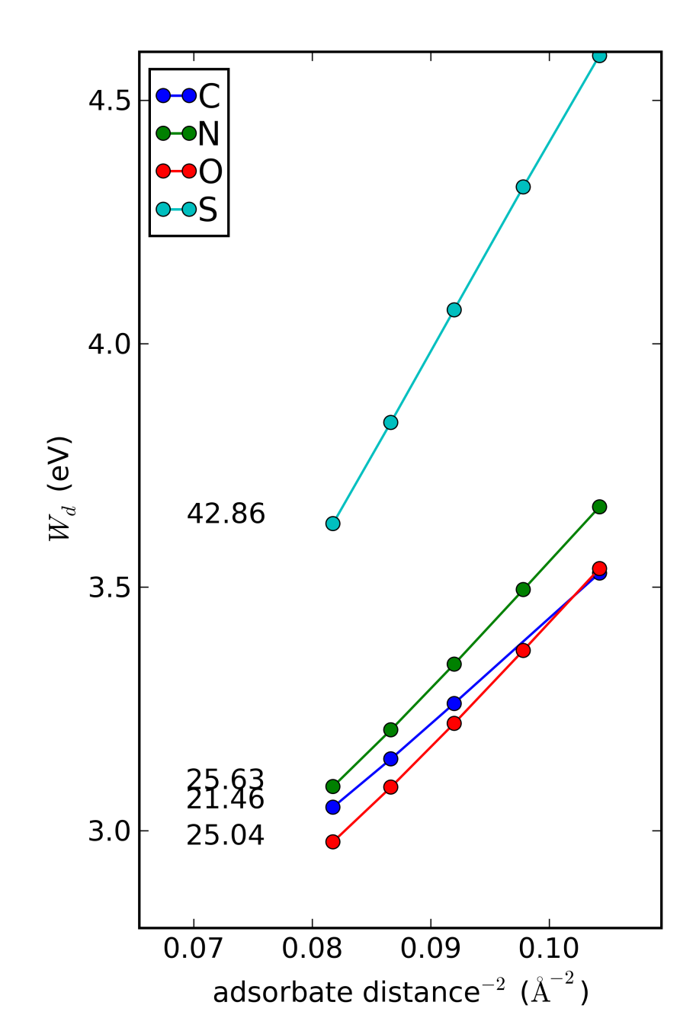

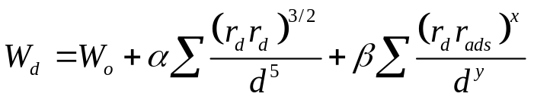
A solid state table for adsorbates
We calculate W_{d} as a function of adsorbate height (changing the overlap of adsorbate and surface d-orbitals)
Each adsorbate has a characteristic effect on the surface d-band
We use this empirical form:
Pd(111)
Adsorbates:
C 0.521 | N 0.529 | O 0.517
 |  | S 0.600

Slide 33
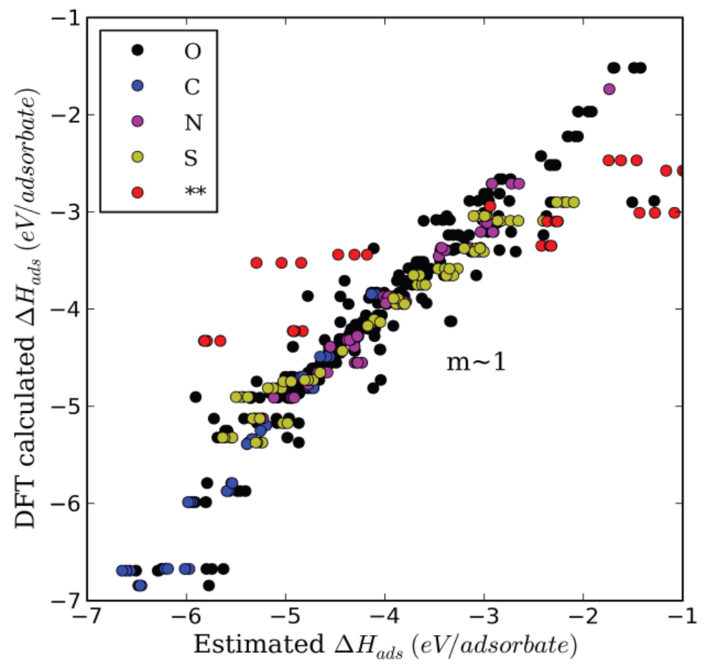
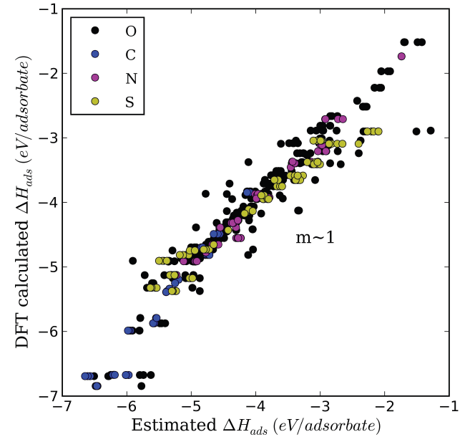
Prediction of Adsorption Energies
Reasonable estimate of
adsorption energies of
C, N, O, or S on
Pt, Pd, Rh, Ir, Cu, Au
Outliers = noble metals
Filled d-bands increase importance of repulsion
Average error < 0.18eV
Not perfect, but reasonable for screening

Slide 34
Summary
Trends in adsorbate bonding on transition metals is pretty simple
  Changes in the d-band (width or energy) change the adsorption behavior in predictable ways
    Adsorbate induced changes
    Alloy induced changes
    Structure induced changes
  All changes are related to changes in overlap between neighboring orbitals.

