Slide 1
BEST PRACTICE
Plunet on Steroids – Advanced use of Plunet API & Header Injections
Ian Barrow
Conversis
Notes:
Before we start I’d like to ask you a few questions if I may:
How many of you regularly work on multilingual projects?
On multilingual projects over 10 languages? Over 20?
For those who still have their hands raised. What’s the largest number of languages/locales you’ve dealt with in a project?
one of the unique challenges of our area of life sciences with globally reaching Studies
Conversis regularly work on 30+ language/locale combination projects. with the largest I can recall being 85 though there may have been larger.
The examples I give later will be focused on multilingual projects, but the fact that you don’t work multilingual projects doesn’t mean this presentation isn’t useful for you.

Slide 2
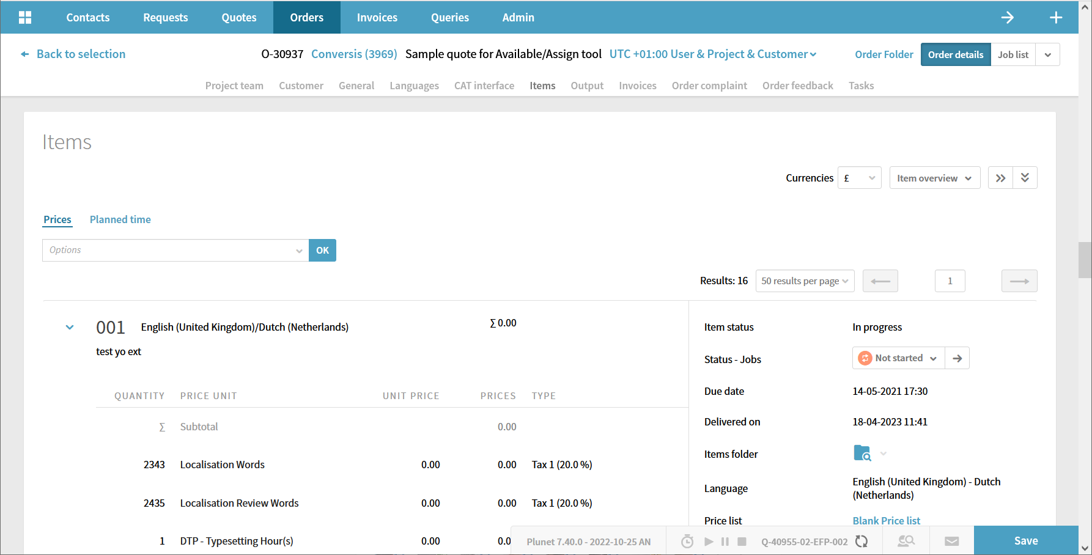
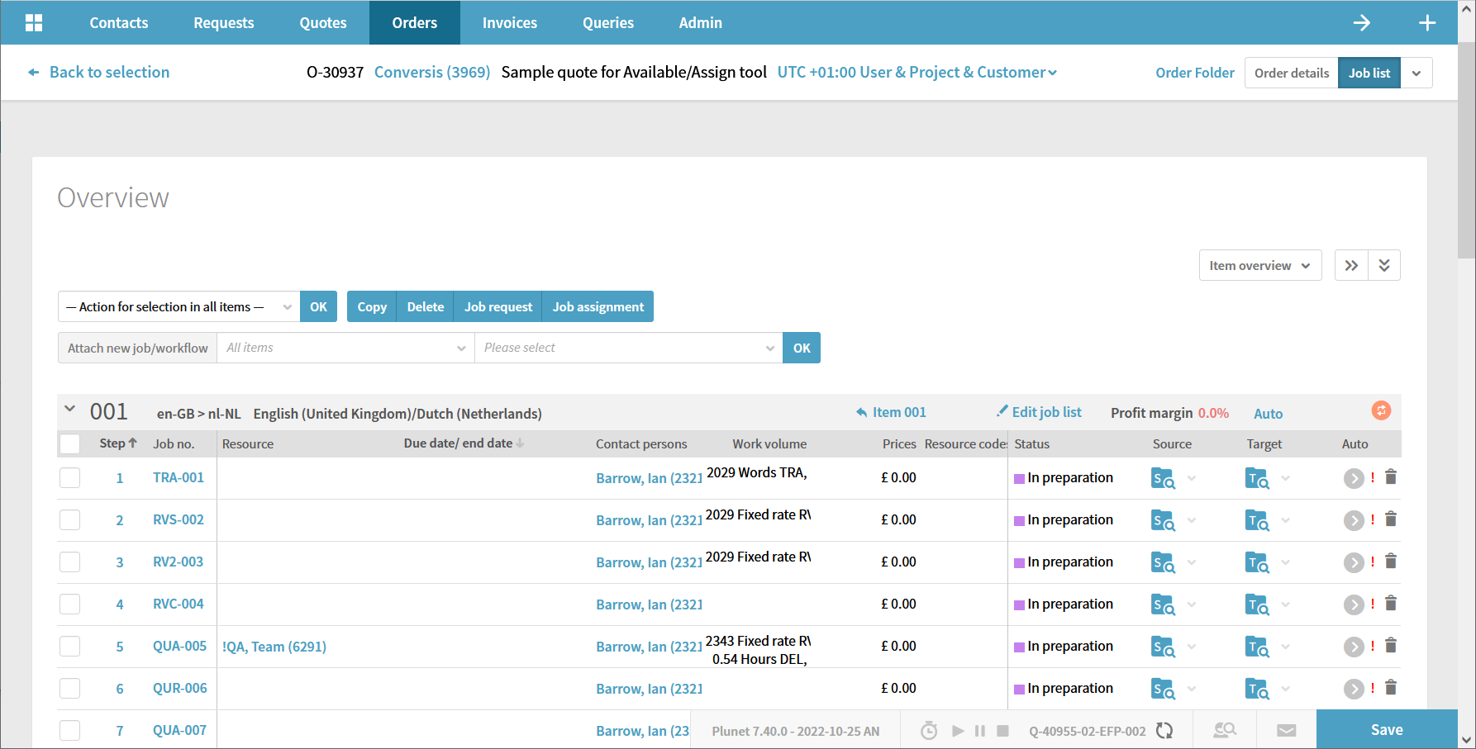
Plunet
Notes:
This is Plunet, I’m sure you all recognise it.
Conversis been using Plunet as our TBMS solution since 2014
Over the last 6 years we’ve been working on adjusting our Plunet instance form Plunet as you know it, to what weaffectionaly refer to as :
Plunet on Steroids!

Slide 3
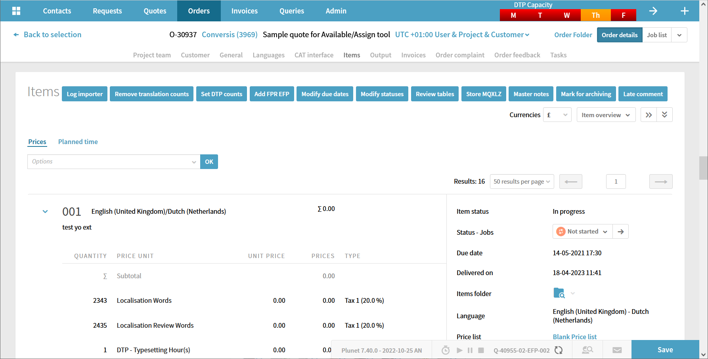
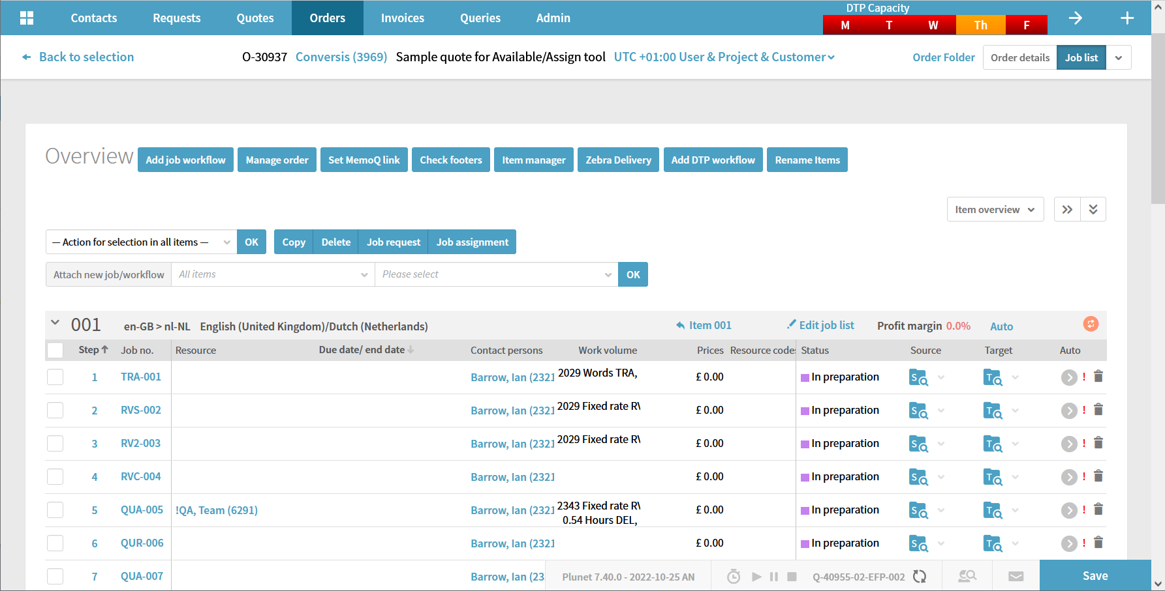
Plunet – On Steroids
Notes:
Much of what Conversis has done to bring about this change has been done using functionality that is available to you thanks to Plunet themselves

Slide 4
Ingredients For Making Plunet Steroids
Plunet SOAP API
JavaScript/jQuery Code Injection
Secret Ingredient…
Notes:
3 main areas Conversis use to pump up or Plunet instance:
1,2,3.
In this presentation I will show you how you can use these ingredients along some specific examples of the functionality that Conversis has created thanks to them.

Slide 5
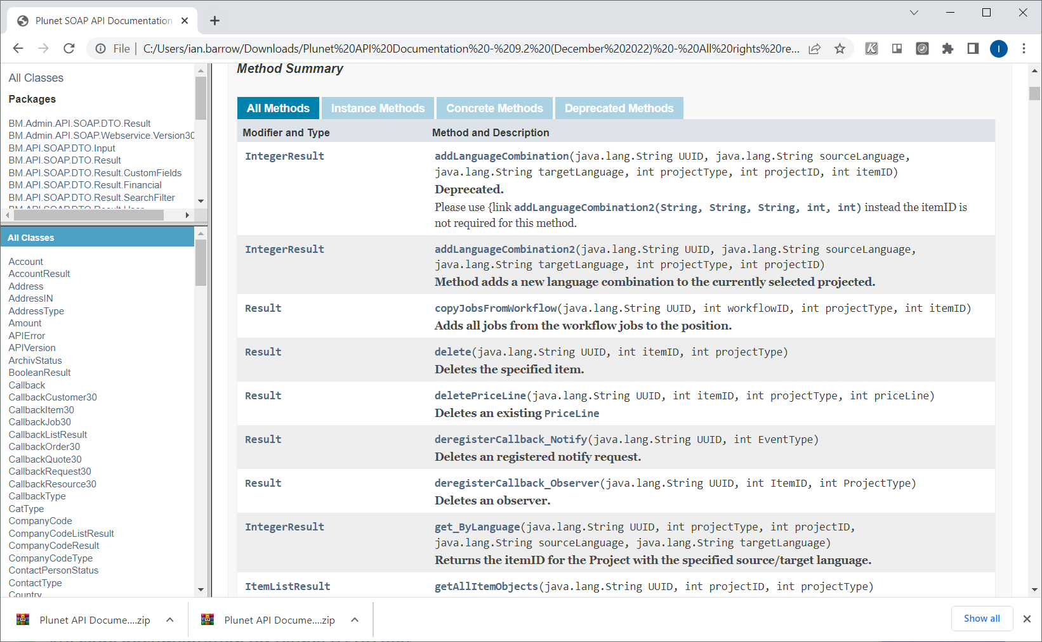
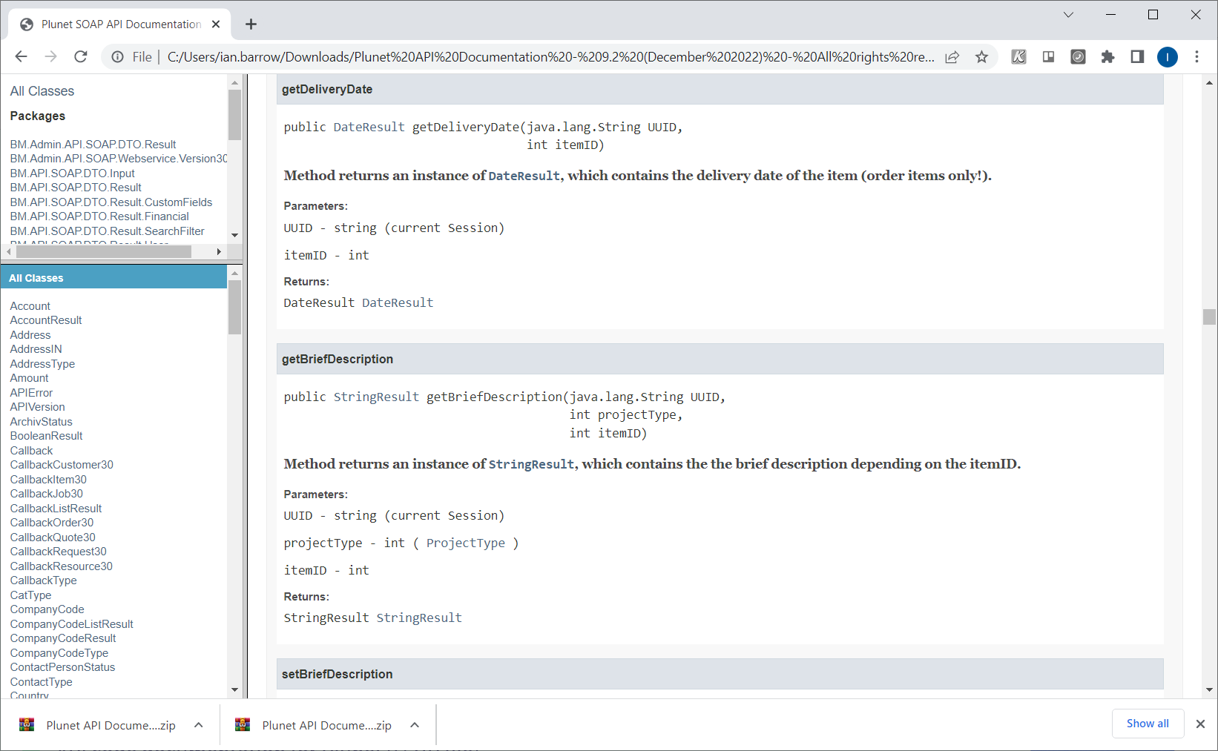
Plunet API - Documentation
Frequently used web services:
PlunetAPI
DataOrder30
DataItem30
DataJob30
https://helpdesk.plunet.com/plugins/servlet/desk/site/global/article/2818150/Plunet+SOAP+API
API code documentation for Plunet 9 (ZIP file)
Plunet API Javadoc\index.html
Notes:
Plunet API documentation which can be downloaded from the link at the bottom of this screen
is very detailed and one of the better web service API documents I’ve had to read.
Each web service has It’s call listed clearly with a description of what they do.
Clicking on the call link gives details of what is required to make the call and the result you can expect.
Here are 4 web services I use a lot
PlunetAPI is used for security and generates a Universally Unique Identifier that can be used with all subsequent calls.
Other 3 calls are for managing, well it’s kind of obvious.

Slide 6
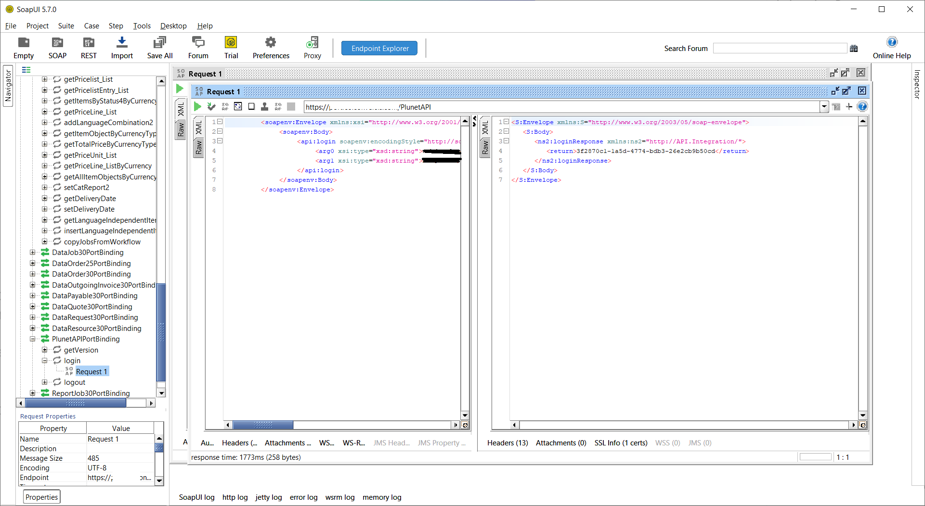
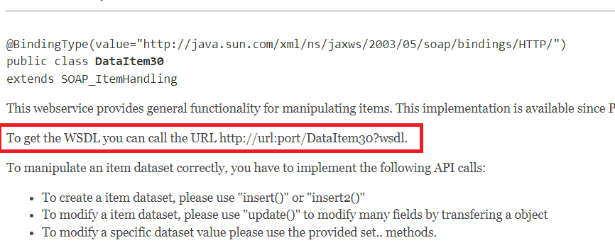
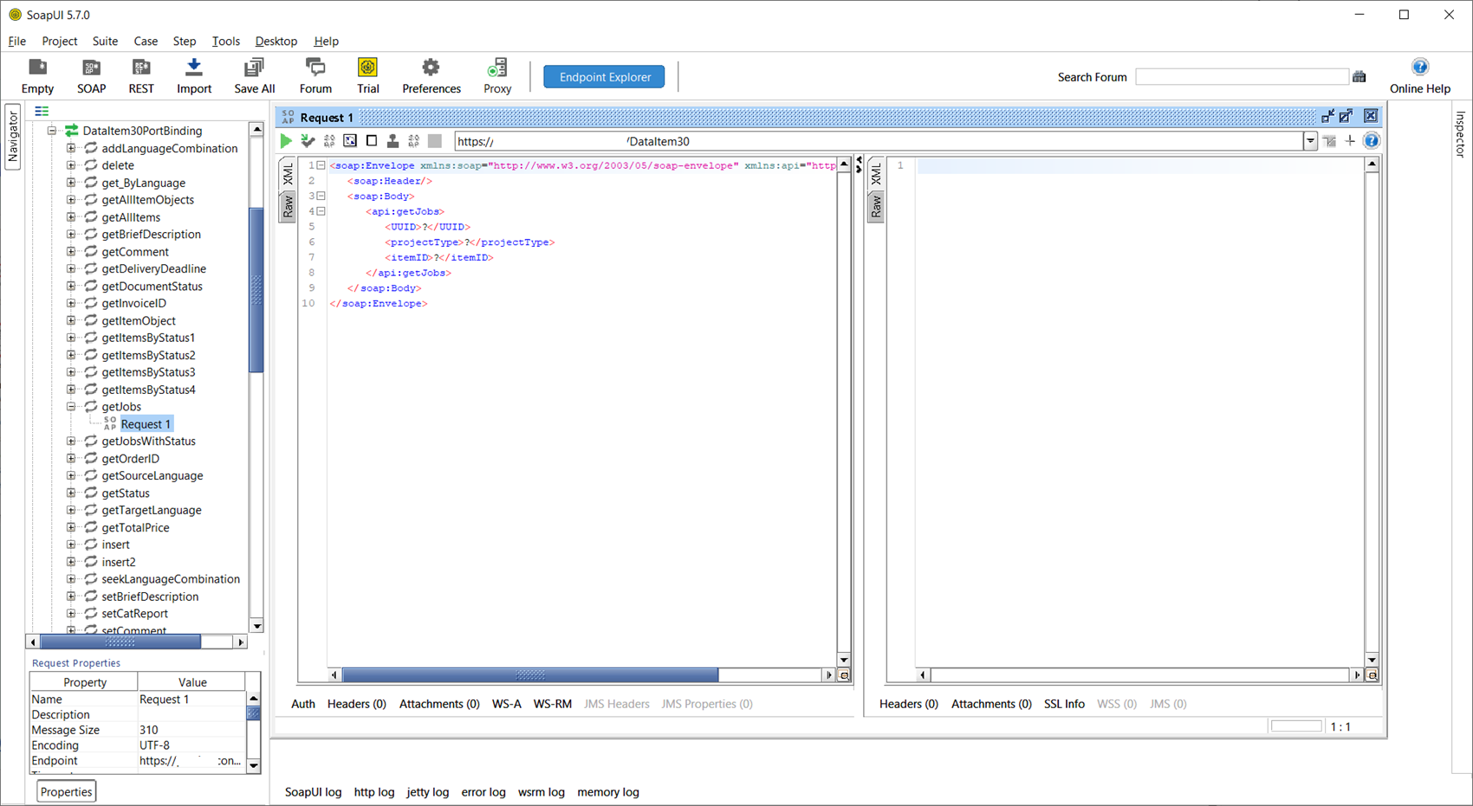
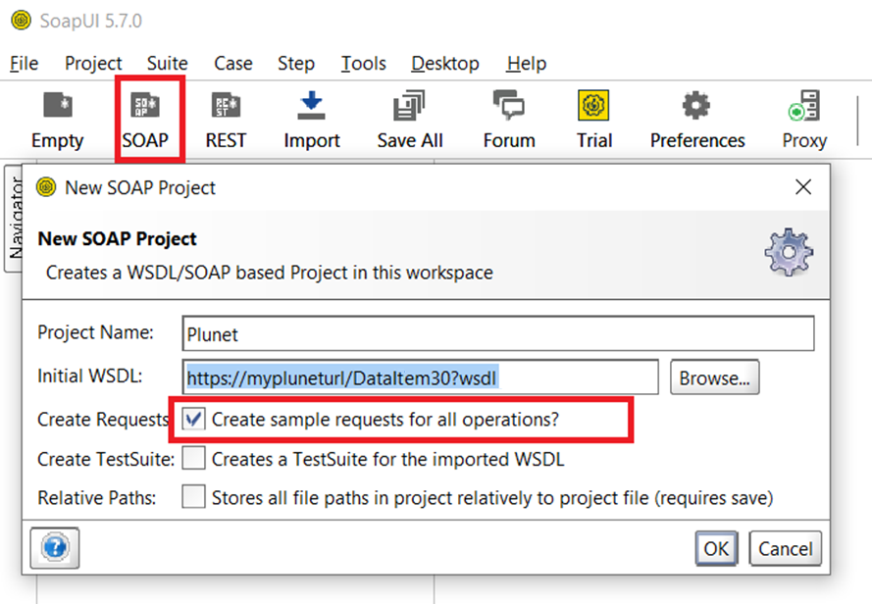
Plunet API - Soap UI
https://www.soapui.org/downloads/thank-you-for-downloading-soapui/
Notes:
When looking to experiment with making API calls SOAP UI is my preferred tool
Plunet’s documentation shows you the url you can use in SOAP UI.
In SOAP UI it’s easy to add a web service to the user interface.
Soap UI very quickly generates a list of all calls as well as creating sample requests.
Once the request is populated simply pressing the green play icon will lauch the request and the response should be shown on the right hand side.
Depending on the version of SOAP UI, you’ll need to Click “XML”
I’m sure you all agree that this is a easy way to experiment with individual calls, but can’t really be used for efficient processing.
For that we need to do a little development

Slide 7
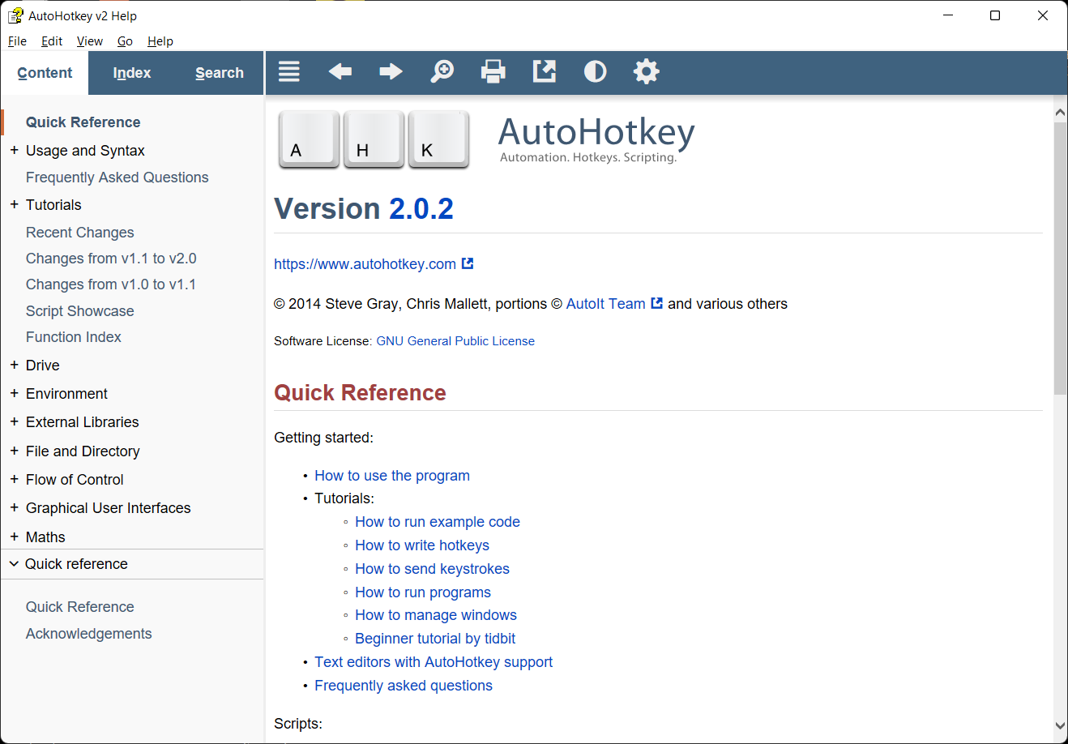
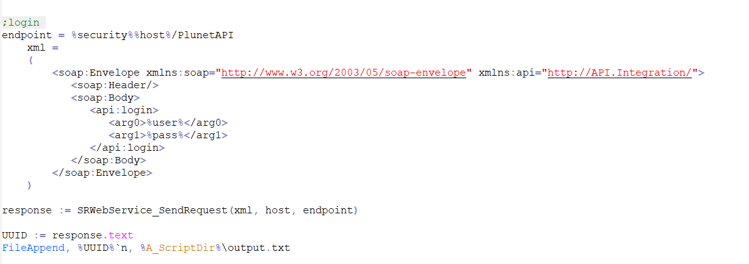
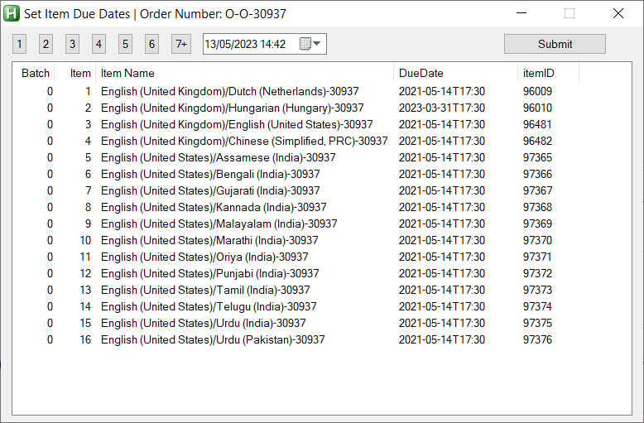
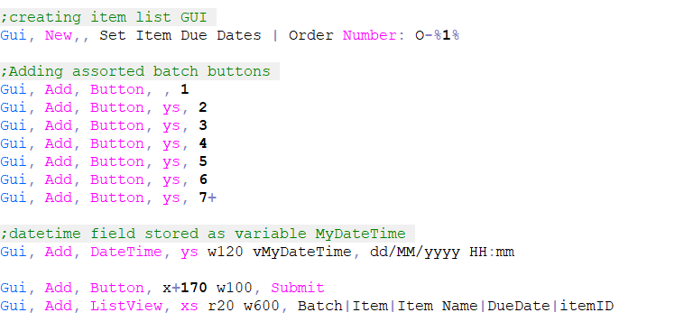
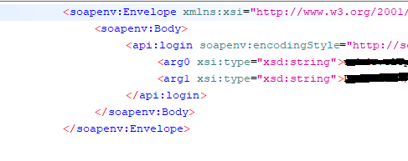
Plunet API - AutoHotkey
Easy to Learn
Easy to build executables
Detailed help file
Simple dialog creation
https://www.autohotkey.com/ Examples: https://community.plunet.com/t/83hbzmw?r=m1h4q2m
Notes:
For myself my go to option for creating functions this is a scripting tool called auto hotkey
Done properly it’s possible to copy the XML structures straight from SOAP UI and use them in Autohotkey scripts
One of the reason I like Autohotkey is that it’s very simple to create user interfaces in the code
This is by no means the only option when it comes to programming calls
However I have found it to be easy to learn
You can build executables with a simple right click on the script file.
The help is incredibly rich with examples on almost every line of code. It also incudes a tutorial that really helps you get to understand how it work.
And as stated earlier really easy basic UI creation
For those that want to look to use AHK there are a couple of example scripts available on the link at the bottom of this screen.
Bridge to js injection slide
This of course is all good, but having a bunch of executables, on your network/PC not as efficient as you’d like it to be.
Ideally, you’d want to launch this functionality from within Plunet: this is where Plunet’s injection setup can be a game changer

Slide 8
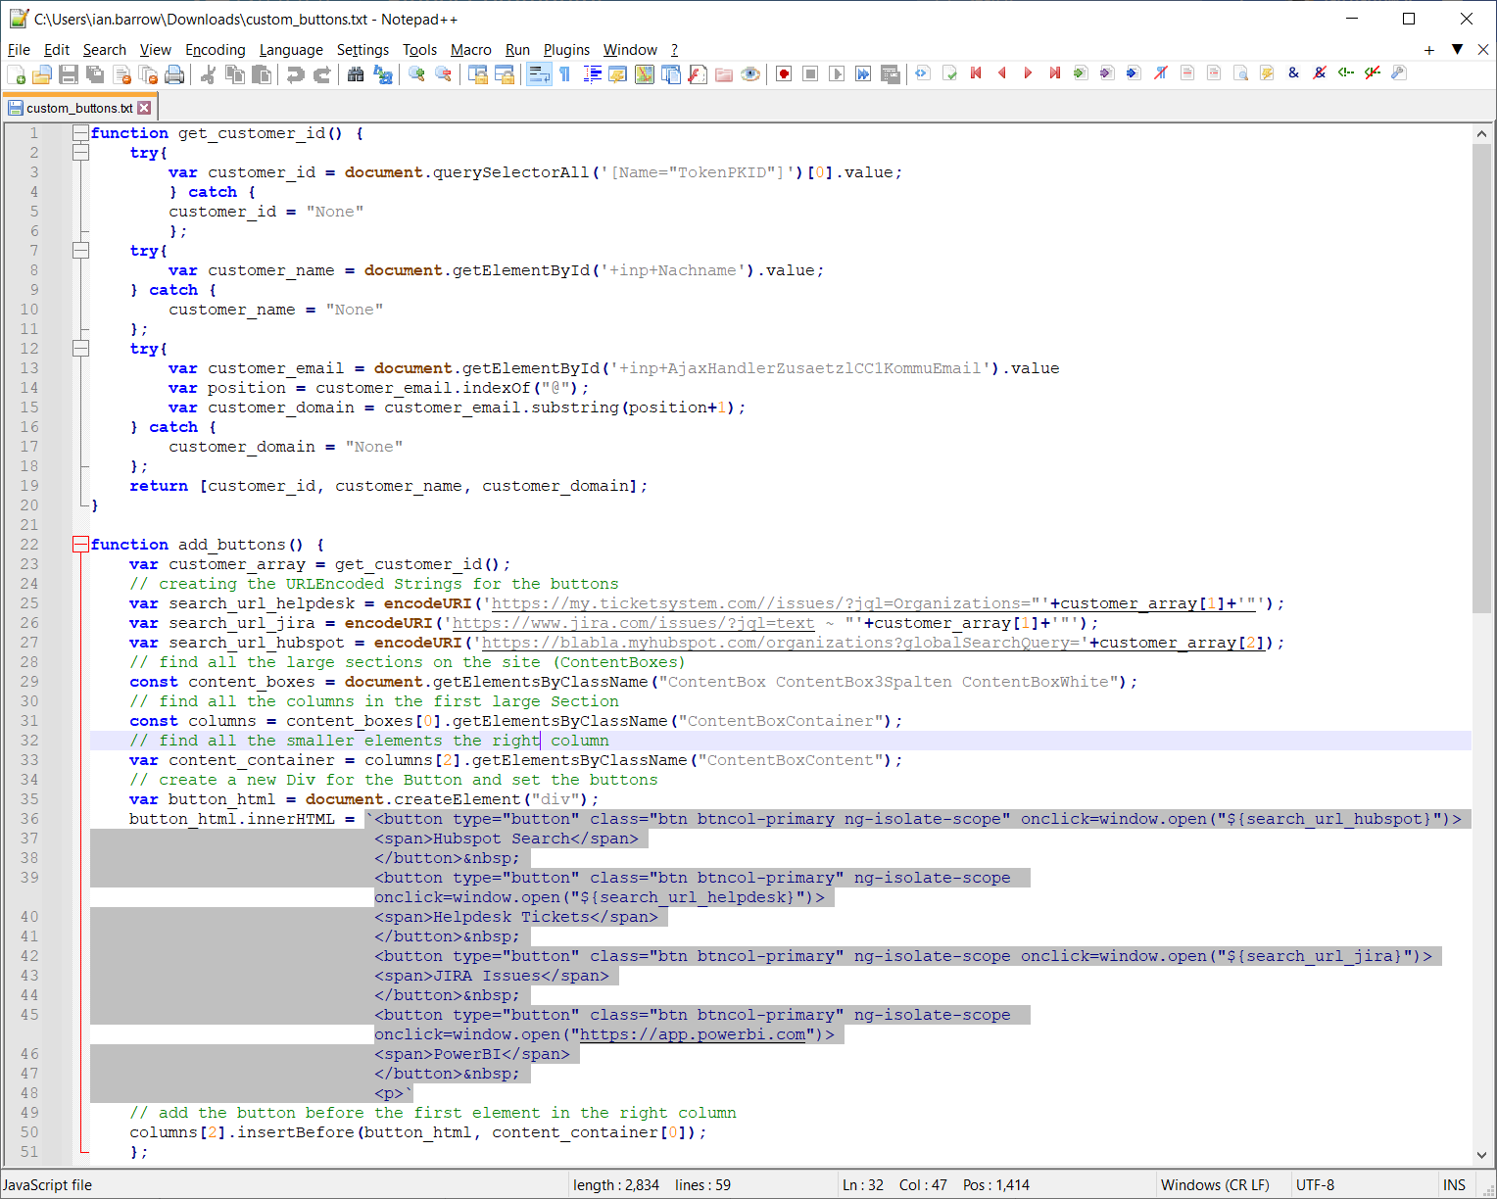
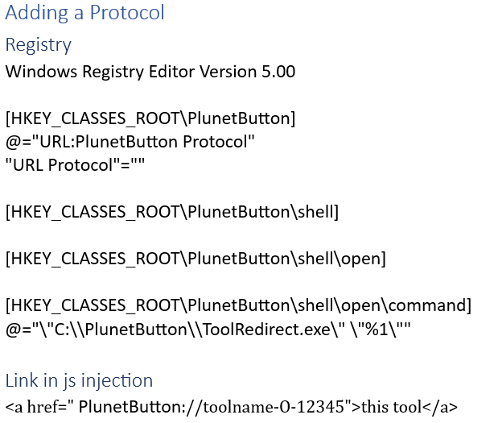
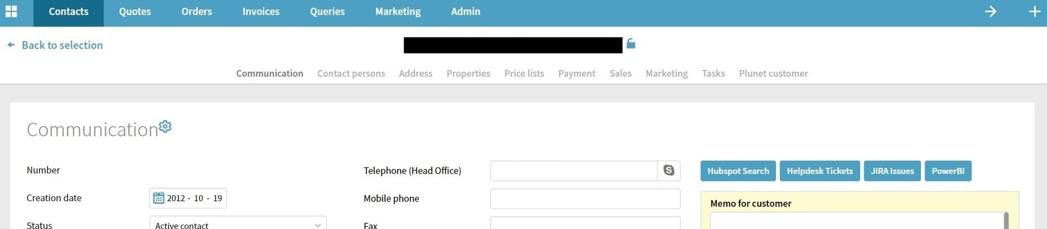
JavaScript/jQuery Code Injection
https://community.plunet.com/t/35hn5tk/hidden-gem-integrating-your-own-javascript-code-into-plunet
Notes:
Last year I had the pleasure of discussing the code injection with Plunet’s very own Sufian Reiter
Sufian created the article referenced at the bottom of this page that uses this example code which generates the buttons in this screenshot here.
I would recommend to you all to give that article a good reading.
At this time I’d like to briefly touch on how you can link the executables we would have created earlier with the buttons added to Plunet
At Conversis we’ve linked the 2 using a protocol that you can add to your windows registry. Sorry Mac users I’ve no idea is such a thing can be done o the mac.
By doing this clicking on a button can launch an executable from you local PC or Network.
At Conversis we read some information off of the page such as order number, along with the function we want to run and pass this to a single exe, that can be used to launch the various tools we have created as well as pass information such as order number.
Last tip from me on this. When coding always perform a check for locked entry. For a normal API user login, It’s not possible to edit a job if someone has it currently open.

Slide 9
ASK YOUSELF: WHERE DOES IT HURT?
Orders / Quotes / Items Jobs / Pricing / Communication
Notes:
Now all this is well and good but knowing what you want to use the API for, if anything may be a little bit daunting.
There is no one truth for all and will depend a lot on the type of project you are running. For Convers as I said at the beginning our biggest challenge is that fact that almost all our projects are multilingual and therefore we end up having to duplicate a lot of actions, that a single language vendor may not.

Slide 10
Some examples
Log importing into multiple items
Calculating and updating price quantities
Remove item price units (e.g., reset word counts)
Modifying item due dates
Automatic Selecting and adding workflows
Renaming items
Setting Job due dates based on quantities charged
Updating job comments
Mark receivables and payables as paid
Set text fields in job linked to elements to be used in emails
Approve/without invoice Jobs after delivery
bulk communications
Pull in external data such as team capacity reports
Notes:
Here are some examples of the type of thing Conversis have used the JS injection and API for.

Slide 11
Secret Ingredient
Live Replicated Database
Minimal impact on live database
Database should be read and not written
Read using MySQL queries
Additional Functionality
Gathering prices for adding to price units
Business Intelligence exports
Richer, more complex quote creation
MySQL query example (all resources prices): https://community.plunet.com/t/60hcrhw?r=y4hcbpb
Notes:
The last of my 3 items is our not so secret ingredient, our live replicated database.
For those that have on premise instances of Plunet it is possible to set up a replication of your Plunet database. I believe that Plunet support may be able to assist with this.
Why a replicated database you may ask. Remove any risk of damaging your live plunet instance. Affecting the performance of your plunet instance.
The reason we do this is that it gives us access to even more information that is not available through the API. Such as:
Note the link below contains an example MySQL select query that lists all active resources and the price for each of their active price lists, price units.

Slide 12
Ian Barrow
Ian.barrow@conversis.com

