Slide 1
F# Tools

Slide 2
F# Tools
.NET SDK
Visual Studio
Visual Studio Code / Ionide-fsharp
JetBrains Rider
F# Interactive
.NET Interactive / Notebooks

Slide 3
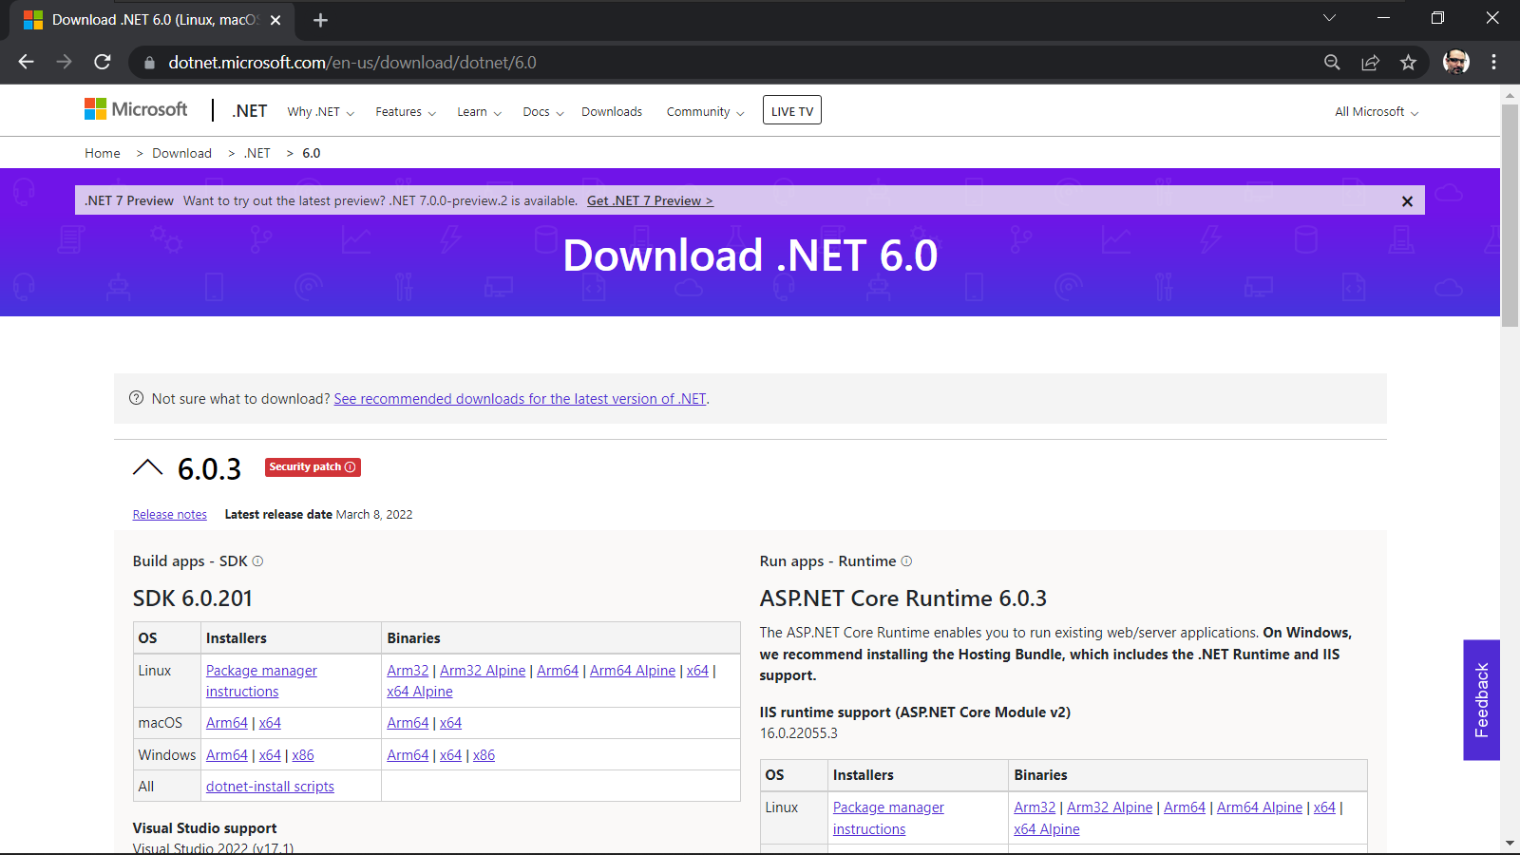
.NET 6.0 SDK

Slide 4
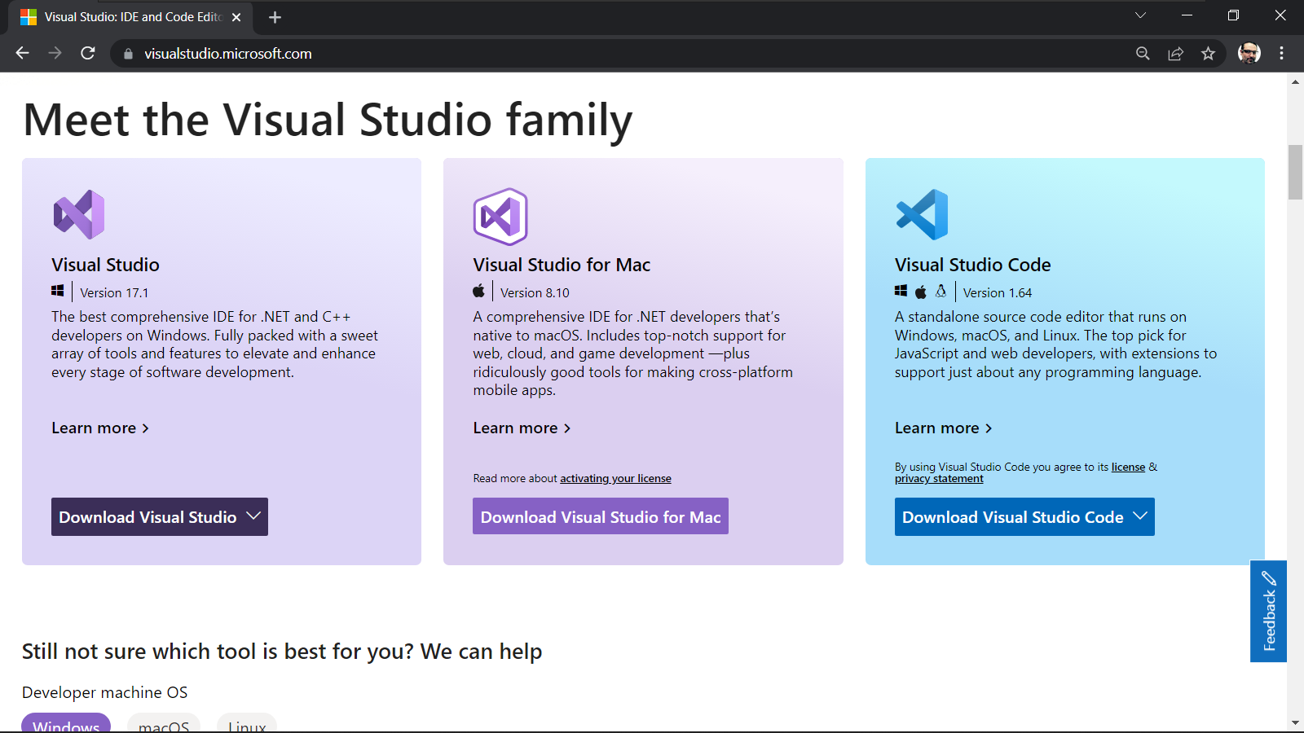
Visual Studio

Slide 5
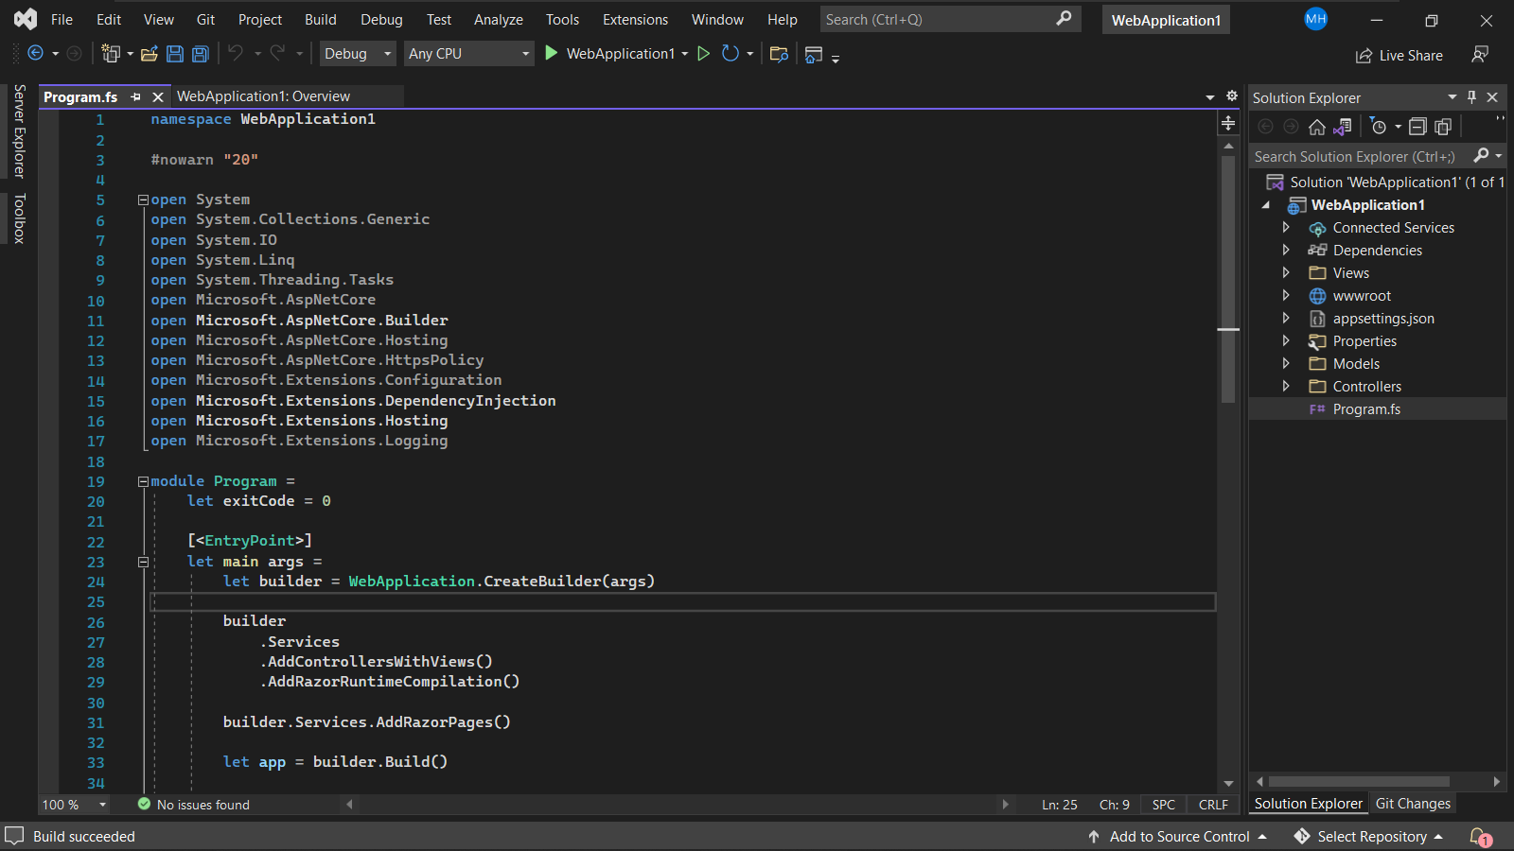
Visual Studio and F#

Slide 6
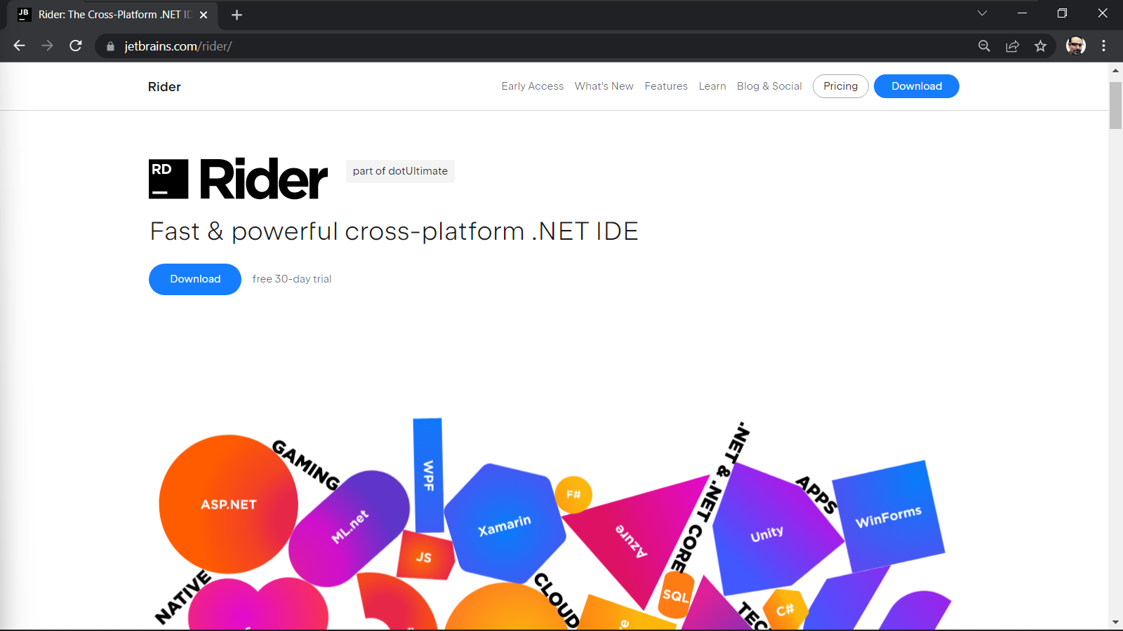
JetBrains Rider

Slide 7
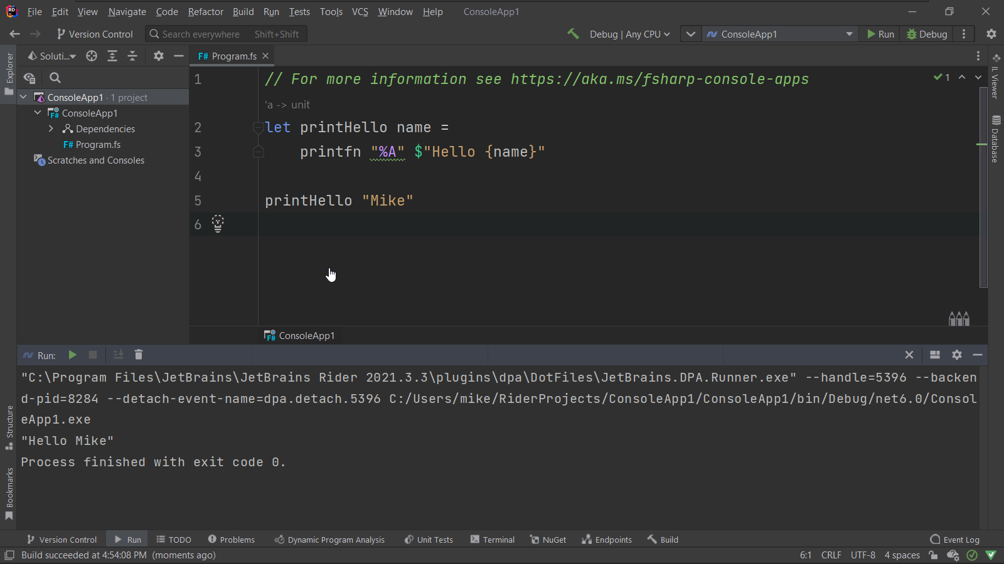
JetBrains Rider

Slide 8
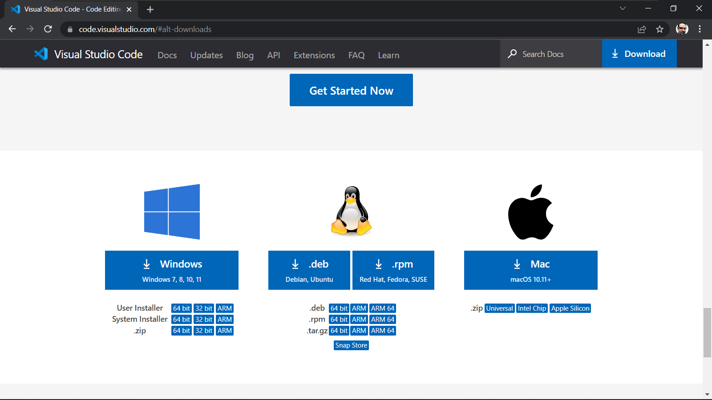
Visual Studio Code

Slide 9
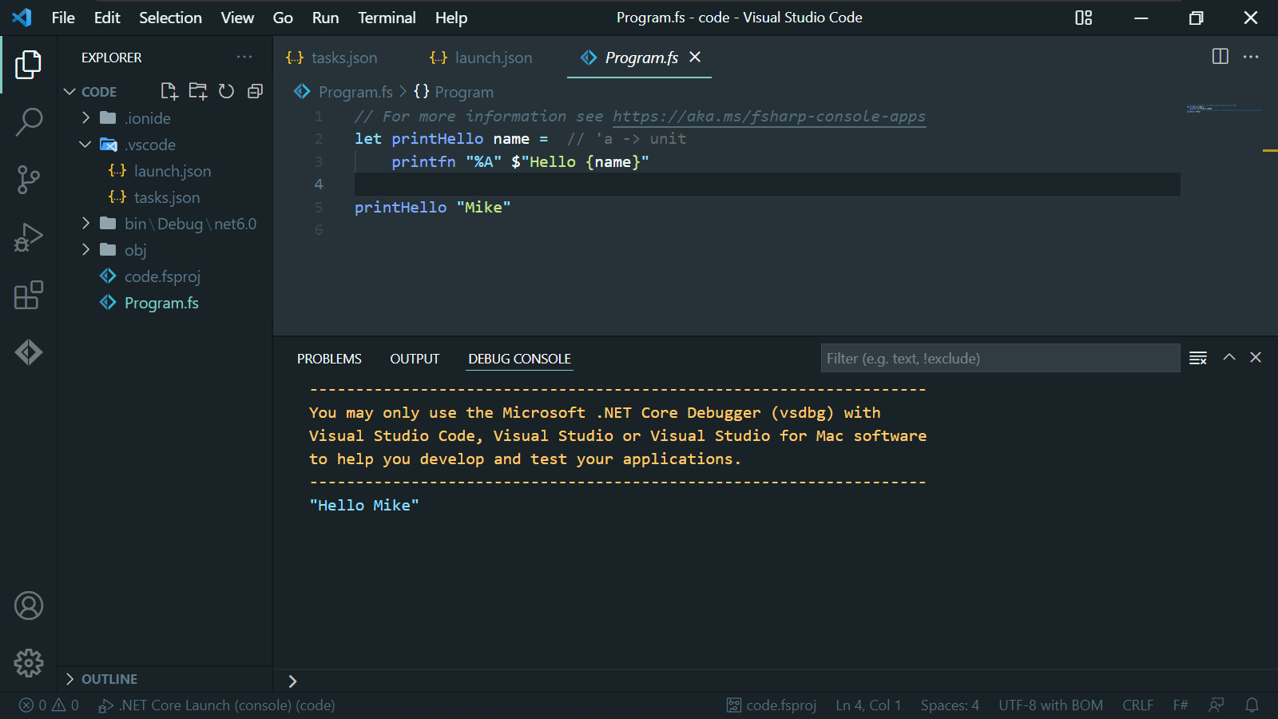
Visual Studio Code

Slide 10
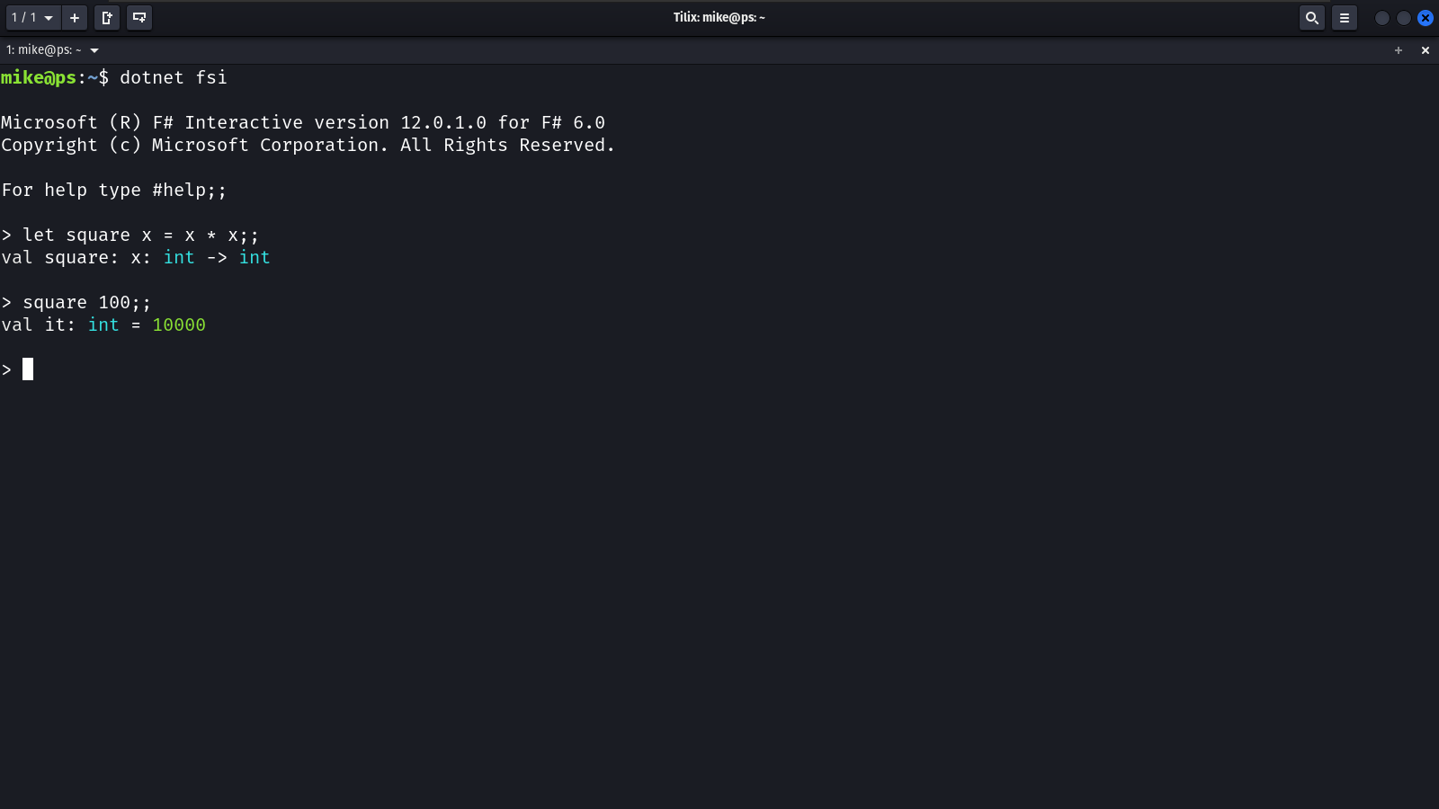
F# Interactive

Slide 11
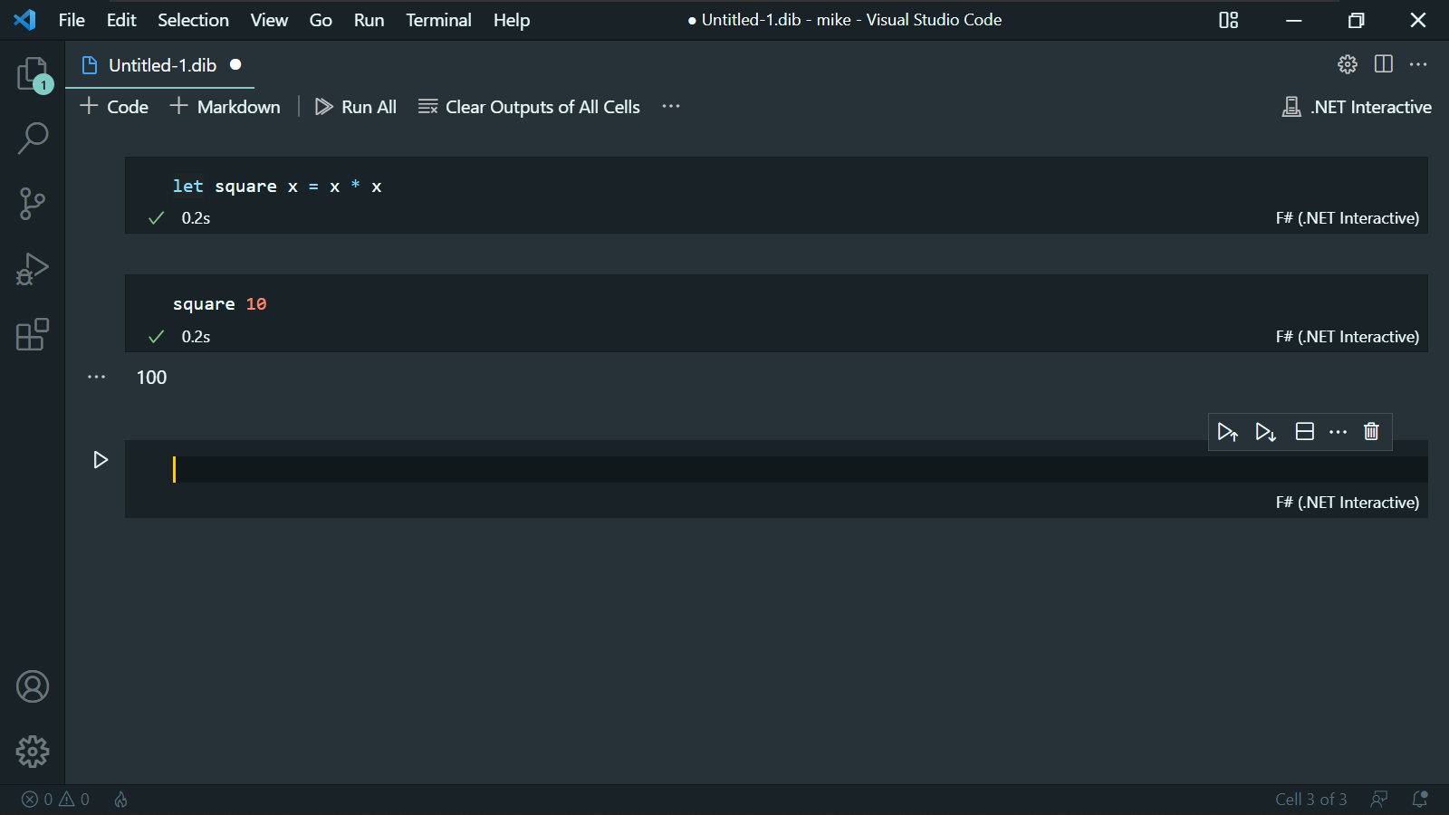
.NET Interactive

