Slide 1
F# and the .NET CLI

Slide 2

The .NET CLI
The command line interface for .NET
Cross-platform
Create, build and run F# .NET projects
Run F# scripts

Slide 3
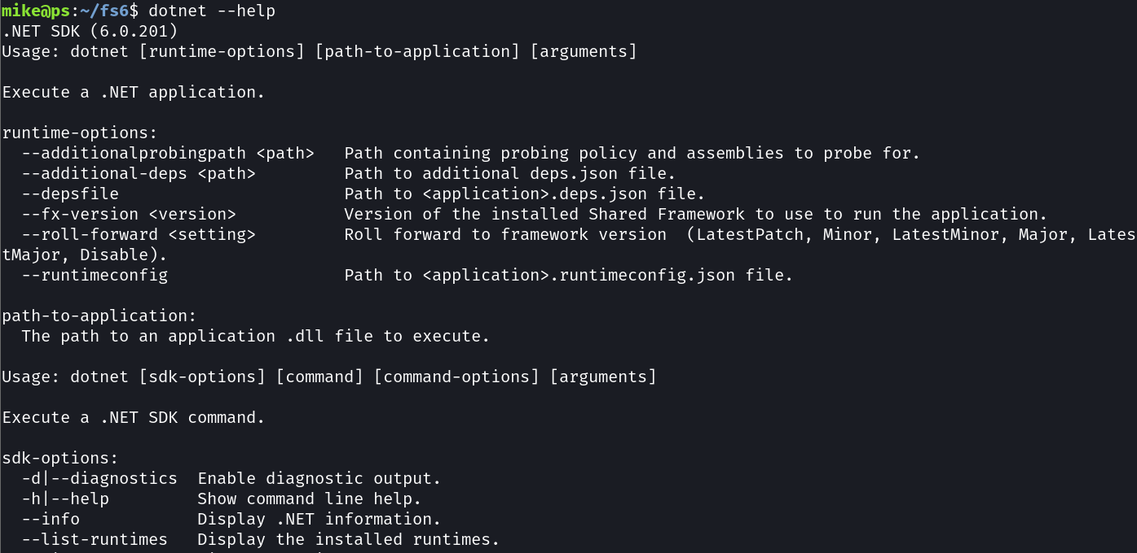
The “dotnet” Command

Slide 4
dotnet --list-runtimes
dotnet --list-sdks
dotnet new
dotnet build
dotnet run
dotnet watch
dotnet fsi
List installed .NET runtimes
List installed .NET SDK’s
Create a new project
Compile the project
Execute the project
Watch for changes in the project and build / run
Start the F# interactive terminal or run scripts

Slide 5
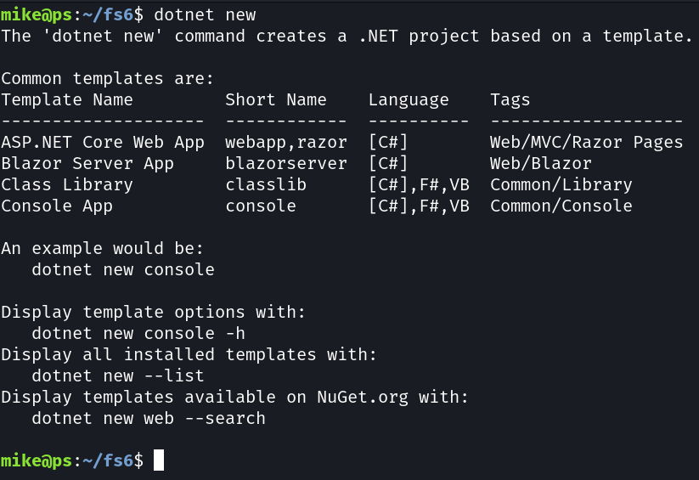
New Project

Slide 6


.NET F# Projects
Source Files
A project is a one or more source files that contain source code
Assemblies
Source files are compiled into assemblies that can be executed or reused

Slide 7
Create a New F# Project
dotnet new console -n fsharp1 -o src/fsharp1 -lang f#

Slide 8
Create a New F# Project
Create a new project
dotnet new console -n fsharp1 -o src/fsharp1 -lang f#

Slide 9
Create a New F# Project
dotnet new console -n fsharp1 -o src/fsharp1 -lang f#
Template

Slide 10
Create a New F# Project
Name of the project
dotnet new console -n fsharp1 -o src/fsharp1 -lang f#

Slide 11
Create a New F# Project
dotnet new console -n fsharp1 -o src/fsharp1 -lang f#
Location

Slide 12
Create a New F# Project
Use F#!
dotnet new console -n fsharp1 -o src/fsharp1 -lang f#

Slide 13
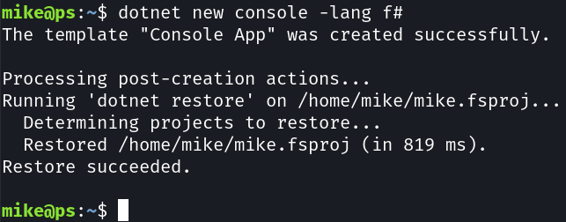
Create a New F# Project
dotnet new console -n fsharp1 -o src/fsharp1 -lang f#

Slide 14
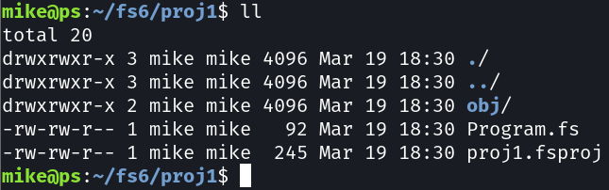
New F# Project Structure

Slide 15
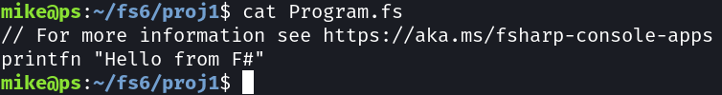
.NET 6.0 Default Application

Slide 16
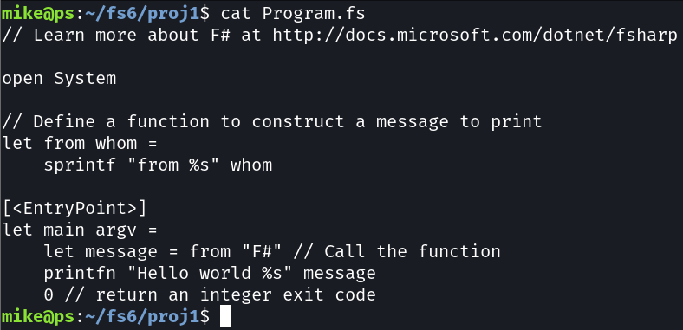
.NET 5.0 Default Application

Slide 17
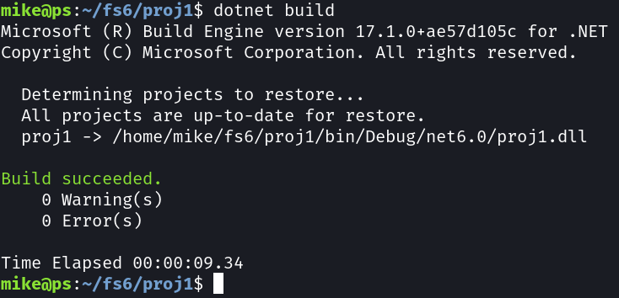
Build F# Project
dotnet build

Slide 18

Build F# Project
dotnet run

Slide 19
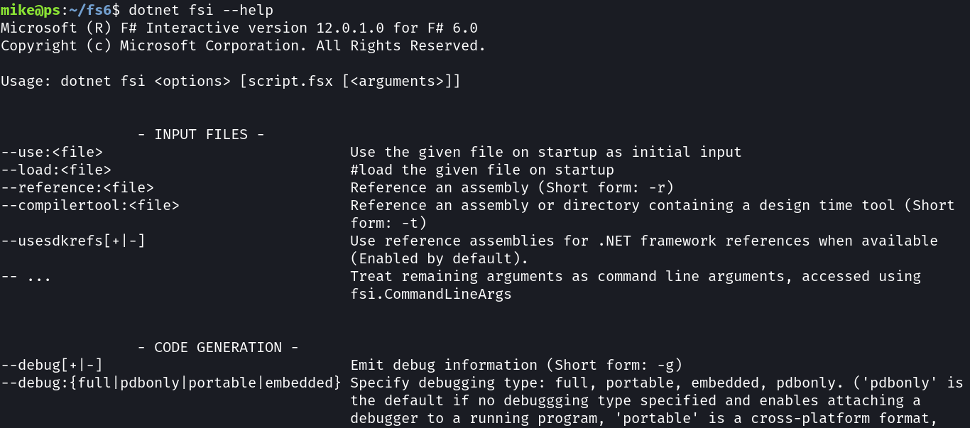
“dotnet fsi” Command

Slide 20
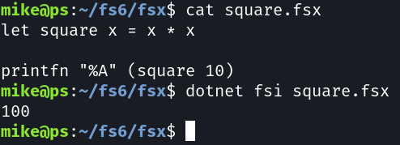
Run an F# Script
dotnet fsi [script.fsx [<arguments>]]

