Slide 1
F# 6 Fundamentals
Foundations of Functional Programming with F#
Michael Heydt
Developer and Trainer
@mikeheydt www.smac.io

Slide 2
Topics in the module
Overview

Slide 3
F# Syntax and Imperative Fundamentals

Slide 4
Declaring a Variable

Slide 5
“do”

Slide 6
Expressions vs Statements

Slide 7
Declaring a Function

Slide 8
Conditional Expression: if..then..else

Slide 9
Reading from the Console

Slide 10
Writing to the Console

Slide 11
Entry Points

Slide 12
Classes

Slide 13
Match

Slide 14
Basic types
Type Name
.NET Type
bool
byte / sbyte
Int16 / int32 / int64, uint16 / uint32 / uint64
float32, single, float, double, decimal
char
string
unit
Boolean
Unsigned / signed byte
16, 32 and 64 bit integers
32-bit, 64-bit, and 28 digit min float
char
string
N/A

Slide 15
F# has access to all .NET types, including objects

Slide 16
Data and functions are separate. This is considered a benefit over OOPs.

Slide 17
F# does support objects, but primarily for interoperation with .NET

Slide 18
F# is executed from beginning of file to end. Only code earlier in the file can be referenced.

Slide 19
F# is declarative – what to do Not imperative – how to do it

Slide 20
F# uses whitespace for scoping instead of brackets {}

Slide 21
Unit

Slide 22
printf / printfn
Format specifier
Meaning
%A
%s
%c
%d, %i
%f, %F
%b
%%
Any value
String
Char
Decimal integer
Floating point
Boolean (output ‘true’ or ‘false’)
Just a ‘%’

Slide 23
Strings
// Using a verbatim string
let xmlFragment1 = @"<book author=""Milton, John"" title=""Paradise Lost"">"
// Using a triple-quoted string
let xmlFragment2 = """<book author="Milton, John" title="Paradise Lost">"""
Information about the code above. Code should be in Roboto Mono font, while slide title and supplemental text should remain in PS TT Commons.

Slide 24
Matching patterns: arrays

Slide 25
Class Definition
type MyClass(a) =
let field1 = a
let field2 = "text"
do printfn "%d %s" field1 field2
member this.F input =
printfn "Field1 %d Field2 %s Input %A" field1 field2 input

Slide 26
Comparison: F# if vs C#
F#
C#

Slide 28
Functional Programming Concepts

Slide 29
Four Key Concepts of F#
Function Oriented
Not object-oriented
Expressions
Rather than statements
Algebraic Types
For domain models
Pattern Matching
For control flow

Slide 30
Functional Programming Concepts

Slide 31
Function
In the relational approach, a function f: X→Y is a binary relation between X and Y that associates to each element of X exactly one element of Y.
https://en.wikipedia.org/wiki/Function_(mathematics)

Slide 32
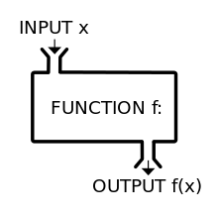
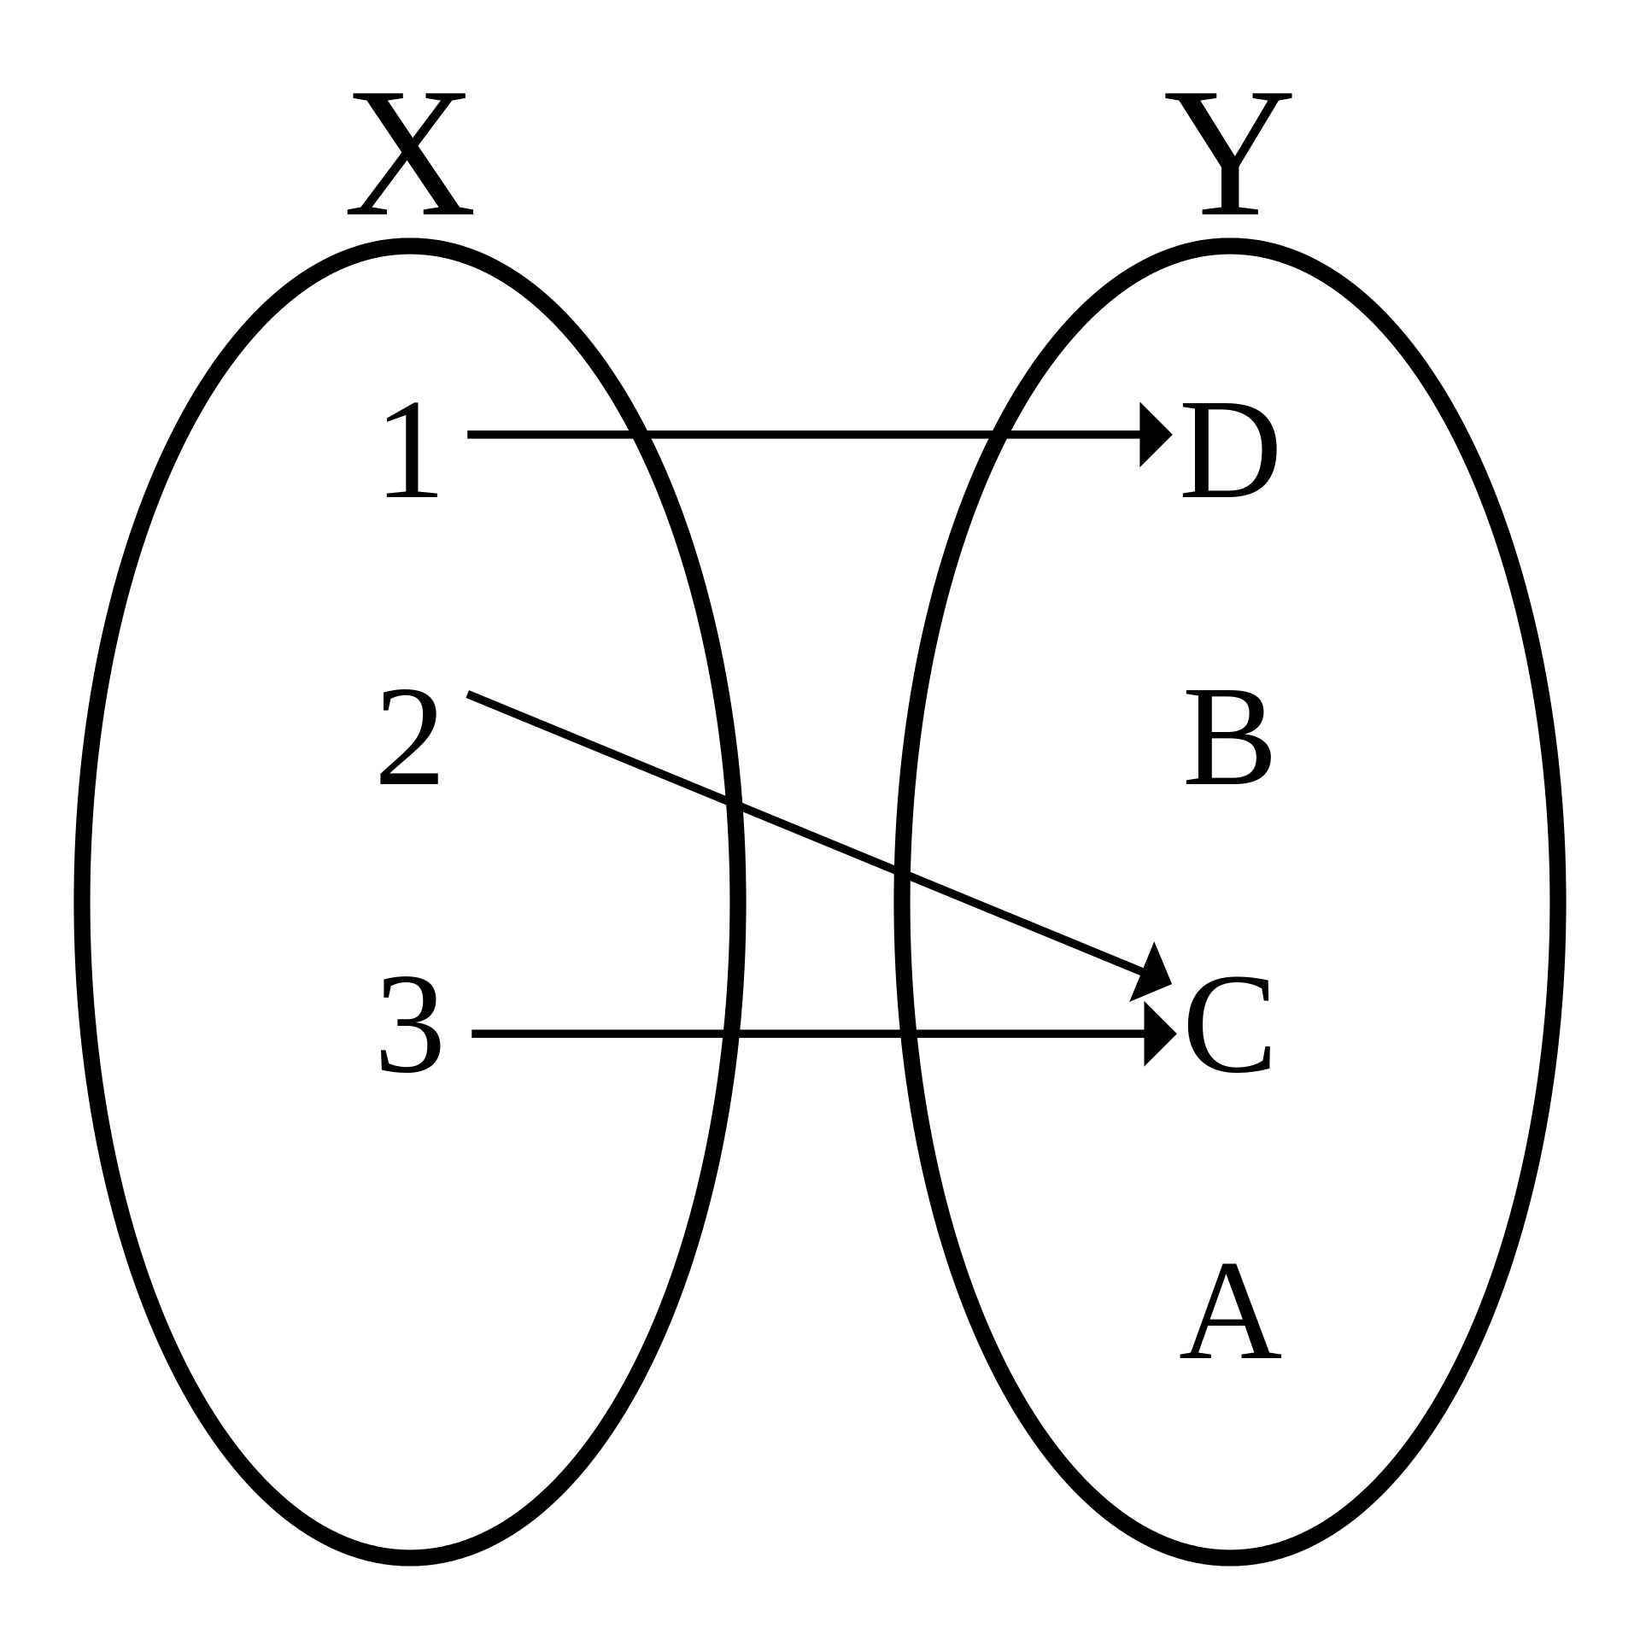
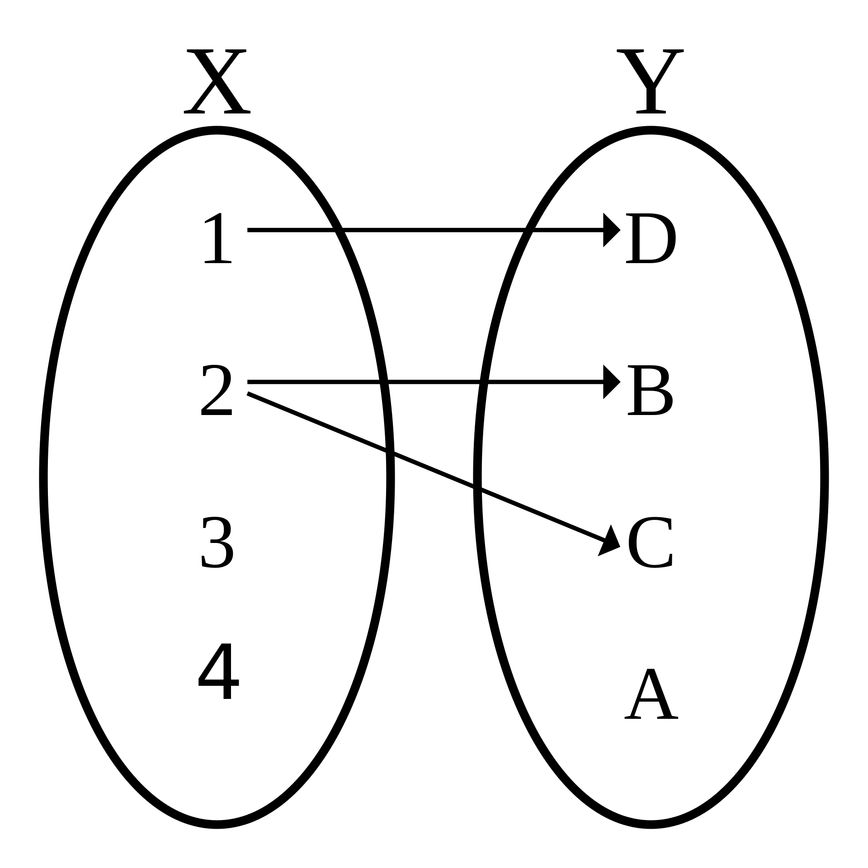
Functions
Black-box
One input
One output
Maps Domain to Range
Values in X -> Y
Not a Function
This is bad

Slide 33
Single-Valued Functions

Slide 34
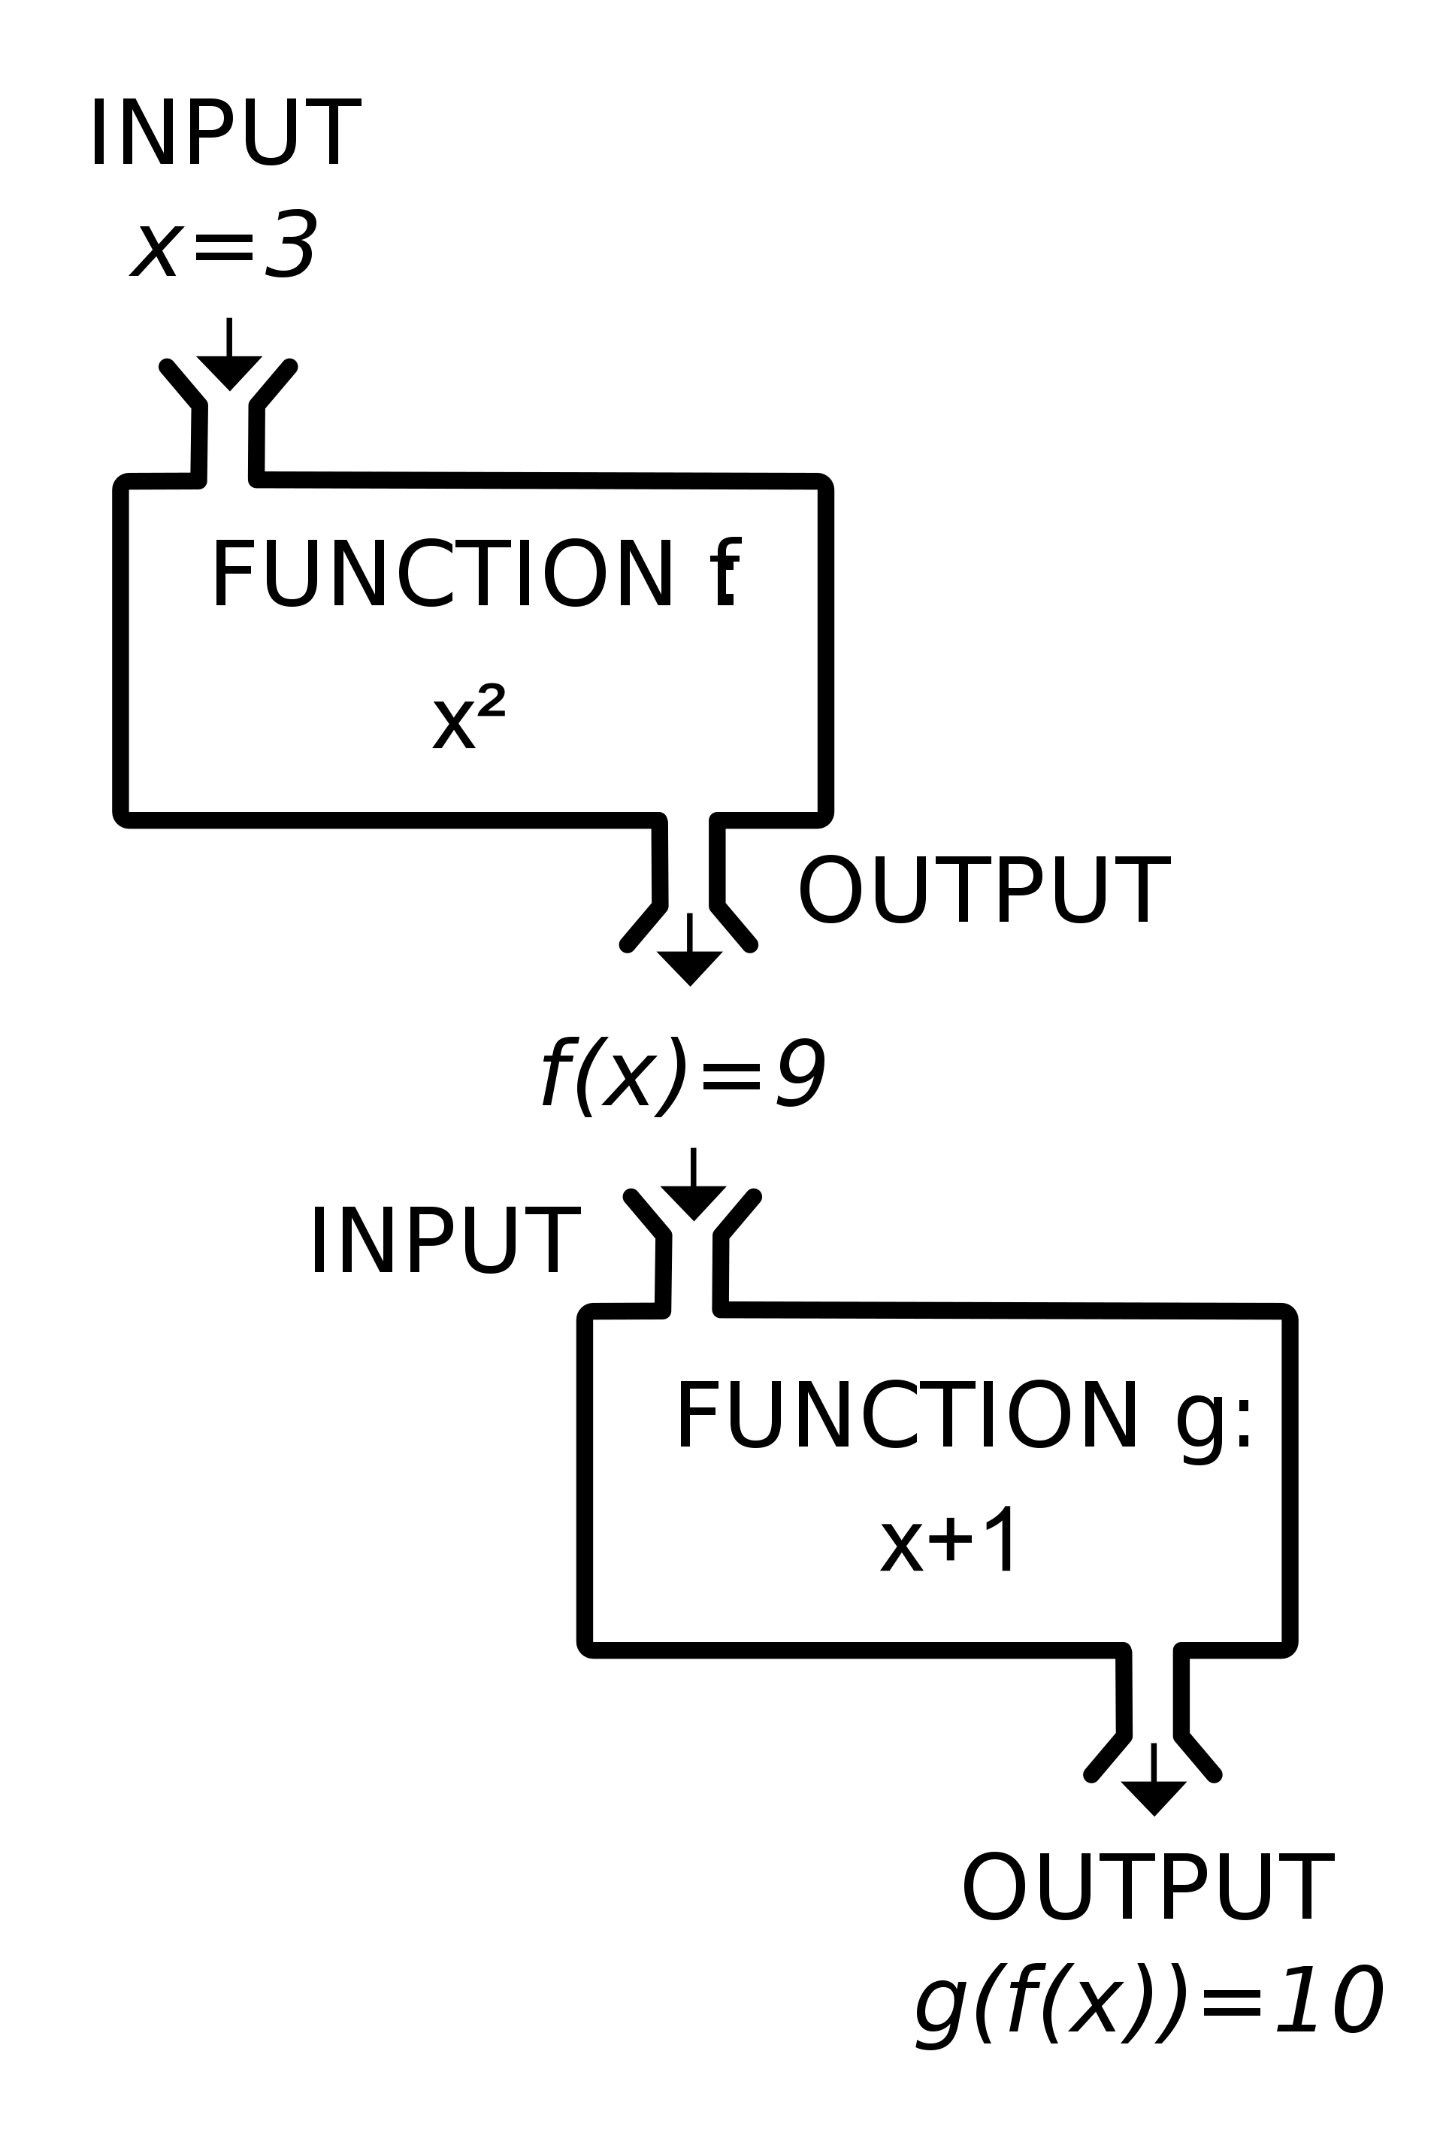
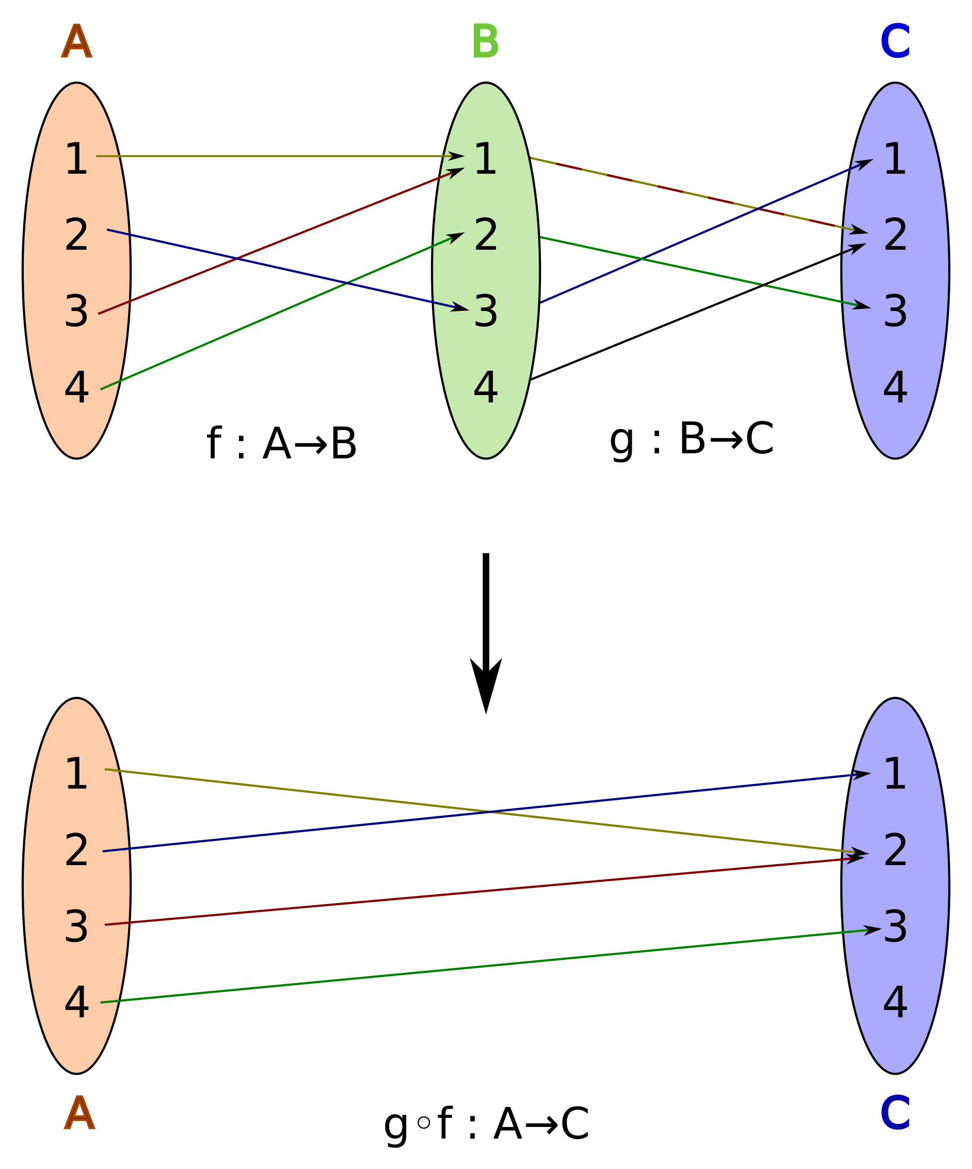
Composite Functions

Slide 35
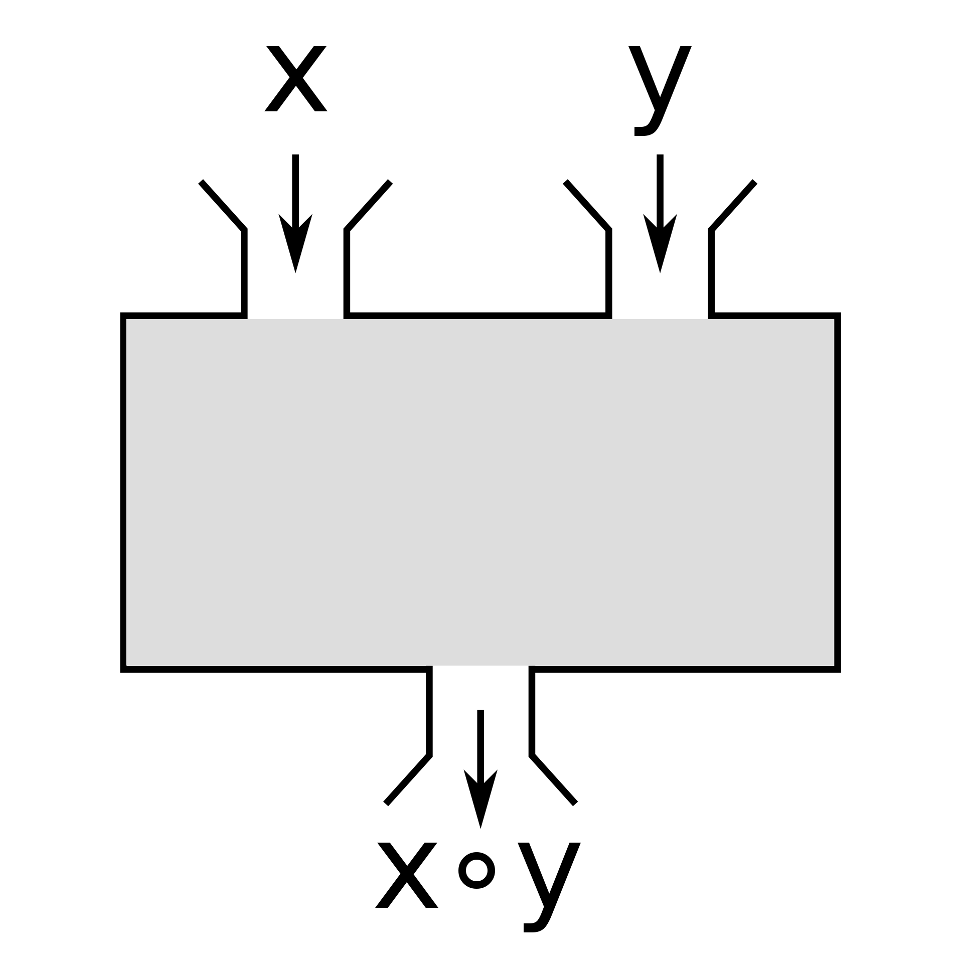
Binary Functions

Slide 36
Working with Functions

Slide 37
Single parameter function
> let square x = x * x
val square: x: int -> int
Components of a function declaration include: let / name, parameters, body

Slide 38
Functions are expressions, and expressions return a value, even if the value is ()

Slide 39
Return value
> let square x = x * x
val square: x: int -> int
Functions are expressions, and expressions return a value, even if the value is ()

Slide 40
Multiline functions
let square x =
x * x
val square: x: int -> int
Functions can span multiple lines. Indent the lines of the function. When done, go back to outer indent (or ;; in fsi).

Slide 41
Function Signature
> let square x = x * x
val square: x: int -> int
Type after the last arrow is the return type
All other types are function parameters
All types are inferred, including the return type

Slide 42
Call a function
> let square x = x * x
val square: x: int -> int
> square 3
val it: int = 9
Function name followed by the parameters separated by spaces

Slide 43
This is an error
> let square x = x * x
val square: x: int -> int
> square 3.
error FS0001: This expression was expected to have type
'int'
but here has type
'float'
Function name followed by the parameters separated by spaces

Slide 44
Coerce type of parameter
> let square (x: float) = x * x
val square: x: float -> float
> square 3.
val it: float = 9.0
square 3
val it: float = 9.0
Specify the name, the a : and type, and surround those three with parentheses.

Slide 45
Casting
> float;;
val it: (int -> float) = <fun:it@59-7>
let square x =
float (x * x)
val square: x: int -> float
> square 3
val it: float = 9.0
square 3.
// error message omitted
Casting is performed using functions, following with the functional nature of F#.

Slide 46
Specify return type
> float;;
val it: (int -> float) = <fun:it@59-7>
let square x : float =
float (x * x)
val square: x: int -> float
: <type name> at end of declaration

Slide 47
Specify type of parameter
let square (x : float) =
x * x
val square: x: float -> float
Each parameter is wrapped in parentheses with a : and type name

Slide 48
Function overloading is not possible in F#

Slide 49
square 3 + 1

Slide 50
(square 3) + 1 = 10?

Slide 51
(square 3) + 1 = 10?
square (3 + 1) = 16?

Slide 52
square 3 + 1 = 10
val square: x: int -> int

Slide 53
square 3 + 1 = 10
val square: x: int -> int

Slide 54
square 3 + 1 = 10
9

Slide 55
square 3 + 1 = 10
9
+ 1 = 10
val it: (int -> int -> int) = <fun:it@16-4>

Slide 56
square 3 + 1 = 10
9
+ 1 = 10
10
= 10

Slide 57
square 3 + 1 = 10
9
+ 1 = 10
10
= 10
val it: ('a -> 'a -> bool) when 'a: equality

Slide 58
square 3 + 1 = 10
9
+ 1 = 10
10
= 10
val it: bool = true

Slide 59
Multiple parameter functions
> let distance x y =
let delta = x - y
if delta < 0 then -delta else delta
val distance: x: int -> y: int -> int
> distance 1 2
val it: int = 1
> distance 2 1
val it: int = 1
Function name followed by the parameter names separated by spaces.

Slide 60
Parameter
The definition of a value expected by a function
Citation: Author/Source, Title, Link/Short URL

Slide 61
Argument
The value provided for a parameter when calling a function
Citation: Author/Source, Title, Link/Short URL

Slide 62
Type inference rule of thumb
If you have a parameter without a type annotation then inference will tend to fail due to framework library overloads. Type specification on the parameter then force correctness
Citation: Author/Source, Title, Link/Short URL

Slide 63
Outer functions (in an API)
Specify types to formalize the API.
Citation: Author/Source, Title, Link/Short URL

Slide 64
Wait, what is that function signature?

Slide 65
Wait, what is that function signature?
val distance: x: int -> y: int -> int

Slide 66
All F# functions internally are single parameter
> let distance x y =
let delta = x - y
if delta < 0 then -delta else delta
val distance: x: int -> y: int -> int
Multiple parameter functions are syntactic sugar

Slide 67
This is immensely important to functional programming for partial application and currying

Slide 68
Partial Application and Currying

Slide 69
Functional Pipelines and Composition

Slide 70
Higher Order Functions

Slide 71
Recursion

Slide 72
Dependencies as Functions

Slide 73
Topics in the module
Overview

