Slide 1
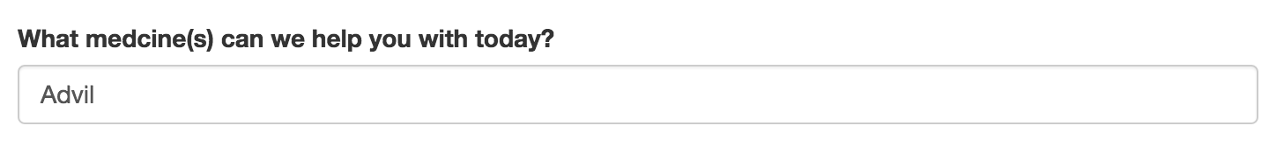
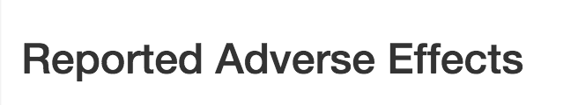
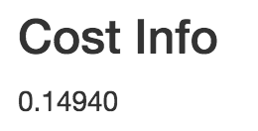

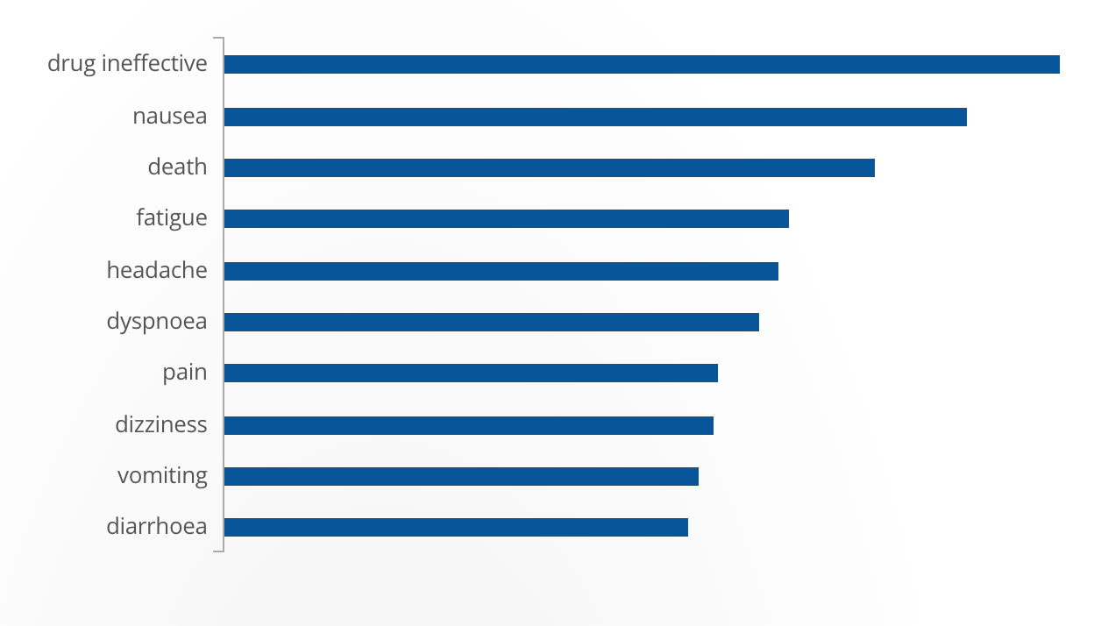





multiple sclerosis
arthritis
hypertension
unknown
diabetes
pain
contraception
psoriasis
Rite Aid, TARGET Corporation, Dolgencorp, Inc. (DOLLAR GENERAL & REXALL), The Kroger Co., Costco Wholesale, Kinray, Shopko Stores Operating Co., LLC.
MIDOL, DOLEX, UP AND UP CHILDRENS IBUPROFEN, IBUPROFEN (NSAID) PAIN RELIEVER/FEVER REDUCER, PROPRINAL, WELBY HEALTH IBUPROFEN, CARE ONE IBUPROFEN INFANTS, HENRY SCHEIN IBUPROFEN, CARE ONE IBUPROFEN, TOPCARE IBUPROFEN CHILDRENS, DG HEALTH IBUPROFEN, KIRKLAND SIGNATURE IBUPROFEN IB, IBUPROFEN PAIN RELIEVER/FEVER REDUCER, IBUPROFEN...

