Slide 1

Professional Pharmacist Philippa
USER PERSONA
“I don’t want my patients using recalled drugs!”
Key Goals:
Improve health of patients.
Understand adverse events beyond trials/package insert.
Minimize errors.
Deal with recalls quickly.
Assist patients in adhering to drugs.
Occupation: Pharmacist, Retail
Education: Pharm.D.
Tech Savvy: Medium
Channels:
Pharma. Software
Email alert
Day in the Life:
Fill prescriptions and answer patient questions.
I get a lot of emails from patients, drug companies, regulatory bodies and my corporate parent. I am very focused on helping parents adhere to their drugs prescriptions.
Demographics:
42. | Married| 2 Children | Works Weekends

Slide 2
Pharmacist Notification
CUSTOMER JOURNEY MAP
Contact
Patients
Receive Notice
Check Notice
Contact
Doctors
Questions
Has this drug been recalled?
Can you notify me when a drug gets recalled?
What are the ?
Should I notify my patients?
What are the possible interactions?
Do I need to contact doctors?

Slide 3
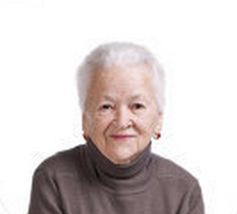
Connie Concerned Consumer
USER PERSONA
“Are these side-effects normal?”
Key Goals:
Take medicine as prescribed by the doctor.
Avoid excess costs.
Avoid interaction between my drugs and other compounds (e.g., grapefruit juice).
Understand if recommended medicines are safe.
Occupation: Retired
Education: Bachelors
Tech Savvy: LOW
Channels:
Text messages
Pharmacy
Children
Day in the Life:
I am on a routine does of prescriptions. I take some with my breakfast, some with lunch and some with dinner to manage my diabetes and high blood pressure.
Demographics:
65 | Retired | Retired with husband. | 2 kids + 4 grandkids

Slide 4

Precautious Parent Paula, Mom
USER PERSONA
“I need to make sure my children’s medicine is safe.”
Key Goals:
Check on children’s medicines.
Learn about side effects.
Learn about prices.
Occupation: In-home mother
Education: BA
Tech Savvy: HIGH
Channels:
IPHONE
TEXTS
CNN
Day in the Life:
I have children. I frequently have to take them to the pediatrician's office. When I get a new prescription for the kids, I like to know all the details about it, ultimately, I trust my doctor.
Demographics:
31 yrs. | Married | 2.5 children | Likes to download apps.

Slide 5
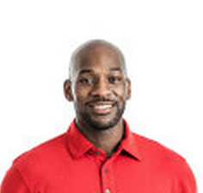
Carl Care Coordinator, First Born Son
USER PERSONA
“My elderly mother has so many prescriptions. How can I track them all?”
Key Goals:
Administer drugs to mother with dementia.
Ensure safety of drug intake.
Monitor side-affects of drugs.
Occupation: Analyst
Education: BS, MS
Tech Savvy: HIGH
Channels:
NPR
Twitter
Text Messages
Day in the Life:
I am the primary care-giver for my mother who lives with me, my wife and two teenage children. I have to keep track of her medications and ensure she takes them all. That can be difficult, given the number of medications she takes weekly.
Demographics:
48 | MARRIED | ONE OF 3 KIDS| VETERAN

