Slide 1
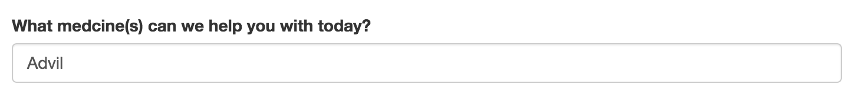
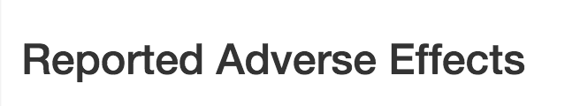
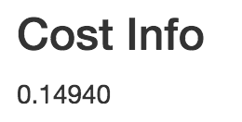

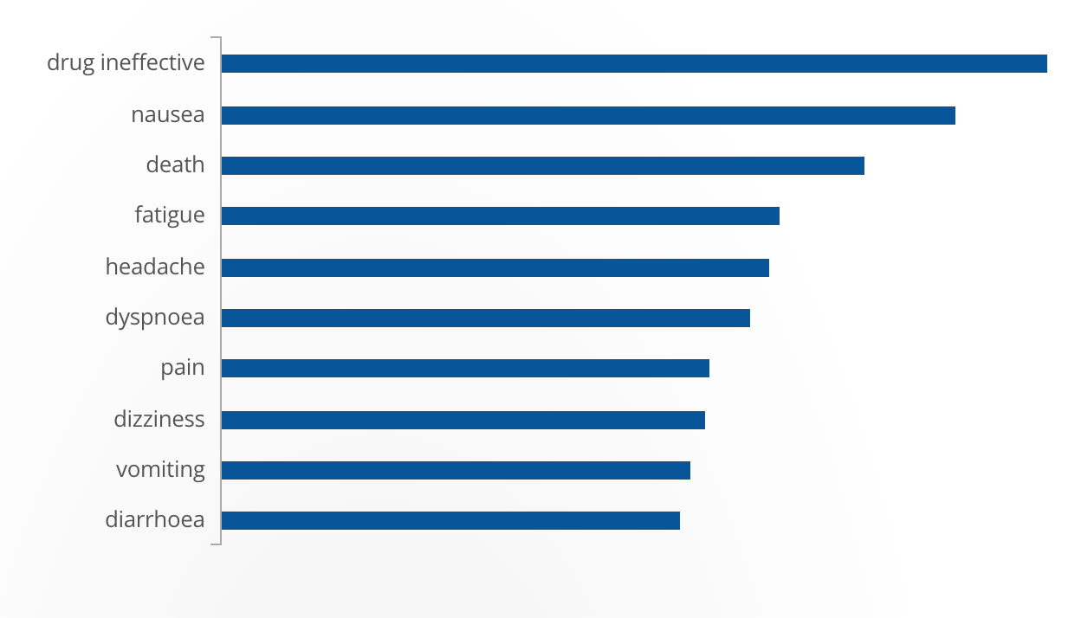





multiple sclerosis
arthritis
hypertension
unknown
diabetes
pain
contraception
psoriasis
Rite Aid, TARGET Corporation, Dolgencorp, Inc. (DOLLAR GENERAL & REXALL), The Kroger Co., Costco Wholesale, Kinray, Shopko Stores Operating Co., LLC.
MIDOL, DOLEX, UP AND UP CHILDRENS IBUPROFEN, IBUPROFEN (NSAID) PAIN RELIEVER/FEVER REDUCER, PROPRINAL, WELBY HEALTH IBUPROFEN, CARE ONE IBUPROFEN INFANTS, HENRY SCHEIN IBUPROFEN, CARE ONE IBUPROFEN, TOPCARE IBUPROFEN CHILDRENS, DG HEALTH IBUPROFEN, KIRKLAND SIGNATURE IBUPROFEN IB, IBUPROFEN PAIN RELIEVER/FEVER REDUCER, IBUPROFEN...

Slide 2
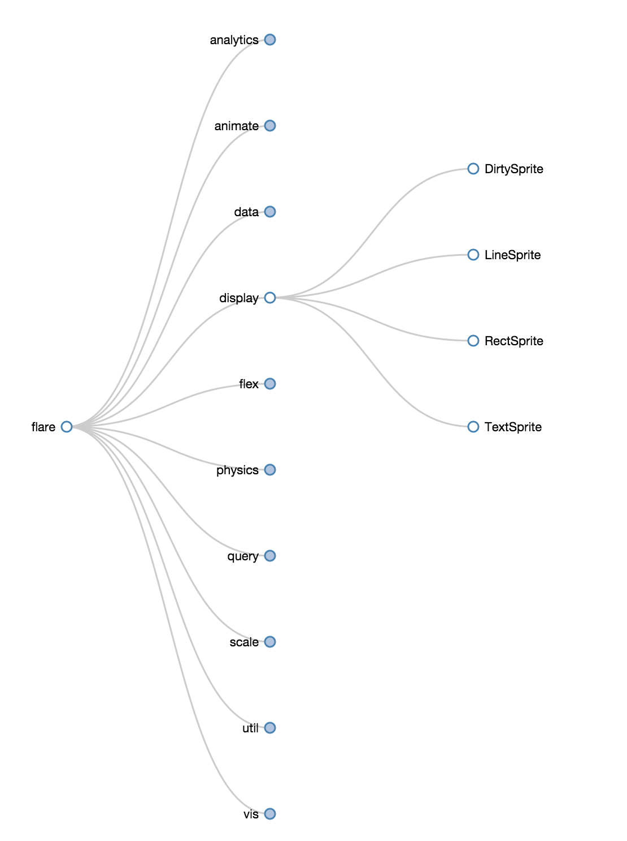
Drug Class or Indication Explorer
Investigate report adverse events or listed side-effects
Start with class or indication (e.g., NSAID or pain reliever)
Compare drugs within classes or across classes
http://mbostock.github.io/d3/talk/20111018/tree.html
https://mohansun-canvas.herokuapp.com/content/training/

Slide 3
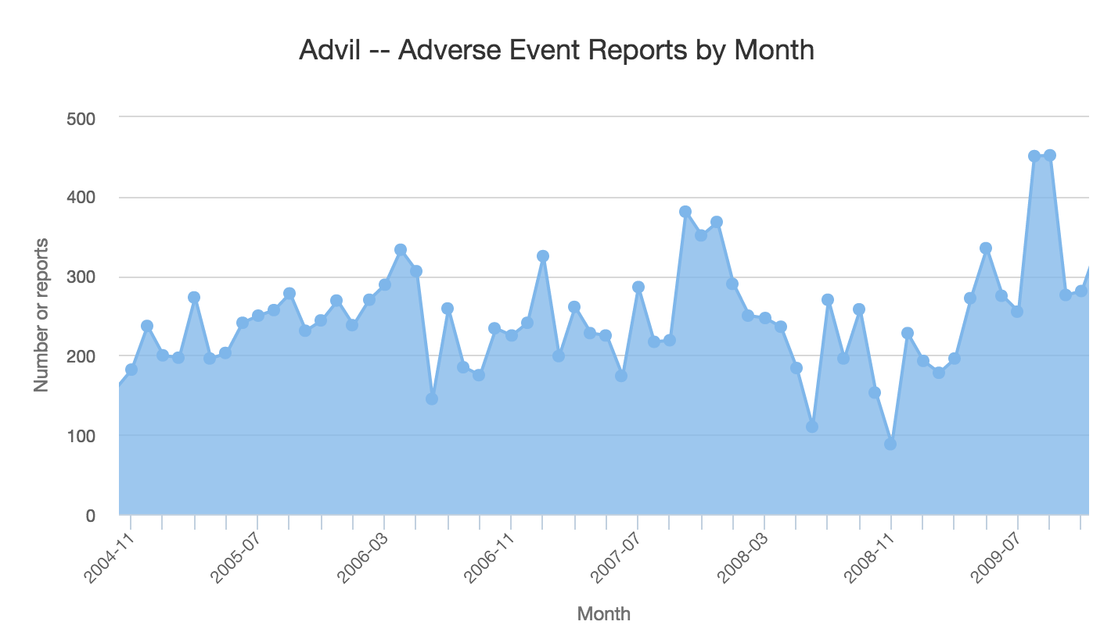
Drug adverse reports over time

Slide 4
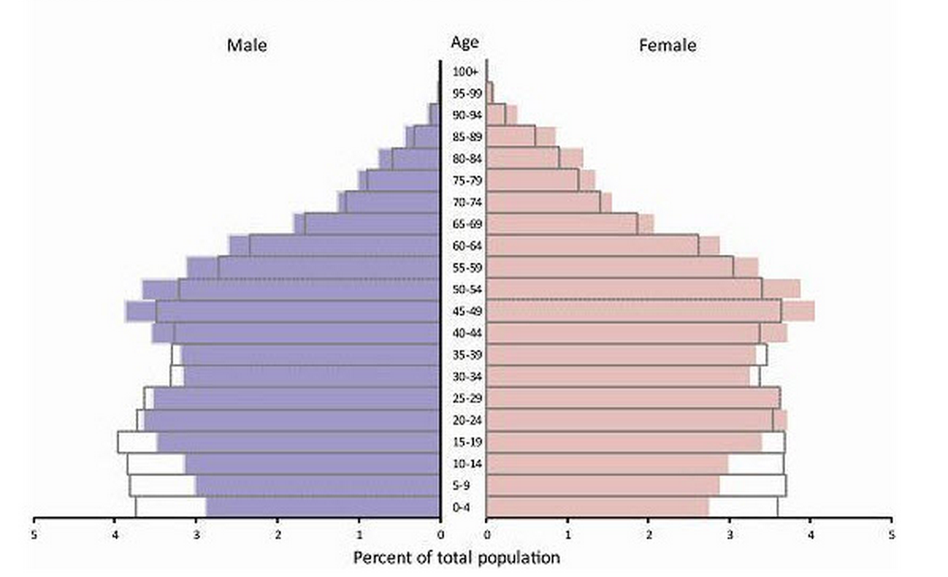
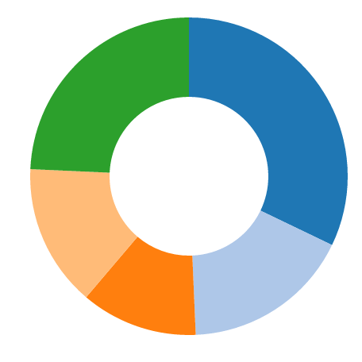
Explore adverse events within group of events for a drug (e.g., Pancreatitis)
http://stackoverflow.com/questions/25044997/creating-population-pyramid-with-d3-js
Consumer or non-health pro.
Physician
Other health pro.
Pharmacist
Lawyer
http://jsfiddle.net/gregfedorov/qh9x5/9/

