Slide 1



Code-Switched Text Synthesis in Unseen Language Pairs
I-Hung Hsu ¹, Avik Ray ², Shubham Grag ², Nanyun Peng ^{2,3}, Jing Huang ²
¹ University of Southern California
² Amazon Alexa AI
³ University of California, Los Angeles
Present at ACL 2023

Slide 2
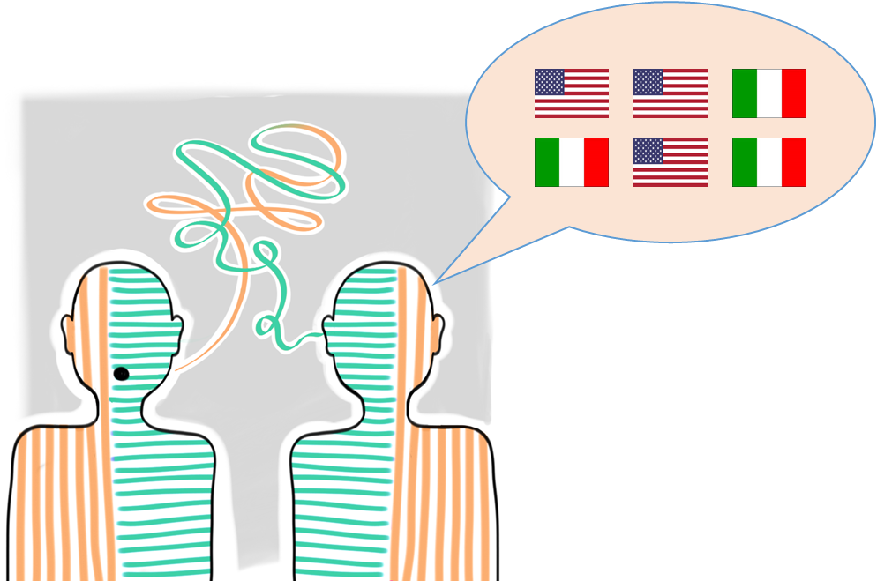
Text synthesis for code-switching
Code-switching is the linguistic phenomenon of using more than one languages in an utterance or conversation.
Generating realistic code-switching sentences is important for downstream NLP applications since real code-switched text data is hard to collect.
Figure Source: https://owlcation.com/humanities/Code-Switching-Definition-Types-and-Examples-of-Code-Switching

Slide 3
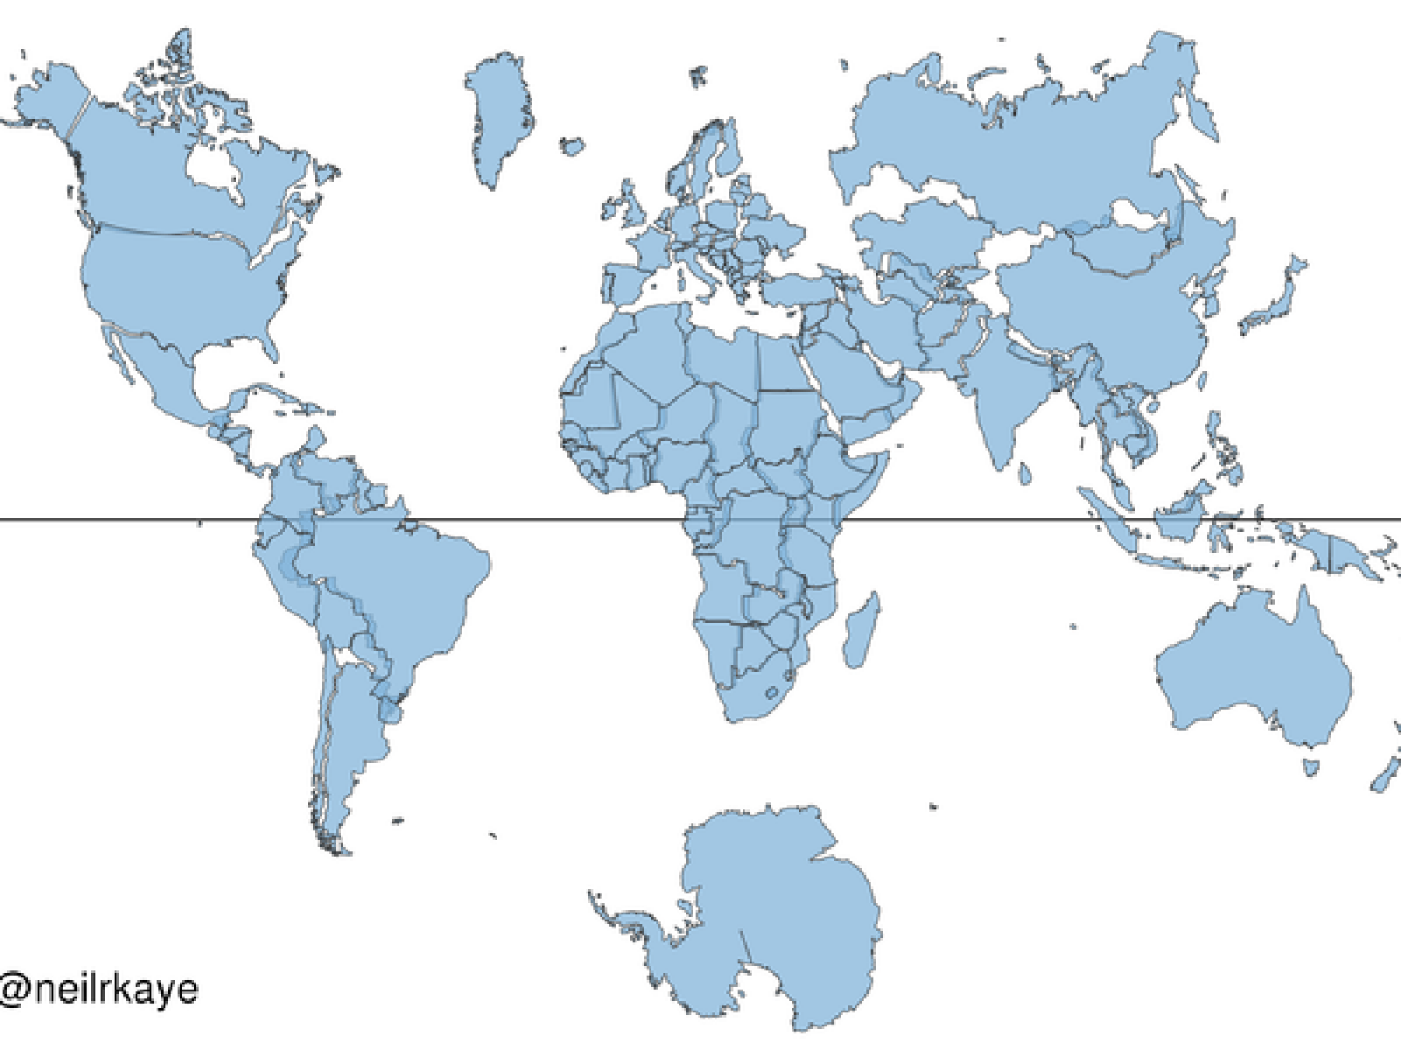
Code-switching is prevalent across multiple language pairs.
Despite code-switching happens in many different cases, prior work on code-switched text synthesis focus more on language pairs where code-switching training data is more available.
Spanish-English
Hindi-English
…
Hindi-English
Bengali-English
Tamil-English
Arabic-French
Is it possible to use existing resources to assist resource-limited language pairs’ synthesis?
Swahili-English

Slide 4
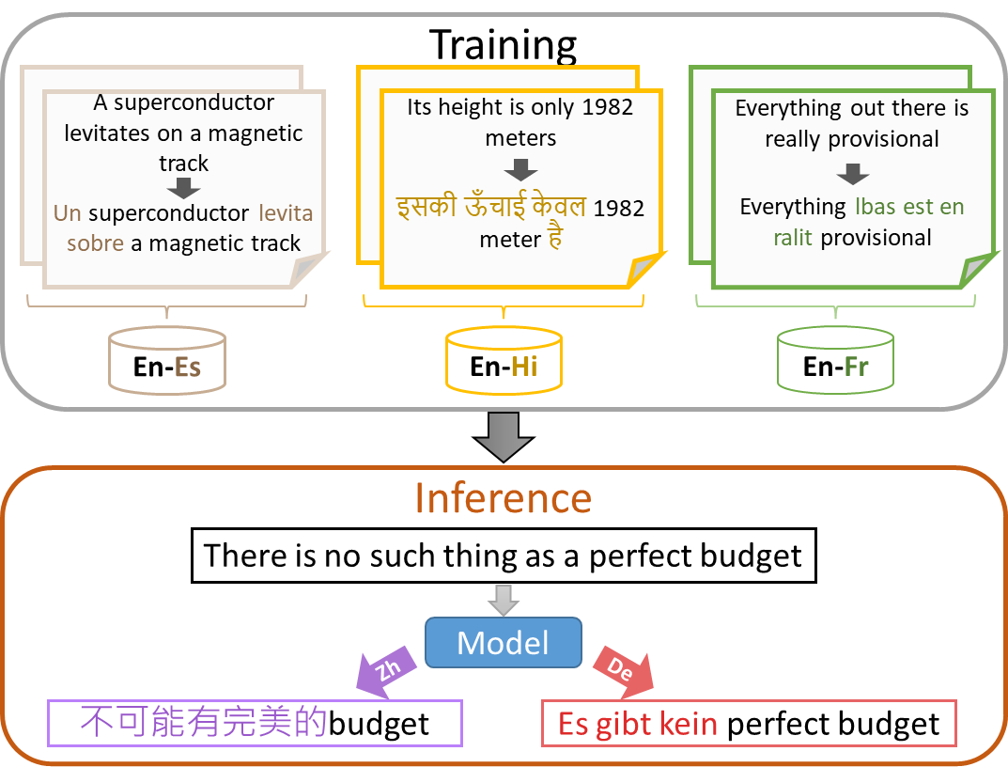
Problem Formulation
Goal: Synthesizing code-switched text in multiple language pairs, even for language pairs where their code-switching text is never provided.
Input: a monolingual sentence x^{e} in language l^{e}, and an assigned language l^{m}
Output: a code-switched sentence x^{m,e} that mixes l^{m} and l^{e}

Slide 5
Two specific challenges
How can the model effectively generate tokens in multiple languages, including those lacking code-switched training data?
How can models acquire the transferable capability to perform code-switching?
Notes:
to the constrained training data?

Slide 6
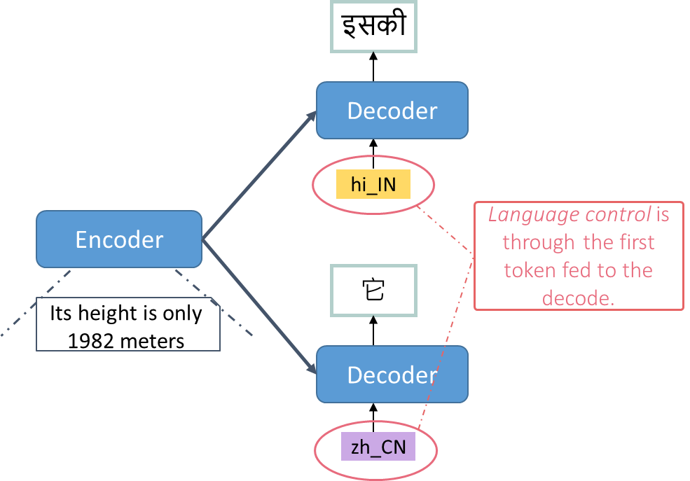
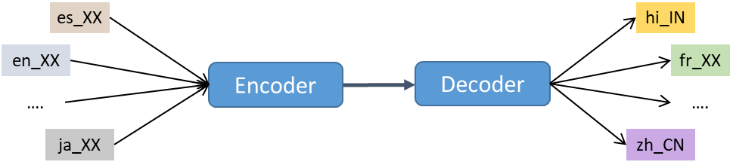
Leveraging multilingual machine translation
Use mBART50-many-to-many-mmt [Tang+ 2020] as the backbone
Multilingual machine translation
A single model can generate tokens across different languages.
Addressing the first challenge.
After this step, we will get a Pre-trained Multilingual Machine Translation Model (PMMTM)

Slide 7


Then, finetune PMMTM using code-switched data
Transformer Block
Transformer Block
Training Corpus for Code-Switching
Adapter
En-Es
En-Hi
En-Fr
Adapter
Adapter
Sample
Q
K
V
Q
K
V
इसकी
इसकी
Encoder
Decoder
Prefix
Encoder
Prefix
Decoder
Its height is only 1982 meters
hi_IN
इसकी
Its height is only 1982 meters
hi_IN
इसकी

Slide 8
GLOSS = GeneraLized cOde-Switched text Synthesizer
es_XX
hi_IN
Stage 1 : Pre-trained Multilingual Machine Translation Model
en_XX
fr_XX
Encoder
Decoder
….
….
ja_XX
zh_CN
Stage 2 : Fine-tune on Training Data for Code-Switching
with additional code-switching module plugged
Transformer Block
Transformer Block
Training Corpus for Code-Switching
Adapter
En-Es
En-Hi
En-Fr
Adapter
Adapter
Sample
Q
K
V
Q
K
V
इसकी
इसकी
Encoder
Decoder
Prefix
Encoder
Prefix
Decoder
Its height is only 1982 meters
hi_IN
इसकी
Its height is only 1982 meters
hi_IN
इसकी
Notes:
A quick summary for getting our Generalized Code-switchied text synthesizer, so called GLOSS.

Slide 9
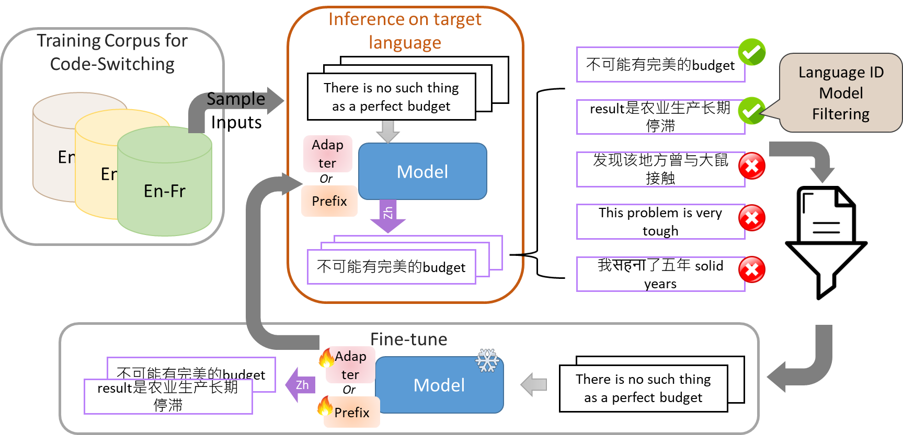
GLOSS with Self-Training
This procedure can be executed with multiple rounds.

Slide 10
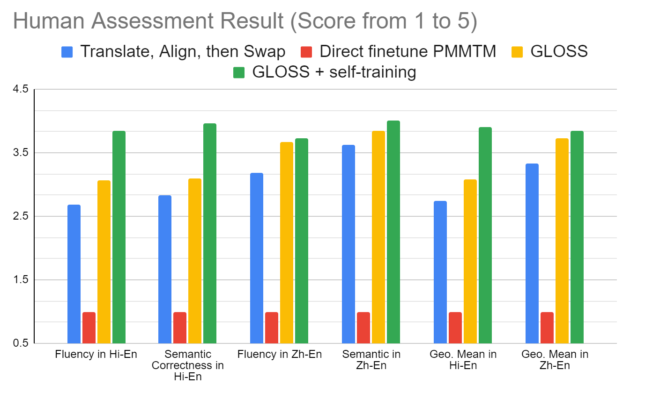
The evaluation of GLOSS is conducted through both automated and human assessments.
Translate, Align, then Swap generate less fluent text.
Direct finetune PMMTM leads to serious overfitting.
GLOSS performs the best. Self-training further improves GLOSS.
Baselines
Translate, Align, then Swap
First use MT model to get a translation pair.
Use word aligner to get translation word alignment.
Randomly swap translated words
Direct finetune PMMTM
Instead of using adapter/prefix, directly finetune PMMTM

Slide 11
Conclusion
We present the first attempt to study whether we can generalize code-switched text synthesis to language pairs without code-switched training data.
We propose GLOSS, which augment pre-trained machine translation model with additional code-switching module. We show that this method can learn transferable code-switched ability.

