Slide 1
NativeScript + Angular
as ex. Tweety app

Slide 2
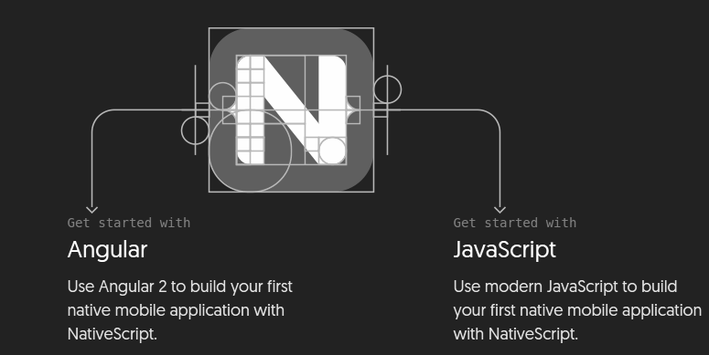
NativeScript + Angular or NativeScript + JS

Slide 3
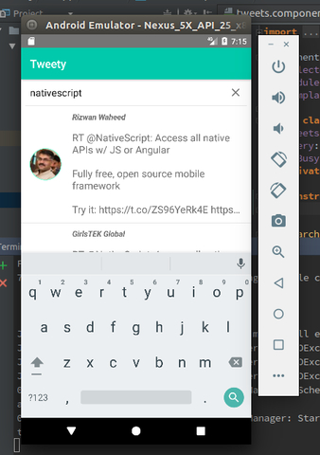
Set up system and run
Set up your system. On the NativeScript
side you can find hands-on tutorials
that walk you set up your system
Clone project from GitHub
Run tns install
Run tns run android

Slide 4
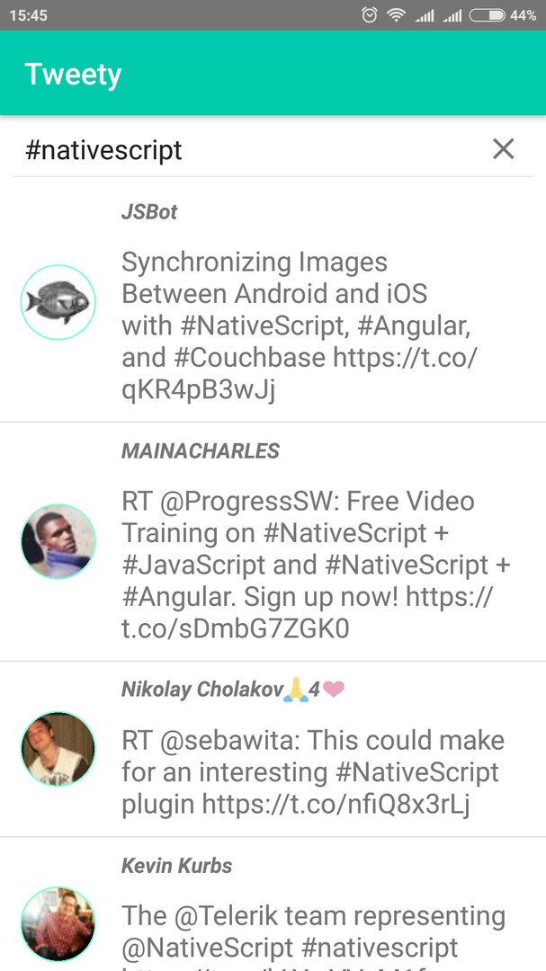
Finished mobile app Tweety

Slide 5
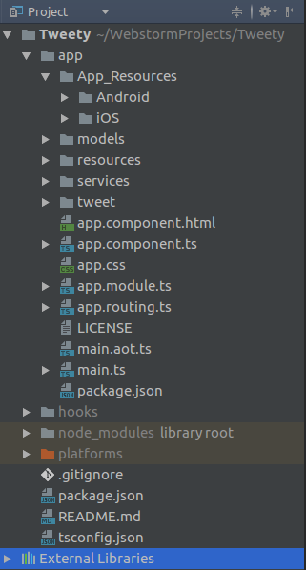
Project structure

Slide 6
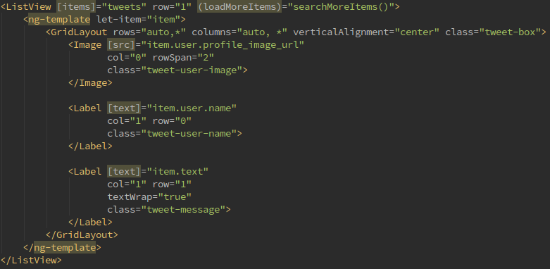

NativeScript UI (ListView and SearchBar)

Slide 7
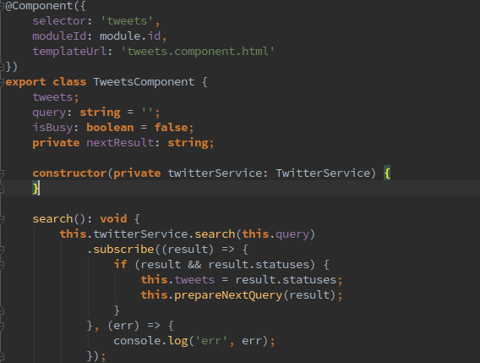
Angular

Slide 8
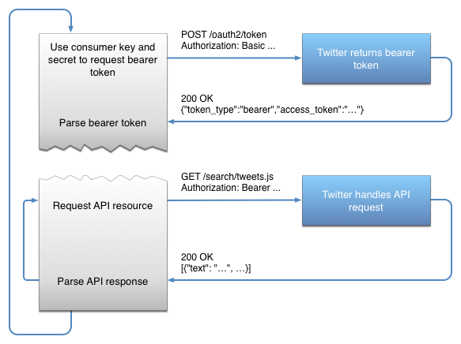
Twitter Auth (application-only auth)

Slide 9
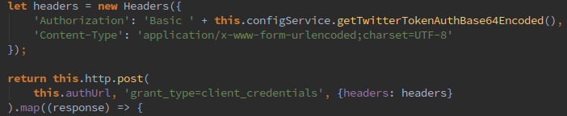
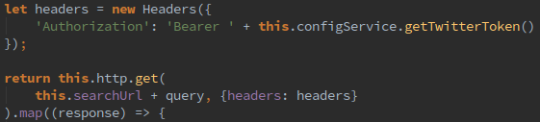
Auth with Twitter (application-only auth)
First step
Token
Second step

Slide 10
Q / A

