Slide 1
Implementation of the PLUS open-source toolkit for translational research of ultrasound-guided intervention systems
Andras Lasso, Tamas Heffter, Csaba Pinter, Tamas Ungi, Adam Rankin and Gabor Fichtinger
Laboratory for Percutaneous Surgery (Perk Lab) School of Computing Queen’s University, Kingston, ON, Canada

Slide 2
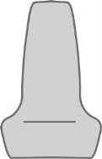
Introduction
PLUS – Public software Library for UltraSound imaging
Goal: facilitate rapid prototyping of ultrasound-guided intervention systems for translational clinical research
Acquire, process, transfer synchronized ultrasound image and position data
History: utilizing parts of SynchroGrab library (Boisvert, Gobbi, et al., 2008)
Open-source: BSD license, no strings attached, citation appreciated
Ultrasound
computer
Tracker
Reference
Needle
Probe
3D Slicer
computer
Image
Phantom model

Slide 3
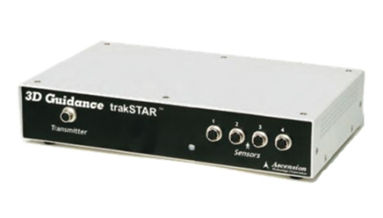
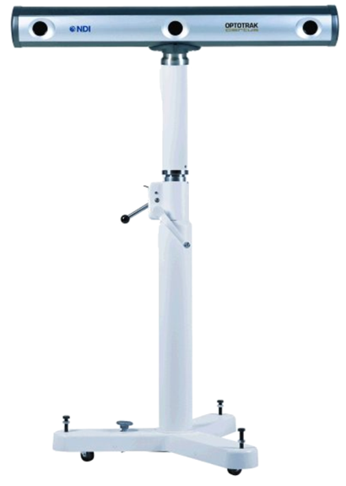
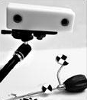
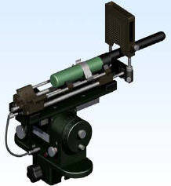
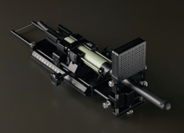
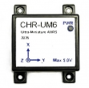
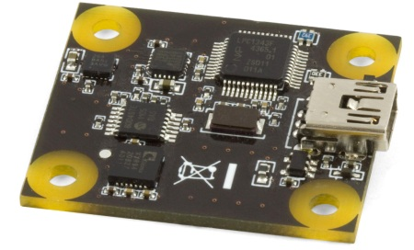
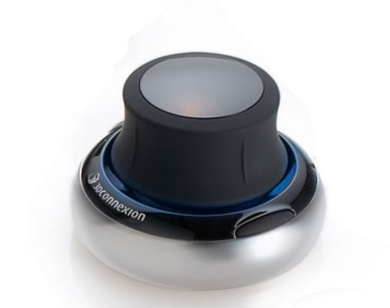
Data acquisition - tracking
Ascension EM tracker
NDI Aurora, Polaris, and Certus optical and electromagnetic trackers
Claron MicronTracker optical tracker
Brachy steppers (CMS Accuseed, Burdette Medical systems, CIVCO)
PhidgetSpatial inertial measurement device
CHRobotics inertial measurement device
3dConnexion SpaceNavigator 3D mouse
OpenIGTLink (for BrainLab, Siemens MRI scanners, and other compatible devices)
Software devices: file source, US simulator

Slide 4
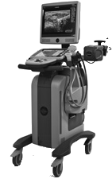
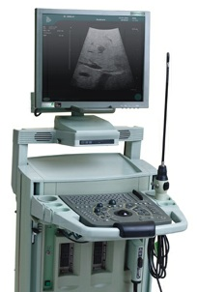
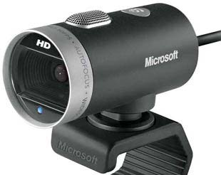
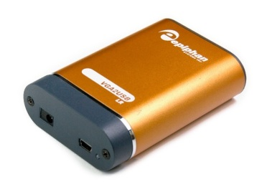

Data acquisition - imaging
Ultrasonix: B-mode & RF (through research interface)
BK ProFocus: B-mode & RF (through research interface)
ImagingControl framegrabbers
Epiphan framegrabbers
Video for Windows devices
OpenIGTLink (for MUSiiC, Siemens MRI scanners, and other compatible devices)
Other software devices: file source, US simulator

Slide 5
Sequence metafile
ObjectType = Image
NDims = 3
BinaryData = True
BinaryDataByteOrderMSB = False
CompressedData = True
DimSize = 820 616 97
ElementType = MET_UCHAR
…
UltrasoundImageOrientation = MF
Seq_Frame0000_ProbeToTrackerTransform = 0.956683 -0.263308 0.124204 -190.886 0.269031 0.962616 -0.0315089 -98.0911 -0.111264 0.0635588 0.991756 -1949.07 0 0 0 1
Seq_Frame0000_ProbeToTrackerTransformStatus = OK
Seq_Frame0000_ReferenceToTrackerTransform = 0.260287 0.964665 0.0408926 -208.632 -0.96117 0.262899 -0.0838866 -115.511 -0.0916731 -0.0174702 0.995636 -1992.7 0 0 0 1
Seq_Frame0000_ReferenceToTrackerTransformStatus = OK
Seq_Frame0000_StylusToTrackerTransform = 1 -8.43482e-005 0.000190641 0.370779 8.39344e-005 1 0.000146179 0.316166 -0.00019069 -0.000146138 1 -0.0640528 0 0 0 1
Seq_Frame0000_StylusToTrackerTransformStatus = INVALID
Seq_Frame0000_Timestamp = 345.627957
Seq_Frame0000_ImageStatus = OK
Seq_Frame0001_ProbeToTrackerTransform = 0.956528 -0.263235 0.125549 -190.803 0.268591 0.962861 -0.0275255 -97.8538 -0.113641 0.0600503 0.991706 -1948.58 0 0 0 1
Seq_Frame0001_ProbeToTrackerTransformStatus = OK
…
Seq_Frame0096_StylusToTrackerTransform = 1 0.000362791 -8.01739e-005 -0.106056 -0.000363818 1 -0.000369765 -0.839888 8.00139e-005 0.000370927 1 0.0862409 0 0 0 1
Seq_Frame0096_StylusToTrackerTransformStatus = INVALID
Seq_Frame0096_Timestamp = 355.783014
Seq_Frame0096_ImageStatus = OK
ElementDataFile = LOCAL
xœìÝw...
Extension to the Meta IO standard image file format (*.mha, *.mhd)
Images readable by many existing applications (3D Slicer, ParaView, ImageJ, ITKSnap, …)
Extra information for tracking/reconstruction
Image orientation
Transforms from tracker
Tracker and image status
Timestamps
etc.
Used by all applications of Plus

Slide 6
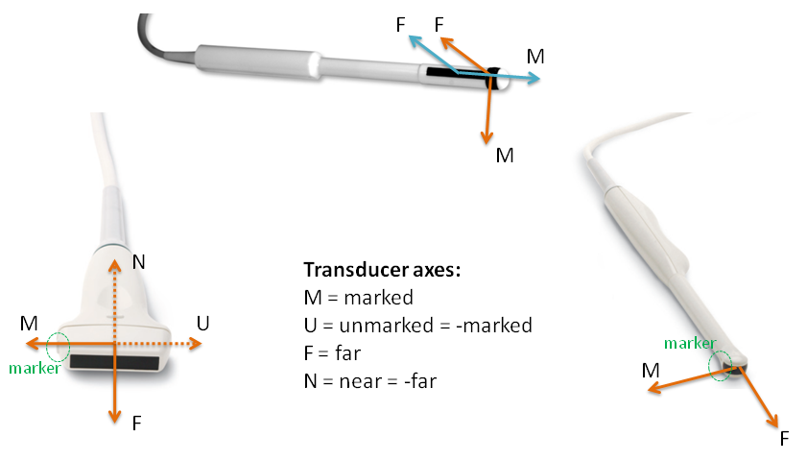
Ultrasound image orientation
Specify the orientation of the X and Y axes of the image
Standard orientation in Plus: B-mode => MF, RF-mode => FM

Slide 7
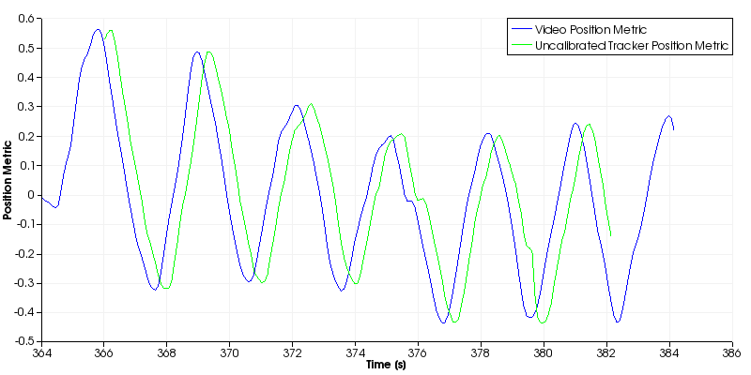
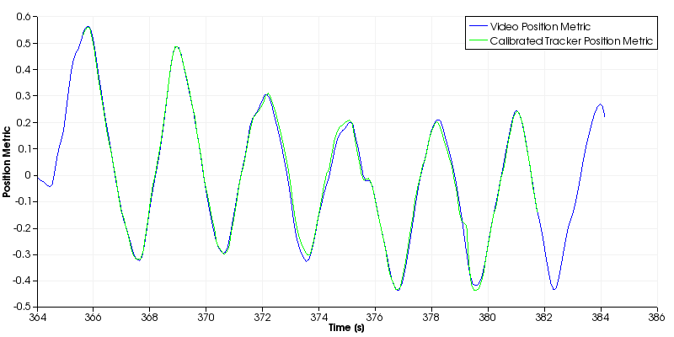
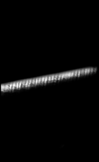
Temporal calibration
Goal: determine time offset between data streams
Extract the same information (e.g., position) and find the time offset that leads to maximum correlation of the signals
Use accurate clock (∼1ms is achievable with multimedia timers)
Timestamp filtering: detect delayed data, reduce jitter
Limit maximum speed
without temporal calibration
with temporal calibration
Frame index
time

Slide 8
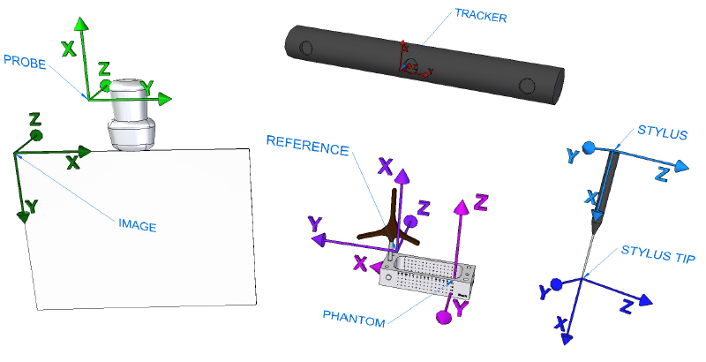
Spatial calibration
Goal: determine the PROBE to IMAGE transform

Slide 9
Spatial calibration
Goal: determine the PROBE to IMAGE transform
Determine STYLUS to STYLUS TIP transform (pivot calibration)
Determine PHANTOM to PHANTOM REFERENCE transform (landmark registration)
Determine the IMAGE to PHANTOM transform (known fiducial line positions in the phantom, segmented visible line positions in the image)
PHANTOM
STYLUS TIP
IMAGE
PROBE
PHANTOM REFERENCE
STYLUS
TRACKER

Slide 10
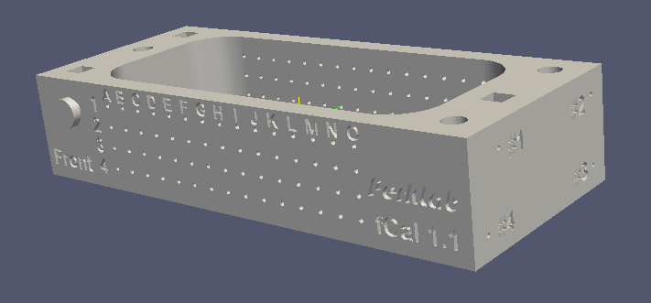
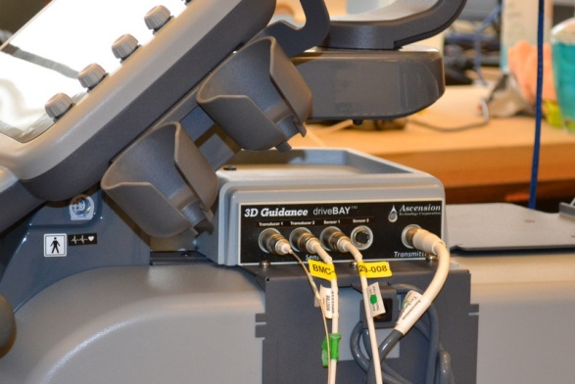
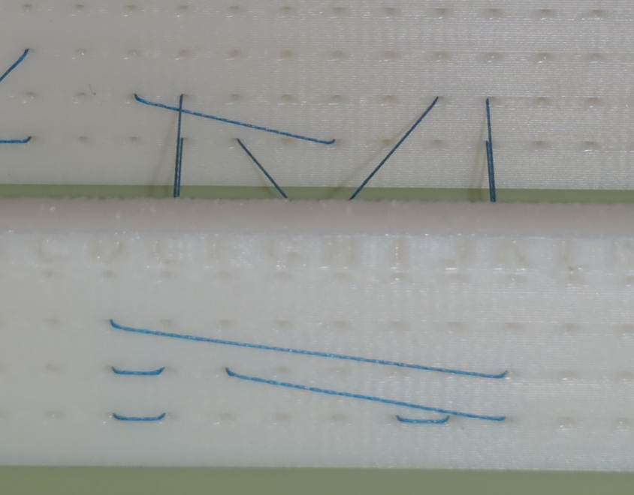
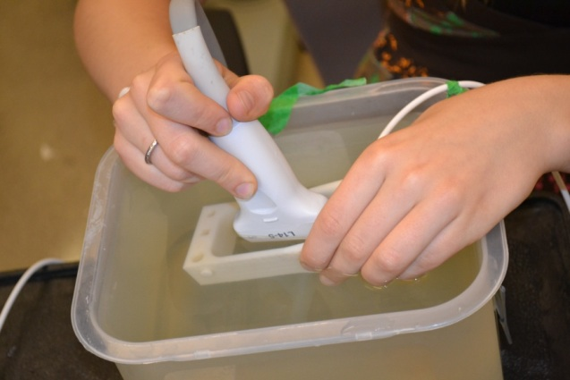
Spatial calibration
Tutorials with all data, models, tips&tricks.
Performing tracked ultrasound probe calibration using fCal
How to build an fCal calibration phantom

Slide 11
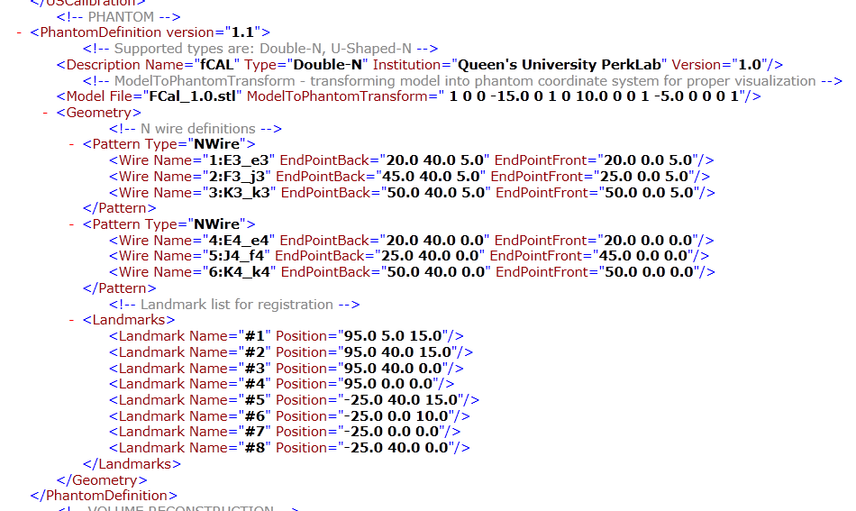
Spatial calibration
Generic description of the phantom

Slide 12
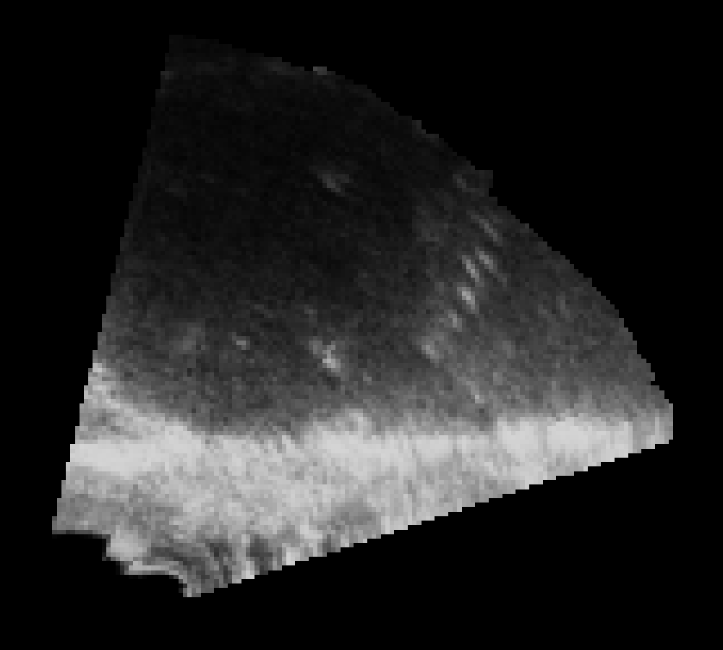
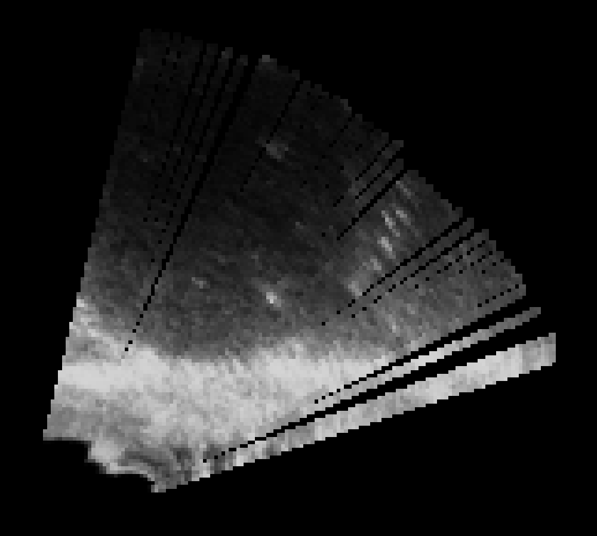
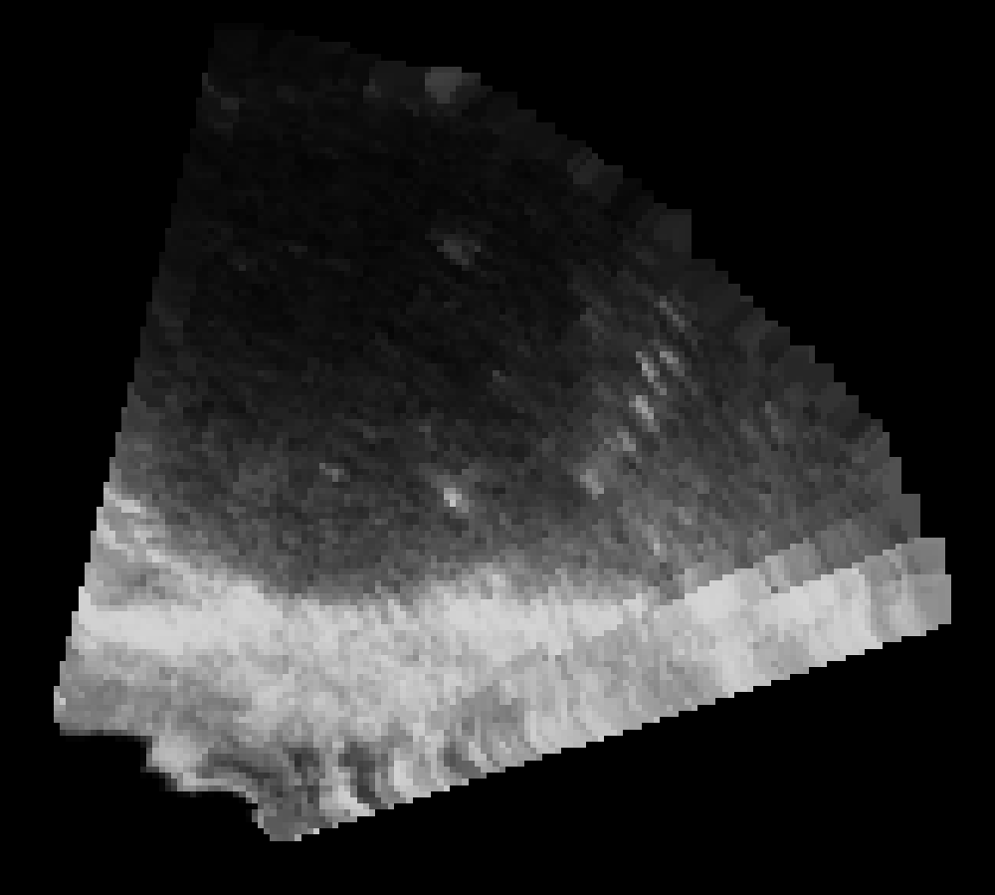
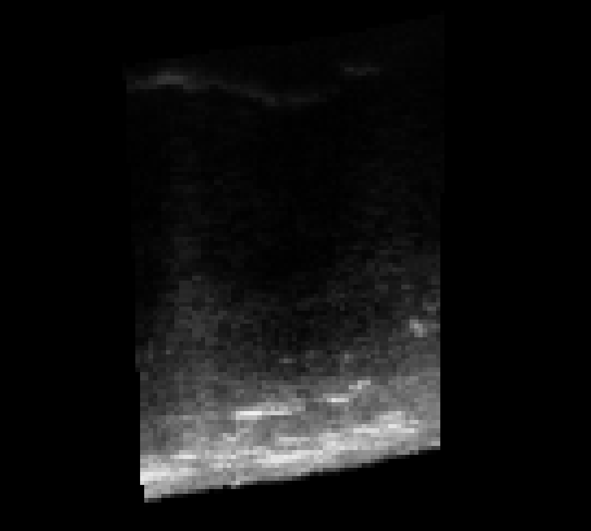
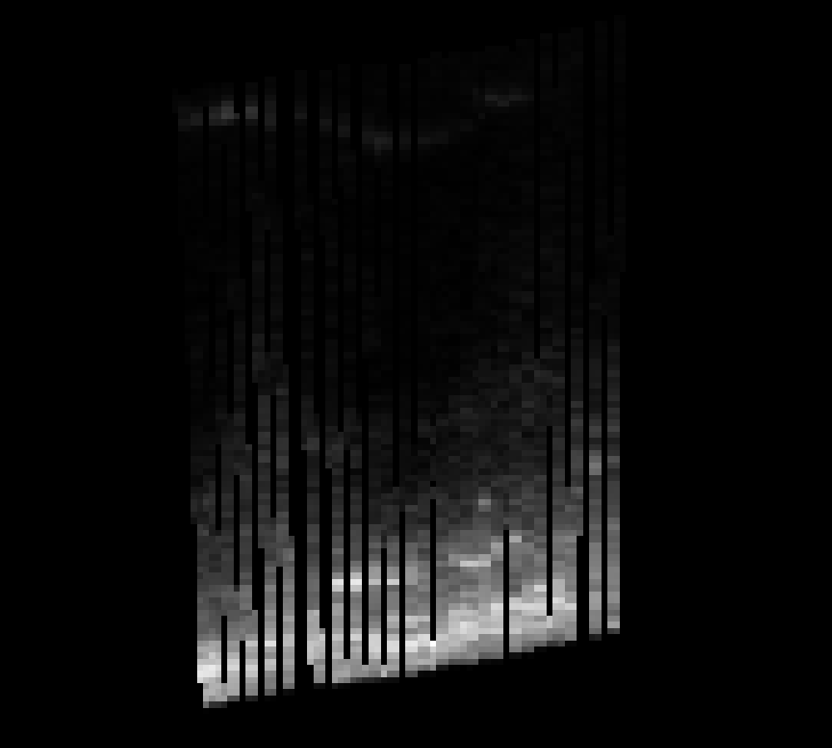
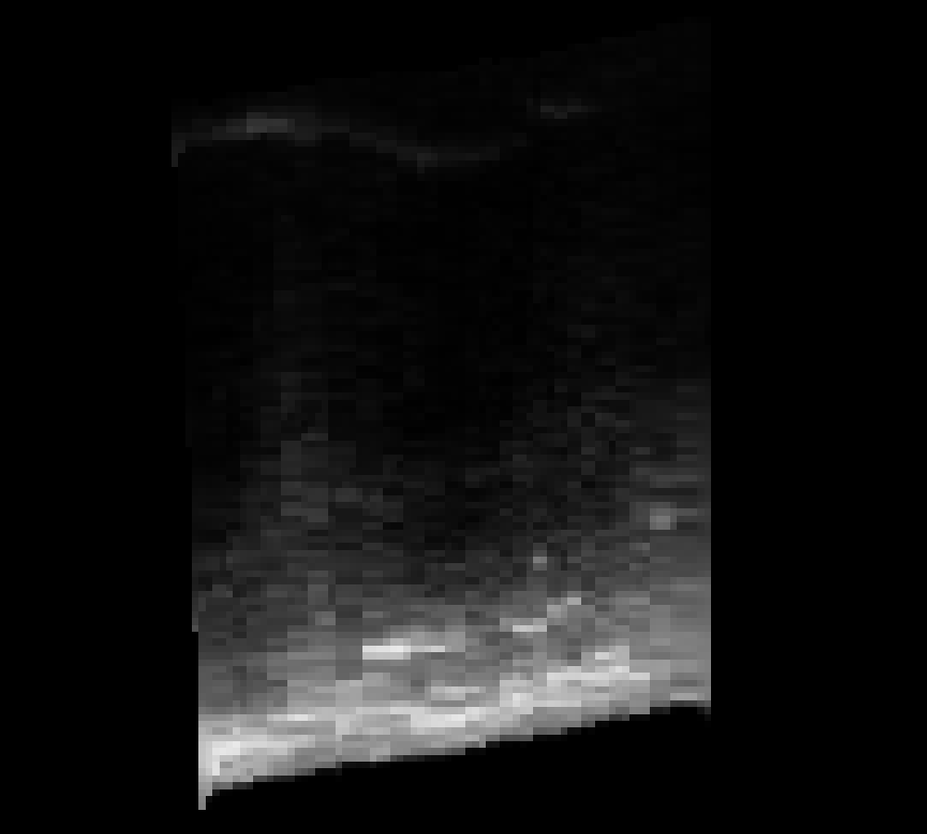
Processing
RF to B-mode conversion: brightness conversion and scan conversion for linear and curvilinear transducers
Volume reconstruction: with hole filling, multi-threaded
Ground truth
Reconstructed volume without hole filling
Reconstructed volume with hole filling

Slide 13
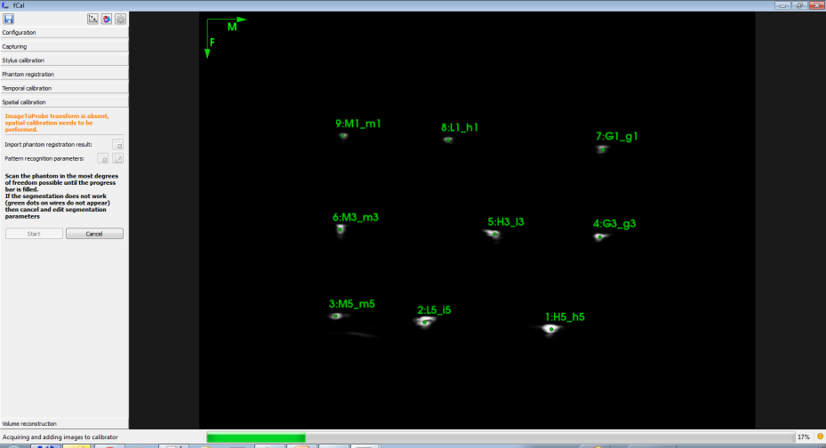
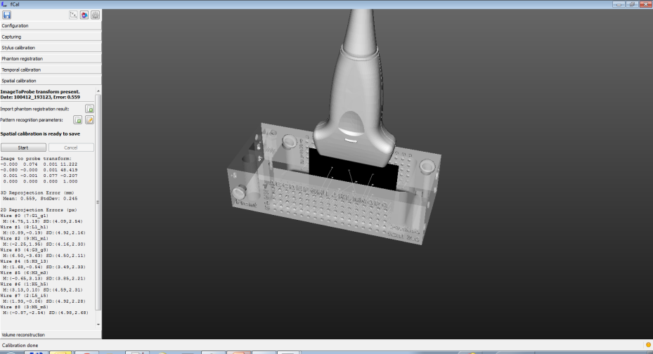
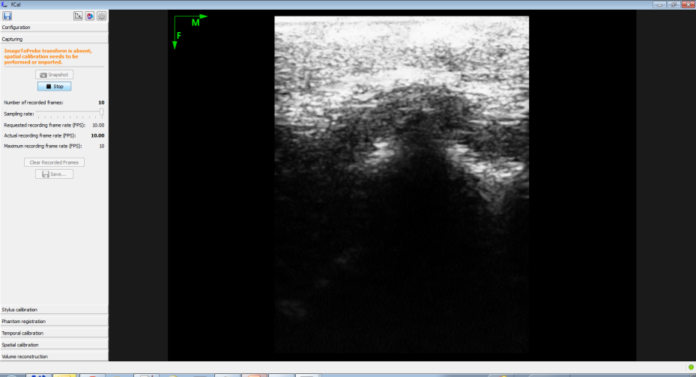
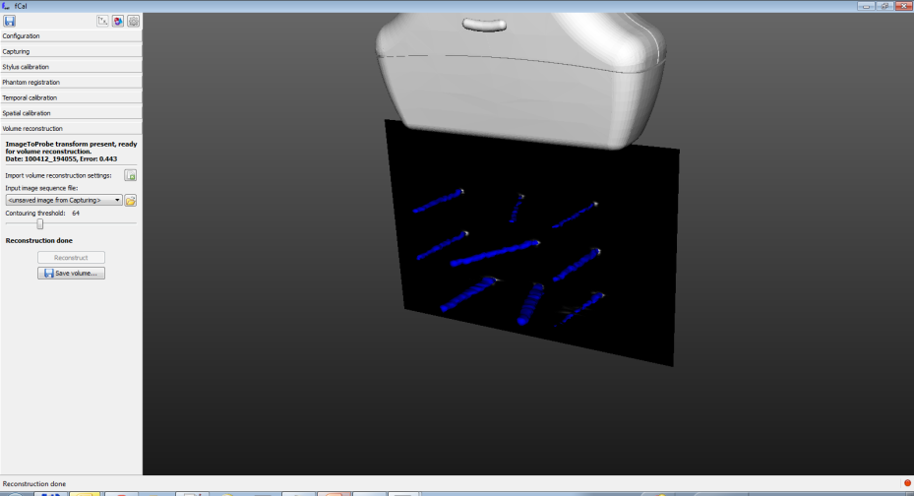
fCal application
Spatial and temporal calibration
Basic visualization
Recording
Volume reconstruction

Slide 14
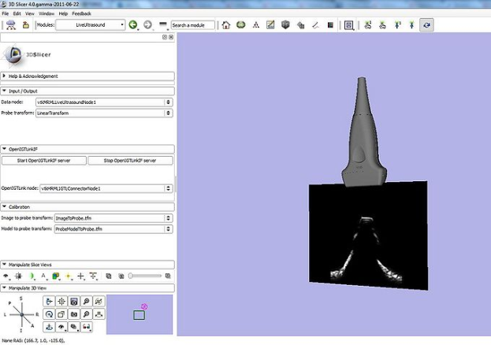
PlusServer application
Console application (no GUI)
Typically runs on the ultrasound computer
Broadcasts data through OpenIGTLink (e.g., to 3D Slicer)
Remote control access
Control data recording
Request volume reconstruction

Slide 15
Performance
Calibration accuracy
Temporal: standard deviation of repeated lag measurements is a couple of msec
Spatial: fiducial line reprojection mean error is about 0.5mm (Ultrasonix L14-5 transducer with SonixGPS), total error is about 1mm
Data acquisition: fCal can typically keep up with the data acquisition speed (30-60 fps full-frame, 100-150 fps reduced depth and/or sector size)
OpenIGTLink broadcasting: 10-20 fps
Visualization in 3D Slicer: 10 fps (due to default OpenIGTLinkIF refresh rate)

Slide 16
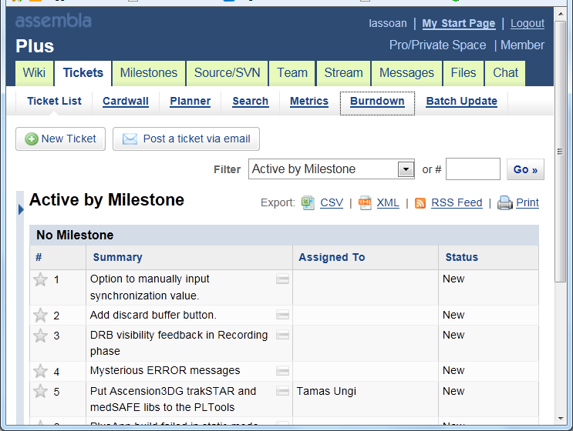
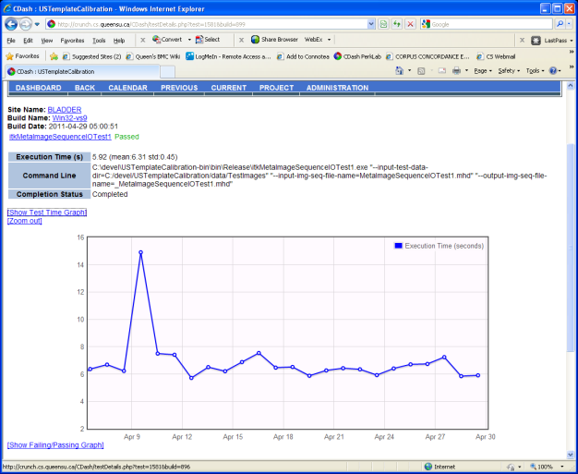
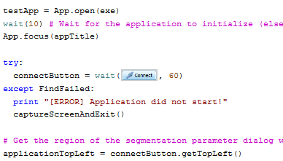
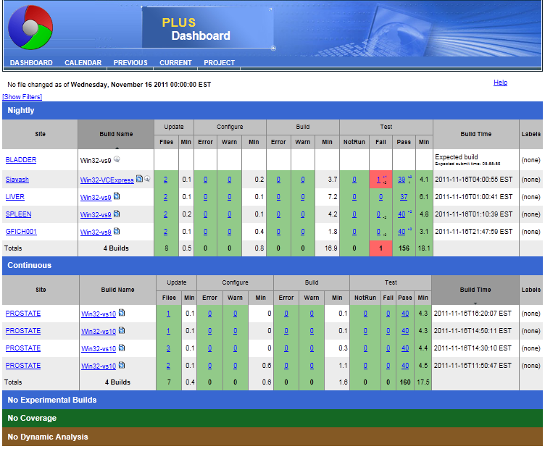
Development process
Source control, tickets, releases, messaging (www.assembla.com/spaces/plus)
Standardized build environment (using CMake): automatically download and configure all required software components
Documentation: wiki, doxygen
Automatic tests: CTest, CDash, Sikuli (=> QtTest?)

Slide 17
System overview
Developed in the PerkLab
Developed by collaborators
Perk Tutor
ProstateNav
SlicerIGT
Live ultrasound
...
Transform recorder
DICOM-RT import
...
Dose comparison
SlicerRT
3D Slicer extension manager
3D Slicer
Registration
Segmentation
...
Visualization
VTK, ITK, CTK, QT, DCMTK, …
OpenIGTLink
Temporal and spatial calibration
OpenIGTLink
PLUS
Device interface
software
hardware
Ultrasound scanner
Navigation system
MRI scanner
Custom needle guide
Custom phantoms
Notes:
what our research lab is doing from a software development perspective

Slide 18
PLUS Architecture Overview
Applications
fCal
PlusServer
iCal
…
Temporal calibration
N-Wire calibration
Algorithms
Single wall calibration
Volume reconstruction
Line segmentation
…
Data
Tracked frame
Channel
Device
Data sources
Device Specific SDK
Hardware
Notes:
This shows a layered approach to what depends on what
SDK – software development kit, functions to interact with a specific piece of hardware

Slide 19
PLUS Data Pipeline
EM Tracker
B Virtual Mixer
B Virtual Capture
Channel
Channel
Visualization Client
Ultrasound
Rf Virtual Mixer
B-mode Channel
Channel
Rf-mode Channel
Rf Virtual Capture
Data Flow
Devices are the creation point of data
Recorded data from world
Simulated data, processed data
Channels are the communication point between devices
Outputs tracked frames for client consumption

Slide 20
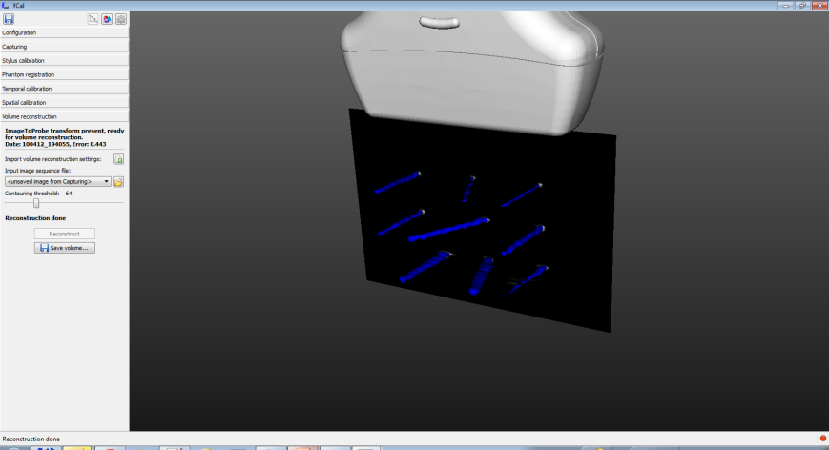
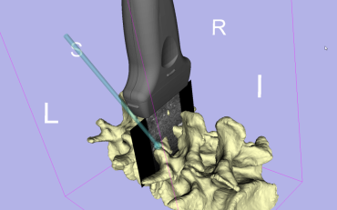
Thank you!
PLUS: https://www.assembla.com/spaces/plus
Source code, binary releases, documentations, tutorials, etc.
Slicer IGT: https://www.assembla.com/spaces/SlicerIGT
3D Slicer extensions for additional visualization and analysis.
Contact: Andras Lasso (lasso@cs.queensu.ca) http://perk.cs.queensu.ca

Slide 21
Appendix

Slide 22
Source: https://subversion.assembla.com/svn/plus/trunk/doc/overview/PlusOverview.pptx

