Slide 1
PLUS Tutorial: How to build an fCal calibration phantom
www.assembla.com/spaces/plus
Source: https://subversion.assembla.com/svn/plus/trunk/doc/tutorials/PlusTutorialBuildingfCalPhantom.pptx

Slide 2
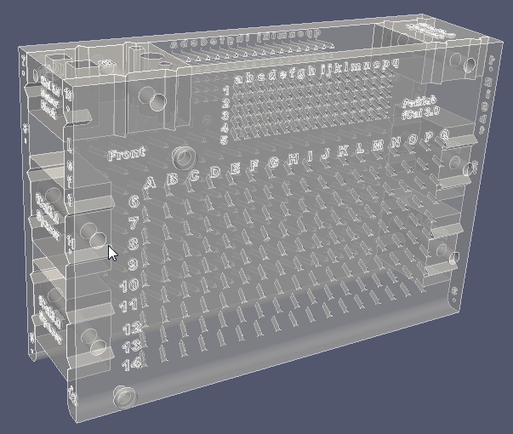
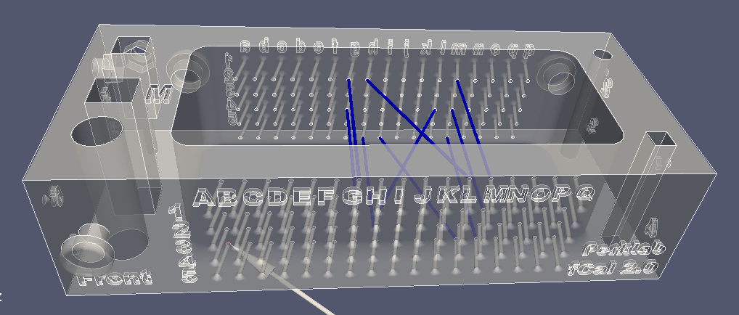
Calibration phantom revisions
Phantom model: fCal_2.0, Wiring: wiring_2.0
Recommended calibration phantom for 30-90mm imaging depth
Phantom model: fCal_3.0
Experimental calibration phantom for >90mm imaging depth
fCal_2.0
fCal_3.0

Slide 3
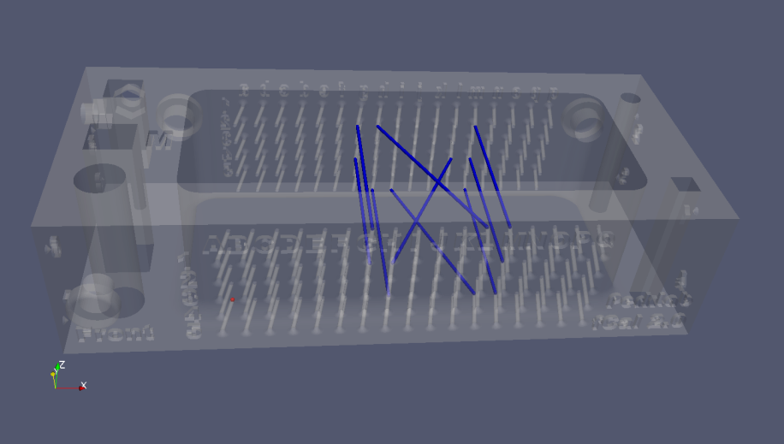
Print the phantom
Download the phantom model in STL format from the repository:
https://subversion.assembla.com/svn/plus/trunk/PlusLib/data/CADModels/fCalPhantom/
You can have a look at the model file in 3D Slicer or Paraview
Print the STL file using a regular 3D rapid prototyping printer
FDM printing of dense ABS plastic is recommended
The cost should be around $30-$150
If you do not have access to a 3D printer know or the local 3D printing shops are expensive then you can just upload your model and get it by post within a couple of days: http://3dprintingpricecheck.com/ http://www.3ders.org/3d-printing/3d-print-services.html

Slide 4
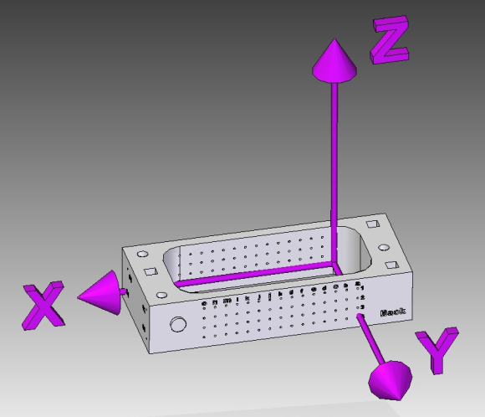
Insert fiducial lines into the phantom
Fiducial line material: regular fishing line, about 0.2-0.3 mm diameter
The endpoints of the fiducial lines shall correspond to the description in the device set configuration XML file, such as: https://subversion.assembla.com/svn/plus/trunk/PlusLib/data/ConfigFiles/PlusConfiguration_SonixTouch_Ascension3DG_L14_fCal2.0.xml
The screenshots available at https://subversion.assembla.com/svn/plus/trunk/doc/specifications/fCalPhantom can also be helpful in verifying that the fiducial lines have been inserted correctly
The automatic calibration method in fCal supports a fiducial line structure containing any number of parallel N patterns.
Phantom mode: fCal_2.0, Wiring: wiring_2.0:
<Geometry> <Pattern Type="NWire">
<Wire Name="7:G1_g1" EndPointFront="30.0 0.0 20.0" EndPointBack="30.0 40.0 20.0" />
<Wire Name="8:L1_h1" EndPointFront="55.0 0.0 20.0" EndPointBack="35.0 40.0 20.0" />
<Wire Name="9:M1_m1" EndPointFront="60.0 0.0 20.0" EndPointBack="60.0 40.0 20.0" />
</Pattern>
<Pattern Type="NWire">
<Wire Name="4:G3_g3" EndPointFront="30.0 0.0 10.0" EndPointBack="30.0 40.0 10.0" />
<Wire Name="5:H3_l3" EndPointFront="35.0 0.0 10.0" EndPointBack="55.0 40.0 10.0" />
<Wire Name="6:M3_m3" EndPointFront="60.0 0.0 10.0" EndPointBack="60.0 40.0 10.0" />
</Pattern>
<Pattern Type="NWire">
<Wire Name="1:H5_h5" EndPointFront="35.0 0.0 0.0" EndPointBack="35.0 40.0 0.0" />
<Wire Name="2:L5_i5" EndPointFront="55.0 0.0 0.0" EndPointBack="40.0 40.0 0.0" />
<Wire Name="3:M5_m5" EndPointFront="60.0 0.0 0.0" EndPointBack="60.0 40.0 0.0" />
</Pattern>
...
</Geometry>
Back
The 3D coordinates of the EndPoints are defined in the Phantom coordinate system. The Phantom coordinate system’s origin is the endpoint of the bottom left hole (on fCal-2.x it is the A5), inside the box.
See the image on the right or the coordinate system definition model here for more information: https://www.assembla.com/spaces/plus/wiki/Coordinate_system_definitions

Slide 5
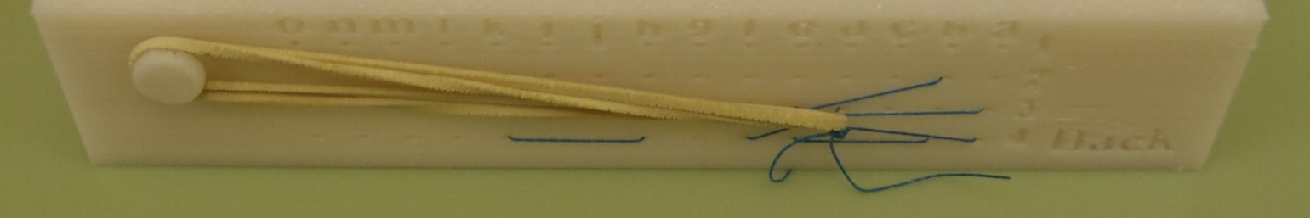
Line stretching
The fiducial lines should be stretched enough to be completely straight (the stretching has negligible effect on the line visibility, so it is enough to stretch it just so that it is straight)
You can stretch the fiducial lines by using a rubber band as it is shown in the picture below
Slanted holes in fCal_2.x and later phantoms take care of line alignment within a hole.
Stretching

Slide 6
Appendix

Slide 7
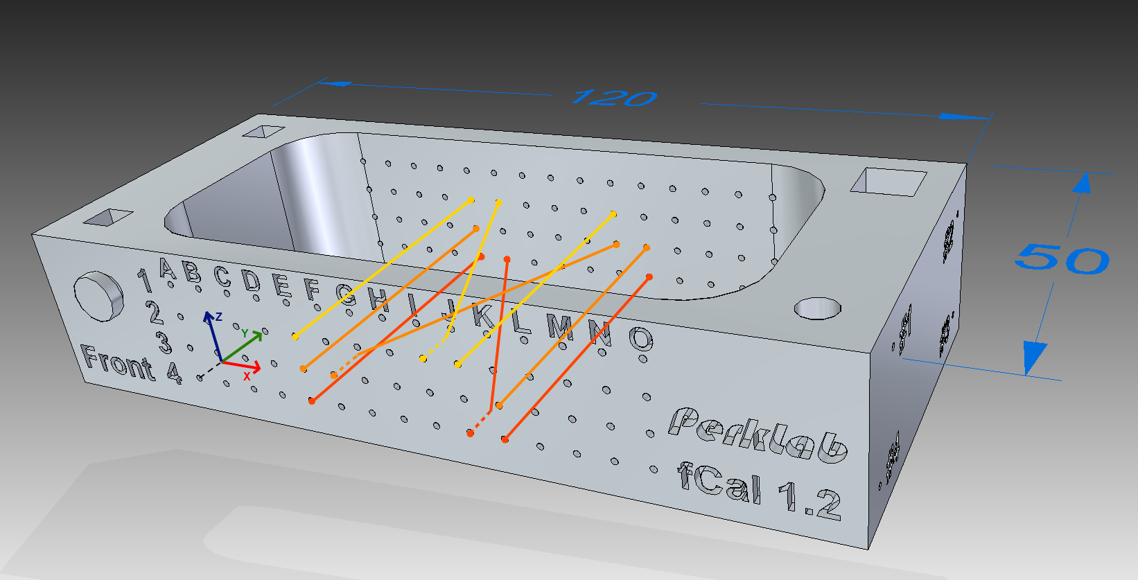
Obsolete phantom revisions
Phantom model: fCal_1.0, Wiring: wiring_1.x
obsolete, use fCal_2.0 instead

Slide 8
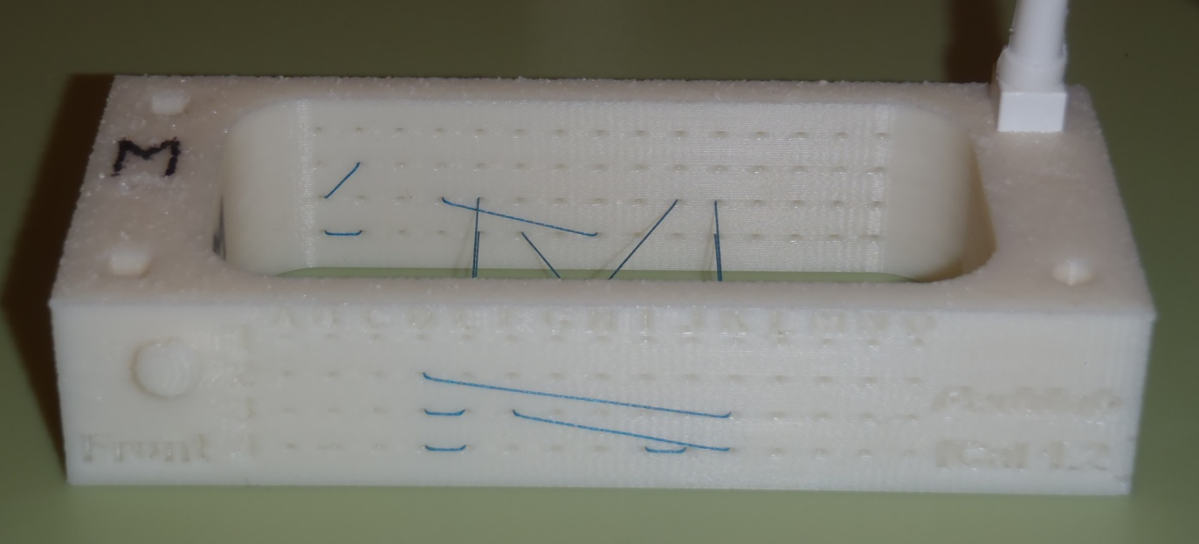

Line alignment
Line alignment is only an issue for fCal_1.x phantoms. Slanted holes in fCal_2.x and later phantoms take care of line alignment within a hole.
The fiducial line has a much smaller diameter than the printed holes, therefore it makes a big difference which side of the hole the line is aligned to
All the lines are aligned to the same side of the holes. This ensures that the distance between the lines remain the same.
By convention, we always align the lines to the left side of the holes for parallel wires (wire 1, 3, 4, 6)
Due to the thickness of the phantom wall, the diagonal wires (wire 2, 5) can only be aligned in one way (towards the center of the phantom)
Align to the left
←
←
→
←
←
←
←
→
←
Front
←
←
←

Slide 9
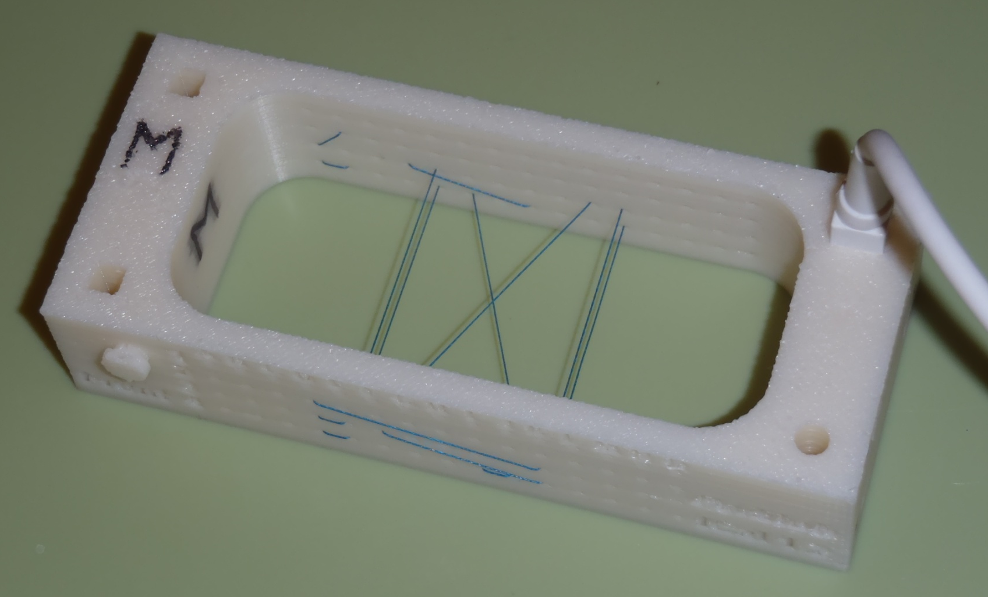
Example
Phantom model: fCal_1.0, Wiring: wiring_1.0
e3 (wire 1)
j3 (wire 2)
k3 (wire 3)
e4 (wire 4)
f4 (wire 5)
k4 (wire 6)
Front
E3 (wire 1)
F3 (wire 2)
K3 (wire 3)
E4 (wire 4)
J4 (wire 5)
K4 (wire 6)

