Slide 1
PLUS Tutorial: Ultrasound probe calibration using fCal
www.assembla.com/spaces/plus
Source: https://subversion.assembla.com/svn/plus/trunk/doc/tutorials/PlusTutorialfCalCalibrationProcess.pptx

Slide 2
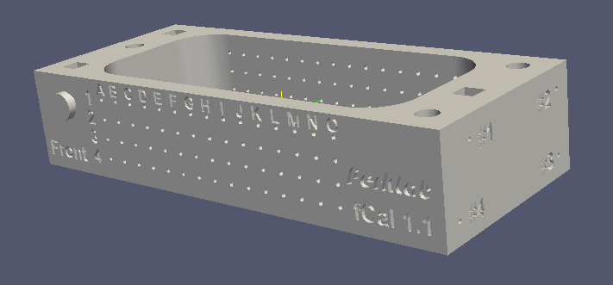
Concept
Goal: Determine the Image-to-Probe transform.
Use the correspondence of known wire positions in 3D and segmented wire positions in the US image.
N-wires are attached to a precisely manufactured calibration phantom (see image below) – see phantom building tutorial (PlusTutorialBuildingfCalPhantom.pptx ) for phantom building instructions.

Slide 3
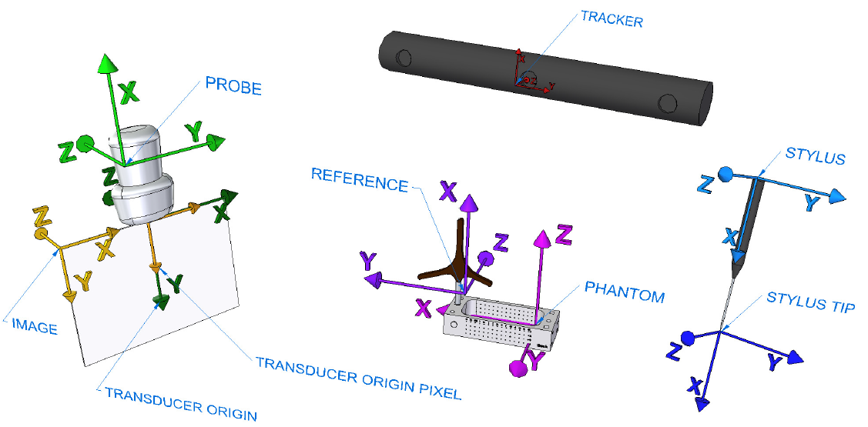
Coordinate systems
https://subversion.assembla.com/svn/plus/trunk/doc/specifications/CoordinateSystems/FreehandCalibration_CoordinateRepresentation.png

Slide 4
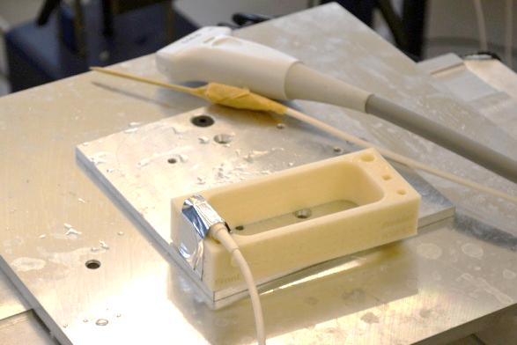
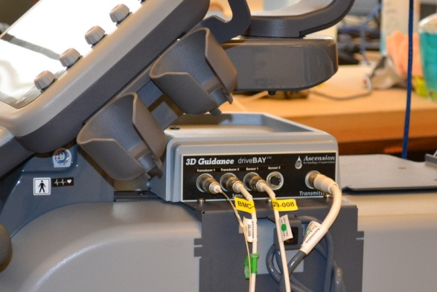
Hardware setup
Device set used in this tutorial:
Sonix Touch with GPS extension
Tracker tools
Probe
Reference
Stylus
fCal 1.x calibration phantom
Sonix GPS side cover removed for accessing all connectors

Slide 5
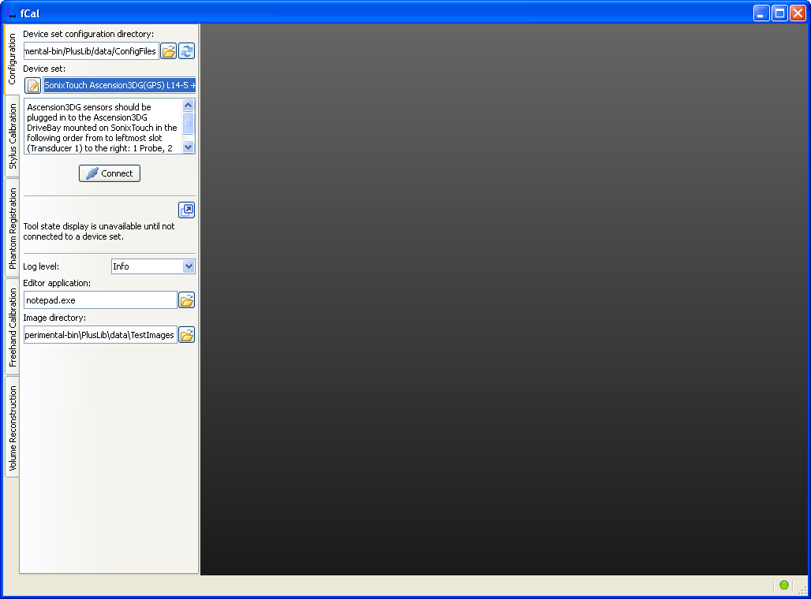
Software setup
Start fCal.exe
Select your device set and click Connect

Slide 6
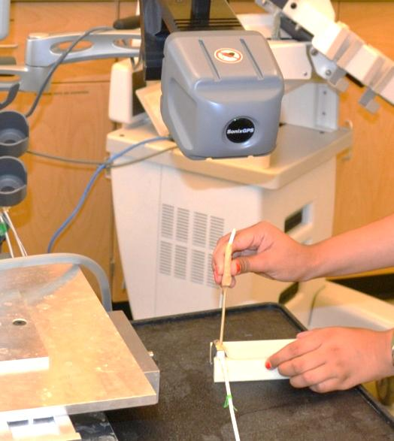
Stylus calibration
Attach an EM sensor to any pointing object.
fCal collects 100 different points.
Stylus tip should be fixed to the reference while pivoting the sensor on a sphere surface.

Slide 7
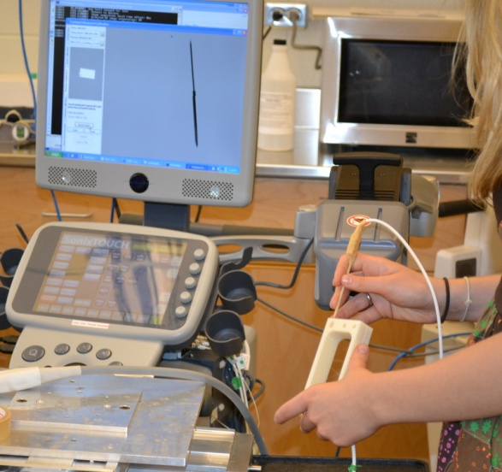
Phantom registration
Registration of predefined landmark points.
Model points are defined in the configuration XML file.
Tracked points are collected by the stylus.

Slide 8
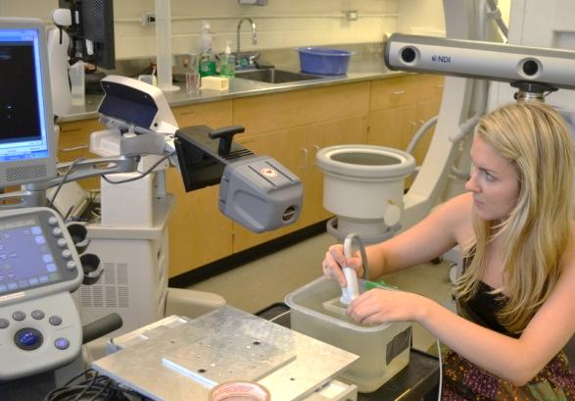
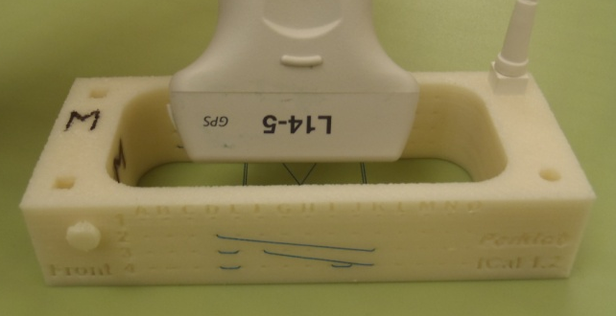
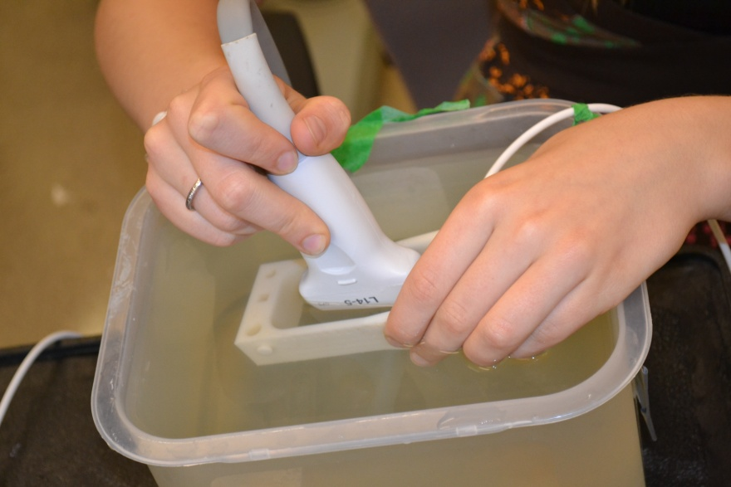
Image collection and calibration
Align the transducer to have the marked side on the A1 side of the phantom
Marking on the transducer
A
1
Front
Module automatically collects 100 images for validation, 200 images for calibration.
Images with failed registration are discarded.
Move slowly.
Keep the transducer orthogonal to the wires to have optimal image quality.

