Slide 1
Compute transform between Transducer and Image coordinate system
Spatial calibration in Plus provides the transformation from the Image coordinate system (that has the origin in one of the image corner) to the Probe coordinate system. However, some users are interested in knowing positions in the Transducer coordinate system, which has similar orientation (axes are parallel but the order and direction may be different) as the Image coordinate system, but has the origin in the middle of the transducer pixel and the unit is mm.
These slides explain how to determine the transformation between the Image and Transducer coordinate system, which can be used to obtain the Transducer to Probe transform.
For example, BrainLab provides image pose in the Transducer coordinate system. To perform volume reconstruction using Plus, the TransducerToImage transform has to be computed as follows.

Slide 2
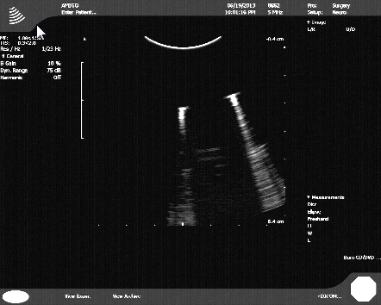
1. Coordinate systems definition
z
Image
(unit: pixel)
x (M=marked)
M
y (F=far)
Transducer
(unit: mm)
x
y
TransducerOrigin point
(930, 194,0)_{Image}
z
x
Tracker
(unit: mm)
Defined in the MRI space
y
z
1200 pixel
1920 pixel

Slide 3
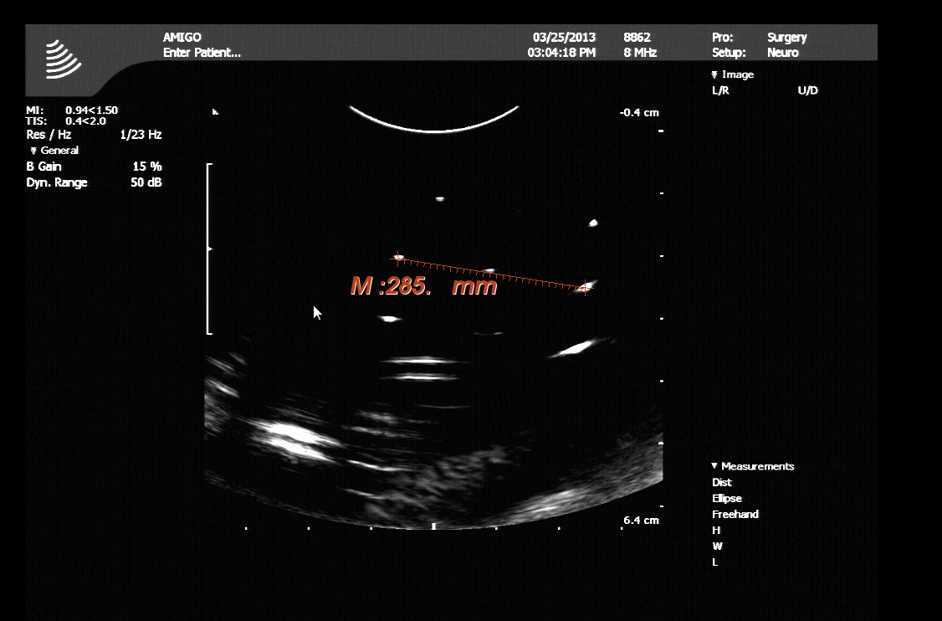
2. Determine pixel spacing
Pixel spacing: (30mm/285pixel, 20mm/190pixel) = (0.105, 0.105) mm/pixel = 0.105 mm/pixel.

Slide 4
3. Compute TransducerToImage
P_{Image} = TransducerToImage * P_{Transducer}
1. Translation
For the TransducerOrigin point:
TransducerOrigin_{Image} = (934,194,0,1)
TransducerOrigin_{Transducer} = (0,0,0,1)
Therefore, the last column of the transform is the same as TransducerOrigin_{Image}
3. Axis directions
Transducer x axis = Image x axis => first column is [TransducerToImageScale,0,0]
Transducer y axis = Image -z axis => second column [0,0,-TransducerToImageScale]
Transducer z axis = Image y axis => third column is [0,TransducerToImageScale,0]
934
194
0
1
 |  |  | 934
 |  |  | 194
 |  |  | 0
0 | 0 | 0 | 1
0
0
0
1
=
*
Putting it all together:
TransducerToImage =
9.5 | 0 | 0 | 934
0 | 0 | 9.5 | 194
0 | -9.5 | 0 | 0
0 | 0 | 0 | 1
2. Scaling
Image (pixel) = TransducerToImageScale * Transducer (mm)
1 pixel = TransducerToImageScale * 0.105mm
TransducerToImageScale = 1 pixel/0.105 mm = 9.5 pixel/mm

Slide 5
Config file contents
<PlusConfiguration …>
…
<CoordinateDefinitions>
<Transform From="Transducer" To="Image"
Matrix="
9.5 0.0 0.0 934
0.0 0.0 9.5 194
0.0 -9.5 0.0 0
0 0 0 1"/>
</CoordinateDefinitions>
…
</PlusConfiguration>

Slide 6
If ImageToProbe matrix is known
If ImageToProbe matrix is known then the some values can be determined from that matrix:
x and y pixel spacing is the norm of the first and second column of the ProbeToImage transform matrix
Image axis directions are: x axis = M (marked), y axis = F (far)

