Slide 1
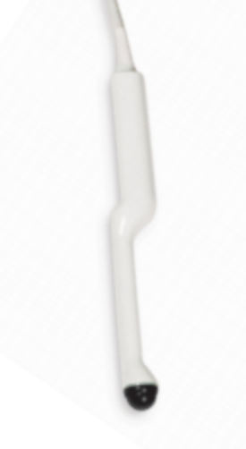
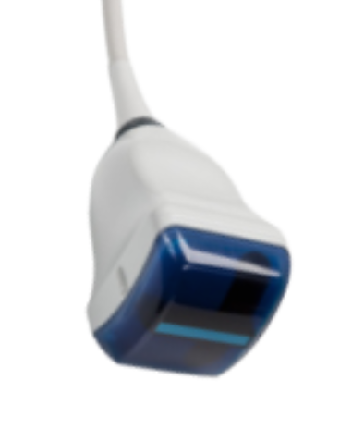
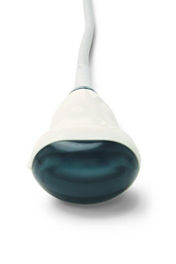
Ultrasonix motorized transducer transforms computation

Slide 2
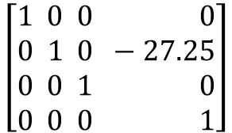
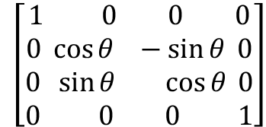
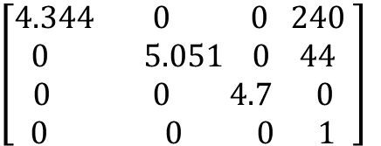
Name | Origin | Axis directions | Unit
Image | Center of the pixel in the corner that is closest to the unmarked side of the transducer, near the transducer surface | X = towards marked direction Y= towards the far side of the image (sound propagation direction) Z = cross(X,Y) | Pixels
Motor | Transducer coordinate system origin projected on the rotation axis of the motor | X = motor rotation axis Y = image F direction when RotationAngleDeg=0 Z = cross(X,Y) | mm
MotorRotated | Same as Motor | X = motor rotation axis Y = Motor coordinate system Y axis right-hand rotated around the X axis by RotationAngleDeg Z = Motor coordinate system Z axis right-hand rotated around the Z axis by RotationAngleDeg | mm
Transducer | Location of the center element on the transducer surface. It may rotate around the rotation axis of the motor. | Same as MotorRotated | mm
MotorRotatedToTransducerTransform
= translation by radius
=
RotationAngleDeg = 30
$$\left[\begin{aligned}1 0 0 0 \\ 0 1 0 −27.25 \\ 0 0 1 0 \\ 0 0 0 1\end{aligned}\right]$$
z
Image
y
x
Transducer
z
y
z
x
TransducerToImageTransform
= translation by transducer origin in the image and scaling by pixel spacing
=
MotorRotated
z
y
MotorToMotorRotatedTransform
= rot(RotationAngleDeg)
=
Motor
y
x
x
$$\left[\begin{aligned}1 0 0 0 \\ 0 \cos{θ }−\sin{θ} 0 \\ 0 \sin{θ} \cos{θ} 0 \\ 0 0 0 1\end{aligned}\right]$$
$$\left[\begin{aligned}4.344 0 0 240 \\ 0 5.051 0 44 \\ 0 0 4.7 0 \\ 0 0 0 1\end{aligned}\right]$$

Slide 3
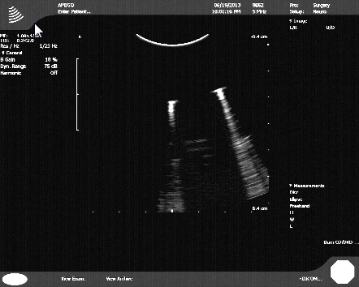
1. Coordinate systems definition
z
Image
(unit: pixel)
x (M=marked)
M
y (F=far)
Transducer
(unit: mm)
x
y
TransducerOrigin point
(240, 44,0)_{Image}
z

Slide 4
Compute TransducerToImage
P_{Image} = TransducerToImage * P_{Transducer}
=> TransducerToImage=???
1. Translation
For the TransducerOrigin point:
TransducerOrigin_{Image} = (240,44,0,1)
TransducerOrigin_{Transducer} = (0,0,0,1)
2. Scaling
Image (pixel) = TransducerToImageSpacing * Transducer (mm)
1 pixel = TransducerToImageSpacing * 0.23mm (x)
1 pixel = TransducerToImageSpacing * 0.198mm (y)
TransducerToImageSpacing = 1 pixel/0.23 mm = 4.344 pixel/mm (x)
For y axis: 5.051
For z axis: average of x and y (only used for transforming 3D objects, e.g., for display; it does not have any effect on where points are transformed within the image plane)
240
44
0
1
? | ? | ? | 240
? | ? | ? | 44
? | ? | ? | 0
0 | 0 | 0 | 1
0
0
0
1
=
*
4.344 | 0 | 0 | 240
0 | 5.051 | 0 | 44
0 | 0 | 4.7 | 0
0 | 0 | 0 | 1
3. Axis directions
Axis directions are the same for the Transducer and Image coordinate systems, therefore spacing values are placed in the diagonal
Putting it all together:
TransducerToImage =

Slide 5
Configuration file
Complete device set configuration file for volume reconstruction:
PlusDeviceSet_Server_SonixTouch_MotorizedTransducer_Porta.xml
<CoordinateDefinitions>
<Transform From="Transducer" To="Image"
Matrix="
4.344 0 0 240
0 5.051 0 44
0 0 4.7 0
0 0 0 1" />
<Transform From="MotorRotated" To="Transducer"
Matrix="
1 0 0 0
0 1 0 -27.25
0 0 1 0
0 0 0 1" />
</CoordinateDefinitions>

