Slide 1
Compute transform between transducer center and the Image coordinate system
Spatial calibration in Plus provides the transformation from the Image coordinate system (that has the origin in one of the image corner) to the Probe coordinate system. However, some users are interested in knowing positions in the Ultrasound coordinate system, which has the same orientation and spacing as the Image coordinate system, but has the origin in the middle of the transducer pixel.
These slides explain how to determine the transformation between the Image and Ultrasound coordinate system, which can be used to obtain the Ultrasound to Probe transform.
For example, BrainLab provides image pose in the Ultrasound coordinate system. To perform volume reconstruction using Plus, the UltrasoundToImage transform has to be computed as follows.

Slide 2
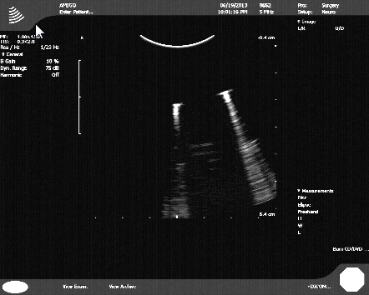
1. Coordinate systems definition
Image
(unit: pixel)
z
x
y
x
M
Ultrasound
(unit: mm)
y
z
TransducerOrigin point
(930, 194,0)_{Image}
ReferenceStar
(unit: mm)
x
x
Tracker
(unit: mm)
Defined in the MRI space
y
y
z
z
1200 pixel
1920 pixel

Slide 3
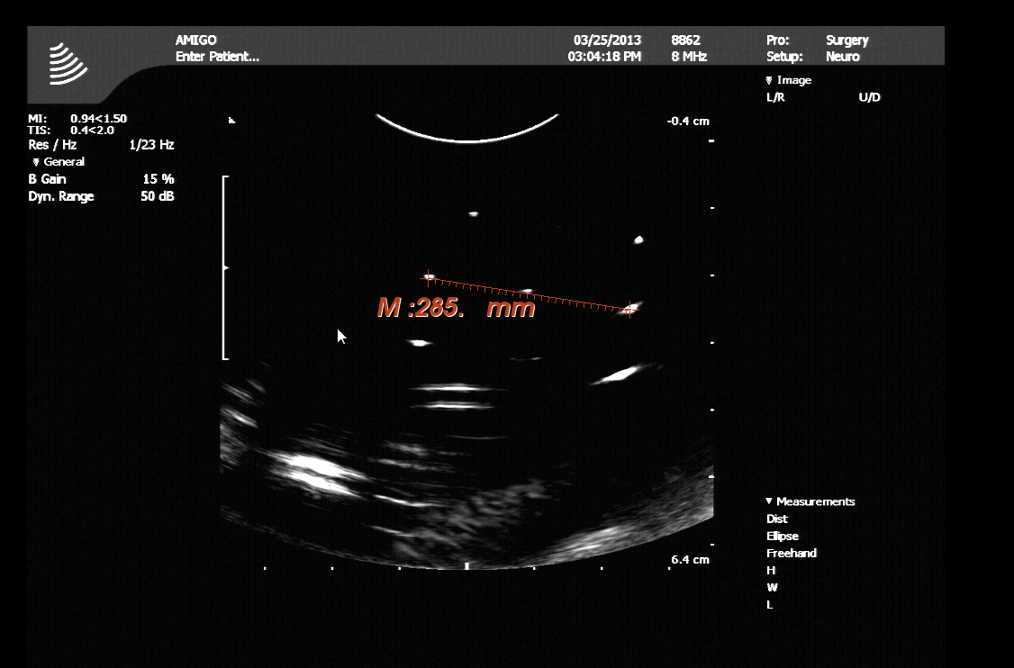
2. Determine pixel spacing
Pixel spacing: (30mm/285pixel, 20mm/190pixel) = (0.105, 0.105) mm/pixel = 0.105 mm/pixel.

Slide 4
3. Compute UltrasoundToImage
P_{Image} = UltrasoundToImage * P_{Ultrasound}
=> UltrasoundToImage=???
1. Translation:
For the TransducerOrigin point:
TransducerOrigin_{Image} = (934,194,0,1)
TransducerOrigin_{Ultrasound} = (0,0,0,1)
2. Scaling:
Image (pixel) = UltrasoundToImage * Ultrasound (mm)
1 pixel = UltrasoundToImage * 0.105mm
UltrasoundToImage = 1 pixel/0.105 mm = 9.5 pixel/mm
9.5 | ? | ? | ?
? | 9.5 | ? | ?
? | ? | 9.5 | ?
0 | 0 | 0 | 1
934
194
0
1
? | ? | ? | 934
? | ? | ? | 194
? | ? | ? | 0
0 | 0 | 0 | 1
0
0
0
1
=
*
9.5 | 0 | 0 | 934
0 | 0 | 9.5 | 194
0 | -9.5 | 0 | 0
0 | 0 | 0 | 1
3. Axis directions:
Order of columns, optionally multiplying the column by -1
with trial and error
Putting it all together:
UltrasoundToImage =

Slide 5
Config file contents
<PlusConfiguration …>
…
<CoordinateDefinitions>
<Transform From="Ultrasound" To="Image"
Matrix="
9.5 0.0 0.0 934
0.0 0.0 9.5 194
0.0 -9.5 0.0 0
0 0 0 1"/>
</CoordinateDefinitions>
…
</PlusConfiguration>

Slide 6
If ImageToProbe matrix is known
If ImageToProbe matrix is known then the some values can be determined from that matrix:
x and y pixel spacing is the norm of the first and second column of the ProbeToImage transform matrix
Image axis directions are: x axis = M (marked), y axis = F (far)

