Slide 1
PLUS Volume Reconstruction
Thomas Vaughan, Andras Lasso
Laboratory for Percutaneous Surgery,
Queen’s University

Slide 2
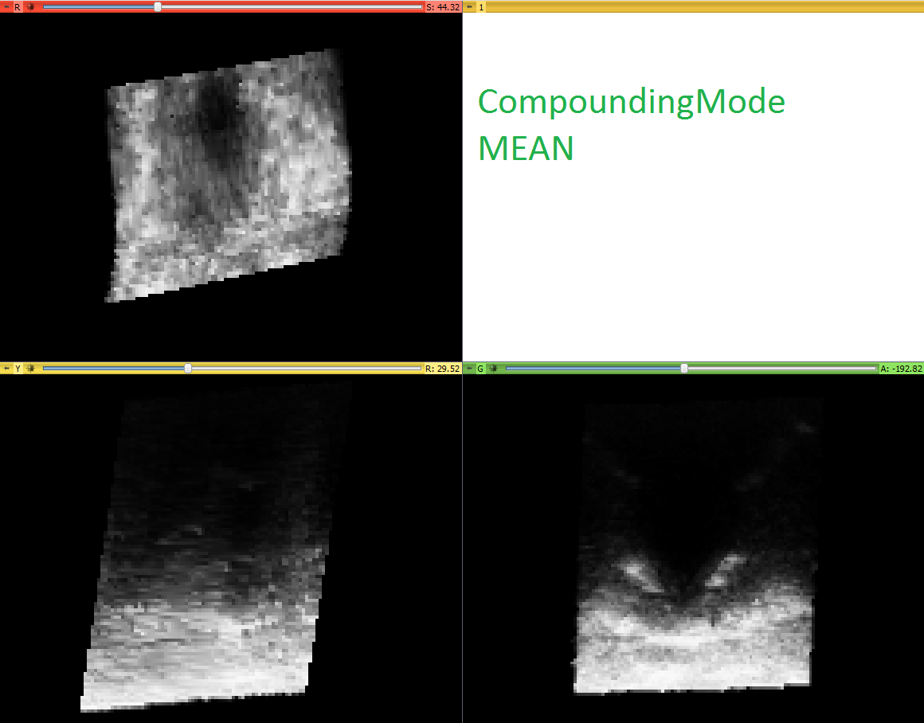
CompoundingMode=“MEAN”
Interpolation=“LINEAR”
HoleFilling=“ON” (sticks)

Slide 3
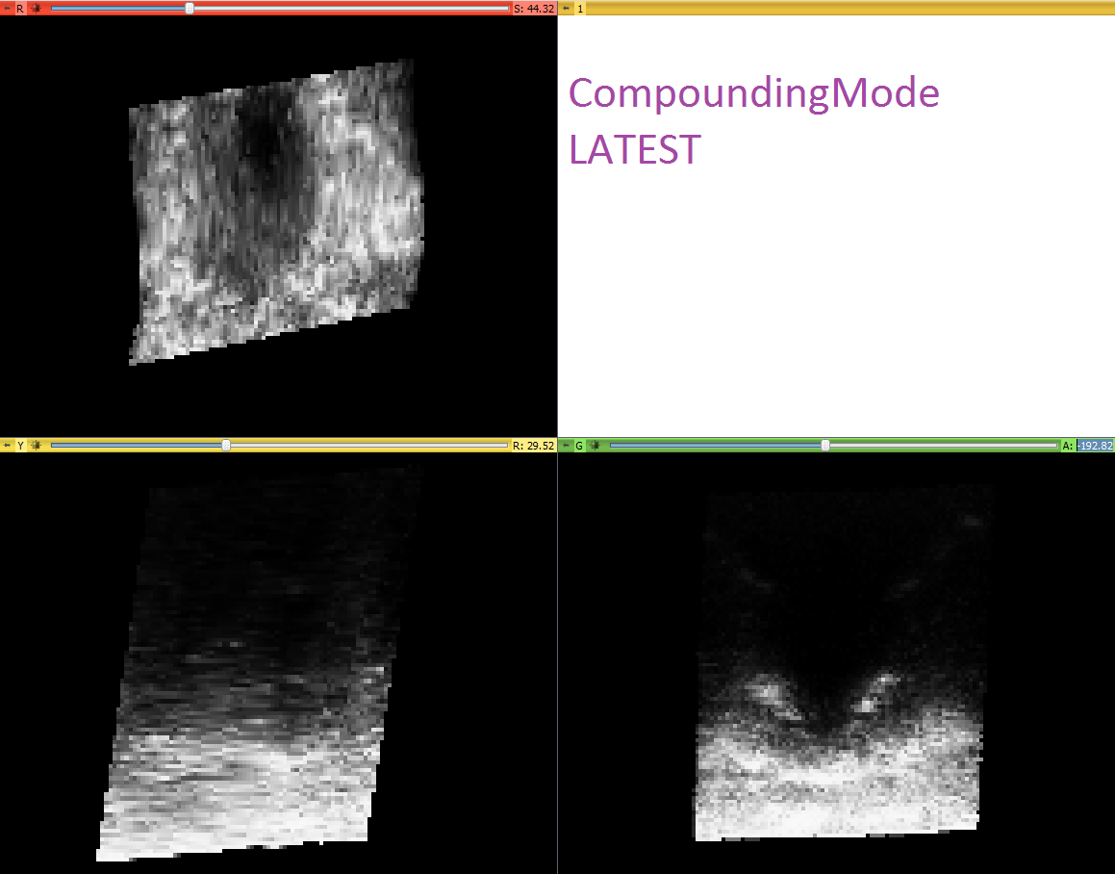
CompoundingMode=“LATEST”
Interpolation=“LINEAR”
HoleFilling=“ON” (sticks)

Slide 4
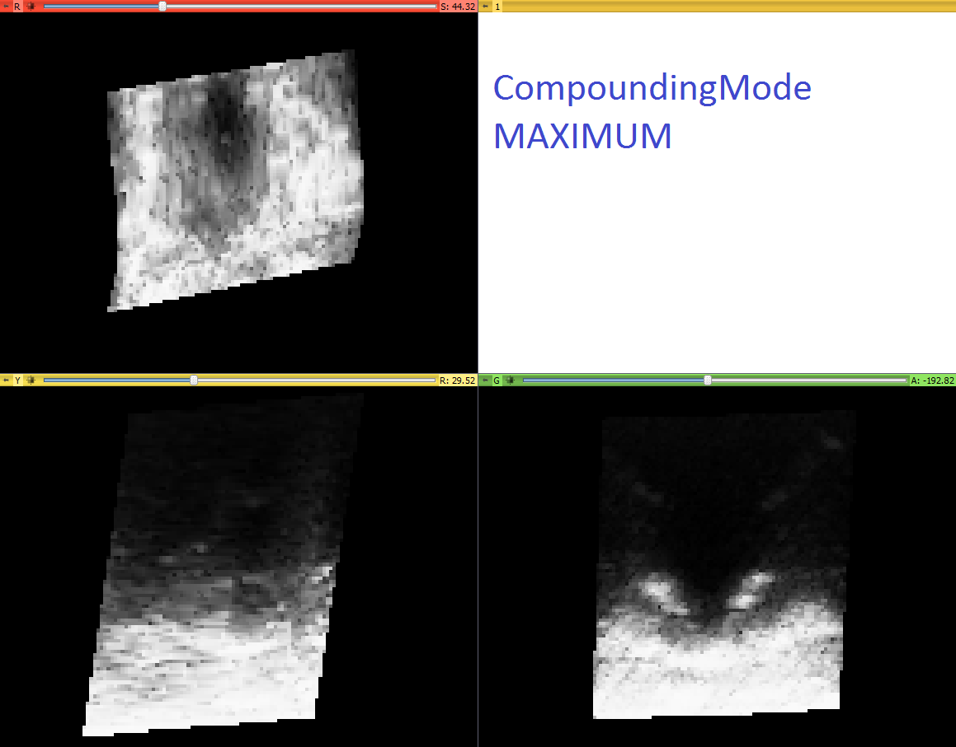
CompoundingMode=“MAXIMUM”
Interpolation=“LINEAR”
HoleFilling=“ON” (sticks)

