Slide 1
Development of a Hole Filling Algorithm for Ultrasound Volume Reconstruction
April 18th, 2012
Thomas Vaughan, Andras Lasso, Tamas Ungi, Gabor Fichtinger
Laboratory for Percutaneous Surgery School of Computing, Queen’s University, Canada

Slide 2
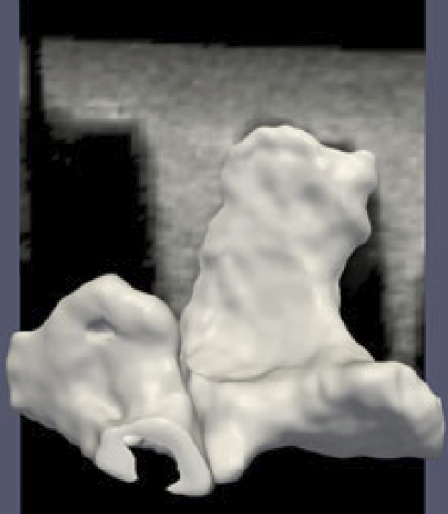
Introduction: Motivation
Reconstructed Volumes: 3D volume from 2D Ultrasound images
US/CT/MRI Registration
Surface models
Any slice orientation
No well-documented free software for volume reconstruction
Spine model registered to ultrasound. Khallaghi, et al. 2010.
Objective: Make freely-available, open-source volume reconstruction software for use by clinicians and researchers
Laboratory for Percutaneous Surgery (The Perk Lab) – Copyright © Queen’s University, 2012
- 2 -

Slide 3
Introduction: Volume Reconstruction Methods
Solberg, et al. 2007.
1. Function-Based Methods
2D slice information are used as input to a mathematical function that generates a 3D volume. (example: Radial Basis Function)
2. Voxel-Based Methods
Iterate through all voxels in the output volume and find the closest corresponding pixels in 2D image planes.
3. Pixel-Based Methods
Iterate through all pixels of the input slices and insert them into the output volume (bin filling), then fill remaining holes if needed (hole filling).
Laboratory for Percutaneous Surgery (The Perk Lab) – Copyright © Queen’s University, 2012
- 3 -

Slide 4
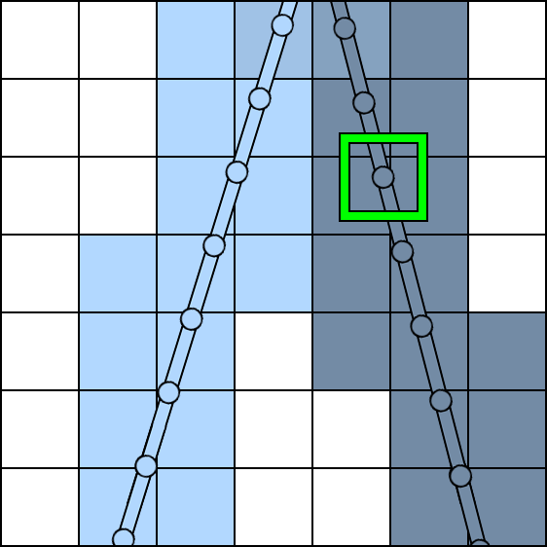
Introduction: Distribution Step
Insert tracked images using reverse tri-linear interpolation (Gobbi, Peters. 2002)
A single pixel value is distributed over 8 voxels
Store the number of intersecting slices as an accumulation buffer
If more than one pixel intersects a voxel, use accumulation buffer as weight in averaging
The distribution of a single pixel is shown by a green box.
Not all voxels will be filled, there still remain holes.
Images are difficult to interpret, can be effectively unusable
Laboratory for Percutaneous Surgery (The Perk Lab) – Copyright © Queen’s University, 2012
- 4 -

Slide 5
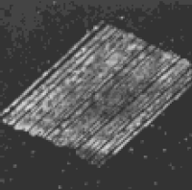
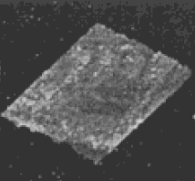
Introduction: Hole Filling
Proposed methods:
Values based on surrounding neighborhood:
average or maximum (Nelson, Pretorius. 1997)
Gaussian distance weight average (San José-Estépar, et al. 2003.)
Nelson, Pretorius.
1997
Holes present
Holes filled
Spreading distributed voxels over a larger region
Example: using a Gaussian kernel (Ohbuchi, et al. 1992)
Laboratory for Percutaneous Surgery (The Perk Lab) – Copyright © Queen’s University, 2012
- 5 -

Slide 6
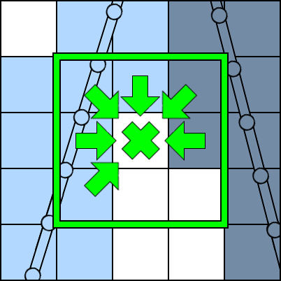
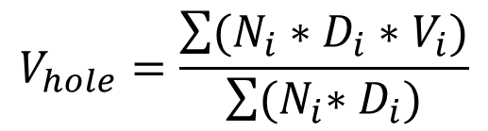
Methods: Our Hole Filling Algorithm
Weighted average over NxNxN kernel region:
D = Gaussian distance weight
N = # of intersecting slices
V = Voxel Intensity
Gaussian distance weight is used by San José-Estépar, et al. 2003.
Variable kernel size
Voxels inside a kernel of N = 3 contributing to hole value
Laboratory for Percutaneous Surgery (The Perk Lab) – Copyright © Queen’s University, 2012
- 6 -

Slide 7
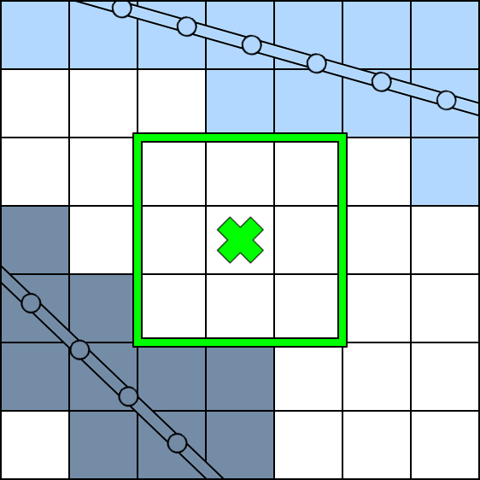
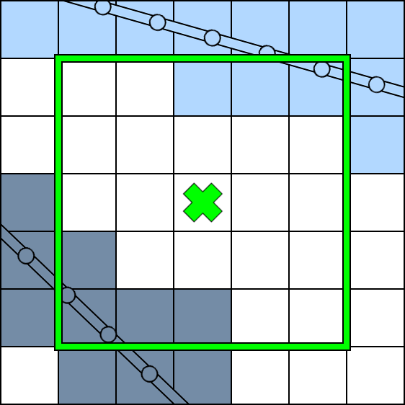
Methods: Variable Kernel Size
User specifies:
minimum number of non-hole voxels in the kernel region
kernel size for this range
standard deviation for this range
Start with the smallest kernel size, then if there is insufficient information, go to the next (larger) size
Inadequate information
Hole can be filled
Laboratory for Percutaneous Surgery (The Perk Lab) – Copyright © Queen’s University, 2012
- 7 -

Slide 8
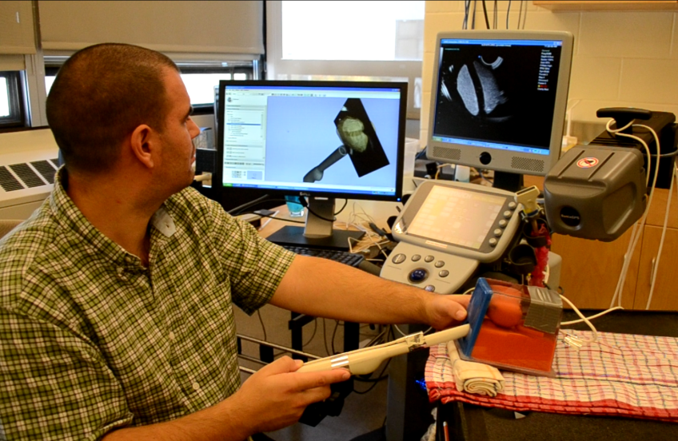
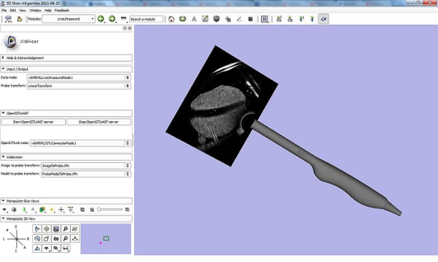
Methods: Implementation in PLUS
https://www.assembla.com/spaces/plus/
PLUS is the Public software Library for UltraSound
Freely-available, open-source
Based on well-known, maintained software libraries such as VTK and ITK
Implementation easy to change if and when needed
Used in several labs across the world
Laboratory for Percutaneous Surgery (The Perk Lab) – Copyright © Queen’s University, 2012
- 8 -

Slide 9
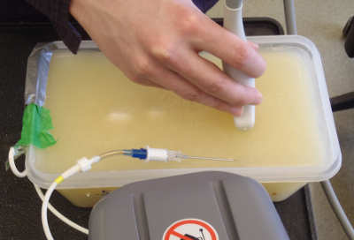
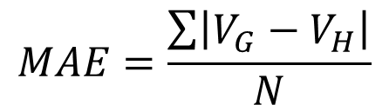
Methods: Evaluation
Ground Truth: Insert a dense set of images directly into volume
Simulate holes by using only a subset of the images
Qualitative Metric:
Visual Assessment, but there is potential bias
Quantitative Metric:
Calculate Mean Absolute Error (MAE) for hole voxels (Dewi, et al. 2009. Rohling, et al. 1999)
Universally applicable
VH = Hole Voxel Intensity
VG = Ground Truth Voxel Intensity
N = Number of Hole Voxels
Laboratory for Percutaneous Surgery (The Perk Lab) – Copyright © Queen’s University, 2012
- 9 -

Slide 10
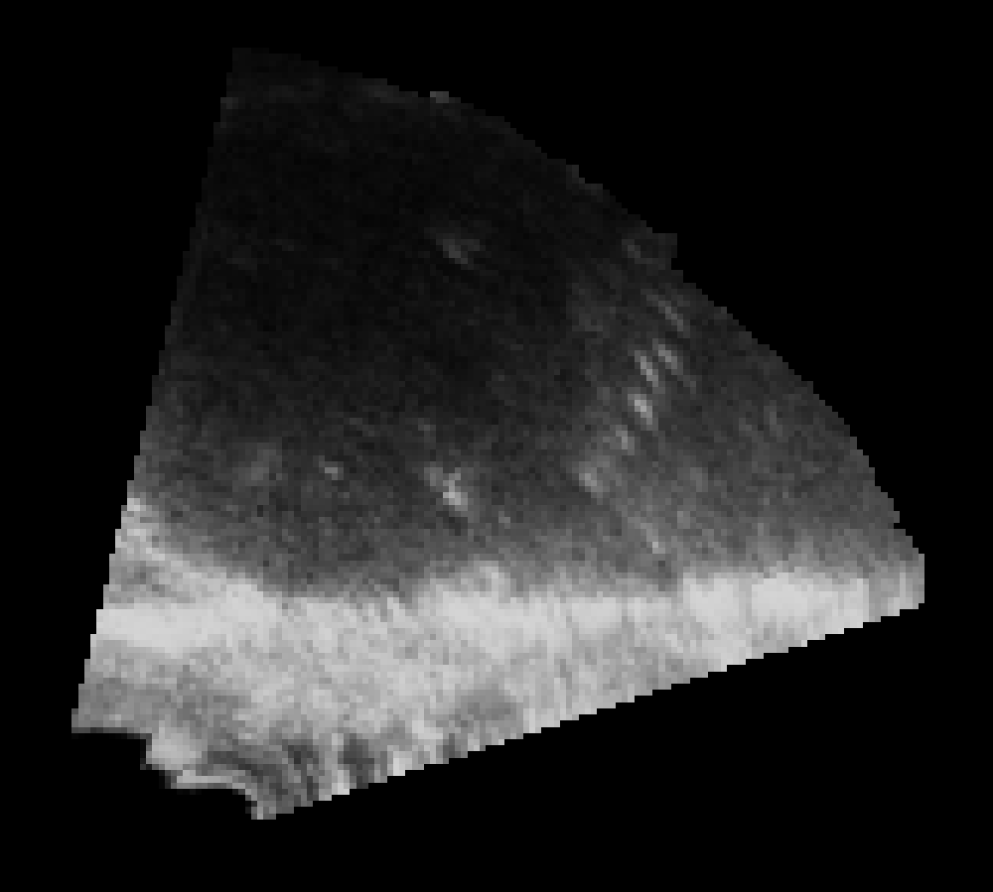
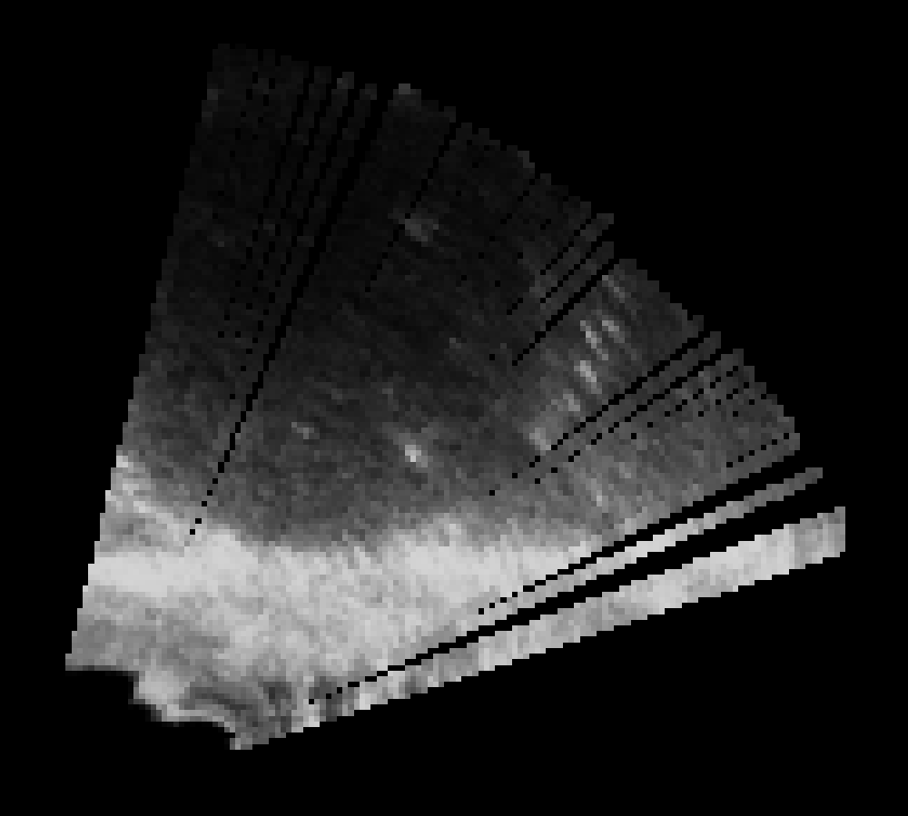
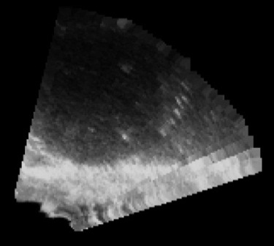
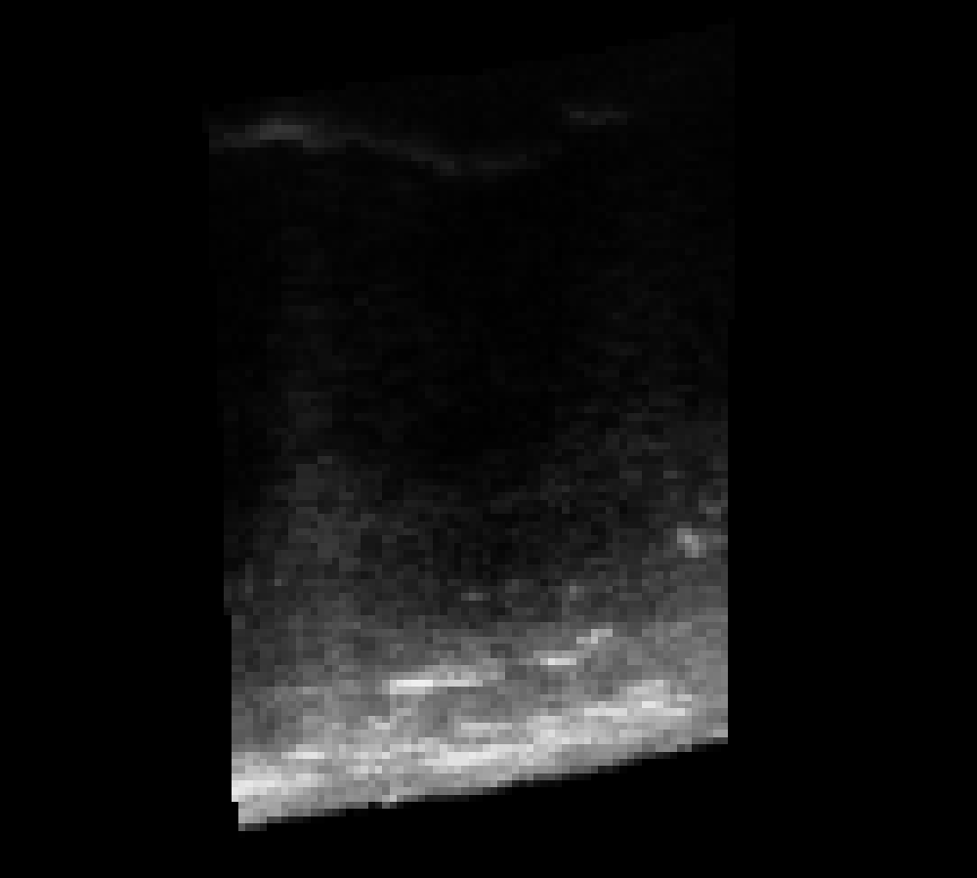
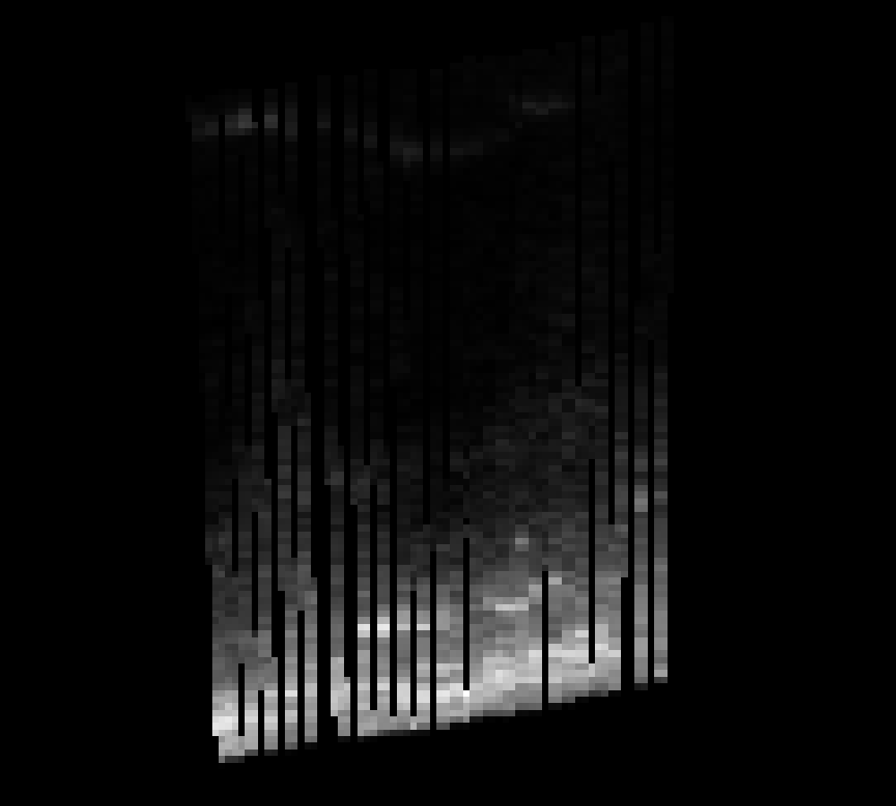
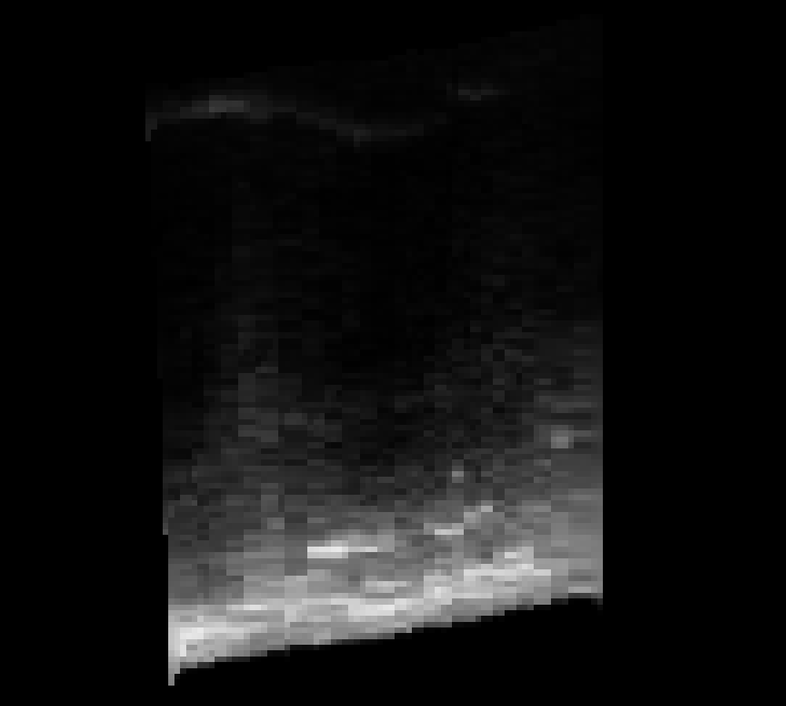
Results: Qualitative Analysis
Images from the Ground Truth (left) are compared to the reconstructed images (right).
“Ground
Truth”
 | Ground Truth | No Hole Filling | Hole Filling
Prostate_1
Spine_1
Small holes appear to be filled in using suitable values
Easier to identify structures
Occasionally blocky results, or seams in larger holes
With Hole
Filling
No Hole
Filling
Prostate Phantom and Spine Phantom images
Queen’s University, Canada
Laboratory for Percutaneous Surgery (The Perk Lab) – Copyright © Queen’s University, 2012
- 10 -

Slide 11
Results: Quantitative Analysis
Hole filling reduces the amount of error in reconstructed volumes
Dataset | No Hole Filling | Hole Filling
Prostate_1 | 64.57 | 8.47
Spine_1 | 17.10 | 2.37
No Hole
Filling
With Hole
Filling
Laboratory for Percutaneous Surgery (The Perk Lab) – Copyright © Queen’s University, 2012
- 11 -

Slide 12
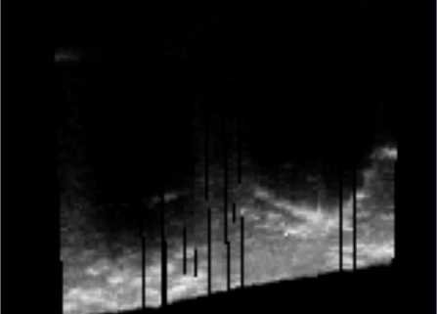
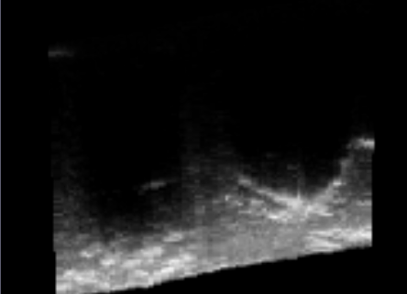
Conclusion
A free, open source Volume Reconstructor is now readily available
Our hole filling algorithm has been shown to increase the accuracy of reconstructed volumes
Questions?
Laboratory for Percutaneous Surgery (The Perk Lab) – Copyright © Queen’s University, 2012
- 12 -

Slide 13
References
[1] - Khallaghi, S., P. Mousavi, R H. Gong, S. Gill, J. Boisvert, G. Fichtinger, D. R. Pichora, D. P. Borschneck, and P. Abolmaesumi, "Registration of a Statistical Shape Model of the Lumbar Spine to 3D Ultrasound Images", Medical Image Computing and Computer-Assisted Intervention (MICCAI) 2010, Beijing, China, Springer, pp. 68-75, 2010
[2] - O. V. Solberg, et al. Freehand 3D Ultrasound Reconstruction Algorithms – A Review. Ultrasound in Med. & Biol., Vol. 33, No. 7, pp. 991–1009, 2007
[3] - Gobbi DG, Peters TM. Interactive intra-operative 3D ultrasound reconstruction and visualization. Proceedings of Medical Image Computing and Computer-Assisted Intervention (MICCAI), Tokyo, Japan: Springer, 2002;2489:156 –163.
[4] - Nelson TR, Pretorius DH. Interactive acquisition, analysis and visualization of sonographic volume data. Int J Imag Systems Technol 1997;8:26 –37.
[5] - San José-Estépar et al. A theoretical framework to threedimensional ultrasound reconstruction from irregularly sampled data. Ultrasound Med Biol 2003b;29:255–269.
[6] - Ohbuchi R, Chen D, Fuchs H. Incremental volume reconstruction and rendering for 3-D ultrasound imaging. Proceedings of Visualization in Biomedical Computing ’92, Chapel Hill, NC, USA: SPIE, 1992;1808:312–323.
[7] – D.E.O. Dewi, M.H.F. Wilkinson, T.L.R. Mengko, et al. 3D Ultrasound Reconstruction of Spinal Images using an Improved Olympic Hole-Filling Method. ICICI-BME, pp 1-5. 2009.
[8] – R. Rohling, A. Gee, and L. Berman, "A comparison of freehand threedimensional ultrasound reconstruction techniques," Medical Image Analysis, vol. 3, no. 4, pp. 339-359, 1999.
Laboratory for Percutaneous Surgery (The Perk Lab) – Copyright © Queen’s University, 2012

