Slide 1
PLUS Tutorial: Ultrasound probe calibration using fCal
www.assembla.com/spaces/plus
Author: Tamas Ungi, Andras Lasso

Slide 2
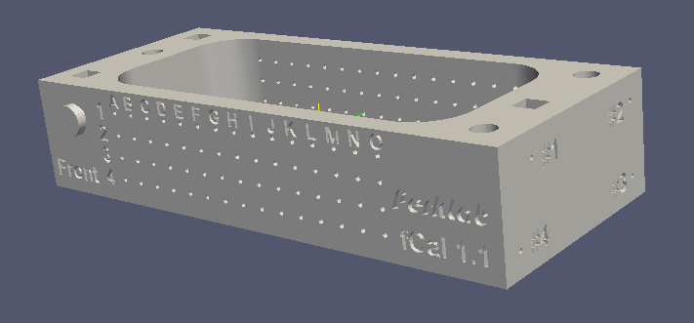
Concept
Goal: Determine the Image-to-Probe transform.
Use the correspondence of known wire positions in 3D and segmented wire positions in the US image.
N-wires are attached to a precisely manufactured calibration phantom (see image below) – see phantom building tutorial for instructions for building a phantom

Slide 3
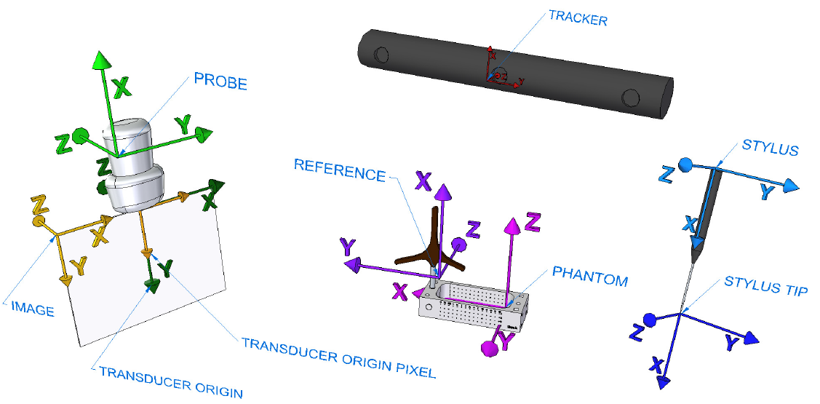
Coordinate systems
https://www.assembla.com/code/plus/subversion/nodes/trunk/PlusLib/docs/fCAL/CoordinateSystems/FreehandCalibration_CoordinateRepresentation.png

Slide 4
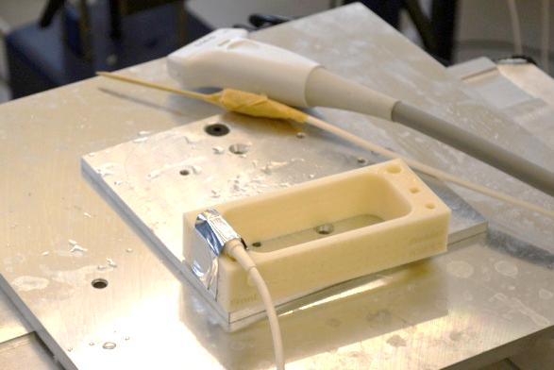
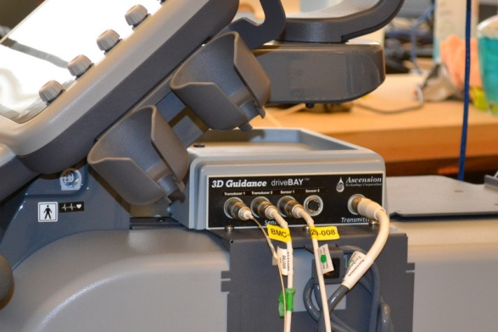
Hardware setup
Device set used in this tutorial:
Sonix Touch with GPS extension
Tracker tools
Probe
Reference
Stylus
fCal 1.x calibration phantom
Sonix GPS side cover removed for accessing all connectors

Slide 5
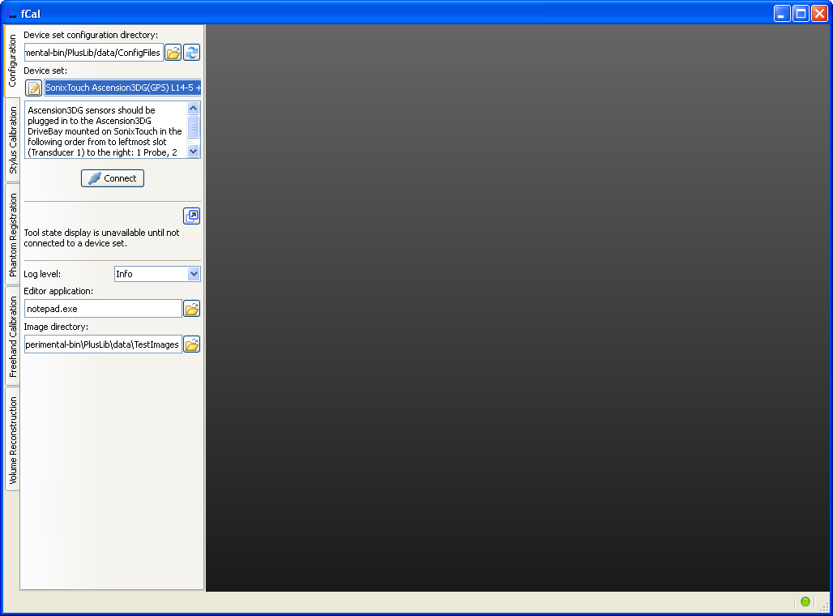
Software setup
Start fCal.exe
Select your device set and click Connect

Slide 6
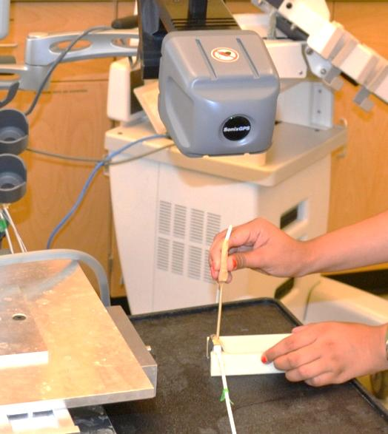
Stylus calibration
Attach an EM sensor to any pointing object.
fCal collects 100 different points.
Stylus tip should be fixed to the reference while pivoting the sensor on a sphere surface.

Slide 7
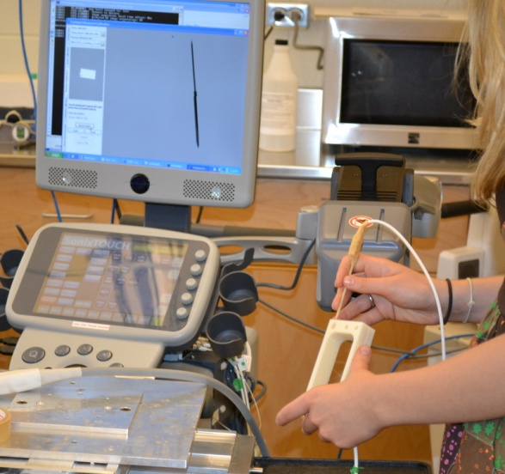
Phantom registration
Registration of predefined landmark points.
Model points are defined in the configuration XML file.
Tracked points are collected by the stylus.

Slide 8
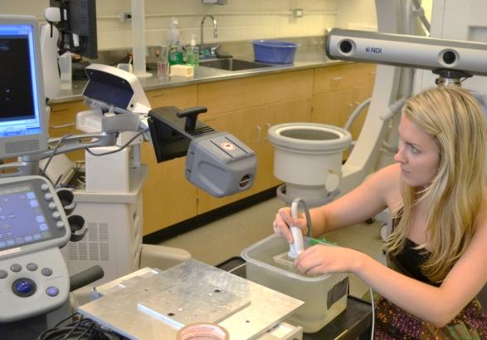
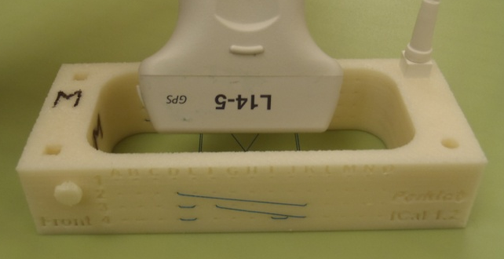
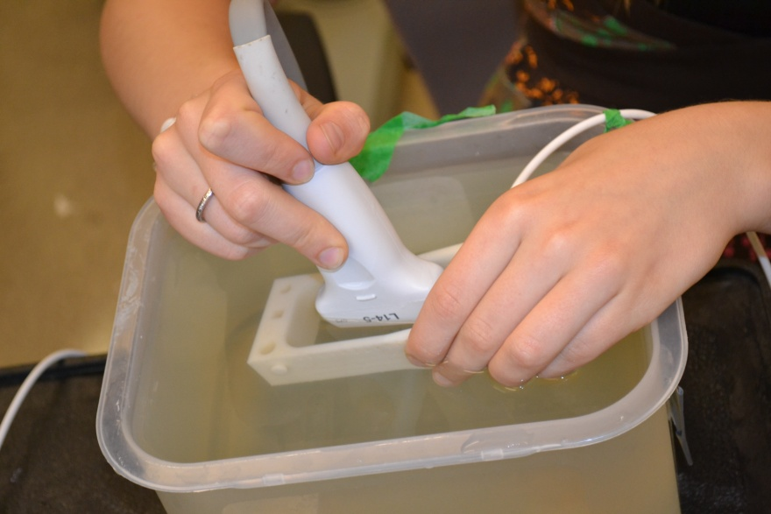
Image collection and calibration
Align the transducer to have the marked side on the A1 side of the phantom
Marking on the transducer
A
1
Front
Module automatically collects 100 images for validation, 200 images for calibration.
Images with failed registration are discarded.
Move slowly.
Use all degrees of freedom.

