Slide 1
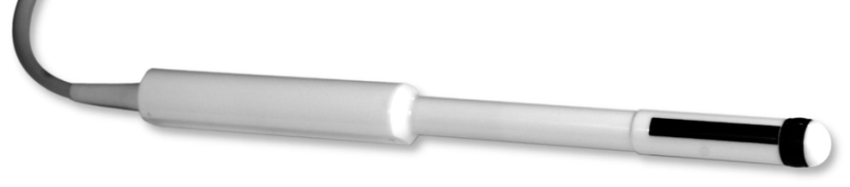
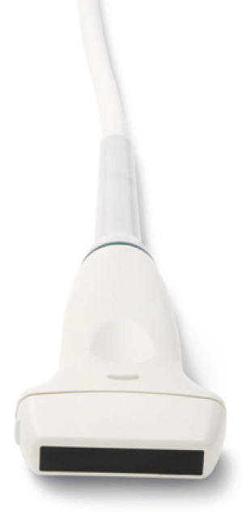
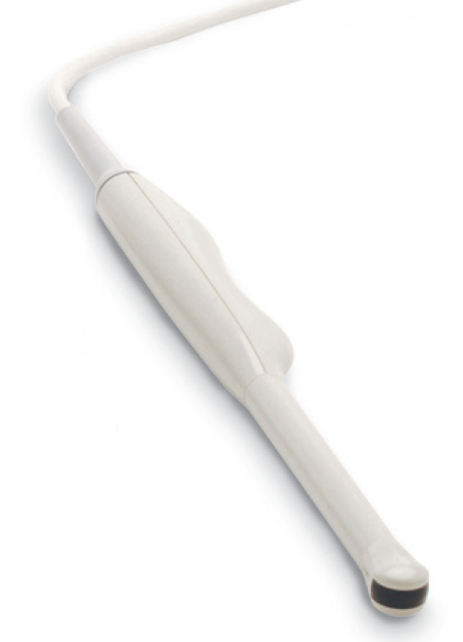
F
F
M
M
N
Transducer axes:
M = marked
U = unmarked = -marked
F = far
N = near = -far
M
U
marker
marker
M
F
F

Slide 2
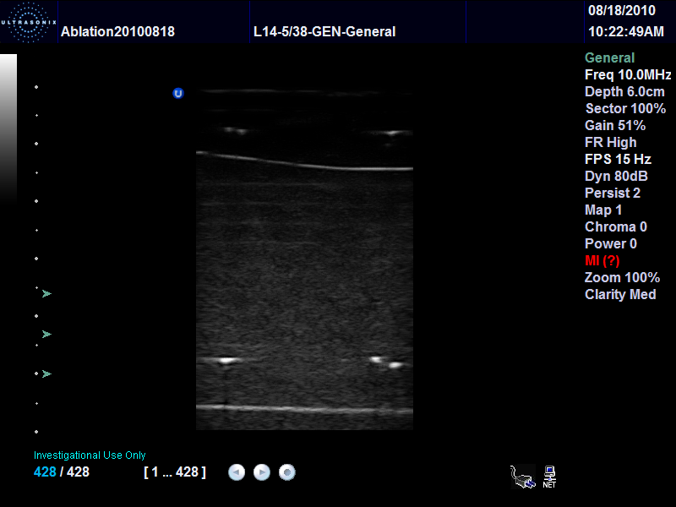
N
M
U
Marker symbol (U) is shown at the marked/near corner
F

Slide 3
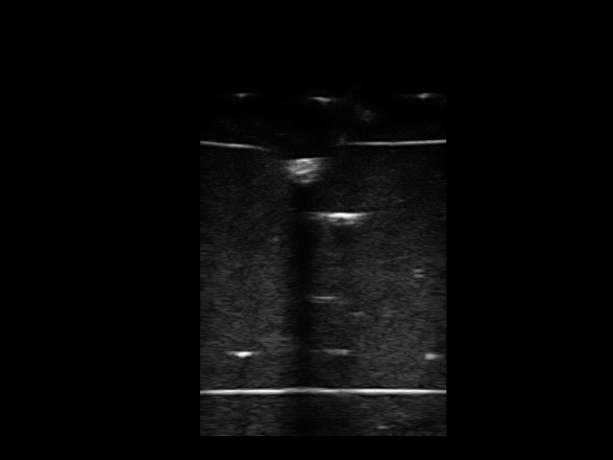
(x=0, y=0)
x direction (towards x increase)
(x=640, y=0)
N
y
(towards y increase)
M
U
F
(x=0, y=480)
(x=640, y=480)
x=U
y=F
=> UltrasoundImageOrientation = UF

Slide 4
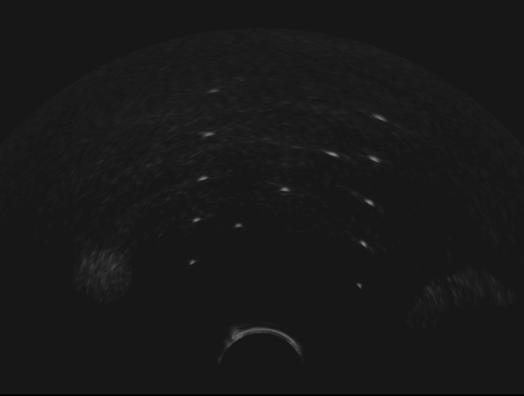
Defining the region of interest for volume reconstruction - curvilinear transducer
F
Image size:
640x480 pixels
U
M
N
FanAngles[2] = 60 (deg)
FanAngles[1] = -60 (deg)
MF coordinate
System origin
(0, 0)
FanDepth = 450 (pixels)
FanOrigin = 320 40 (pixels)
Fan is always defined in the MF coordinate system!
If the UltrasoundImageOrientation in the stored file is not MF, and the file is loaded into a software that ignores the UltrasoundImageOrientation field (such as ImageJ, Slicer, Paraview) then the XY positions and orientations shown in the software has to be transformed. E.g., if UltrasoundImageOrientation=MN and the FanOrigin appears in the (320,440) position in ImageJ then the FanOrigin in the XML config file shall be (320,40).

Slide 5
Defining the region of interest for volume reconstruction - linear transducer
Image size: 640x480 pixels
F
U
M
N
ClipRectangleSize (second component) = 360 (pixels)
ClipRectangleSize (first component) = 600 (pixels)
MF coordinate
system origin
(0, 0)
ClipRectangleOrigin = 20 40 (pixels)
ClipRectangle is always defined in the MF coordinate system!
Clipping rectangle must be always defined. Clipping fan is optional. All pixels that are outside the clipping rectangle or the clipping fan will be ignored in volume reconstruction.

Slide 6
Defining the transducer geometry for RF scan conversion - curvilinear transducer
OutputImageSizePixel[0]=820
Obsolete! (only for Plus-2.0.x)
In current versions use TransducerCenterPixel:
TransducerCenterPixel[0] = OutputImageSizePixel[0]/2
TransducerCenterPixel[1] = (RadiusStartMm –OutputImageStartDepthMm) / OutputImageSpacingMmPerPixel[1]
OutputImageSizePixel[1]=616
ThetaStopDeg = 60.0
ThetaStartDeg = -60.0
F
RadiusStopMm = 82.0
OutputImageStartDephMm = -3.0
RadiusStartMm = 10.0
(0, 0)
M
TransducerGeometry= " CURVILINEAR"
Output image size in mm = OutputImageSizePixel * OutputImageSpacingMmPerPixel

Slide 7
Defining the transducer geometry for RF scan conversion - curvilinear transducer
OutputImageSizePixel[0]=820
Plus 2.1.x and above
OutputImageSizePixel[1]=616
ThetaStopDeg = 60.0
ThetaStartDeg = -60.0
F
Transducer CenterPixel[1] = 53
RadiusStopMm = 82.0
RadiusStartMm = 10.0
(0, 0)
M
TransducerCenterPixel[0] = 410
TransducerGeometry= " CURVILINEAR"
Output image size in mm = OutputImageSizePixel * OutputImageSpacingMmPerPixel

Slide 8
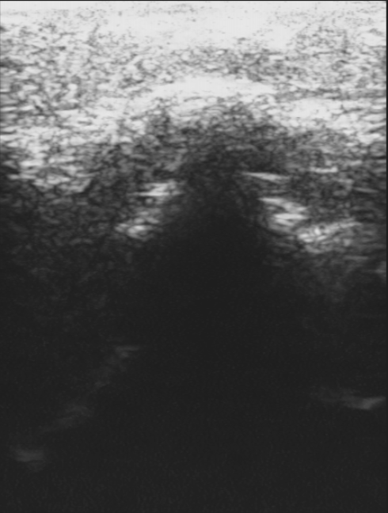
Defining the transducer geometry for RF scan conversion - linear transducer
(0, 0)
M
Transducer CenterPixel[1] = 15
F
TransducerCenterPixel[0] = 150
OutputImageSizePixel[1]=616
ImagingDepthMm = 55.0
TransducerWidthMm = 38.0
OutputImageSizePixel[0]=820
TransducerGeometry="LINEAR"
Output image size in mm = OutputImageSizePixel * OutputImageSpacingMmPerPixel

